Slide 1

Notes:
I will present a tool to help you guide your compiler into generating better code.
I will focus initially on clang, but discuss other compilers in the latter parts of the talk.
The tool I will discussing is optimization remarks. Don’t worry if you’ve never heard of it, few did.

Slide 2




Ofek Shilon
Developer
@Istra Research
ofekshilon@gmail.com
OfekShilon

Slide 3
Takeaways
Clang optimization remarks:
Shed light on optimizations that were tried but failed.
Learn how to:
  get them,
  understand (some of) them,
  solve (some of) them, get better optimizations.
Notes:
The first about 2/3ds of this talk would be limited to clang only, then the scope would be broadened a bit.
Optimization passes typically leave logs behind – these are called optimization remarks. (sometimes optimization diganostics in the docs)
They are phrased by and for compiler authors and so call for some deciphering, but once that is done – we have a new tool to understand optimization problems and sometimes solve them .
This might be a big deal. You’ve probably heard ‘the compiler tends to be overly pessimistic’ or ‘the compiler can’t prove stuff’, but now this is no longer theoretical. With optimization remarks we can shed light on the exact places in our code and the exact over-pessimism to try and improve on.
I aim that by the end of this talk you’d
know how to obtain optimization remarks,
know how to interpret some of them and
how to apply the conclusions so your compiler would be able to perform better optimizations on your code

Slide 4
Part 1: Getting Them

Slide 5
-Rpass

Slide 6
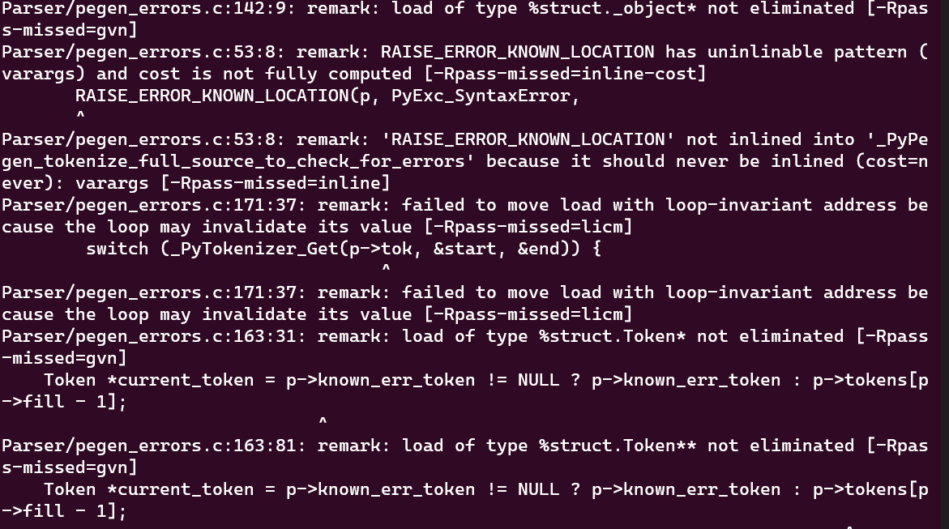
-Rpass sample output

Slide 7
-Rpass
llvm-opt-report

Slide 8
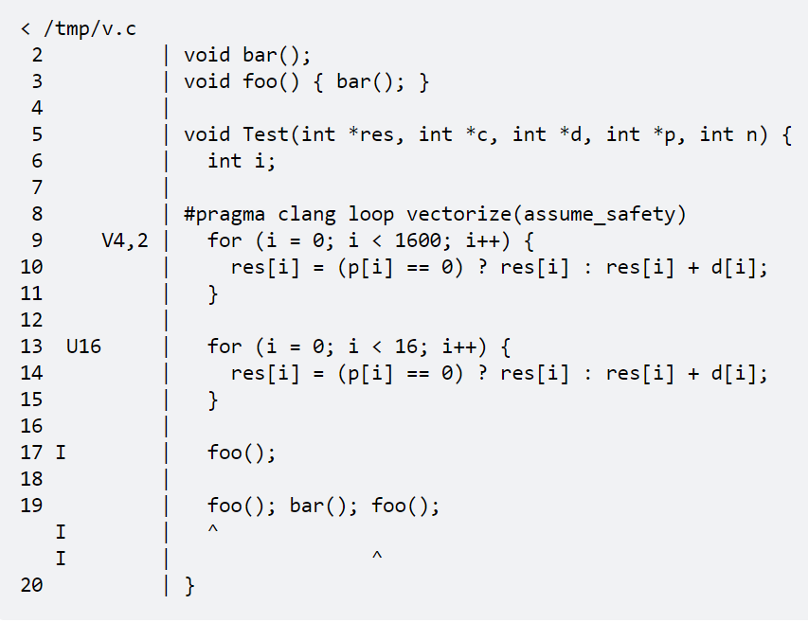
llvm-opt-report
https://reviews.llvm.org/D25262
https://github.com/llvm/llvm-project/tree/main/llvm/tools/llvm-opt-report
Notes:
First step forward, by the distinguished LLVM developer Hal Finkel. The actual code is displayed, which is a very good idea, and remarks are encoded (encrypted!) on the left.
Mentioned this for historical completeness, please don’t use it – we got better tools today.

Slide 9
-Rpass
llvm-opt-report
opt-viewer

Slide 10
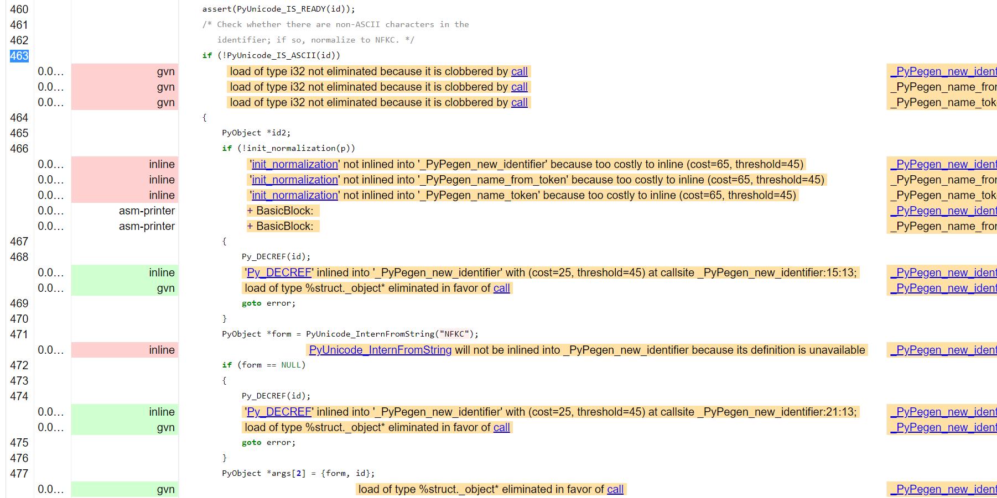
opt-viewer sample output
Notes:
Html of the c++ sources, annotated with optimization remarks.
Major, major step forward.
I realize the text is still opaque, we will dive in in great detail.

Slide 11
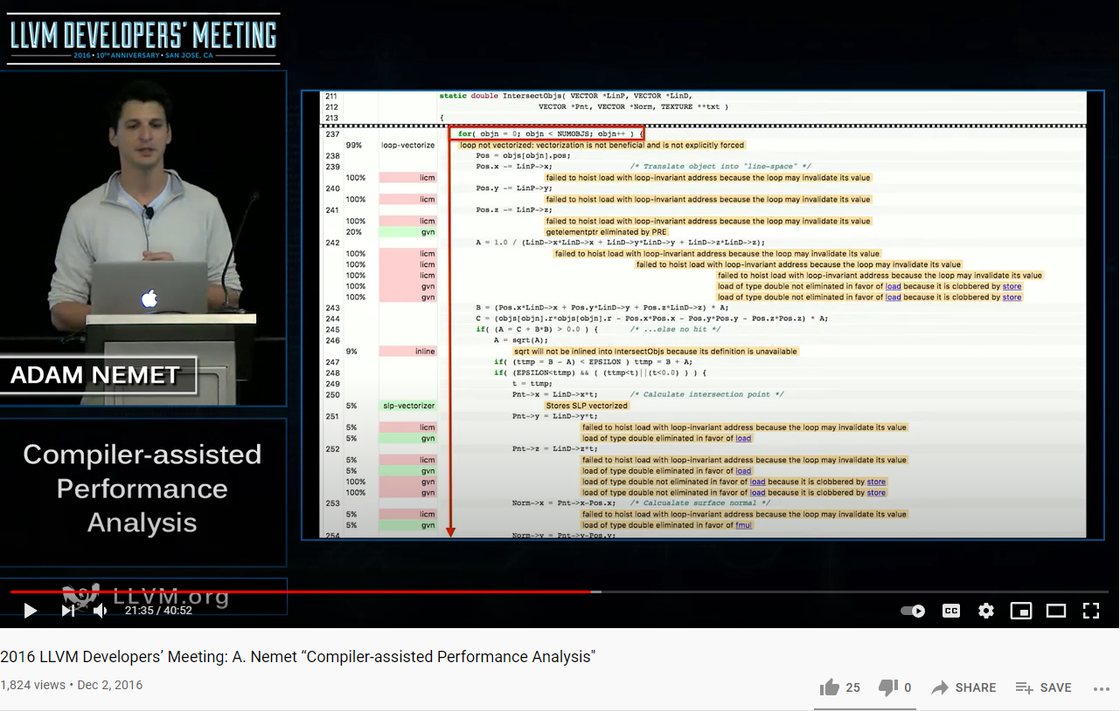
opt-viewer
2016 work led by Adam Nemet (Apple) https://www.youtube.com/watch?v=qq0q1hfzidg
Part of LLVM master:
https://github.com/llvm/llvm-project/tree/main/llvm/tools/opt-viewer
Downloadable via deb pkg:
llvm-14-tools
Notes:
Clang-only

Slide 12
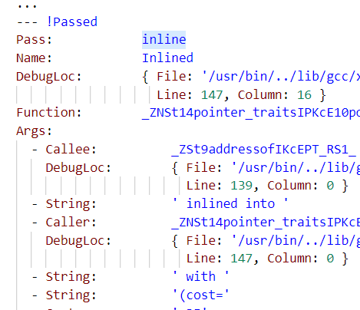
opt-viewer Usage
Build with an extra clang switch:
-fsave-optimization-record
  *.opt.yaml files are generated, by default in the obj folder.
Generate htmls:
  $ opt-viewer.py
  --output-dir <htmls folder>
  --source-dir <repo>
  <yamls folder>

Slide 13
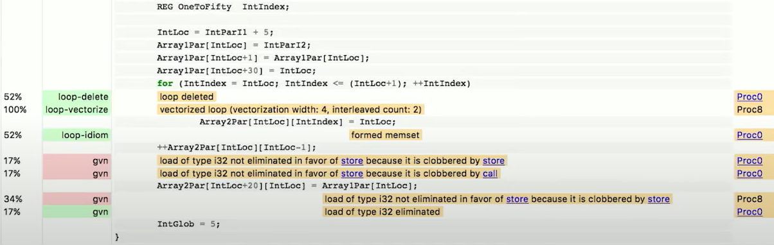
opt-viewer additions over -Rpass
Hotness
(PGO)
Inlining context

Slide 14
-Rpass
llvm-opt-report
opt-viewer
OptView2

Slide 15
opt-viewer is great (seriously), but
Heavy
  High I/O
  High memory
  >1G htmls
Designed (and presented) for compiler authors
  Mostly non actionable to developers

Slide 16
Improvements in OptView2
Denoise:
  Collect only optimization failures (by default)
  Exclude system headers (by default)
  Remove duplicities,
  Filter remark types via config file/command line
Optional split-to-subfolders
Display column info (location within line)
Sortable, resizable & pageable index
...

Slide 17
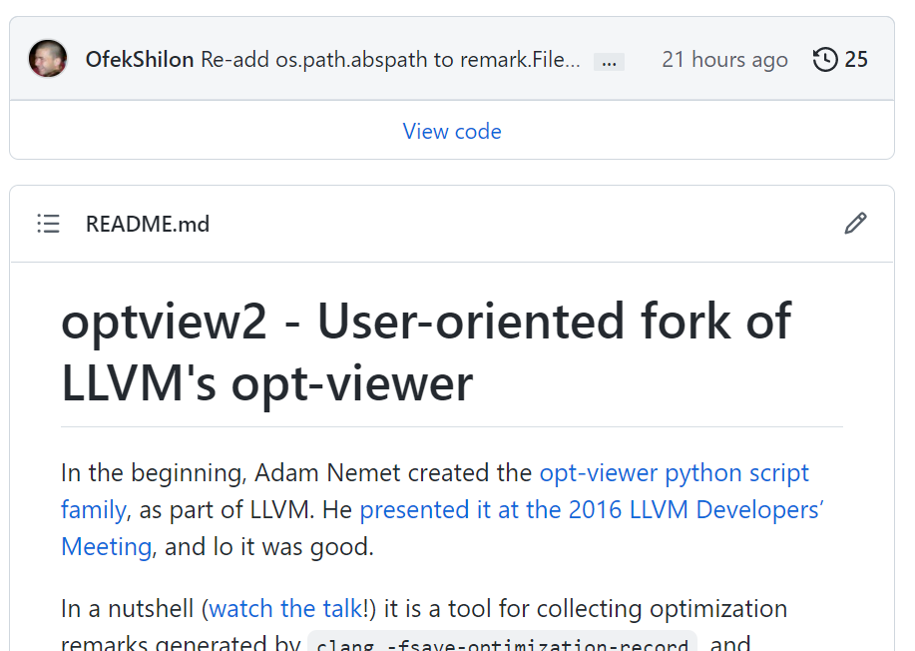
OptView2 – coming to trunk
https://github.com/OfekShilon/optview2

Slide 18
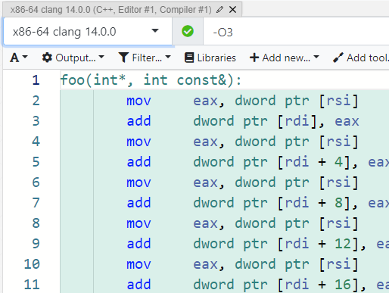
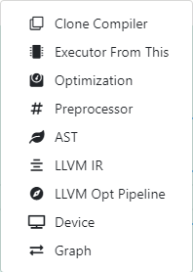
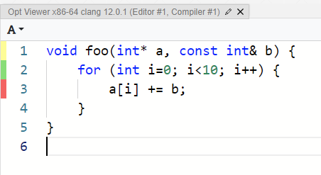
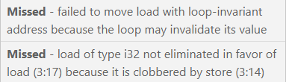
View in compiler explorer!
Notes:
I had the pleasure of submitting some fixes to compiler explorer handling of remarks

Slide 19
Part 2: Understanding and Using Them

Slide 20
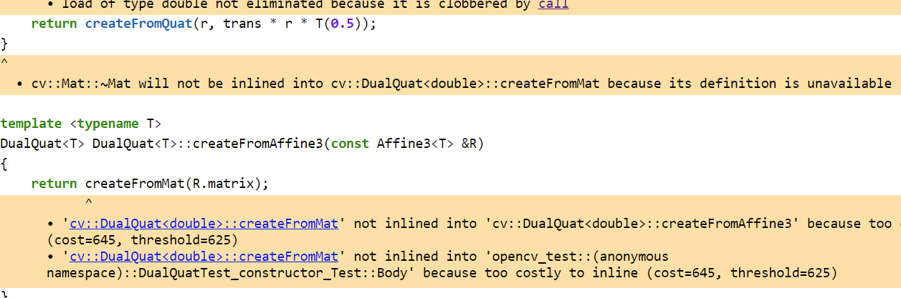
1. Inlining
https://ofekshilon.github.io/optview2-opencv/core/modules_core_include_opencv2_core_dualquaternion.inl.hpp.html#L80
Notes:
Replace with Godbolt

Slide 21
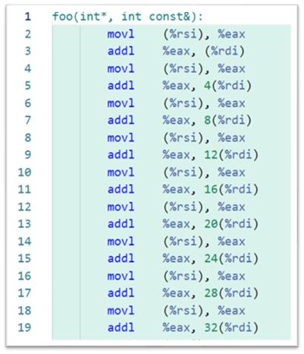
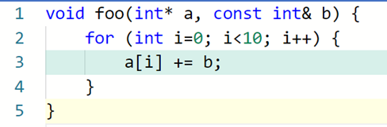
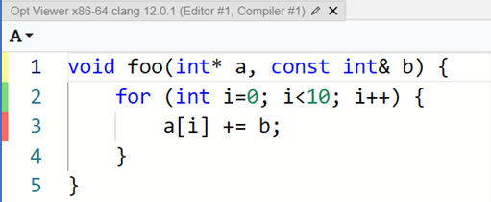

2. "Clobbered by store"
https://godbolt.org/z/T7h4nK3G7
Notes:
Appear gradually

Slide 22
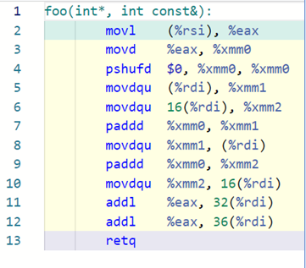
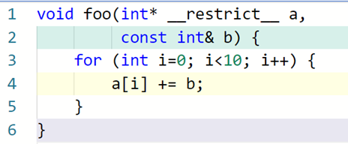
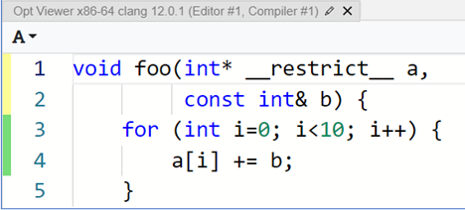
2. "Clobbered by store"
Notes:
Appear gradually

Slide 23
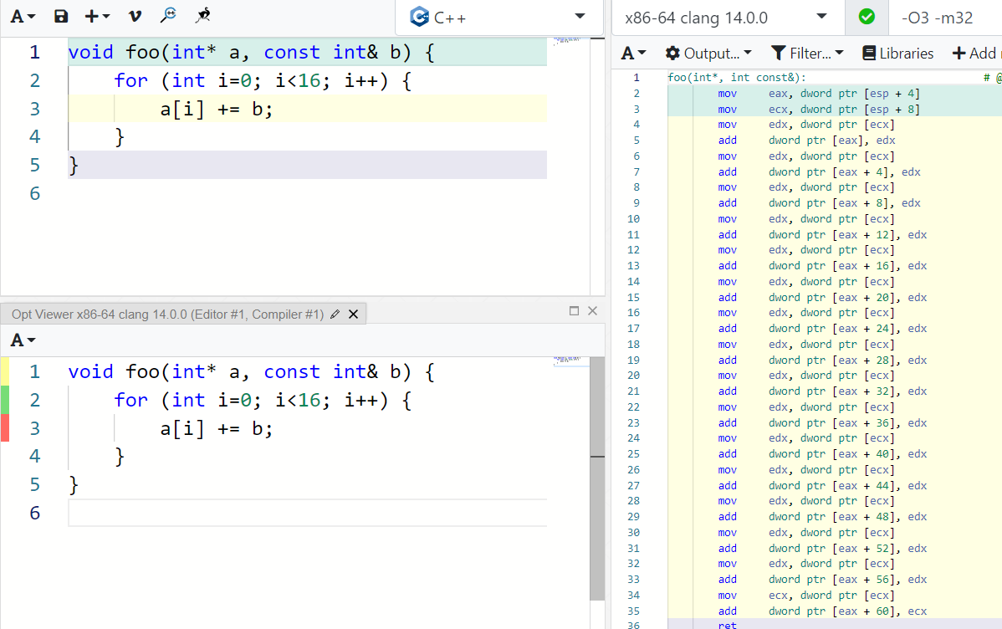
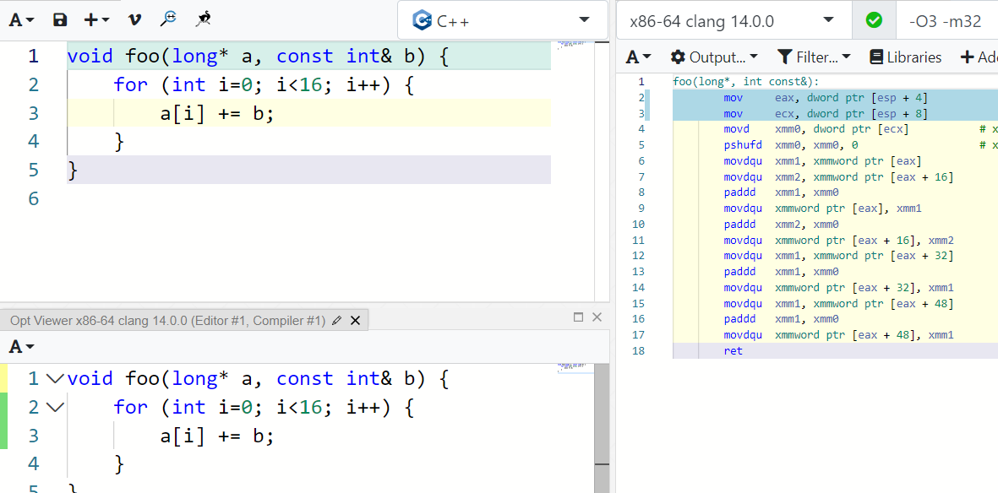
2. "Clobbered by store"

Slide 24
2. "Clobbered by store"
“Strict aliasing is an assumption made by the compiler, that objects of different types will never refer to the same memory location (i.e. alias each other.)”
Mike Acton https://cellperformance.beyond3d.com/articles/2006/06/understanding-strict-aliasing.html
Perhaps can be ‘weaponized’ to communicate non-aliasing to the compiler?
In practice, compilers are struggling.
  Example clang issue: https://github.com/llvm/llvm-project/issues/54646

Slide 25
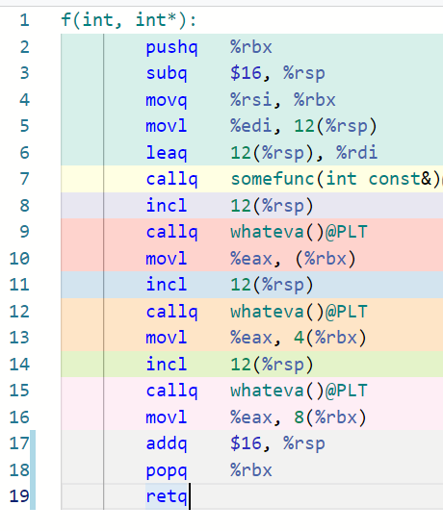
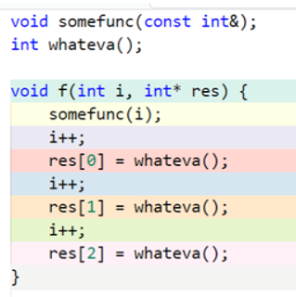
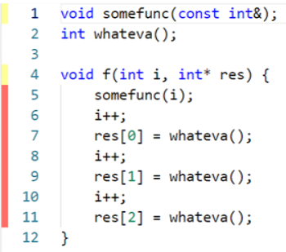

3. “Clobbered by call”
https://godbolt.org/z/jG5jq7c9a

Slide 26
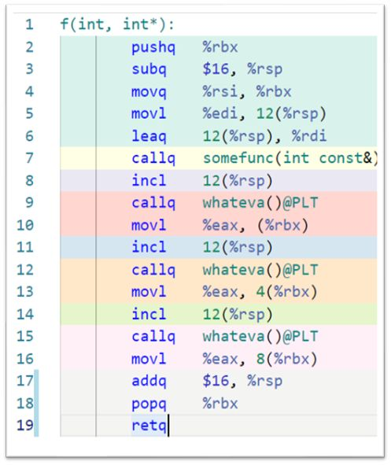
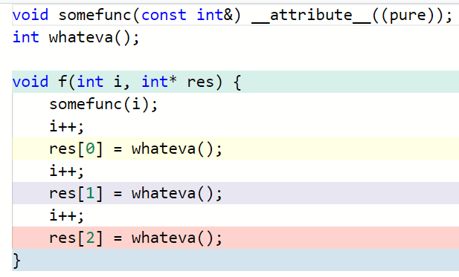
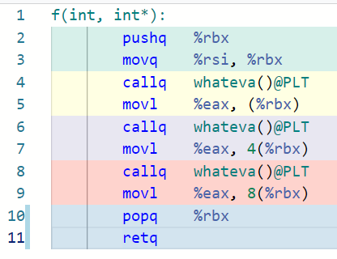
3. “Clobbered by call”
Cheating?.. pure + returns void somefunc() – does nothing, removed entirely.
If returned non-void – wouldn’t work (clang issue: https://github.com/llvm/llvm-project/issues/53102)

Slide 27
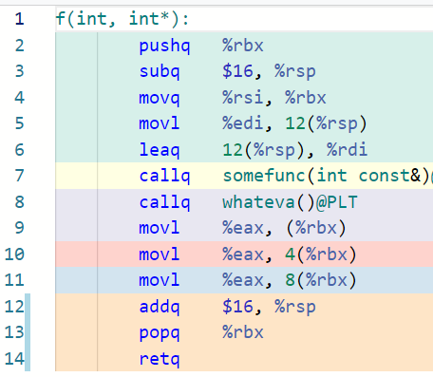
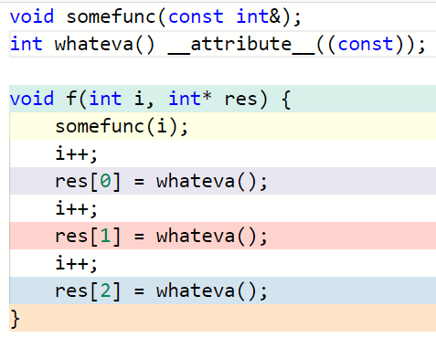
3. “Clobbered by call”
Whateva() called only once, result copied to 2 other places

Slide 28
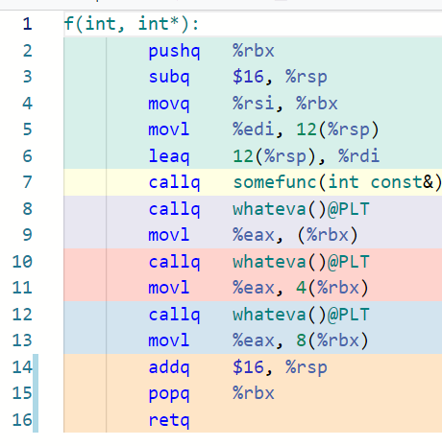
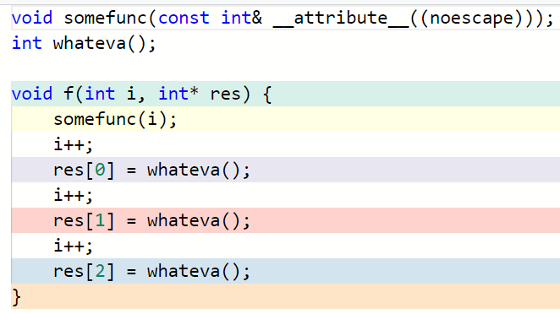
3. “Clobbered by call”

Slide 29
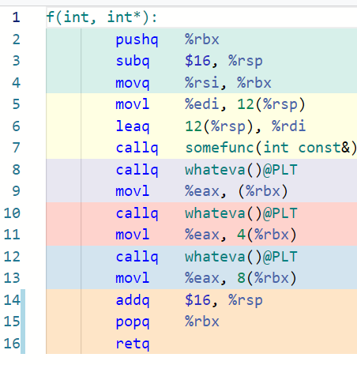
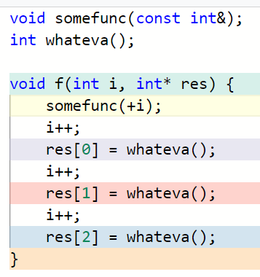
3. “Clobbered by call”
Notes:
Without const – doesn’t work

Slide 30
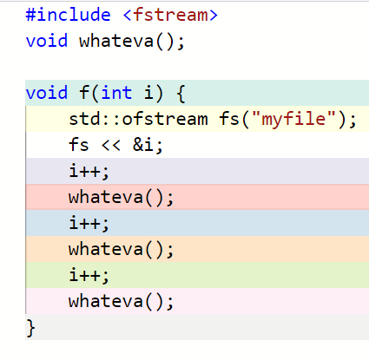
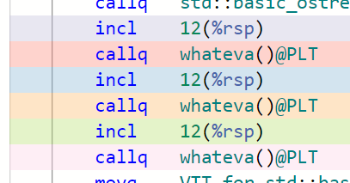
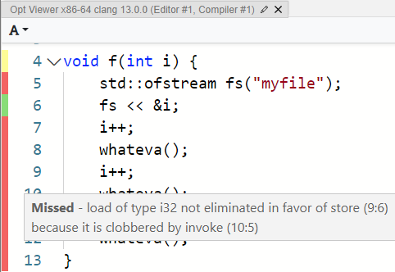
3. “Clobbered by call”
Sometimes the offending call is standard! https://godbolt.org/z/81319zq1E

Slide 31
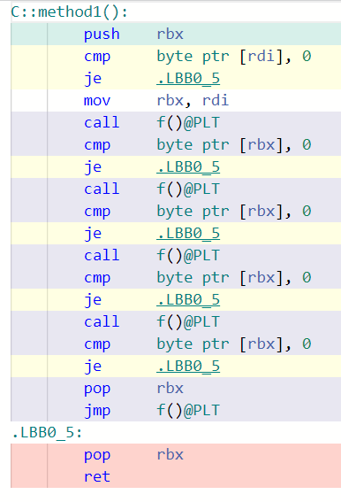
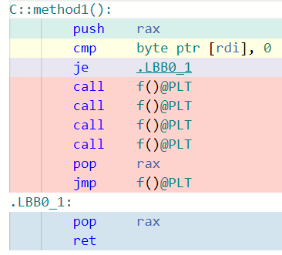
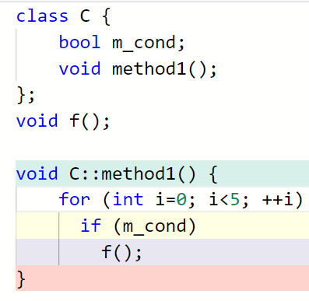
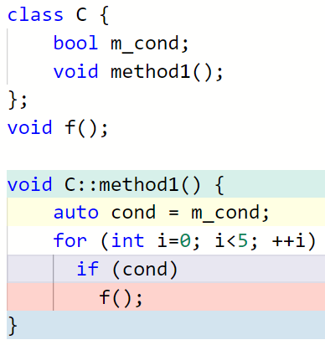

4. “Failed to move load with loop invariant address”
https://godbolt.org/z/YGc83TMnj
Notes:
Replace members with locals
NOT good c++ code!

Slide 32
Cheat Sheet
Symptom | Probable cause | Action
Inlining Failure |  | Add header / forceinline / increase threshold
"Clobbered by store" | Aliasing | restrict / force type diff
"Clobbered by load" | Escape | Attributes pure / const / noescape (typically before the remark site)
"Failed to move load loop invariant" | Escape | All the above + copy to local
* | Don’t understand? | Reduce to bare minimum in godbolt. Might be a compiler limitation.

Slide 33
Part 3: Beyond Classical Clang Toolchain
Notes:
Gradually expand the scope

Slide 34
Opt remarks with LTO
Regular build:
compile
link
cpp file
obj file
cpp file
obj file
binary
cpp file
obj file
Optimization remarks

Slide 35
Opt remarks with LTO
LTO build:
compile
link
cpp file
ll file
cpp file
ll file
binary
cpp file
ll file
BOGUS Optimization remarks
?

Slide 36
Opt remarks with LTO
To get remarks from linker:
  Build with LTO, use –v to dump the list of LL files generated
  Form a binary:
  $ llvm-lto -lto-pass-remarks-output=<yaml outputpath>
  -j=10 -O=3 <obj files list>
Creates a single huge yaml.
No parallelism in creation or consumption by opt-viewer.
Hard to get meaningful results for a large project.
Notes:
Can somewhat reduce remarks volume with
-lto-pass-remarks-filter=<regex>

Slide 37
Opt remarks with LTO
Inlining – non-issue.
Escape & Aliasing – still very much an issue.
“inter-procedural analyses are often less precise … In LLVM, intra-procedural analyses are dominating in numbers and potential. “
(Doerfert, Homerding, Finkel 2019)
Notes:
Rewrite slides

Slide 38
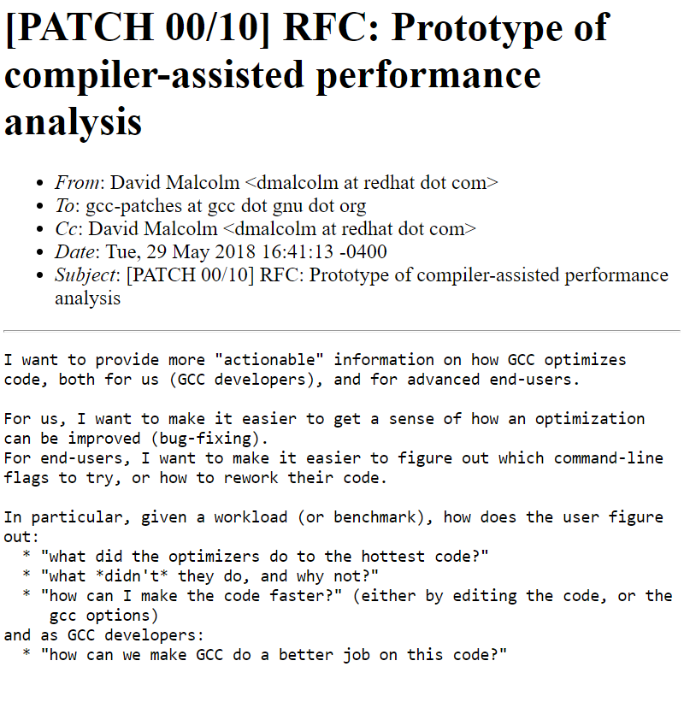
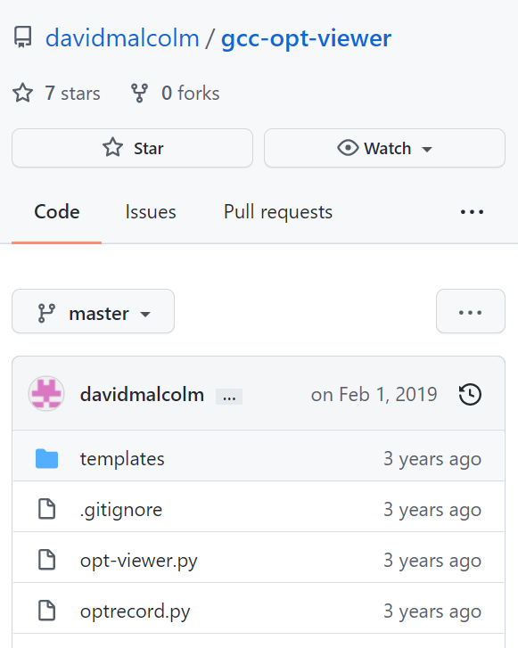
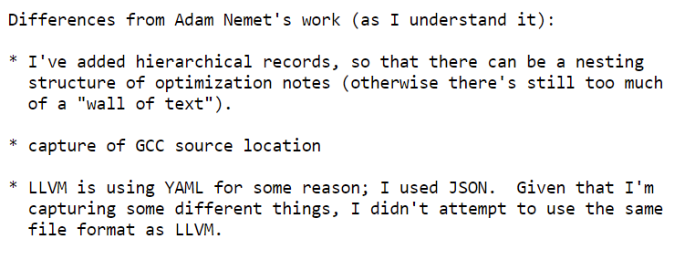
GCC work
https://gcc.gnu.org/legacy-ml/gcc-patches/2018-05/msg01675.html
https://github.com/davidmalcolm/gcc-opt-viewer

Slide 39
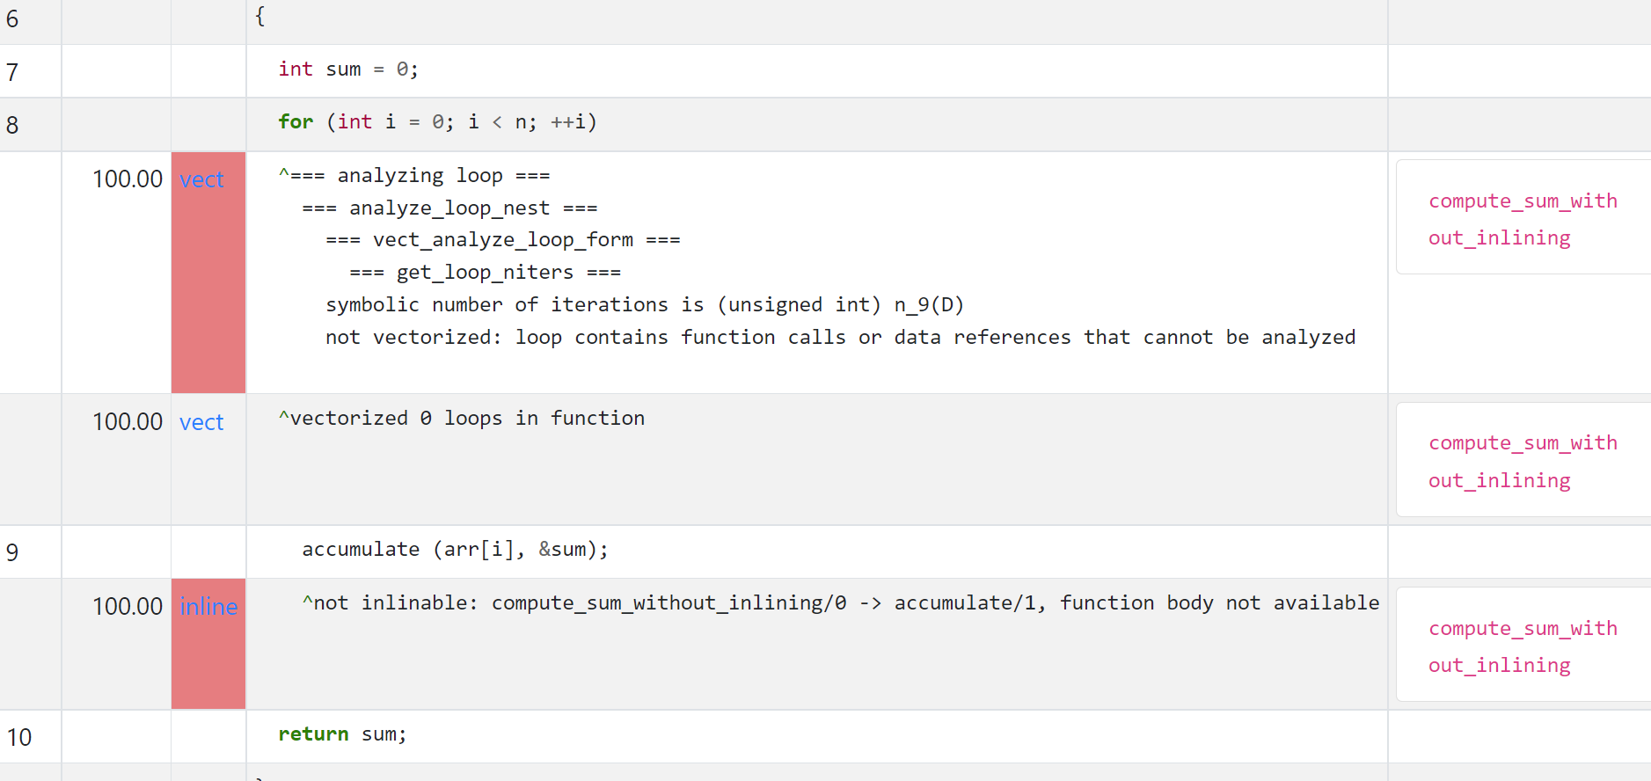
GCC work
https://dmalcolm.fedorapeople.org/gcc/2018-05-18/pgo-demo-test/pgo-demo-test/

Slide 40
GCC work
Active only during 2018
Still at prototype quality
  Compilation might consume 10G+ RAM per single file
  Python scripts often break
    Opened two bugs, one solved in my fork
Notes:
Definitely needs some lovin, Hopefully can still be resurrected.

Slide 41
Decorations across compilers
* Pertains also to locals
** Decorates a function return value
clang | gcc | icc | msvc
__restrict | V | V | __restrict * __declspec(restrict) **
__attribute__((pure)) | V | - | -
__attribute__((const)) | V | V | __declspec(noalias)
__attribute__((noescape)) | - | - | -

Slide 42
Decorations across compilers
`Hedley` (https://github.com/nemequ/Hedley) is a single header including cross-compiler wrappers like:
#if HEDLEY_HAS_ATTRIBUTE(noescape)
# define HEDLEY_NO_ESCAPE __attribute__((__noescape__))
#else
# define HEDLEY_NO_ESCAPE
#endif
Known limitation: noalias
  Check if still applicable: https://github.com/nemequ/hedley/issues/54)
  Or use the fork: https://github.com/OfekShilon/hedley
Can be used to find analogues in other compilers (Sun pragmas etc.)

Slide 43
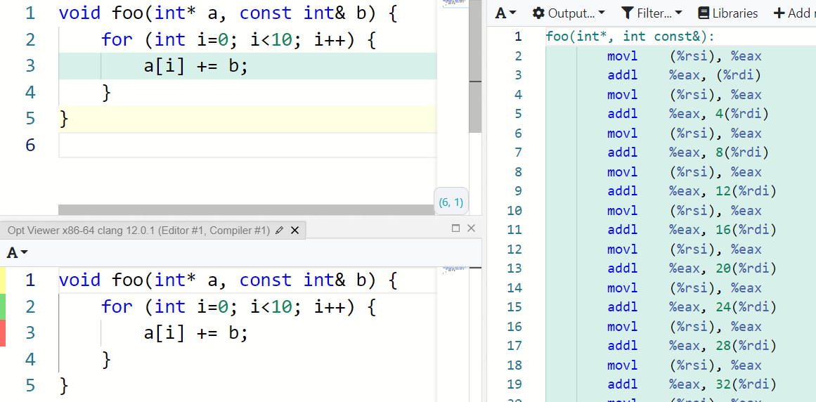
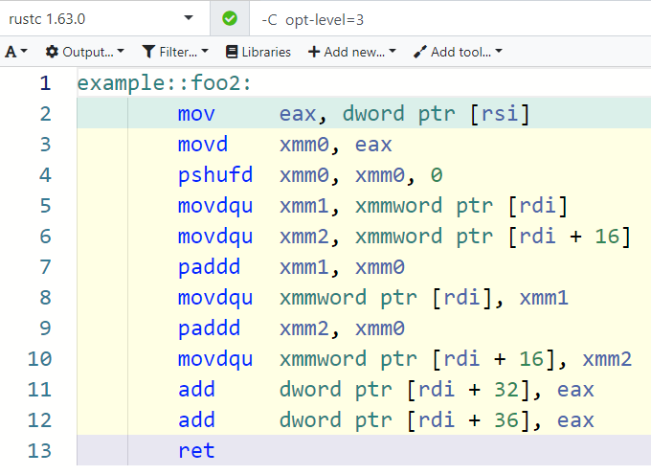
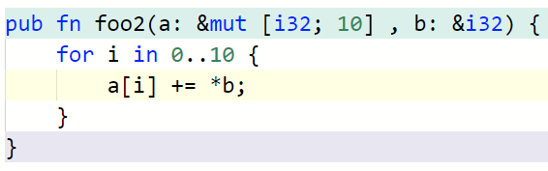
Rust
The borrow-checker has some good news for alias analysis: https://godbolt.org/z/q9ox6n755

Slide 44
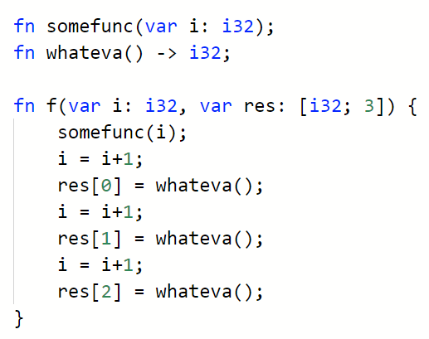
Carbon
Carries some good news about escape analysis:
https://www.foonathan.net/2022/07/carbon-calling-convention/
https://godbolt.org/z/Eo1jv97dW
Notes:
Default `let` semantics

Slide 45
Impact?
Academic works
  PETOSPA: …. Optimistic Static Program Annotations (Doerfert, Homerding, Finkel 2019)
  https://github.com/jdoerfert/PETOSPA/blob/master/ISC19.pdf
    ~15%-20% speedup
  ORAQL: Optimistic Responses to Alias Queries in LLVM (Hückelheim, Doerfert 2021)
  https://www.youtube.com/watch?v=7UVB5AFJM1w
    No impact
  HTO: ... Optimization via Annotated Headers (Moses, Doerfert 2019)
  https://www.youtube.com/watch?v=elmio6AoyK0
    ~50% of full LTO gains
Personal experience: 6 µs -> 4.6 µs

Slide 46
Recommendations
Concentrate on known bottlenecks,
Invest when you
  work at sub-millisecond scale, or
  in very tight loops.

Slide 47
Final Musing
The compiler can talk to you.
You can learn to listen.
And even answer.
Sometimes.

Slide 48
Acknowledgements:
Ilan Ben Hagai
Oded Sharon
Gal Falcon
Roi Barkan
Lior Solodkin
@OfekShilon

Slide 49
Notes:
I will present a tool to help you guide your compiler into generating better code.
I will focus initially on clang, but discuss other compilers in the latter parts of the talk.
The tool I will discussing is optimization remarks. Don’t worry if you’ve never heard of it, few did.

Slide 51
4. “Failed to move load with loop invariant address”
Foreach or other <algorithm>s?
In this toy example – identical code.
  https://godbolt.org/z/jYWhG6zWc
Occasionally different, not always better.

Slide 52
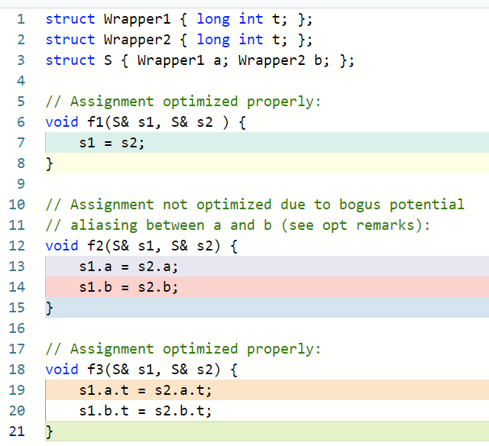
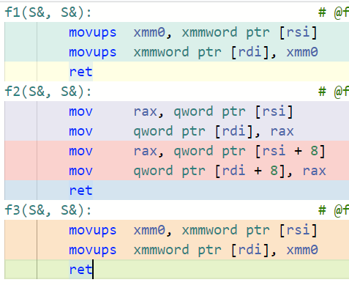

Slide 53
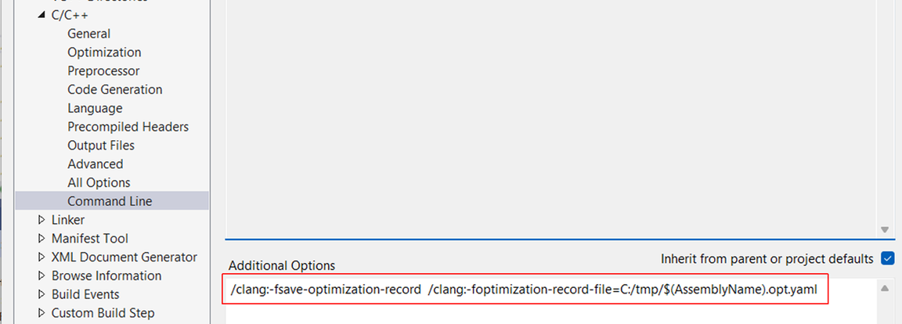
Clang-cl usage

Slide 54

4. “Failed to move load with loop invariant address”
https://godbolt.org/z/jv3sa7cbs

Slide 55

Const method that modifies members

