Slide 1
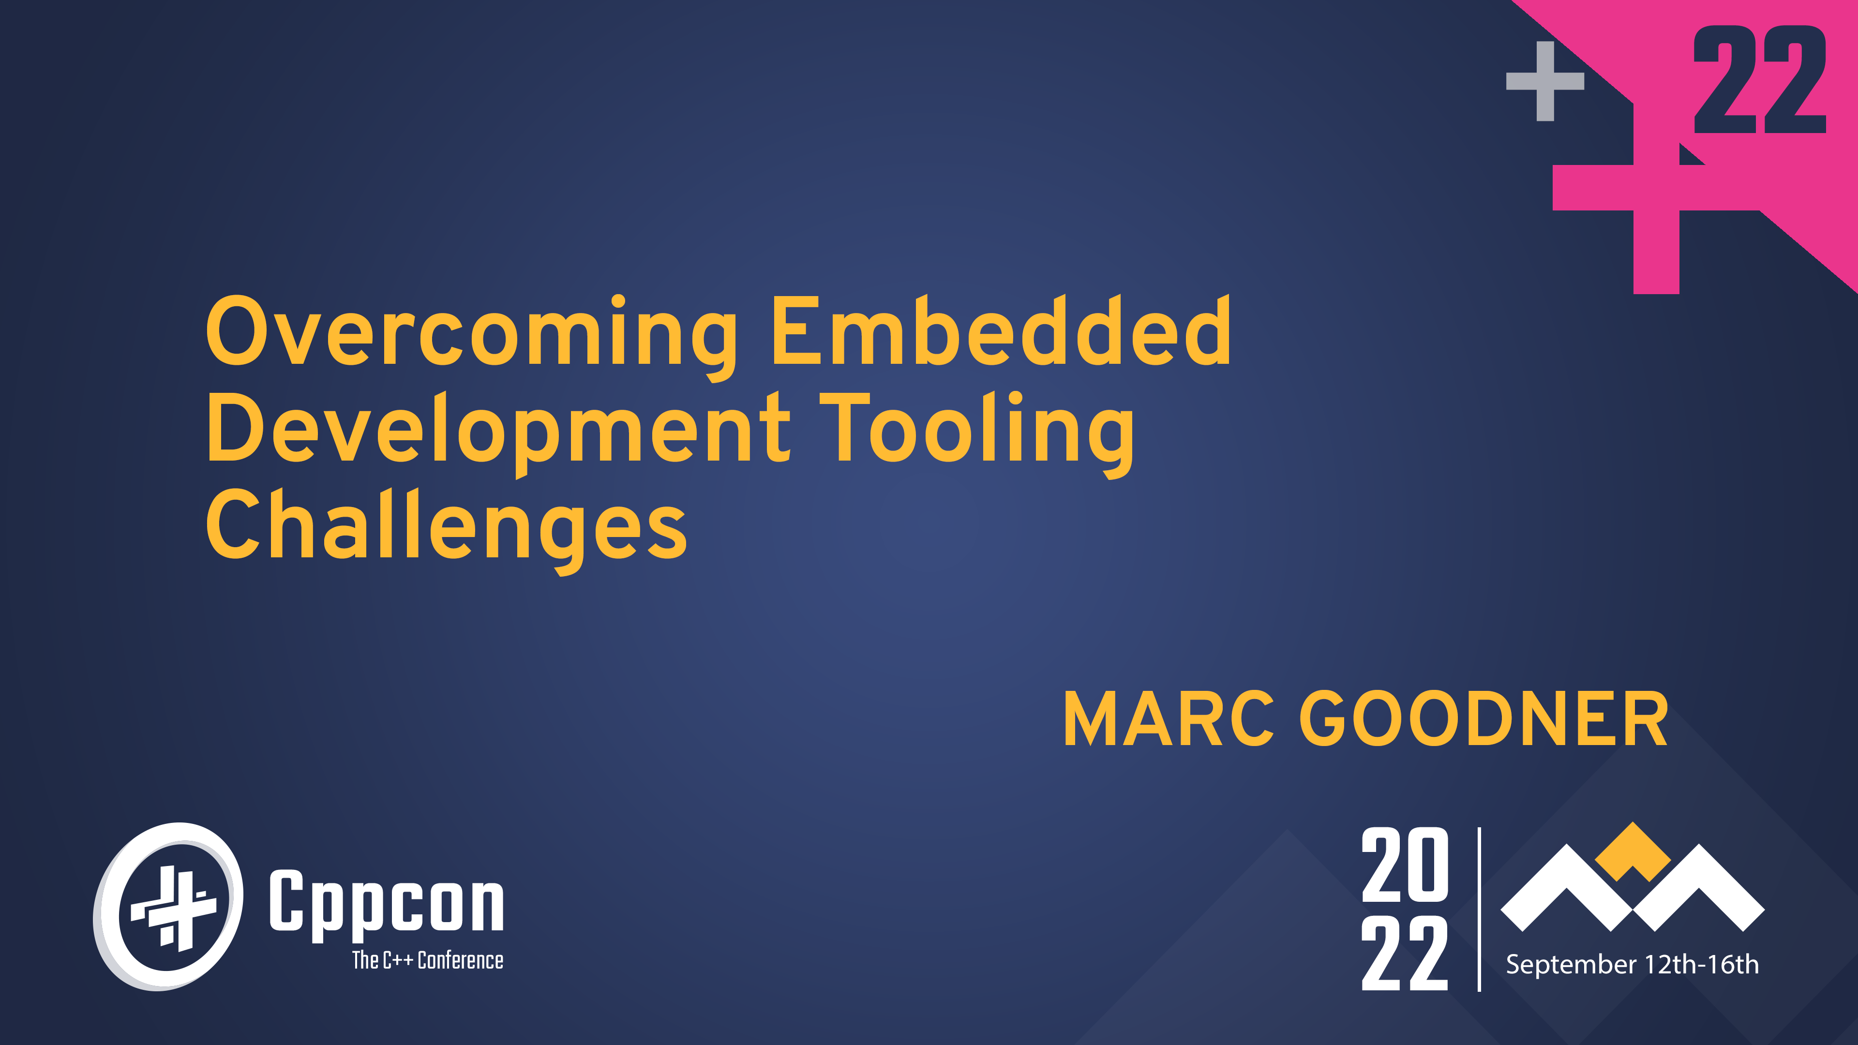

Slide 2
Welcome to CppCon 2022!
Join #visual_studio channel on CppCon Discord https://aka.ms/cppcon/discord
Meet the Microsoft C++ team
Ask any questions
Discuss the latest announcements
Take our survey
https://aka.ms/cppcon

Slide 3
Agenda
Embedded tooling today
Using your IDE for embedded
  CLion
  Visual Studio
  Visual Studio Code
Continuous Integration

Slide 4
What this talk is not
No cloud
The C++ language
Other languages
RTOSes
Embedded Linux
Testing

Slide 5

Embedded tooling today

Slide 6








Slide 7
Silicon vendor tools
Company | IDE | Compiler | Flash/Debug tool | Configurator | make | cmake
Espressif | No | gcc | openocd | No | No | Yes*
Infineon | Yes | proprietary | Yes | Yes | Export | No
Microchip | Yes | proprietary | Yes | Yes | Yes | No
NXP | Yes | gcc | Yes | Yes | Export | Yes
Renesas | Yes | gcc; proprietary | Yes | Yes | Export | No
ST | Yes | gcc | Yes | Yes | Yes | No
TI | Yes | clang; proprietary | Yes | Yes | Export | No

Slide 8
Vendor project tips
Most vendor IDEs are Eclipse CDT based
  Project > Properties
  Unselect “Generate Makefiles automatically”
Project configurators may support other targets
  ST supports Arm GCC with makefile
Look to SDK samples outside of IDE
  NXP provides CMake, Keil, and IAR

Slide 9


Embedded Tools vendors
Optimized compilers
Hardware aware debugging
  Peripheral views
  RTOS views
  Serial / SWO monitors
  Tracing
Safety certifications
CMSIS support

Slide 10
Open CMSIS https://www.open-cmsis-pack.org/
Open evolution of the CMSIS specifications
Focus on reusable components
CMSIS packs
  Sources
  Libs
  Templates and examples
  Device information and startup code
Tooling
  Project generation
  CMSIS pack management
  Build

Slide 11
Using your IDE for embedded
CLion, Visual Studio, and
Visual Studio Code
(plus CMake and vcpkg)

Slide 12
CMake
Study embedded specific examples
Use toolchain files
  Collect common compiler options together
Find you compiler on path
  Don’t rely on hardcoded paths or env vars
Use CMakePresets to capture options
  Easy to use with cli, understood by IDEs

Slide 13
vcpkg artifacts
Artifact: set of packages for a dev env
  Compilers
  Linkers
  Build systems
  Platform SDKs
Project manifest captures dependencies
. ~/.vcpkg/vcpkg-init
vcpkg activate

Slide 14
Demo CMake project
Using a GitHub template and NXP LPC55S69 SDK FreeRTOS sample

Slide 15
CMake Demo steps
. ~/.vcpkg/vcpkg-init.ps1
git clone https://github.com/robotdad/freertos_generic.git
vcpkg activate
cmake --preset m33-debug
cmake --build --preset m33-debug
Install vcpkg
Linux/macOS:
. <(curl https://aka.ms/vcpkg-init.sh -L)
Windows PowerShell:
iex (iwr -useb https://aka.ms/vcpkg-init.ps1)

Slide 16
CLion: CMake
Example CMake project
Set compiler on path
  Settings | Build, Execution, Deployment | Toolchains
  arm-none-eabi-gcc
  IAR
STM32 project importer
  Requires STM32CubeMX and Arm GCC toolchain
Make and other build systems also available

Slide 17
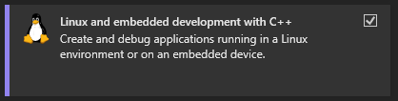
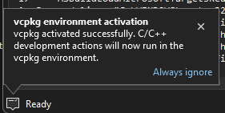
Visual Studio: CMake
Available in Visual Studio 2022
  Add Linux and embedded workload
Example CMake projects
  Use vcpkg activation for toolchains
  Automatic vcpkg activation in 17.4 Preview

Slide 18
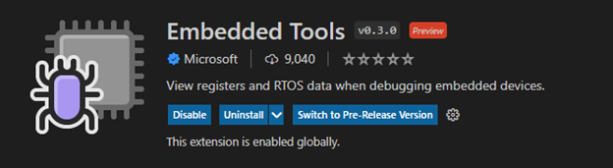
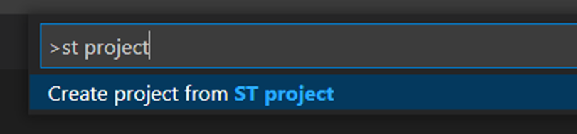

Visual Studio Code: CMake or IAR
Embedded Tools and CMake
  Example CMake projects
    Use vcpkg activation for toolchains
  STM32 project importer
    94% build pass rate on over 3,000 projects
    Requires STM32CubeIDE today
    Works with STM32CubeMX projects
IAR official support
  Project and build
  CSPY

Slide 19
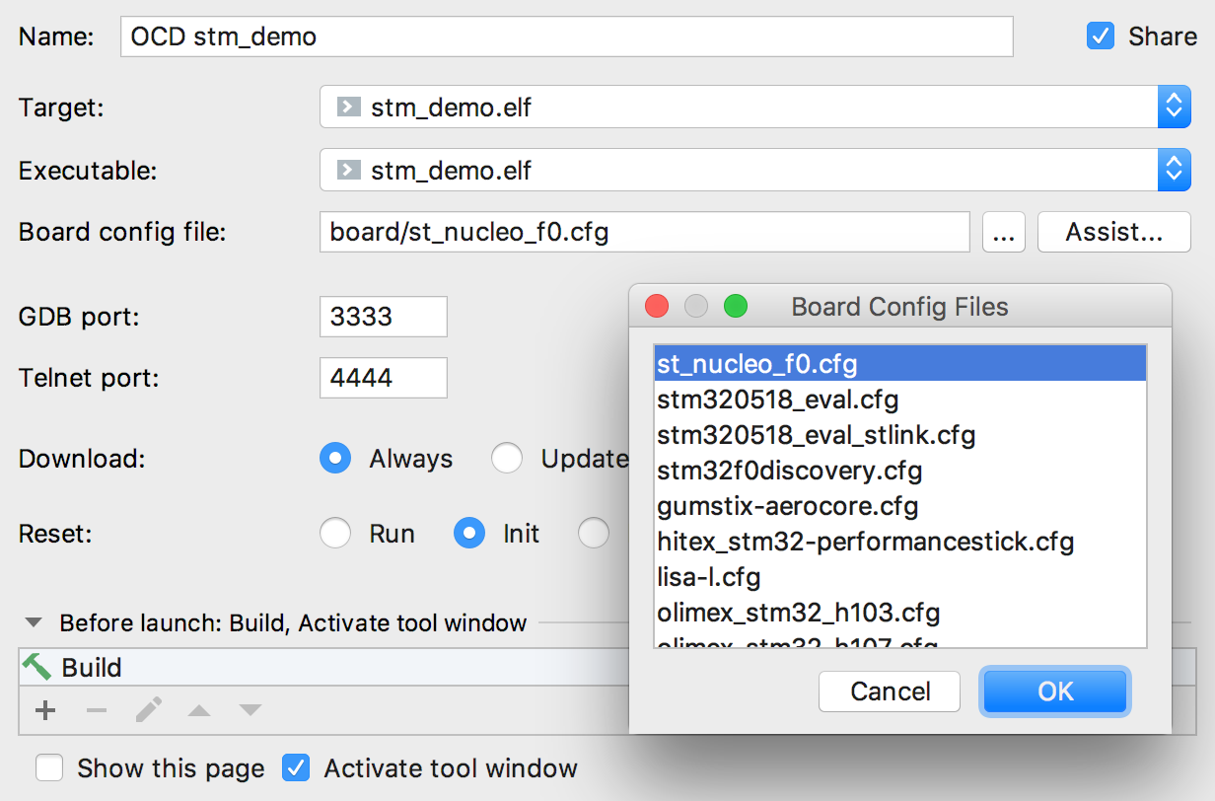
CLion:
On Chip Debugging
Native openocd support
Embedded GDB Configurations
  Run | New Embedded Configuration
    openocd
    JLink
    qemu

Slide 20
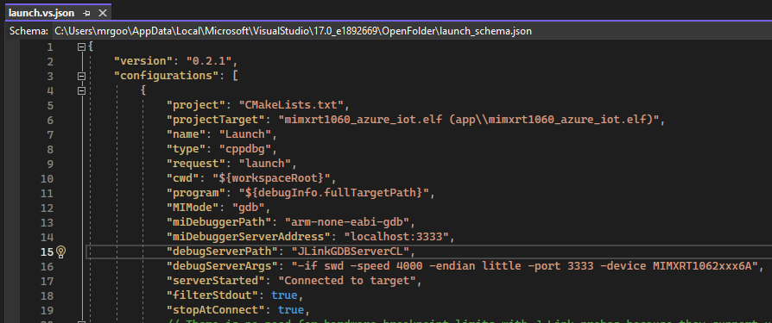
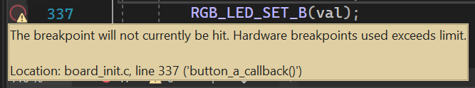
Visual Studio:
On Chip Debugging
Example launch.json for cppdbg
  Openocd
  JLink
  ST-Link
Hardware breakpoint limits

Slide 21
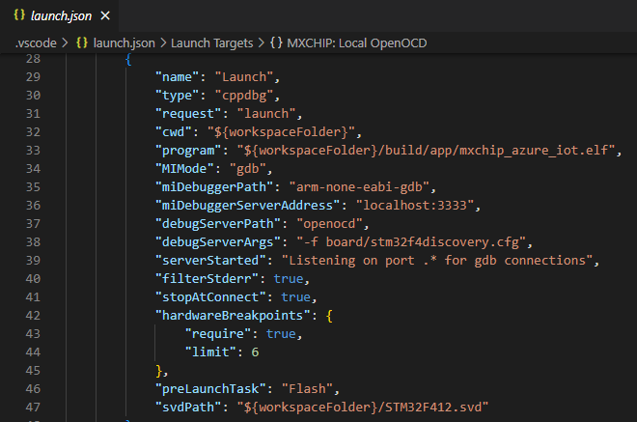

Visual Studio Code: On Chip Debugging
Example launch.json for cppdbg
  Openocd
  JLink
  ST-Link
Hardware breakpoint limits

Slide 22
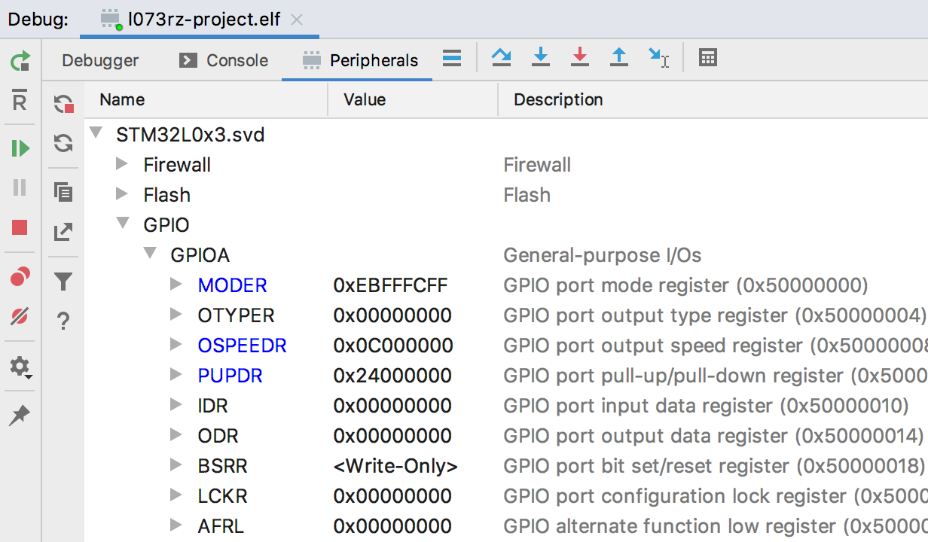
CLion: Peripheral view
Point to your .svd file

Slide 23
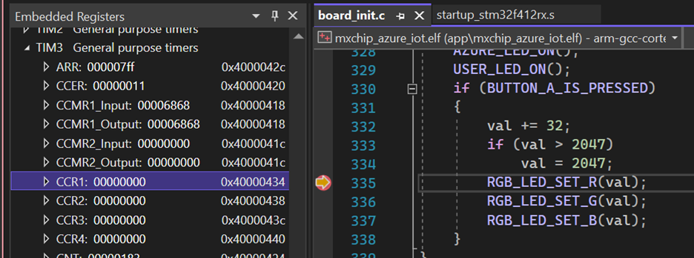
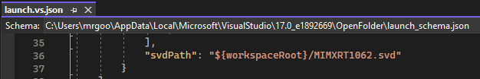
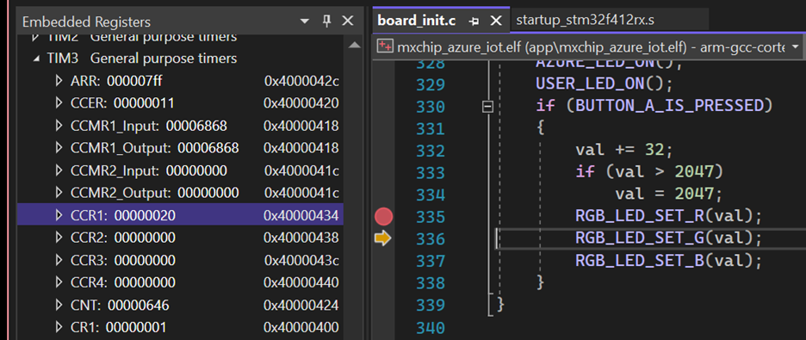
Visual Studio:
Peripheral view
Point to .svd file in launch.vs.json

Slide 24
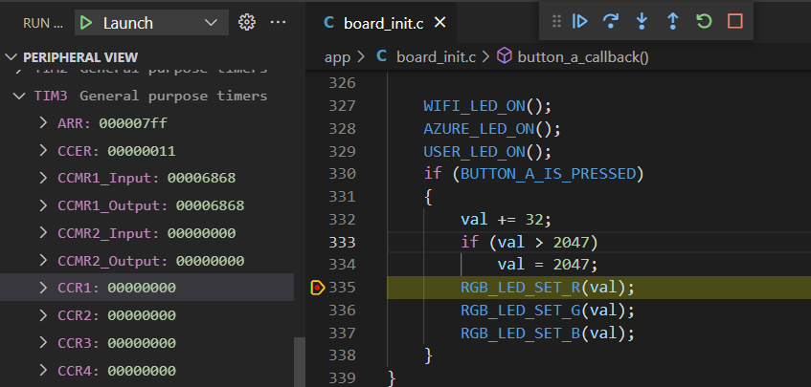
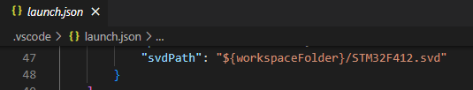
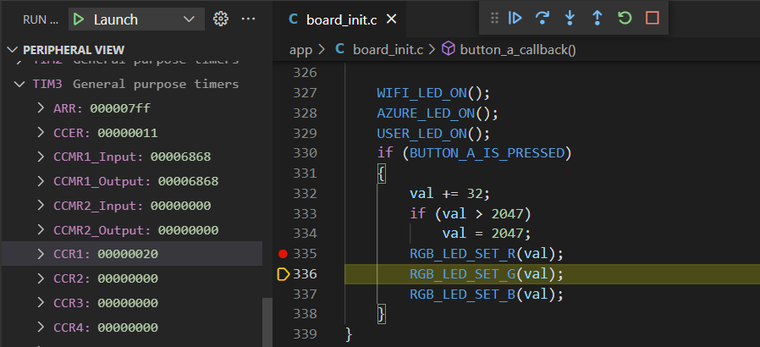
Visual Studio Code: Peripheral view
Point to .svd file in launch.json

Slide 25
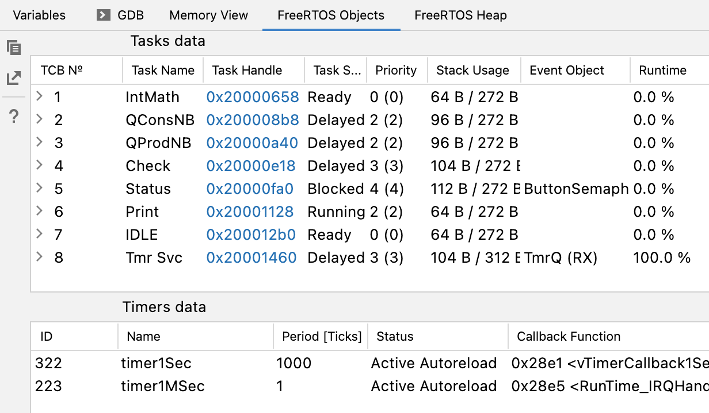
CLion:
RTOS objects
FreeRTOS
Zephyr

Slide 26
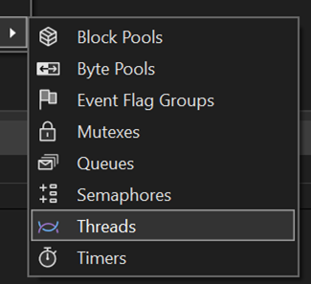
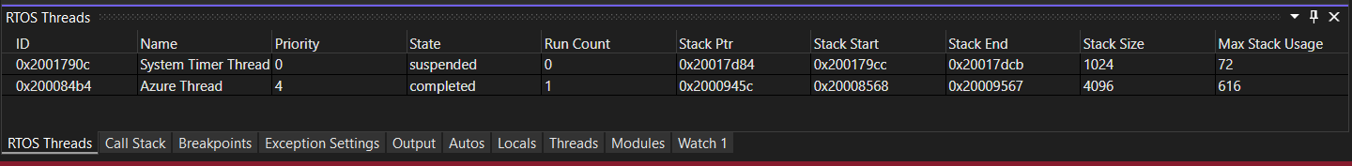
Visual Studio:
RTOS objects
FreeRTOS
Zephyr
Azure RTOS (threadx)

Slide 27
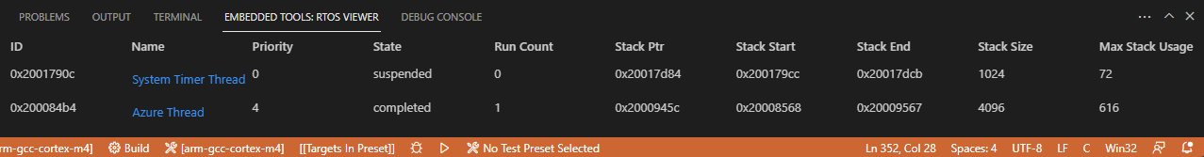
Visual Studio Code: RTOS objects
FreeRTOS
Zephyr
Azure RTOS (threadx)

Slide 28
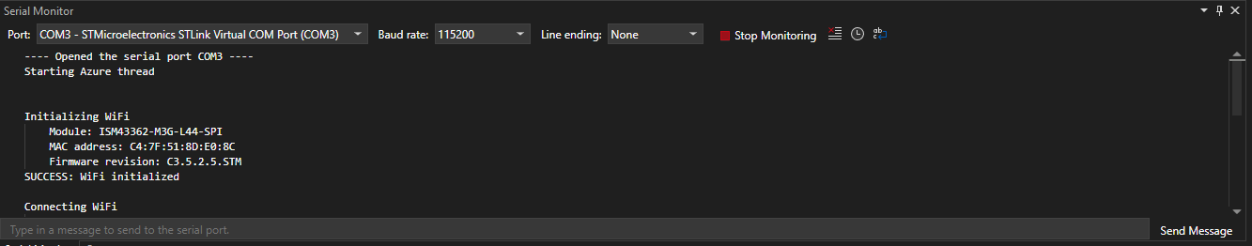
Visual Studio:
Serial monitor
Monitor and send data

Slide 29
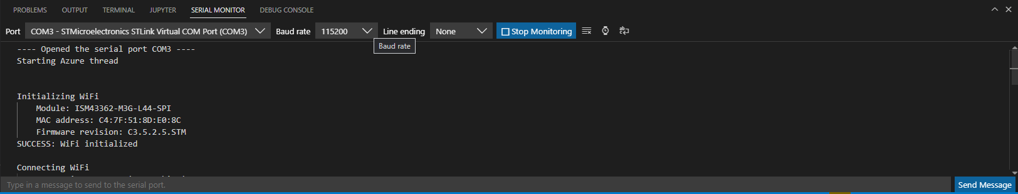
Visual Studio Code: Serial monitor
Monitor and send data

Slide 30
Demo NXP SDK sample
Modified freertos_generic for vcpkg and CMake Presets
CMake with Arm GCC in Visual Studio
IAR project in Visual Studio Code

Slide 31
CLion in review
CMake preferred
  Example CMake projects, GCC or IAR
  STM32 project imports
Embedded features
  GDB to on chip debuggers
  Peripheral view for ARM devices
  RTOS object views for FreeRTOS and Zephyr
Static analysis
  Partial MISRA C / C++

Slide 32
Visual Studio and
Visual Studio Code in Review
CMake preferred
  Example CMake projects
  STM32 project imports
vcpkg artifacts for toolchain acquisition
Embedded features
  GDB to on chip debuggers
  Peripheral view for Arm devices
  RTOS object views for FreeRTOS, Azure RTOS, and Zephyr
  Serial monitor
VS Code extensions for:
  IAR projects, build, and CSPY

Slide 33
Other modern embedded IDEs

Slide 34
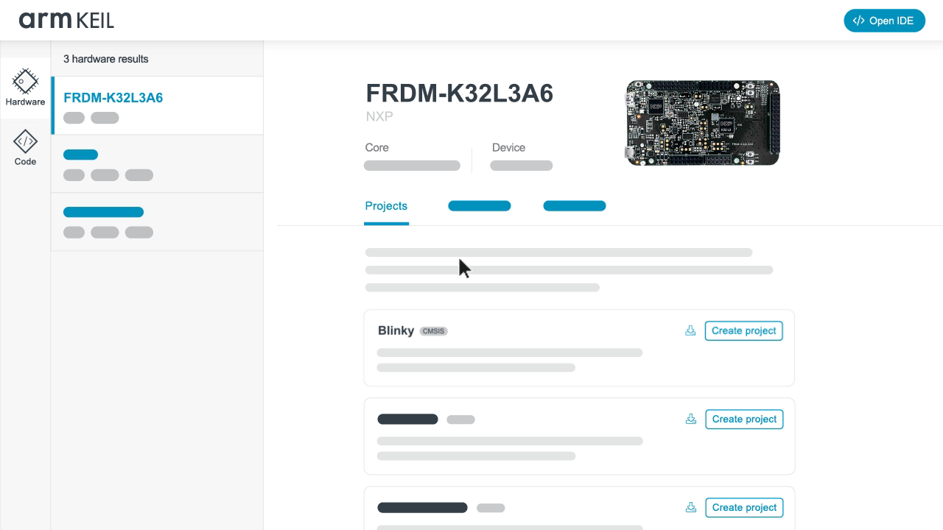
Arm Keil Studio
Cloud IDE
Open CMSIS based
Device debugging over Web USB

Slide 35

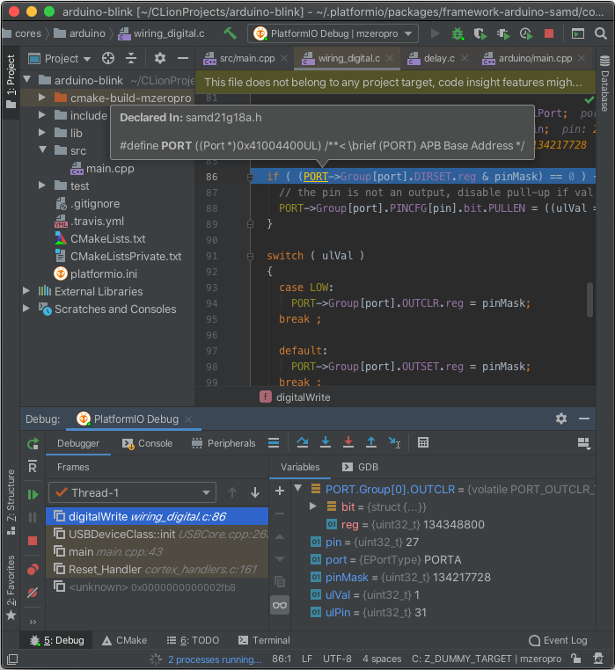
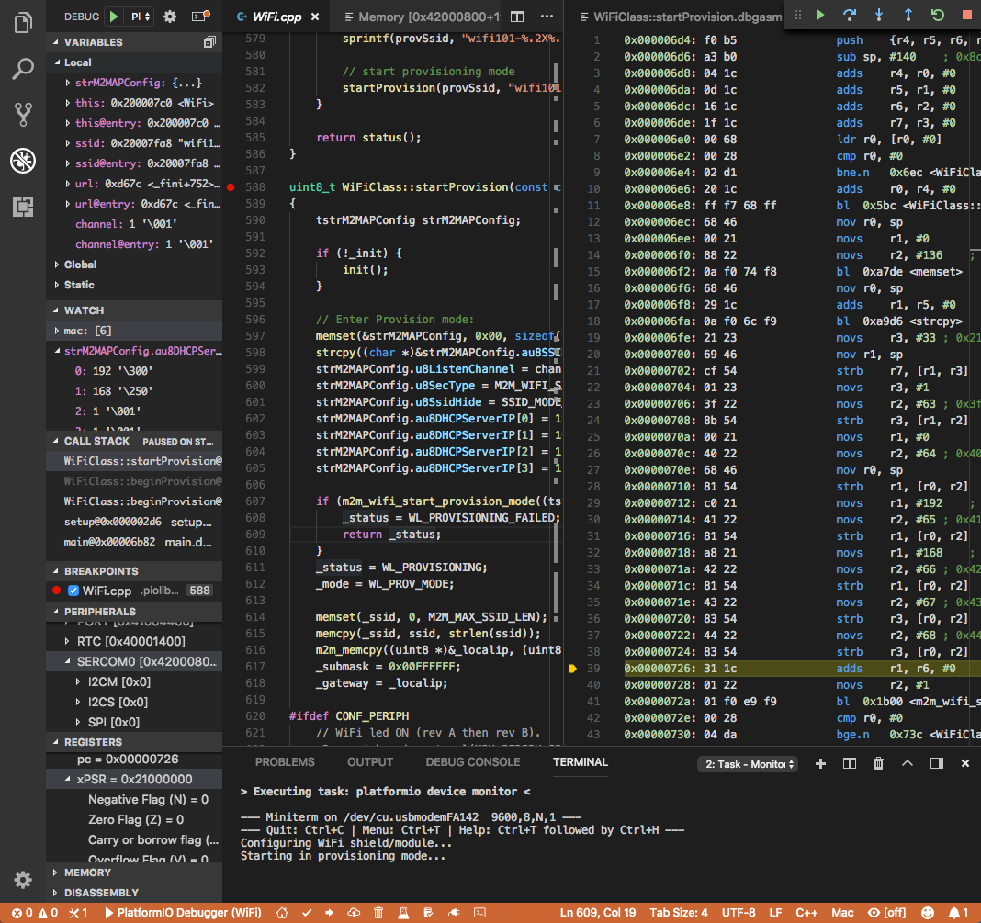
PlatformIO
Core CLI
  Build system
  Package manager
  Library management
  Serial port monitor
  Debugging
  Unit tests
IDE
  VS Code extension
  CLion
CI examples

Slide 36

Continuous Integration

Slide 37
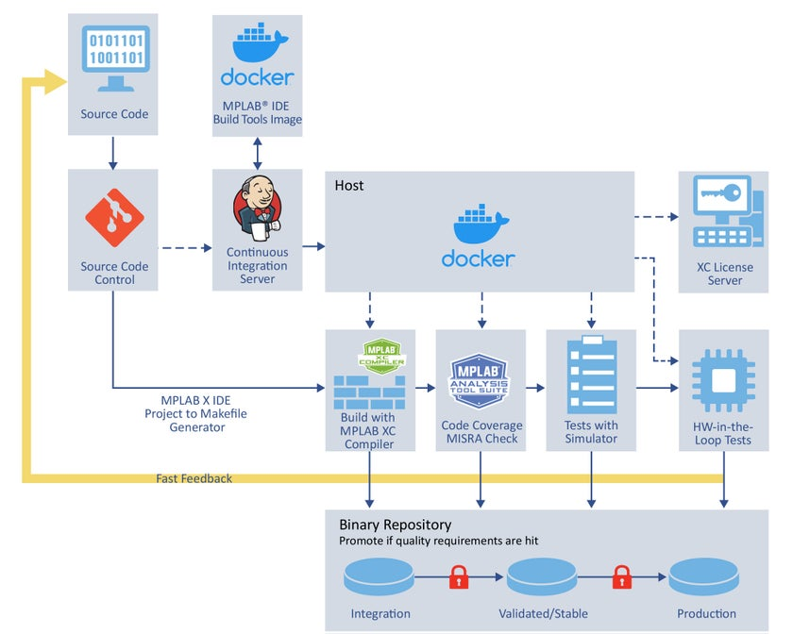
Embedded CI examples
MPLAB CI/CD Wizard
IAR containers
Sample from this talk

Slide 38
Demo GitHub Actions
Build containers and code scanning

Slide 39
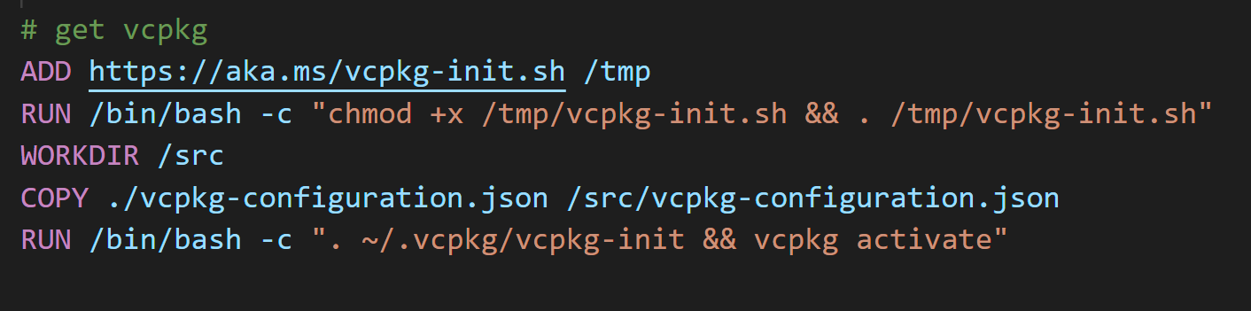
Use multistage build containers
Wire container into the CI system of your choice
Lower layers should change with less frequency
  FROM image AS base
    Base layer, OS and system dependencies
    Artifacts for building your firmware, infrequent changes
  FROM base AS build
    Final layer to build your output as your source change the most
Challenge: Getting your chosen tools into the container

Slide 40
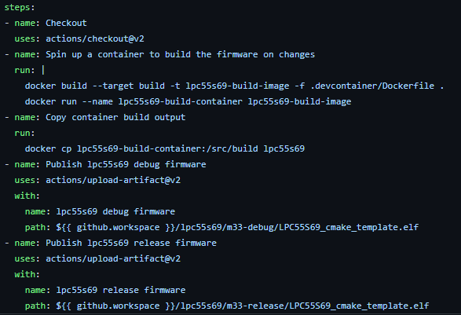
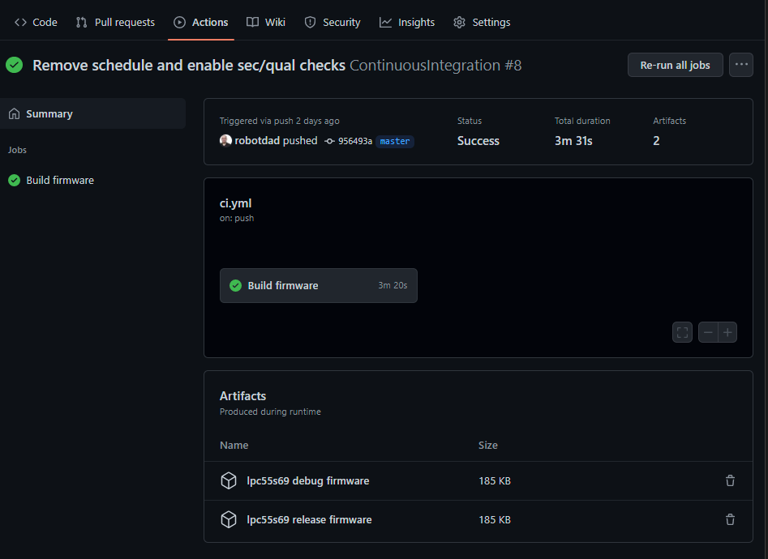
Setting up GitHub Actions
.github/workflows/ci.yml
Run docker build target
Copy build output
Publish output as artifacts
  Use in simulator/hardware tests

Slide 41
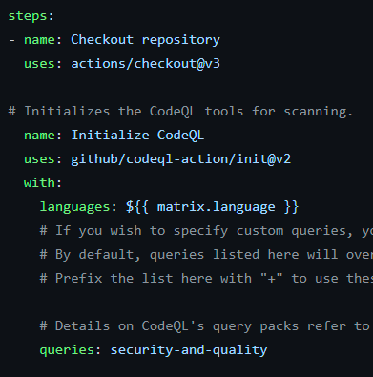
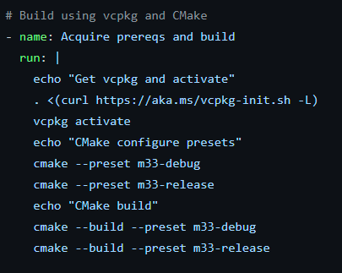
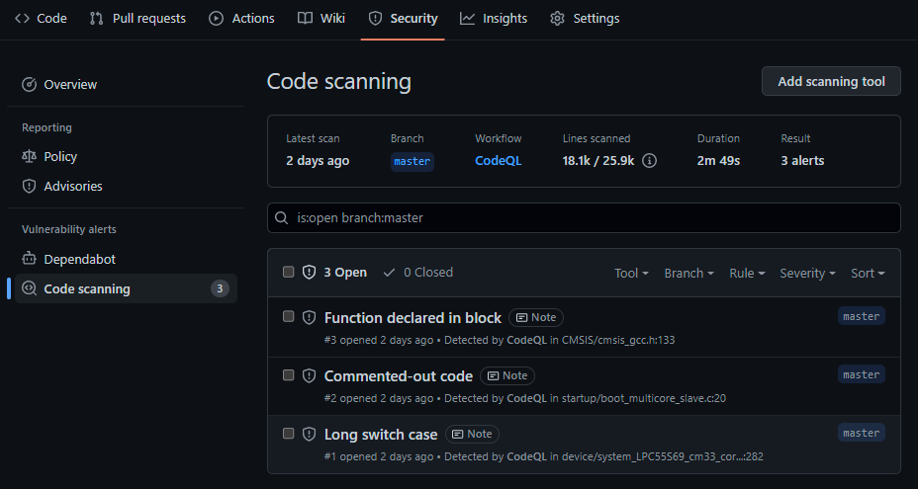
GitHub code scanning
Enable under Security tab
  Creates codeql-analysis.yml
  Select queries for desired scan
Autobuild will not work
  Add your build steps
Alerts under Code Scanning

Slide 42
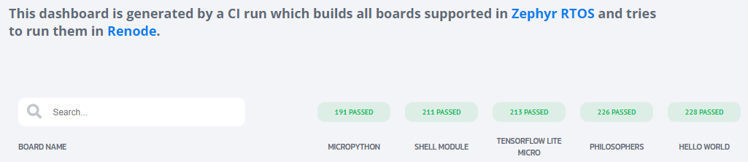
Renode
Simulation environment
  CPU
  Peripherals
  Sensors
  Network
Runs same binary as device
Designed to be part of a CI system
Zephyr validation dashboard

Slide 43

Discussion and Q&A
Links to more info from talk:
https://aka.ms/EmbToolsLinks
Sample shown: https://github.com/robotdad/freertos_generic
Marc Goodner
mgoodner@microsoft.com

Slide 44
Enjoy the rest of the conference!
Join #visual_studio channel on CppCon Discord https://aka.ms/cppcon/discord
Meet the Microsoft C++ team
Ask any questions
Discuss the latest announcements
Take our survey
https://aka.ms/cppcon

Slide 45
Our sessions
Monday 12th​
GitHub Features Every C++ Developer Should Know – Michael Price​
The Imperatives Must Go – Victor Ciura​
What’s New in C++ 23 – Sy Brand​
C++ Dependencies Don’t Have to Be Painful – Augustin Popa​
How Microsoft Uses C++ to Deliver Office – Zachary Henkel​
​
Tuesday​ 13th
High-performance Load-time Implementation Selection – Joe Bialek, Pranav Kant​
C++ MythBusters – Victor Ciura​
​
Wednesday 14th​
-memory-safe C++ - Jim Radigan​
​
Thursday​ 15th
What’s New for You in Visual Studio Code – Marian Luparu, Sinem Akinci​
Overcoming Embedded Development Tooling Challenges – Marc Goodner​
Reproducible Developer Environments – Michael Price​
​
Friday​ 16th
What’s New in Visual Studio 2022 – Marian Luparu, Sy Brand​
C++ Complexity (Keynote) – Herb Sutter​

