Slide 1
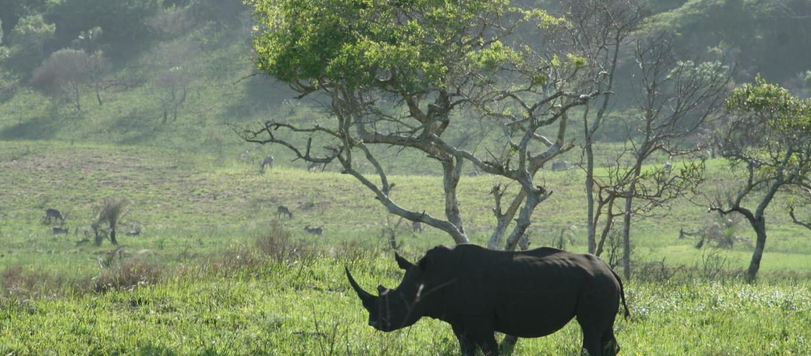
The Biodiversity and
Protected Areas Management
(BIOPAMA) Programme
2017-2023
An initiative of the ACP Group of States financed
by the European Union’s 11th EDF

Slide 2




An initiative of the African, Caribbean and Pacific (ACP) Group of States financed by the European Union (EU)’s 11th European Development Fund.
A Global partnership: BIOPAMA combines
  the protected areas and the biodiversity conservation expertise of the International Union for Conservation of Nature (IUCN) and
  the scientific know how of the Joint Research Centre of the European Commission (JRC).
Implementation in close collaboration with the regional, national and local actors in Africa, the Caribbean and the Pacific countries.
A six year programme (2017-2023), continuing to build on the first programme phase.
A 60 million Euro investment to improve the long-term conservation and sustainable use of biodiversity and natural resources.

Slide 3
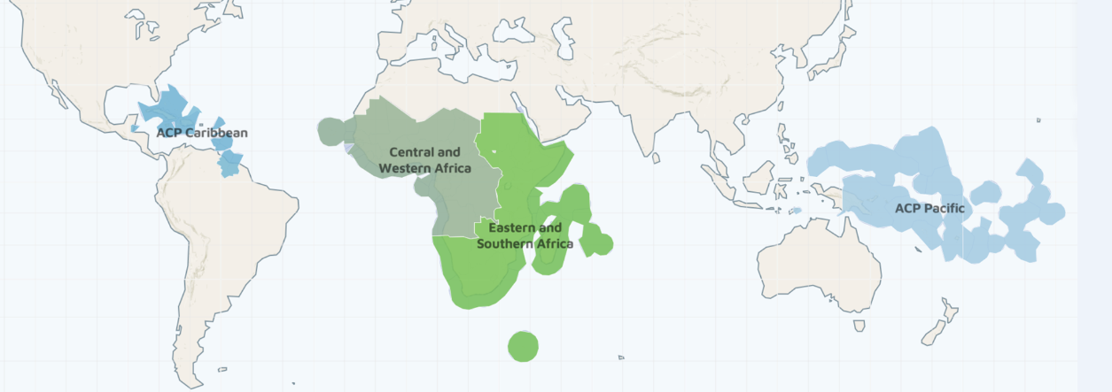
Map: Africa, Caribbean, Pacific
79 developing countries (including Least Developed and Small Island States)
1 + billion people whose livelihoods depend on the natural resources
More than half of the world’s 35 biodiversity hotspots
More than 9,000 protected areas, terrestrial and marine

Slide 4
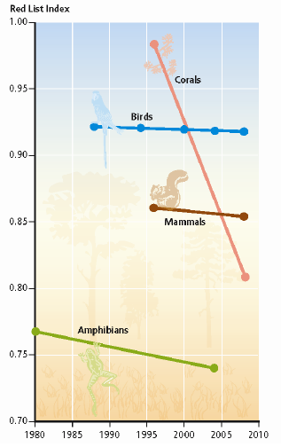
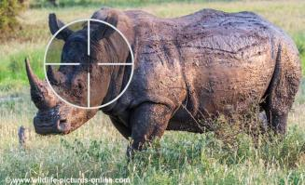
ACP countries’ challenges
The main challenges to ensure biodiversity conservation, sustainable livelihoods and effective protected area management and governance are linked to:
Policy and legal framework
Institutional building
Ineffective law enforcement
Inadequate assessments of impacts from infrastructure developments
Lack of sustainable funding mechanisms.
Consequences
Biodiversity continue declining
Ecosystems increasingly degraded
Climate change impacts to nature and society
Livelihoods, particularly of local communities, at risk.

Slide 5
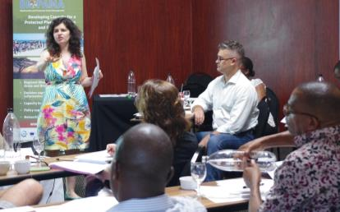
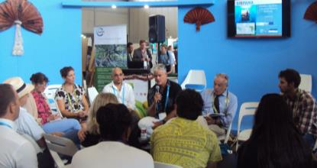
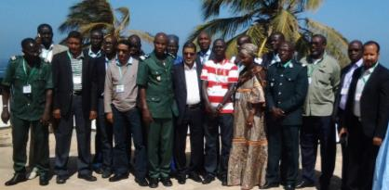
BIOPAMA builds on the progress of an initial phase (2011-2017), initiated by the ACP Group of States and funded by the EU’s 10th European Development Fund. Until 2023, BIOPAMA will continue to assist the ACP countries to address priorities for effective conservation and sustainable use of natural resources by providing tools, services and financial support.
BIOPAMA (2011- 2017) results include:
120+ training and workshops on developing capacity for protected area and data management.
2000+ protected area staff, NGOs, governments, technical networks, academia, local communities and private sector benefited and were involved in the BIOPAMA activities on the ground.
1 ACP wide and 5 regional and sub-regional Reference Information Systems in place
4 fully functional Regional Observatories for protected areas and biodiversity

Slide 6
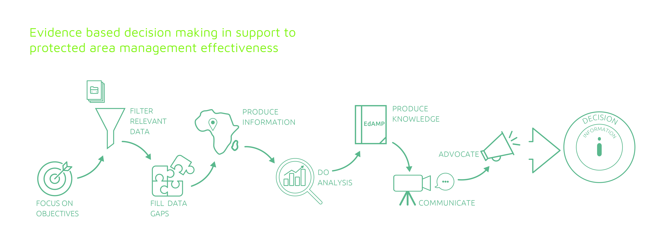
BIOPAMA MISSION (2017-2023)
BIOPAMA aims at reinforcing the management and governance of protected and conserved areas in the79 African, Caribbean and Pacific (ACP) countries through better use and monitoring of information and capacity development on management and governance.
Notes:
BIOPAMA MISSION

Slide 7
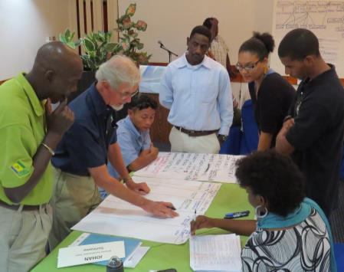
The direct beneficiaries of the BIOPAMA programme are the protected area actors at the regional, national and local levels, whose efforts will continue to be supported by the provision of tools, services, capacity development and the possibility to finance actions at the site level.
Ministries of Environment and National agencies leading on biodiversity conservation
Protected Area agencies
Regional organizations
Local communities living in and around protected areas and
Civil society

Slide 8











Regional organisations, national and local conservation actors are key partners and beneficiaries.
BIOPAMA aims to complement and align with existing platforms and initiatives.
BIOPAMA is implemented at the regional level through the IUCN Regional Offices in Eastern and Southern Africa, West and Central Africa, Mexico Central America and the Caribbean, and Oceania.
Key regional organizations are partners in the programme’s implementation.
Notes:
The African, Caribbean and Pacific regions represent some of the most challenging places on Earth and host a huge share of our planet’s biodiversity. While the programme’s objectives are the same across all the regions, BIOPAMA can only succeed by tailoring them to respond to specific needs and complement countries’ efforts filling the gaps where they exist.

Slide 9

BIOPAMA STRATEGIES (2017-2023)
The Regional Observatories
The Reference Information Systems
The Action Component
Capacity Development
BIOPAMA provides unique and tailored support to protected area authorities in the ACP countries to address their priorities for improved management and governance of biodiversity and natural resources.
Notes:
BIOPAMA Strategy

Slide 10
The Regional Observatories are the central pillar of BIOPAMA’s work. They support data collection, analysis, monitoring and reporting, develop the capacities of staff and organisations to manage this information and provide policy guidance for better decision making on biodiversity conservation.
The Regional Observatories provide tools and services available for stakeholders:
Capacity development for institutions, managers and local communities.
Assessment tools and support for their application including for reporting on MEAs
Planning and decision making support
Data and information management and analysis (The Reference Information Systems)

Slide 11
The Reference Information Systems (RRIS) are a key feature of each Regional Observatory. They bring together the best available science and knowledge and make it easily accessible, at regional, country and site level, supporting policy making on the inter-linked themes of biodiversity, conservation and development.
An open-source, free and secure tool.
Collects and analyses protected areas information and trends.
Includes tools such as IMET (the Integrated Management Effectiveness Tool). Other tools will be added during the life of the programme.
Typical information includes: protected areas and biodiversity ecosystems, species, habitats, pressures, threats, management, governance, climate change vulnerability, etc.
Will be harmonised with other major global datasets, e.g. WDPA, PANORAMA – Solutions for a Healthy Planet and the IUCN Green List of Protected and Conserved Areas.
rris.biopama.org

Slide 12
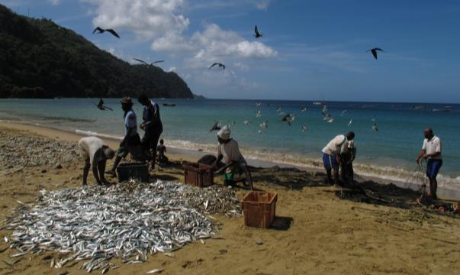
BIOPAMA will support specific actions on the ground aimed at strengthening protected areas and natural resources management effectiveness and governance. The application of the BIOPAMA management and governance assessment tools and data/information from the Regional Observatories will help identify where management action is necessary.
21 million Euros will be assigned for small and medium grants for targeted conservation actions.
They will support activities on the ground, by enabling protected area agencies, NGOs, local communities and other key actors to effectively implement their field projects.
action.biopama.org

Slide 13
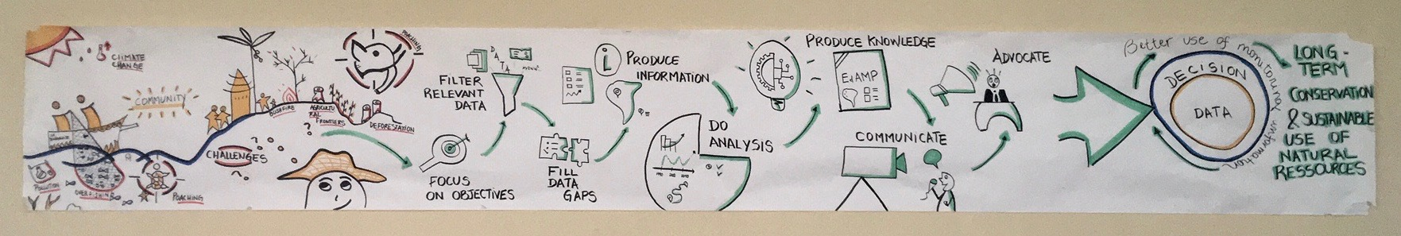
PROTECTED AREA ISSUES
BIOPAMA MISSION
EXPECTED
RESULT
IMPACT
BIOPAMA STRATEGIES
INPUTS
Support to Regional Hubs/ Observatories
Reference Information System
Assessment Tools
Capacity Building
Action Grants
OUTPUTS
Knowledge products
Reports, Plans, Studies
Policy Dialogue

Slide 14



