Slide 1
SharePoint Adoption
Playbook
https://aka.ms/SharePointAdoptionPlaybook

Slide 2




The Success Factors outlined in this deck will help make sure you’re set up for a successful roll-out of SharePoint.
Throughout this deck, you will find templates to help you facilitate your organization’s SharePoint adoption campaign.

Slide 3




Adoption Success Factors
LEARN AND REINFORCE
Stakeholders
Recruit executive sponsors
Empower SharePoint champions
Scenarios
Prioritize your SharePoint scenarios
Measure success
Awareness
Implement SharePoint comms campaign
Execute SharePoint launch events
Training
Train end users
Ready help desk

Slide 4



Stakeholders

Slide 5

Stakeholders
Executive sponsors
Communications to all staff and supporting sponsors/leadership
Act as sponsor and face to the program
Use the technology to model how employees can use it
Success Owner
Ensure business goals set for SharePoint are realized
Drive end user adoption
Champions
Scale adoption efforts across the organization
Evangelize SharePoint and its value across teams
Welcome new users and answer questions
Mott MacDonald developed a network of technology champions by engaging the employees who are most interested and enthusiastic about the new capabilities. The company makes sure the champions are well-trained and sends them out into the business to coach and communicate with their colleagues.

Slide 6
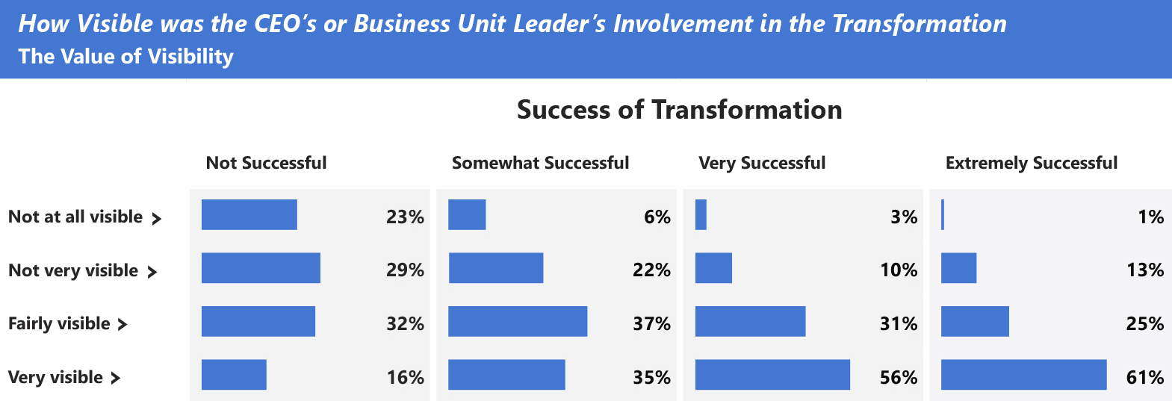
Why is the role of an Executive Sponsor crucial for project success?
  An actively engaged executive sponsor is one of the top drivers of project success.
Adapted exhibit from “Creating organizational transformations”, July 2008, McKinsey Quarterly, www.mckinsey.com
Copyright© 2008 McKinsey & Company. All rights reserved. Reprinted by permission.

Slide 7
Executive Sponsor Communications
Executive Sponsor
Supporting Sponsors
Employees
Key messages
Outline the project’s 5 Ws (what, when, where, why’ and how)
How will benefit organization
Calls to action for supporting sponsors
Highlight resources to support transition
Key messages
Outline the project’s 5 Ws (what, when, where, why’ and how
How will benefit organization and end users
Calls to action for employees: start and stop behaviors
Highlight resources to support transition

Slide 8
How does a Champion help?
Info
Support
Enthusiasm
Answers
Keep your team up-to-date on what’s coming and when
Be on hand to answer questions and help get support involved when needed
Answer ad-hoc questions and demonstrate features
Help show your team the advantages of SharePoint

Slide 9
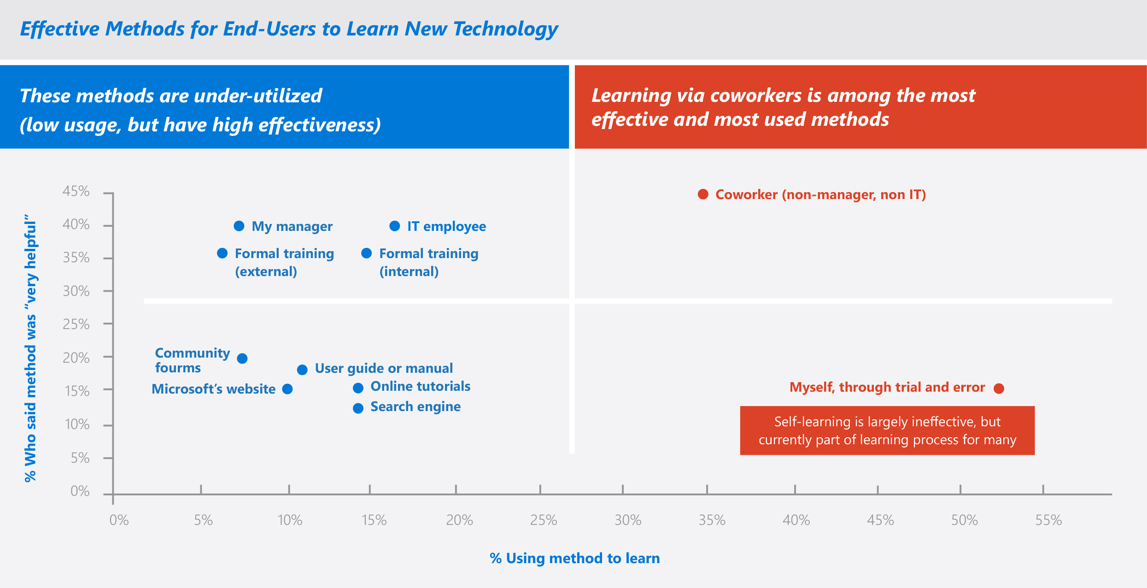
Why are Champions important?
  Learning via coworkers is among the most effective and most used methods
  In a Microsoft End-User study, research indicates learning from co-workers is among the most effective and used
  methods in learning a new technology
SharePoint End-User Study, Apr 2013, Microsoft Corporation

Slide 10

Office 365 Champions Program
  Stay Informed and Connected
Get your champions to sign up for this Microsoft led community, you’ll have access to following opportunities:
Regular email communications (community topics, latest news, tips and resources)
Regular champion-peer networking and sharing
Partnerships with Microsoft at premier events and meetups in your industry
Access to Microsoft subject matter experts and unique Office 365 training and content
https://aka.ms/O365Champions

Slide 11
Stakeholders
Stakeholder Group | Who
Executive Sponsor
Supporting Sponsor(s)
Success Owner
Champion(s)
Mott MacDonald developed a network of technology champions by engaging the employees who are most interested and enthusiastic about the new capabilities. The company makes sure the champions are well-trained and sends them out into the business to coach and communicate with their colleagues.

Slide 12
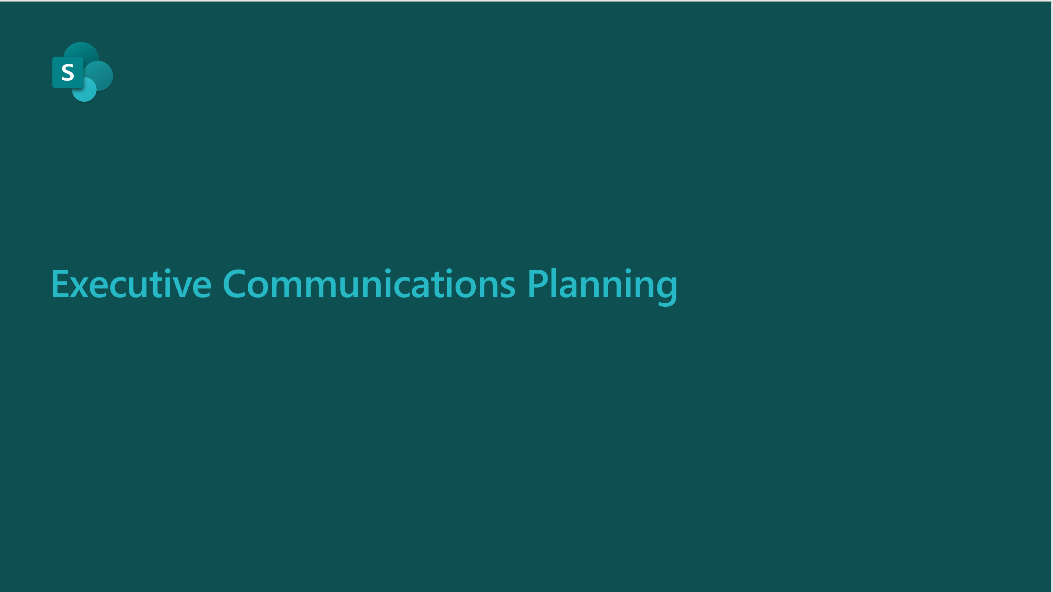
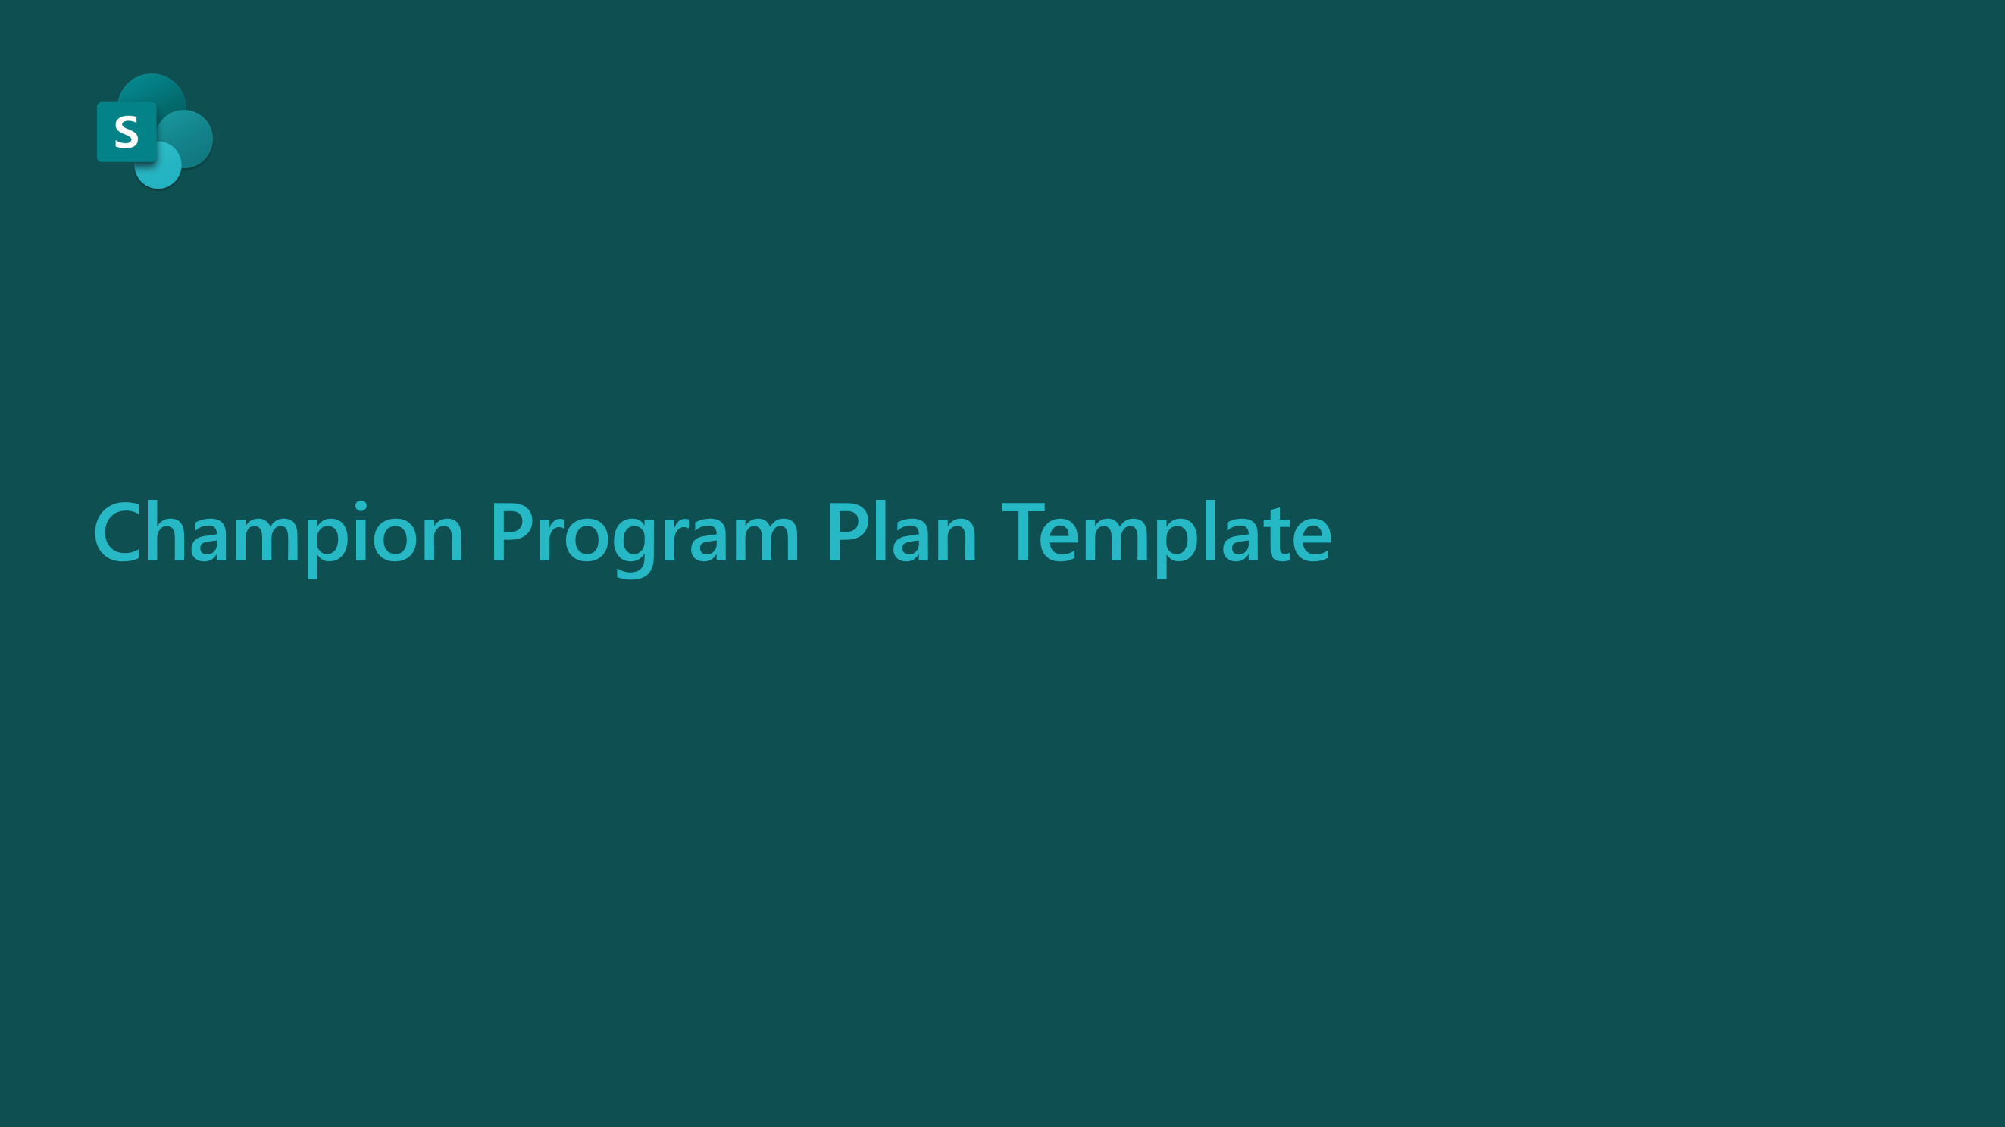
1
Plan executive sponsor communications
Use Executive Communications Planning deck
https://aka.ms/SharePointExecCommPlan
2
Build champions program
Create a plan using the Champion Program Plan
https://aka.ms/SharePointChampionProgramTemplate

Slide 13


Scenarios

Slide 14

Identify Scenarios
Why Scenarios are important:
What is a Scenario?
Scenarios cover the ways your people will use SharePoint to address business challenges or achieve defined goals.
  Allow teams to understand how SharePoint can help them achieve more
  Act as inputs and validation of SharePoint awareness messaging
  Support awareness and readiness activities by putting products in context; people will know when and how to use them

Slide 15
Sample SharePoint Scenarios
Share and work together
Inform and
engage people
Transform
business processes
Harness collective knowledge
Share content inside or outside your organization
Get new team members up to speed quickly on projects
Real time collaboration on documents
Access files from all your devices
Reach broad audiences with intranet site
Support new employee onboarding
Share company news
Connect employees with company leaders
Collect information from your employees, customers, or vendors in a structured manner
Automate manual repetitive tasks
Create apps quickly and easily
Foster communities to share knowledge and best practices
Use video to deliver training
Find relevant content and expertise,
wherever you work
Notes:
Use this slide to inspire decision makers on what’s possible with SharePoint.

Slide 16
How to create your own Scenarios
I want to…
[Description of what I want to do]
Using…
[Specific application of the technology]
I know this is successful when…
[Solution success measure]
As someone in…
[Team]
As someone in
Sales Management
I want to
train my sales reps, who are geographically dispersed, on new products we bring to market
Using
SharePoint Communication Sites, News and Microsoft Stream to create a Sales Training Portal that alerts sales reps of new product training videos on the portal they can consume while on the road
I’ll know this is successful when
my sales team completes the training and indicates in a survey they have improved their ability to sell the new product

Slide 17




Tips for identifying scenarios
Decision Criteria:
Does it solve a real problem?
Is it obtainable?
Will it be widely used (how many people)?
How much ROI does it provide?
Notes:
Use this slide to help guide the initial creation/ideation of solutions.

Slide 18
How to prioritize your Scenarios: Impact vs ease of implementation
High
Med
Low
Medium priority | High priority
Low priority | Medium priority
(Copy these to map!)
Scenario name
Scenario name
Impact
Scenario name
Scenario name
Scenario name
Scenario name
Scenario name
Add your scenario’s name and add as many as needed
Hard
Somewhat
Easy
Ease of implementation
Notes:
Choose a Scenario!
This activity should take place on a whiteboard, use this template to get started. You will also use this template to capture results of the whiteboard exercise and then circulate.
Additionally it is recommended you use sticky notes to represent each solution and have participants place them and move them around on the whiteboard
Identify and agree upon which scenario you are going to focus on.
Encourage everyone to voice their opinions (try not to let one “decision maker” taker over)
Steer them towards choosing a scenario that:
Is obtainable (doesn’t have to be easy, but it has to at least be possible to create in a short amount of time)
Will be used by at least 90% of their employees (or better yet, 100%!) – don’t pick ones that will only be used by the C-level, or managers and up, because ROI will be minimal. Pick something that lifts the entire population up.
Is collaborative. Scenarios that allow employees to interact and collaborate demonstrate the real value of Teams.
Agree on which scenario you will be focusing on. Get everyone’s buy-off! You will need at least one BDM to agree that this is a priority—get an executive sponsor!

Slide 19
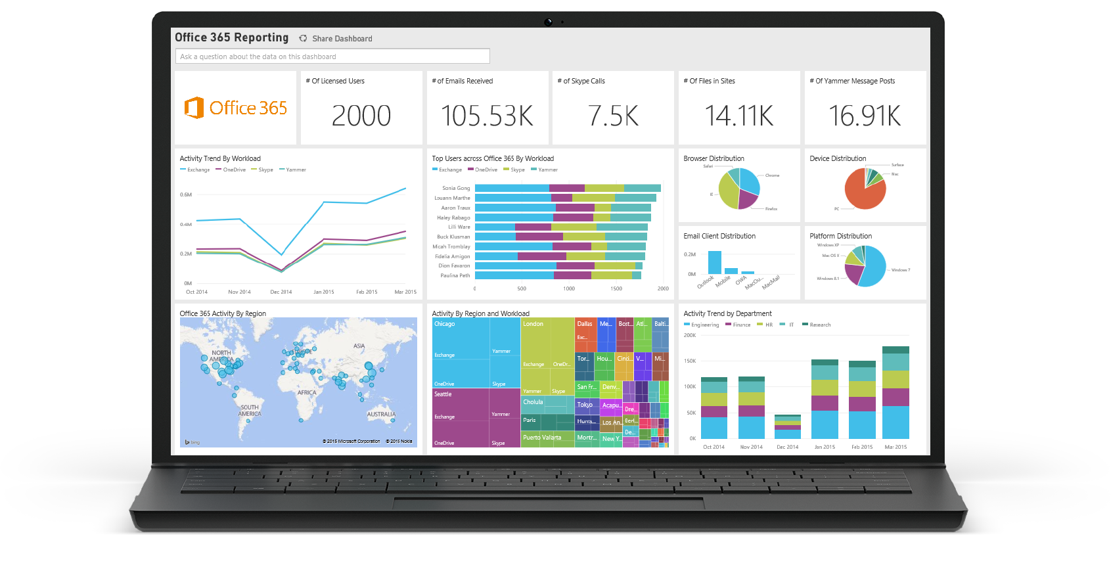
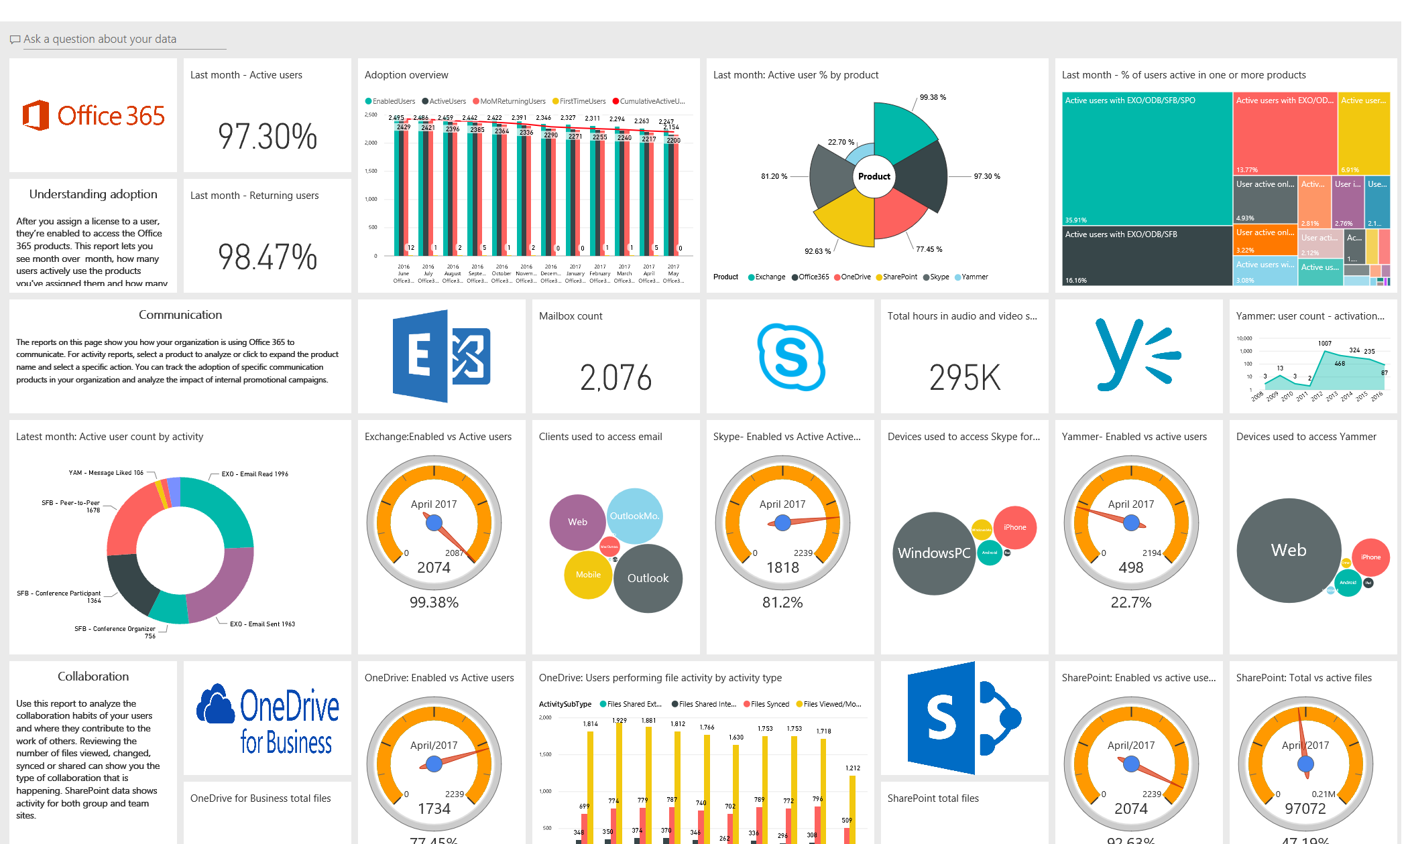
Measure with Microsoft 365 Usage Analytics
Microsoft 365 Usage Analytics
  Basic OneDrive usage reports available in the admin center: Instructions on how to access and interpret the report are here

Slide 20
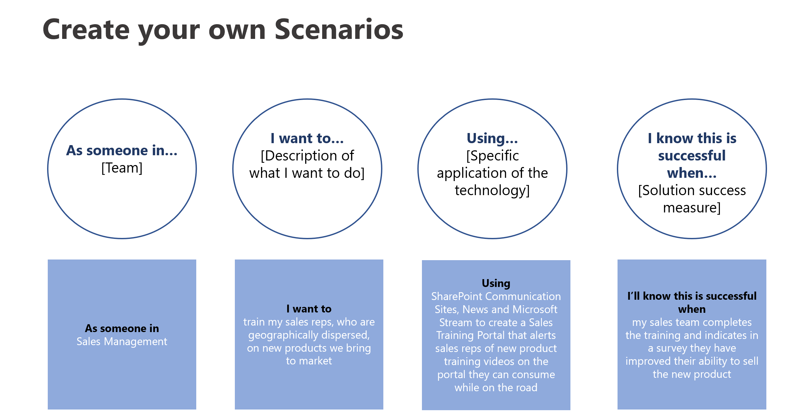
1
Identify and prioritize SharePoint scenarios
Work with your business decision makers to identify SharePoint scenarios
https://aka.ms/SharePointEnvisioningWorkshop

Slide 21


Awareness

Slide 22

Awareness
Teaser Campaign
First Day Set Up
Tips Campaign
Campaign to raise awareness regarding the value SharePoint will provide
Highlight scenarios of value that SharePoint will provide to organization and key roles
Generate excitement and awareness regarding the project
Gain staff buy-in for project by outlining ‘what’s in it for them’
Communication and guide(s) to help end users get set up quickly and easily
Campaign focused on key tips for SharePoint to help employees get the most value from working in new ways
Make it top of mind for staff regarding how to work in new ways with SharePoint
Reinforce new behaviors and resources to support – outline key stop, start, continue behaviors
Launch/Buzz Events
Events to kick-off SharePoint launch and support adoption post-launch
SharePoint scenario-focused events that showcase the user experience
PRE-LAUNCH
LAUNCH
POST-LAUNCH

Slide 23
Plan Communications
Define Objectives
Outline Audiences
Determine
Key Messages
Identify Senders
Outline Channels
Identify objectives for communication(s)
Define audiences for communications, including end user personas and project stakeholders (Sponsors, leadership, champions)
Answer the 5 Ws (who, what, when, where, why) and how
Outline the key project benefits for audiences
Identify senders that can influence key audiences identified
Outline how sponsor/success owner and champions can help amplify and scale key messages
Identify the channels that your key audiences engage with/on

Slide 24
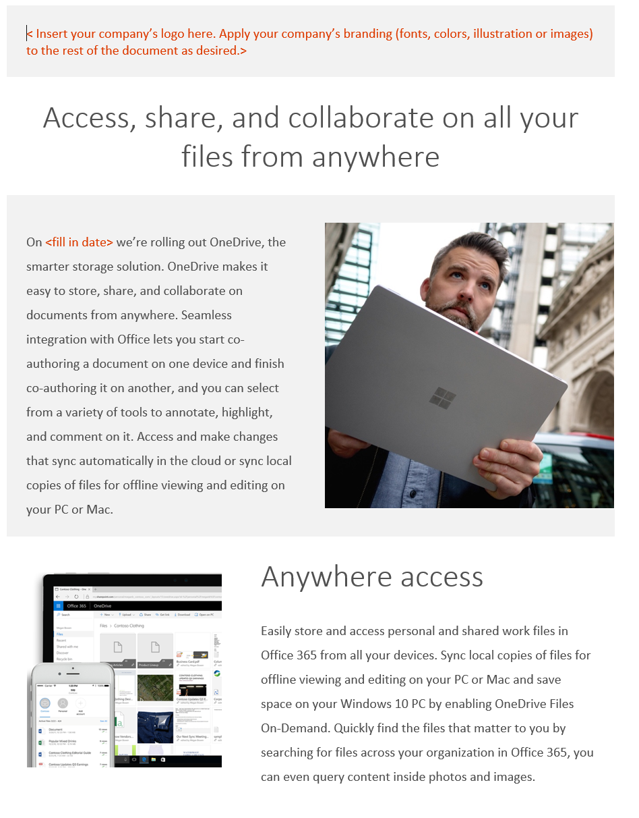
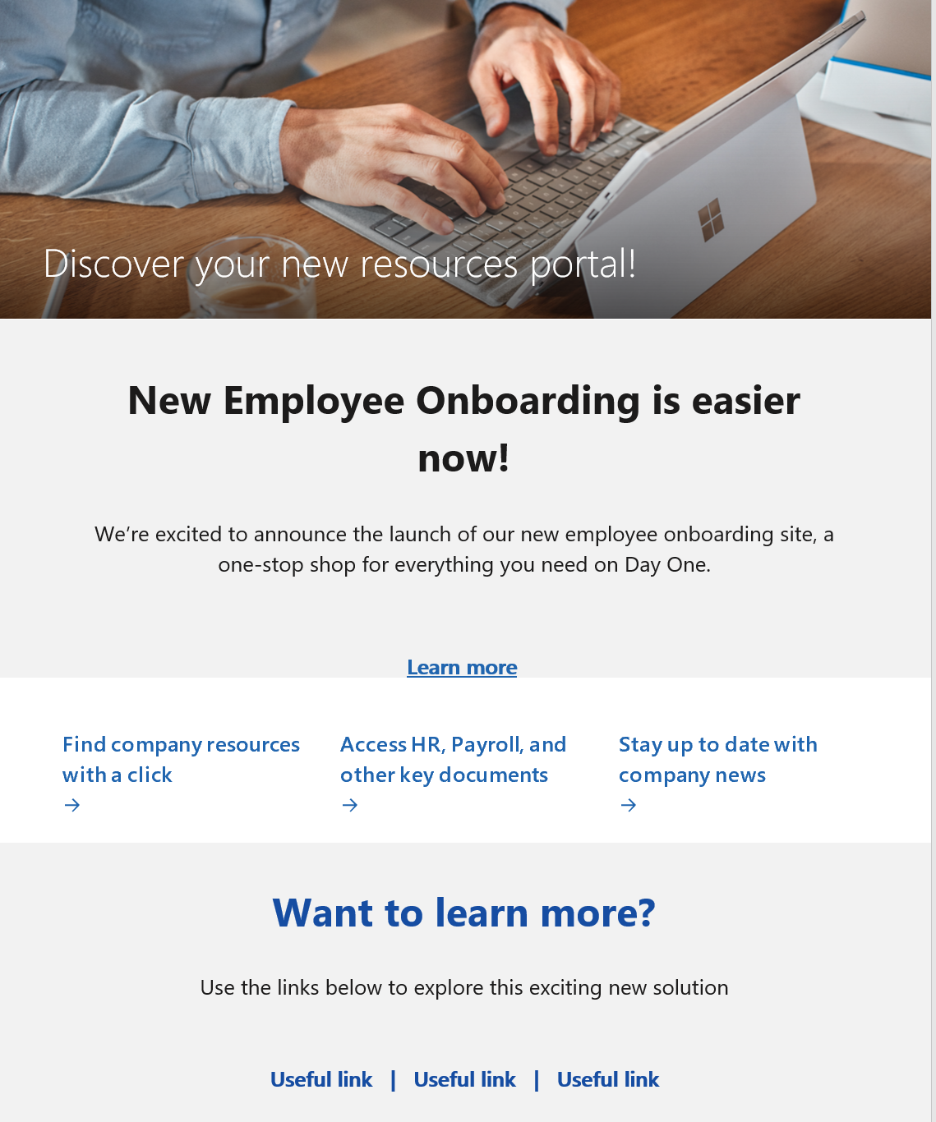
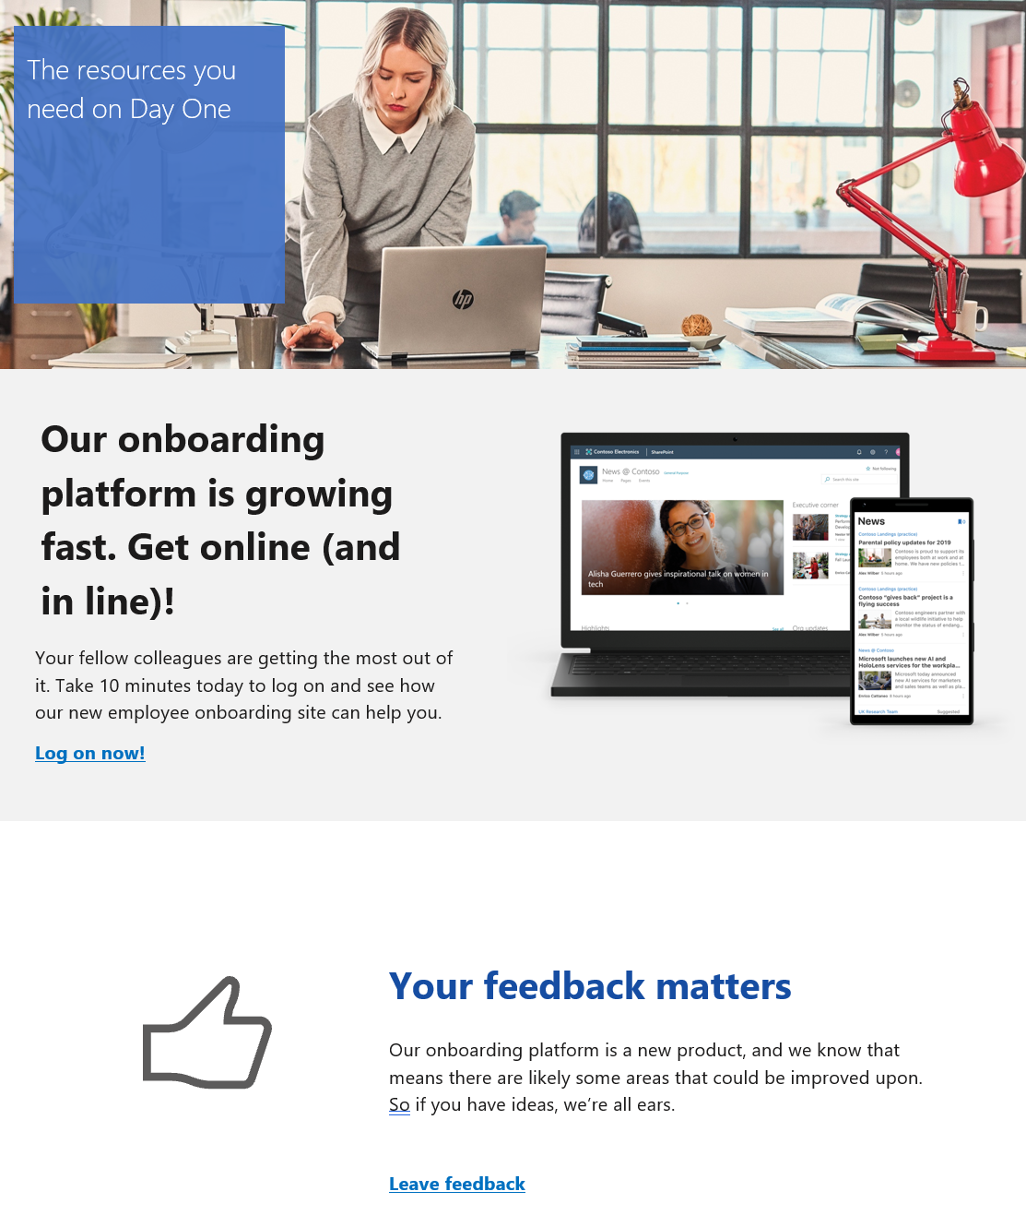
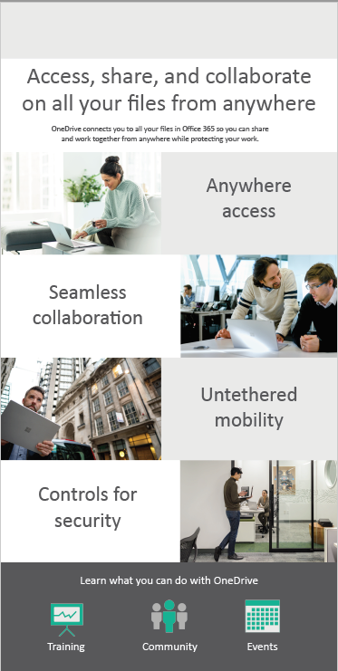
Use Available Templates
See Awareness at http://aka.ms/SharePoint/Resources/Adoption
Teaser Campaign
Announcement news post sample
Tips Campaign
Templates based on SharePoint news feature to deliver relevant content across your organization with modern SharePoint experiences.
SharePoint news, flyer and poster templates
Launch news post sample
Tips news post sample

Slide 25
Plan Launch/Buzz Events
  How to choose your launch event:
Resources and tactics for an effective launch
  Consider your goals for using SharePoint. How can your launch event support these objectives and these particular parts of the business?
  Consider your company culture. What types of activities will resonate with your leadership and your employees?
  Consider your time and resources. Can you mix and match different event activities to plan something that suits your needs and fits into your schedule?
  Consider existing company events. Is there an upcoming company event near the roll-out of SharePoint that could incorporate your launch?
  The following are some resources, ideas, and tactics to help create an effective SharePoint launch:
  Key note from executive sponsor to kick off event
  Booths/stations at onsite event that showcase/demo high-value SharePoint scenarios – scripted
  Run online engagement events using Microsoft Teams live events for team members in remote offices
  Planning Team and Champions wear SharePoint t-shirts,
  order at https://www.co-store.com/iw
  (US customers only)

Slide 26

Encouraging
Ongoing Engagement
Increase SharePoint adoption over time with ongoing awareness and training activity.
Create a Yammer group to continue conversation on best practices and new features
Share success stories as to how people are using SharePoint in innovative and impactful ways
Periodically host additional engagement events like town hall meetings or lunch & learns to drive end user engagement
Set challenges for people and run competitions to celebrate the best ways they’ve used SharePoint to do work differently

Slide 27
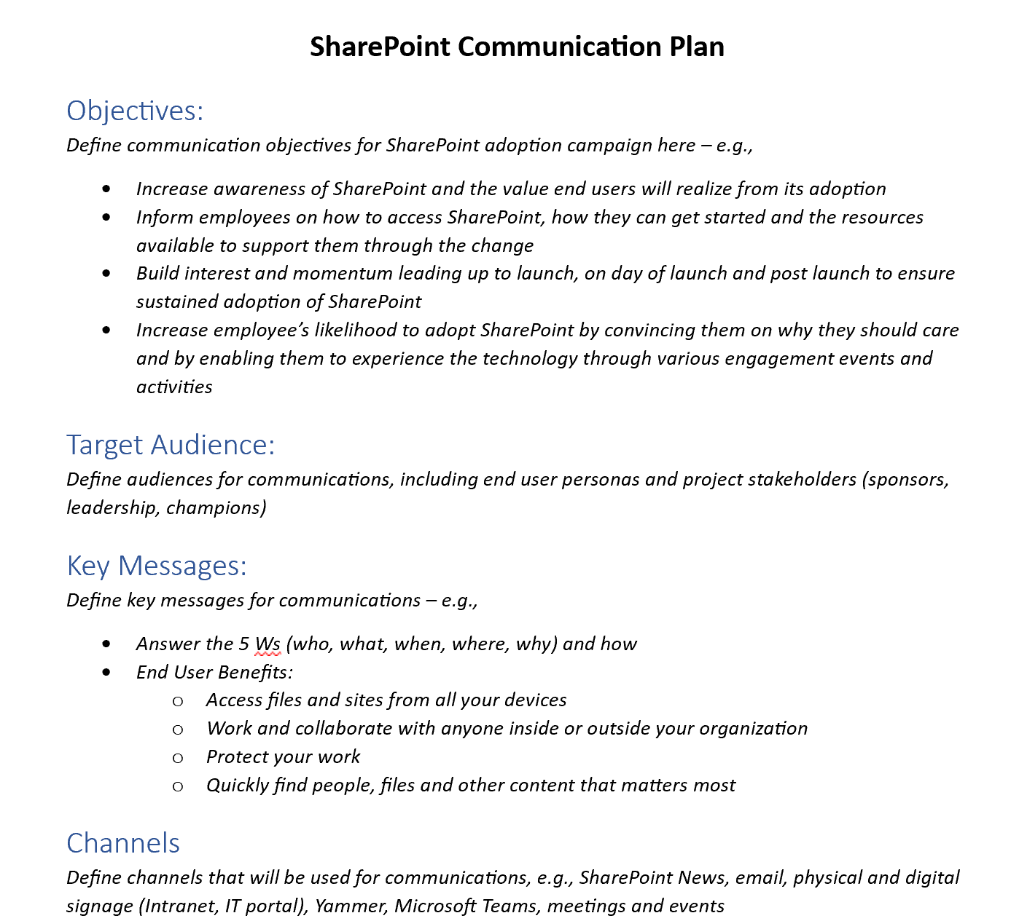
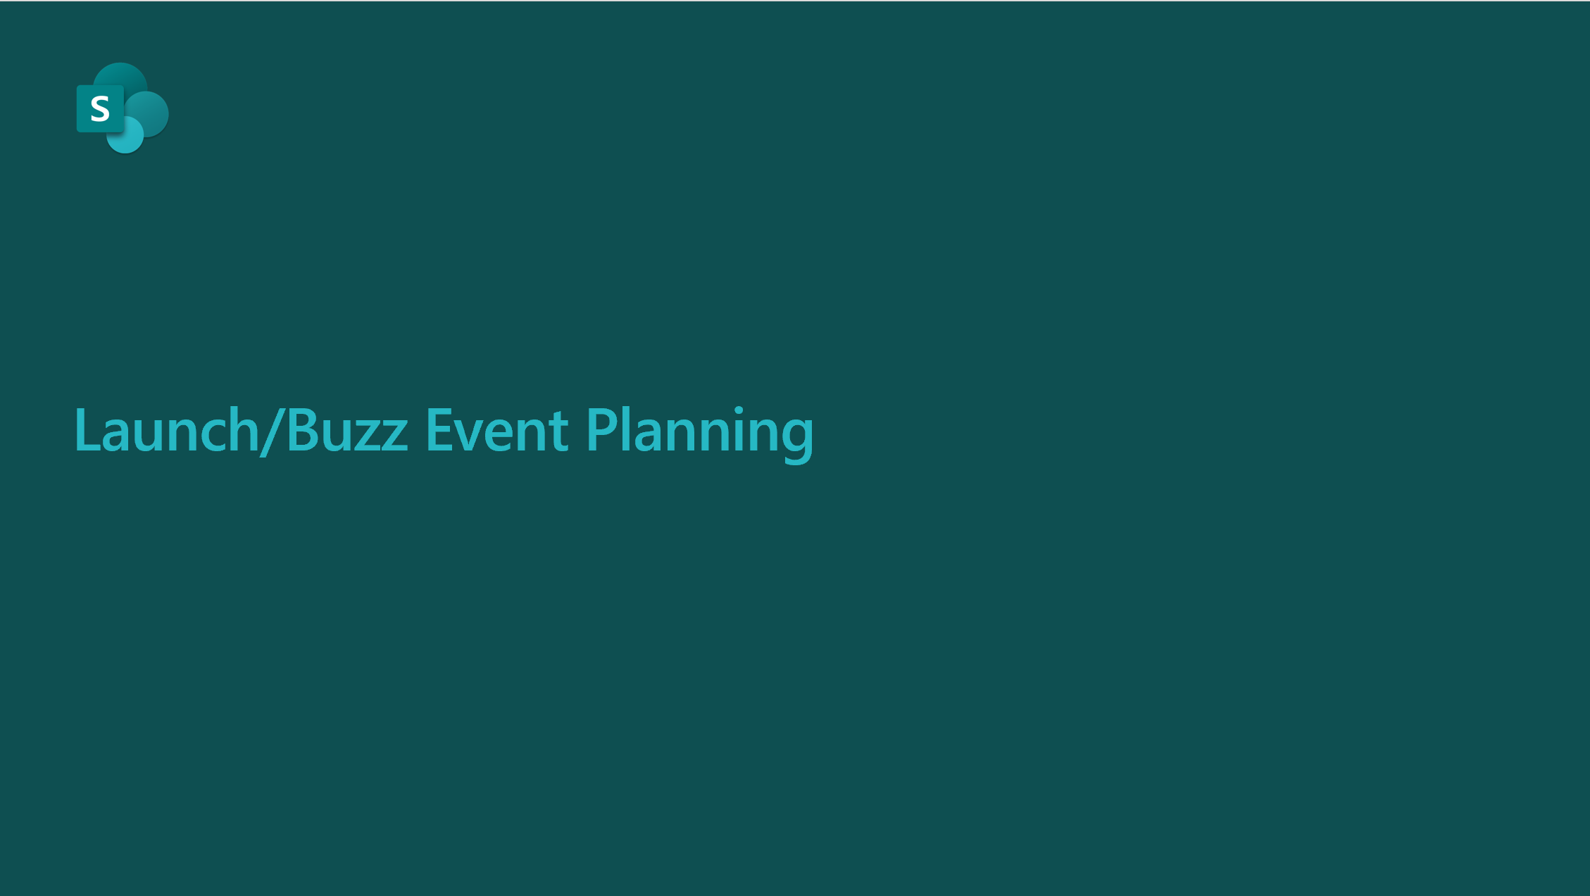
1
Plan awareness campaign with communication plan template
Use Communication Plan template to plan your SharePoint awareness campaign
https://aka.ms/SharePointCommPlanTemplate
2
Plan launch event
Use the Launch/Buzz Event deck to plan your launch event
https://aka.ms/SharePointLaunchEventPlanning

Slide 28


Training

Slide 29
Training
Plan
Deliver Training
Deliver Training
Goals, audience, scenarios & methods
Develop and update training materials
Online, self-paced & instructor led
Online, self-paced & instructor led
Train the Trainer
Train the instructors, helpdesk & champions
SharePoint Training Portal
Set up end user SharePoint training portal
Deliver Training
Online, self-paced & instructor led
PRE-LAUNCH
LAUNCH
POST-LAUNCH

Slide 30
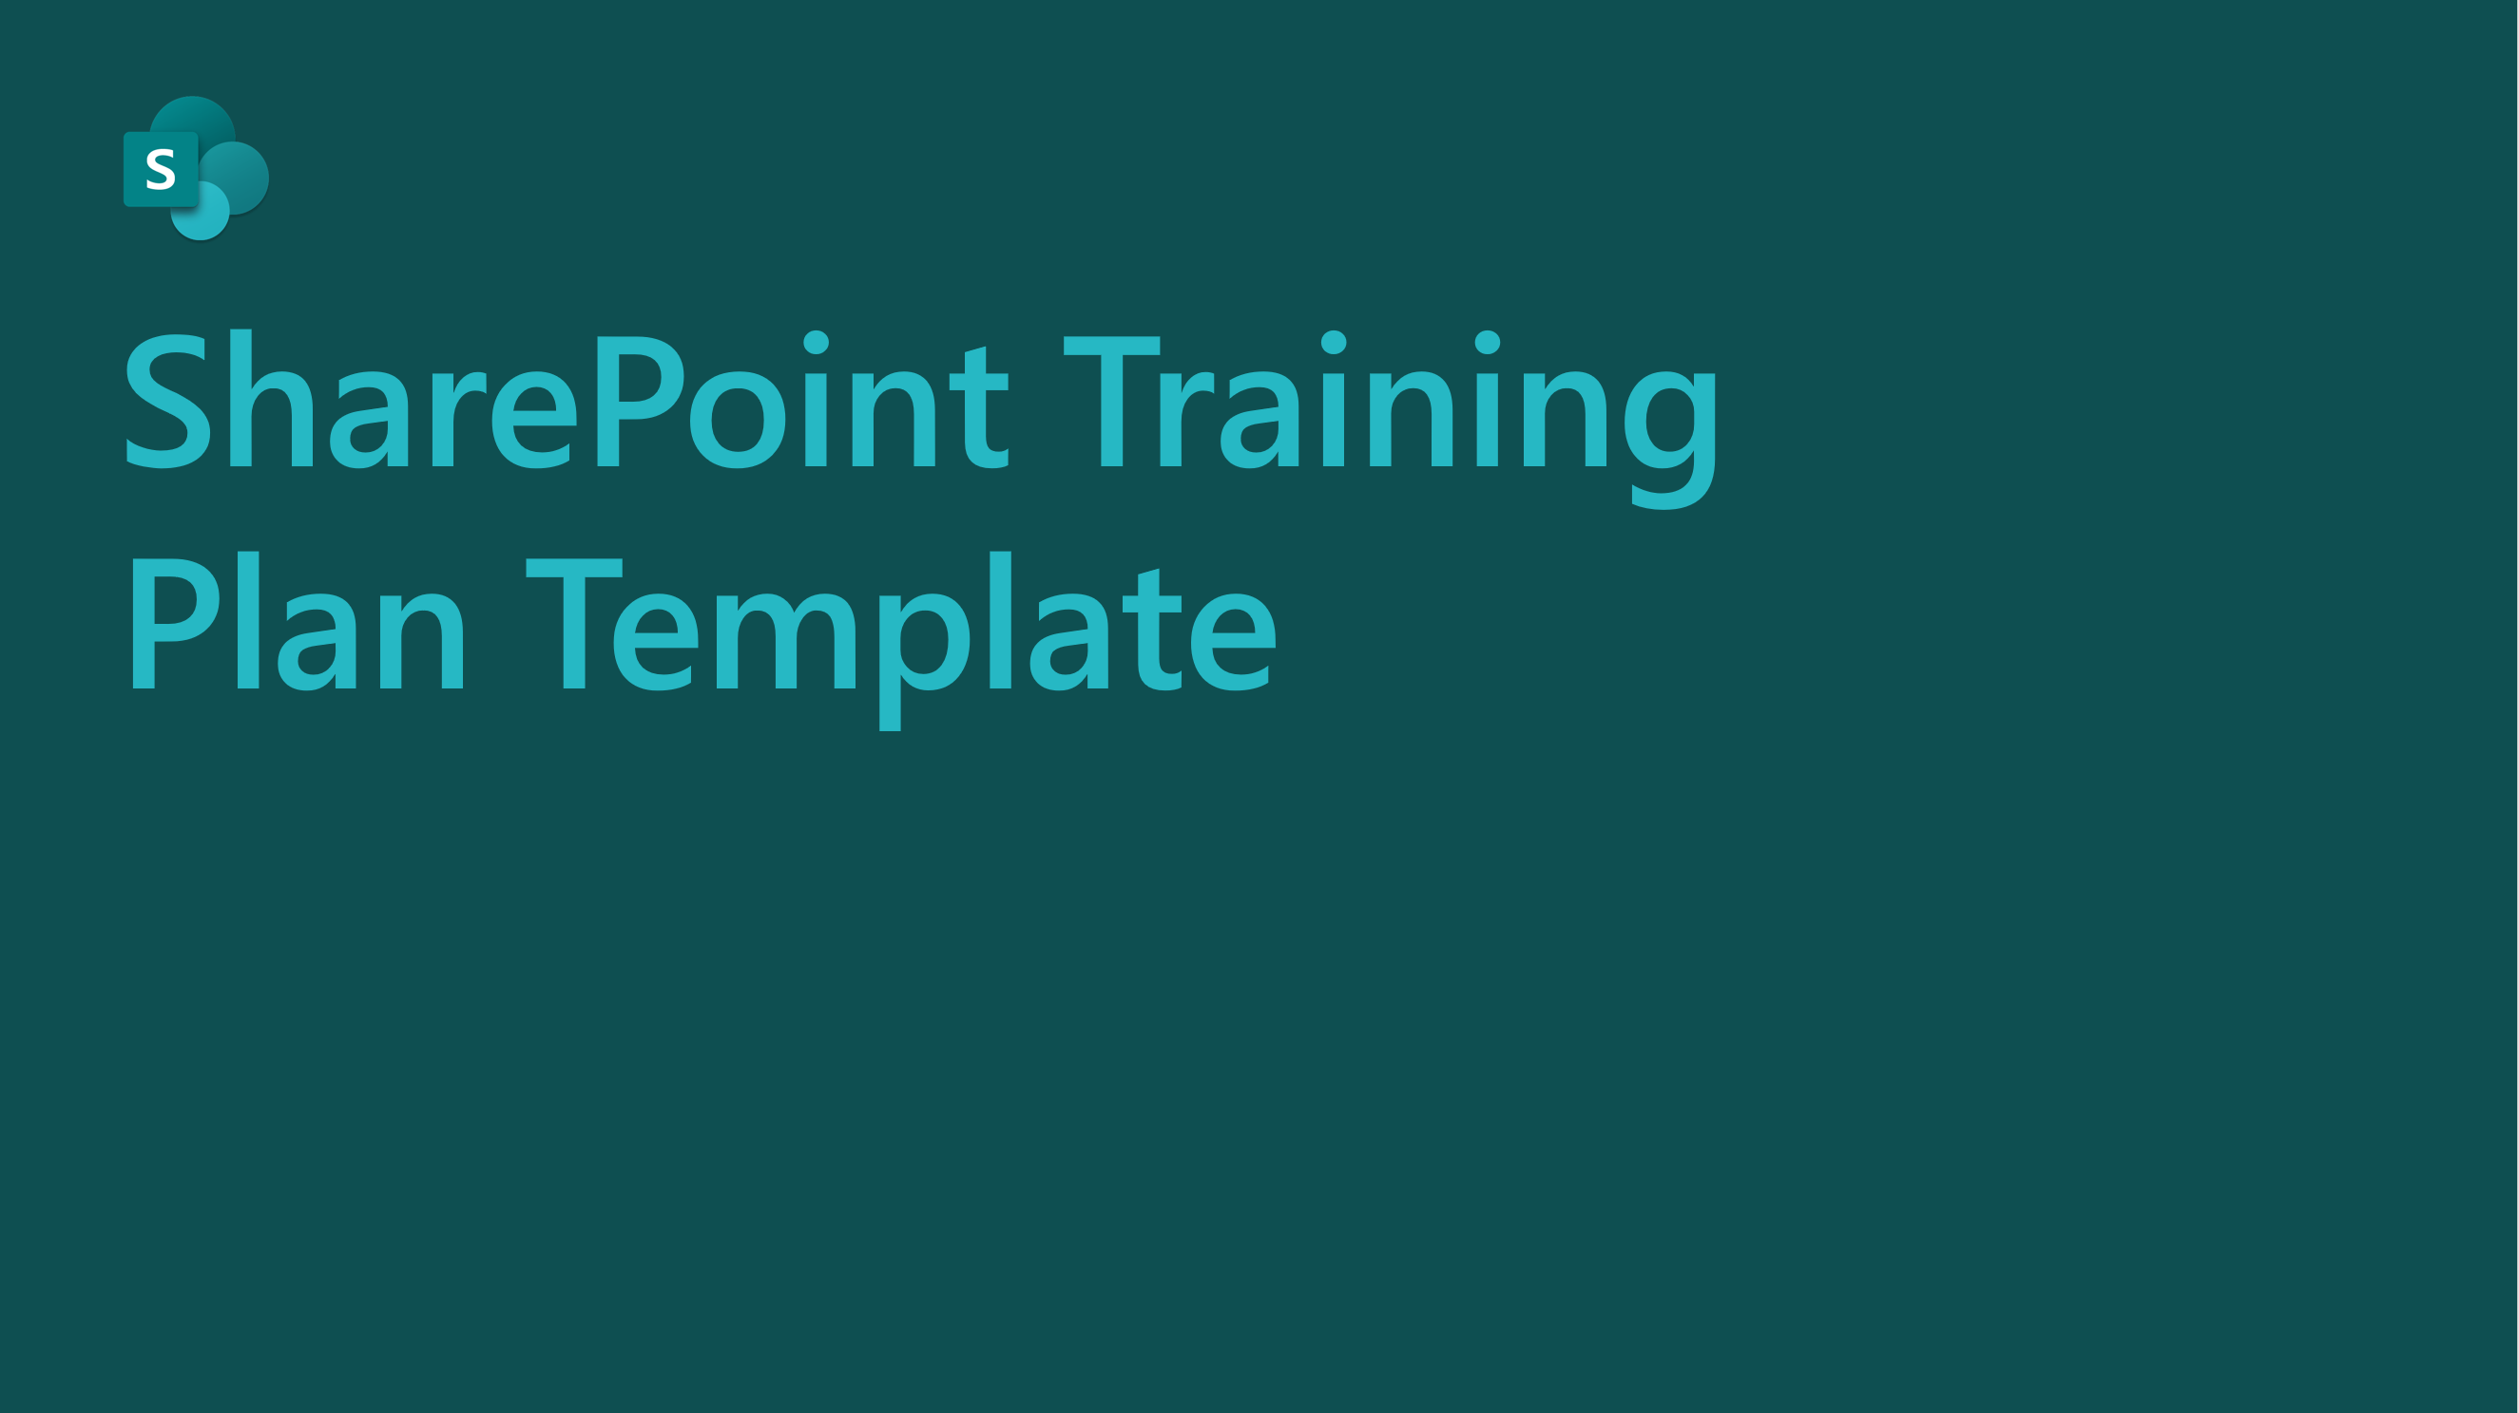
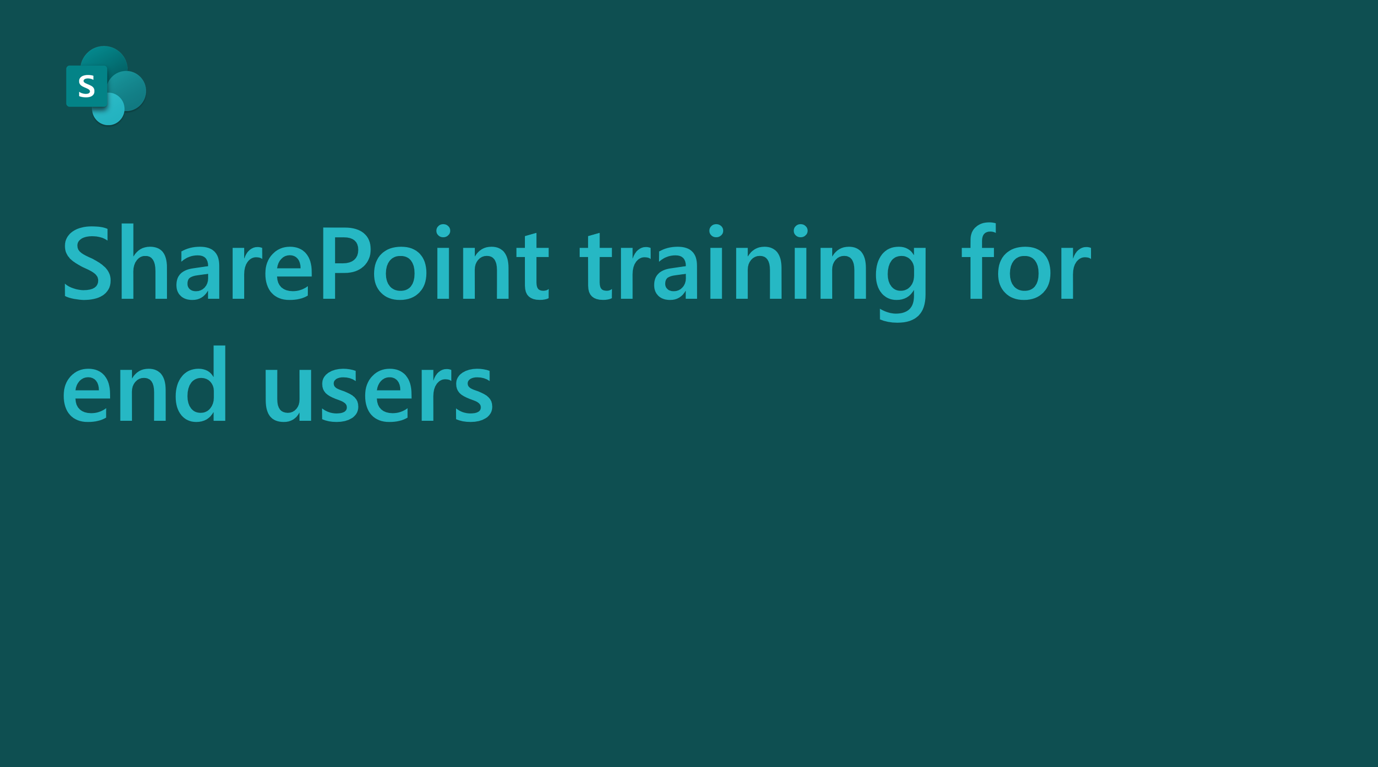
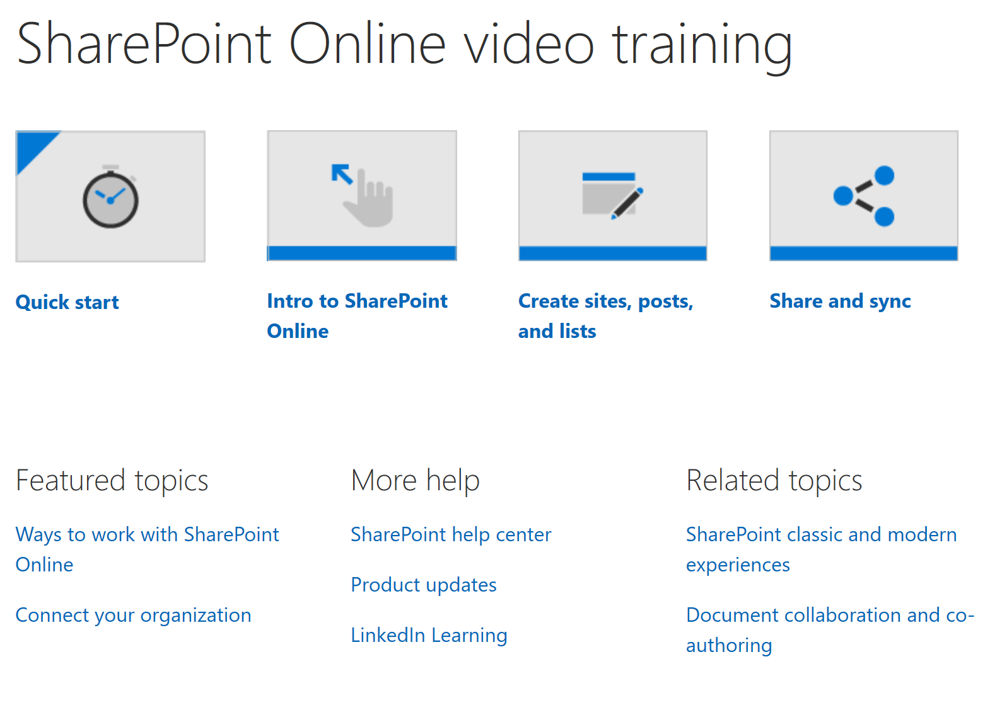
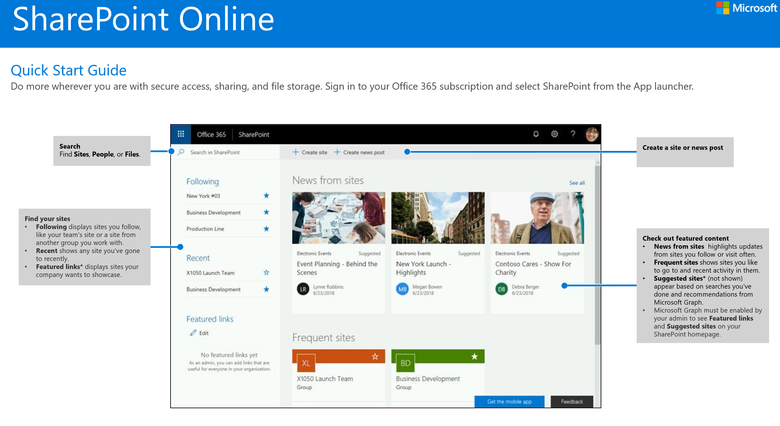
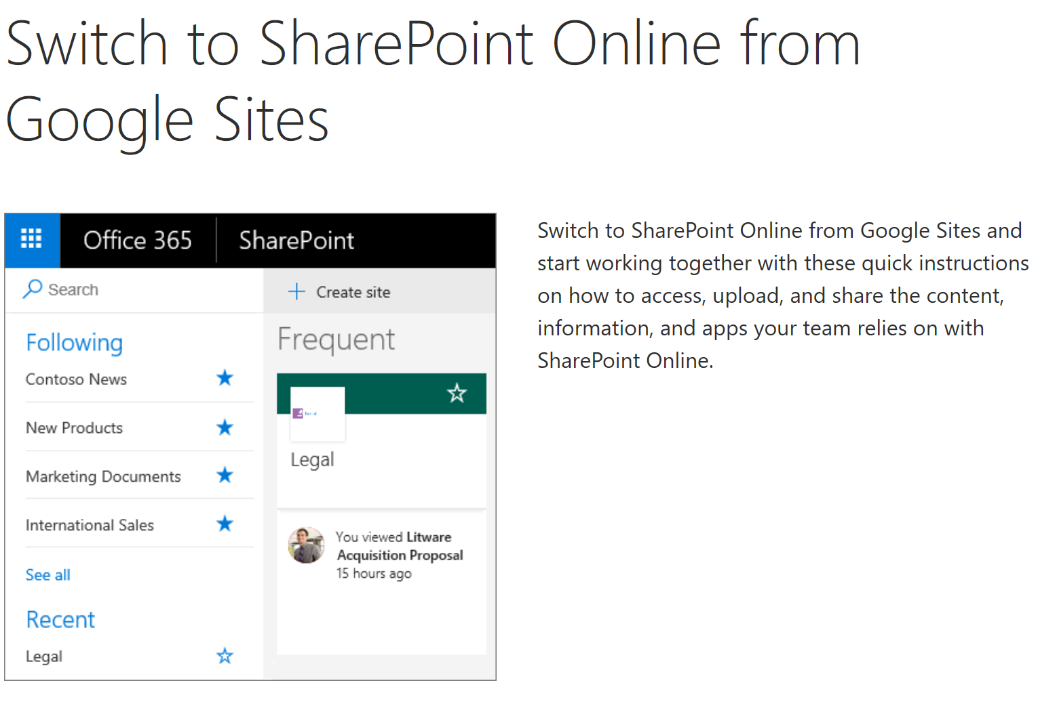
1
Develop training plan
Use the SharePoint Training Plan Template to build your training plan
https://aka.ms/SharePointTrainingPlanTemplate
2
Train help desk, champions, and training instructors
Use the End User Training deck to train the trainers
https://aka.ms/SharePointTrainingPresentation
SharePoint online Training Resources
Quick Start Guide
Make the Switch Training
3
Deliver training
https://aka.ms/SharePointOnlineTraining
https://aka.ms/SharePointQuickStartGuide
https://aka.ms/MakeSwitchGSites
Use the available training materials to train end users

Slide 31


Next Steps

Slide 32
Next Steps
1. Build project plan using available template - https://aka.ms/SharePointAdoptionCampaignPlanTemplate
2. Execute using available materials – https://aka.ms/SharePoint/Resources/Adoption
3. Launch

