Slide 1




Active Code Completion
[ICSE12]
Cyrus Omar
Computer Science
Thomas D. LaToza
Software Engineering
YoungSeok Yoon
Software Engineering
Brad A. Myers
Human-Computer Interaction
School of Computer Science
Carnegie Mellon University
Notes:
Thanks for the introduction, [?]. My name is Cyrus Omar and I’m a graduate student in Computer Science at CMU. My collaborators YoungSeok, Thomas and Brad are also here at ICSE. We span a broad range of disciplines in the School of CS at CMU, and hopefully you’ll see the influences as I describe this generalization of code completion we’ve developed and started to evaluate, called Active Code Completion.

Slide 2
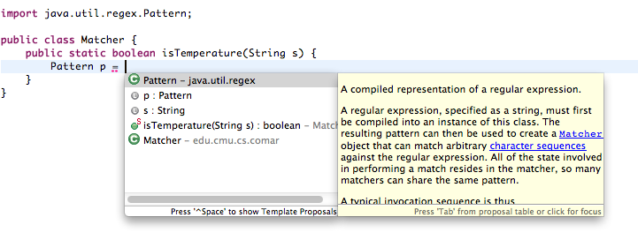
Code Completion
Notes:
If you’ve used an editor like Eclipse, you’re probably familiar with code completion (called “content assist” in Eclipse). Most common form: you invoke a shortcut key and get a menu of contextually-relevant code snippets to select from.

Slide 3
Code Completion is Commonly Used
(Murphy et al, 2006)
Notes:
Content assist (Eclipse’s name for code completion) is among the most commonly executed commands in Eclipse, right up there with copy and paste and basic navigational commands.

Slide 4
Code Completion is Useful
Helps developers explore relevant APIs
  Avoids context switches to external API browsers
Notes:
There is many good reasons for this.

Slide 5
Code Completion is Useful
Helps developers explore relevant APIs
  Avoids context switches to external API browsers
Helps developers avoid mistakes
  Spelling and type errors are reduced
Notes:
There is many good reasons for this.

Slide 6
Code Completion is Useful
Helps developers explore relevant APIs
  Avoids context switches to external API browsers
Helps developers avoid mistakes
  Spelling and type errors are reduced
Reduces required keystrokes
  Increases the amount of information conveyed per keystroke
Notes:
There is many good reasons for this.

Slide 7
A code completion system can be characterized by the set of sources it queries to predict the user’s intent.
Language & API specs
(current editors)
Notes:
Now, a code completion system, such as the one in Eclipse, can be characterized by the set of sources it queries to predict user intent. Eclipse, for example, queries internal representations of the language and API specifications for entities that are relevant to the code context.
There have been a number of other code completion systems described in the literature.

Slide 8
A code completion system can be characterized by the set of sources it queries to predict the user’s intent.
Language & API specs
(current editors)
Usage history
[Robbes & Lanza, ASE08], [Hou & Pletcher, ICSM11]
Notes:
For instance, systems that rank order or reduce the size of the completions list based on usage statistics.

Slide 9
A code completion system can be characterized by the set of sources it queries to predict the user’s intent.
Language & API specs
(current editors)
Usage history
[Robbes & Lanza, ASE08], [Hou & Pletcher, ICSM11]
Example repositories
[Bruch et al, FSE09], [Brandt et al, CHI10], [Mooty et al, VLHCC10],
[Nguyen et al, ICSE12]
Notes:
And a number of systems have looked at different ways to draw from example repositories to offer particularly sophisticated completions. Many of you saw a great talk earlier in the conference by Nguyen at all, for example.

Slide 10
A code completion system can be characterized by the set of sources it queries to predict the user’s intent.
Language & API specs
(current editors)
Usage history
[Robbes & Lanza, ASE08], [Hou & Pletcher, ICSM11]
Example repositories
[Bruch et al, FSE09], [Brandt et al, CHI10], [Mooty et al, VLHCC10],
[Nguyen et al, ICSE12]
Notes:
And a number of systems have looked at different ways to draw from example repositories to offer particularly sophisticated completions. Many of you saw a great talk earlier in the conference by Nguyen at all, for example.

Slide 11
A code completion system can be characterized by the set of sources it queries to predict the user’s intent.
Language & API specs
(current editors)
Usage history
[Robbes & Lanza, ASE08], [Hou & Pletcher, ICSM11]
Example repositories
[Bruch et al, FSE09], [Brandt et al, CHI10], [Mooty et al, VLHCC10],
[Nguyen et al, ICSE12]
Direct user responses
Notes:
Code complet

Slide 12
A code completion system can be characterized by the set of sources it queries to predict the user’s intent.
Language & API specs
(current editors)
Usage history
[Robbes & Lanza, ASE08], [Hou & Pletcher, ICSM11]
Example repositories
[Bruch et al, FSE09], [Brandt et al, CHI10], [Mooty et al, VLHCC10],
[Nguyen et al, ICSE12]
Direct user responses
…to which questions?
Notes:
Code complet

Slide 13
A code completion system can be characterized by the set of sources it queries to predict the user’s intent.
Language & API specs
(current editors)
Usage history
[Robbes & Lanza, ASE08], [Hou & Pletcher, ICSM11]
Example repositories
[Bruch et al, FSE09], [Brandt et al, CHI10], [Mooty et al, VLHCC10],
[Nguyen et al, ICSE12]
Direct user responses
to domain-specific queries
Notes:
Code complet

Slide 14
A code completion system can be characterized by the set of sources it queries to predict the user’s intent.
Language & API specs
(current editors)
Usage history
[Robbes & Lanza, ASE08], [Hou & Pletcher, ICSM11]
Example repositories
[Bruch et al, FSE09], [Brandt et al, CHI10], [Mooty et al, VLHCC10],
[Nguyen et al, ICSE12]
Direct user responses
to domain-specific queries
Let domain experts decide!
Notes:
Code complet

Slide 15
A code completion system can be characterized by the set of sources it queries to predict the user’s intent.
Language & API specs
(current editors)
Usage history
[Robbes & Lanza, ASE08], [Hou & Pletcher, ICSM11]
Example repositories
[Bruch et al, FSE09], [Brandt et al, CHI10], [Mooty et al, VLHCC10],
[Nguyen et al, ICSE12]
Direct user responses
to domain-specific queries
[Omar et al, ICSE12]
= Active Code Completion
Notes:
Code complet

Slide 16
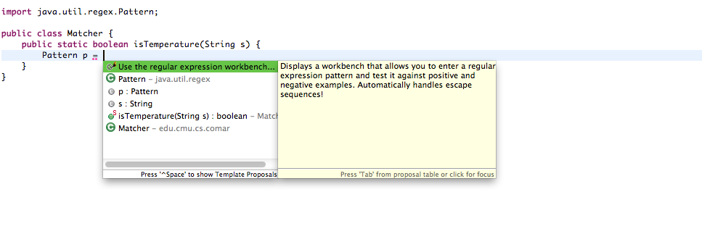
Active Code Completion with GRAPHITE

Slide 17
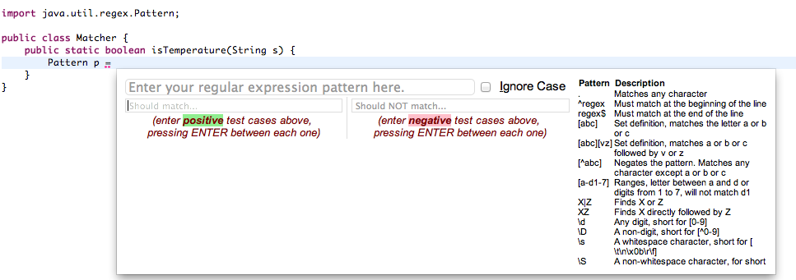
Active Code Completion with GRAPHITE

Slide 18
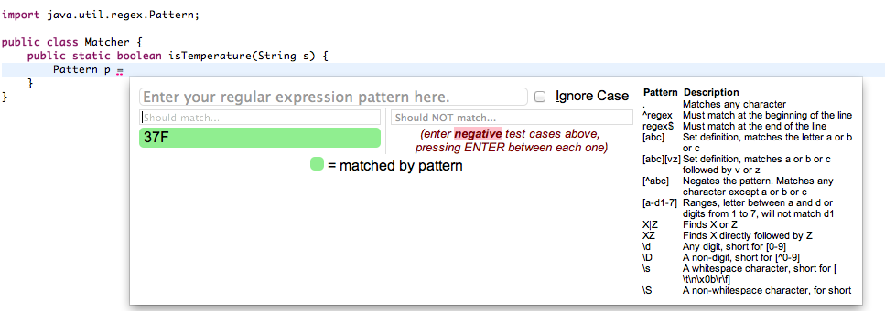
Active Code Completion with GRAPHITE

Slide 19
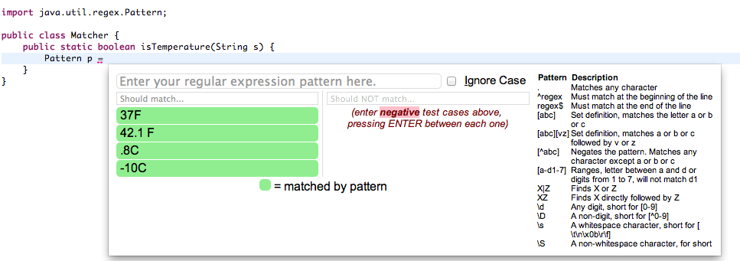
Active Code Completion with GRAPHITE

Slide 20
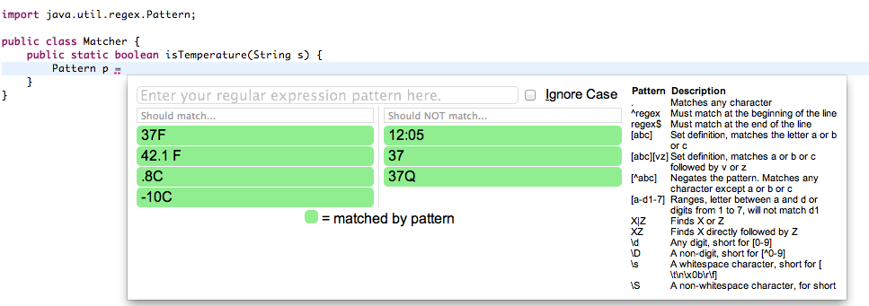
Active Code Completion with GRAPHITE

Slide 21
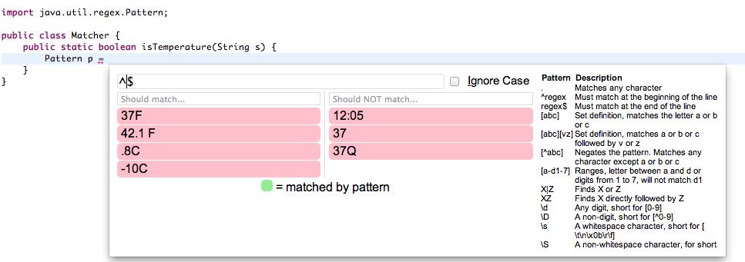
Active Code Completion with GRAPHITE

Slide 22
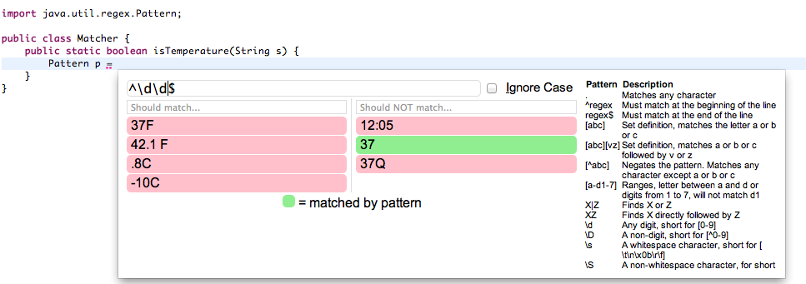
Active Code Completion with GRAPHITE

Slide 23
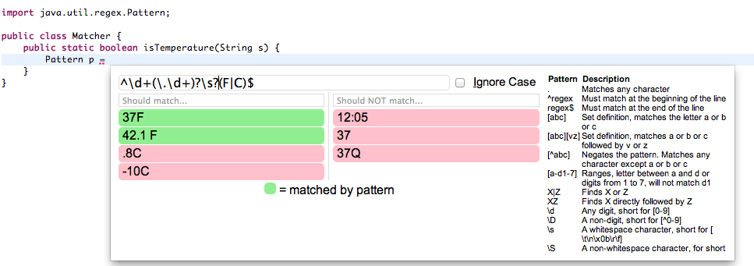
Active Code Completion with GRAPHITE

Slide 24
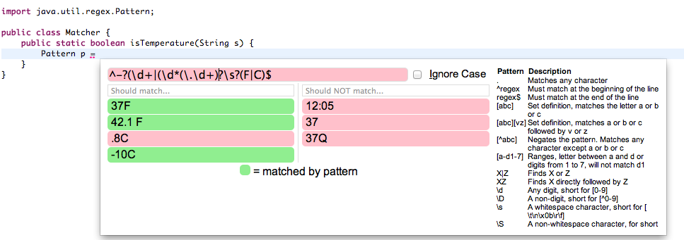
Active Code Completion with GRAPHITE

Slide 25
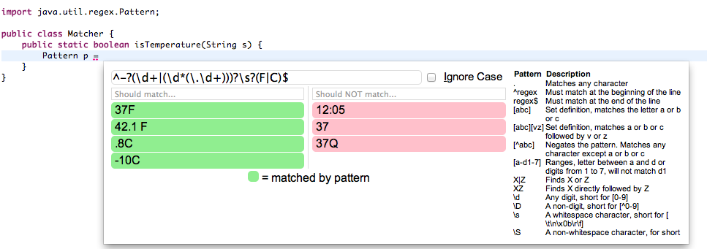
Active Code Completion with GRAPHITE

Slide 26
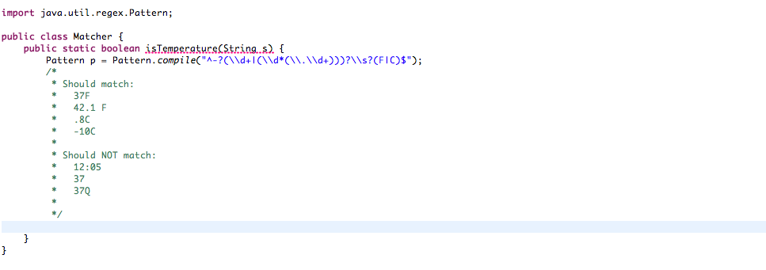
Active Code Completion with GRAPHITE

Slide 27
Our Design Methodology
Large developer survey to validate this idea and develop design criteria and use cases before implementation!
Tool design and implementation (GRAPHITE)
Controlled pilot study to justify usefulness claims

Slide 28
Survey Method
Target: professional developers
Participants recruited from
  “reddit.com” programming forum
    ~340,000 registered readers
  Local CS graduate students mailing list (22)
696 people started the survey (~20 minutes long)
  475 people completed the survey, we only analyzed these responses

Slide 29
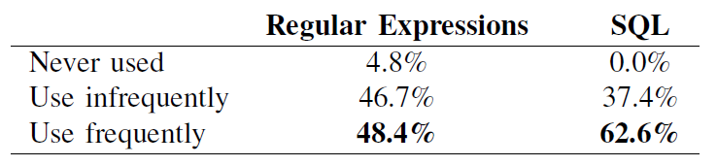
Participant Experience
Participant’s experience with regular expressions and SQL
Along with experience with programming languages, implies that most participants are professional programmers

Slide 30
I. Mockups
For each of three classes
(Color, Regular Expressions, SQL query)
  Ask which strategy they would naturally use to instantiate the given class
  Show them mockup screenshots of our tool
  Ask how often they would use the tool if they wanted to instantiate the class
  Ask them to qualify the answer or make suggestions (open-ended)

Slide 31
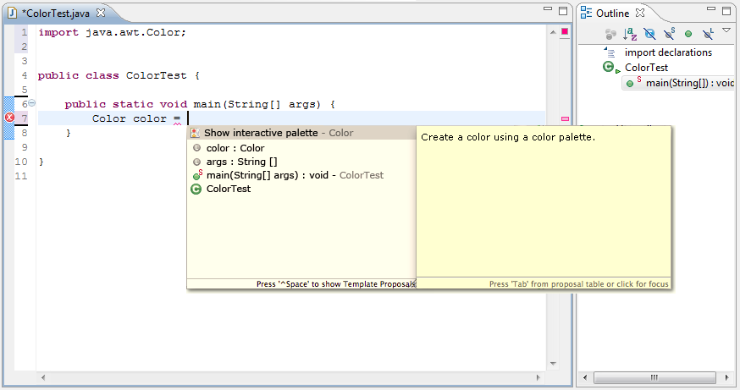
Mockup – Color

Slide 32
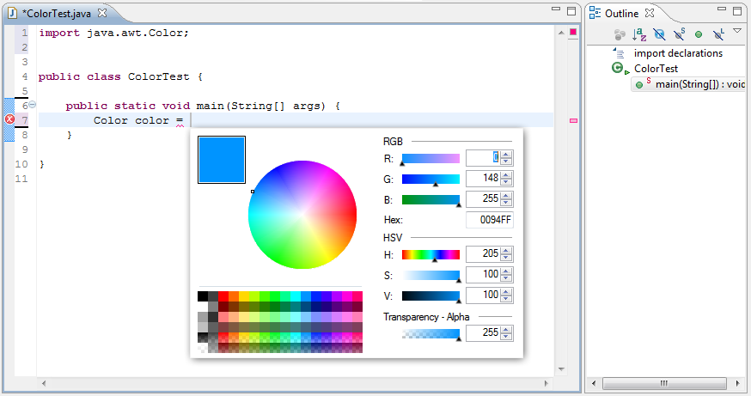
Mockup – Color

Slide 33
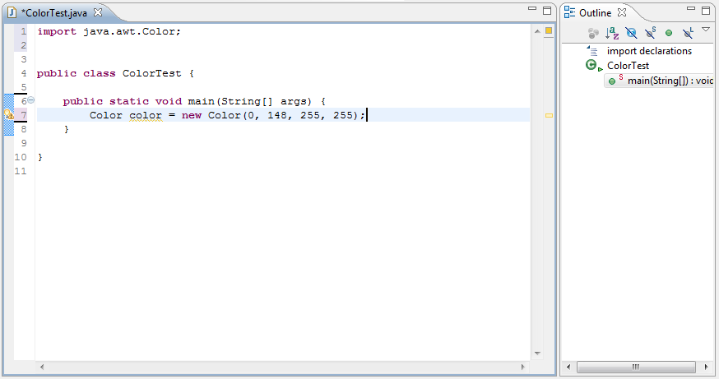
Mockup – Color

Slide 34
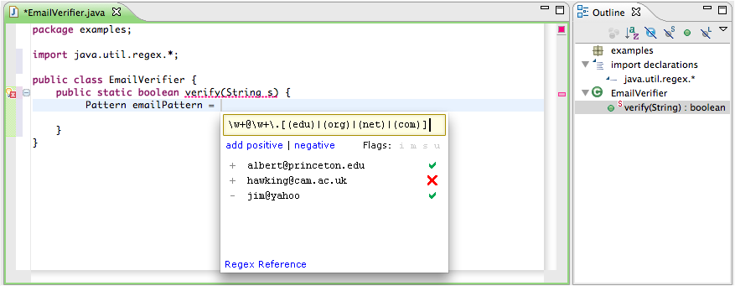
Mockup – Regular Expressions

Slide 35
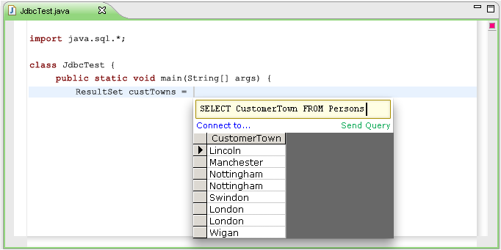
Mockup – SQL queries

Slide 36
I. Mockups
For each of three classes
(Color, Regular Expressions, SQL query)
  Ask which strategy they would naturally use to instantiate the given class
  Show them mockup screenshots of our tool
  Ask how often they would use the tool if they wanted to instantiate the class
  Ask them to qualify the answer or make suggestions (open-ended)

Slide 37
Default Strategy – Regex, SQL

Slide 38
I. Mockups
For each of three classes
(Color, Regular Expressions, SQL query)
  Ask which strategy they would naturally use to instantiate the given class
  Show them mockup screenshots of our tool
  Ask how often they would use the tool if they wanted to instantiate the class
  Ask them to qualify the answer or make suggestions (open-ended)

Slide 39
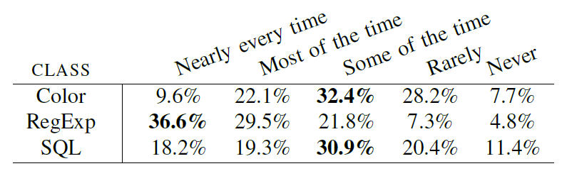
Usefulness of Mockups
“Consider situations where you need to instantiate the [specified] class. What portion of the time, in these situations, do you think you would use this feature?”

Slide 40
I. Mockups
For each of three classes
(Color, Regular Expressions, SQL query)
  Ask which strategy they would naturally use to instantiate the given class
  Show them mockup screenshots of our tool
  Ask how often they would use the tool if they wanted to instantiate the class
  Ask them to qualify the answer or make suggestions (open-ended)

Slide 41
System Design Constraints
Reversibility (19 across classes)
  Bring palette back up from data
Palette settings and state
  Wanted recent regexes + control over comments (12)
  Persistent database connection information (9)
  Recent colors (20)
IDE/language independence
  Several expressed a desire for IDE or even language independence of this feature

Slide 42
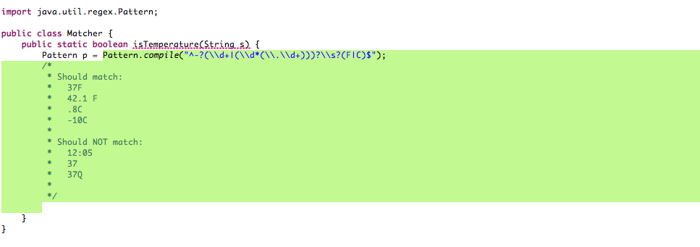
Active Code Completion with GRAPHITE

Slide 43
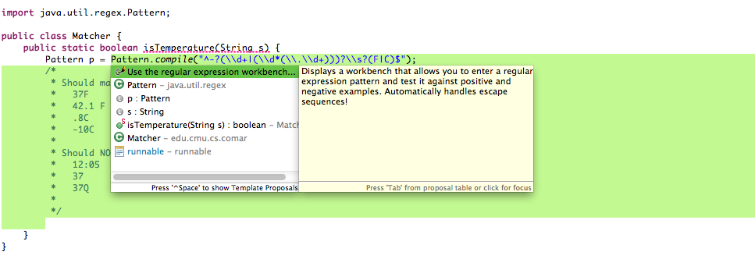
Active Code Completion with GRAPHITE

Slide 44
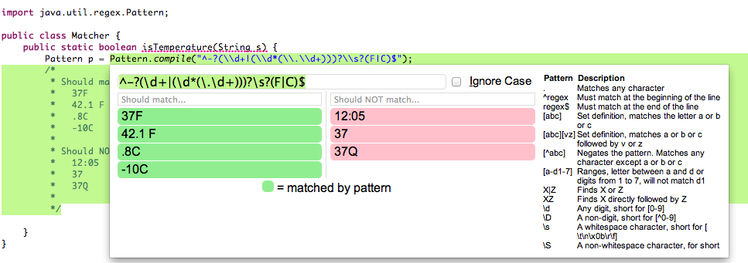
Active Code Completion with GRAPHITE

Slide 45
System Design Constraints
Reversibility (19 across classes)
  Bring palette back up from data
Palette settings and state
  Wanted recent regexes + control over comments (12)
  Persistent database connection information (9)
  Recent colors (20)
IDE/language independence
  Several expressed a desire for IDE or even language independence of this feature

Slide 46
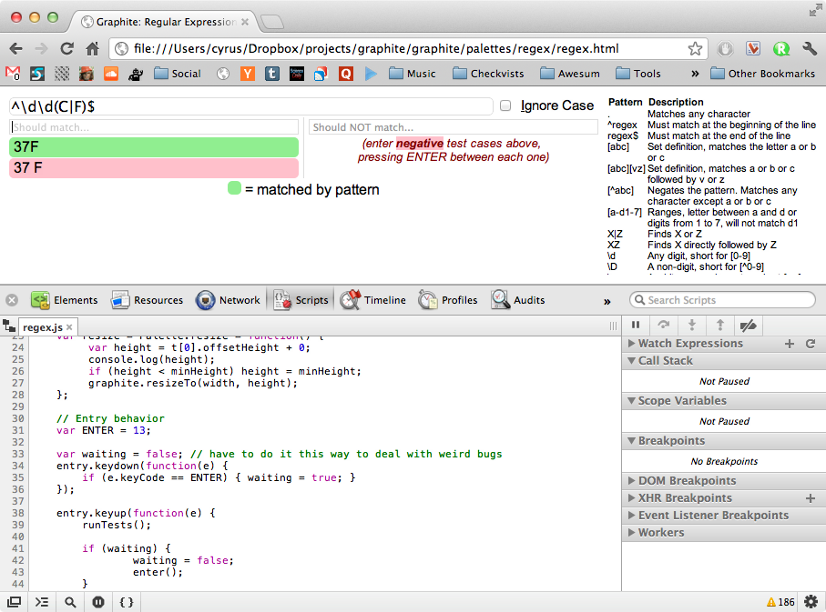

Slide 47
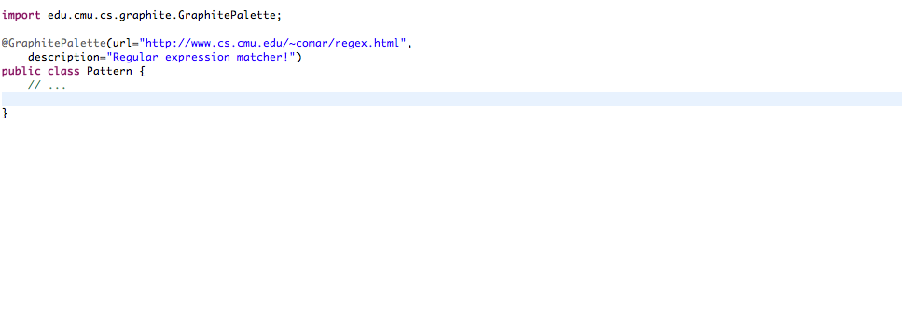
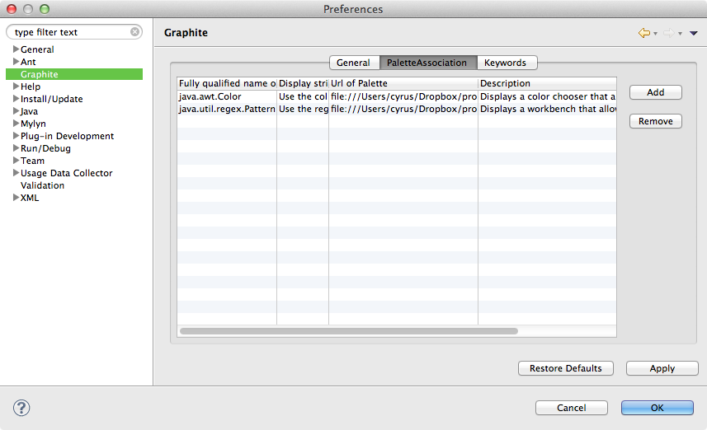
Associating a Palette with a Class
^ or ->

Slide 48
II. Suggestions
Ask what other classes could benefit from these kind of interactive palettes
(open-ended)

Slide 49
Suggestions
Alternatives / Tricky / Literal Syntax (16)
  Example classes
    string, vector, dictionary, matrix
    URLs, paths
    embedded languages (e.g. HTML)

Slide 50
Suggestions
Unclear Parameter Implications (11)
  Example classes
    audio tweaks
    3D transformation matrices
    number/string/date formatting
  What people wanted
    modify the parameters and see the results directly
    without running the application

Slide 51
Suggestions
Query Languages (17)
  Example classes
    regular expressions
    SQL queries
    XPath / XQuery
  What people wanted
    testing the query result directly
    without running the application

Slide 52
Suggestions
Graphical Elements (27)
  What people wanted
    checking the graphical property directly
    manipulating the layout of GUI elements
  Example classes
    color, font, shape, thickness, etc.
    JFrame, layouts, any swing components, etc.

Slide 53
Suggestions
Describe by Example (2)
  Example classes
    keyboard keys (e.g., shortcut keys)
Integrating with Documentation, Tutorials (7)

Slide 54
Pilot Study Overview
Observe users doing regular expression tasks with and without Graphite.
Hypotheses:
  Control subjects (4) will have more trouble with:
    Factory pattern initialization: Pattern.compile(…)
    [Ellis et al, ICSE07]
    Escaping of strings: Pattern.compile(“\\d”)
  Treatment subjects (3) will complete more tasks and test more examples

Slide 55
Protocol
Pre-survey asking the familiarity with:
  Programming languages
  Integrated development environments
  Regular expressions
Give a demo of how to use Graphite plug-in with the Color palette
  Only for the treatment group
Instruct them how to complete the tasks and start the experiment

Slide 56
Pilot Study Results
Hypotheses:
  Control subjects had trouble with:
    Factory pattern initialization: Pattern.compile(…)
    [Ellis et al, ICSE07]
    Escaping of strings: Pattern.compile(“\\d”)
  Treatment subjects completed more tasks and tested more examples

Slide 57
Pilot Study Results
Hypotheses:
  Control subjects had trouble with:
    Factory pattern initialization: Pattern.compile(…)
    [Ellis et al, ICSE07]
    Escaping of strings: Pattern.compile(“\\d”)
  Treatment subjects completed more tasks and tested more examples
Treatment subjects were uniformly positive. Control subjects later shown the palette were also positive.

Slide 58
DEFINITION. Active Code Completion
A code completion system that actively engages both users and providers during code completion
  Providers equip types with specialized user interfaces (palettes)
  API clients interact with palettes to provide requested information about their intent
  API providers generate code based on this information

Slide 59
Benefits of Active Code Completion
Domain-specific tools can be easily integrated directly into the editor (fewer context switches) and discovered more easily.
Palettes can handle tricky aspects of an API (e.g. factory patterns, string escaping)

Slide 60
Our Design Methodology
Large developer survey to validate this idea and develop design criteria and use cases before implementation!
Tool design and implementation (GRAPHITE)
http://www.cs.cmu.edu/~NatProg/graphite.html
Controlled pilot study to justify usefulness claims

Slide 61
Broader Trends
Extensible languages require extensible development environments.
Active typing: directly equipping types with relevant compile-time and design-time logic.
More to come!

Slide 62
Thanks!
Jonathan Aldrich and the CMU PLAID group
Students in 05-899D: Human Aspects of Software Development
(co-taught by Thomas LaToza and Brad Myers)
UIUC Software Engineering Seminar
All our participants and subjects!

