Slide 1

b-b correlation and X(3872) production and prospects
from ATLAS
Roger Jones
On behalf of the ATLAS Collaboration
Beauty 2018
Elba, 9 May 2018
Notes:
1

Slide 2
Outline
ATLAS detector, (multi-,) muon triggers
bb correlation with J/ψ+μ JHEP 11 (2017) 62
X(3872) production measurement, prompt and non-prompt JHEP 01 (2017) 117
Summary and perspectives
Both analyses presented for effective integrated luminosity 11.4 fb⁻¹ at 8 TeV

Slide 3
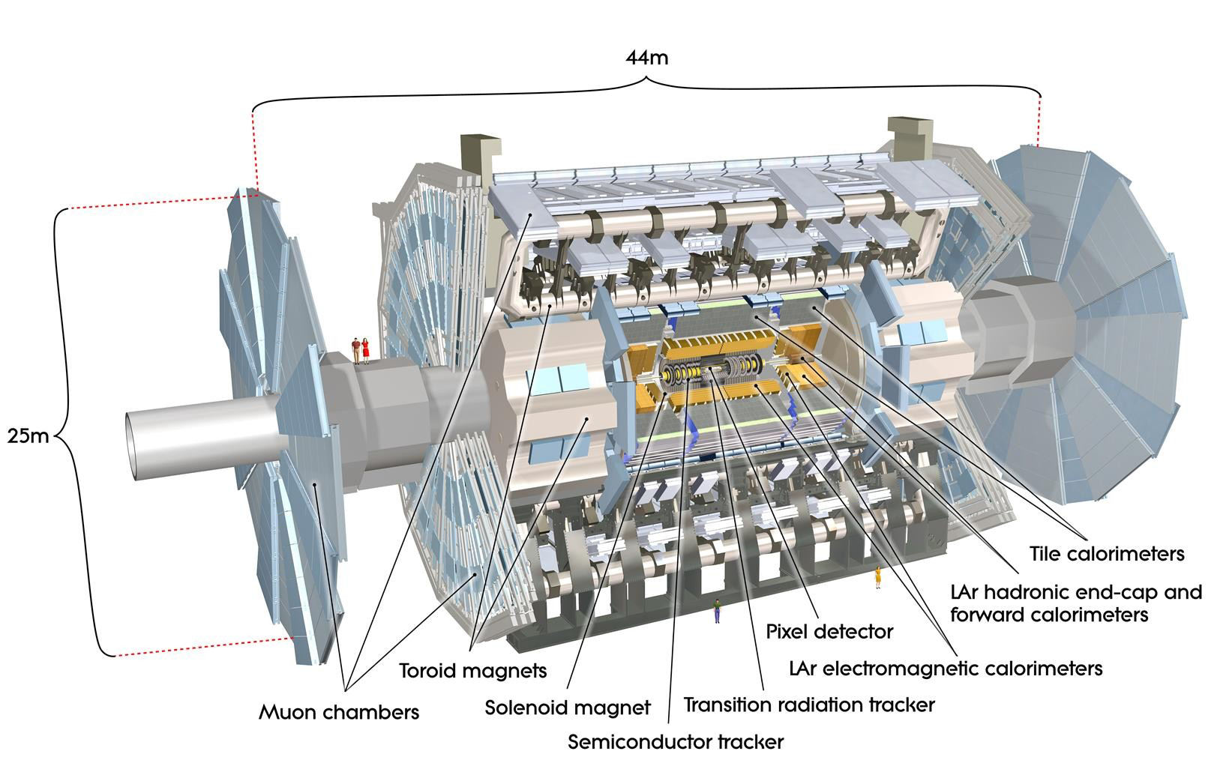
The ATLAS detector at LHC

Slide 4
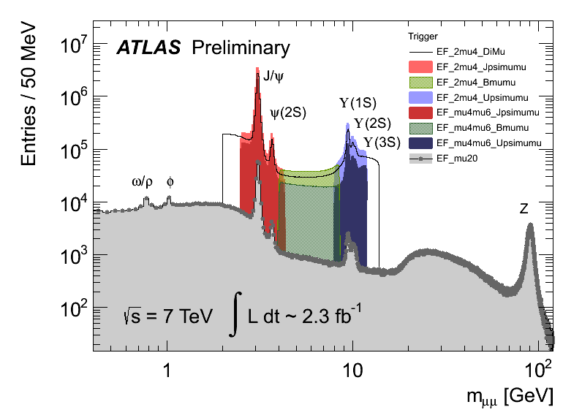
Muon and dimuon triggers in ATLAS
Muon trigger for these analyses:
  2 muons, p_{T} > 4 GeV, |η| < 2.5
History of 20th century particle physics in one plot

Slide 5
bb production at the LHC
Needed for H➔bb and new physics searches
Flavour creation Gluon splitting Flavour Excitation
Need to tag both b’s without losses when colinear
Large Δφ, back-2-back pT balance
Small Δφ, colinear
Large Δη, broad Δφ
Unlike methods using b-jets, J/ψ+μ works for large and small separations

Slide 6
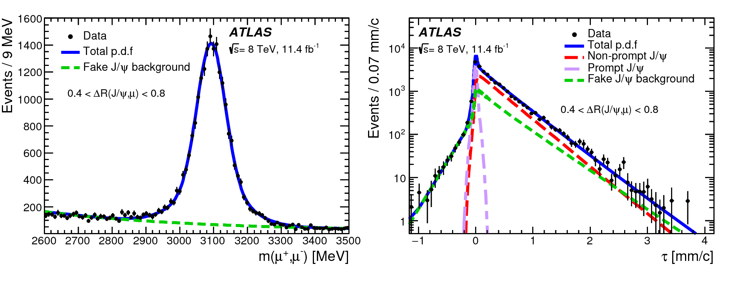
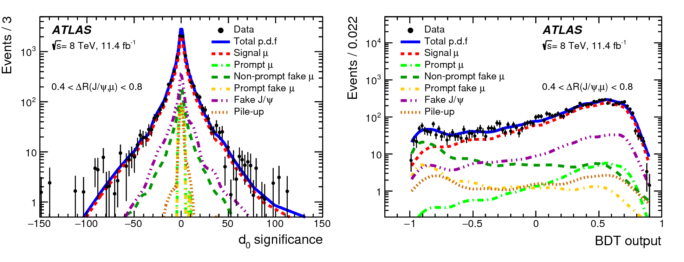
bb Event selection & analysis
J/ψ muons:
  |η| < 2.3
  2.6 < m(μμ) < 3.5 GeV
Additional muons
  |η| < 2.5
  ‘Fakes’ mainly J/ψ+K, control with BDT trained on Monte Carlo
1.9 M J/ψ candidates
τ_{eff} = L_{xy} m(μμ)
c p_{T}(μμ)
Use pseudo proper lifetime of J/ψ to separate prompt/non prompt J/ψ & background, in mass/lifetime fit
L_{xy} = L . p_{T}(μμ)
p_{T}(μμ)
Use 3rd muon impact parameter and BDT to templates from MC to extract signal/prompt/fake contributions

Slide 7
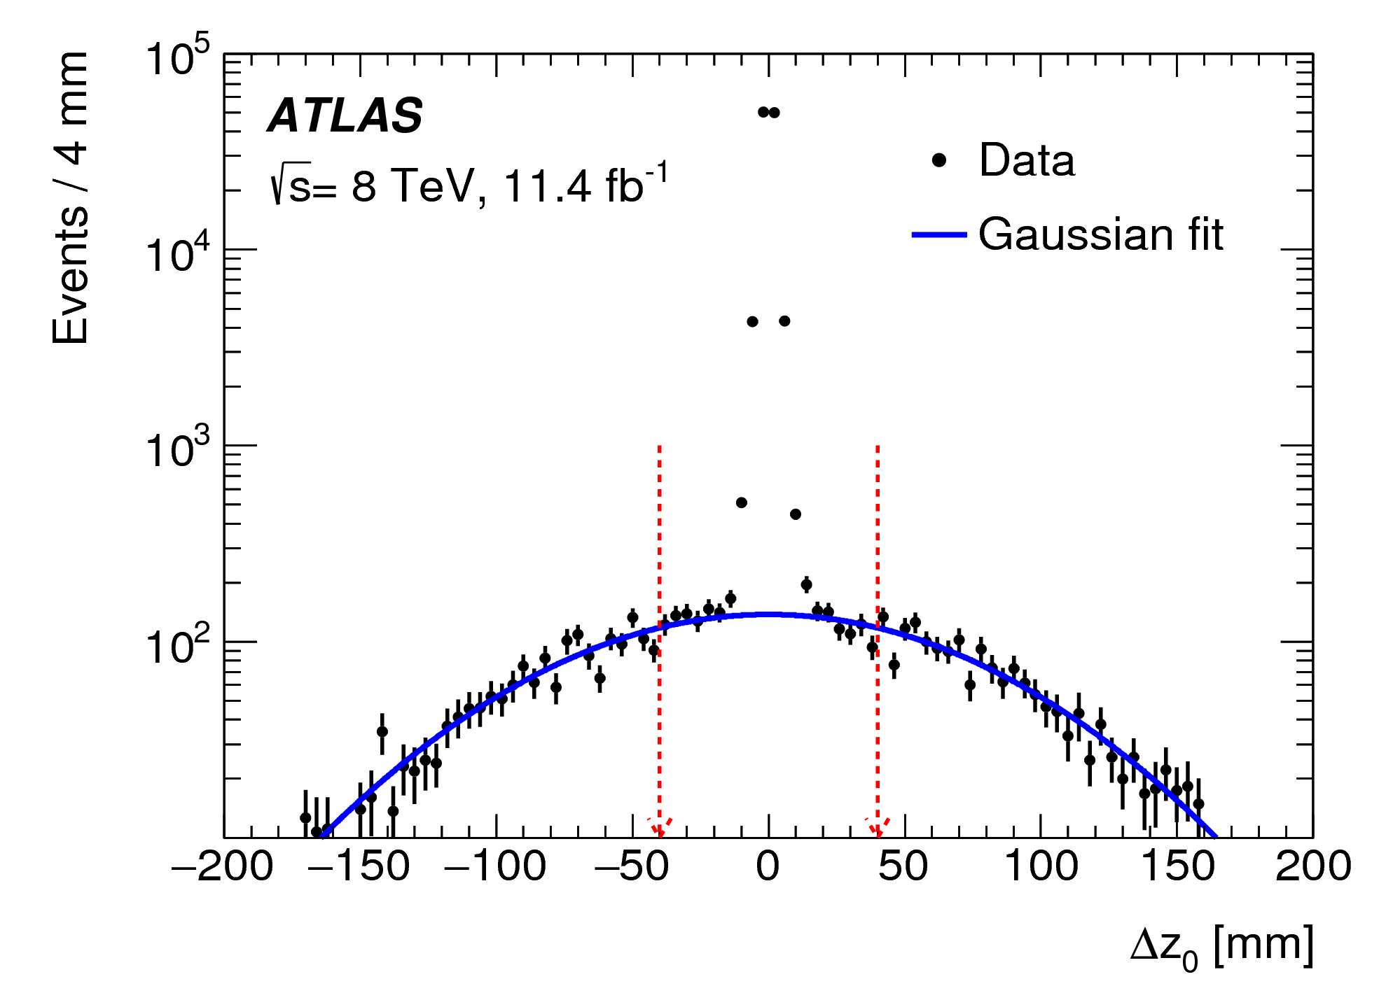
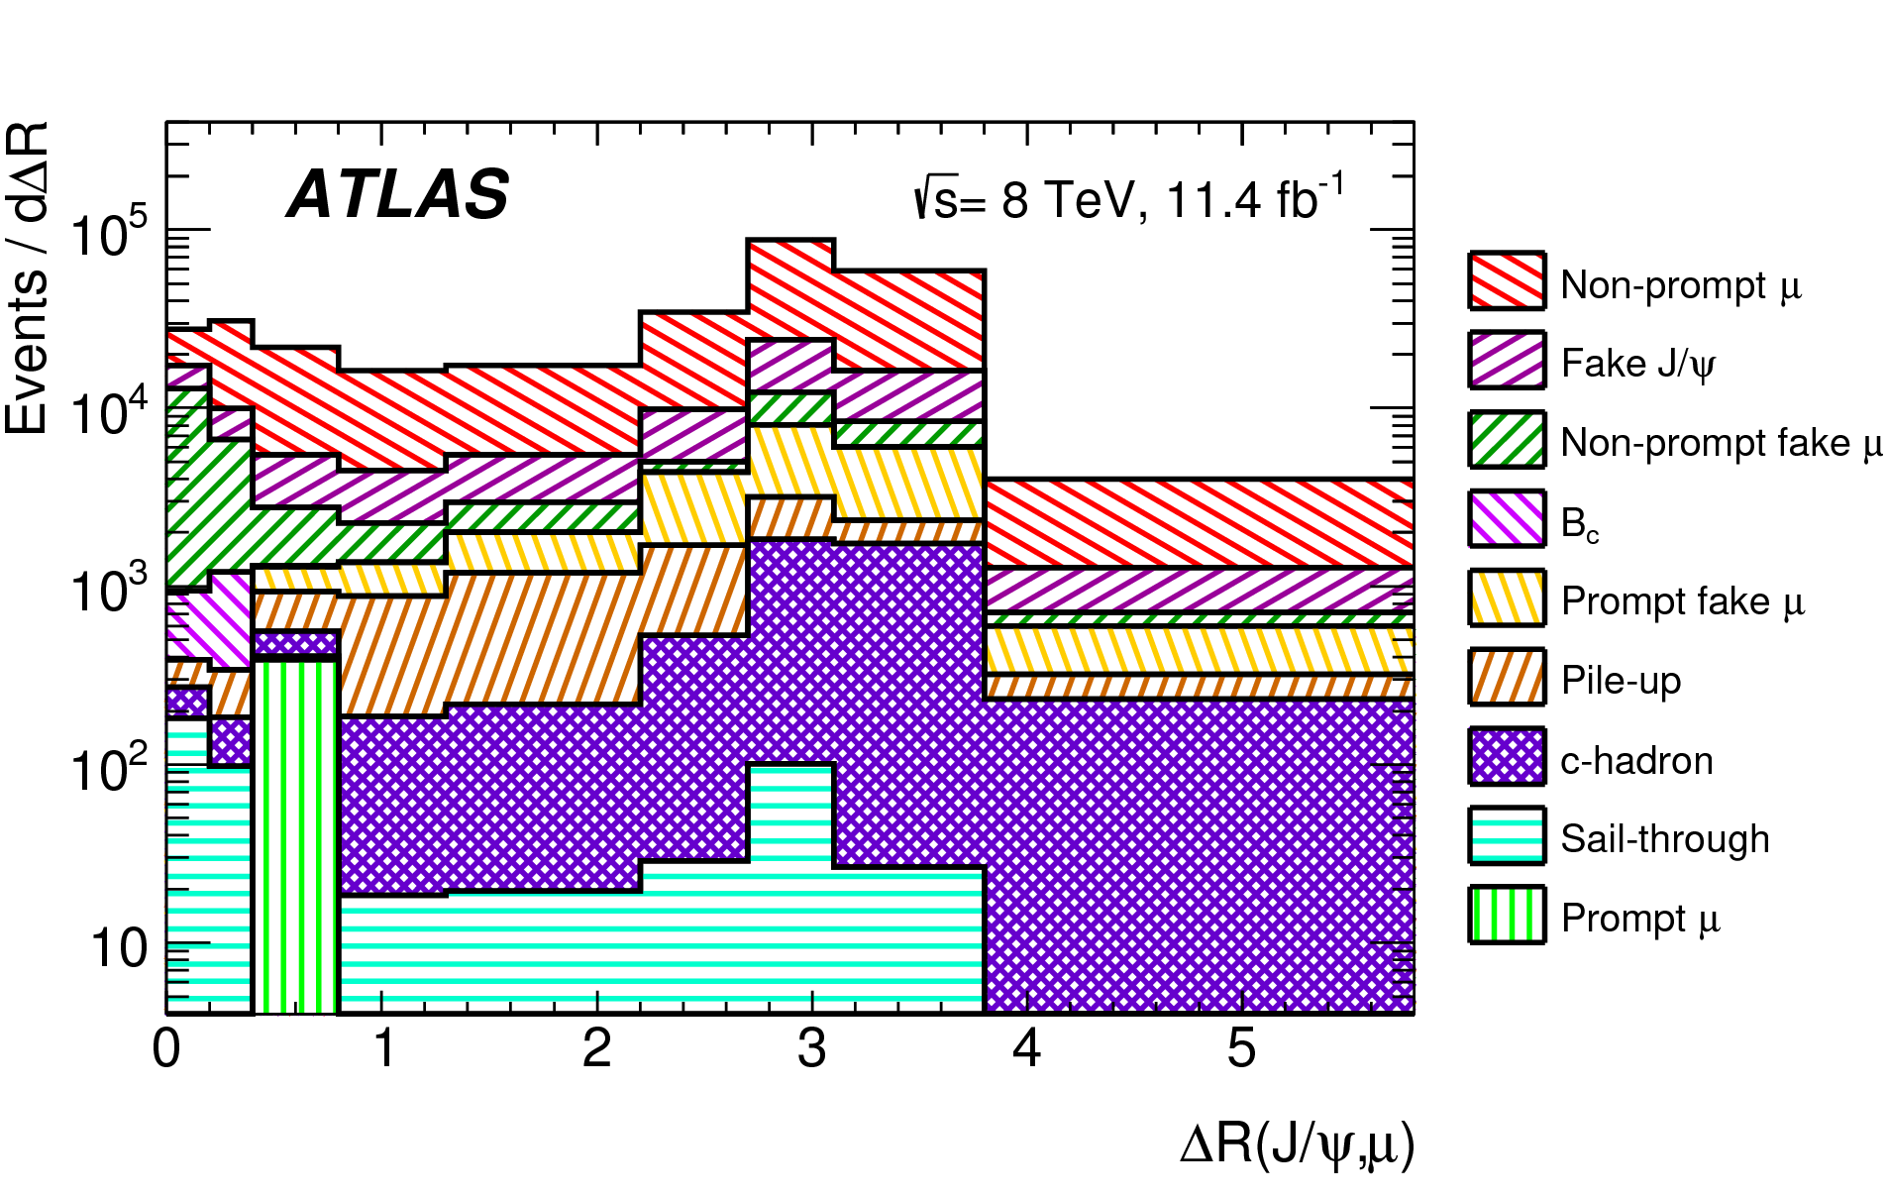
Backgrounds and Corrections
The mean number of pp interactions pre crossing (pileup) at 8 TeV was 20.7
They are spread along the z axis, so fit Δz between the third and either of J/ψ muons to control pile-up background and for control sample for BDT etc
Irreducible backgrounds:
Bc/Bs➔J/ψ+μ+X (control with 4μ sample & MC)
Punch through (control with fake μ sample & MC)
B+D➔J/ψ+μ+X (MC)
Standard efficiency correction maps from tag and probe and MC to scale between energies
Additional (small) corrections for overlapping muon RoIs

Slide 8
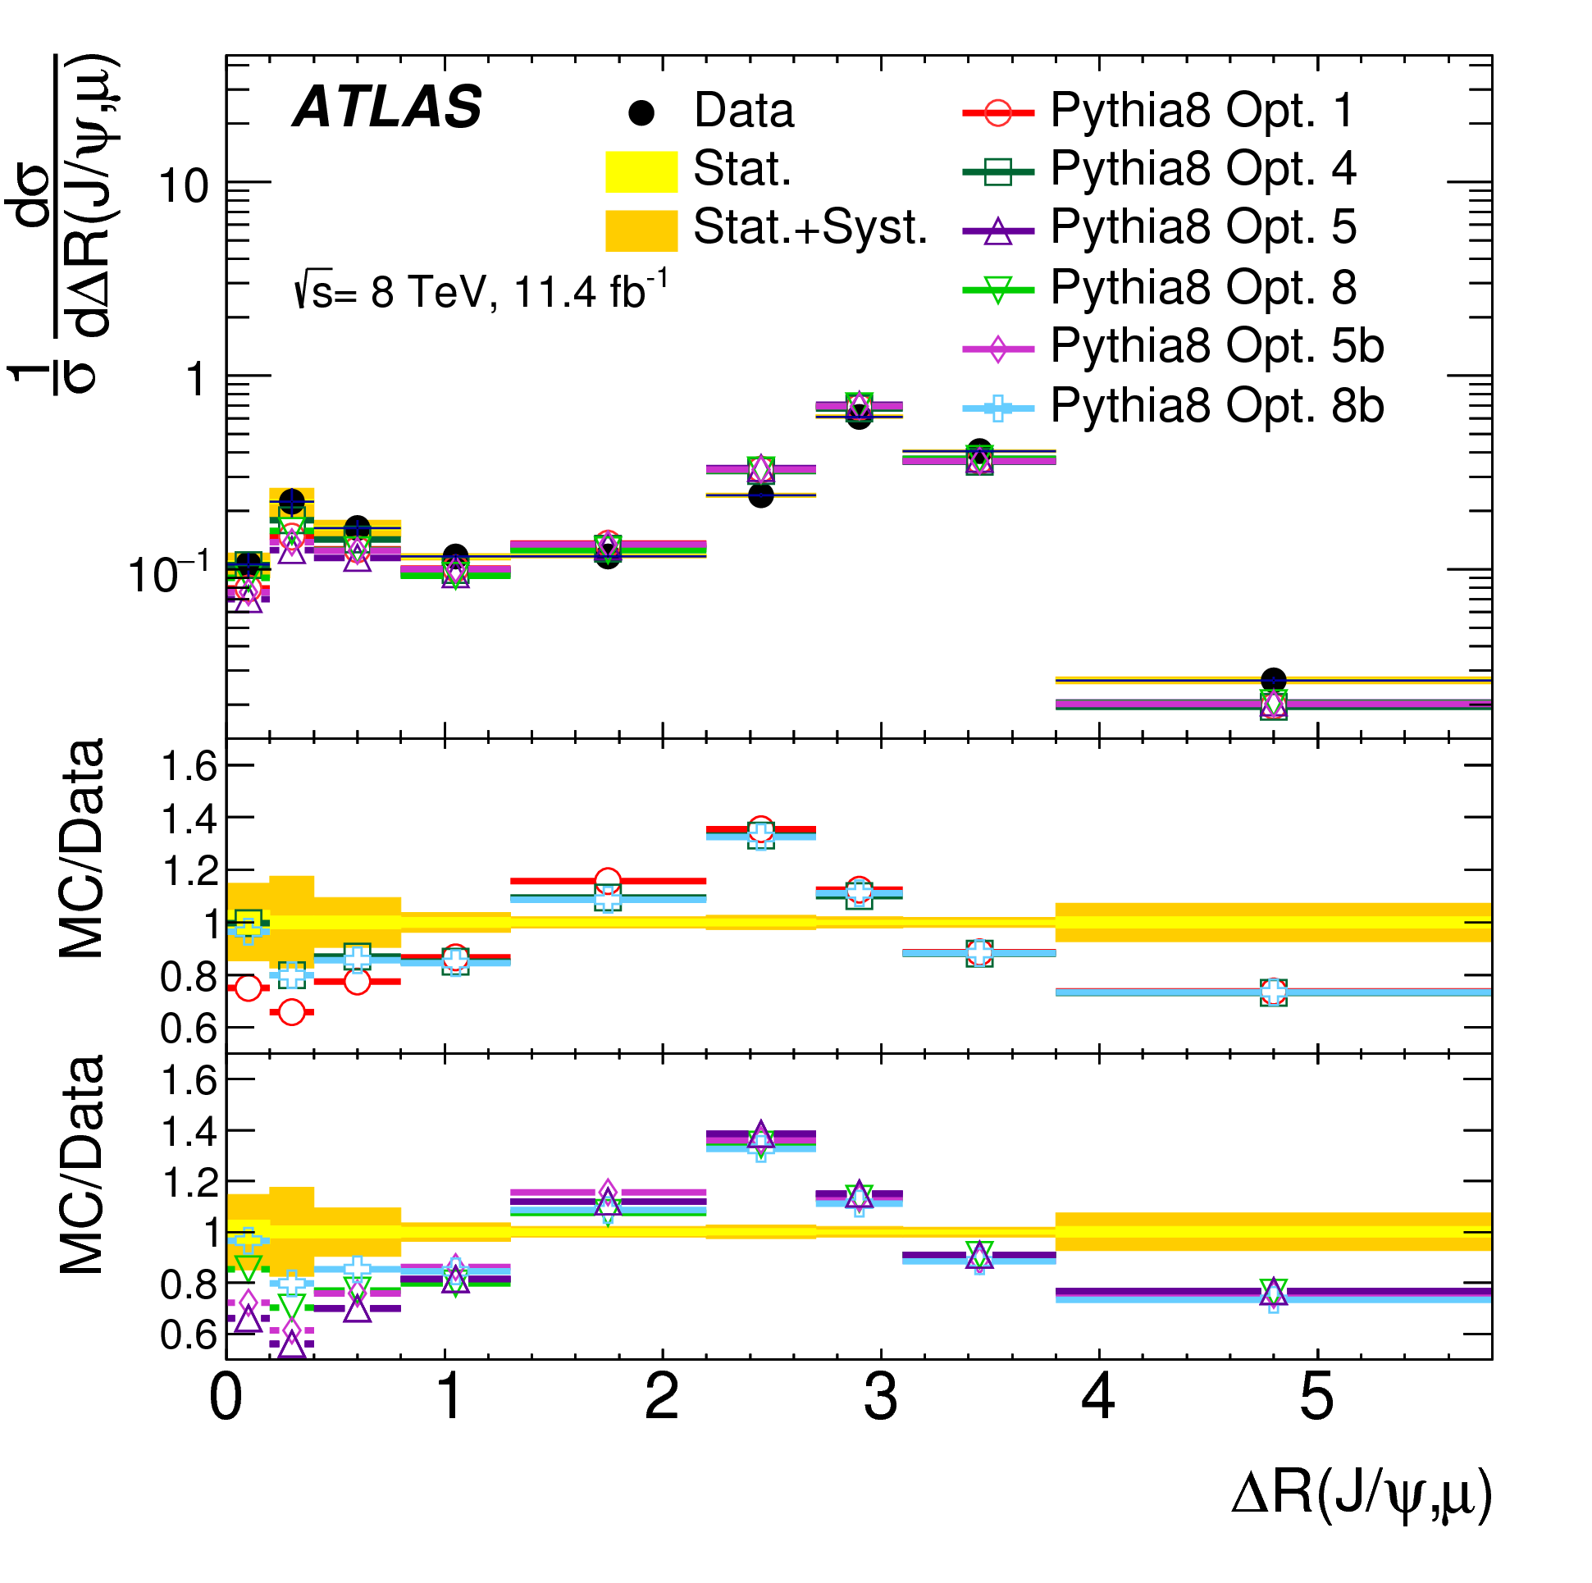
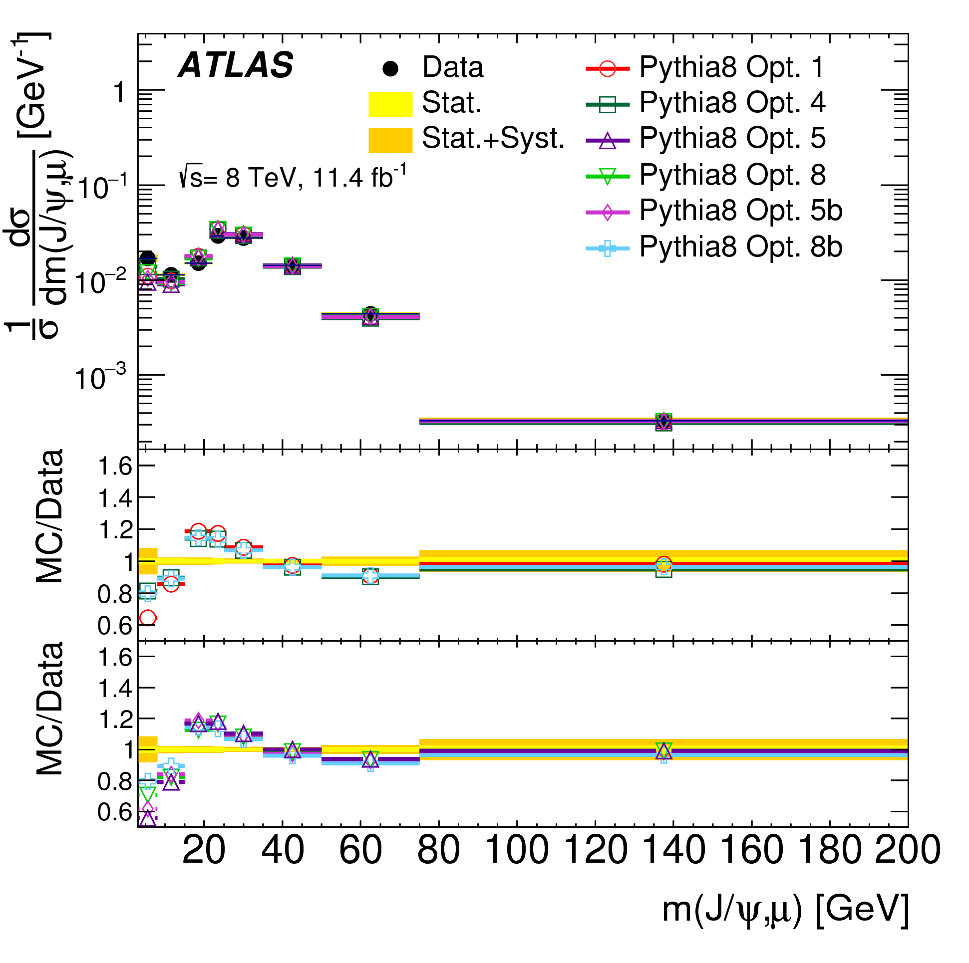
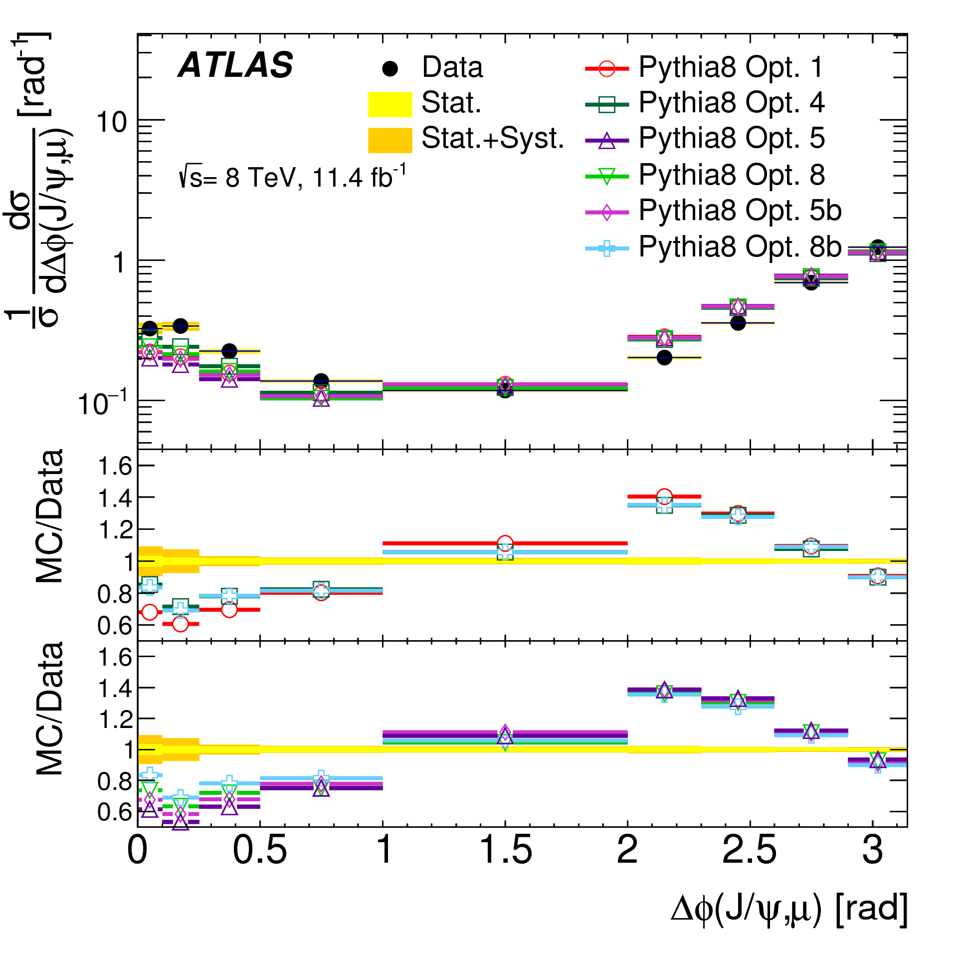
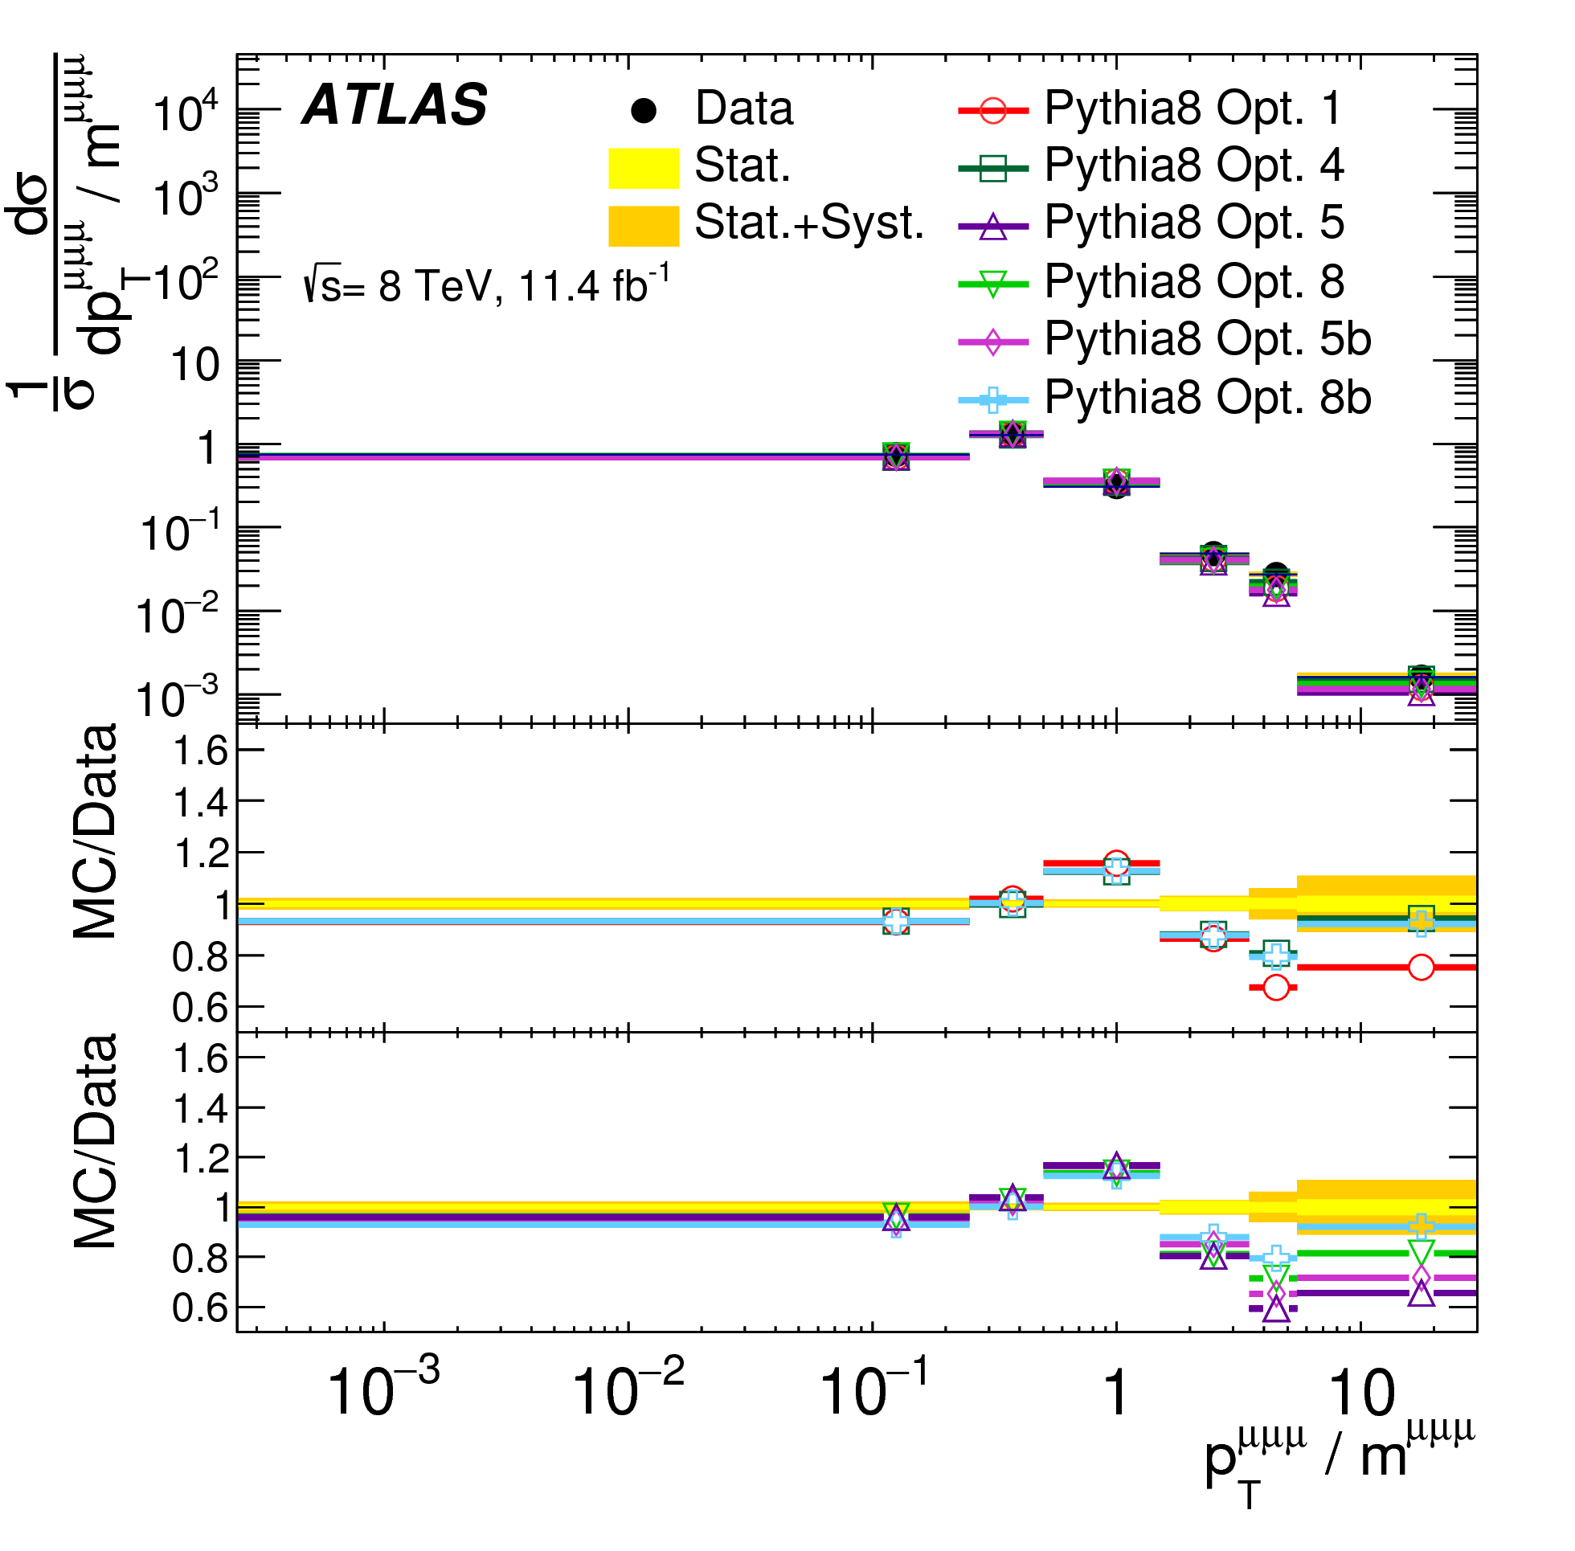
Comparisons with Pythia
Pythia 8 does not reproduce well the shape of the angular distributions
The pT-based scale splitting kernels (Opt 1 and 4) give a better description at low ΔR
Overall the kernel of Opt 4 does best

Slide 9
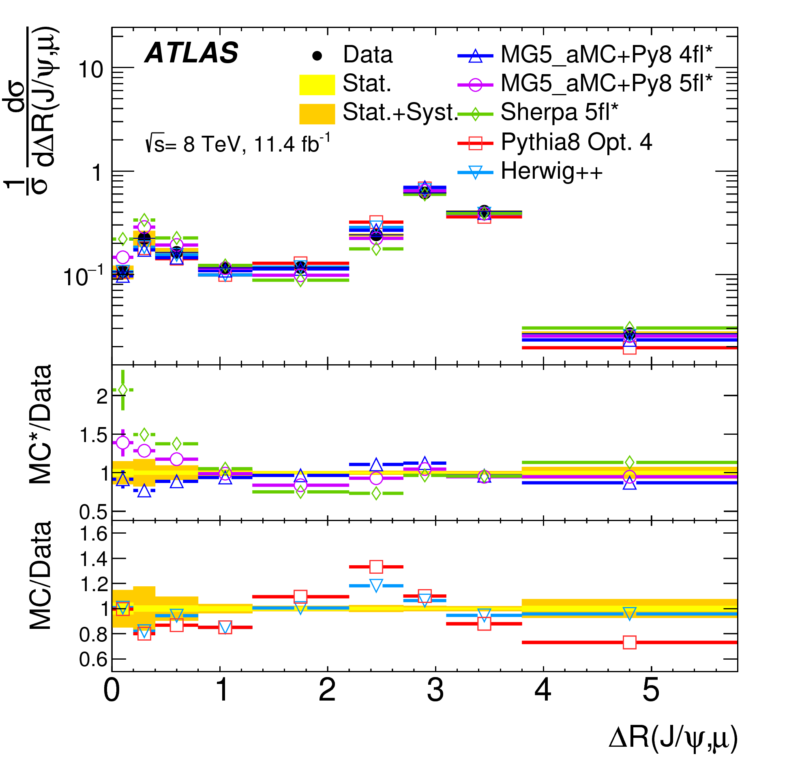
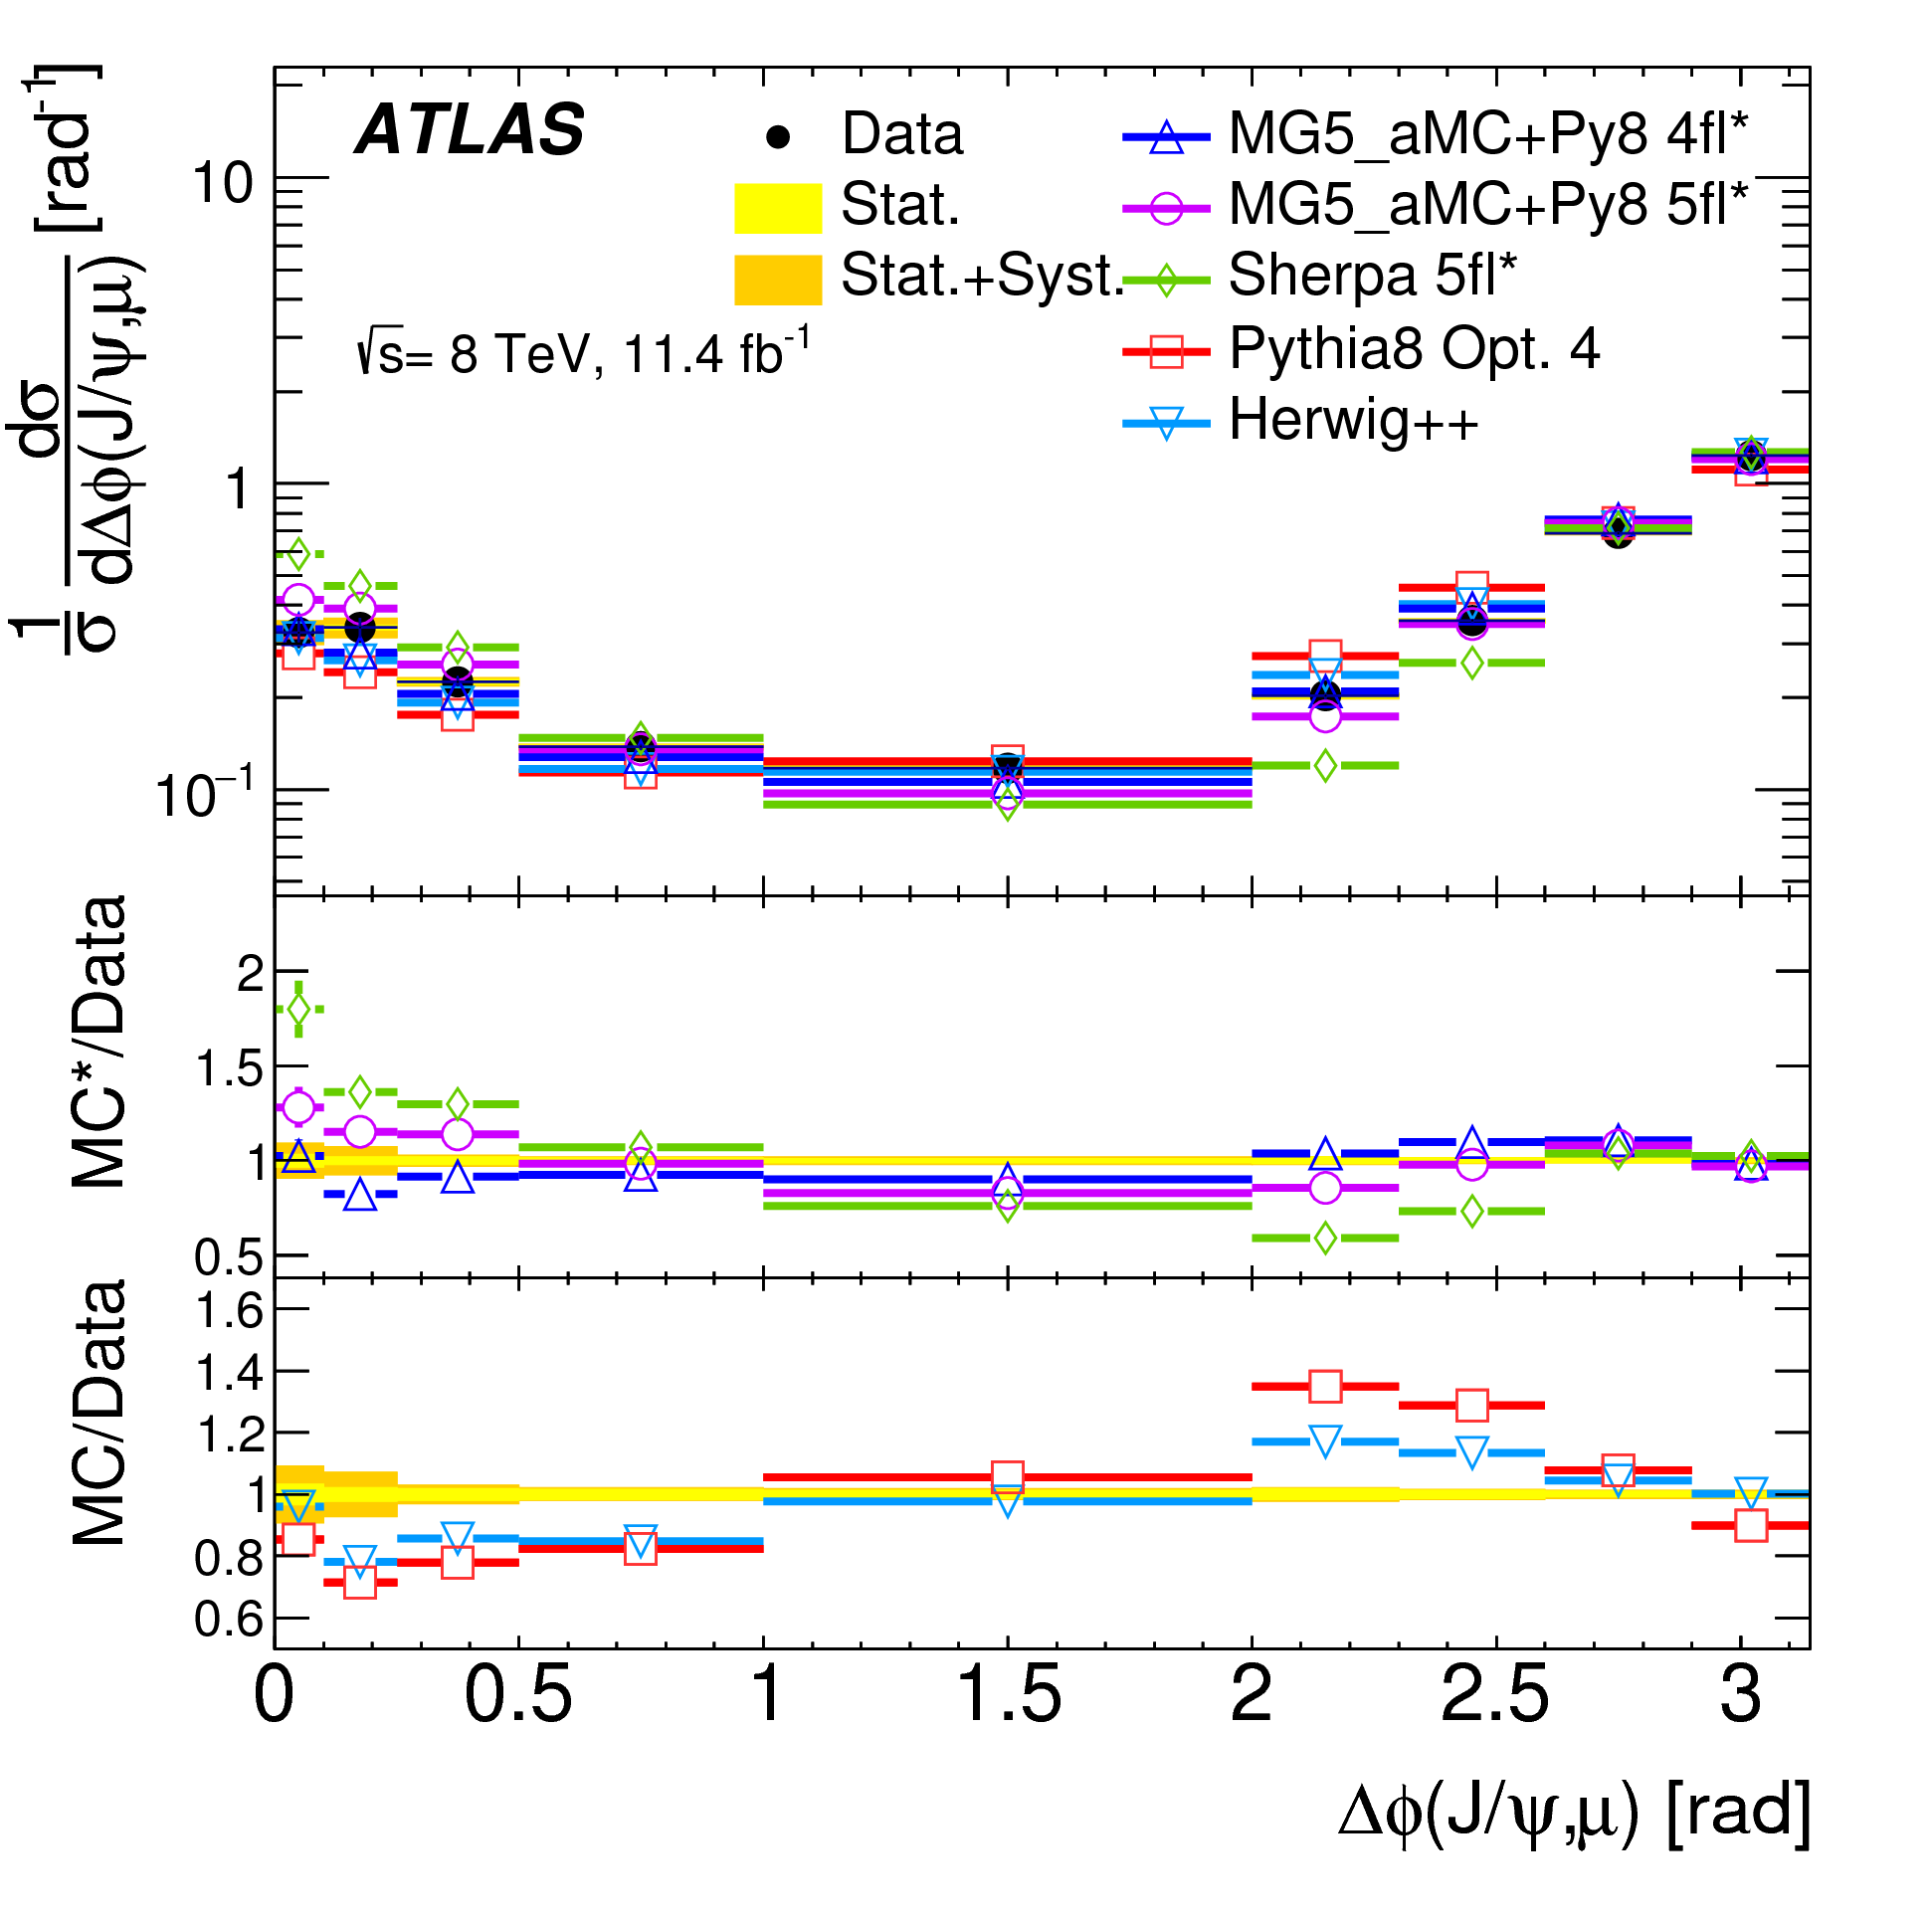
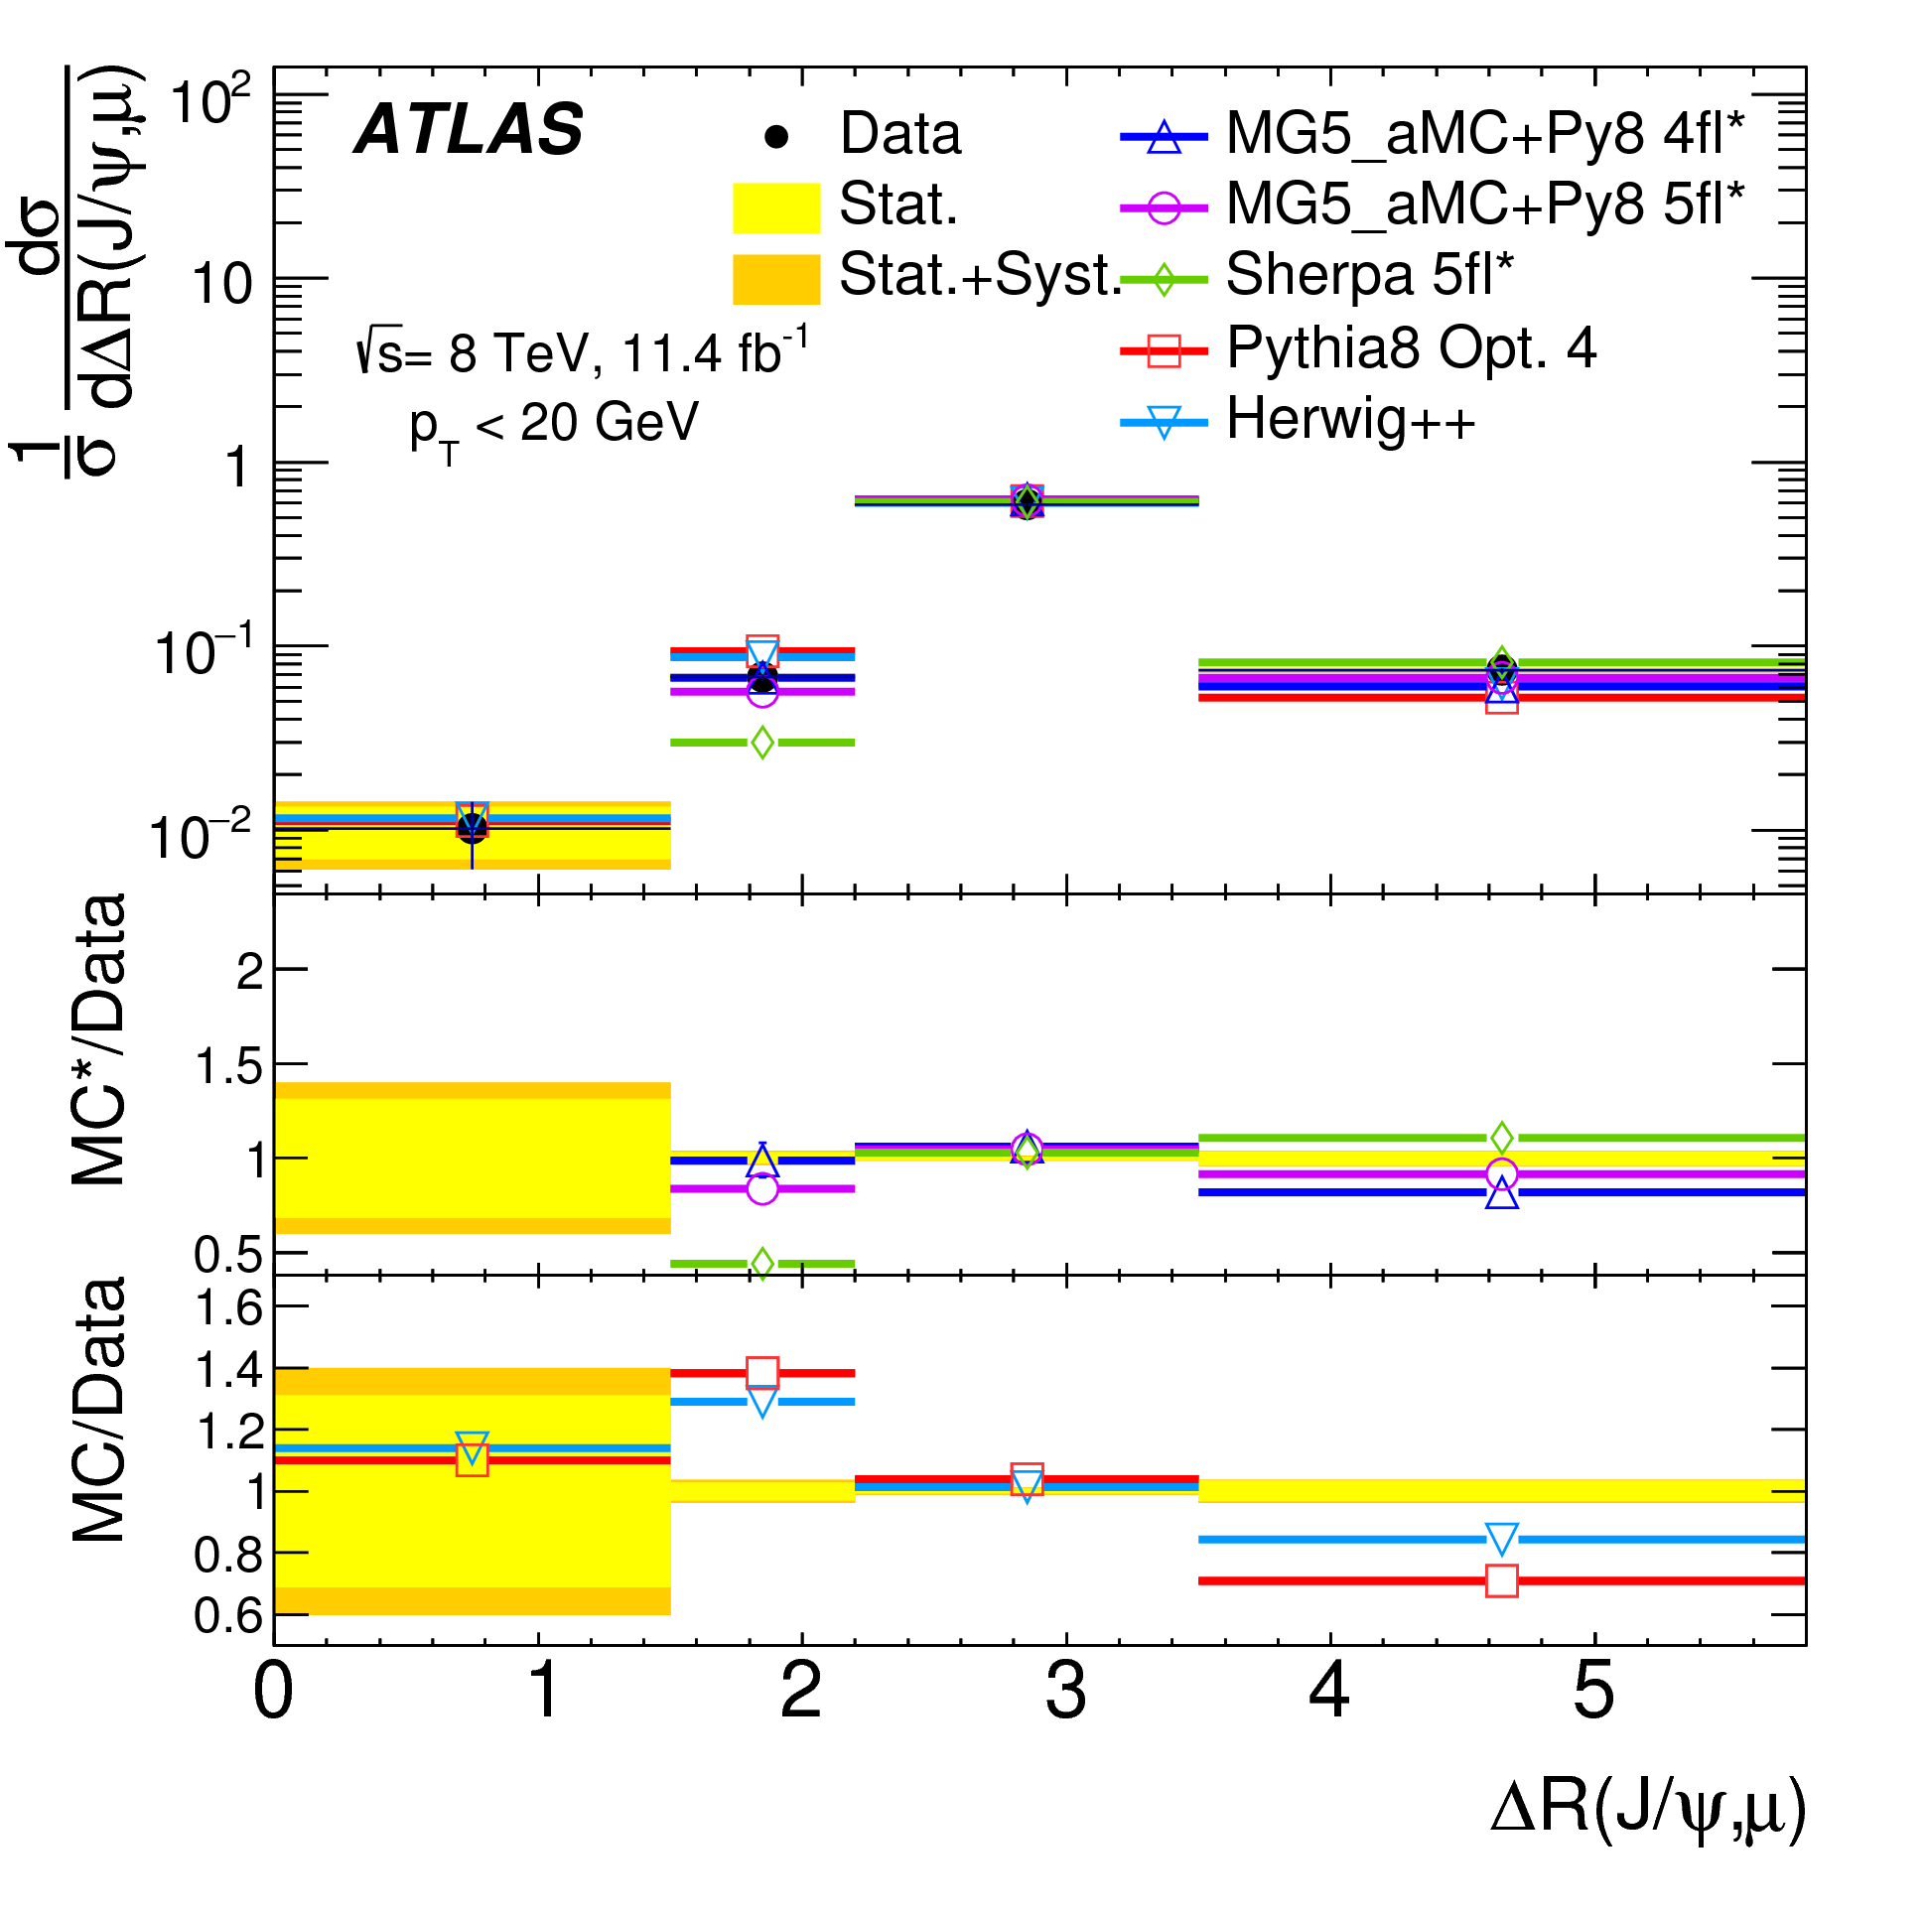
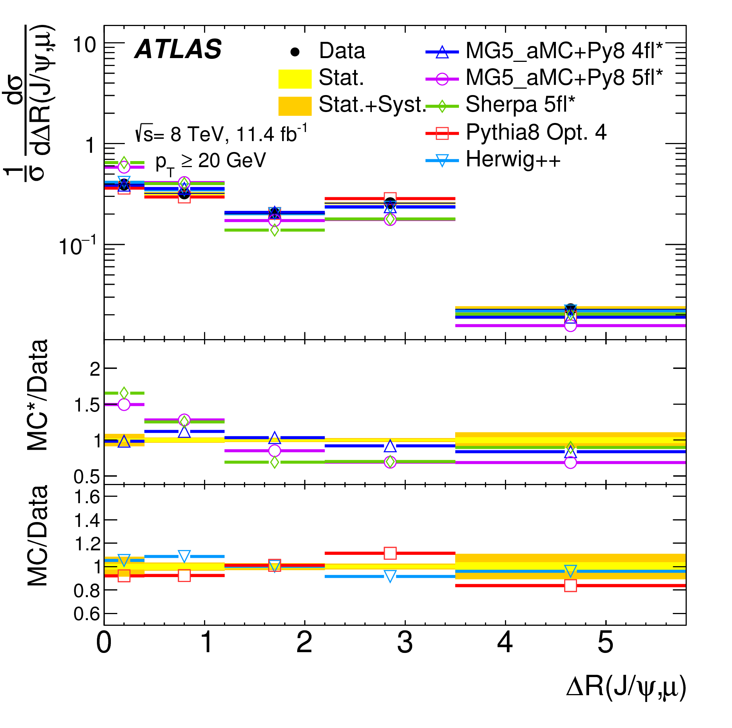
Comparisons with Other Models
Herwig++ is better than Pythia 8 for the ΔR
4- and 5-flavour MadGraph5 predictions sit either side of the data; the 4-flavour prediction is closer
The 5-flavour Sherpa prediction is similar (but worse) than madGraph5
Difference between 4-flavour and 5-flavour predictions are larger in the high-pT ΔR distribution; the 4-flavour version is still closer to data

Slide 10
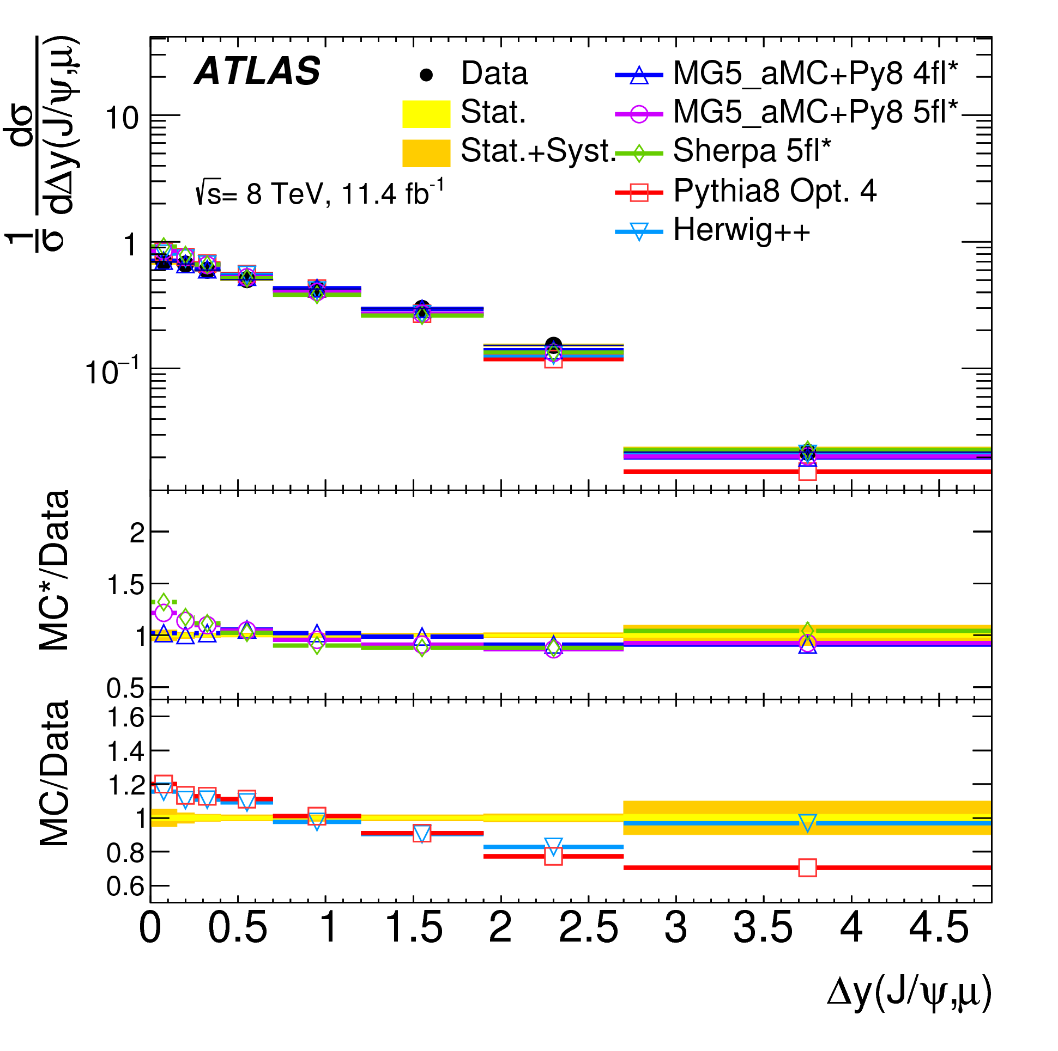
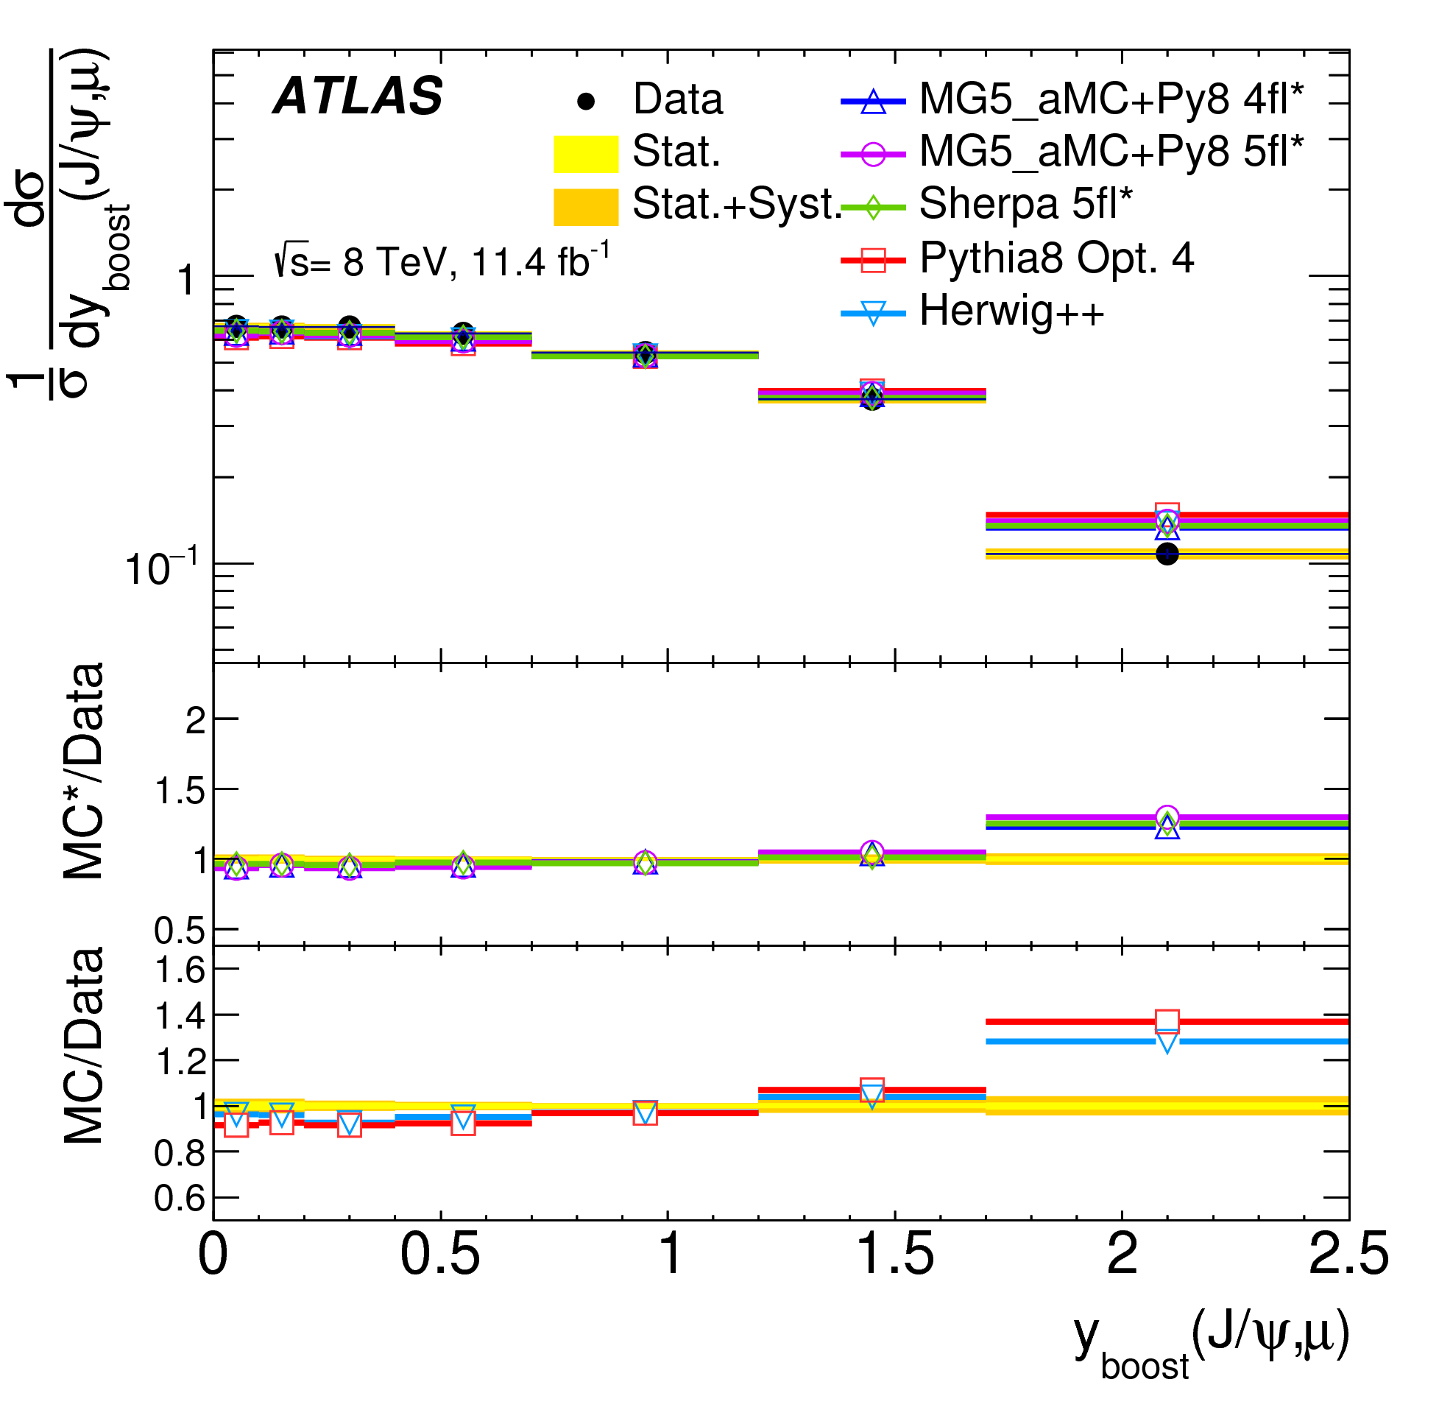
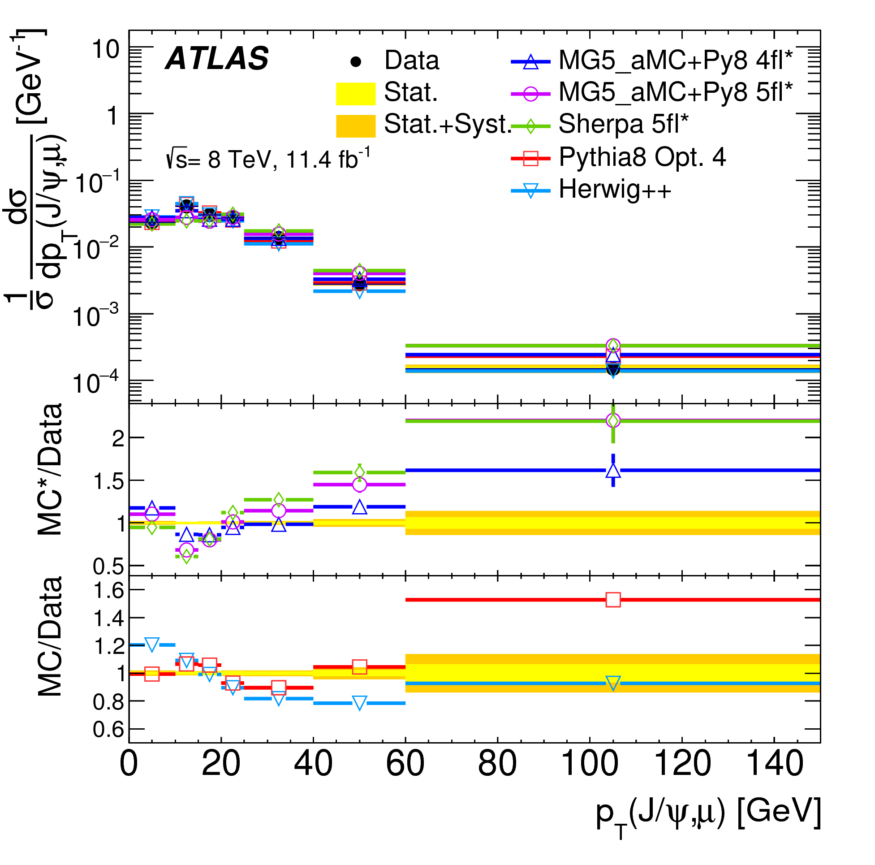
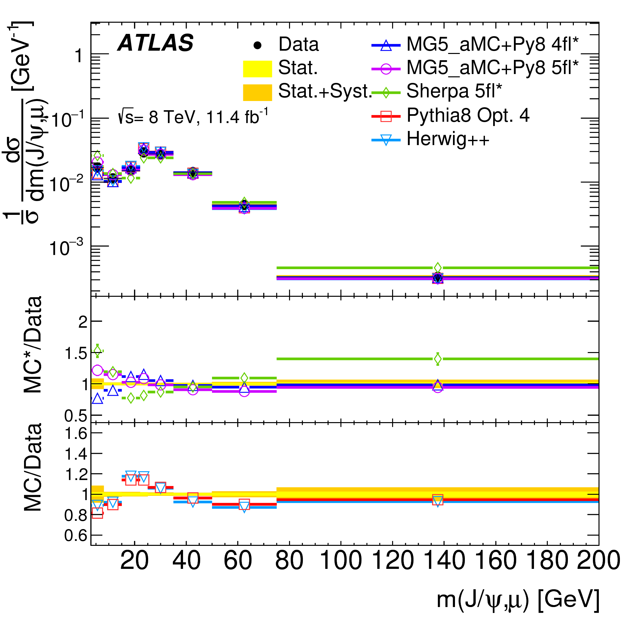
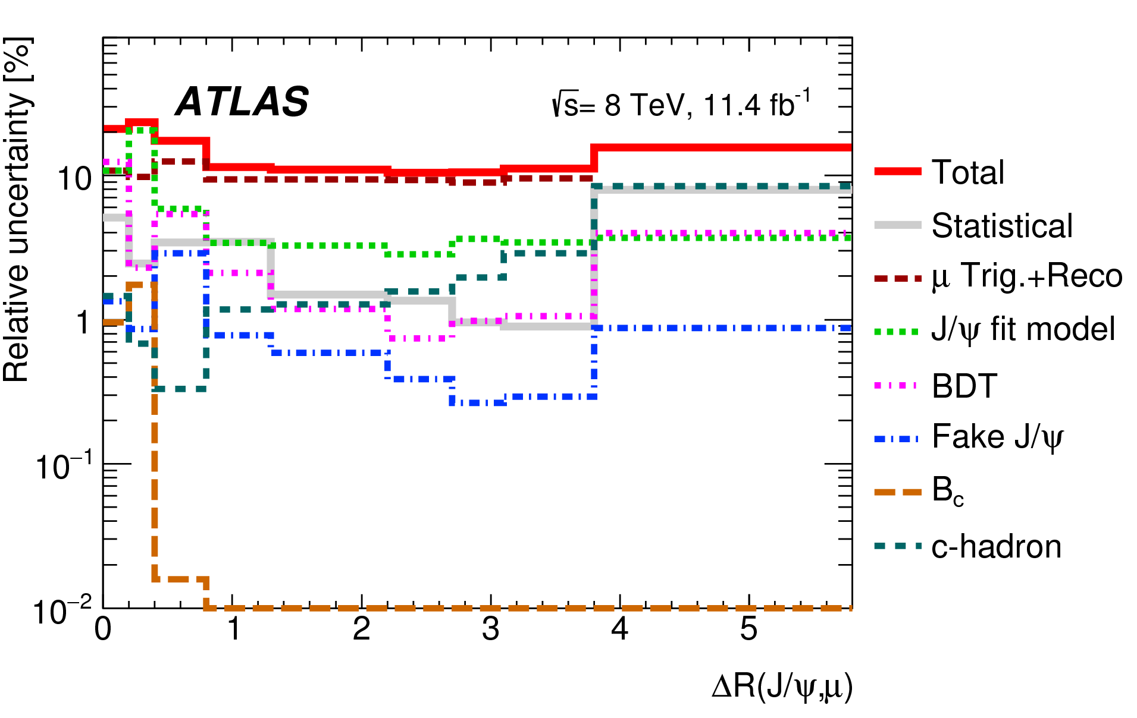
Other results
Similar picture for rapidities, pT, mass etc
Fiducial cross section is also measured
17.7± 0.1 (stat) ± 2.0 (syst) nb
Good understanding of systematics

Slide 11
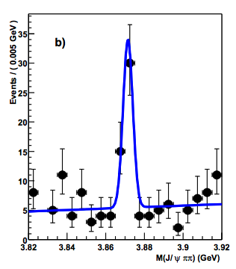
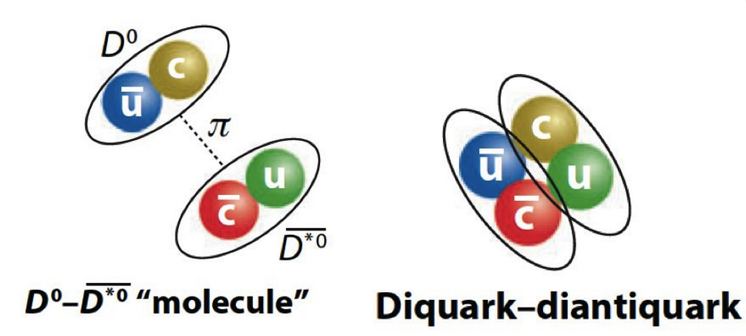
What is X(3872)?
‘Exotic’ resonance first observed by Belle in 2003 in J/ψπ⁺π⁻ final state
Subsequently confirmed by BaBar, CDF, D0 and now LHC experiments
Current world average X(3872) mass very close to the D⁰ D⁰* threshold
What is it? No clear picture yet!
  Loosely bound D⁰ – D⁰* molecule? Unlikely: NRQCD with this premise over-predicts production compared to CMS 2011 measurement
  New excited charmonium state? Unlikely: LHCb measured J^{PC} = 1⁺⁺, no such state expected around that mass
  A mix of these two, χ_{c1}(2P) -(D⁰ D⁰*), with hadronic decays dominated by the χ_{c1}(2P) component? Maybe, if the mixture is determined through fit to CMS results (PRD 96, 074014 (2017))
  Tetraquark (diquark – diantiquark)? Possible, but hard to make any solid predictions
hep-ex/0309032
  Belle
  ATLAS measurement may help answer some of these questions, and/or create new ones
  Measuring X(3872) and the well-studied ψ(2S) in the same analysis and in the same final state J/ψπ⁺π⁻ helps reduce systematics for various ratios and comparisons

Slide 12
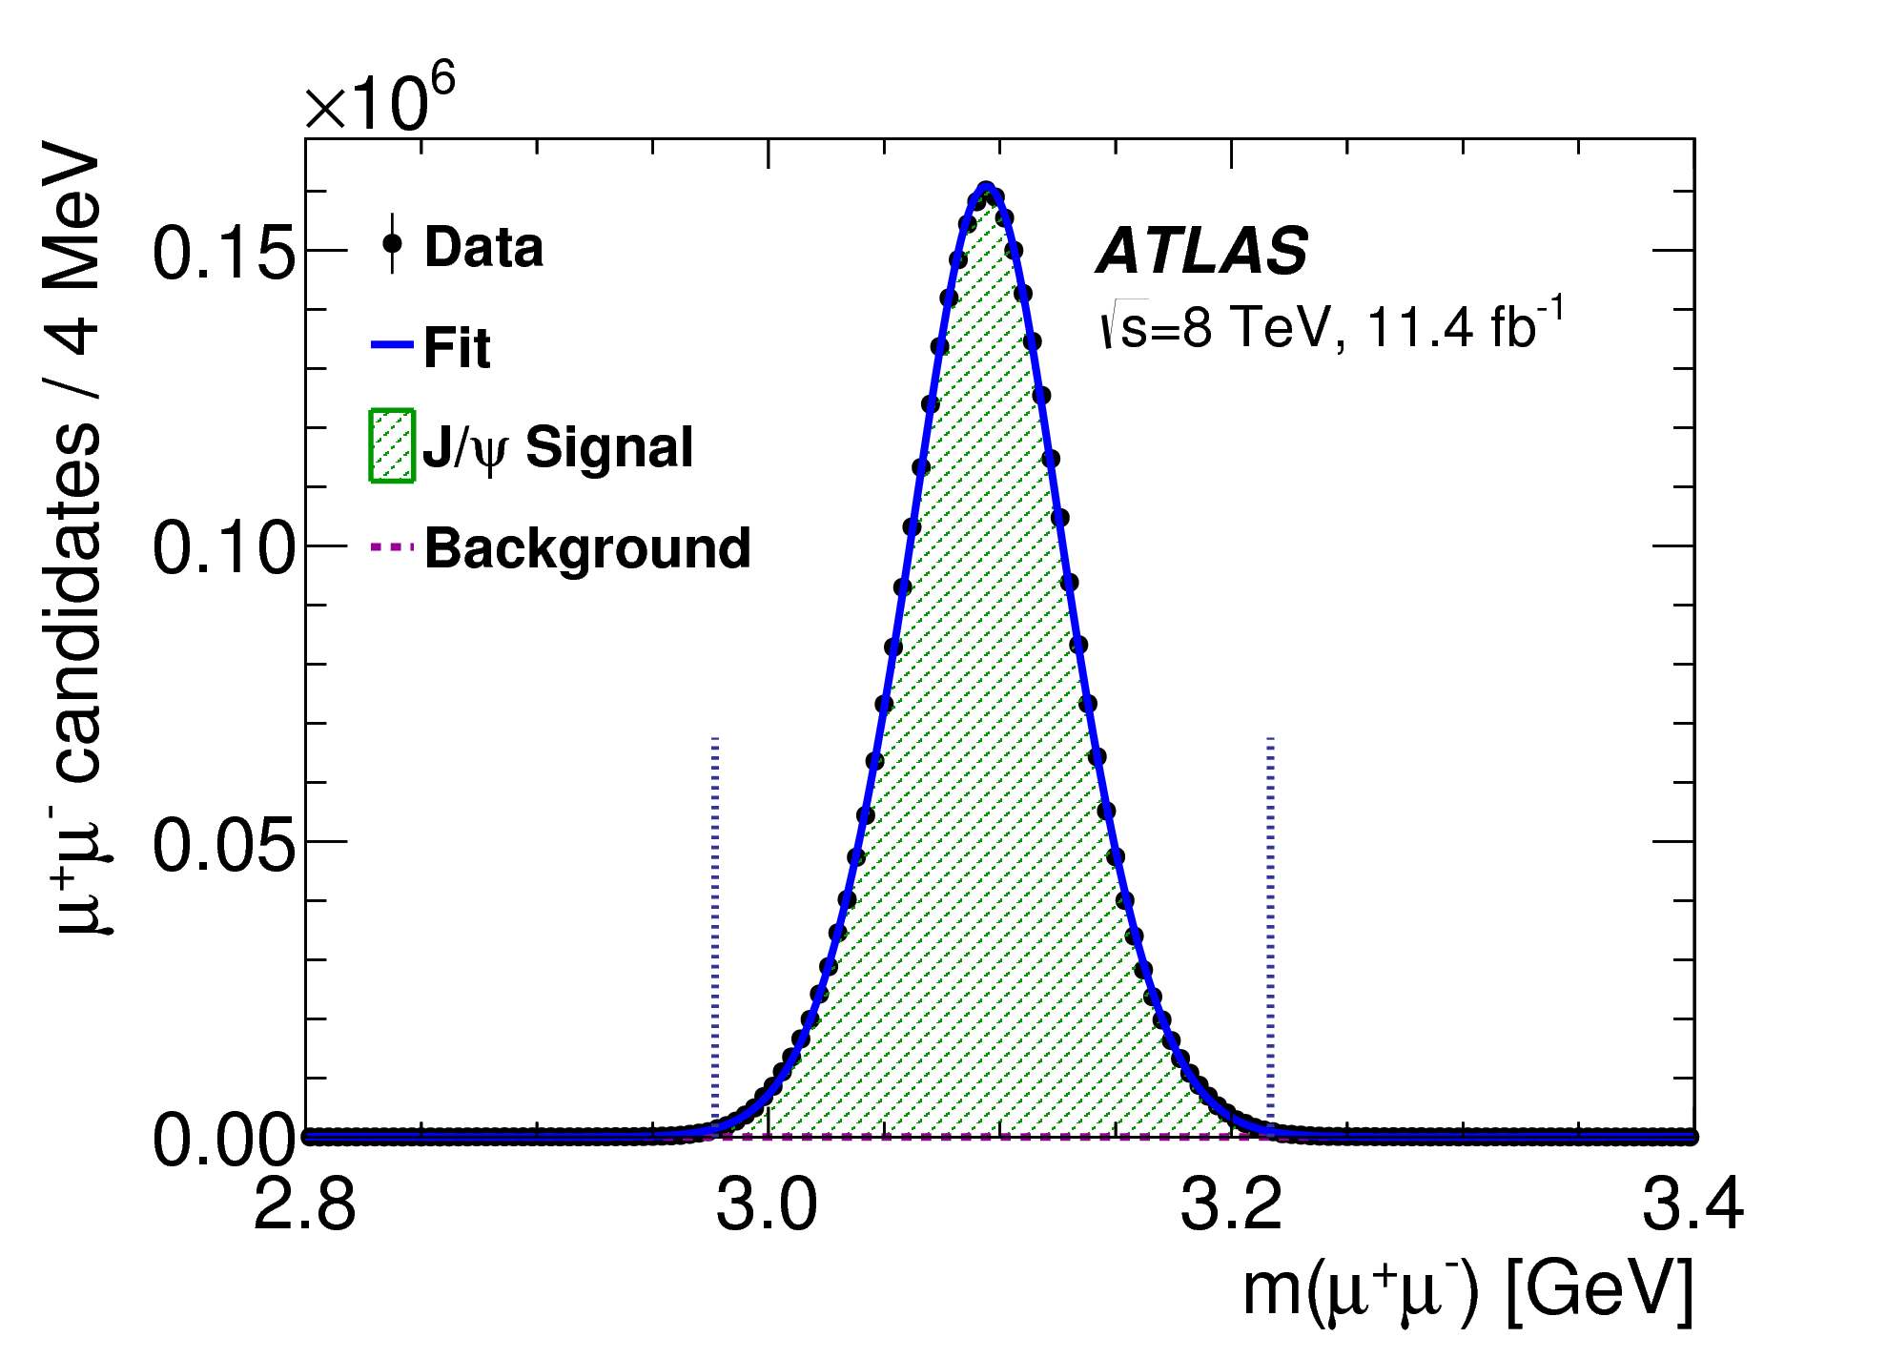
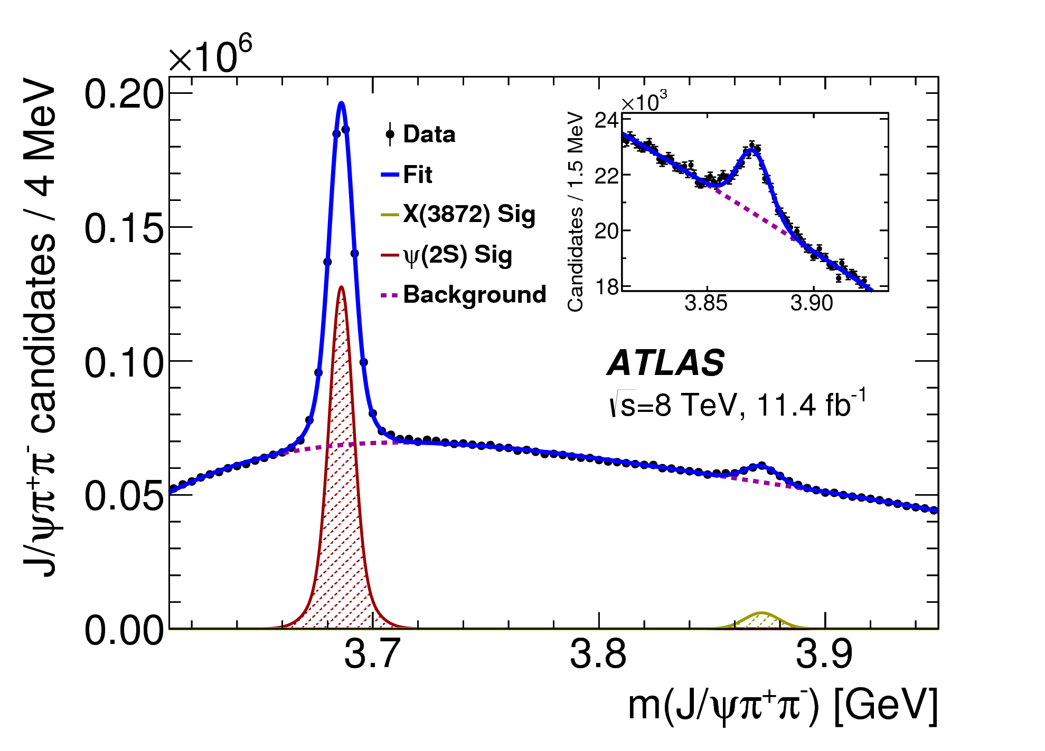
Event selection
Muon cuts:
  Opposite sign `combined’ muons
  p_{T} > 4 GeV, |η| < 2.3
3.6 M J/ψ candidates
J/ψ cuts:
  χ²_{dimu_vtx} < 200, p_{T} > 8 GeV & |y| < 2.3
  | m(J/ψ) - m(J/ψ)_{PDG} | < 120 MeV
Pion cuts
  Opposite sign, p_{T} > 600 MeV, |η| < 2.4
Constrained vertex fit on each μ⁺μ⁻π⁺π⁻ candidate:
  di-muon (2.8 < m_{μμ} < 3.4) GeV fit to a single vertex
  di-muon mass constrained to the J/ψ mass
  pion mass hypothesis used for the other two tracks
370 k ψ(2S) 30 k X(3872)
J/ψπ⁺π⁻ background suppression cuts
  P(χ²_{J/ψππ}) > 4%
  Opening angle ΔR(J/ψ, π±) < 0.5
  Q = m(J/ψπ⁺π⁻) - m(J/ψ)_{PDG} – m(π⁺π⁻) < 300 MeV

Slide 13
Outline of the X(3872) Analysis
Analysis performed for |y| < 0.75 for the J/ψπ⁺π⁻ system, for optimal tracking resolution
p_{T} bin boundaries: [ 10, 12, 16, 22, 40, 70 ] GeV
Effective pseudo-proper lifetime bin boundaries: [-0.3, 0.025, 0.3, 1.5, 15.0] ps
Each J/ψπ⁺π⁻ candidate weighted to correct for trigger/reconstruction/acceptance losses
For each p_{T} and lifetime bin, binned minimum χ² fit in the J/ψπ⁺π⁻ invariant mass to determine ψ(2S) and X(3872) signal yields
For each p_{T} bin, the yields in individual lifetime windows are subsequently fitted:
to determine lifetime dependence and hence
separate the signal into prompt and non-prompt components
The lifetime fits are performed separately for ψ(2S) and X(3872)
Mass narrow/wide Gaussian ratio common for the two states

Slide 14
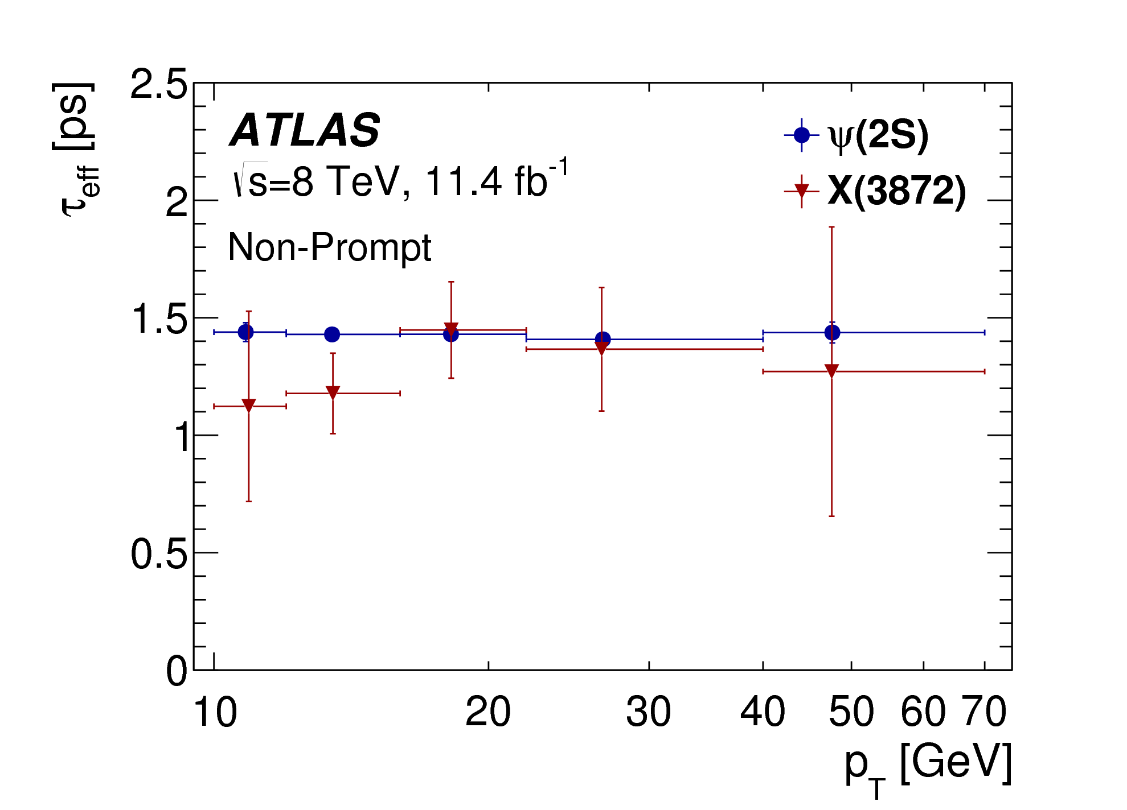
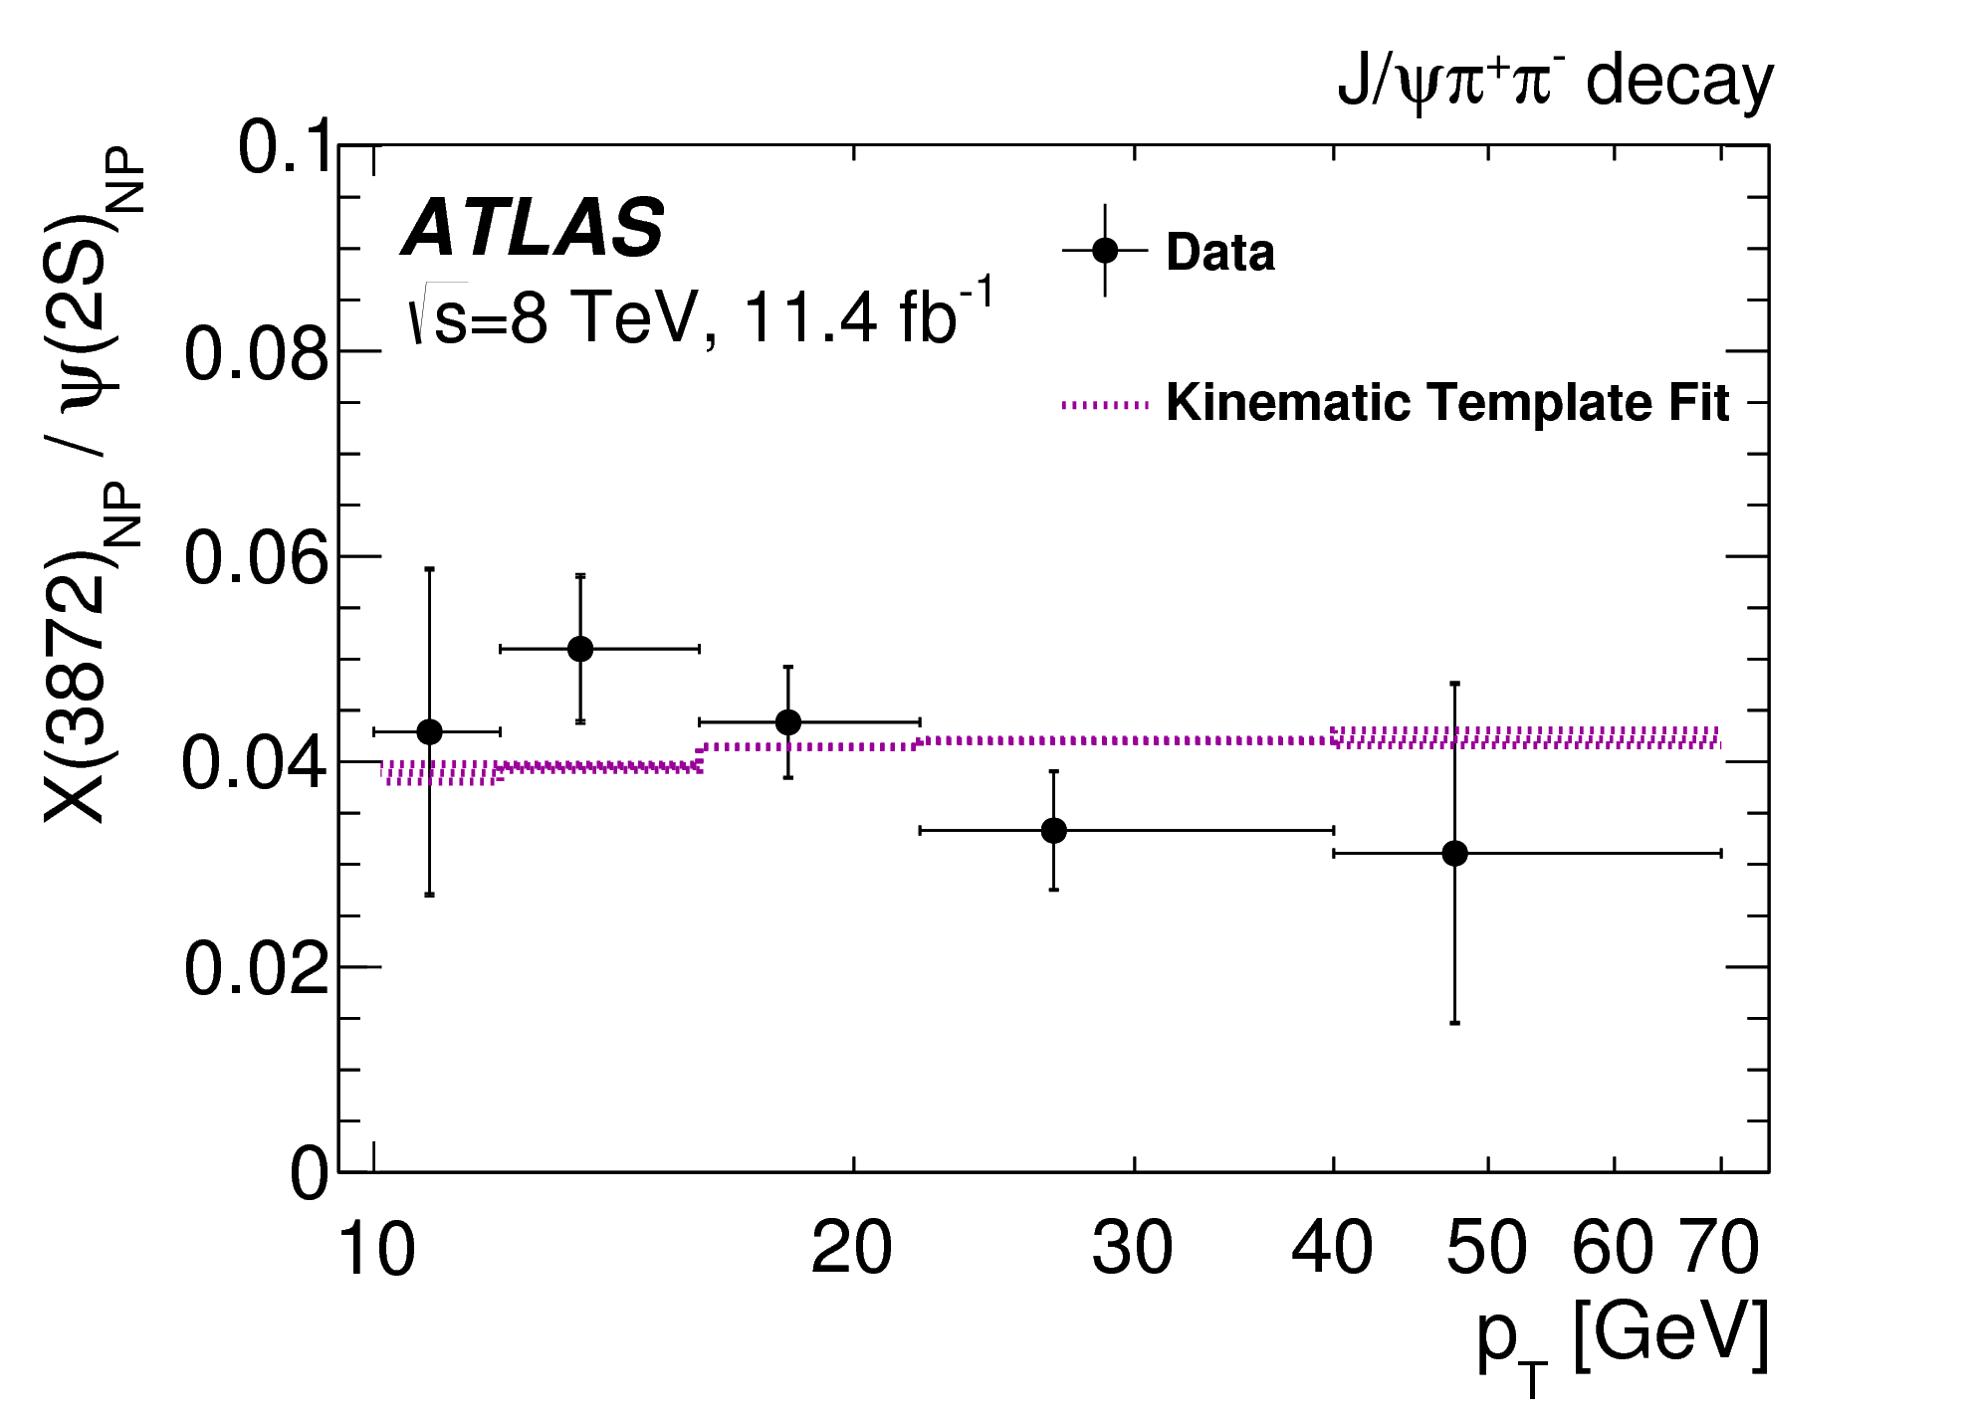
Single or Double lifetime hypothesis
Single: Assume non-prompt ψ(2S) and X(3872) are produced from the same mix of parent b-hadrons:
- same lifetimes for ψ(2S) and X(3872) in each p_{T} bin
- pT spectra of ψ(2S) and X(3872) linked through kinematics
➔Effective lifetimes for ψ(2S) consistent with single component independent of p_{T} ;
X(3872) possibly slightly shorter in low p_{T} bins (from B_{c}?)
➔Double lifetime fit:
τ_{LL} determined from fits to ψ(2S), allowing for some SL contribution
τ_{SL} obtained from simulation, varying B_{c} decay mode
In either case, X(3872):ψ(2S) ratio vrs pT extracted
Fit to kinematic (p_{T}) templates obtained from simulations of various
b-hadron decays into ψ(2S) and X(3872)
➔Extract overall non- prompt X(3872) : ψ(2S) ratio
Non-prompt, single lifetime
Two-lifetime fit results quoted from now on, unless stated otherwise

Slide 15
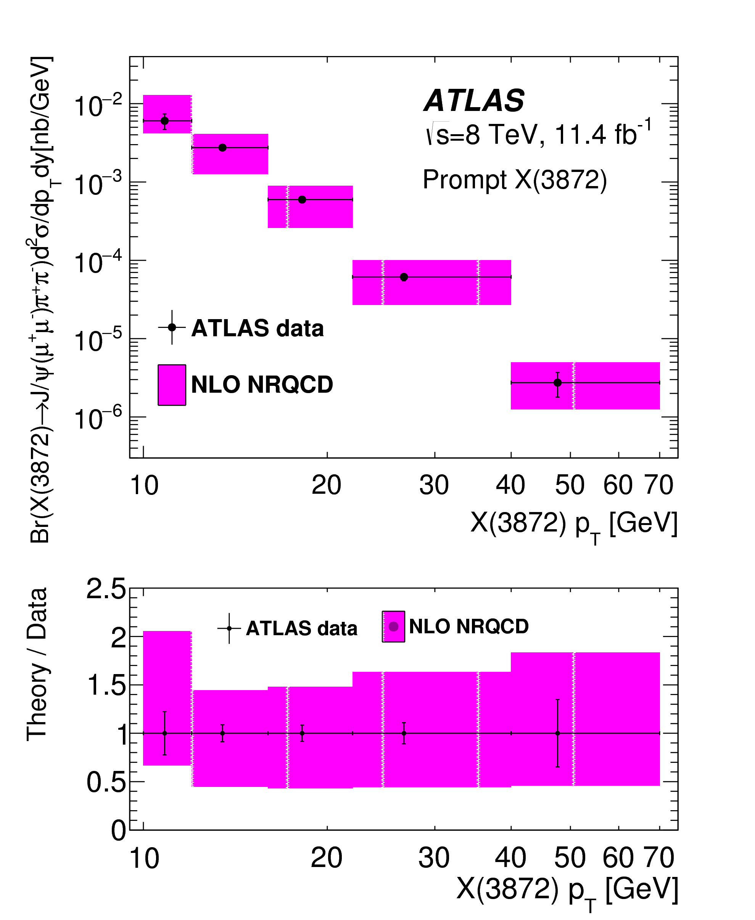
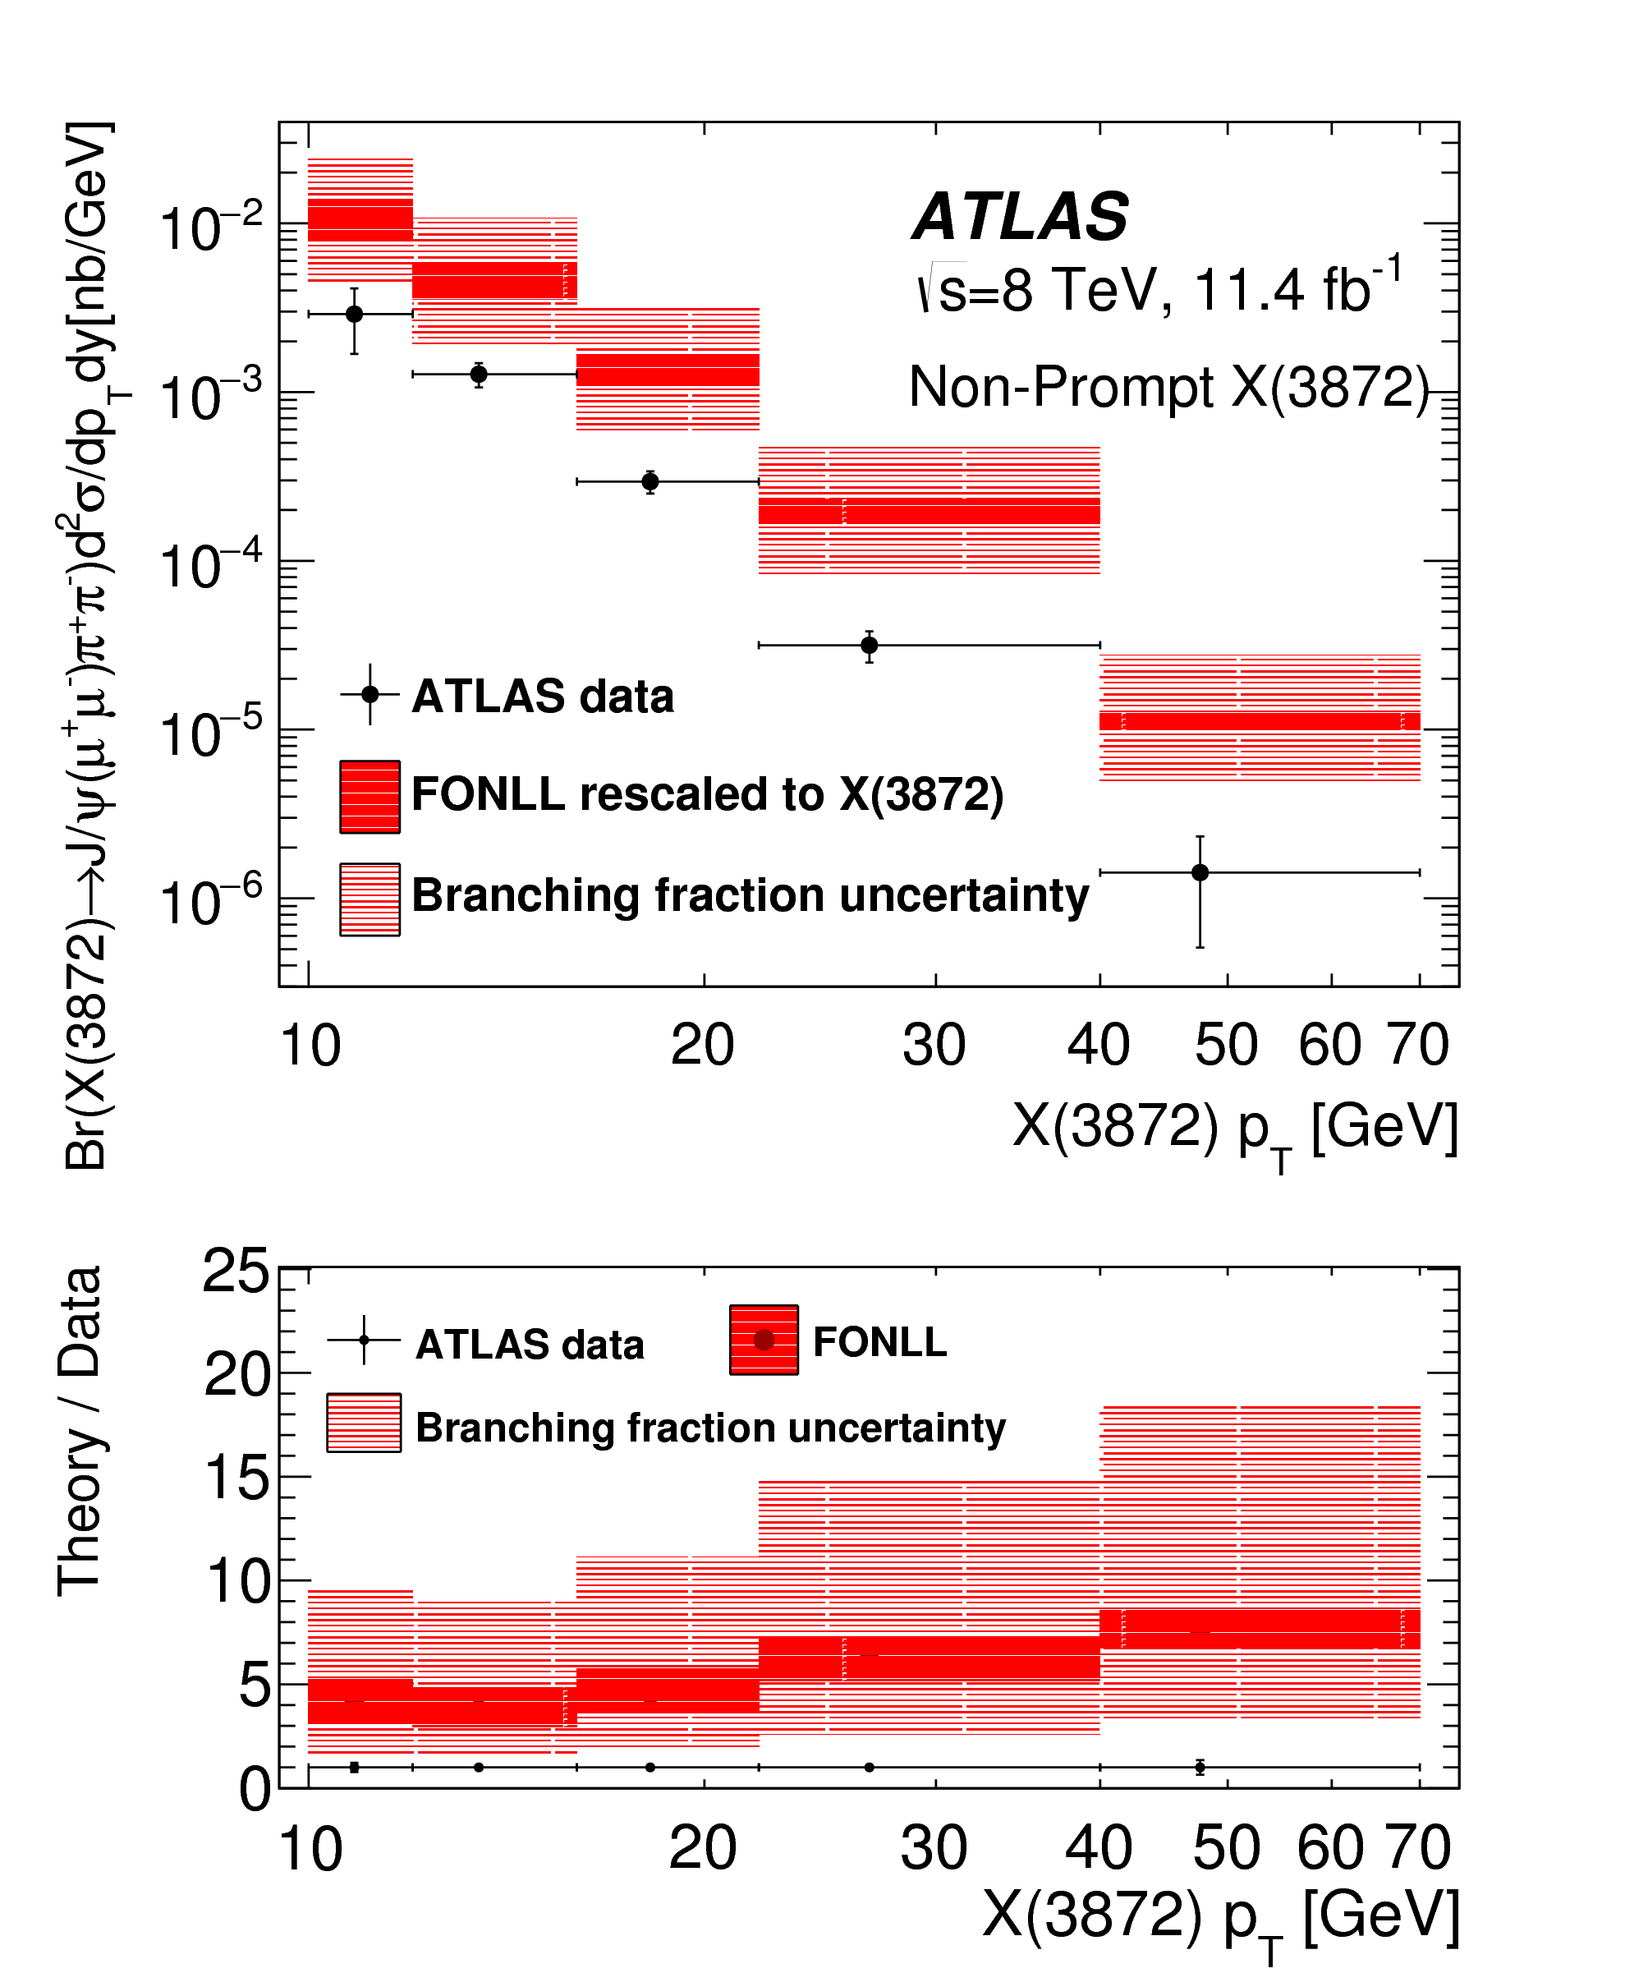

X(3872) cross sections
Prompt: Described well by NLO NRQCD
assumes X(3872) is a mix χ_{c1}(2P) - (D⁰ D⁰*)
χ_{c1}(2P) dominant using production
parameters fitted to CMS data
not surprising, CMS and ATLAS consistent
Non prompt:
use the fitted kinematic template
to recalculate from FONLL ψ(2S)
prediction
BR not measured – used estimate
from Artoisenet, Braaten
based on Tevatron data [hep-ph:0911.2016]
= 18±8 %
Clearly overshoots the data:
factor of 4 to 8, increasing with pT
Prompt
Non-Prompt

Slide 16
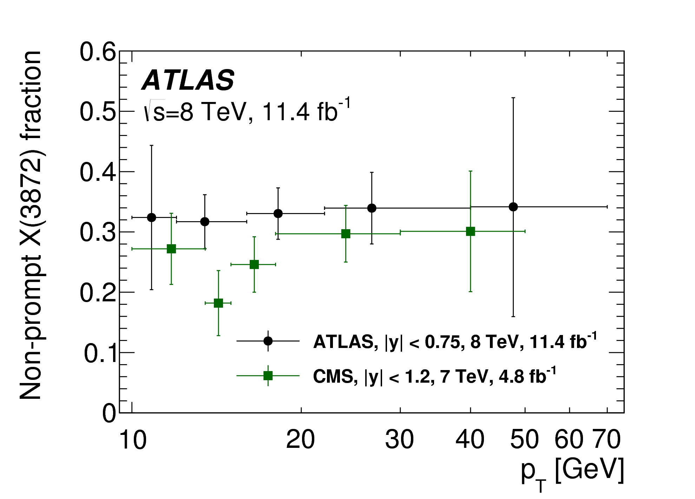
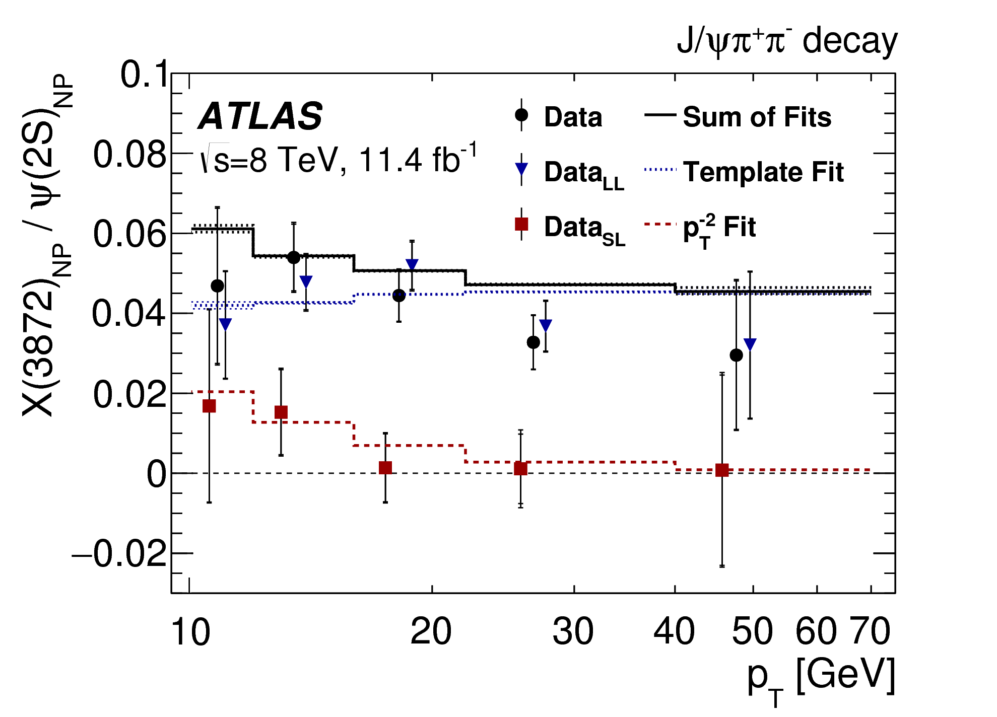
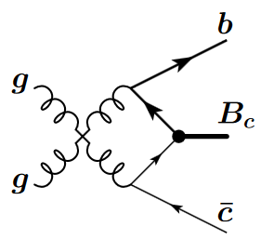
Non-prompt fraction and ratio
:
Non-prompt fraction of X(3872):
- no visible p_{T} dependence
- consistent with CMS result within errors
- Very unlike J/ψ’s stong p_{T} dependence
Ratio of non-prompt X(3872) : ψ(2S)
- long-lived part fitted to kinematic template
- short-lived part: assuming non-fragmentation B_{c}
dominate at low p_{T} [Berezhnoy, arXiv:1309.1979]
- fit with a· p_{T}⁻² relative to fragmentation production
- integrate the fits to determine the fraction of
non-prompt X(3872) that is short-lived,
for pT>10 GeV:
B_{c} small fraction of b-hadrons at LHC => Evidence X(3872) production enhanced in B_{c} decays

Slide 17
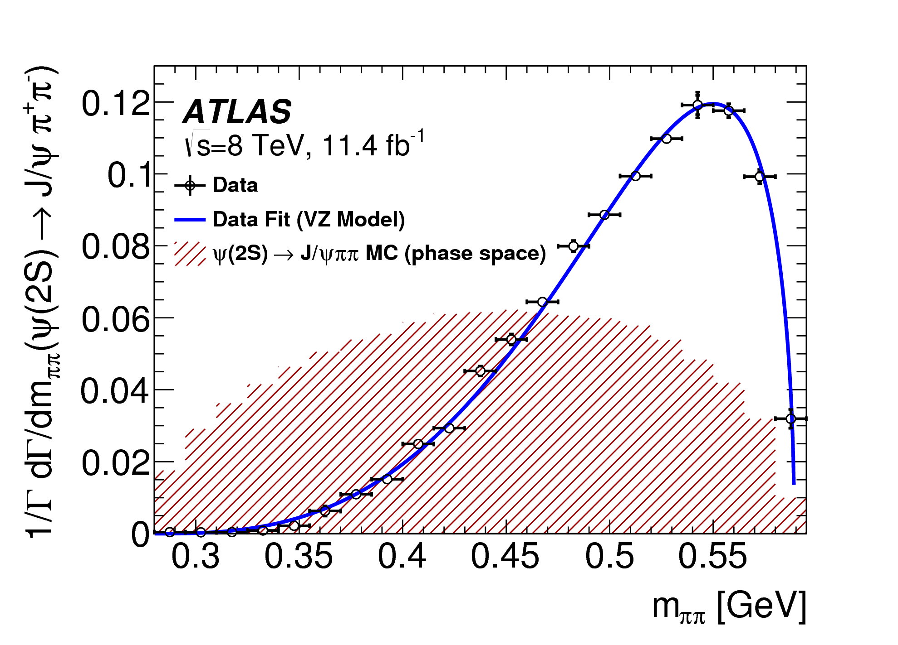

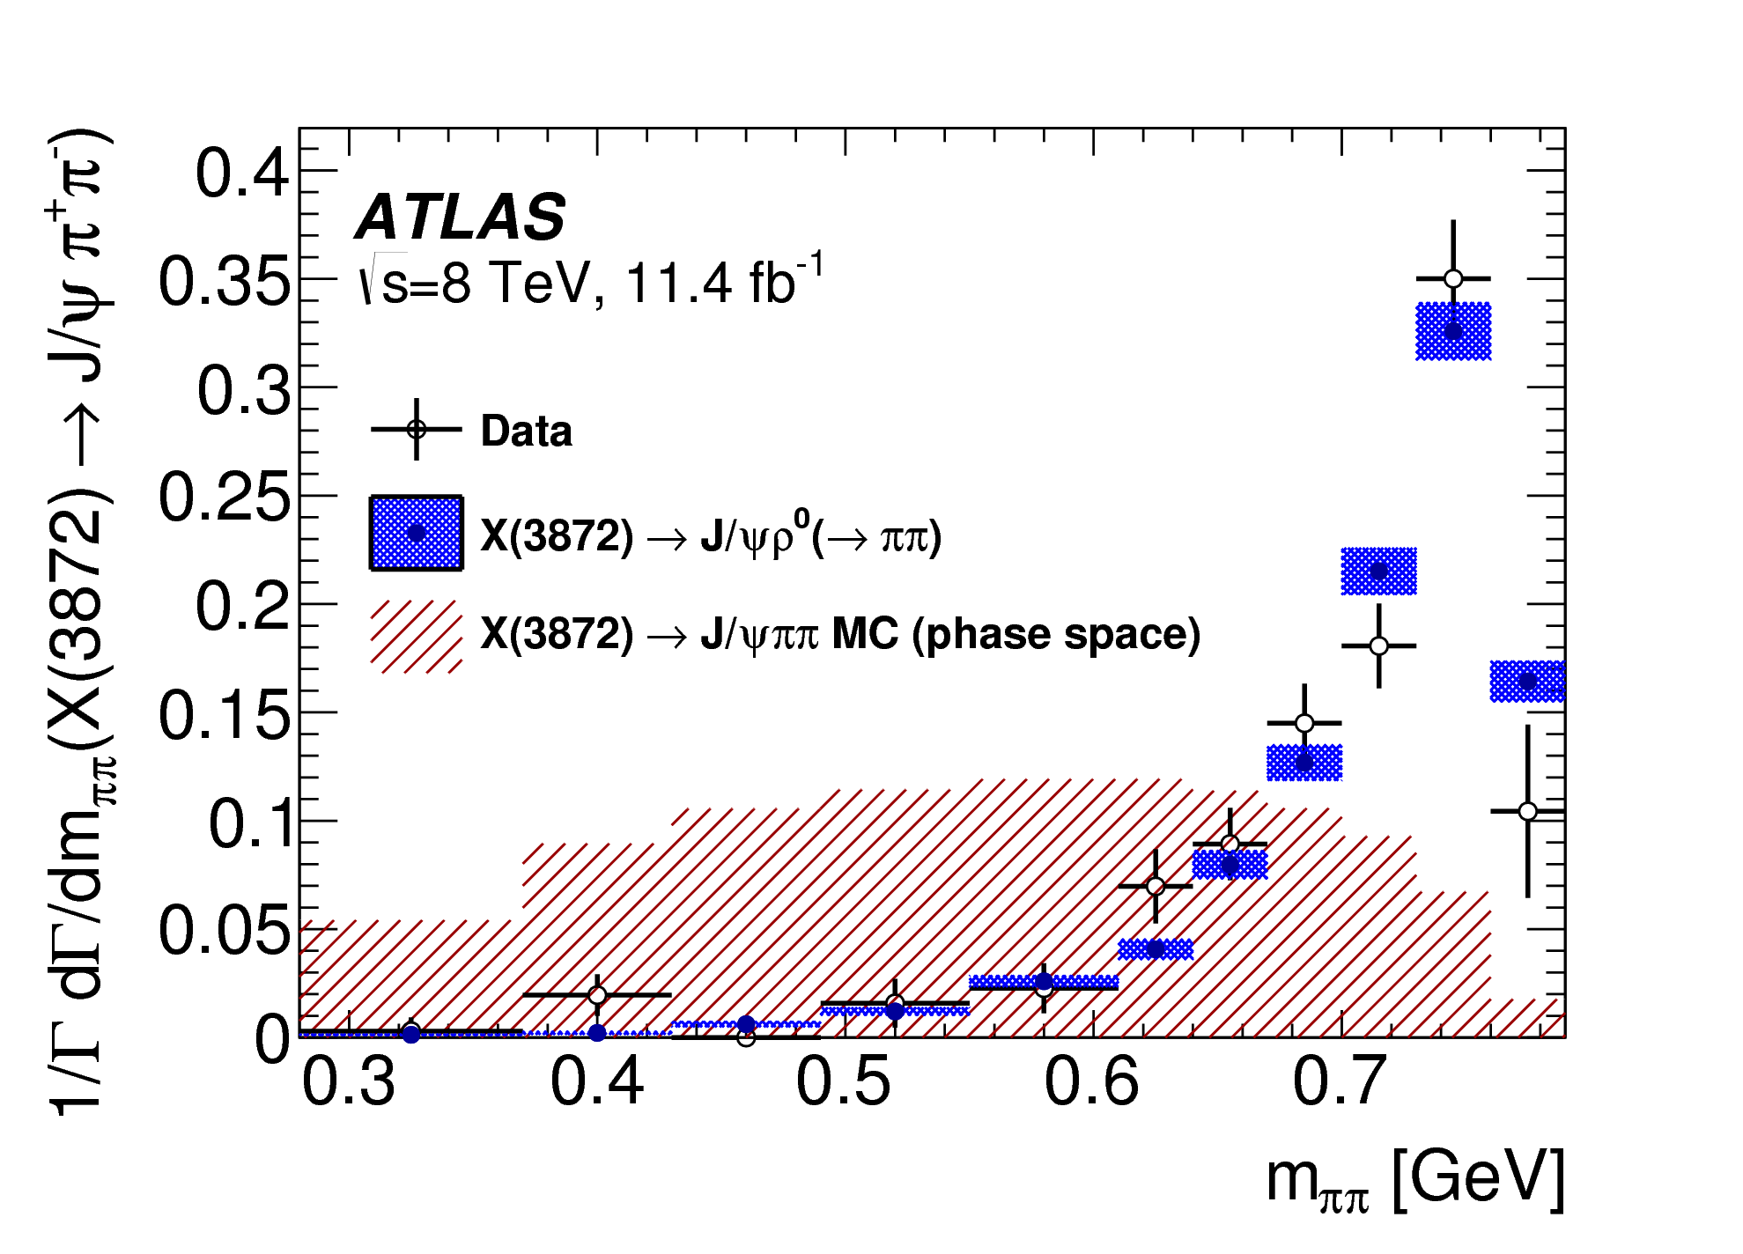
Di-pion mass distributions: results
In ψ(2S) to J/ψπ⁺π⁻ decays
- dipion mass distribution peaks at high masses
- fit to Voloshin-Zakharov function
- found λ = 4.16 ± 0.06(stat) ± 0.03(syst)
- in agreement with previous measurements
In X(3872) to J/ψπ⁺π⁻ decays
- dipion mass distribution has an even sharper peak at high masses
- in agreement with simulation where the di-pion
system is produced via ρ⁰ meson decay
- also in agreement with previous observations

Slide 18
Summary of X(3872) results
Prompt production is described reasonably well by NRQCD with previously determined Long Distance MEs.
Two lifetime models for non-prompt production:
single-lifetime model (with fitted effective lifetime)
two-lifetime model (two fixed lifetimes, fitted fraction), needed for X(3872)
Cross section results, non-prompt fractions largely indifferent to lifetime model
Branching fraction ratios measured in the two models are only slightly different:
Both smaller than 18 ± 8 % estimated from Tevatron data, implicit same-parent-mix assumption.
Two-lifetime model allows for a significant fraction of non-prompt X(3872) to be produced in decays of B_{c}, which have shorter lifetime and expected to have steeper p_{T} dependence.
In this model the fraction of non-prompt X(3872) produced from B_{c} decays is measured to be (for pT>10 GeV)

Slide 19
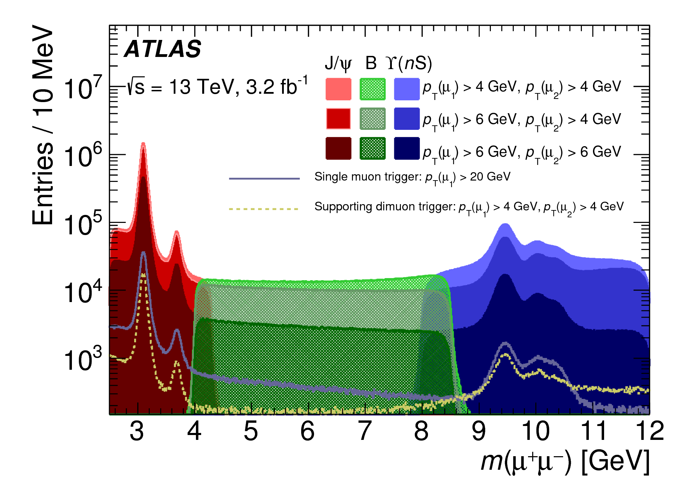
Perspectives
ATLAS is a “general purpose” experiment, and, due to the universality of the detector and ingenuity of analysers, a number of important contributions to heavy quark physics can be made
New studies adding to picture of bb correlations, including colinear case
No clear signs of X_{b} production have been found yet, but X(3872) production have been studied in some detail, with potentially interesting results
A large amount of data collected at 13 TeV are still being studied, with new challenges related to increasing trigger thresholds and increased high pileup

Slide 20
THANK YOU!

Slide 21
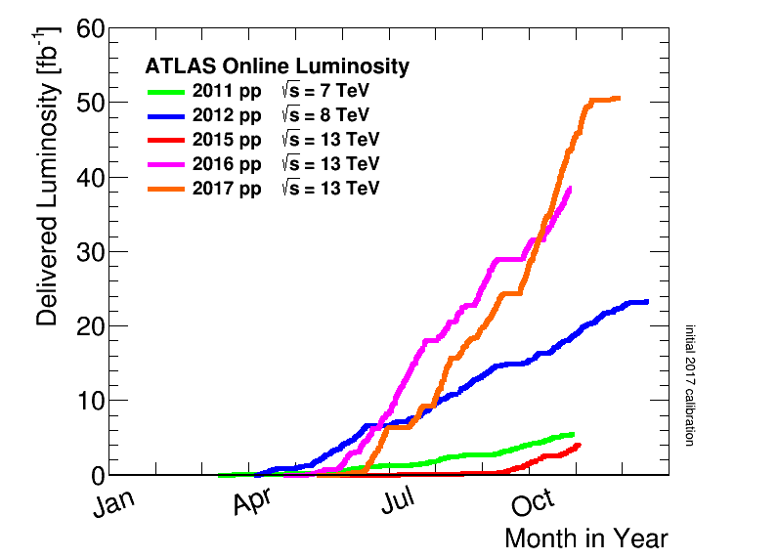
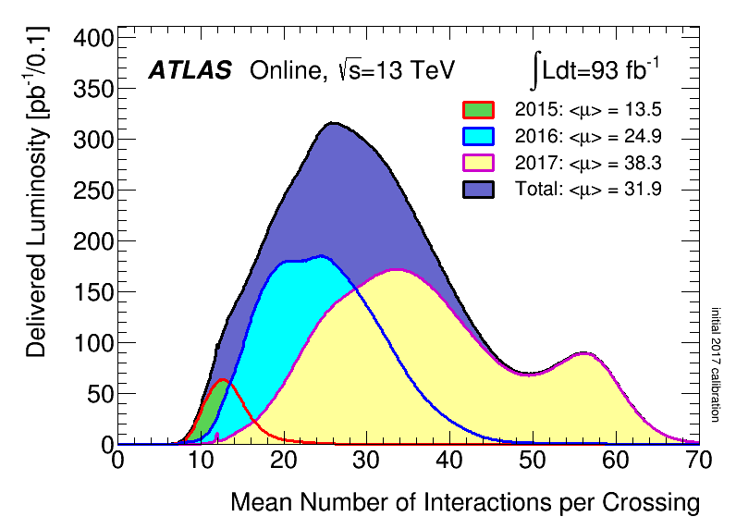
LHC luminosity over the years
ATLAS as a detector is optimised for “high pT” physics – Higgs and BSM searches
In early years of LHC luminosity was not as high, could afford dimuon triggers with low thresholds
Many quarkonium-related measurements made, including some rather unexpected “first observations
In Run 2 many successful low-pT dimuon triggers are heavily prescaled, and muon trigger thresholds creep higher and higher
Need to be more and more creative and inventive to maintain interest in the area of heavy flavour physics

Slide 22
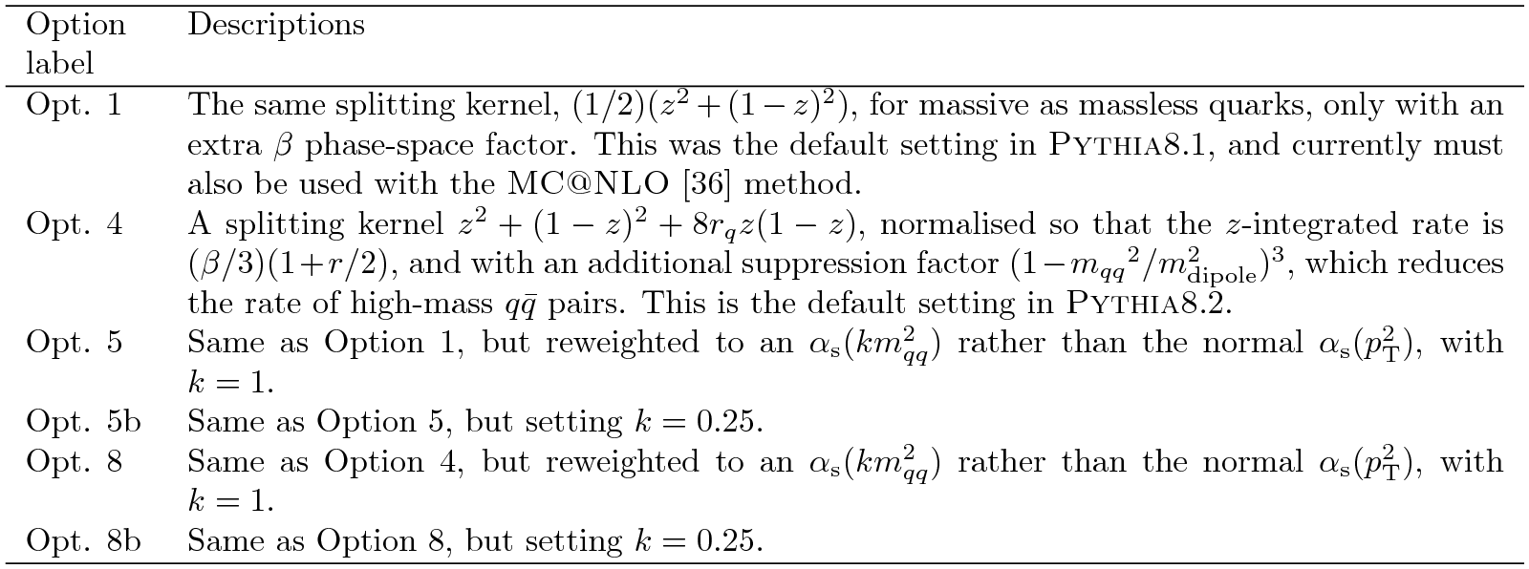
Backup: Table of PYTHIA Options in bb study

Slide 23
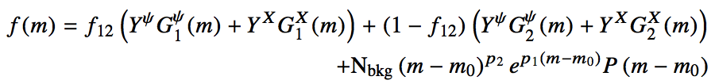
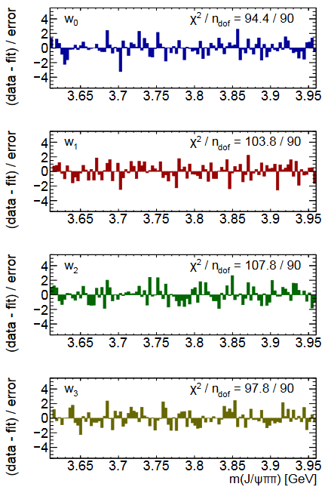

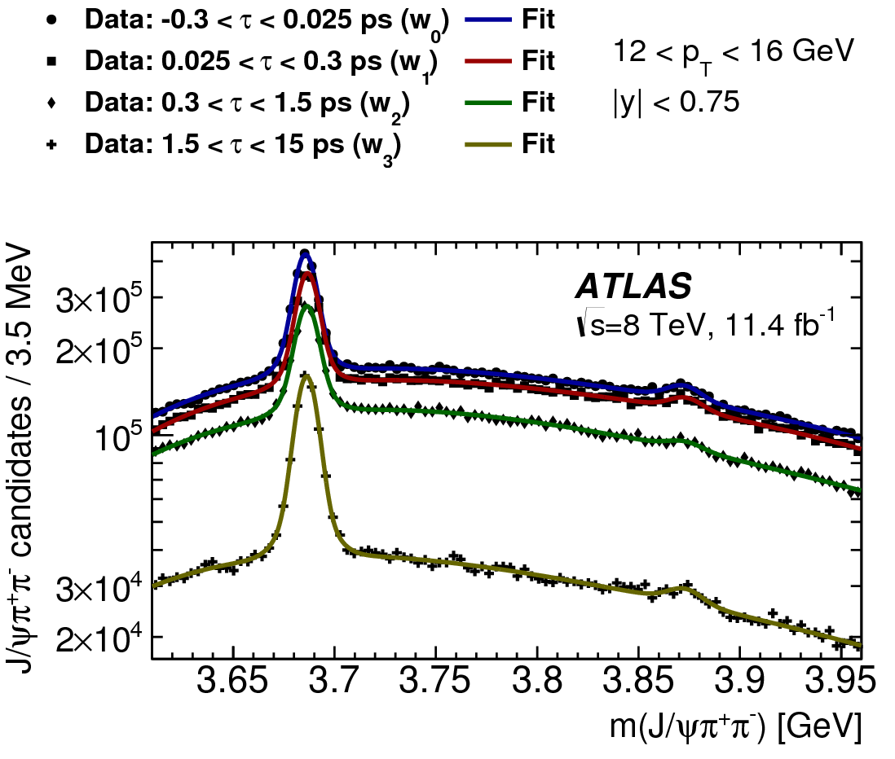
Mass fits in lifetime windows
Mass fits: double-Gaussian signal peaks on a smooth background:
Fraction of narrow Gaussian f₁₂ shared between
ψ(2S) and X(3872)
Resolution parameters linked by
Values of parameters f₁₂ and κ determined from global fits
Verified with MC and varied during systematic studies
p_{T}: 12-16 GeV
Pull distributions

Slide 24
Single lifetime fit - results
Assumption: non-prompt ψ(2S) and X(3872) are produced from the same mix of parent b-hadrons:
- same lifetimes for ψ(2S) and X(3872) in each p_{T} bin
- pT spectra of ψ(2S) and X(3872) linked through kinematics
Effective lifetimes
- for ψ(2S) independent of p_{T}
- for X(3872) possibly slightly shorter in low p_{T} bins
Kinematic template obtained from simulations of various
b-hadron decays into ψ(2S) and X(3872)
- takes into account mass difference and
- possible variation in mass of hadronic association
Non- prompt X(3872) : ψ(2S) ratio
- fit to kinematic template

Slide 25
Two-lifetime fits
Alternative lifetime model: two-lifetime fit
- non-prompt component presented as a sum of short-lived and long-lived
- two single-sided exponentials smeared with the same resolution function
- f_{SL} is a fraction of short-lived within non-prompt – supposedly from B_{c} decays
- statistical power of data does not allow determination of two free lifetimes
- the two lifetimes fixed, the fraction of short-lived contribution left free in the fit
Fixing the two lifetimes
- effective pseudo-proper lifetime depends on
parent’s lifetime and decay kinematics
- τ_{LL} determined from fits to ψ(2S), allowing for some SL contribution
- τ_{SL} obtained from simulation, varying B_{c} decay mode
(low mass association gives shorter effective lifetime)
- both varied within limits shown during systematic studies
Two-lifetime fit results quoted from now on, unless stated otherwise
τ(B±) = 1.638 ± 0.004 ps
τ(B⁰) = 1.525 ± 0.009 ps
τ(B_{s}⁰) = 1.465 ± 0.031 ps
τ(Λ_{b}) = 1.451 ± 0.013 ps
τ_{LL} = 1.45 ± 0.05 ps
τ(B_{c}) 0.507 +/-0.009 ps
τ_{SL} = 0.40 ± 0.05 ps

Slide 26
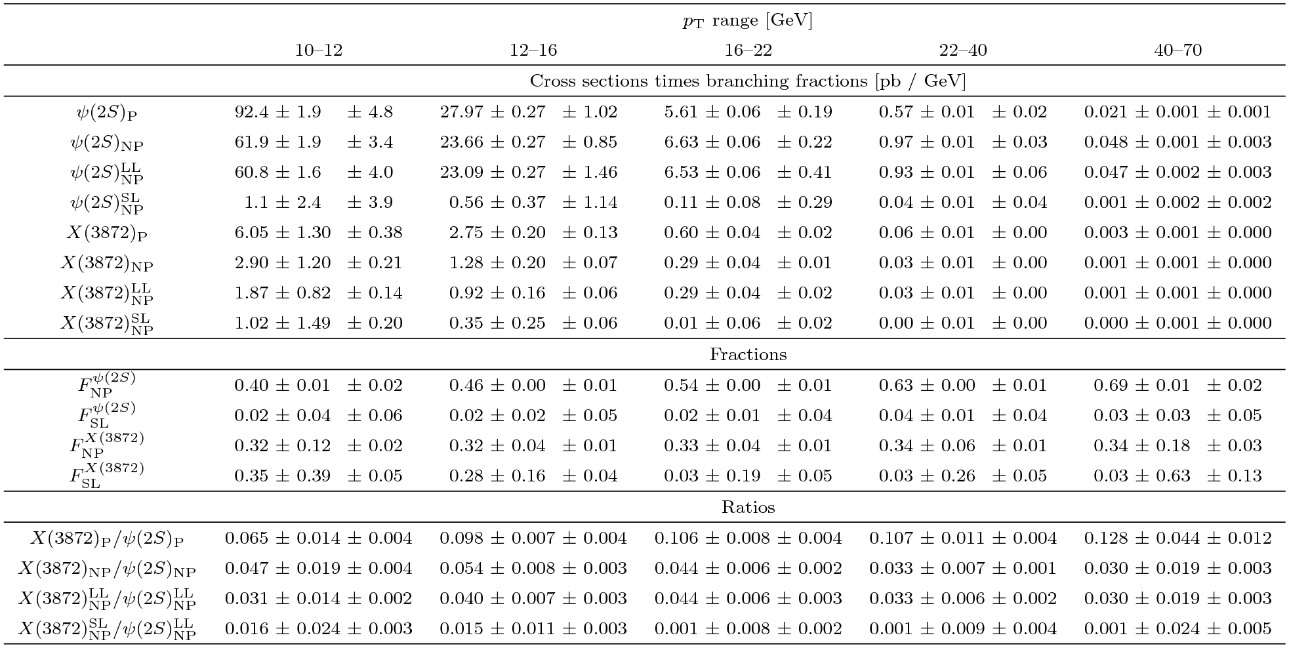
Backup: Table of results for ψ(2S) and X(3872)

Slide 27
τ_{eff} = L_{xy} m(μμ)
p_{T}(μμ)

