Slide 1
LHCb: From the detector to the first physics results
Detector description
  Some performance figures
Event selection
  Hardware and software triggers
  Data processing
Some recent physics results

Slide 2
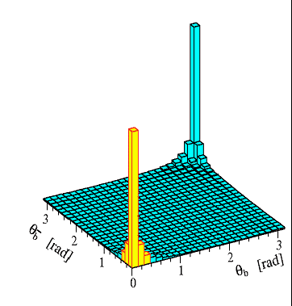
The detector
B and D physics at the LHC are forward/backward
  The interacting partons have different x
  The produced pair are boosted forward or backward, together
    The detector can look only at one side, and get both b, very useful as we have both the signal b and the tagging b in the acceptance
Single arm spectrometer
  Very good vertex detector
  Dipole magnet for accurate
  momentum measurement
  Good particle ID over a large
  momentum range
  Should fit in an existing LEP cavern...

Slide 3
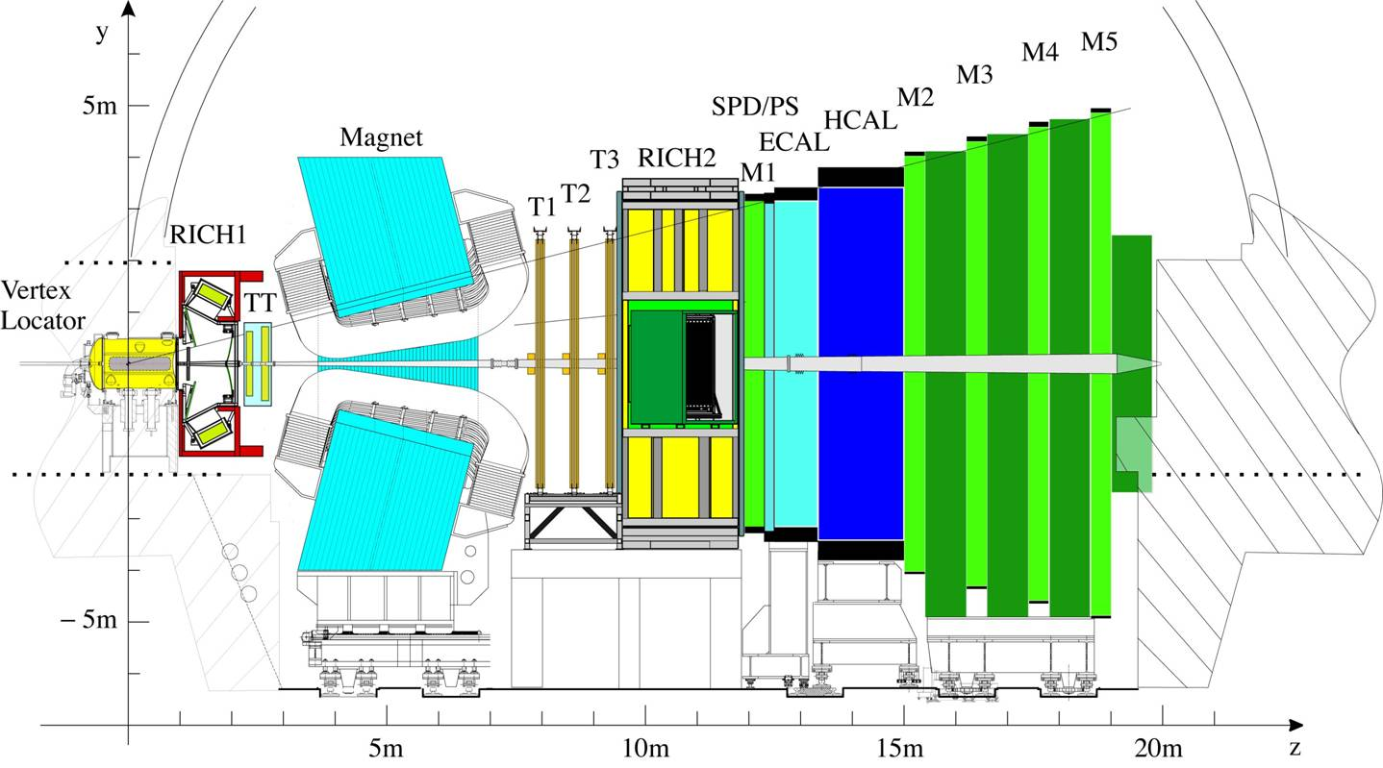
Tracking system
Particle identification
B

Slide 4
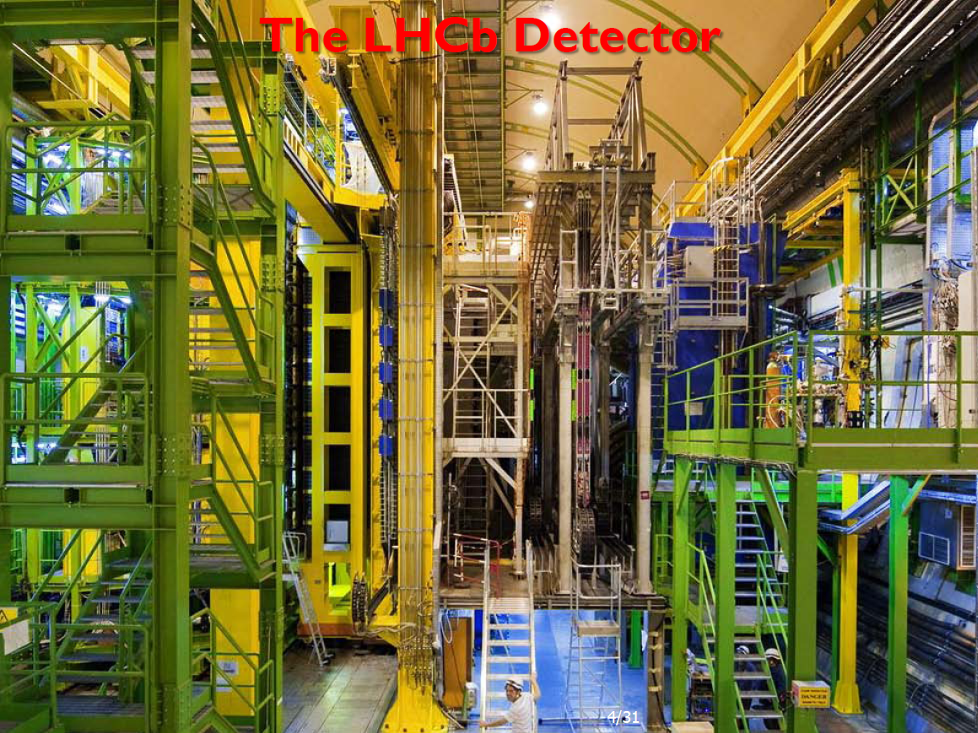

Slide 5
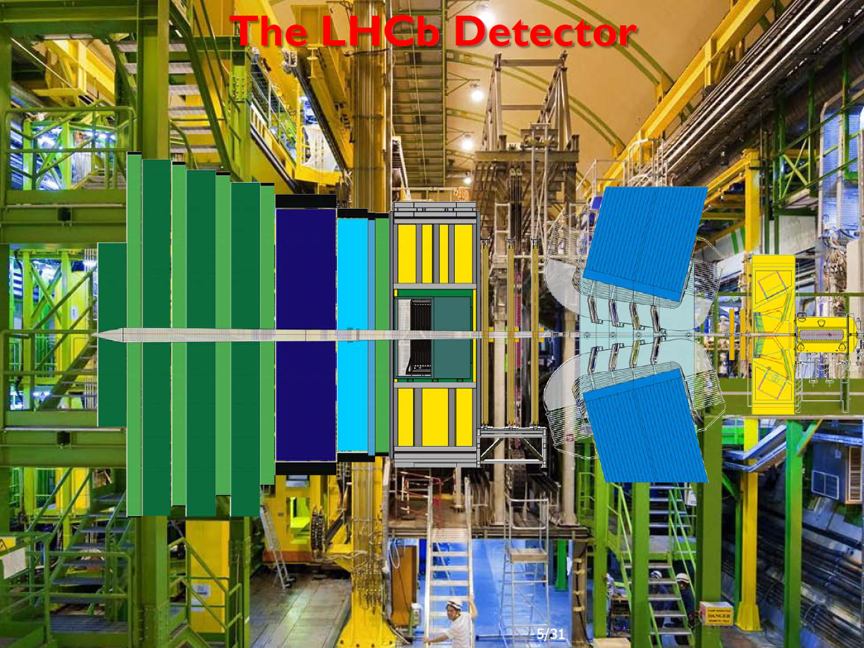

Slide 6
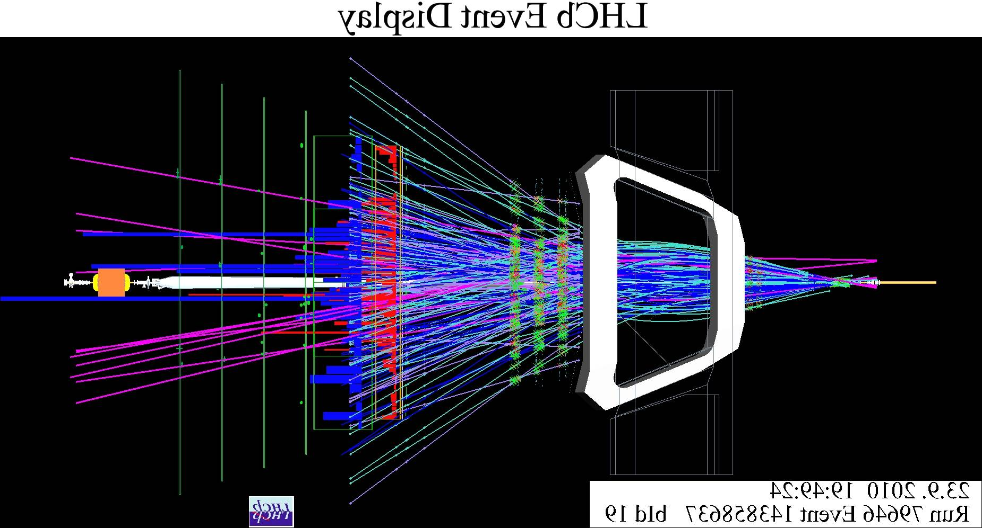
A typical event...

Slide 7
Main components
Vertex detector
  Should measure the primary vertex, and the B decay vertex
    Flight distance of the order of a few centimetres
    Primary vertex with typically 40 particles
      Including backward going tracks
  Measurements as close as possible to the interaction point,
    i.e. of the beams ! Sensor at 7.5 mm in operation
    Retracts to a ‘garage’ position if LHC is not in “Stable beam” mode, to give more space for beam injection and tolerate beam excursions before it is fully stable
  Very accurate silicon detector
    Strip pitch from 40 to 100 micrometers
    Need to position back the detector mechanically for each fill with a precision of a few micrometers !
    Minimize the multiple scattering between the real vertex and the measuring sensors

Slide 8
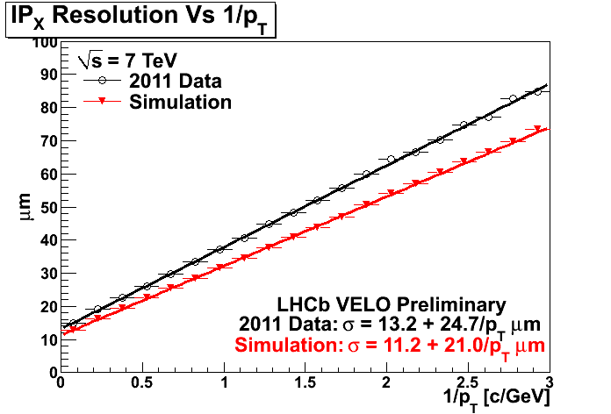
  Impact parameter resolution summarizes the performance
B daughters

Slide 9
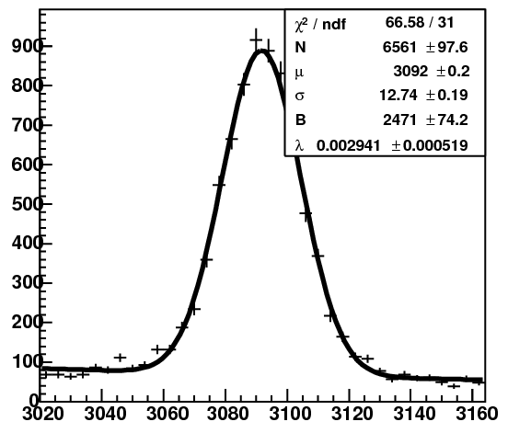
Trackers
  Silicon strip detectors (TT, IT) or straw tubes (OT)
  Over 99% of the channels are working perfectly
  Main function: Measure the momentum
    Accurate field map, measured when no detector was around
    Integrated B.dl ≈ 4 Tm
    Re-measured this winter on one accessible zone (~600 points), confirm the values for the field, with a shift of 10 mm along the beam
  Performance is measured
  on the J/Ψ mass resolution
  13 MeV resolution,
    MC expectation: ~10 MeV
  Alignment is not yet perfect
    Somme effects still to be
    understood

Slide 10
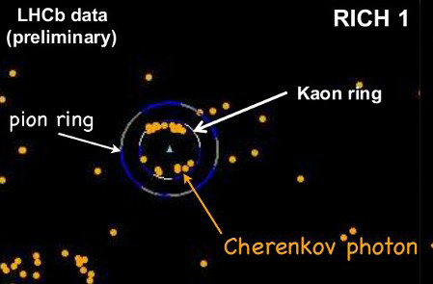
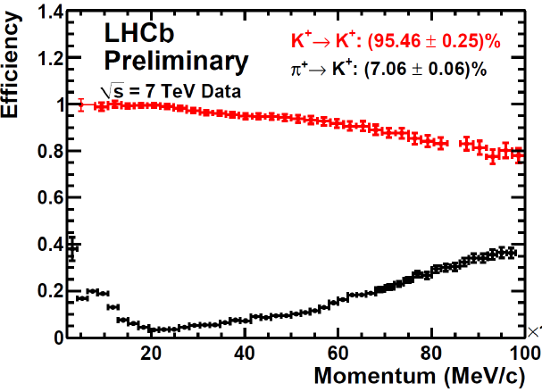
Particle identification with the RICH
  About 500 HPD devices, 32x32 cells each.
    ½ million cells!
  A charged particle produces Cerenkov photons, that are located on a ring centred around the track’s position
  2 detectors, the first one with 2 radiators
    Gives π/K separation
    for a large momentum
    range
  Careful alignment required
    The HPD are sensitive to magnetic field
    Variation of the gas refractive index with temperature...

Slide 11
Calorimeter to identify electrons, photons, π⁰
  ~6000 cells in the electromagnetic calorimeter
  SPD to distinguish charged/neutral, PreShower to identify early showers, i.e. electromagnetic
    Resolution conform to expectation
Hadronic calorimeter
  ~1500 cells, mainly for the hardware trigger
5 stations of muon detector
  ~1300 MWPC + a few GEM chambers
  Over 99% efficient
    Gaps in OR to be insensitive to local problems.
  Muon identification, and hardware trigger
    Cells are projective in the 5 stations
    Almost aligned hits, non-pointing gives the deflection by the magnetic field, i.e. an estimate of the momentum

Slide 12
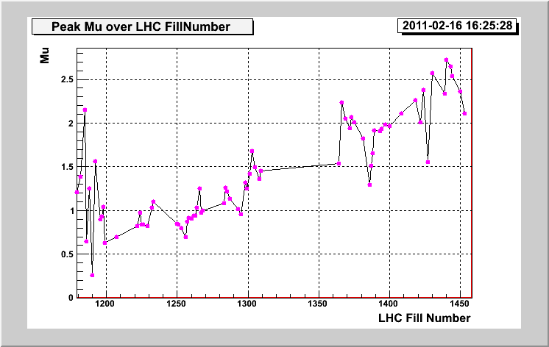
Event selection
LHCb runs at a limited luminosity
  Originally, a single interaction per beam crossing was required
    Easier to associate primary vertex and B decay
    Average number of interaction per crossing μ = 0.4
  But LHC has now a smaller than designed number of bunches
    Same luminosity with less bunches = more interaction per crossing
  We worked in 2010 with up to 2.5 interactions per crossing

Slide 13
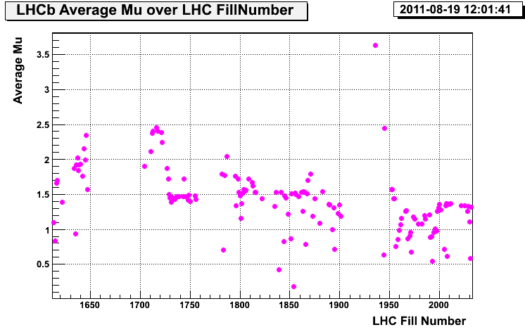
  In 2011 the LHC has more bunches, with 50 ns bunch separation.
    One detector (OT) sees the signals from previous and next crossings
    We had to reduce the number of interactions per crossings
  Our running conditions is now μ ≤ 1.5
    This means at a luminosity of 3.5 10³² cm⁻²s⁻¹
    This is 1.5 times the design value, with half the number of bunches!
    We designed LHCb for μ ~ 0.4 !
  But we run now at
  constant luminosity
Design value

Slide 14
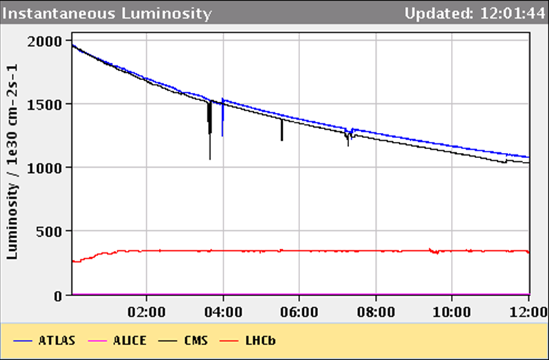
Luminosity levelling
  Separate the beams in the vertical plane to decrease the overlap, and thus the rate of collisions (luminosity)
  Start with a very modest, and increase slowly (~30 minutes) to avoid detector trips
  All data taken in the same pile-up conditions!
ATLAS
CMS
LHCb
(design)

Slide 15
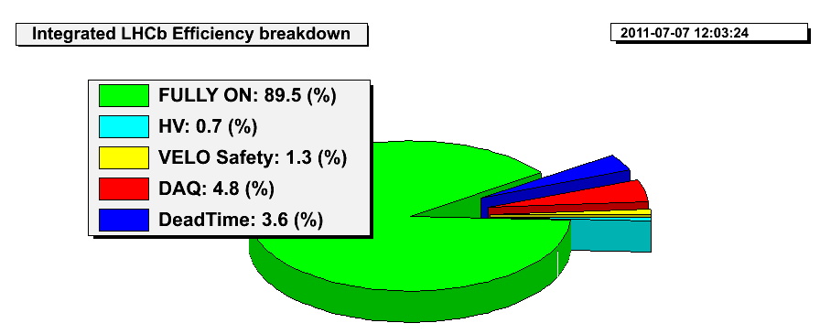
Overall efficiency OK
Monitor of the operational losses
  We should also apply the trigger and selection efficiencies, but this is channel dependent and is part of the selection efficiency.

Slide 16
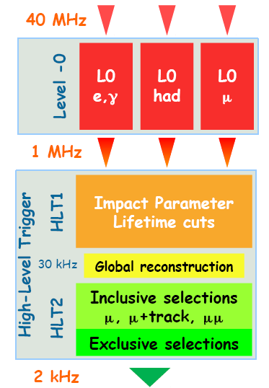
Event selection in several steps
  Interaction rate about ~10 MHz
    40 MHz clock, only ~1/3 with beams
  Hardware trigger (L0) at about 800 kHz
    Events with a muon over ~1 GeV Pt
    Or with a local Hadronic transverse energy over 3.6 GeV
    Also triggers on e, γ, π° with similar thresholds
    In principle 1 MHz rate is feasible, but the high occupancy gives high dead time now
      Work in progress to gain 10-15%
  Software trigger in a ~1350 CPU farm
    ~20000 copies of the code are running in parallel
      25 ms per event in average
    ~3 kHz output rate
3 kHz

Slide 17
HLT1: topology
  Idea: Find a track with high impact parameter to the Primary Vertex and high enough momentum
    100 micrometers
    1 GeV Pt
  For that, reconstruct all Velo tracks, select those with impact parameter, measure their momentum by the full tracking
    As a B decay has several tracks fulfilling these requirements, no need to be 100% efficient per track
  For muon triggers, this track should be validated as muon
HLT2: Selection by physics channel
  Full event reconstruction, but no particle ID.
  Topological trigger to find a displaced vertex with high enough mass
  Many specific channels for dedicated studies
    J/Ψ, Ф, D→Kπ, ...

Slide 18
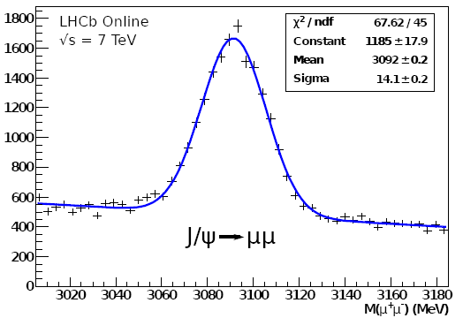
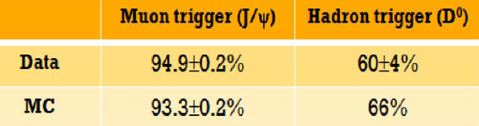
Online monitoring of physics candidates
  Mass plots
  Efficiency as expected
    2010 low lumi settings
We have also several technical triggers
  Luminosity: random sampling of crossings
    Luminosity by counting the fraction of empty crossings = e^{-μ} where μ is the average number of interaction per event (Poisson)
  Sampling of unbiased events at various levels

Slide 19
Offline selection: The stripping
  Data is reconstructed fully, and a series of preliminary analyses is run, to select events per (group of) physics channels.
    Should reduce the rate of <10Hz per channel
      Should get a manageable set of < 100,000,000 events per year!
    Several output streams corresponding to the various physics groups
  Run in semi-online mode
    Data quality validation using an ‘Express stream’
      Result available within a few hours
    Reconstruction takes about 1 second per event
      A file is about 80k events → One day of CPU
    We write a raw data file every 25 seconds at 3 kHz...
      A few thousand files per day = a few thousand jobs continuously !
  The various output streams are merged to get files of reasonable size.
    All is ready in principle 2-3 days after data taking.

Slide 20
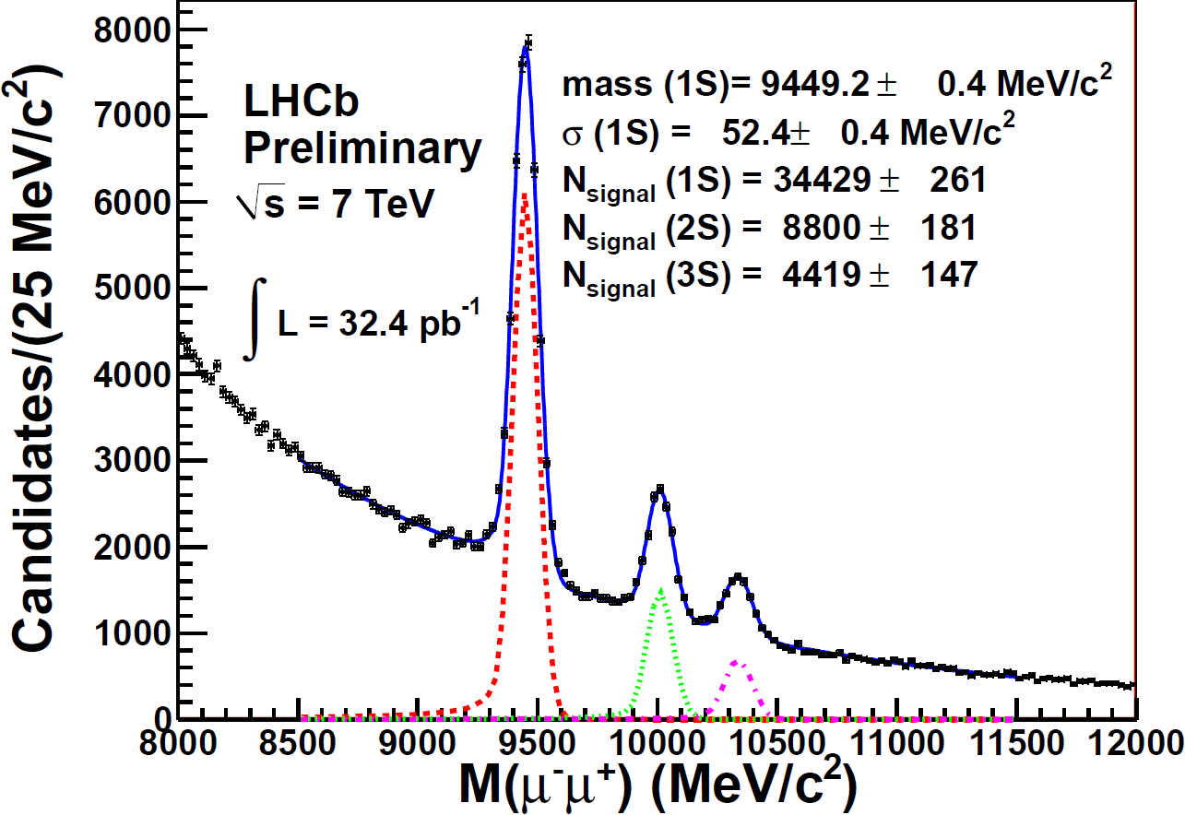
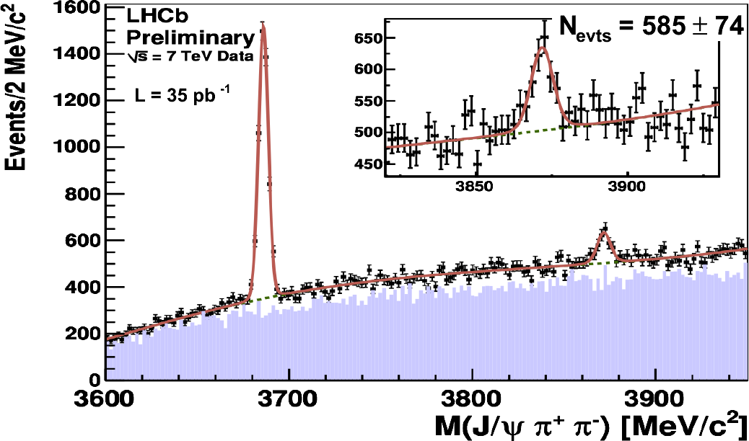
Some physics results
Spectroscopy
  Find known resonances in various channels
    And look for less clear ones...
      Mass resolution and good PID are key components
    See poster on quarkonium production
X(3872)
Upsilon region
M_{X(3872)} = [3871.96 ± 0.46(stat) ± 0.10(sys)] MeV/c²

Slide 21
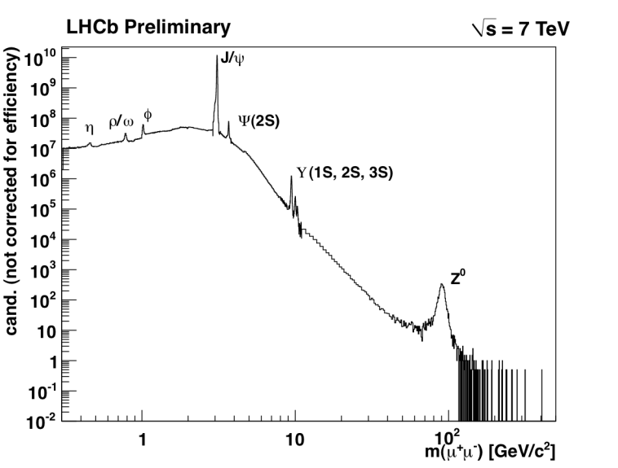
Dimuon mass spectrum (log scales)
1960’s
1980,90’s
1970’s
?
2011

Slide 22
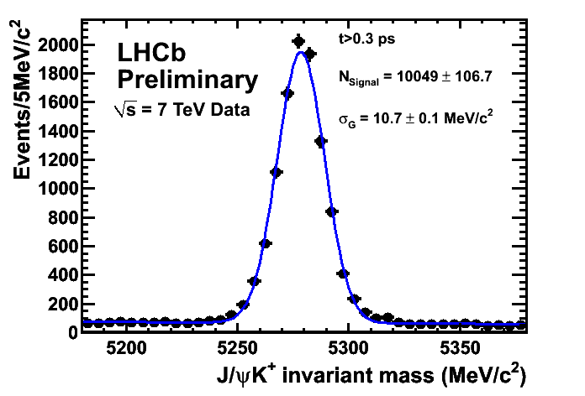
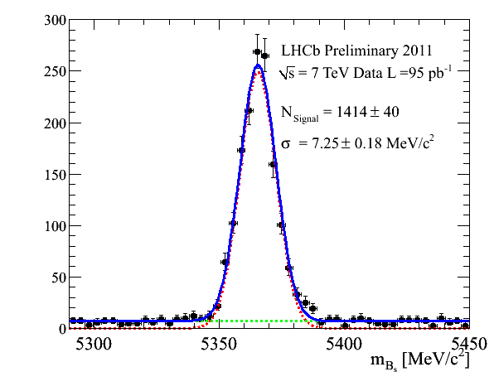
Mass measurements
PDG
[MeV/c²]
LHCb-CONF-2011-027: masses [MeV/c²]
5279.17 ± 0.29
5279.50 ± 0.30
5279.50 ± 0.30
5366.30 ± 0.60
5620.2 ± 1.6
6277 ± 6
World-best mass measurements!

Slide 23
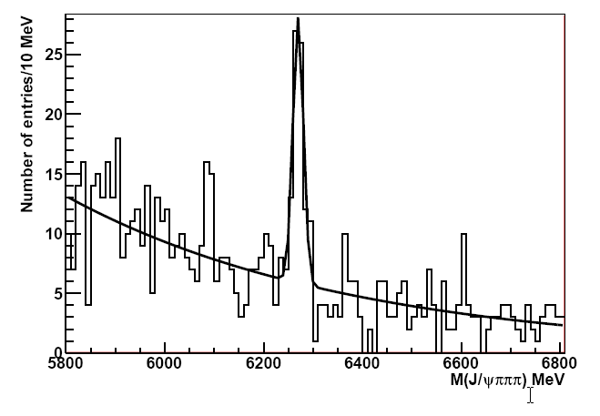
New decay modes
  First observation of
  Branching fraction ratio
    BR( )/BR( ) = 3.0 ± 0.6 ± 0.4
LHCb preliminary

Slide 24
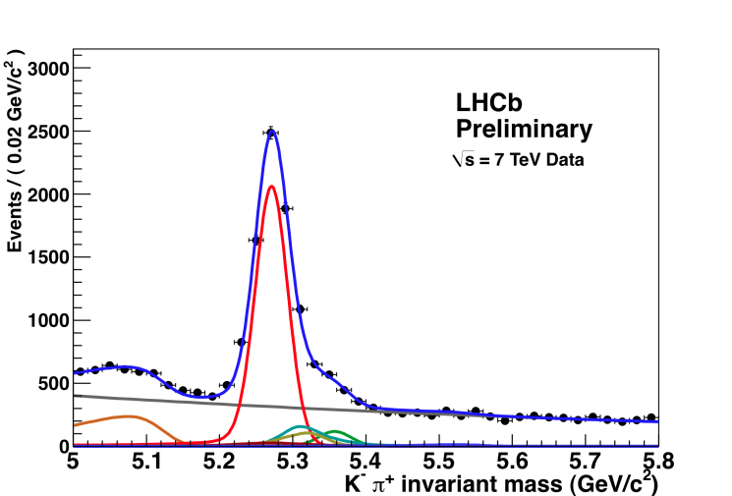
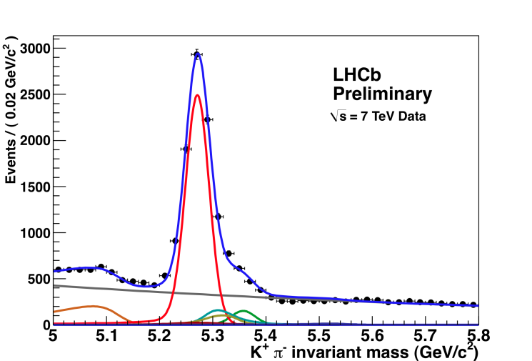
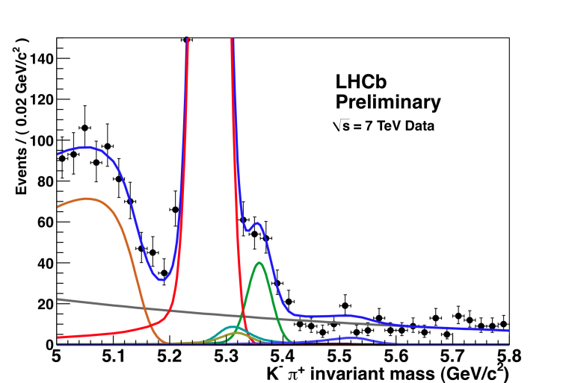
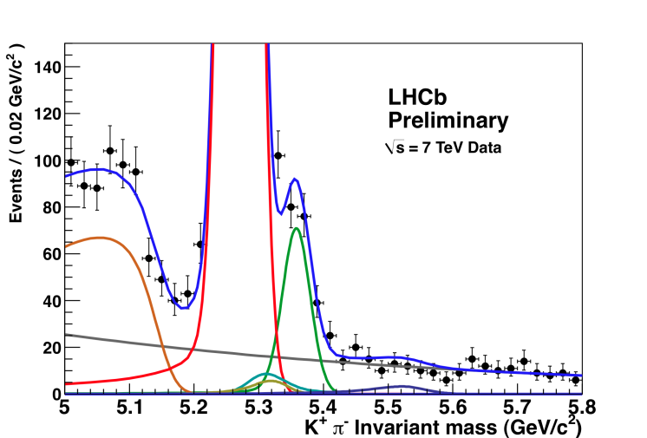
CP asymmetries
Raw asymmetries are clear: particle/antiparticle
Selection optimized
for A_{CP}(B⁰→Kπ)
Asymmetry = -0.095 ± 0.011
B⁰
Selection optimized
for A_{CP}(B_{S}⁰→πK)
Asymmetry = 0.28 ± 0.08
B⁰_{S}

Slide 25
Extract physical asymmetries
  Use control channels to measure the detector asymmetries
    and untagged
  Production asymmetries measured by
Results
  A_{CP}(B⁰→K⁺π⁻) = -0.088 ± 0.011 (stat) ± 0.008 (syst)
    First 5σ measurement of CP violation in the B system in hadron collider
  A_{CP}(B_{S}⁰ →π⁺K⁻) = 0.27 ± 0.08 (stat) ± 0.02 (syst) (preliminary)
    First evidence of CP violation in B_{S}→πK

Slide 26
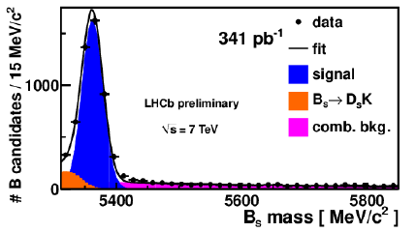
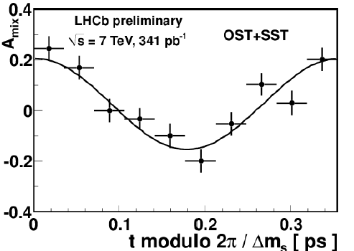
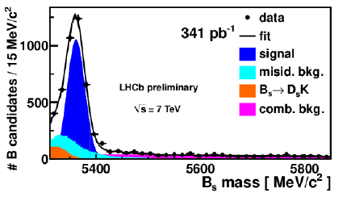
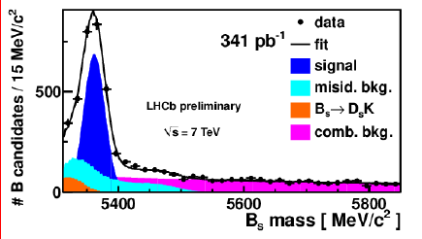
Measurement of ∆m_{s}
∆m_{s} – mixing frequency in B_{s} using with 3 different D decay modes
Mixing amplitude
Δ𝑚_{𝑠}=17.725 ± 0.041𝑠𝑡𝑎𝑡 ± 0.025 𝑠𝑦𝑠𝑡 𝑝𝑠⁻¹

Slide 27
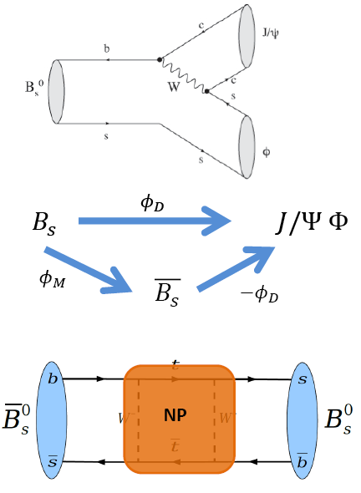
φ_{S} measurement in B_{S} mixing
  Bs->J/Ψφ is dominated by tree diagram. (penguin contribution is in order of 10⁻³-10⁻⁴)
  Interference between direct & mixing decays gives a CP violating phase φ_{S}=φ_{M}-2φ_{D}.
  φ_{S} in SM is small and well predicted: φ_{S}=0.0363±0.017 rad
  Good sensitivity for New Physics: φ_{S}=φ_{S}SM+φ_{S}^{NP}

Slide 28
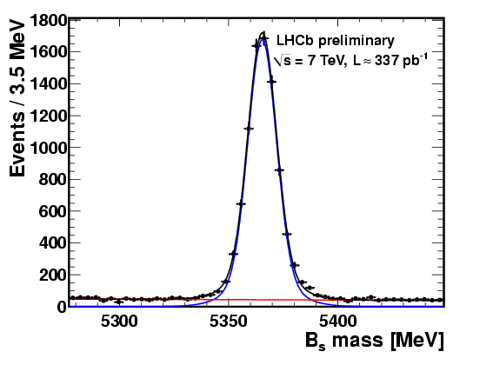
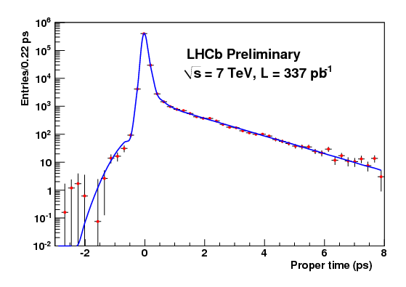
B_{S}gJ/Ψφ signal
Preliminary result with 337 pb⁻¹ data up to end of June 2011 approved by the collaboration last week
8276 ± 94 signal candidates
Effective time resolution 50 fs

Slide 29
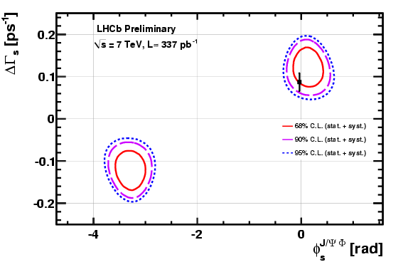
World best result
𝜙𝑠 = 0.13 ± 0.18 𝑠𝑡𝑎𝑡 ± 0.07 𝑠𝑦𝑠 rad
ΔΓ𝑠 = 0.123 ± 0.029 𝑠𝑡𝑎𝑡 ± 0.008 𝑠𝑦𝑠 𝑝𝑠⁻¹
Γ𝑠 = 0.656 ± 0.009 𝑠𝑡𝑎𝑡 ± 0.008 𝑠𝑦𝑠 𝑝𝑠⁻¹

Slide 30
Rare decays: B_{s} → µµ
Ultra rare decays
  FCNC and helicity suppressed
SM predicts (via box and penguin diagrams):
BR(B_{s} → µµ) = (3.2 ± 0.2) · 10 ⁻⁹
With ~300 pb-1 of LHCb data we expect
~3.2 B_{s} → µµ events from Standard Model
CDF reported the observation:
BR(B_{s} → µµ) = (1.8 ^{+1.1}_{-0.9}) · 10 ⁻⁸ arxiv: 1107.2304
LHCb presents preliminary result with 300 pb⁻¹
LHCb-CONF-2011-037:
BR(B_{s}⁰ → µµ) < 1.3 (1.6) · 10 ⁻⁸ at 90%(95%)C.L.
Combining with preliminary result with 37 pb⁻¹
PLB 699(2011) 330
BR(B_{s}⁰ → µµ) < 1.2 (1.5) · 10 ⁻⁸ at 90%(95%)C.L.
Combining with CMS observation
LHCb-CONF-2011-047:
BR(B_{s}⁰ → µµ) < 0.9 (1.1) · 10 ⁻⁸ at 90%(95%)C.L.
Excess seen by CDF is not confirmed

Slide 31
Conclusion
LHCb is working as expected
  The detector performs (almost) as in the simulation
  Higher instantaneous luminosity
    1.5 times the design values, with half the number of bunches
World class measurements already obtained
  With 2010 data (37 pb⁻¹) and the spring 2011 (300 pb⁻¹) data
    Already very competitive with B-factories and Tevatron
  Another 350 pb⁻¹ already collected in 2011
    Hope to reach 1000 pb⁻¹ this year
Hope to see the sign of New Physics soon!

