Slide 1
Sharp Waiting-Time Bounds for Multiserver Jobs
Weina Wang
Carnegie Mellon University
Stochastic Networks Conference 2022

Slide 2



Joint work with
Yige Hong
Carnegie Mellon University
Qiaomin Xie
University of Wisconsin–Madison
Mor Harchol-Balter
Carnegie Mellon University
[1] Y. Hong, and W. Wang, “Sharp waiting-time bounds for multiserver jobs.” arXiv 2021
[2] W. Wang, Q. Xie, and M. Harchol-Balter, “Zero queueing for multi-server jobs.” SIGMETRICS 2021

Slide 3

What is a multiserver job?
👩🏻
requires 4 servers to run
👧🏻
“server need = 4”
😼
single-server job
👨🏻
multi-server job
servers

Slide 4




Why multiserver jobs?
Modern cloud clusters run workloads as containers (lightweight Virtual Machines)
container requires certain resources to run
→ multiserver job

Slide 5
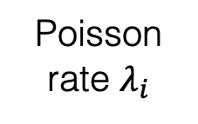
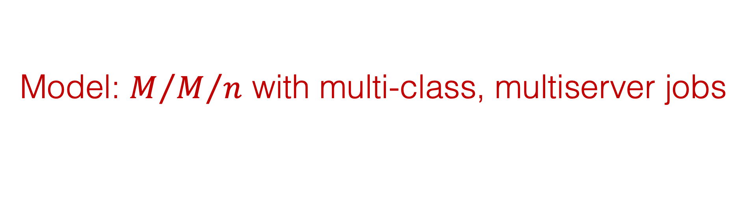
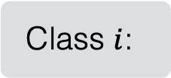



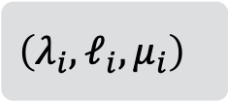
Model: $M/{M/n}$ with multi-class, multiserver jobs
hold for Exp($μ_{i}$) time
Class $i$:
$$\left(λ_{i}, ℓ_{i}, μ_{i}\right)$$
$n$ servers
prioritize smaller or larger server needs?
❓
e.g., FCFS
K jobs classes
Servers idle when next job does not fit
Poisson rate $λ_{i}$
server need: $ℓ_{i}$

Slide 6

Model: $M/{M/n}$ with multi-class, multiserver jobs
Class $i$:
$$\left(λ_{i}, ℓ_{i}, μ_{i}\right)$$
$n$ servers
❓
e.g., best-fit
K jobs classes
Poisson rate $λ_{i}$
server need: $ℓ_{i}$
service time ~ Exp($μ_{i}$)

Slide 7
Model: $M/{M/n}$ with multi-class, multiserver jobs
Class $i$:
$$\left(λ_{i}, ℓ_{i}, μ_{i}\right)$$
$n$ servers
❓
e.g., prioritize smaller server needs
K jobs classes
Poisson rate $λ_{i}$
server need: $ℓ_{i}$
service time ~ Exp($μ_{i}$)

Slide 8
Mean queueing/waiting times
How should we understand these different behaviors?

Slide 9
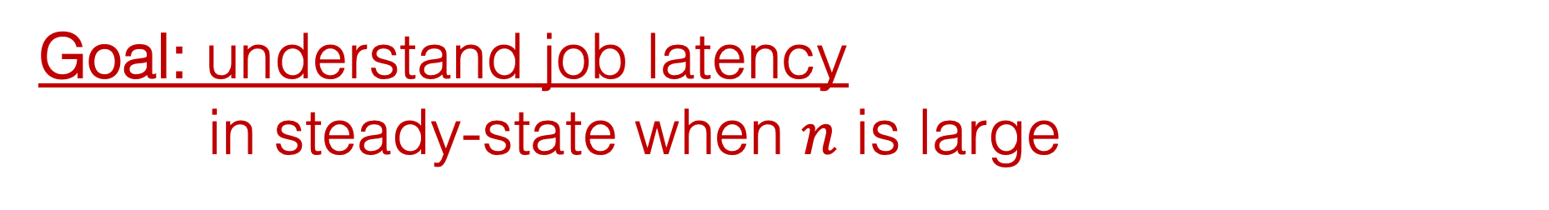

Goal: understand job latency in steady-state when $n$ is large
Which scheduling policy minimizes queueing time?
What is the queueing probability?
What is the queueing/waiting time?
❓
$n$ servers

Slide 10
Related work
Exact solutions are unknown
  Only known for two-server systems [Brill, Green 1984], [Filippopoulos, Karatza 2007]
Stability of FCFS is hard
  All classes have the same service rate [Rumyantsev, Morozov 2017], [Afanaseva, Bashtova, Grishunina 2019]
  Two-class system [Grosof, Harchol-Balter, Scheller-Wolf 2020]
Bounds in exponential/divisible setting
  [Grosof, Harchol-Balter, Scheller-Wolf 2021]
Finite-time horizon cost minimization
  [Zychlinski, Chan, Dong 2022]

Slide 11
Related work (cont’d): related models
Dropping model
  [Arthurs, Kaufman 1979], [Hunt, Kurtz 1993], [Bean, Gibbens, Zachary 1995], [Dasylva, Srikant 1999]…
VM (Virtual Machine) scheduling
  [Maguluri, Srikant, Ying 2012, 2014], [Xie, Dong, Lu, Srikant 2015], [Psychas, Ghaderi 2017, 2019], …
Multi-task jobs/batch jobs
  [Wang, Harchol-Balter, Jiang, Scheller-Wolf, Srikant 2018], [Daw, Pender 2019], [Daw, Fralix, Pender 2020], [Hampshire, Bao, Lasecki, Daw, Pender 2020], [Zubeldia 2020], [Weng, Wang 2021], …
Summary: limited understanding of latency of
multiserver jobs in large systems

Slide 12







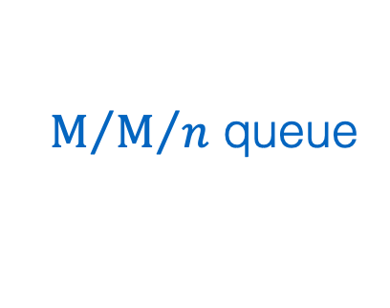






$n$ is large
High utilization and low latency at the same time!
queue. time
$$>0$$
$$→0$$
$$→0$$
$$→0$$
queue. prob.
$$→1$$
$$→1$$
$$∈\left(0, 1\right)$$
$$→0$$
slack capacity: $𝔼\left[\#idle servers\right]$
$$Θ\left(1\right)$$
$$Θ\left(\sqrt{n}\right)$$
$$ω\left(\sqrt{n}\right)$$
NDS
Halfin-Whitt
[Atar 2012], …
[Halfin and Whitt 1981], …
$n$ servers
$M/{M/n}$ queue

Slide 13


$n$ is large, server-needs are also large
queue. time
$$>0$$
$$→0$$
$$→0$$
$$→0$$
❓
queue. prob.
$$→1$$
$$→1$$
$$∈\left(0, 1\right)$$
$$→0$$
slack capacity: $𝔼\left[\#idle servers\right]$
$$Θ\left(1\right)$$
$$Θ\left(\sqrt{n}\right)$$
$$ω\left(\sqrt{n}\right)$$
$n/2$ servers
NDS
Halfin-Whitt
[Atar 2012], …
[Halfin and Whitt 1981], …
$n$ servers
$n/2$ servers
$M/{M/n}$ queue
$M/{M/2}$ queue

Slide 14
Server needs grow as datacenters grow
Google Borg trace 2019
[Tirmazi et al. 2020], [Wilkes 2019]
(server need)
Figure taken from [Grosof, Harchol-Balter, Scheller-Wolf 2020]

Slide 15
$n$ is large, server-needs are also large
queue. time
$$>0$$
$$→0$$
$$→0$$
$$→0$$
❓
queue. prob.
New: jointly scaling load and server needs
$$→1$$
$$→1$$
$$∈\left(0, 1\right)$$
$$→0$$
slack capacity: $𝔼\left[\#idle servers\right]$
$$Θ\left(1\right)$$
$$Θ\left(\sqrt{n}\right)$$
$$ω\left(\sqrt{n}\right)$$
NDS
Halfin-Whitt
[Atar 2012], …
[Halfin and Whitt 1981], …

Slide 16

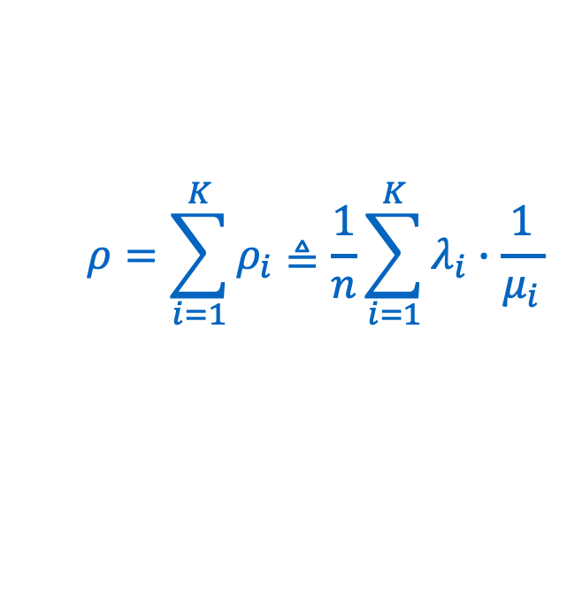
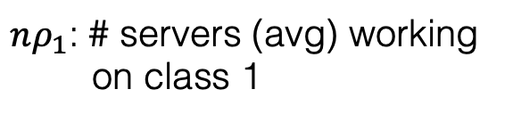

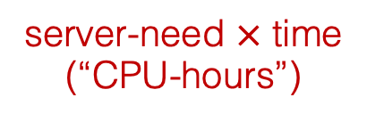
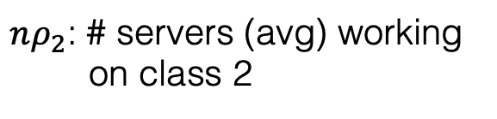
Load and slack capacity
$$ρ=\sum_{i=1}^{K}{ρ_{i}}≜\frac{1}{n}\sum_{i=1}^{K}{λ_{i}∙\frac{ 1 }{μ_{i}}}$$
$$ℓ_{i}$$
server-need $×$ time
(“CPU-hours”)
(single-server jobs)
$nρ_{1}$: # servers (avg) working
on class 1
Class $i$:
$$\left(λ_{i}, ℓ_{i}, μ_{i}\right)$$
$nρ_{2}$: # servers (avg) working
on class 2
K jobs classes
…
Poisson rate $λ_{i}$
$δ=n\left(1−ρ\right)$: slack capacity
server need: $ℓ_{i}$
service time ~ Exp($μ_{i}$)
$n$ servers

Slide 17
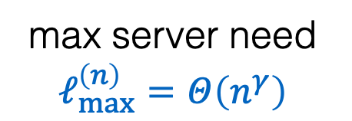

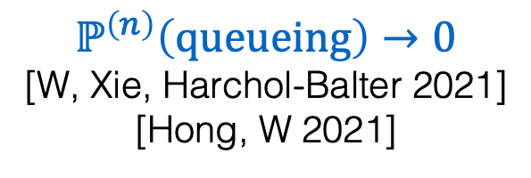
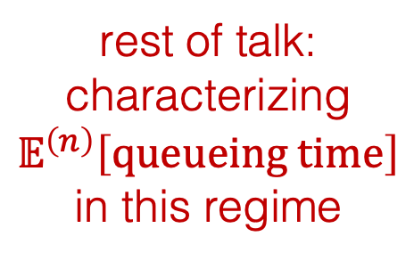



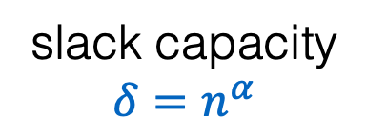
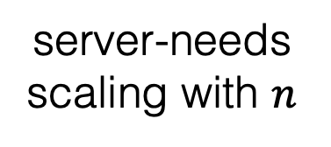
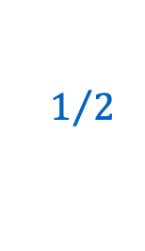
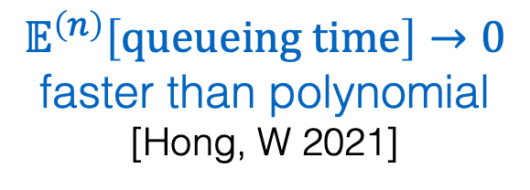
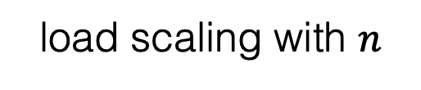

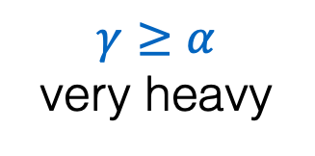
Results (simplified)
max server need $ℓ_{max}^{\left(n\right)}=Θ\left(n^{γ}\right)$
$$γ$$
Under “work-conserving” policies:
analogy for NDS
analogy for HW
$$1$$
$$ℙ^{\left(n\right)}\left(queueing\right)→0$$
[W, Xie, Harchol-Balter 2021]
[Hong, W 2021]
rest of talk:
characterizing $𝔼^{\left(n\right)}\left[queueing time\right]$ in this regime
$$γ≥α$$
very heavy
$$𝔼^{\left(n\right)}\left[queueing time\right]→0$$
faster than polynomial
[Hong, W 2021]
server-needs scaling with $n$
$$α$$
$$0$$
$$1/2$$
$$1$$
load scaling with $n$
slack capacity $δ=n^{α}$

Slide 18
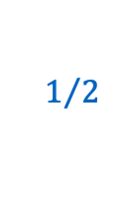


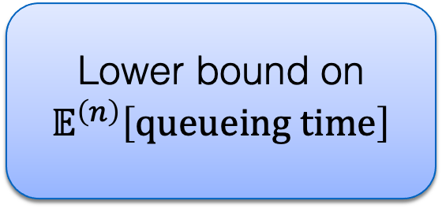

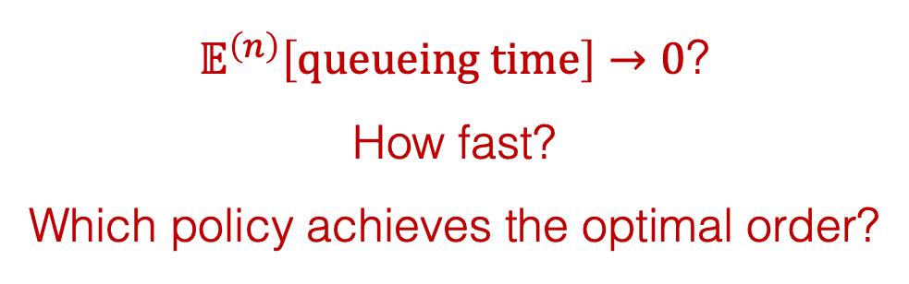




Results (simplified) cont’d
$𝔼^{\left(n\right)}\left[queueing time\right]→0$?
How fast?
Which policy achieves the optimal order?
$$γ$$
max server need $ℓ_{max}^{\left(n\right)}=Θ\left(n^{γ}\right)$
$$1$$
slack capacity $δ=n^{α}$
$$α$$
$$0$$
$$1/2$$
$$1$$
FCFS
Lower bound on $𝔼^{\left(n\right)}\left[queueing time\right]$
Optimal policy:
P-Priority

Slide 19

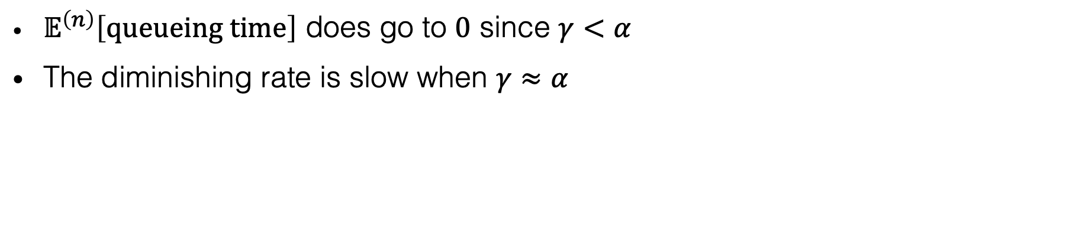





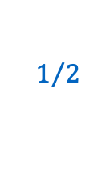
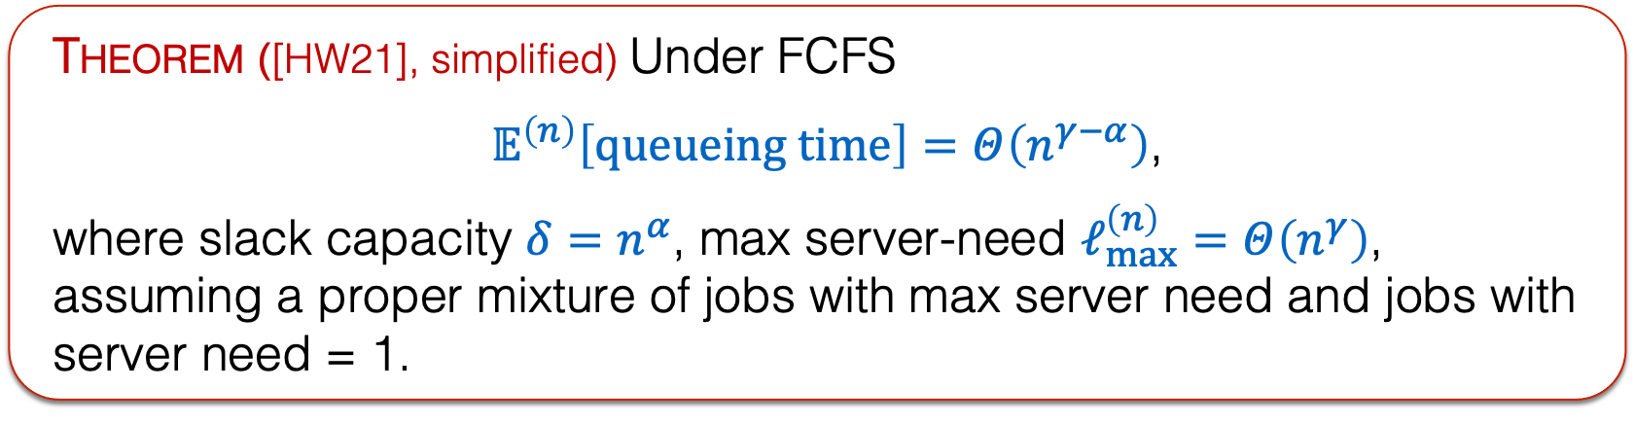

FCFS
Theorem ([HW21], simplified) Under FCFS
$𝔼^{\left(n\right)}\left[queueing time\right]=Θ\left(n^{γ−α}\right)$,
where slack capacity $δ=n^{α}$, max server-need $ℓ_{max}^{\left(n\right)}=Θ\left(n^{γ}\right)$, assuming a proper mixture of jobs with max server need and jobs with server need = 1.
$$γ$$
max server need $ℓ_{max}^{\left(n\right)}=Θ\left(n^{γ}\right)$
$𝔼^{\left(n\right)}\left[queueing time\right]$ does go to $0$ since $γ<α$
The diminishing rate is slow when $γ≈α$
$$1$$
slack capacity $δ=n^{α}$
$$α$$
$$0$$
$$1/2$$
$$1$$

Slide 20
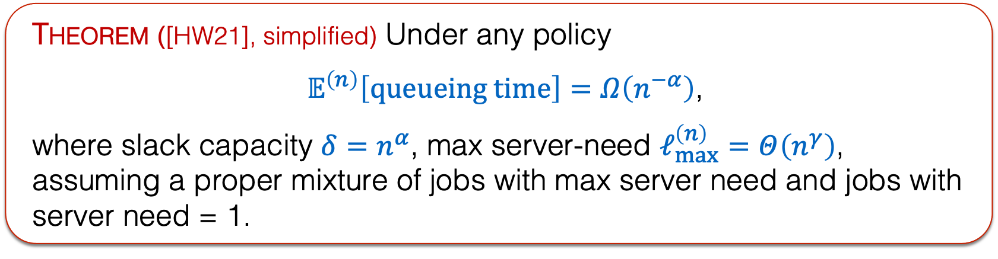
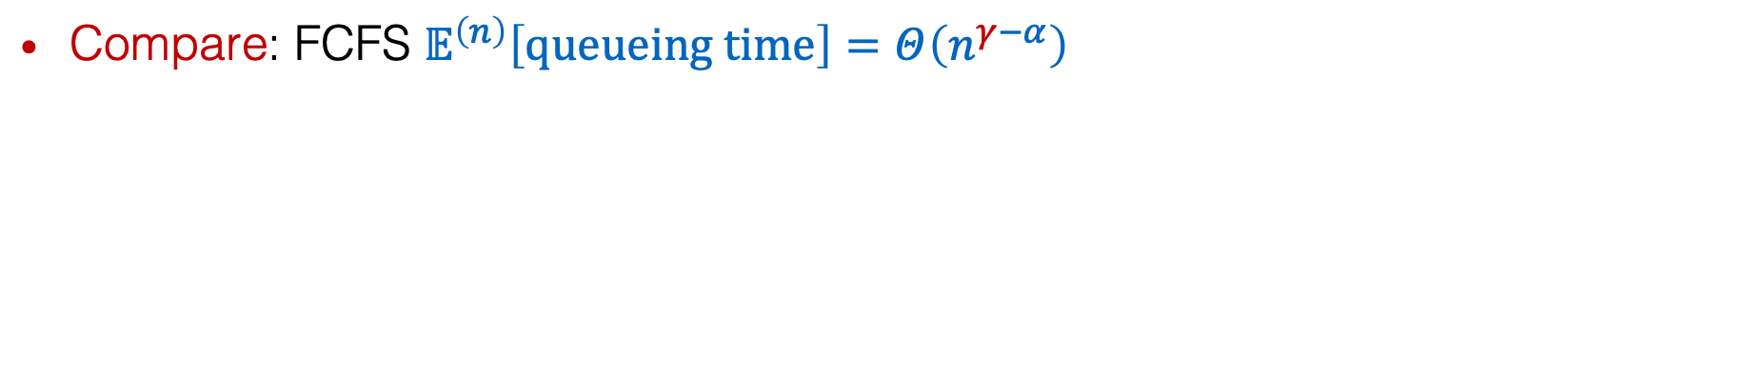
Lower bound
Theorem ([HW21], simplified) Under any policy
$𝔼^{\left(n\right)}\left[queueing time\right]=Ω\left(n^{−α}\right)$,
where slack capacity $δ=n^{α}$, max server-need $ℓ_{max}^{\left(n\right)}=Θ\left(n^{γ}\right)$,
assuming a proper mixture of jobs with max server need and jobs with server need = 1.
$$γ$$
max server need $ℓ_{max}^{\left(n\right)}=Θ\left(n^{γ}\right)$
Compare: FCFS $𝔼^{\left(n\right)}\left[queueing time\right]=Θ\left(n^{γ−α}\right)$
$$1$$
slack capacity $δ=n^{α}$
$$α$$
$$0$$
$$1/2$$
$$1$$

Slide 21
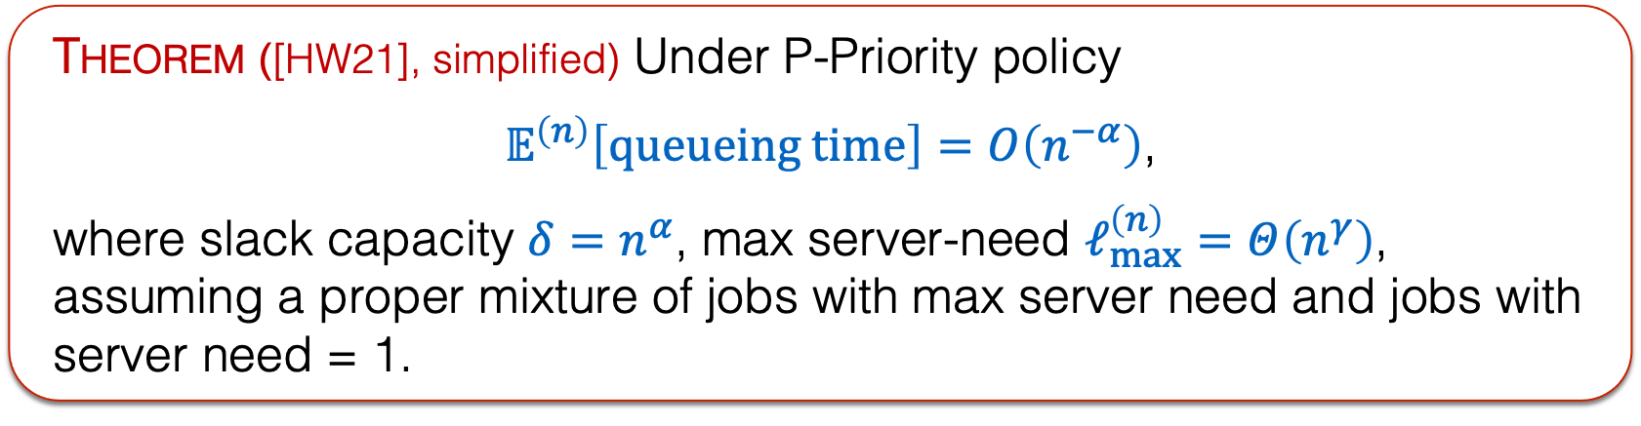
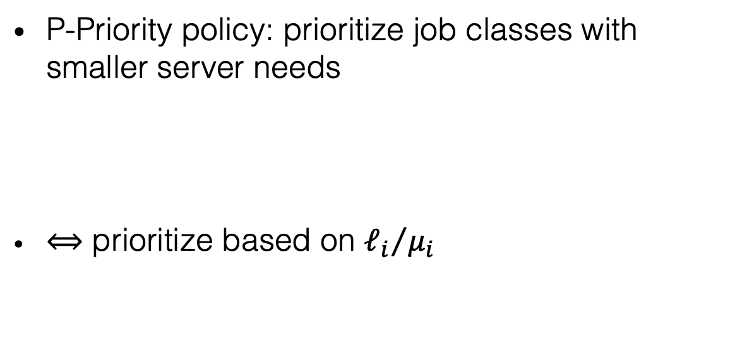
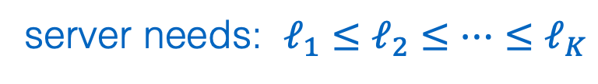
P-Priority
Theorem ([HW21], simplified) Under P-Priority policy
$𝔼^{\left(n\right)}\left[queueing time\right]=O\left(n^{−α}\right)$,
where slack capacity $δ=n^{α}$, max server-need $ℓ_{max}^{\left(n\right)}=Θ\left(n^{γ}\right)$,
assuming a proper mixture of jobs with max server need and jobs with server need = 1.
P-Priority policy: prioritize job classes with smaller server needs
$⟺$ prioritize based on ${ℓ_{i}}/{μ_{i}}$
$$γ$$
max server need $ℓ_{max}^{\left(n\right)}=Θ\left(n^{γ}\right)$
$$1$$
server needs: $ℓ_{1}≤ℓ_{2}≤…≤ℓ_{K}$
high priority
low priority
slack capacity $δ=n^{α}$
$$α$$
$$0$$
$$1/2$$
$$1$$

Slide 22
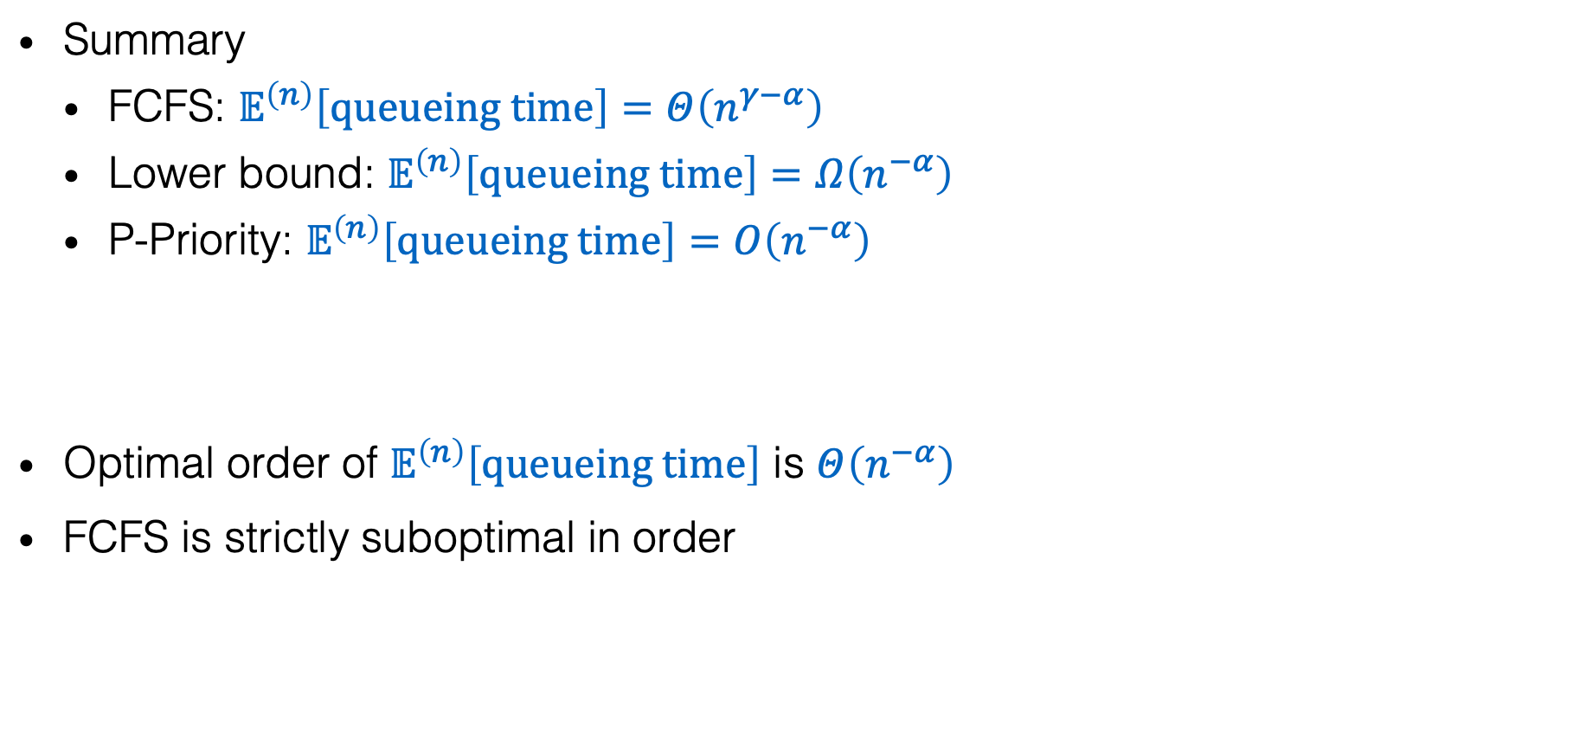
Optimal order
Summary
  FCFS: $𝔼^{\left(n\right)}\left[queueing time\right]=Θ\left(n^{γ−α}\right)$
  Lower bound: $𝔼^{\left(n\right)}\left[queueing time\right]=Ω\left(n^{−α}\right)$
  P-Priority: $𝔼^{\left(n\right)}\left[queueing time\right]=O\left(n^{−α}\right)$
Optimal order of $𝔼^{\left(n\right)}\left[queueing time\right]$ is $Θ\left(n^{−α}\right)$
FCFS is strictly suboptimal in order
$$γ$$
max server need $ℓ_{max}^{\left(n\right)}=Θ\left(n^{γ}\right)$
$$1$$
slack capacity $δ=n^{α}$
$$α$$
$$0$$
$$1/2$$
$$1$$

Slide 23

General results
Summary
  FCFS: $𝔼^{\left(n\right)}\left[queueing time\right]=Θ\left(\frac{σ^{2}}{nδ}\right)$
  Lower bound: $𝔼^{\left(n\right)}\left[queueing time\right]=Ω\left(\max_{i^{∗}≤i≤K}{\frac{1}{λ}\frac{σ_{i}^{2}}{{ℓ_{i}δ}_{i}}}\right)$
  P-Priority: $𝔼^{\left(n\right)}\left[queueing time\right]=O\left(\max_{i^{∗}≤i≤K}{\frac{1}{λ}\frac{σ_{i}^{2}}{{ℓ_{i}δ}_{i}}}\right)$
$$γ$$
max server need $ℓ_{max}^{\left(n\right)}=Θ\left(n^{γ}\right)$
$$1$$
slack capacity $δ=n^{α}$
$$α$$
$$0$$
$$1/2$$
$$1$$

Slide 24
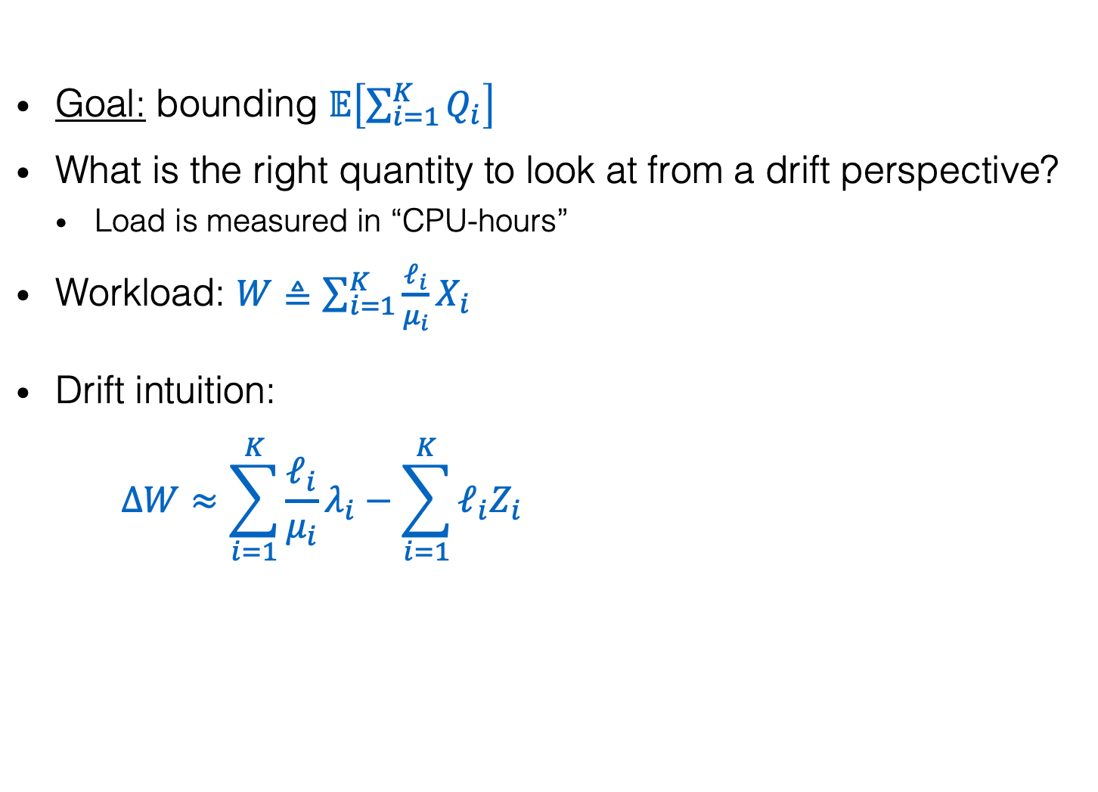
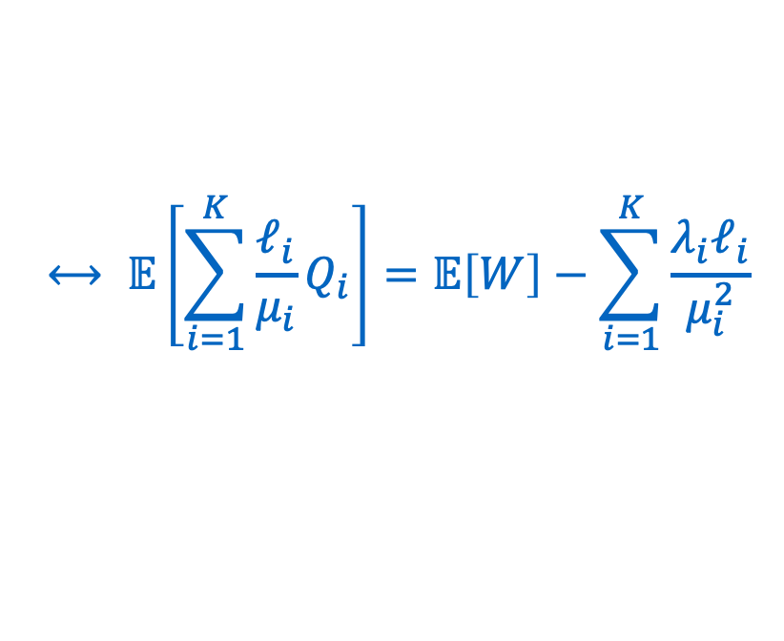


General proof plan
$Q_{i}$: # class $i$ jobs in queue
$X_{i}$: # class $i$ jobs in system
$Z_{i}$: # class $i$ jobs in service
$$Q_{i}=X_{i}−Z_{i}$$
Goal: bounding $𝔼\left[\sum_{i=1}^{K}{Q_{i}}\right]$
What is the right quantity to look at from a drift perspective?
  Load is measured in “CPU-hours”
Workload: $W≜\sum_{i=1}^{K}{\frac{ℓ_{i}}{μ_{i}}X_{i}}$
Drift intuition:
$$ΔW≈\sum_{i=1}^{K}{\frac{ℓ_{i}}{μ_{i}}λ_{i}}−\sum_{i=1}^{K}{ℓ_{i}Z_{i}}$$
$$⟷ 𝔼\left[\sum_{i=1}^{K}{\frac{ℓ_{i}}{μ_{i}}Q_{i}}\right]=𝔼\left[W\right]−\sum_{i=1}^{K}{\frac{{λ_{i}ℓ}_{i}}{μ_{i}^{2}}}$$
when total server need is large enough
$$≈\left(n−δ\right)−\left(n−ℓ_{max}\right)=−\left(δ−ℓ_{max}\right)$$
$$n−δ$$
total # busy servers

Slide 25

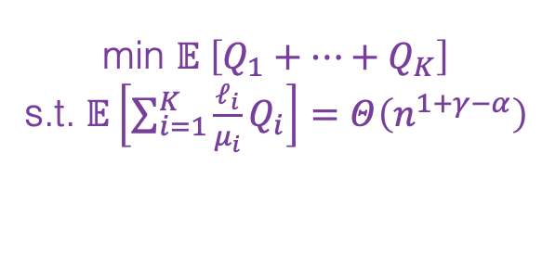

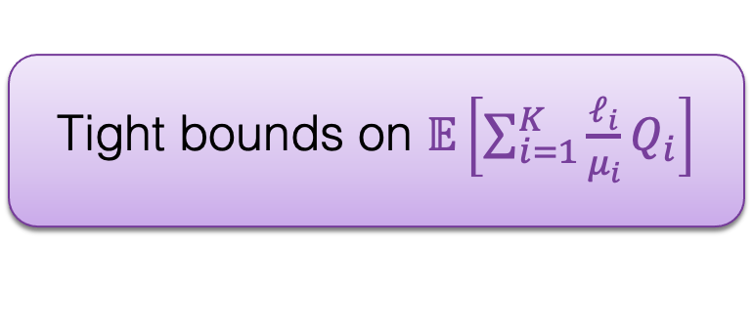
General proof plan (cont’d)
Tight bounds on $𝔼\left[\sum_{i=1}^{K}{\frac{ℓ_{i}}{μ_{i}}Q_{i}}\right]$
Different priority classes in different traffic regimes
$$Q_{i} approx.∝λ_{i}$$
min $𝔼 \left[Q_{1}+…+Q_{K}\right]$
s.t. $𝔼\left[\sum_{i=1}^{K}{\frac{ℓ_{i}}{μ_{i}}Q_{i}}\right]=Θ\left(n^{1+γ−α}\right)$
FCFS
Lower bound on $𝔼^{\left(n\right)}\left[queueing time\right]$
Optimal policy:
P-Priority

Slide 26
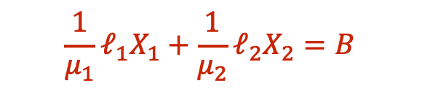





Upper Bounding $𝔼\left[W\right]=𝔼\left[\sum_{i=1}^{K}{\frac{1}{μ_{i}}ℓ_{i}X_{i}}\right]$
$Q_{i}$: # class $i$ jobs in queue
$X_{i}$: # class $i$ jobs in system
$Z_{i}$: # class $i$ jobs in service
$$Q_{i}=X_{i}−Z_{i}$$
If we had: $ΔW≤−ε$ when $W≥B$,
then $W$ would concentrate inside $B$. [Hajek 1982], [Bertsimas, Gamarnik, Tsitsiklis 1998]
Recall: $ΔW≈n−δ−\sum_{i=1}^{K}{ℓ_{i}Z_{i}}$, where $\sum_{i=1}^{K}{ℓ_{i}Z_{i}}≈n−ℓ_{max}$ when $\sum_{i=1}^{K}{ℓ_{i}X_{i}}≥n$
$$ℓ_{2}X_{2}$$
How to deal with this gap?
$$ℓ_{1}X_{1}+ℓ_{2}X_{2}=n$$
$$\frac{1}{μ_{1}}ℓ_{1}X_{1}+\frac{1}{μ_{2}}ℓ_{2}X_{2}=B$$
negative drift
$$ℓ_{1}X_{1}$$

Slide 27

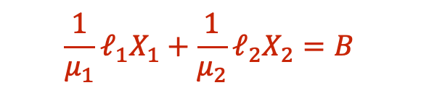

Idea: State-space concentration
$Q_{i}$: # class $i$ jobs in queue
$X_{i}$: # class $i$ jobs in system
$Z_{i}$: # class $i$ jobs in service
$$Q_{i}=X_{i}−Z_{i}$$
$$ℓ_{2}X_{2}$$
$$ℓ_{1}X_{1}+ℓ_{2}X_{2}=n$$
$$\frac{1}{μ_{1}}ℓ_{1}X_{1}+\frac{1}{μ_{2}}ℓ_{2}X_{2}=B$$
negative drift
$$ℓ_{1}X_{1}$$
First show that the state concentrates outside of this grey area:
use another Lyapunov function

Slide 28
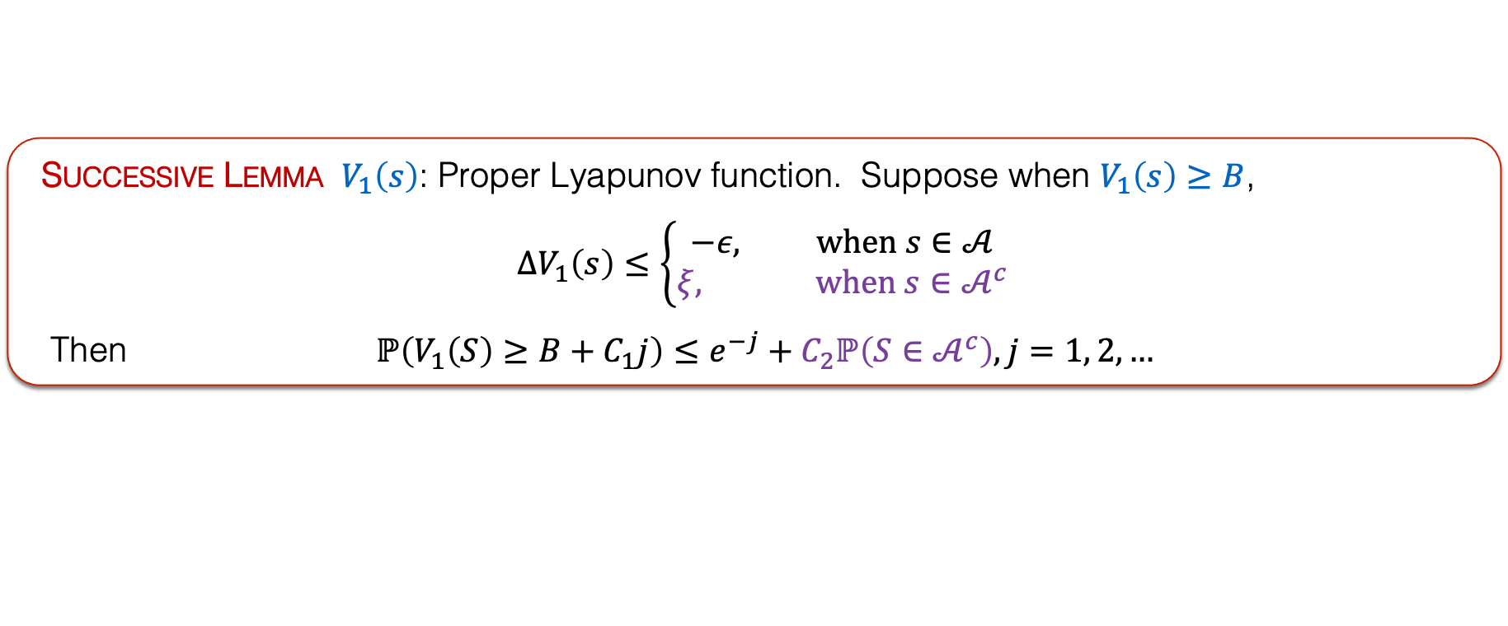
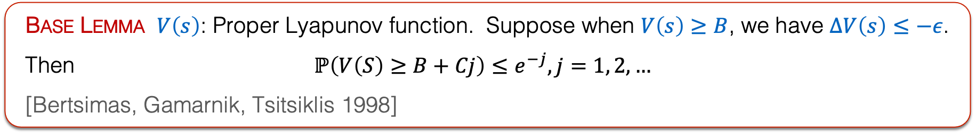
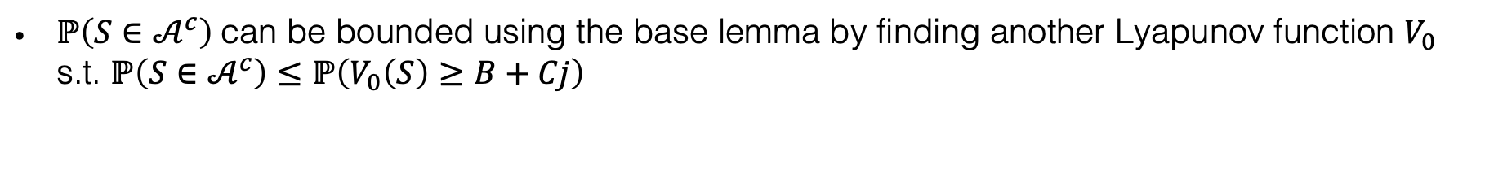
Generalizable technique:
Successive state-space concentration
Base Lemma $V\left(s\right)$: Proper Lyapunov function. Suppose when $V\left(s\right)≥B$, we have $ΔV\left(s\right)≤−ε$.
Then $ℙ\left(V\left(S\right)≥B+Cj\right)≤e^{−j}, j=1, 2, …$
[Bertsimas, Gamarnik, Tsitsiklis 1998]
Successive Lemma $V_{1}\left(s\right)$: Proper Lyapunov function. Suppose when $V_{1}\left(s\right)≥B$,
$$ΔV_{1}\left(s\right)≤\left\{\begin{aligned}−ε, when s∈𝒜 \\ ξ, when s∈𝒜^{c}\end{aligned}\right.$$
Then $ℙ\left(V_{1}\left(S\right)≥B+C_{1}j\right)≤e^{−j}+C_{2}ℙ\left(S∈𝒜^{c}\right), j=1, 2, …$
$ℙ\left(S∈𝒜^{c}\right)$can be bounded using the base lemma by finding another Lyapunov function $V_{0}$ s.t. $ℙ\left(S∈𝒜^{c}\right)≤ℙ\left(V_{0}\left(S\right)≥B+Cj\right)$

Slide 29
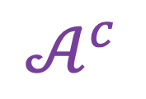
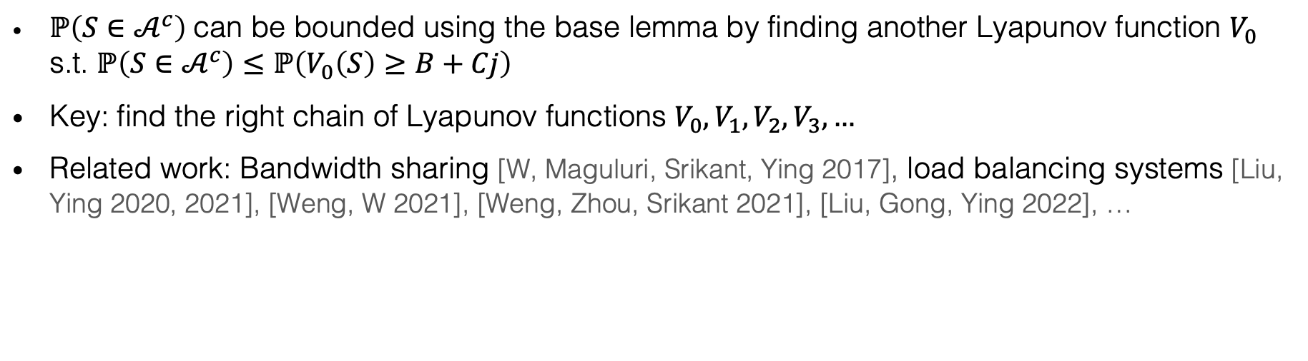
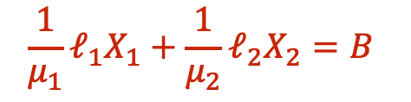
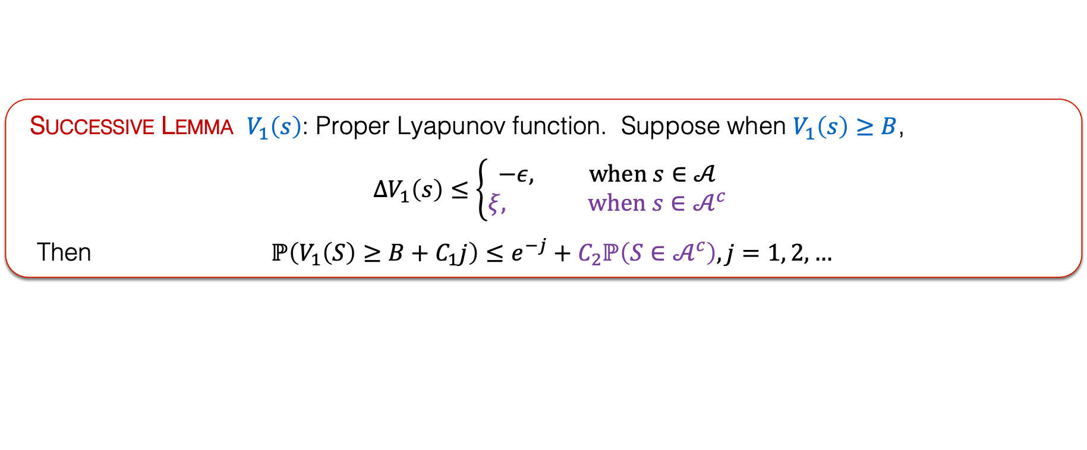



Generalizable technique:
Successive state-space concentration (cont’d)
Successive Lemma $V_{1}\left(s\right)$: Proper Lyapunov function. Suppose when $V_{1}\left(s\right)≥B$,
$$ΔV_{1}\left(s\right)≤\left\{\begin{aligned}−ε, when s∈𝒜 \\ ξ, when s∈𝒜^{c}\end{aligned}\right.$$
Then $ℙ\left(V_{1}\left(S\right)≥B+C_{1}j\right)≤e^{−j}+C_{2}ℙ\left(S∈𝒜^{c}\right), j=1, 2, …$
$ℙ\left(S∈𝒜^{c}\right)$can be bounded using the base lemma by finding another Lyapunov function $V_{0}$ s.t. $ℙ\left(S∈𝒜^{c}\right)≤ℙ\left(V_{0}\left(S\right)≥B+Cj\right)$
Key: find the right chain of Lyapunov functions $V_{0}, V_{1}, V_{2}, V_{3}, …$
Related work: Bandwidth sharing [W, Maguluri, Srikant, Ying 2017], load balancing systems [Liu, Ying 2020, 2021], [Weng, W 2021], [Weng, Zhou, Srikant 2021], [Liu, Gong, Ying 2022], …
$$ℓ_{2}X_{2}$$
$$ℓ_{1}X_{1}+ℓ_{2}X_{2}=n$$
$$\frac{1}{μ_{1}}ℓ_{1}X_{1}+\frac{1}{μ_{2}}ℓ_{2}X_{2}=B$$
$$𝒜^{c}$$
negative drift
$$ℓ_{1}X_{1}$$

Slide 30
General proof plan (cont’d)
Tight bounds on $𝔼\left[\sum_{i=1}^{K}{\frac{ℓ_{i}}{μ_{i}}Q_{i}}\right]$
Different priority classes in different traffic regimes
$$Q_{i} approx.∝λ_{i}$$
min $𝔼 \left[Q_{1}+…+Q_{K}\right]$
s.t. $𝔼\left[\sum_{i=1}^{K}{\frac{ℓ_{i}}{μ_{i}}Q_{i}}\right]=Θ\left(n^{1+γ−α}\right)$
FCFS
Lower bound on $𝔼^{\left(n\right)}\left[queueing time\right]$
Optimal policy:
P-Priority

Slide 31
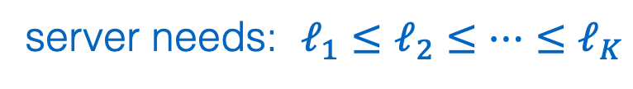

General proof plan (cont’d)
$$γ$$
max server need $ℓ_{max}^{\left(n\right)}=Θ\left(n^{γ}\right)$
$$1$$
Tight bounds on $𝔼\left[\sum_{i=1}^{K}{\frac{ℓ_{i}}{μ_{i}}Q_{i}}\right]$
slack capacity $δ=n^{α}$
$$α$$
Suppose only class $K$ is in red regime while others are in blue:
We show that $𝔼\left[\sum_{i=1}^{K−1}{\frac{ℓ_{i}}{μ_{i}}Q_{i}}\right]$ decays fast with $n$ (used SSC)
Workload in queue concentrates on class $K$
$$0$$
$$1/2$$
$$1$$
Different priority classes in different traffic regimes
server needs: $ℓ_{1}≤ℓ_{2}≤…≤ℓ_{K}$
Optimal policy:
P-Priority
high priority
low priority

Slide 32








Summary
What is the queueing probability?
Which scheduling policy minimizes queueing time?
Fast diminishing in blue regime for work-conserving policies
P-Priority has the optimal order in red regime
What is the queueing/waiting time?
$$γ$$
max server need $ℓ_{max}^{\left(n\right)}=Θ\left(n^{γ}\right)$
$$1$$
Fast diminishing in blue regime
Red regime, FCFS: $Θ\left(n^{γ−α}\right)$
Red regime, P-Priority: $Θ\left(n^{−α}\right)$
slack capacity $δ=n^{α}$
$$α$$
$$0$$
$$1/2$$
$$1$$

Slide 33
Open problems
Order bounds under general arrival and departure processes?
Policies that degrade gracefully in even heavier traffic regimes?
Preemption or not?
Multi-dimensional resources?
Autoscaling of resource uses?
…
$$γ$$
max server need $ℓ_{max}^{\left(n\right)}=Θ\left(n^{γ}\right)$
$$1$$
slack capacity $δ=n^{α}$
$$α$$
$$0$$
$$1/2$$
$$1$$

