Slide 1
Language Documentation and formal representations of language
Laura Tomokiyo
Notes:
http://www.pri.org/stories/2014-09-03/university-kansas-linguist-risking-ire-russia-helping-kazakhstan-change-its
3:38
Esp. 8:30

Slide 2
What is language documentation?
Provides “a comprehensive record of the linguistic practices characteristic of a given speech community” (Himmelman 1998)
Focuses on description and archiving
Forms the basis for further analysis

Slide 3
Why LD for endangered languages
Conservation
Analysis
Education
Revitalization
Reclamation

Slide 4
Why LD for language technologies
Many language technologists are not experts in linguistics, but are experts in the kind of data they need and can collaborate with linguists
Language technologists need to know about the standards and practices core to linguistics
We don’t arbitrarily define new technological or mathematical standards and practices, but too often that’s exactly what happens for language
Developing models for documenting the sounds, words, and relationships between words in endangered languages will help in creating systems in low-resource and rapid deployment situations

Slide 5
Stone Age resources
Inscriptions on stones, bones, clay tablets
Not produced to provide a linguistic record
Yet have been successfully used to explore long-extinct languages
Hittite reconstruction
We know something about government, law, trade, religion
What was adolescent conversation like???
Is it possible to have the verb in first position in subordinate clauses???

Slide 6
Modern-day resources
All information needed for further descriptive analysis should be contained in the corpus
The corpus should conform strictly to established and interoperable standards, practices, and formats
The corpus should be large enough that important evidence for grammatical structure can be extracted
Elicited data?
Negative examples?

Slide 7
What does LD look like?
Primary data | Apparatus
Recordings/records of observable linguistic behavior and metalinguistic knowledge (possible basic formats: session and lexical database) Interoperable formats are crucial (plain text, xml) | Per session | Overall
 | Metadata Time and location of recording Participants Recording team Recording equipment Content descriptors Annotations Transcription Translation Further linguistic and ethnographic glossing and commentary | Metadata Location of documented community Project team(s) Participants Acknowledgments General access resources Introduction Orthographic conventions Ethnographic sketch Sketch grammar Glossing conventions Indices Links to other resources...
From Himmelmann 2006

Slide 8
Ethical considerations
Do no harm
Respect cultural norms of privacy, status, compensation
Reciprocity and equity
Plan research collaboratively – the researcher’s viewpoint is not the only one
The indigenous knowledge system is rich
Give back
What would actually be useful to the community?
Obtain informed consent
Explore oral/communal consent
Archive and disseminate
Shared data is more useful than no data
Language is too precious to be proprietary

Slide 9
Formal representations: words and grammar
Meaning
Number
Gender
Person
Possessives
Distance
Direction
Voice
Register
…

Slide 10
IPA
International Phonetic Alphabet
A standard for making distinctions between sounds
A set of symbols for writing those sounds down
Corresponding practices for deciding whether related sounds should be
Written with the same symbol (allophonic variation / phonemic transcription)
Written with modifiers (diacritics esp. for idiolects)
Written with two different symbols (phonemic distinction or phonetic transcription)

Slide 11
Formal representations: sounds
Identify the sounds in a language which, if changed, make a difference in meaning in that language
Characterize the difference between those sounds
Situate those sounds in the context of
The sounds humans can make
The sounds of other languages

Slide 12
Orthography ≠ phonetics
One letter, many sounds
equity, equal, beneath
One sound, many letters
cash, character, king, queen

Slide 13
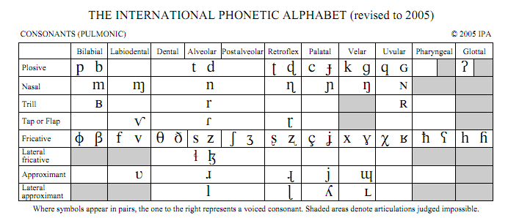

Slide 14
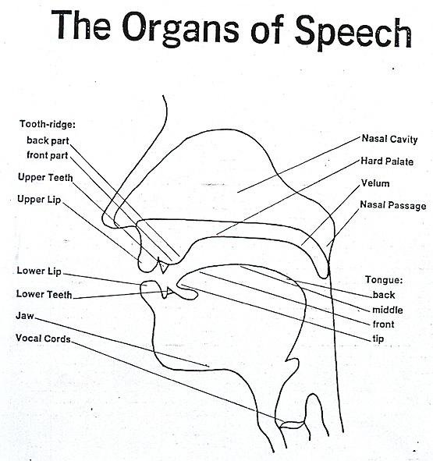

Slide 15
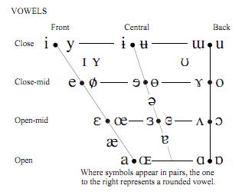
Bert but between
beat
boot /bu:t/
bit
put
bait
boat
bet
bought
bat
baht
/biːt/ /bɪt/ /beit/ /bɛt/ /bæt/ /bait/
/bɝt/ /bʌt/ /bətween/
/buːt/ /boːt/ /bɔːt/ /bɑːt/
Disclaimer: American English vowels are not usually the pure sounds

Slide 16
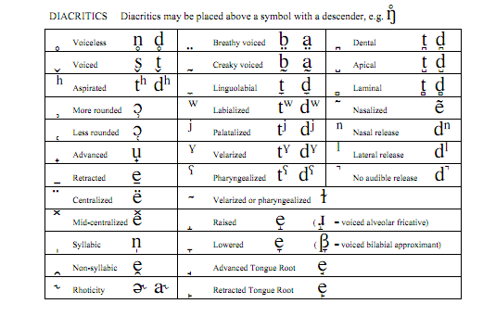

Slide 17
Exercises
Swadesh list with groups of 3
First 10 first
Then try the remainder until time is up
regroup to discuss differences between speakers, transcriber agreement
Homework to transcribe
http://millercenter.org/president/speeches/speech-332 #paragraph 2
Notes:
Or use prerecorded data, e.g. http://www.heart-of-wales.co.uk/welsh.htm#
http://accent.gmu.edu/browse_language.php?function=find&language=english
http://archive.org/details/rosettaproject_wuu_swadesh-a1_audio-1

Slide 18
Swadesh List
I
You
We
this
that
who?
what?
not
all (of a number)
many
one
two
big
long (not 'wide')
small
woman
man (adult male human)
person (individual human)
fish (noun)
bird
dog
louse
tree (not log)
seed (noun!)
leaf (botanics)
root (botanics)
bark (of tree)
Skin
flesh
Blood
bone
Notes:
Try to identify 2-3 students who can be “informants” for partners

Slide 19
Discussion
What was hard?
Where did transcribers differ?
Where did speakers differ?

Slide 20
ASCII alternatives to the IPA symbols
Various ASCII representations
AA, AH, AX, AY, …
Biased toward English, and a particular view of English
Speakers of different languages have different issues
Unfamiliar character-pronunciation mapping (j/y)
Unfamiliar character set (e.g. Japanese)
Inexperience writing the language down (e.g. Iñupiaq)
Different systems can define own phoneme set, but ultimately need to be multilingual
Notes:
What to do if someone uses a word in another language if you’re trying to transcribe with a monolingual phone set?

