Slide 1


Deep Learning
(Part II)
School of Computer Science
10-601B Introduction to Machine Learning
Readings:
Nielsen (online book) Neural Networks and Deep Learning
Matt Gormley
Lecture 17
October 26, 2016

Slide 2
Reminders
Homework 5
  due Wed., Nov. 2nd
Homework 6
  (not out yet)
  implement a Conv Net!

Slide 3
Outline
Deep Neural Networks (DNNs)
  Three ideas for training a DNN
  Experiments: MNIST digit classification
  Autoencoders
  Pretraining
Convolutional Neural Networks (CNNs)
  Convolutional layers
  Pooling layers
  Image recognition
Recurrent Neural Networks (RNNs)
  Bidirectional RNNs
  Deep Bidirectional RNNs
  Deep Bidirectional LSTMs
  Connection to forward-backward algorithm
Part I
Part II

Slide 4
Convolutional Neural Nets

Slide 5
Background: Image Processing
A convolution matrix is used in image processing for tasks such as edge detection, blurring, sharpening, etc.
Input Image
0 | 0 | 0 | 0 | 0 | 0 | 0
0 | 1 | 1 | 1 | 1 | 1 | 0
0 | 1 | 0 | 0 | 1 | 0 | 0
0 | 1 | 0 | 1 | 0 | 0 | 0
0 | 1 | 1 | 0 | 0 | 0 | 0
0 | 1 | 0 | 0 | 0 | 0 | 0
0 | 0 | 0 | 0 | 0 | 0 | 0
Convolved Image
Convolution
1 | 1 | 1 | 1 | 1
1 | 0 | 0 | 1 | 0
1 | 0 | 1 | 0 | 0
1 | 1 | 0 | 0 | 0
1 | 0 | 0 | 0 | 0
0 | 0 | 0
0 | 1 | 1
0 | 1 | 0

Slide 6
Background: Image Processing
A convolution matrix is used in image processing for tasks such as edge detection, blurring, sharpening, etc.
Input Image
0 | 0 | 0 | 0 | 0 | 0 | 0
0 | 1 | 1 | 1 | 1 | 1 | 0
0 | 1 | 0 | 0 | 1 | 0 | 0
0 | 1 | 0 | 1 | 0 | 0 | 0
0 | 1 | 1 | 0 | 0 | 0 | 0
0 | 1 | 0 | 0 | 0 | 0 | 0
0 | 0 | 0 | 0 | 0 | 0 | 0
Convolved Image
Convolution
3 | 2 | 2 | 3 | 1
2 | 0 | 2 | 1 | 0
2 | 2 | 1 | 0 | 0
3 | 1 | 0 | 0 | 0
1 | 0 | 0 | 0 | 0
0 | 0 | 0
0 | 1 | 1
0 | 1 | 0

Slide 7
Background: Image Processing
A convolution matrix is used in image processing for tasks such as edge detection, blurring, sharpening, etc.
Input Image
0 | 0 | 0 | 0 | 0 | 0 | 0
0 | 1 | 1 | 1 | 1 | 1 | 0
0 | 1 | 0 | 0 | 1 | 0 | 0
0 | 1 | 0 | 1 | 0 | 0 | 0
0 | 1 | 1 | 0 | 0 | 0 | 0
0 | 1 | 0 | 0 | 0 | 0 | 0
0 | 0 | 0 | 0 | 0 | 0 | 0
Convolved Image
Convolution
3 | 2 | 2 | 3 | 1
2 | 0 | 2 | 1 | 0
2 | 2 | 1 | 0 | 0
3 | 1 | 0 | 0 | 0
1 | 0 | 0 | 0 | 0

Slide 8
Background: Image Processing
A convolution matrix is used in image processing for tasks such as edge detection, blurring, sharpening, etc.
Input Image
0 | 0 | 0 | 0 | 0 | 0 | 0
0 | 1 | 1 | 1 | 1 | 1 | 0
0 | 1 | 0 | 0 | 1 | 0 | 0
0 | 1 | 0 | 1 | 0 | 0 | 0
0 | 1 | 1 | 0 | 0 | 0 | 0
0 | 1 | 0 | 0 | 0 | 0 | 0
0 | 0 | 0 | 0 | 0 | 0 | 0
Convolved Image
Convolution
3 | 2 | 2 | 3 | 1
2 | 0 | 2 | 1 | 0
2 | 2 | 1 | 0 | 0
3 | 1 | 0 | 0 | 0
1 | 0 | 0 | 0 | 0

Slide 9
Background: Image Processing
A convolution matrix is used in image processing for tasks such as edge detection, blurring, sharpening, etc.
Input Image
0 | 0 | 0 | 0 | 0 | 0 | 0
0 | 1 | 1 | 1 | 1 | 1 | 0
0 | 1 | 0 | 0 | 1 | 0 | 0
0 | 1 | 0 | 1 | 0 | 0 | 0
0 | 1 | 1 | 0 | 0 | 0 | 0
0 | 1 | 0 | 0 | 0 | 0 | 0
0 | 0 | 0 | 0 | 0 | 0 | 0
Convolved Image
Convolution
3 | 2 | 2 | 3 | 1
2 | 0 | 2 | 1 | 0
2 | 2 | 1 | 0 | 0
3 | 1 | 0 | 0 | 0
1 | 0 | 0 | 0 | 0

Slide 10
Background: Image Processing
A convolution matrix is used in image processing for tasks such as edge detection, blurring, sharpening, etc.
Input Image
0 | 0 | 0 | 0 | 0 | 0 | 0
0 | 1 | 1 | 1 | 1 | 1 | 0
0 | 1 | 0 | 0 | 1 | 0 | 0
0 | 1 | 0 | 1 | 0 | 0 | 0
0 | 1 | 1 | 0 | 0 | 0 | 0
0 | 1 | 0 | 0 | 0 | 0 | 0
0 | 0 | 0 | 0 | 0 | 0 | 0
Convolved Image
Convolution
3

Slide 11
Background: Image Processing
A convolution matrix is used in image processing for tasks such as edge detection, blurring, sharpening, etc.
Input Image
0 | 0 | 0 | 0 | 0 | 0 | 0
0 | 1 | 1 | 1 | 1 | 1 | 0
0 | 1 | 0 | 0 | 1 | 0 | 0
0 | 1 | 0 | 1 | 0 | 0 | 0
0 | 1 | 1 | 0 | 0 | 0 | 0
0 | 1 | 0 | 0 | 0 | 0 | 0
0 | 0 | 0 | 0 | 0 | 0 | 0
Convolved Image
Convolution
3 | 2

Slide 12
Background: Image Processing
A convolution matrix is used in image processing for tasks such as edge detection, blurring, sharpening, etc.
Input Image
0 | 0 | 0 | 0 | 0 | 0 | 0
0 | 1 | 1 | 1 | 1 | 1 | 0
0 | 1 | 0 | 0 | 1 | 0 | 0
0 | 1 | 0 | 1 | 0 | 0 | 0
0 | 1 | 1 | 0 | 0 | 0 | 0
0 | 1 | 0 | 0 | 0 | 0 | 0
0 | 0 | 0 | 0 | 0 | 0 | 0
Convolved Image
Convolution
3 | 2 | 2

Slide 13
Background: Image Processing
A convolution matrix is used in image processing for tasks such as edge detection, blurring, sharpening, etc.
Input Image
0 | 0 | 0 | 0 | 0 | 0 | 0
0 | 1 | 1 | 1 | 1 | 1 | 0
0 | 1 | 0 | 0 | 1 | 0 | 0
0 | 1 | 0 | 1 | 0 | 0 | 0
0 | 1 | 1 | 0 | 0 | 0 | 0
0 | 1 | 0 | 0 | 0 | 0 | 0
0 | 0 | 0 | 0 | 0 | 0 | 0
Convolved Image
Convolution
3 | 2 | 2 | 3

Slide 14
Background: Image Processing
A convolution matrix is used in image processing for tasks such as edge detection, blurring, sharpening, etc.
Input Image
0 | 0 | 0 | 0 | 0 | 0 | 0
0 | 1 | 1 | 1 | 1 | 1 | 0
0 | 1 | 0 | 0 | 1 | 0 | 0
0 | 1 | 0 | 1 | 0 | 0 | 0
0 | 1 | 1 | 0 | 0 | 0 | 0
0 | 1 | 0 | 0 | 0 | 0 | 0
0 | 0 | 0 | 0 | 0 | 0 | 0
Convolved Image
Convolution
3 | 2 | 2 | 3 | 1

Slide 15
Background: Image Processing
A convolution matrix is used in image processing for tasks such as edge detection, blurring, sharpening, etc.
Input Image
0 | 0 | 0 | 0 | 0 | 0 | 0
0 | 1 | 1 | 1 | 1 | 1 | 0
0 | 1 | 0 | 0 | 1 | 0 | 0
0 | 1 | 0 | 1 | 0 | 0 | 0
0 | 1 | 1 | 0 | 0 | 0 | 0
0 | 1 | 0 | 0 | 0 | 0 | 0
0 | 0 | 0 | 0 | 0 | 0 | 0
Convolved Image
Convolution
3 | 2 | 2 | 3 | 1
2

Slide 16
Background: Image Processing
A convolution matrix is used in image processing for tasks such as edge detection, blurring, sharpening, etc.
Input Image
0 | 0 | 0 | 0 | 0 | 0 | 0
0 | 1 | 1 | 1 | 1 | 1 | 0
0 | 1 | 0 | 0 | 1 | 0 | 0
0 | 1 | 0 | 1 | 0 | 0 | 0
0 | 1 | 1 | 0 | 0 | 0 | 0
0 | 1 | 0 | 0 | 0 | 0 | 0
0 | 0 | 0 | 0 | 0 | 0 | 0
Convolved Image
Convolution
3 | 2 | 2 | 3 | 1
2 | 0

Slide 17
Background: Image Processing
A convolution matrix is used in image processing for tasks such as edge detection, blurring, sharpening, etc.
Input Image
0 | 0 | 0 | 0 | 0 | 0 | 0
0 | 1 | 1 | 1 | 1 | 1 | 0
0 | 1 | 0 | 0 | 1 | 0 | 0
0 | 1 | 0 | 1 | 0 | 0 | 0
0 | 1 | 1 | 0 | 0 | 0 | 0
0 | 1 | 0 | 0 | 0 | 0 | 0
0 | 0 | 0 | 0 | 0 | 0 | 0
Convolved Image
Convolution
3 | 2 | 2 | 3 | 1
2 | 0 | 2 | 1 | 0
2 | 2 | 1 | 0 | 0
3 | 1 | 0 | 0 | 0
1 | 0 | 0 | 0 | 0

Slide 18
Background: Image Processing
A convolution matrix is used in image processing for tasks such as edge detection, blurring, sharpening, etc.
Input Image
0 | 0 | 0 | 0 | 0 | 0 | 0
0 | 1 | 1 | 1 | 1 | 1 | 0
0 | 1 | 0 | 0 | 1 | 0 | 0
0 | 1 | 0 | 1 | 0 | 0 | 0
0 | 1 | 1 | 0 | 0 | 0 | 0
0 | 1 | 0 | 0 | 0 | 0 | 0
0 | 0 | 0 | 0 | 0 | 0 | 0
Convolved Image
Identity Convolution
1 | 1 | 1 | 1 | 1
1 | 0 | 0 | 1 | 0
1 | 0 | 1 | 0 | 0
1 | 1 | 0 | 0 | 0
1 | 0 | 0 | 0 | 0
0 | 0 | 0
0 | 1 | 0
0 | 0 | 0

Slide 19
Background: Image Processing
A convolution matrix is used in image processing for tasks such as edge detection, blurring, sharpening, etc.
Input Image
0 | 0 | 0 | 0 | 0 | 0 | 0
0 | 1 | 1 | 1 | 1 | 1 | 0
0 | 1 | 0 | 0 | 1 | 0 | 0
0 | 1 | 0 | 1 | 0 | 0 | 0
0 | 1 | 1 | 0 | 0 | 0 | 0
0 | 1 | 0 | 0 | 0 | 0 | 0
0 | 0 | 0 | 0 | 0 | 0 | 0
Convolved Image
Blurring
Convolution
.4 | .5 | .5 | .5 | .4
.4 | .2 | .3 | .6 | .3
.5 | .4 | .4 | .2 | .1
.5 | .6 | .2 | .1 | 0
.4 | .3 | .1 | 0 | 0
.1 | .1 | .1
.1 | .2 | .1
.1 | .1 | .1

Slide 20
Background: Image Processing
A convolution matrix is used in image processing for tasks such as edge detection, blurring, sharpening, etc.
Input Image
0 | 0 | 0 | 0 | 0 | 0 | 0
0 | 1 | 1 | 1 | 1 | 1 | 0
0 | 1 | 0 | 0 | 1 | 0 | 0
0 | 1 | 0 | 1 | 0 | 0 | 0
0 | 1 | 1 | 0 | 0 | 0 | 0
0 | 1 | 0 | 0 | 0 | 0 | 0
0 | 0 | 0 | 0 | 0 | 0 | 0
Convolved Image
Blurring
Convolution
.4 | .5 | .5 | .5 | .4
.4 | .2 | .3 | .6 | .3
.5 | .4 | .4 | .2 | .1
.5 | .6 | .2 | .1 | 0
.4 | .3 | .1 | 0 | 0
.1 | .1 | .1
.1 | .2 | .1
.1 | .1 | .1

Slide 21
Convolutional Neural Network (CNN)
CNN key idea:
Treat convolution matrix as parameters and learn them!
Input Image
0 | 0 | 0 | 0 | 0 | 0 | 0
0 | 1 | 1 | 1 | 1 | 1 | 0
0 | 1 | 0 | 0 | 1 | 0 | 0
0 | 1 | 0 | 1 | 0 | 0 | 0
0 | 1 | 1 | 0 | 0 | 0 | 0
0 | 1 | 0 | 0 | 0 | 0 | 0
0 | 0 | 0 | 0 | 0 | 0 | 0
Convolved Image
Learned
Convolution
.4 | .5 | .5 | .5 | .4
.4 | .2 | .3 | .6 | .3
.5 | .4 | .4 | .2 | .1
.5 | .6 | .2 | .1 | 0
.4 | .3 | .1 | 0 | 0
θ₁₁ | θ₁₂ | θ₁₃
θ₂₁ | θ₂₂ | θ₂₃
θ₃₁ | θ₃₂ | θ₃₃

Slide 22
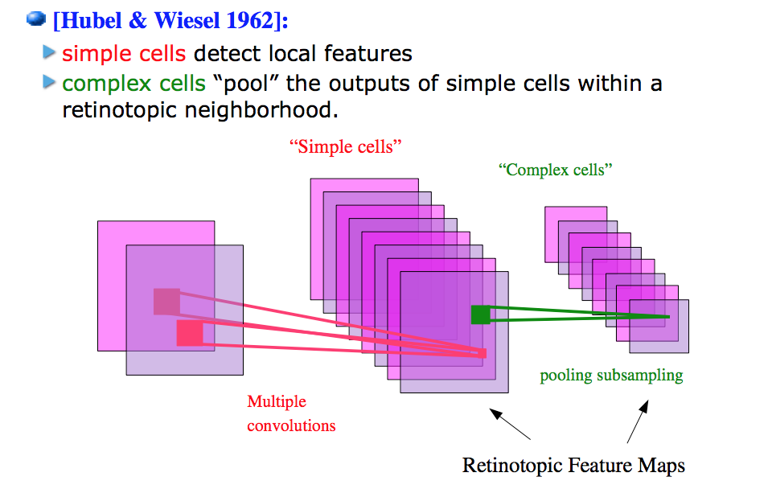
Model of vision in animals
Slide from William Cohen

Slide 23
Huber & Wiesel Video
https://www.youtube.com/watch?v=8VdFf3egwfg

Slide 24
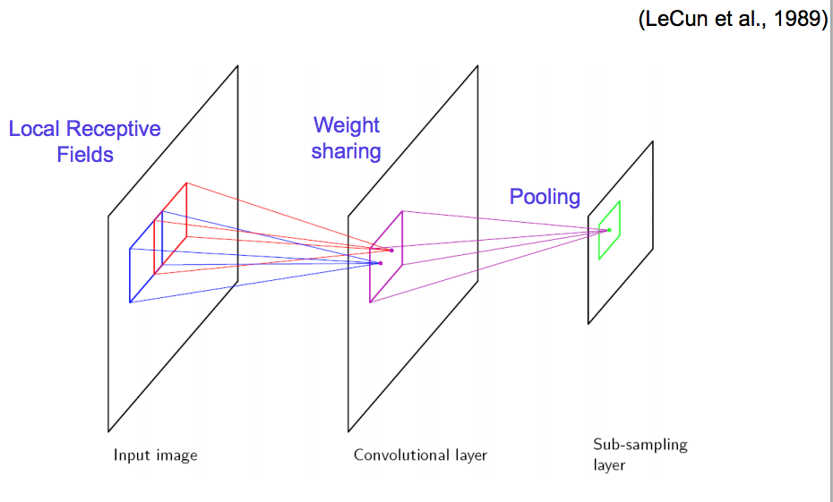
Vision with ANNs
Slide from William Cohen

Slide 25
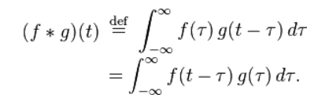
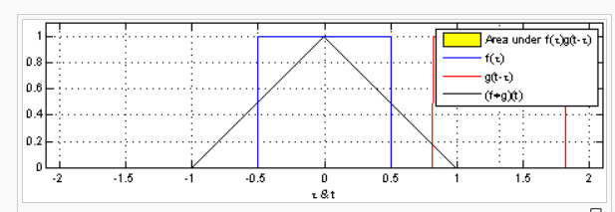
What’s a convolution?
https://en.wikipedia.org/wiki/Convolution
1-D
Slide from William Cohen

Slide 26
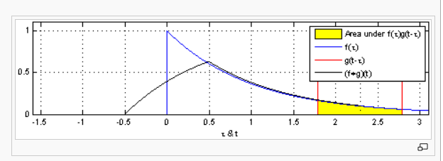
What’s a convolution?
https://en.wikipedia.org/wiki/Convolution
1-D
Slide from William Cohen

Slide 27
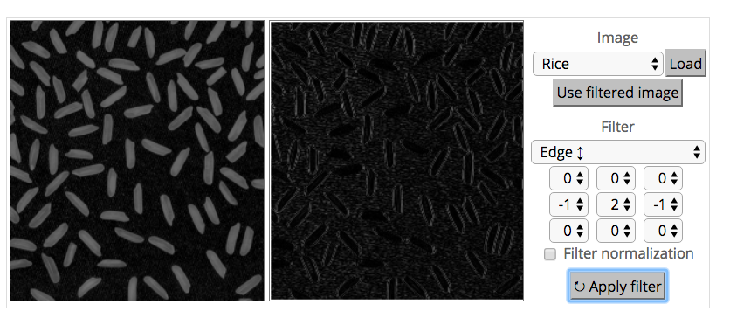
What’s a convolution?
http://matlabtricks.com/post-5/3x3-convolution-kernels-with-online-demo
Slide from William Cohen

Slide 28
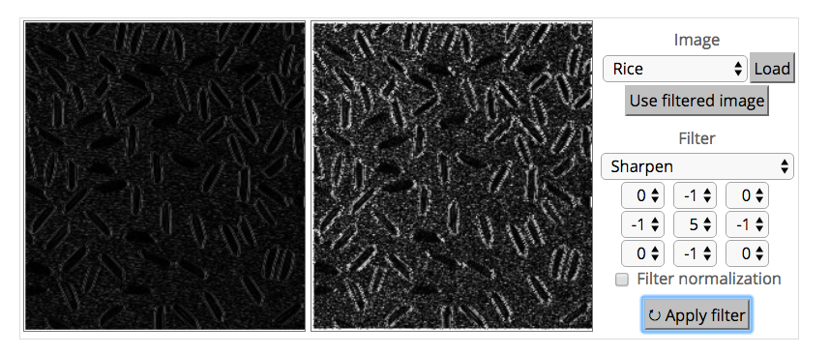
What’s a convolution?
http://matlabtricks.com/post-5/3x3-convolution-kernels-with-online-demo
Slide from William Cohen

Slide 29
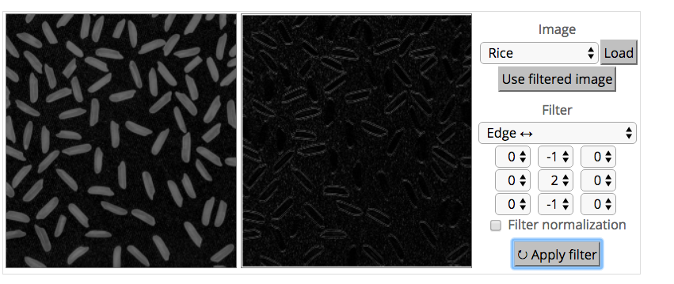
What’s a convolution?
http://matlabtricks.com/post-5/3x3-convolution-kernels-with-online-demo
Slide from William Cohen

Slide 30
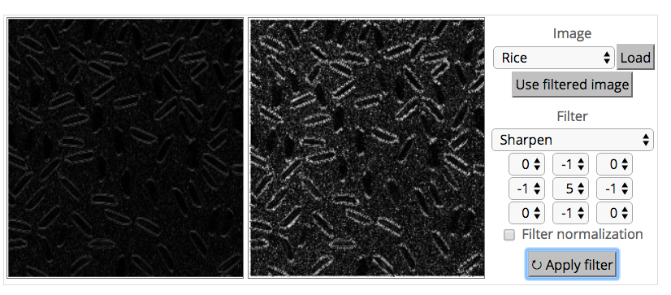
What’s a convolution?
http://matlabtricks.com/post-5/3x3-convolution-kernels-with-online-demo
Slide from William Cohen

Slide 31
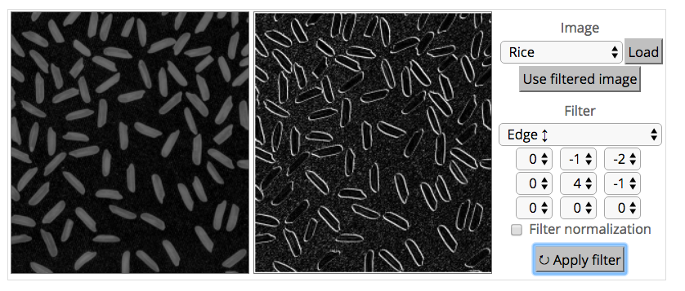
What’s a convolution?
http://matlabtricks.com/post-5/3x3-convolution-kernels-with-online-demo
Slide from William Cohen

Slide 32
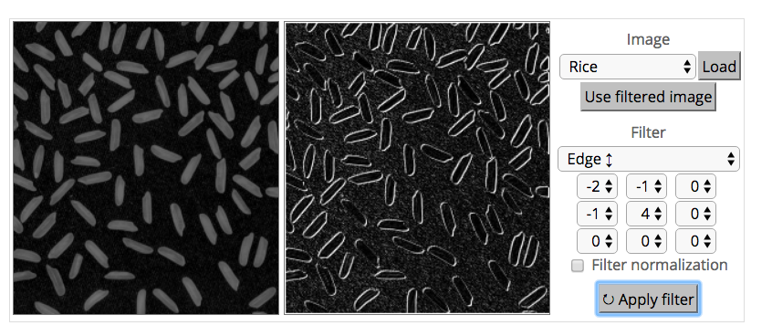
What’s a convolution?
http://matlabtricks.com/post-5/3x3-convolution-kernels-with-online-demo
Slide from William Cohen

Slide 33
What’s a convolution?
Basic idea:
  Pick a 3x3 matrix F of weights
  Slide this over an image and compute the “inner product” (similarity) of F and the corresponding field of the image, and replace the pixel in the center of the field with the output of the inner product operation
Key point:
  Different convolutions extract different types of low-level “features” from an image
  All that we need to vary to generate these different features is the weights of F
Slide from William Cohen

Slide 34
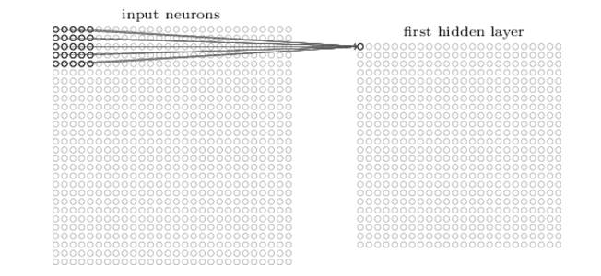
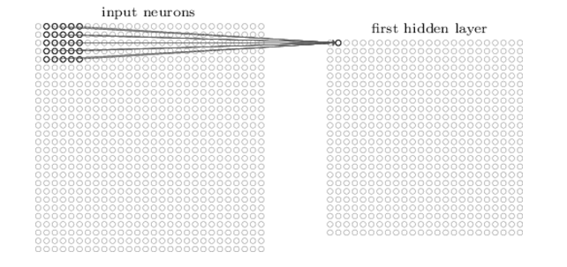
How do we convolve an image with an ANN?
Note that the parameters in the matrix defining the convolution are tied across all places that it is used
Slide from William Cohen

Slide 35
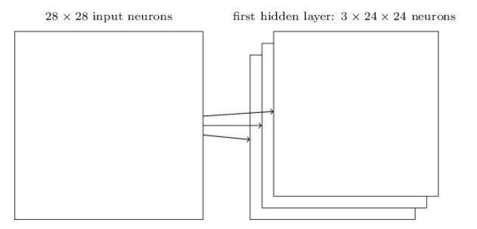
How do we do many convolutions of an image with an ANN?
Slide from William Cohen

Slide 36
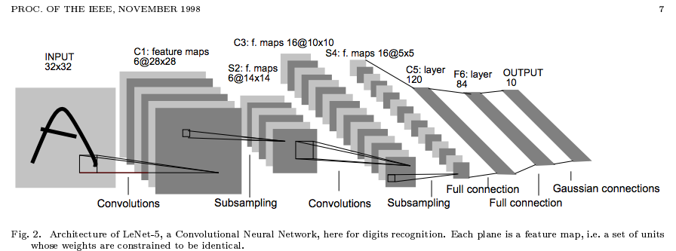
Convolutional Neural Network (CNN)
Typical layers include:
  Convolutional layer
  Max-pooling layer
  Fully connected layer
  (Nonlinear layer)
  Softmax
These can be arranged into arbitrarily deep topologies

Slide 37
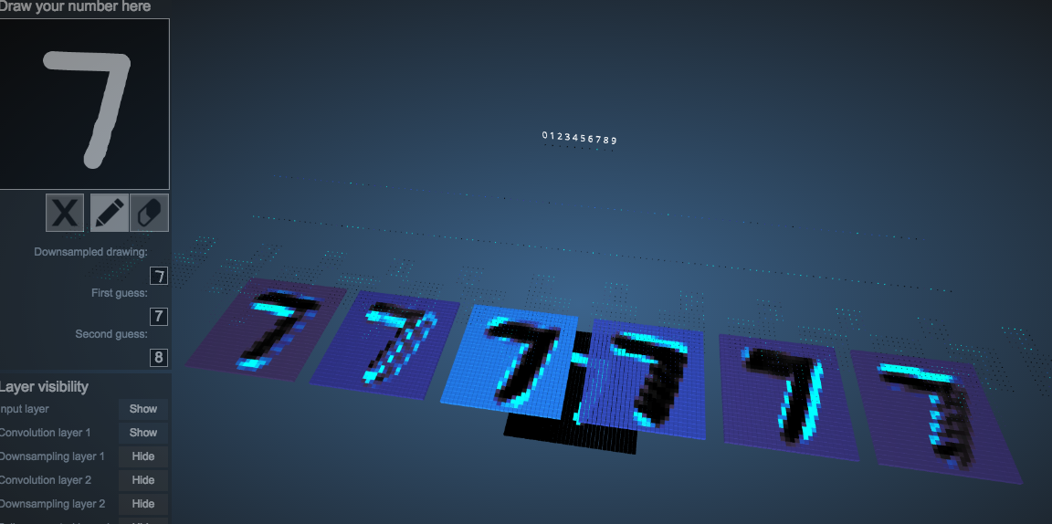

Example: 6 convolutions of a digit
http://scs.ryerson.ca/~aharley/vis/conv/
Slide from William Cohen

Slide 38
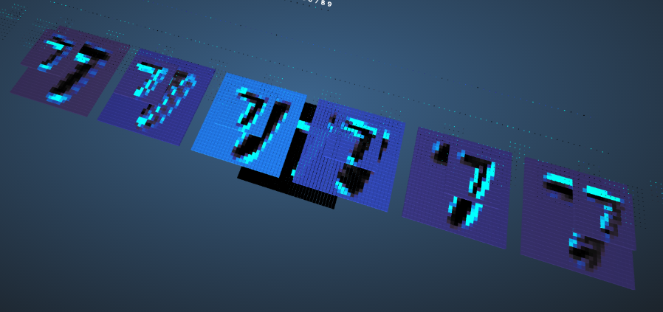

CNNs typically alternate convolutions, non-linearity, and then downsampling
Downsampling is usually averaging or (more common in recent CNNs) max-pooling
Slide from William Cohen

Slide 39
Convolution of a Color Image
Color images consist of 3 floats per pixel for RGB (red, green blue) color values
Convolution must also be 3-dimensional
Figure from Fei-Fei Li & Andrej Karpathy & Justin Johnson (CS231N)

Slide 40
Convolution of a Color Image
Animation of 3D convolution
http://cs231n.github.io/convolutional-networks/
Figure from Fei-Fei Li & Andrej Karpathy & Justin Johnson (CS231N)

Slide 41
Max-pooling
Figure from Fei-Fei Li & Andrej Karpathy & Justin Johnson (CS231N)

Slide 42
Max-pooling
Figure from Fei-Fei Li & Andrej Karpathy & Justin Johnson (CS231N)

Slide 43
Why do max-pooling?
Saves space
Reduces overfitting?
Because I’m going to add more convolutions after it!
  Allows the short-range convolutions to extend over larger subfields of the images
    So we can spot larger objects
    Eg, a long horizontal line, or a corner, or …
Slide from William Cohen

Slide 44
Another CNN visualization
https://cs.stanford.edu/people/karpathy/convnetjs/demo/mnist.html
Slide from William Cohen

Slide 45
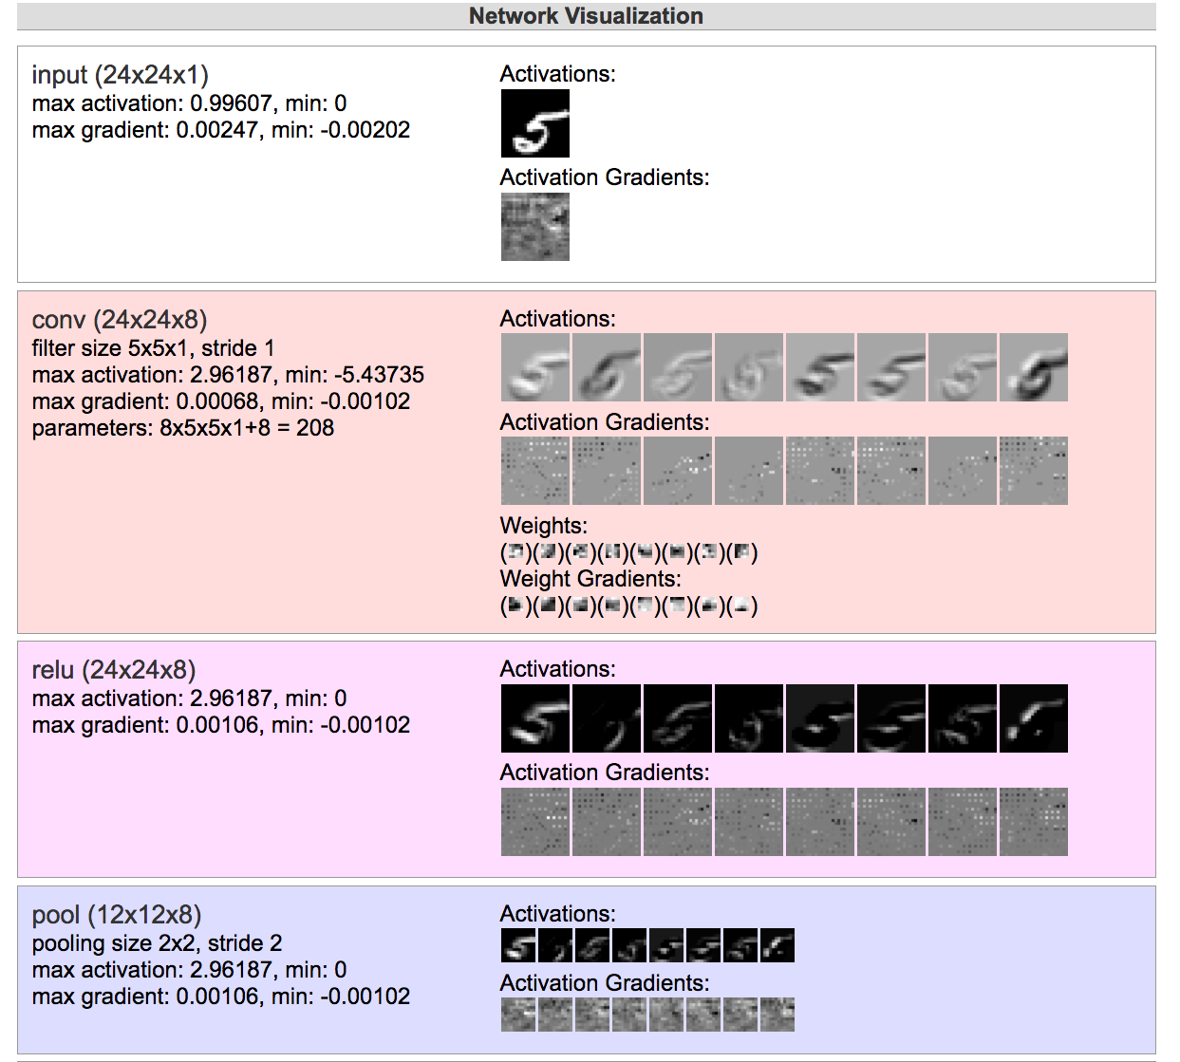


Slide from William Cohen

Slide 46
Why do max-pooling?
Saves space
Reduces overfitting?
Because I’m going to add more convolutions after it!
  Allows the short-range convolutions to extend over larger subfields of the images
    So we can spot larger objects
    Eg, a long horizontal line, or a corner, or …
At some point the feature maps start to get very sparse and blobby – they are indicators of some semantic property, not a recognizable transformation of the image
Then just use them as features in a “normal” ANN
Slide from William Cohen

Slide 47
Slide from William Cohen

Slide 48
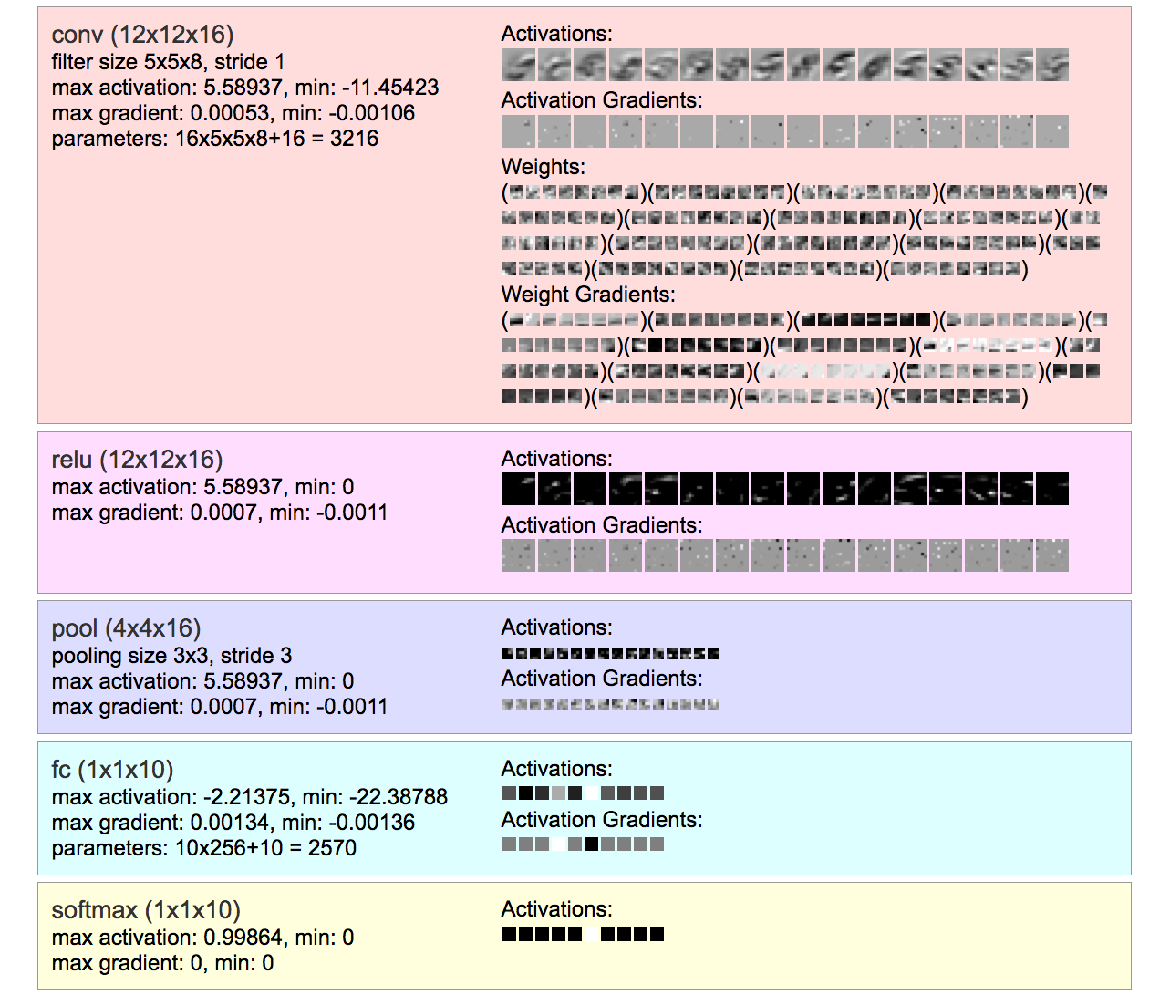



Slide from William Cohen

Slide 49
Why do max-pooling?
Saves space
Reduces overfitting?
Because I’m going to add more convolutions after it!
  Allows the short-range convolutions to extend over larger subfields of the images
    So we can spot larger objects
    Eg, a long horizontal line, or a corner, or …
Slide from William Cohen

Slide 50
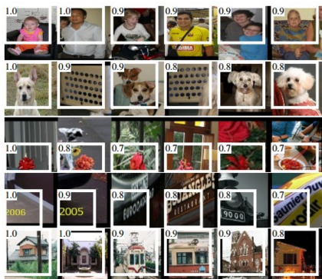
Alternating convolution and downsampling
5 layers up
The subfield in a large dataset that gives the strongest output for a neuron
Slide from William Cohen

Slide 51
Example: Image Classification
ImageNet LSVRC-2011 contest:
  Dataset: 1.2 million labeled images, 1000 classes
  Task: Given a new image, label it with the correct class
  Multiclass classification problem
Examples from http://image-net.org/

Slide 52
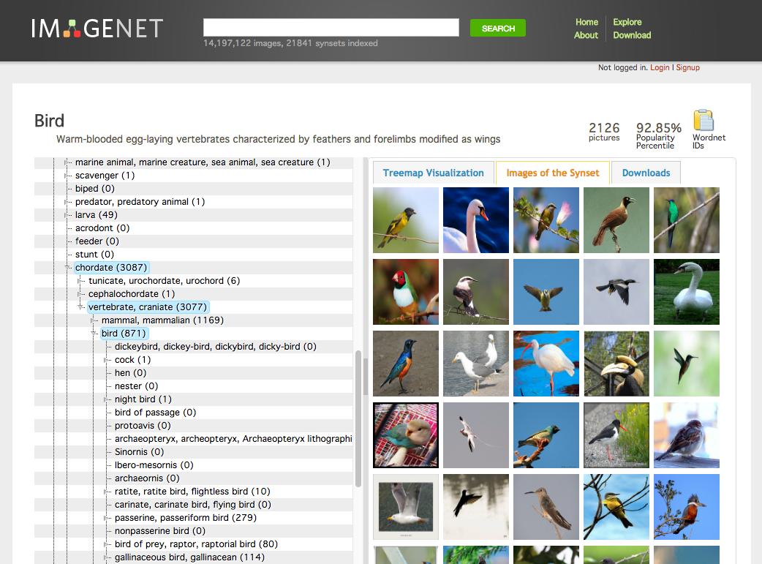
Notes:
http://image-net.org/explore?wnid=n01503061

Slide 53
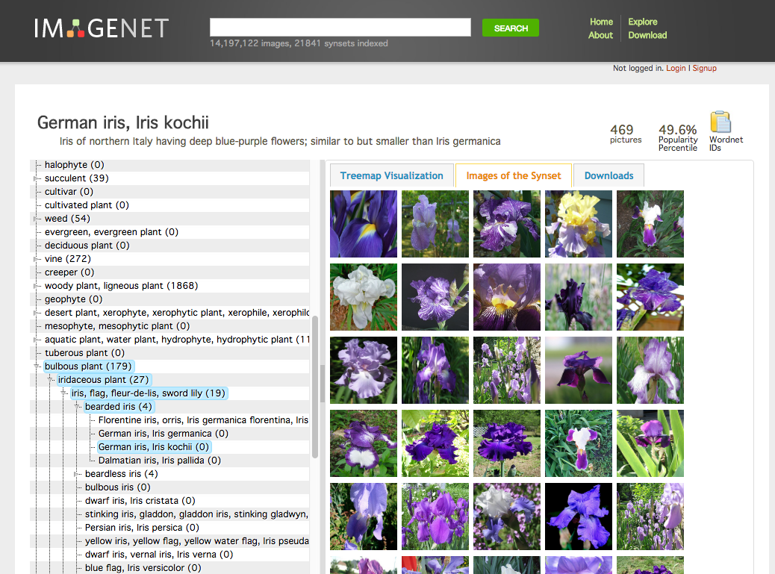
Notes:
http://image-net.org/synset?wnid=n12414159

Slide 54
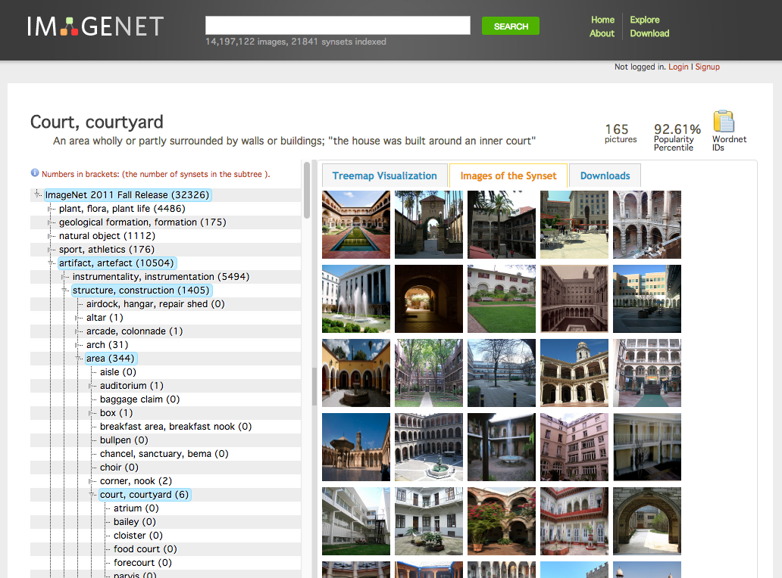
Notes:
http://image-net.org/explore?wnid=n04105893

Slide 55
Example: Image Classification
CNN for Image Classification
(Krizhevsky, Sutskever & Hinton, 2012)
15.3% error on ImageNet LSVRC-2012 contest
Input image (pixels)
Five convolutional layers
(w/max-pooling)
Three fully connected layers
1000-way softmax

Slide 56
CNNs for Image Recognition
Slide from Kaiming He

Slide 57
Recurrent Neural Networks

Slide 58
Dataset for Supervised
Part-of-Speech (POS) Tagging
Data:
n
v
p
d
n
y⁽¹⁾
Sample 1:
time
flies
like
an
arrow
x⁽¹⁾
n
n
v
d
n
y⁽²⁾
Sample 2:
time
flies
like
an
arrow
x⁽²⁾
n
v
p
n
n
y⁽³⁾
Sample 3:
flies
fly
with
their
wings
x⁽³⁾
p
n
n
v
v
y⁽⁴⁾
Sample 4:
with
time
you
will
see
x⁽⁴⁾
Notes:
Why would you want a model that’s not a linear chain?
Well, here’s an example.
Here I’ll generate tagged sentences.
When I pull a sample out of my pocket, sometimes it’s a tagging of “Time flies like an arrow” … but sometimes it’s a tagging of some other sentence.
Some sentences are more likely than others, and we are using POS tags to help model which sentences are likely.
The bigram “an arrow” is likely not because there’s a bigram parameter for it – there isn’t – but because the model captures something more general: determiners like to be followed by nouns.

Slide 59
Dataset for Supervised
Handwriting Recognition
Data:
Sample 1:
u
n
e
x
p
e
c
t
e
d
y⁽¹⁾
x⁽¹⁾
Sample 2:
v
o
l
c
a
n
i
c
y⁽²⁾
x⁽²⁾
Sample 2:
e
m
b
r
a
c
e
s
y⁽³⁾
x⁽³⁾
Figures from (Chatzis & Demiris, 2013)
Notes:
Why would you want a model that’s not a linear chain?
Well, here’s an example.
Here I’ll generate tagged sentences.
When I pull a sample out of my pocket, sometimes it’s a tagging of “Time flies like an arrow” … but sometimes it’s a tagging of some other sentence.
Some sentences are more likely than others, and we are using POS tags to help model which sentences are likely.
The bigram “an arrow” is likely not because there’s a bigram parameter for it – there isn’t – but because the model captures something more general: determiners like to be followed by nouns.

Slide 60
Dataset for Supervised
Phoneme (Speech) Recognition
Data:
Sample 1:
h#
dh
ih
s
w
uh
z
iy
z
iy
y⁽¹⁾
x⁽¹⁾
Sample 2:
f
ao
r
ah
s
s
h#
y⁽²⁾
x⁽²⁾
Figures from (Jansen & Niyogi, 2013)
Notes:
Why would you want a model that’s not a linear chain?
Well, here’s an example.
Here I’ll generate tagged sentences.
When I pull a sample out of my pocket, sometimes it’s a tagging of “Time flies like an arrow” … but sometimes it’s a tagging of some other sentence.
Some sentences are more likely than others, and we are using POS tags to help model which sentences are likely.
The bigram “an arrow” is likely not because there’s a bigram parameter for it – there isn’t – but because the model captures something more general: determiners like to be followed by nouns.

Slide 61
Time Series Data
Question 1: How could we apply the neural networks we’ve seen so far (which expect fixed size input/output) to a prediction task with variable length input/output?
n
v
p
d
n
y
time
flies
like
an
arrow
x

Slide 62
Time Series Data
Question 1: How could we apply the neural networks we’ve seen so far (which expect fixed size input/output) to a prediction task with variable length input/output?
n
v
p
d
n
y
time
flies
like
an
arrow
x
y₁
y₂
y₃
y₄
y₅
h₁
h₂
h₃
h₄
h₅
x₁
x₂
x₃
x₄
x₅

Slide 63
Time Series Data
Question 2: How could we incorporate context (e.g. words to the left/right, or tags to the left/right) into our solution?
y₁
y₂
y₃
y₄
y₅
y
x₁
x₂
x₃
x₄
x₅
x
Multiple Choice:
Working left-to-right, use features of…
 | x_{i-1} | x_{i} | x_{i+1} | y_{i-1} | y_{i} | y_{i+1}
A | ✓
B |  |  |  | ✓
C | ✓ |  |  | ✓
D | ✓ |  |  | ✓ | ✓ | ✓
E | ✓ | ✓ |  | ✓ | ✓ | ✓
F | ✓ | ✓ | ✓ | ✓
G | ✓ | ✓ | ✓ | ✓ | ✓
H | ✓ | ✓ | ✓ | ✓ | ✓ | ✓

Slide 64
Recurrent Neural Networks (RNNs)
Definition of the RNN:
y₁
y₂
y₃
y₄
y₅
h₁
h₂
h₃
h₄
h₅
x₁
x₂
x₃
x₄
x₅

Slide 65
Recurrent Neural Networks (RNNs)
Definition of the RNN:
y₁
y₂
y₃
y₄
y₅
h₁
h₂
h₃
h₄
h₅
x₁
x₂
x₃
x₄
x₅

Slide 66
Recurrent Neural Networks (RNNs)
Definition of the RNN:
If T=1, then we have a standard feed-forward neural net with one hidden layer
All of the deep nets from last lecture required fixed size inputs/outputs
y₁
h₁
x₁

Slide 67
Recurrent Neural Networks (RNNs)
Definition of the RNN:
y_{t}
h
x_{t}

Slide 68
Recurrent Neural Networks (RNNs)
Definition of the RNN:
By unrolling the RNN through time, we can share parameters and accommodate arbitrary length input/output pairs
Applications: time-series data such as sentences, speech, stock-market, signal data, etc.
y_{t}
h
x_{t}

Slide 69
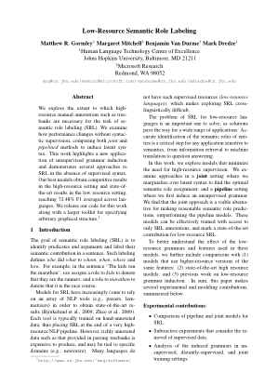
Background: Backprop through time
(Robinson & Fallside, 1987)
(Werbos, 1988)
(Mozer, 1995)
Recurrent neural network:
BPTT:
1. Unroll the computation over time
y₄
y_{t+1}
x₄
b₃
2. Run backprop through the resulting feed-forward network
x_{t+1}
x₃
b_{t}
b₂
a
x_{t}
x₂
b₁
a
x₁

Slide 70
Bidirectional RNN
Recursive Definition:
y_{t}
h
h
x_{t}

Slide 71
Bidirectional RNN
Recursive Definition:
y₁
y₂
y₃
y₄
h₁
h₂
h₃
h₄
h₁
h₂
h₃
h₄
x₁
x₂
x₃
x₄

Slide 72
Bidirectional RNN
Recursive Definition:
y₁
y₂
y₃
y₄
h₁
h₂
h₃
h₄
h₁
h₂
h₃
h₄
x₁
x₂
x₃
x₄

Slide 73
Bidirectional RNN
Recursive Definition:
y₁
y₂
y₃
y₄
Is there an analogy to some other recursive algorithm(s) we know?
h₁
h₂
h₃
h₄
h₁
h₂
h₃
h₄
x₁
x₂
x₃
x₄
Notes:
How do these

Slide 74
Deep RNNs
Recursive Definition:
Figure from (Graves et al., 2013)

Slide 75
Deep Bidirectional RNNs
y_{t}
h’
Notice that the upper level hidden units have input from two previous layers (i.e. wider input)
Likewise for the output layer
What analogy can we draw to DNNs, DBNs, DBMs?
h’
h
h
x_{t}
Figure from (Graves et al., 2013)
Notes:
Analogy: higher level hidden units are capturing high level features of the forward and backward context.

Slide 76
Long Short-Term Memory (LSTM)
Motivation:
Standard RNNs have trouble learning long distance dependencies
LSTMs combat this issue
y₁
y₂
…
y_{T-1}
y_{T}
h₁
h₂
…
h_{T-1}
h_{T}
x₁
x₂
…
x_{T-1}
x_{T}

Slide 77
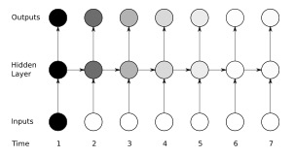
Long Short-Term Memory (LSTM)
Motivation:
Vanishing gradient problem for Standard RNNs
Figure shows sensitivity (darker = more sensitive) to the input at time t=1
Figure from (Graves, 2012)

Slide 78
Long Short-Term Memory (LSTM)
Motivation:
LSTM units have a rich internal structure
The various “gates” determine the propagation of information and can choose to “remember” or “forget” information
Figure from (Graves, 2012)

Slide 79
Long Short-Term Memory (LSTM)
y₁
y₂
y₃
y₄
x₁
x₂
x₃
x₄

Slide 80
Long Short-Term Memory (LSTM)
Input gate: masks out the standard RNN inputs
Forget gate: masks out the previous cell
Cell: stores the input/forget mixture
Output gate: masks out the values of the next hidden
Figure from (Graves et al., 2013)

Slide 81
Long Short-Term Memory (LSTM)
y₁
y₂
y₃
y₄
x₁
x₂
x₃
x₄

Slide 82
Deep Bidirectional LSTM (DBLSTM)
Figure: input/output layers not shown
Same general topology as a Deep Bidirectional RNN, but with LSTM units in the hidden layers
No additional representational power over DBRNN, but easier to learn in practice
Figure from (Graves et al., 2013)

Slide 83
Deep Bidirectional LSTM (DBLSTM)
How important is this particular architecture?
Jozefowicz et al. (2015) evaluated 10,000 different LSTM-like architectures and found several variants that worked just as well on several tasks.
Figure from (Graves et al., 2013)

Slide 84
Summary
CNNs
  Are used for all aspects of computer vision, and have won numerous pattern recognition competitions
  Able learn interpretable features at different levels of abstraction
  Typically, consist of convolution layers, pooling layers, nonlinearities, and fully connected layers
RNNs
  Applicable to tasks such as sequence labeling, speech recognition, machine translation, etc.
  Able to learn context features for time series data
  Vanishing gradients are still a problem – but LSTM units can help

Slide 85
Tutorials
LSTMs
  Christopher Olah’s blog
  http://colah.github.io/posts/2015-08-Understanding-LSTMs/
Convolutional Neural Networks
  Andrej Karpathy, CS231n Notes
  http://cs231n.github.io/convolutional-networks/

