Slide 1
Clustering.
Unsupervised Learning
Maria-Florina Balcan
10/17/2016

Slide 2
Clustering, Informal Goals
Goal: Automatically partition unlabeled data into groups of similar datapoints.
Question: When and why would we want to do this?
Useful for:
• Automatically organizing data.
• Understanding hidden structure in data.
• Preprocessing for further analysis.
• Representing high-dimensional data in a low-dimensional space (e.g., for visualization purposes).

Slide 3
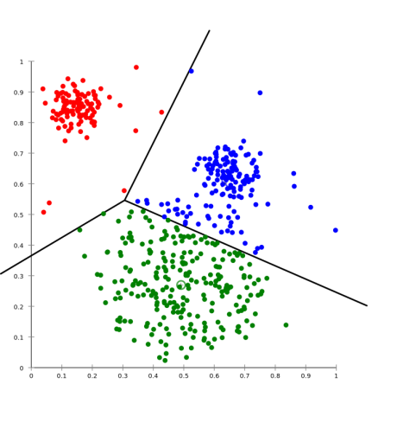
Clustering
Last time: Partitional objective based clustering
Focused on k-means and k-means ++
Lloyd’s method
Initialization techniques (random, furthest traversal, k-means++)
Today: hierarchical Clustering.
Single linkage, Complete linkage

Slide 4
What value of k???
Heuristic: Find large gap between k -1-means cost and k-means cost.
Hold-out validation/cross-validation on auxiliary task (e.g., supervised learning task).
Try hierarchical clustering.

Slide 5









Hierarchical Clustering
[sports]
All topics
[fashion]
sports
fashion
tennis
Lacoste
soccer
Gucci
A hierarchy might be more natural.
Different users might care about different levels of granularity or even prunings.

Slide 6
Hierarchical Clustering
Top-down (divisive)
Partition data into 2-groups (e.g., 2-means)
Recursively cluster each group.
Bottom-Up (agglomerative)
Start with every point in its own cluster.
All topics
Repeatedly merge the “closest” two clusters.
Different defs of “closest” give different algorithms.
sports
fashion
tennis
Lacoste
soccer
Gucci

Slide 7
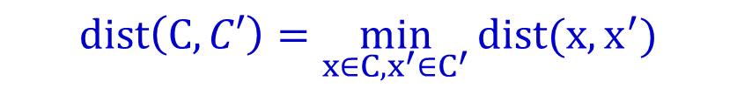
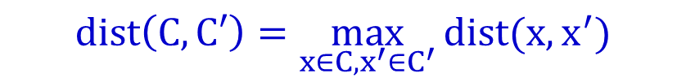

Bottom-Up (agglomerative)
Have a distance measure on pairs of objects.
All topics
d(x,y) – distance between x and y
sports
fashion
E.g., # keywords in common, edit distance, etc
soccer
tennis
Gucci
Lacoste
Single linkage:
$$dist\left(C,C′\right)=\min_{x∈C,x^{′}∈C^{′}}{dist(x,x^{′})}$$
Complete linkage:
$$dist\left(C,C′\right)=\max_{x∈C,x^{′}∈C^{′}}{dist(x,x^{′})}$$
Average linkage:
$$dist\left(C,C′\right)=\underset{x∈C,x^{′}∈C^{′}}{avg}{dist(x,x^{′})}$$

Slide 8
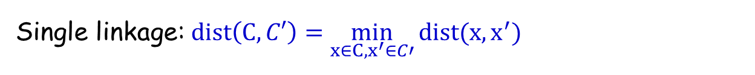
Single Linkage
Bottom-up (agglomerative)
Start with every point in its own cluster.
Repeatedly merge the “closest” two clusters.
Single linkage: $dist\left(C,C′\right)=\min_{x∈C,x^{′}∈C′}{dist(x,x^{′})}$
Dendogram
5
A B C D E F
4
A B C D E
3
A B C
1
A B
2
D E
-3
-2
0
2.1
3.2
6
A
B
C
D
E
F

Slide 9
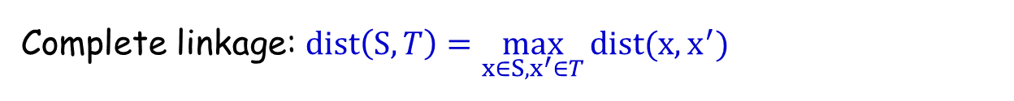
Complete Linkage
Bottom-up (agglomerative)
Start with every point in its own cluster.
Repeatedly merge the “closest” two clusters.
Complete linkage: $dist\left(S,T\right)=\max_{x∈S,x^{′}∈T}{dist(x,x^{′})}$
One way to think of it: keep max diameter as small as possible at any level.
5
A B C D E F
3
A B C
4
DEF
1
A B
2
D E
-3
-2
0
2.1
3.2
6
A
B
C
D
E
F

Slide 10
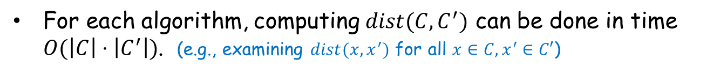
Running time for Single and Complete Linkage
Each algorithm starts with N clusters, and performs N-1 merges.
For each algorithm, computing $dist(C,C^{′})$ can be done in time $O(\left|C\right|⋅\left|C^{′}\right|)$. (e.g., examining $dist(x,x^{′})$ for all $x∈C, x^{′}∈C′$)
Time to compute all pairwise distances and take smallest is $O(N^{2})$.
Overall time is $O(N^{3})$.
In fact, can run all these algorithms in time $O(N^{2}\log{N)}$.
If curious, see: Christopher D. Manning, Prabhakar Raghavan and Hinrich Schütze, Introduction to Information Retrieval, Cambridge University Press. 2008. http://www-nlp.stanford.edu/IR-book/

Slide 11
What You Should Know
Partitional Clustering. k-means and k-means ++
Lloyd’s method
Initialization techniques (random, furthest traversal, k-means++)
Hierarchical Clustering.
Single linkage, Complete linkage

