Slide 1
The Boosting Approach to Machine Learning
Maria-Florina Balcan
10/31/2016

Slide 2
Boosting
General method for improving the accuracy of any given learning algorithm.
Works by creating a series of challenge datasets s.t. even modest performance on these can be used to produce an overall high-accuracy predictor.
Works amazingly well in practice --- Adaboost and its variations one of the top 10 algorithms.
Backed up by solid foundations.
Notes:
Add a slide with Adaboost!

Slide 3
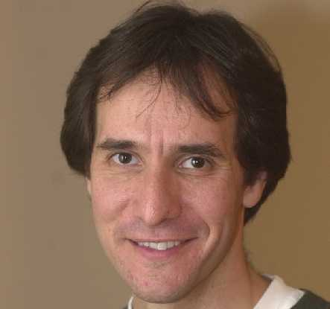
Readings:
The Boosting Approach to Machine Learning: An Overview. Rob Schapire, 2001
Theory and Applications of Boosting. NIPS tutorial.
http://www.cs.princeton.edu/~schapire/talks/nips-tutorial.pdf
Plan for today:
Motivation.
A bit of history.
Adaboost: algo, guarantees, discussion.
Focus on supervised classification.
Notes:
Add a slide with Adaboost!

Slide 4


An Example: Spam Detection
E.g., classify which emails are spam and which are important.
Not spam
spam
Key observation/motivation:
Easy to find rules of thumb that are often correct.
E.g., “If buy now in the message, then predict spam.”
E.g., “If say good-bye to debt in the message, then predict spam.”
Harder to find single rule that is very highly accurate.
Notes:
Add a slide with Adaboost!

Slide 5




An Example: Spam Detection
Boosting: meta-procedure that takes in an algo for finding rules of thumb (weak learner). Produces a highly accurate rule, by calling the weak learner repeatedly on cleverly chosen datasets.
$$h_{1}$$
$$h_{2}$$
$$h_{3}$$
Emails
…
$$h_{T}$$
apply weak learner to a subset of emails, obtain rule of thumb
apply to 2nd subset of emails, obtain 2nd rule of thumb
apply to 3rd subset of emails, obtain 3rd rule of thumb
repeat T times; combine weak rules into a single highly accurate rule.
Notes:
Add a slide with Adaboost!

Slide 6
Boosting: Important Aspects
How to choose examples on each round?
Typically, concentrate on “hardest” examples (those most often misclassified by previous rules of thumb)
How to combine rules of thumb into single prediction rule?
take (weighted) majority vote of rules of thumb
Notes:
Add a slide with Adaboost!

Slide 7
Historically….
Notes:
Add a slide with Adaboost!

Slide 8
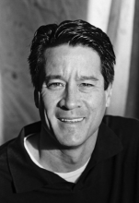
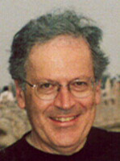
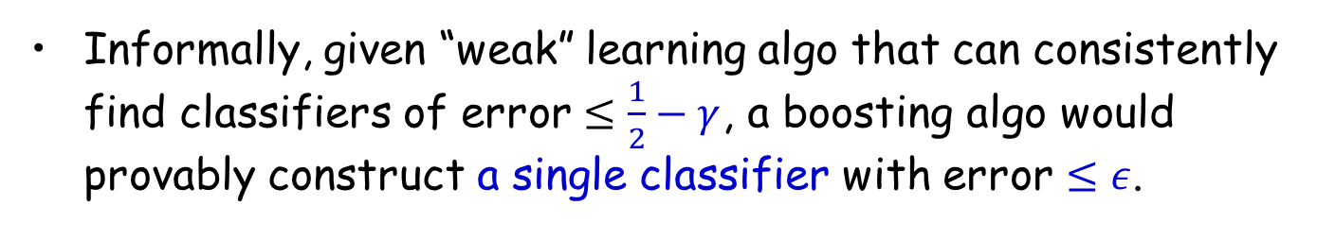
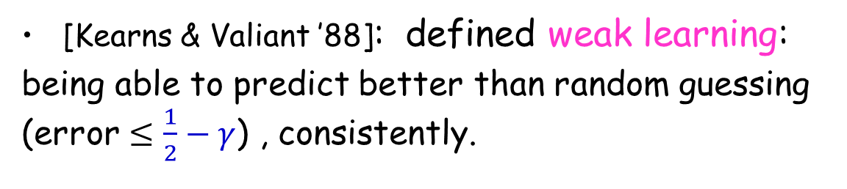
Weak Learning vs Strong Learning
[Kearns & Valiant ’88]: defined weak learning:
being able to predict better than random guessing (error $≤\frac{1}{2}−γ$) , consistently.
Posed an open pb: “Does there exist a boosting algo that turns a weak learner into a strong learner (that can produce arbitrarily accurate hypotheses)?”
Informally, given “weak” learning algo that can consistently find classifiers of error $≤\frac{1}{2}−γ$, a boosting algo would provably construct a single classifier with error $≤ε$.

Slide 9


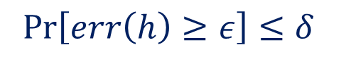
Weak Learning vs Strong/PAC Learning
Strong (PAC) Learning
Weak Learning
$∃$algo A
$∀ c∈H$
$∀D$
$∀ ε>0$
$∀ δ>0$
A produces h s.t.:
$∃$algo A
$∃γ>0$
$∀ c∈H$
$∀D$
$∀ ε>\frac{1}{2}−γ$
$∀ δ>0$
A produces h s.t.
$$Pr\left[err\left(h\right)≥ε\right]≤δ$$
$$Pr\left[err\left(h\right)≥ε\right]≤δ$$
[Kearns & Valiant ’88]: defined weak learning & posed an open pb of finding a boosting algo.

Slide 10
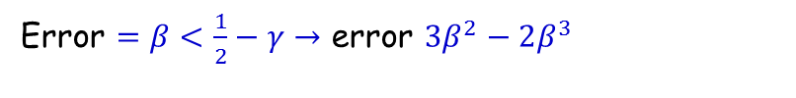
Surprisingly….
Weak Learning =Strong Learning
Original Construction [Schapire ’89]:
poly-time boosting algo, exploits that we can learn a little on every distribution.
A modest booster obtained via calling the weak learning algorithm on 3 distributions.
Error $=β<\frac{1}{2}−γ→$ error $3β^{2}−2β^{3}$
Then amplifies the modest boost of accuracy by running this somehow recursively.
Cool conceptually and technically, not very practical.
Notes:
Learn h1 from D0 with error < 49%
Modify D0 so that h1 has error 50% (call this D1)
If heads wait for an example x where h1(x)=f(x), otherwise wait for an example where h1(x)!=f(x).
Learn h2 from D1 with error < 49%
Modify D1 so that h1 and h2 always disagree (call this D2)
Learn h3 from D2 with error <49%.
Now vote h1,h2, and h3. This has error better than any of the “weak” hypotheses h1,h2 or h3.
Repeat this as needed to lower the error rate more….

Slide 11
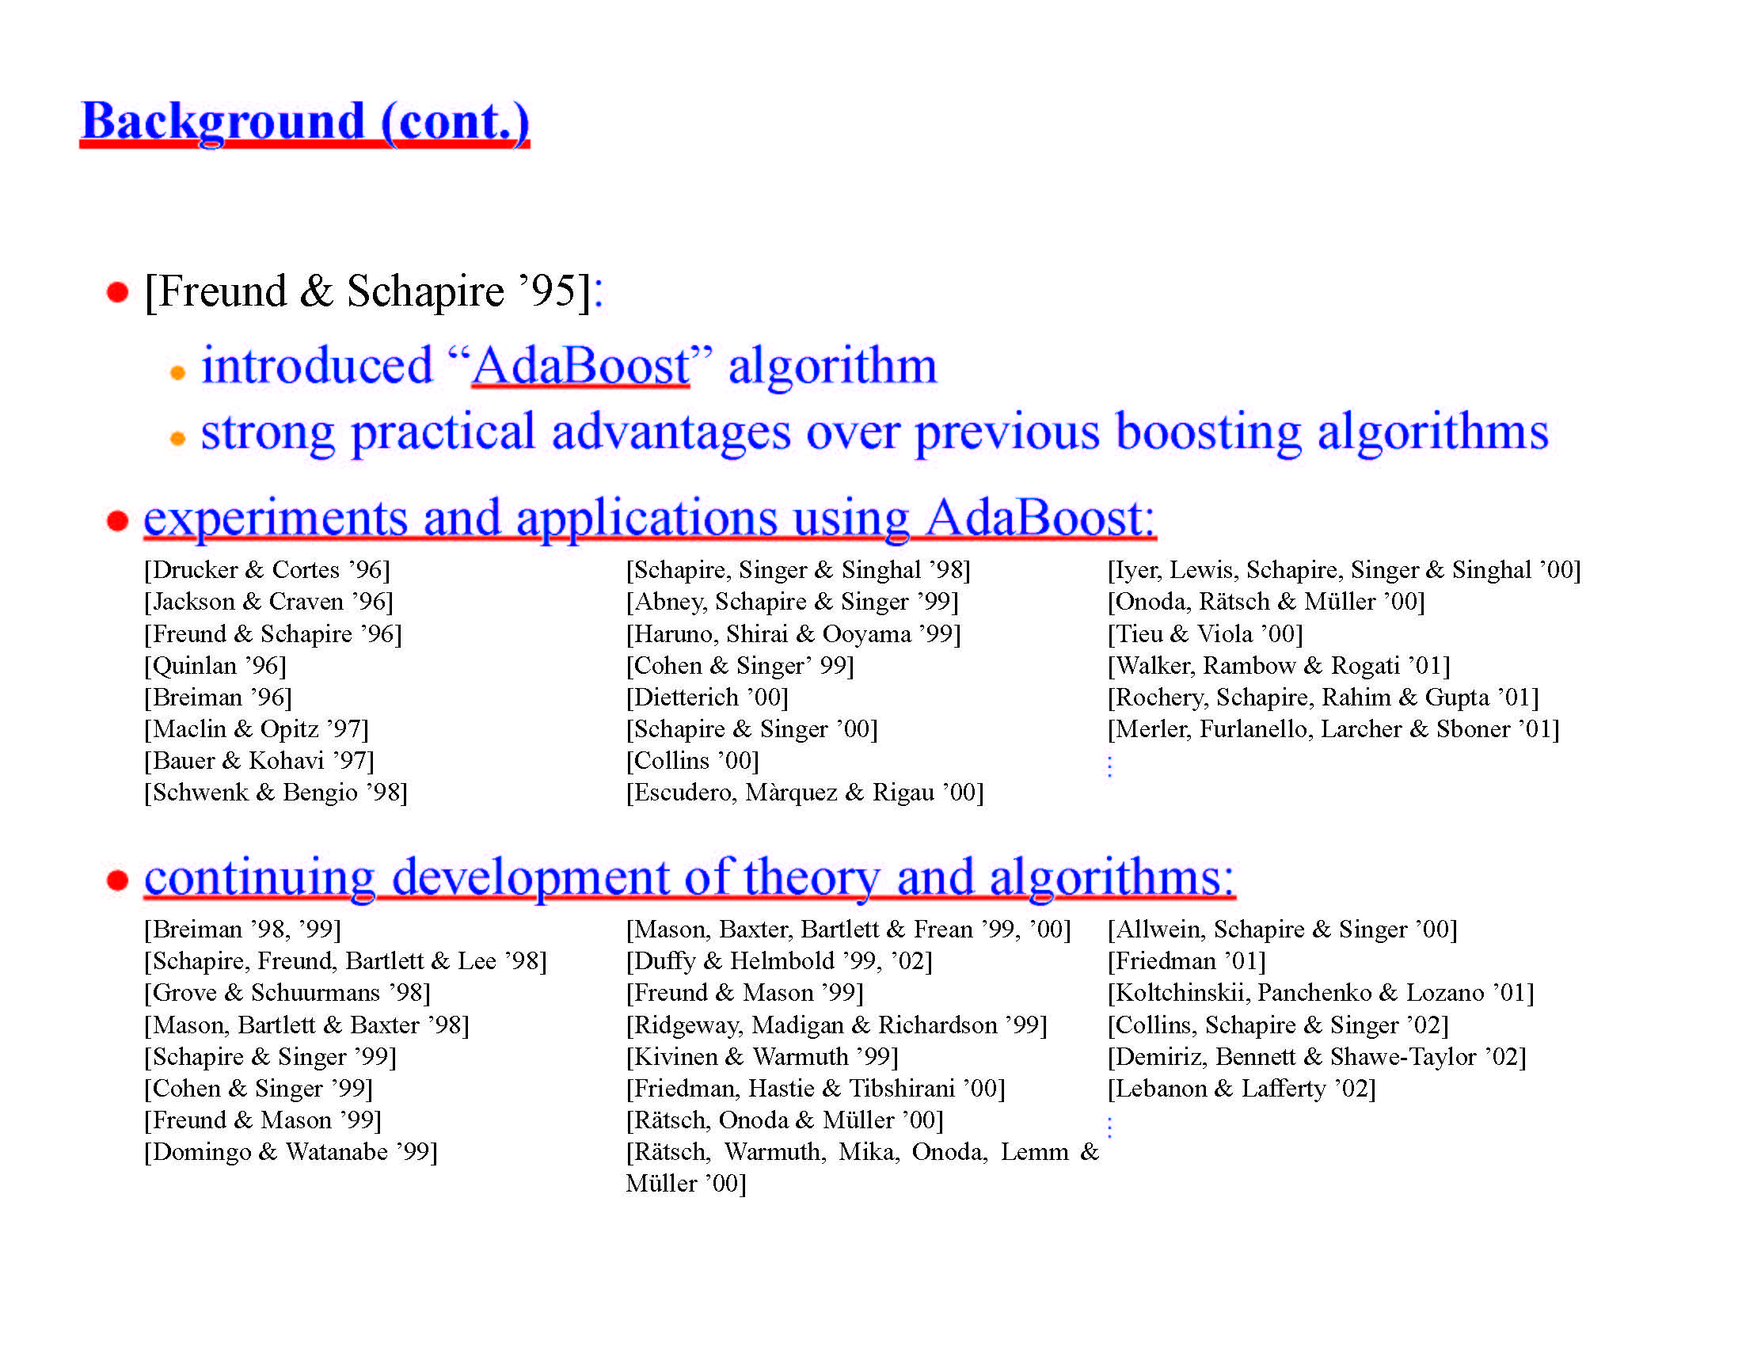
An explosion of subsequent work
Notes:
Add a slide with Adaboost!

Slide 12
Adaboost (Adaptive Boosting)
“A Decision-Theoretic Generalization of On-Line Learning and an Application to Boosting”
[Freund-Schapire, JCSS’97]
Godel Prize winner 2003
Notes:
Add a slide with Adaboost!

Slide 13
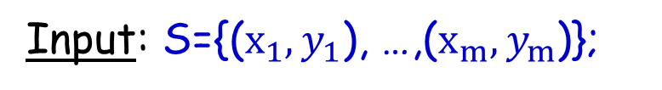
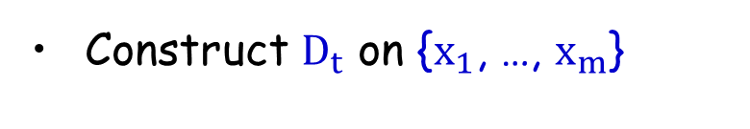
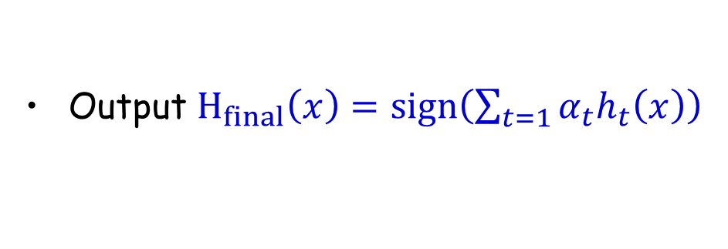



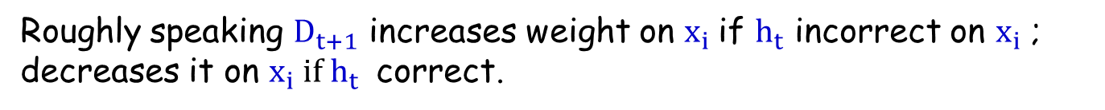
Informal Description Adaboost
Boosting: turns a weak algo into a strong learner.
Input: S={($x_{1},y_{1}$), …,($x_{m},y_{m}$)};
$x_{i}∈X$, $y_{i}∈Y=\{−1,1\}$
weak learning algo A (e.g., Naïve Bayes, decision stumps)
+
+
+
+
+
For t=1,2, … ,T
$$h_{t}$$
+
Construct $D_{t}$ on {$x_{1}$, …, $x_{m}$}
+
+
-
-
-
Run A on $D_{t}$ producing $h_{t}:X→\{−1,1\}$ (weak classifier)
-
-
-
-
-
$ϵ_{t}=P_{{x_{i} \sim D}_{t}}(h_{t}\left(x_{i}\right)≠y_{i})$ error of $h_{t}$ over $D_{t}$
Output $H_{final}\left(x\right)=sign\left(\sum_{t=1}{α_{t}h_{t}\left(x\right)}\right)$
Roughly speaking $D_{t+1}$ increases weight on $x_{i}$if $h_{t}$ incorrect on $x_{i}$ ; decreases it on $x_{i} if h_{t}$ correct.
Notes:
Add a slide with Adaboost!

Slide 14
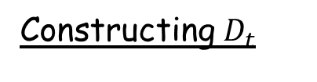
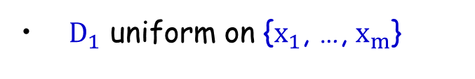
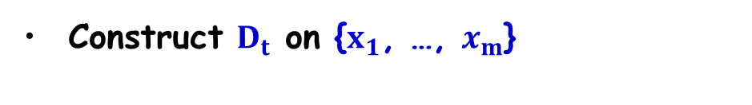

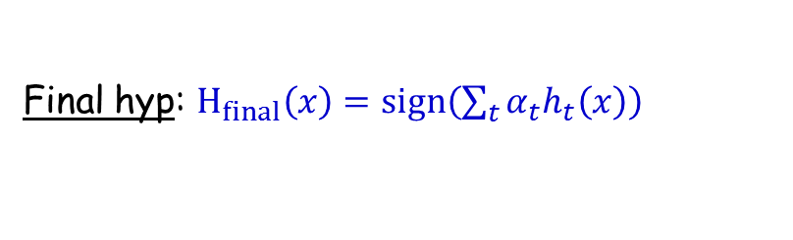


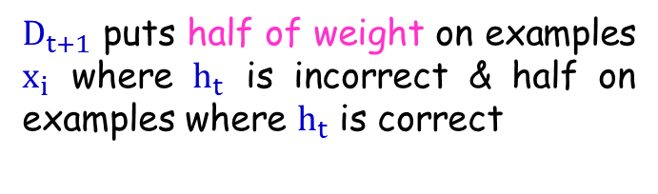
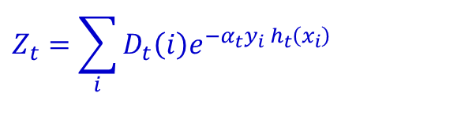
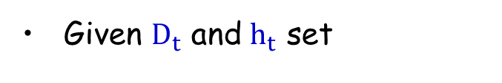
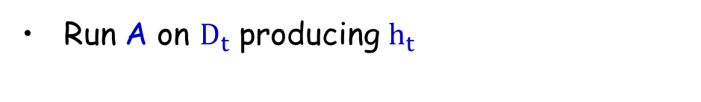
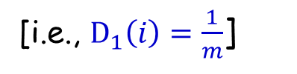
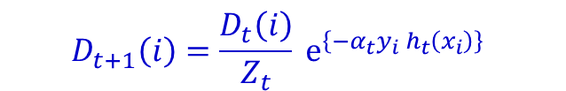
Adaboost (Adaptive Boosting)
Weak learning algorithm A.
For t=1,2, … ,T
Construct $D_{t}$ on {$x_{1}$, …, $x_{m}$}
Run A on $D_{t}$ producing $h_{t}$
Constructing $D_{t}$
$D_{1}$ uniform on {$x_{1}$, …, $x_{m}$}
[i.e., $D_{1}\left(i\right)=\frac{1}{m}$]
Given $D_{t}$ and $h_{t}$ set
$$D_{t+1}\left(i\right)=\frac{D_{t}\left(i\right)}{Z_{t}} e^{\left\{−α_{t}y_{i} h_{t}\left(x_{i}\right)\right\} }$$
$D_{t+1}\left(i\right)=\frac{D_{t}\left(i\right)}{Z_{t}} e^{\left\{−α_{t}\right\} }$ if$y_{i}=h_{t}\left(x_{i}\right)$
$D_{t+1}\left(i\right)=\frac{D_{t}\left(i\right)}{Z_{t}} e^{\left\{α_{t}\right\} }$ if$y_{i}≠h_{t}\left(x_{i}\right)$
$$Z_{t}=\sum_{i}{D_{t}\left(i\right)e^{−α_{t}y_{i} h_{t}\left(x_{i}\right)}}$$
$$α_{t}=\frac{1}{2}\ln\left(\frac{1−ε_{t}}{ε_{t}}\right)>0$$
$D_{t+1}$ puts half of weight on examples $x_{i}$ where $h_{t}$ is incorrect & half on examples where $h_{t}$ is correct
Final hyp: $H_{final}\left(x\right)=sign\left(\sum_{t}{α_{t}h_{t}\left(x\right)}\right)$
Notes:
Add a slide with Adaboost!

Slide 15
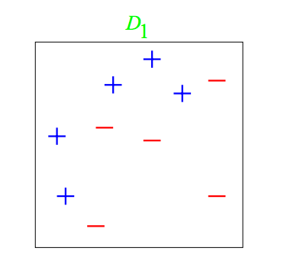
Adaboost: A toy example
Weak classifiers: vertical or horizontal half-planes (a.k.a. decision stumps)

Slide 16
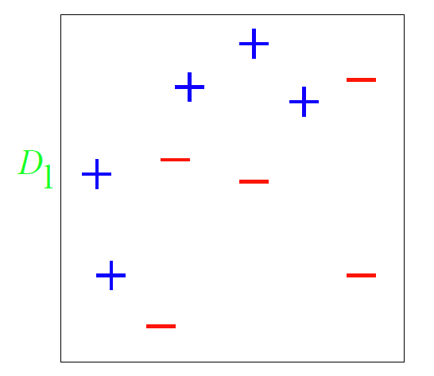
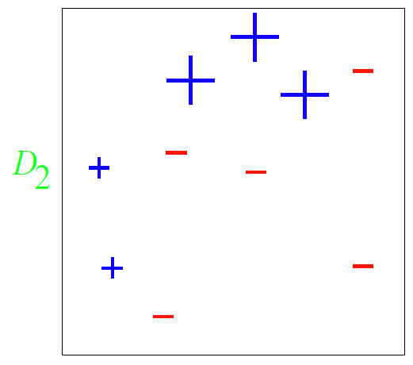
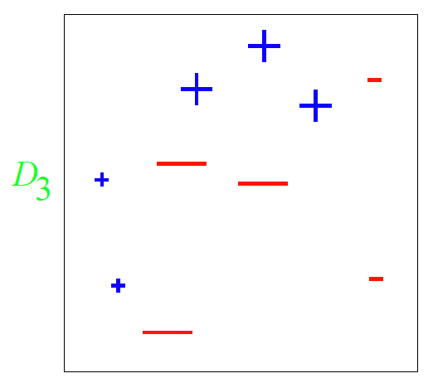
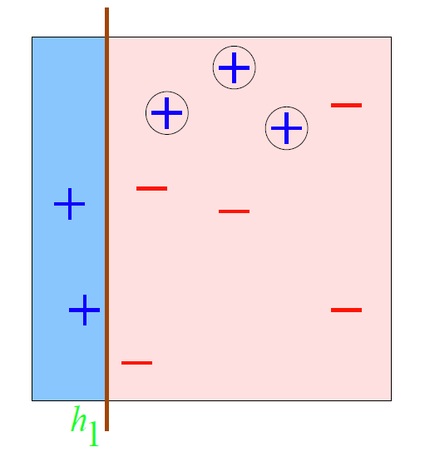
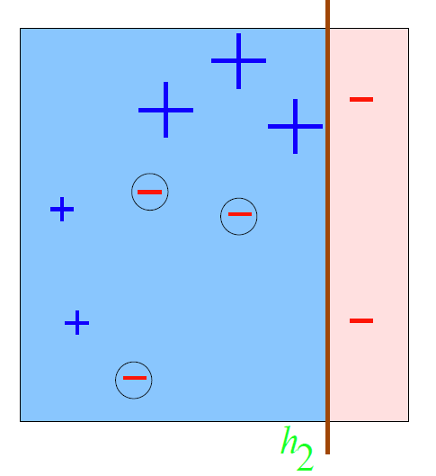
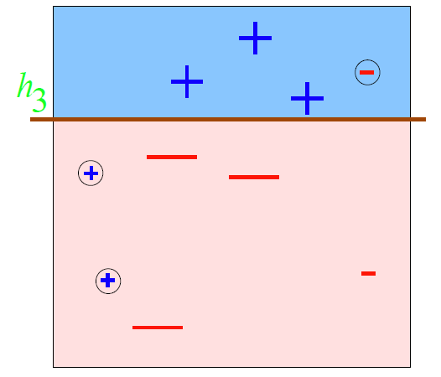
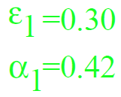
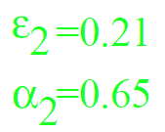
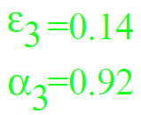
Adaboost: A toy example

Slide 17
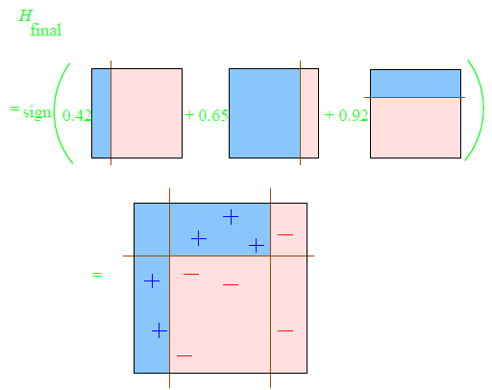
Adaboost: A toy example

Slide 18


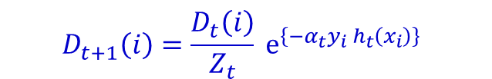
Adaboost (Adaptive Boosting)
Weak learning algorithm A.
For t=1,2, … ,T
Construct $D_{t}$ on {$x_{1}$, …, $x_{m}$}
Run A on $D_{t}$ producing $h_{t}$
Constructing $D_{t}$
$D_{1}$ uniform on {$x_{1}$, …, $x_{m}$}
[i.e., $D_{1}\left(i\right)=\frac{1}{m}$]
Given $D_{t}$ and $h_{t}$ set
$D_{t+1}\left(i\right)=\frac{D_{t}\left(i\right)}{Z_{t}} e^{\left\{−α_{t}\right\} }$ if$y_{i}=h_{t}\left(x_{i}\right)$
$$D_{t+1}\left(i\right)=\frac{D_{t}\left(i\right)}{Z_{t}} e^{\left\{−α_{t}y_{i} h_{t}\left(x_{i}\right)\right\} }$$
$D_{t+1}\left(i\right)=\frac{D_{t}\left(i\right)}{Z_{t}} e^{\left\{α_{t}\right\} }$ if$y_{i}≠h_{t}\left(x_{i}\right)$
$$α_{t}=\frac{1}{2}\ln\left(\frac{1−ε_{t}}{ε_{t}}\right)>0$$
$D_{t+1}$ puts half of weight on examples $x_{i}$ where $h_{t}$ is incorrect & half on examples where $h_{t}$ is correct
Final hyp: $H_{final}\left(x\right)=sign\left(\sum_{t}{α_{t}h_{t}\left(x\right)}\right)$
Notes:
Add a slide with Adaboost!

Slide 19
Nice Features of Adaboost
Very general: a meta-procedure, it can use any weak learning algorithm!!!
(e.g., Naïve Bayes, decision stumps)
Very fast (single pass through data each round) & simple to code, no parameters to tune.
Shift in mindset: goal is now just to find classifiers a bit better than random guessing.
Grounded in rich theory.

Slide 20


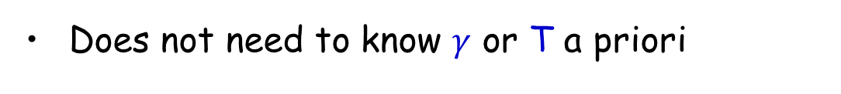
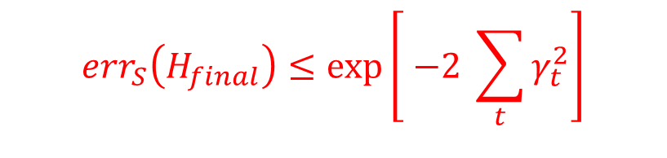
Guarantees about the Training Error
Theorem
$ε_{t}=1/2−γ_{t}$ (error of $h_{t}$ over $D_{t}$)
$$err_{S}\left(H_{final}\right)≤\exp\left[ −2 \sum_{t}{γ_{t}^{2}}\right]$$
So, if
$∀t, γ_{t}≥γ>0$, then $err_{S}\left(H_{final}\right)≤\exp\left[ −2 γ^{2}T\right]$
The training error drops exponentially in T!!!
To get $err_{S}\left(H_{final}\right)≤ε$, need only $T=O\left(\frac{1}{γ^{2}}\log\left(\frac{1}{ε}\right)\right)$rounds
Adaboost is adaptive
Does not need to know $γ$ or T a priori
$$γ_{t}≫ γ$$
Can exploit
Notes:
Add a slide with Adaboost!

Slide 21

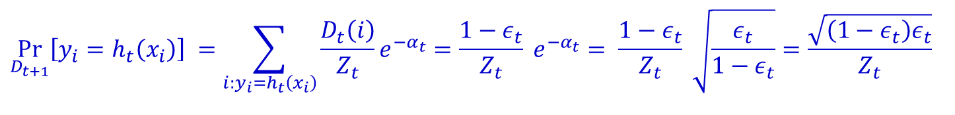

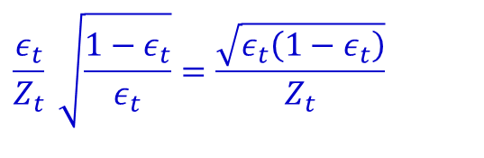
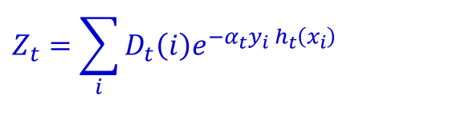

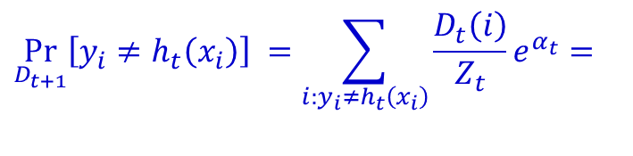
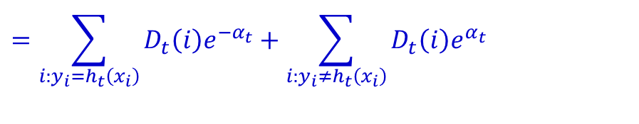
Understanding the Updates & Normalization
Claim: $D_{t+1}$ puts half of the weight on $x_{i}$ where $h_{t}$ was incorrect and half of the weight on $x_{i}$ where $h_{t}$ was correct.
Recall $D_{t+1}\left(i\right)=\frac{D_{t}\left(i\right)}{Z_{t}} e^{\left\{−α_{t}y_{i} h_{t}\left(x_{i}\right)\right\} }$
Probabilities are equal!
$$\underset{D_{t+1}}{Pr}\left[y_{i}≠h_{t}\left(x_{i}\right)\right] =\sum_{i:y_{i}≠h_{t}\left(x_{i}\right)}{\frac{D_{t}\left(i\right)}{Z_{t}}e^{α_{t}}}=$$
$$ε_{t} \frac{1}{Z_{t}} e^{α_{t}}=$$
$$\frac{ε_{t}}{Z_{t}} \sqrt{\frac{{1−ε}_{t}}{ε_{t}}}=\frac{\sqrt{ε_{t}\left(1−ε_{t}\right)}}{Z_{t}}$$
$$\underset{D_{t+1}}{Pr}\left[y_{i}=h_{t}\left(x_{i}\right)\right] =\sum_{i:y_{i}=h_{t}\left(x_{i}\right)}{\frac{D_{t}\left(i\right)}{Z_{t}}e^{−α_{t}}}=\frac{1−ε_{t}}{Z_{t}} e^{−α_{t}}= \frac{1−ε_{t}}{Z_{t}} \sqrt{\frac{ε_{t}}{1−ε_{t}}}=\frac{\sqrt{\left(1−ε_{t}\right)ε_{t}}}{Z_{t}}$$
$$Z_{t}=\sum_{i}{D_{t}\left(i\right)e^{−α_{t}y_{i} h_{t}\left(x_{i}\right)}}$$
$$=\sum_{i:y_{i}=h_{t}\left(x_{i}\right)}{D_{t}\left(i\right)e^{−α_{t}}}+\sum_{i:y_{i}≠h_{t}\left(x_{i}\right)}{D_{t}\left(i\right)e^{α_{t}}}$$
$$=\left(1−ε_{t}\right)e^{−α_{t}}+ε_{t}e^{α_{t}}=2\sqrt{ε_{t}\left(1−ε_{t}\right)}$$
Notes:
Add a slide with Adaboost!

Slide 22
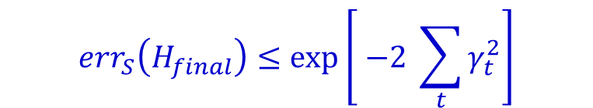
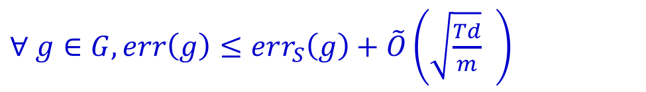
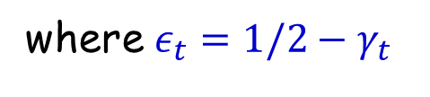
Generalization Guarantees (informal)
$$err_{S}\left(H_{final}\right)≤\exp\left[ −2 \sum_{t}{γ_{t}^{2}}\right]$$
Theorem
where $ε_{t}=1/2−γ_{t}$
How about generalization guarantees?
Original analysis [Freund&Schapire’97]
Let H be the set of rules that the weak learner can use
Let G be the set of weighted majority rules over T elements of H (i.e., the things that AdaBoost might output)
Theorem [Freund&Schapire’97]
T= # of rounds
$∀ g∈G, err\left(g\right)≤err_{S}\left(g\right)+\tilde{O}\left(\sqrt{\frac{Td}{m}} \right)$
d= VC dimension of H

Slide 23
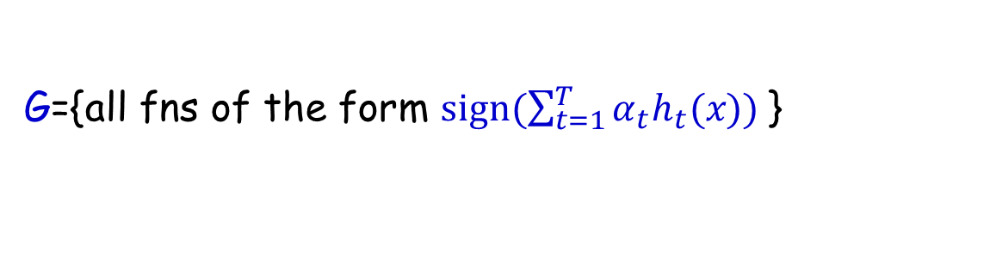
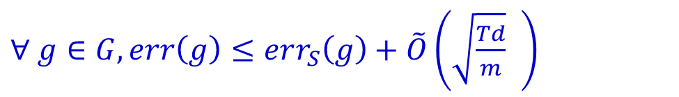
Generalization Guarantees
$$err_{S}\left(H_{final}\right)≤\exp\left[ −2 \sum_{t}{γ_{t}^{2}}\right]$$
Theorem
where $ε_{t}=1/2−γ_{t}$
How about generalization guarantees?
Original analysis [Freund&Schapire’97]
H space of weak hypotheses; d=VCdim(H)
$H_{final}$ is a weighted vote, so the hypothesis class is:
G={all fns of the form $sign(\sum_{t=1}^{T}{α_{t}h_{t}(x)) }$}
Theorem [Freund&Schapire’97]
$∀ g∈G, err\left(g\right)≤err_{S}\left(g\right)+\tilde{O}\left(\sqrt{\frac{Td}{m}} \right)$
T= # of rounds
Key reason: $VCdim\left(G\right)=\tilde{O}\left(dT\right)$ plus typical VC bounds.

Slide 24

Generalization Guarantees
Theorem [Freund&Schapire’97]
T= # of rounds
$∀ g∈G, err\left(g\right)≤err_{S}\left(g\right)+\tilde{O}\left(\sqrt{\frac{Td}{m}} \right)$
d= VC dimension of H
generalization
error
error
train error
complexity
T= # of rounds

Slide 25

Generalization Guarantees
Experiments with boosting showed that the test error of the generated classifier usually does not increase as its size becomes very large.
Experiments showed that continuing to add new weak learners after correct classification of the training set had been achieved could further improve test set performance!!!

Slide 26
Generalization Guarantees
Experiments with boosting showed that the test error of the generated classifier usually does not increase as its size becomes very large.
Experiments showed that continuing to add new weak learners after correct classification of the training set had been achieved could further improve test set performance!!!
These results seem to contradict FS’87 bound and Occam’s razor (in order achieve good test error the classifier should be as simple as possible)!

Slide 27
How can we explain the experiments?
R. Schapire, Y. Freund, P. Bartlett, W. S. Lee. present in “Boosting the margin: A new explanation for the effectiveness of voting methods” a nice theoretical explanation.
Key Idea:
Training error does not tell the whole story.
We need also to consider the classification confidence!!
Notes:
Add a slide with Adaboost!

Slide 28
What you should know
The difference between weak and strong learners.
AdaBoost algorithm and intuition for the distribution update step.
The training error bound for Adaboost and overfitting/generalization guarantees aspects.
Notes:
Add a slide with Adaboost!

Slide 29
Advanced (Not required) Material
Notes:
Add a slide with Adaboost!

Slide 30






Analyzing Training Error: Proof Intuition
Theorem
$ε_{t}=1/2−γ_{t}$ (error of $h_{t}$ over $D_{t}$)
$$err_{S}\left(H_{final}\right)≤\exp\left[ −2 \sum_{t}{γ_{t}^{2}}\right]$$
On round $t$, we increase weight of $x_{i}$ for which $h_{t}$ is wrong.
If $H_{final}$ incorrectly classifies $x_{i}$,
- Then $x_{i}$ incorrectly classified by (wtd) majority of $h_{t}$’s.
- Which implies final prob. weight of $x_{i}$ is large.
Can show probability $≥\frac{1}{m}\left(\frac{1}{\prod_{t}{Z_{t}}}\right)$
Since sum of prob. $=1$, can’t have too many of high weight.
Can show # incorrectly classified $≤m \left(\prod_{t}{Z_{t}}\right)$.
And $(\prod_{t}{Z_{t})→0}.$

Slide 31



Analyzing Training Error: Proof Math
Step 1: unwrapping recurrence: $D_{T+1}\left(i\right)= \frac{1}{m}$ $\left(\frac{\exp\left({−y}_{i}f\left(x_{i}\right)\right)}{\prod_{t}{Z_{t}}}\right)$ where $f\left(x_{i}\right)=\sum_{t}{α_{t}h_{t}\left(x_{i}\right)}$.
[Unthresholded weighted vote of $h_{i}$ on $x_{i}$ ]
Step 2:${ err}_{S}\left(H_{final}\right)≤\prod_{t}{Z_{t}.}$
Step 3: $\prod_{t}{Z_{t}=\prod_{t}{2\sqrt{ε_{t}\left(1−ε_{t}\right)}}=\prod_{t}{\sqrt{1−4γ_{t}^{2}}}≤e^{−2\sum_{t}{γ_{t}^{2}}}}$

Slide 32





Analyzing Training Error: Proof Math
Step 1: unwrapping recurrence: $D_{T+1}\left(i\right)= \frac{1}{m}$ $\left(\frac{\exp\left({−y}_{i}f\left(x_{i}\right)\right)}{\prod_{t}{Z_{t}}}\right)$ where $f\left(x_{i}\right)=\sum_{t}{α_{t}h_{t}\left(x_{i}\right)}$.
Recall $D_{1}\left(i\right)=\frac{1}{m}$ and $D_{t+1}\left(i\right)=D_{t}\left(i\right)$ $\frac{\exp\left(−y_{i}α_{t}h_{t}\left(x_{i}\right)\right)}{Z_{t}}$
${ D}_{T+1}\left(i\right)=$ $\frac{\exp\left(−y_{i}α_{T}h_{T}\left(x_{i}\right)\right)}{Z_{T}}×D_{T}\left(i\right)$
$=$ $\frac{\exp\left(−y_{i}α_{T}h_{T}\left(x_{i}\right)\right)}{Z_{T}}×\frac{\exp\left(−y_{i}α_{T−1}h_{T−1}\left(x_{i}\right)\right)}{Z_{T−1}}{×D}_{T−1}\left(i\right)$
$$…….$$
$=$ $\frac{\exp\left(−y_{i}α_{T}h_{T}\left(x_{i}\right)\right)}{Z_{T}}×⋯×\frac{\exp\left(−y_{i}α_{1}h_{1}\left(x_{i}\right)\right)}{Z_{1}}$ $\frac{1}{m}$
$=\frac{1}{m}$ $\frac{\exp\left(−y_{i}f\left(x_{i}\right)\right)}{\prod_{t}{Z_{t}}}$
$=\frac{1}{m}$ $\frac{\exp\left(−y_{i}{(α}_{1}h_{1}\left(x_{i}\right)+…+α_{T}h_{T}\left(x_{T}\right))\right)}{Z_{1}⋯Z_{T}}$

Slide 33










Analyzing Training Error: Proof Math
Step 1: unwrapping recurrence: $D_{T+1}\left(i\right)= \frac{1}{m}$ $\left(\frac{\exp\left({−y}_{i}f\left(x_{i}\right)\right)}{\prod_{t}{Z_{t}}}\right)$ where $f\left(x_{i}\right)=\sum_{t}{α_{t}h_{t}\left(x_{i}\right)}$.
Step 2:${ err}_{S}\left(H_{final}\right)≤\prod_{t}{Z_{t}.}$
$${ err}_{S}\left(H_{final}\right)=\frac{1}{m}\sum_{i}{1_{y_{i}≠H_{final}\left(x_{i}\right)}}$$
exp loss
$$=\frac{1}{m}\sum_{i}{1_{y_{i}f\left(x_{i}\right)≤0}}$$
0/1 loss
1
$$≤\frac{1}{m}\sum_{i}{\exp\left(−y_{i}f\left(x_{i}\right)\right)}$$
0
$$=\sum_{i}{D_{T+1}\left(i\right)\prod_{t}{Z_{t}}}$$
$=\prod_{t}{Z_{t}.}$

Slide 34

Analyzing Training Error: Proof Math
Step 1: unwrapping recurrence: $D_{T+1}\left(i\right)= \frac{1}{m}$ $\left(\frac{\exp\left({−y}_{i}f\left(x_{i}\right)\right)}{\prod_{t}{Z_{t}}}\right)$ where $f\left(x_{i}\right)=\sum_{t}{α_{t}h_{t}\left(x_{i}\right)}$.
Step 2:${ err}_{S}\left(H_{final}\right)≤\prod_{t}{Z_{t}.}$
Step 3: $\prod_{t}{Z_{t}=\prod_{t}{2\sqrt{ε_{t}\left(1−ε_{t}\right)}}=\prod_{t}{\sqrt{1−4γ_{t}^{2}}}≤e^{−2\sum_{t}{γ_{t}^{2}}}}$
Note: recall $Z_{t}=\left(1−ε_{t}\right)e^{−α_{t}}+ε_{t}e^{α_{t}}=2\sqrt{ε_{t}\left(1−ε_{t}\right)}$
$α_{t}$ minimizer of $α→\left(1−ε_{t}\right)e^{−α}+ε_{t}e^{α}$

