Slide 1
Active Learning
Maria-Florina Balcan
10/02/2016

Slide 2


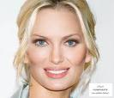
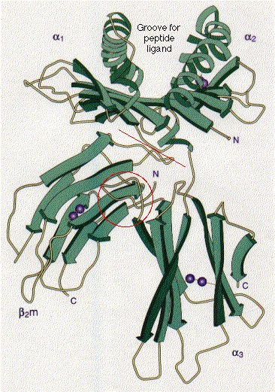
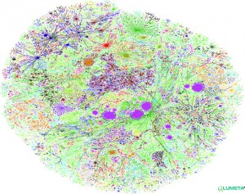
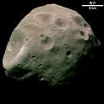
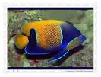







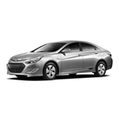

Classic Fully Supervised Learning Paradigm Insufficient Nowadays
Modern applications: massive amounts of raw data.
Only a tiny fraction can be annotated by human experts.
Protein sequences
Billions of webpages
Images

Slide 3

Modern ML: New Learning Approaches
Modern applications: massive amounts of raw data.
Active learning: techniques that best utilize data, minimizing need for expert/human intervention.
Learning Algorithm
Expert

Slide 4
Active Learning
Additional resources:
Two faces of active learning. Sanjoy Dasgupta. 2011.
Active Learning. Bur Settles. 2012.
Active Learning. Balcan-Urner. Encyclopedia of Algorithms. 2015

Slide 5
Batch Active Learning
Data Source
Underlying data distr. D.
Unlabeled examples
Expert
Learning Algorithm
Request for the Label of an Example
A Label for that Example
Request for the Label of an Example
A Label for that Example
. . .
Algorithm outputs a classifier w.r.t D
Learner can choose specific examples to be labeled.
Goal: use fewer labeled examples
[pick informative examples to be labeled].

Slide 6
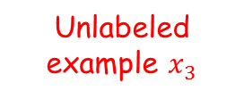


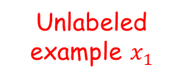

Selective Sampling Active Learning
Data Source
Underlying data distr. D.
Unlabeled example $x_{2}$
Expert
Unlabeled example $x_{3}$
Unlabeled example $x_{1}$
Learning Algorithm
A label $y_{1}$for example $x_{1}$
A label $y_{3}$for example $x_{3}$
Request for label or let it go?
Request label
Request label
Let it go
Algorithm outputs a classifier w.r.t D
Selective sampling AL (Online AL): stream of unlabeled examples, when each arrives make a decision to ask for label or not.
Goal: use fewer labeled examples
[pick informative examples to be labeled].

Slide 7
What Makes a Good Active Learning Algorithm?
Guaranteed to output a relatively good classifier for most learning problems.
Doesn’t make too many label requests.
Hopefully a lot less than passive learning and SSL.
Need to choose the label requests carefully, to get informative labels.

Slide 8
Can adaptive querying really do better than passive/random sampling?
YES! (sometimes)
We often need far fewer labels for active learning than for passive.
This is predicted by theory and has been observed in practice.

Slide 9

Can adaptive querying help? [CAL92, Dasgupta04]
Threshold fns on the real line:
h_{w}(x) = 1(x ¸ w), C = {h_{w}: w 2 R}
-
+
Active Algorithm
w
Get N unlabeled examples
How can we recover the correct labels with $≪N$ queries?
Do binary search!
Just need O(log N) labels!
+
-
-
Output a classifier consistent with the N inferred labels.
$N=O(1/ϵ)$ we are guaranteed to get a classifier of error $≤ϵ$.
Passive supervised: $Ω(1/ϵ)$ labels to find an ε-accurate threshold.
Active: only $O(\log{1/ϵ})$ labels.
Exponential improvement.

Slide 10
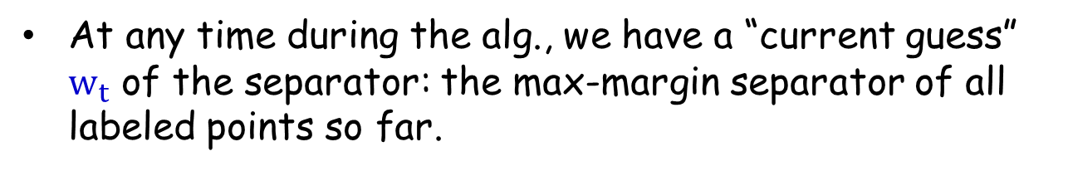
Common Technique in Practice
Uncertainty sampling in SVMs common and quite useful in practice.
E.g., [Tong & Koller, ICML 2000; Jain, Vijayanarasimhan & Grauman, NIPS 2010; Schohon Cohn, ICML 2000]
Active SVM Algorithm
At any time during the alg., we have a “current guess” $w_{t}$ of the separator: the max-margin separator of all labeled points so far.
Request the label of the example closest to the current separator.

Slide 11
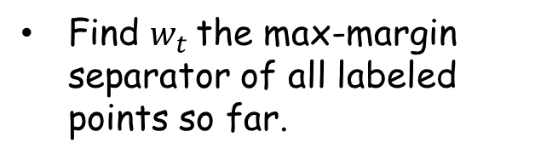

Common Technique in Practice
Active SVM seems to be quite useful in practice.
[Tong & Koller, ICML 2000; Jain, Vijayanarasimhan & Grauman, NIPS 2010]
Algorithm (batch version)
Input $S_{u}$={$x_{1}$, …,$x_{m_{u}}$} drawn i.i.d from the underlying source D
Start: query for the labels of a few random $x_{i}$s.
For $t=1$, ….,
Find $w_{t}$the max-margin separator of all labeled points so far.
Request the label of the example closest to the current separator: minimizing $\left|x_{i}⋅w_{t}\right|$.
(highest uncertainty)

Slide 12
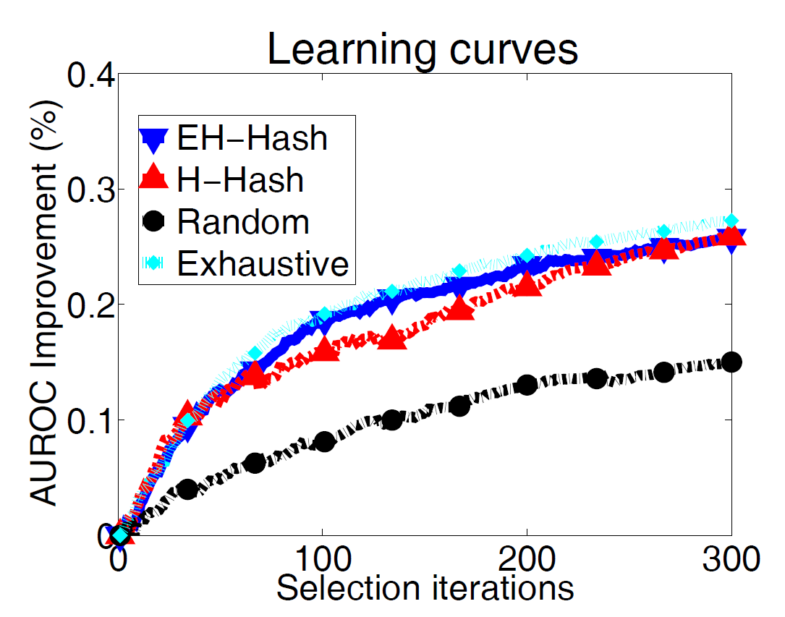
Common Technique in Practice
Active SVM seems to be quite useful in practice.
E.g., Jain, Vijayanarasimhan & Grauman, NIPS 2010
Newsgroups dataset (20.000 documents from 20 categories)

Slide 13
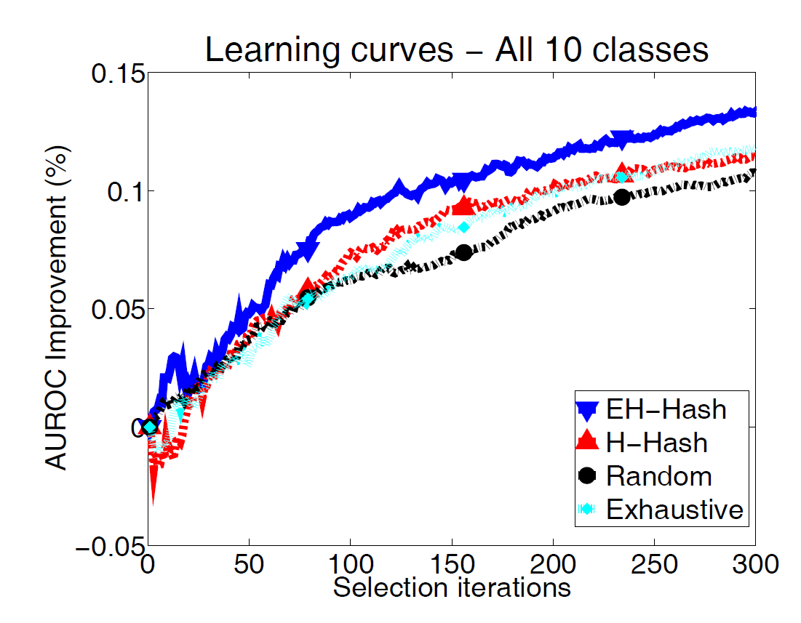
Common Technique in Practice
Active SVM seems to be quite useful in practice.
E.g., Jain, Vijayanarasimhan & Grauman, NIPS 2010
CIFAR-10 image dataset (60.000 images from 10 categories)

Slide 14
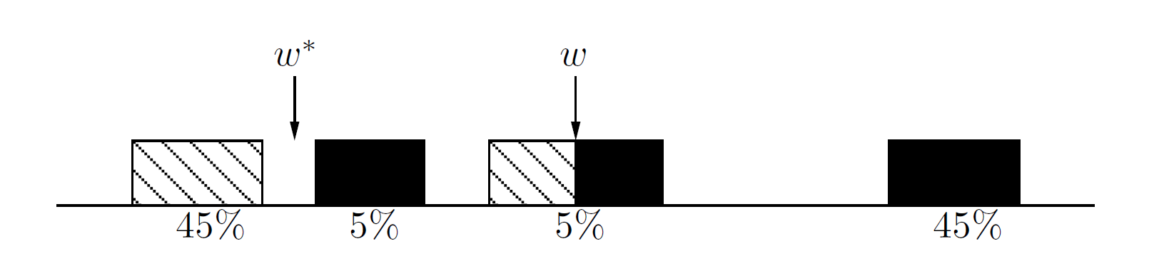
Active SVM/Uncertainty Sampling
Works sometimes….
However, we need to be very very very careful!!!
Myopic, greedy technique can suffer from sampling bias.
A bias created because of the querying strategy; as time goes on the sample is less and less representative of the true data source.
[Dasgupta10]

Slide 15
Active SVM/Uncertainty Sampling
Works sometimes….
However, we need to be very very careful!!!

Slide 16
Active SVM/Uncertainty Sampling
Works sometimes….
However, we need to be very very careful!!!
Myopic, greedy technique can suffer from sampling bias.
Bias created because of the querying strategy; as time goes on the sample is less and less representative of the true source.
Observed in practice too!!!!
Main tension: want to choose informative points, but also want to guarantee that the classifier we output does well on true random examples from the underlying distribution.

Slide 17
Safe Active Learning Schemes
Disagreement Based Active Learning
Hypothesis Space Search
[CAL92]
[BBL06]
[Hanneke’07, DHM’07, Wang’09 , Fridman’09, Kolt10, BHW’08, BHLZ’10, H’10, Ailon’12, …]

Slide 18


Version Spaces
X – feature/instance space; distr. D over X; $c^{∗}$ target fnc
Fix hypothesis space H.
Definition (Mitchell’82)
Assume realizable case: $c^{∗}∈H$.
Given a set of labeled examples ($x_{1},y_{1}$), …,($x_{m_{l}},y_{m_{l}}$),
$$y_{i}=c^{∗}(x_{i})$$
Version space of H: part of H consistent with labels so far.
I.e., $h∈ VS(H)$ iff ${h\left(x_{i}\right)=c}^{∗}\left(x_{i}\right)$ $∀i∈\{1, …,m_{l}\}$.

Slide 19
Version Spaces
X – feature/instance space; distr. D over X; $c^{∗}$ target fnc
Fix hypothesis space H.
Definition (Mitchell’82)
Assume realizable case: $c^{∗}∈H$.
Given a set of labeled examples ($x_{1},y_{1}$), …,($x_{m_{l}},y_{m_{l}}$),
$$y_{i}=c^{∗}(x_{i})$$
Version space of H: part of H consistent with labels so far.
current version space
E.g.,: data lies on circle in R², H = homogeneous linear seps.
+
+
region of disagreement in data space

Slide 20
Version Spaces. Region of Disagreement
Definition (CAL’92)
Version space: part of H consistent with labels so far.
Region of disagreement = part of data space about which there is still some uncertainty (i.e. disagreement within version space)
$x∈X, x∈DIS(VS\left(H\right))$ iff $∃{h_{1}, h}_{2}∈VS(H),{ h}_{1}\left(x\right)≠h_{2}(x)$
current version space
E.g.,: data lies on circle in R², H = homogeneous linear seps.
+
+
region of disagreement in data space

Slide 21
Disagreement Based Active Learning [CAL92]
current version space
region of uncertainy
Algorithm:
Pick a few points at random from the current region of uncertainty and query their labels.
Stop when region of uncertainty is small.
Note: it is active since we do not waste labels by querying in regions of space we are certain about the labels.

Slide 22
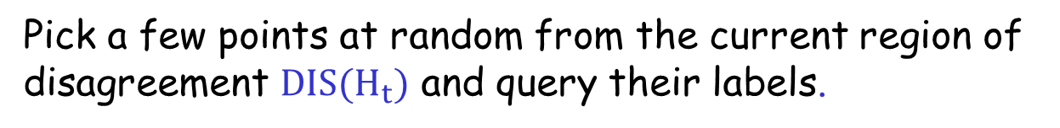


Disagreement Based Active Learning [CAL92]
current version space
region of uncertainy
Algorithm:
Query for the labels of a few random $x_{i}$s.
Let
$H_{1}$ be the current version space.
For $t=1$, ….,
Pick a few points at random from the current region of disagreement $DIS(H_{t})$ and query their labels.
Let $H_{t+1}$ be the new version space.

Slide 23
Region of uncertainty [CAL92]
Current version space: part of C consistent with labels so far.
“Region of uncertainty” = part of data space about which there is still some uncertainty (i.e. disagreement within version space)
current version space
+
+
region of uncertainty in data space

Slide 24
Region of uncertainty [CAL92]
Current version space: part of C consistent with labels so far.
“Region of uncertainty” = part of data space about which there is still some uncertainty (i.e. disagreement within version space)
new version space
+
+
New region of disagreement in data space

Slide 25
How about the agnostic case where the target might not belong the H?
Notes:
Make it specific

Slide 26

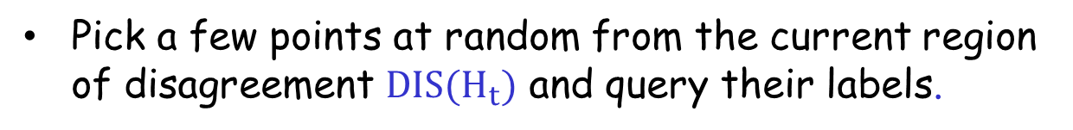

A² Agnostic Active Learner [BBL’06]
current version space
region of disagreement
Algorithm:
Careful use of generalization bounds; Avoid the sampling bias!!!!
Let
$$H_{1}=H.$$
For $t=1$, ….,
Pick a few points at random from the current region of disagreement $DIS(H_{t})$ and query their labels.
Throw out hypothesis if you are statistically confident they are suboptimal.

Slide 27
Other Interesting ALTechniques used in Practice
Interesting open question to analyze under what conditions they are successful.

Slide 28
Density-Based Sampling
Centroid of largest unsampled cluster

Slide 29
Uncertainty Sampling
Closest to decision boundary (Active SVM)

Slide 30
Maximal Diversity Sampling
Maximally distant from labeled x’s

Slide 31
Ensemble-Based Possibilities
Uncertainty + Diversity criteria
Density + uncertainty criteria

Slide 32
What You Should Know
Active learning could be really helpful, could provide exponential improvements in label complexity (both theoretically and practically)!
Common heuristics (e.g., those based on uncertainty sampling). Need to be very careful due to sampling bias.
Safe Disagreement Based Active Learning Schemes.
Understand how they operate precisely in the realizable case (noise free scenarios).

Slide 33
Advanced additional (not required material)
Notes:
Make it specific

Slide 34
Disagreement based algorithms: How about the agnostic case where the target might not belong the H?
Notes:
Make it specific

Slide 35
A² Agnostic Active Learner [BBL’06]
current version space
region of disagreement
Algorithm:
Careful use of generalization bounds; Avoid the sampling bias!!!!
Let
$$H_{1}=H.$$
For $t=1$, ….,
Pick a few points at random from the current region of disagreement $DIS(H_{t})$ and query their labels.
Throw out hypothesis if you are statistically confident they are suboptimal.

Slide 36
Formal General Guarantees for Agnostic AL
A² the first algorithm which is robust to noise.
[Balcan, Beygelzimer, Langford, ICML’06]
[Balcan, Beygelzimer, Langford, JCSS’08]
“Region of disagreement” style: Pick a few points at random from the current region of disagreement, query their labels, throw out hypothesis if you are statistically confident they are suboptimal.
Guarantees for A² [BBL’06,’08]:
It is safe (never worse than passive learning) & exponential improvements.
C – thresholds, low noise, exponential improvement.
c*
C - homogeneous linear separators in R^{d},
D - uniform, low noise, only d² log (1/ε) labels.
A lot of subsequent work.
[Hanneke’07, DHM’07, Wang’09 , Fridman’09, Kolt10, BHW’08, BHLZ’10, H’10, Ailon’12, …]
Notes:
Make it specific

Slide 37
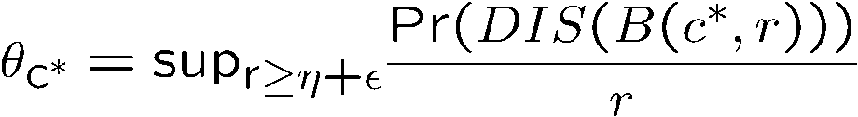
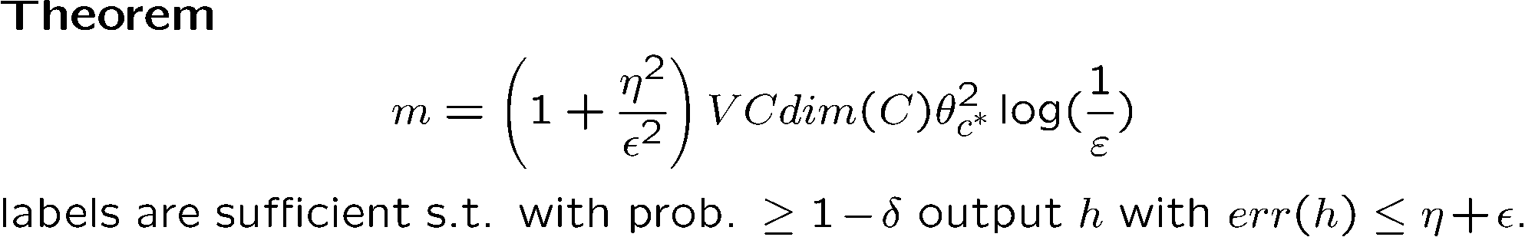
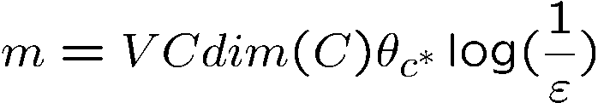

General guarantees for A² Agnostic Active Learner
“Disagreement based”: Pick a few points at random from the current region of uncertainty, query their labels, throw out hypothesis if you are statistically confident they are suboptimal.
[BBL’06]
How quickly the region of disagreement collapses as we get closer and closer to optimal classifier
Guarantees for A² [Hanneke’07]:
Disagreement coefficient
Realizable case:
Linear Separators, uniform distr.:
c*
Notes:
Make it specific

Slide 38
Disagreement Based Active Learning
“Disagreement based ” algos: query points from current region of disagreement, throw out hypotheses when statistically confident they are suboptimal.
Generic (any class), adversarial label noise.
Computationally efficient for classes of small VC-dimension
Still, could be suboptimal in label complex & computationally inefficient in general.
Lots of subsequent work trying to make is more efficient computationally and more aggressive too: [Hanneke07, DasguptaHsuMontleoni’07, Wang’09 , Fridman’09, Koltchinskii10, BHW’08, BeygelzimerHsuLangfordZhang’10, Hsu’10, Ailon’12, …]

