Slide 1
Improving Fairness, Efficiency, and Stability in HTTP-based Adaptive Video Streaming with FESTIVE
Junchen Jiang (CMU)
Vyas Sekar (Stony Brook U)
Hui Zhang (CMU/Conviva Inc.)

Slide 2
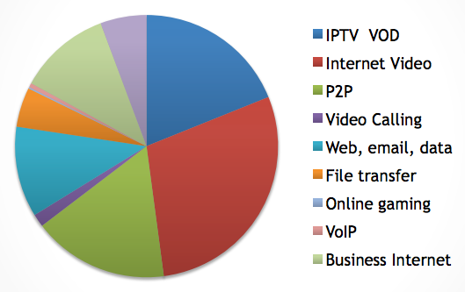
Video Traffic is Becoming Dominant
2011, 66+% of Internet traffic is video. [Akamai]
2016, 86% will be video traffic. [Cisco]
The Internet is becoming a Video Network

Slide 3
Background: HTTP-based Video
2nd Chunk in bitrate A
A2
Client
HTTP Adaptive Player
B1
A1
A2
…
…
A1
A1
A1
A2
B1
B2
…
…
HTTP GET A1
Cache
B1
B2
Web browser
Web server
Web server
HTTP
HTTP
TCP
TCP
Server
Why HTTP?
Use existing CDN, Stateless server, NAT/firewall traversal

Slide 4
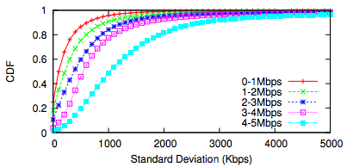
The Need for Bitrate Adaptation?
Video quality matters [sigcomm11]
Significant variability of intra-session bandwidth
[sigcomm12]
Bitrate adaptation offers a trade-off between high bitrate, low join time and buffering ratio.

Slide 5
Three Metrics of Goodness
Inefficiency: Fraction of bandwidth not being used or overused
Unfairness: Discrepancy of bitrates used by multiple players
Instability: The frequency and magnitude of recent switches
Bitrate
(Mbps)
Bottleneck b/w 2Mbps
Player A
1.3
0.7
Bitrate
(Mbps)
time
Player B
0.7
time

Slide 6
Real World: SmoothStreaming
Setup: total b/w 3Mbps, three SmoothStreaming players
Player A
Visually, SmoothStreaming performs bad.
Player B
Player C

Slide 7
How Do State-of-Art Players Perform?
SmoothStreaming (SS)
Akamai
Adobe
Netflix
Unfairness index
Instability index
Inefficiency index
SmoothStreaming (SS) appears to be better than other players.
Notes:
We have seen SmoothStreaming.
Now, let’s look at other commercial players using these metrics.
Again three players, sharing a stable bottleneck bandwidth of 3Mbps.
It seems that the problem is unique to SmoothStreaming. In fact, it turns out that SmoothStreaming is better than others
The problem is even worse with more players

Slide 8
Why it is Hard?
Limited control
Overlaid on HTTP
Constrained by browser sandbox
Limited feedback
No packet level feedback, only throughput
Local view
Client-driven adaptation
Independent control loop
Notes:
We see that all the four commercial player are not good, but why it is hard?
There are three reasons…
Third, each player is interacting with the network independently.

Slide 9
Our Work
Understand the root causes of these problems
How can we fix these ?
Within constraints of HTTP-based video
Solution: FESTIVE (Fair, Efficient and Stable AdapTIVE)
Outperforms industry-standard players in all three metrics!
Notes:
Our goal of this paper is two-fold
First, to understand the root cause of all these problems of inefficiency, unfairness and instability.
Second, we will give a concrete solution called FESTIVE to fix the problems. Within the same framework of today’s HTTP player.
Our results show that FESTIVE outperforms industry-standard players in all three metrics.

Slide 10
Roadmap
Motivation
Design
Abstract player model
Chunk scheduling
Bitrate selection
Stateful algorithm
Damping update
Bandwidth estimation
Evaluation
Summary

Slide 11
Abstract Player Model
B/W Estimation
Bitrate Selection
Chunk Scheduling
Video Player
Throughput of a chunk
Bitrate of next chunk
When to request
GET
Internet
HTTP
Chunk
1. Three components
2. Feedback loop between player and the network

Slide 12
Today: Periodic Chunk Scheduling
Many players use this to keep fixed video buffer
e.g., if chunk duration = 2 sec, chunk requests at T= 0,2,4,… sec
Example setup: Total bandwidth: 2Mbps
Bitrate 0.5 Mbps, 2 sec chunks
Chunk size: 0.5 Mbps x 2 sec = 1.0Mb
b/w (Mbps)
2
Throughput: 2 Mbps
1 sec
0.5 sec
1 sec
0.5 sec
1
1 sec
1 sec
Throughput: 1 Mbps
0
1s
2s
time
Throughput: 1 Mbps
Player A, T=0,2,4,…
Player B
T=0,2,4,…
Player C
T=1,3,5,…
Unfair! Start time impacts observed throughput
NOT a TCP problem!

Slide 13
Solution: Randomized Scheduling
Request with a randomized interval
3 players: Bitrate 0.5 Mbps, 2 sec chunks
b/w (Mbps)
Throughput: ~1.3 Mbps
2
1
Throughput: ~1.3 Mbps
0
time
Throughput: ~1.3 Mbps
1s
2s
Player A
Player B
Player C
Intuition: fair chance to see each other.

Slide 14
Today’s Bitrate Selection
Strawman: Bitrate = f (observed throughput)
Example setup: Total bandwidth 2Mbps
Player A: 0.7 Mbps, Player B: 0.3 Mbps, Player C: 0.3 Mbps
b/w (Mbps)
2
Throughput: ~1.6 Mbps
1
0.6
Throughput: ~1.1 Mbps
0
time
Throughput: ~1.1 Mbps
Player A
Player B
Player C
Unfair! Bitrate impacts observed throughput.
Biased feedback loop implies unfairness

Slide 15
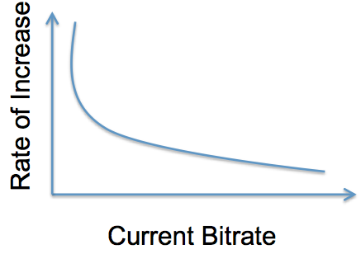
Solution: Stateful Bitrate Selection
Intuition: Compensate for the bias!
Check if in increase phase -- stateful.
Lower bitrate player ramps up more quickly.
Bitrate
Player A
Player B
Time

Slide 16
FESTIVE Overall Design
Video Player
B/W Estimation
Bitrate Selection
Chunk Scheduling
Stateful selection
Harmonic mean
Randomized scheduling
Delayed update
Bitrate of next chunk
When to request
Throughput of a chunk
GET
HTTP

Slide 17
Roadmap
Motivation
Design
Evaluation
Methodology
Robustness
Summary
Notes:
We have introduced the design, and now let’s move to the evaluation

Slide 18
Methodology
Emulated algorithm + Local Ethernet
Real player
+ Local Ethernet
(SmoothStreaming)
A conservative approximation.
FESTIVE + Local Ethernet
Real player
+ real Internet
(Adobe, Netflix)
Notes:
The high-level goal is the compare FESTIVE with real players like Netflix and Adobe.
Ideally, we want a head-to-head comparison. But it is unrealistic, because the player is proprietary, so it’s impossible to implement it in commercial player.
So, our methodology is to add a intermediate step. We reverse engineer the real player algorithm, and implement it in a local simplified model where we can both implement FESTIVE and those emulated algorithm, and we run them both on local ethernet.
And the point of this method is that we make sure that the emulated algorithm performs as a conservative approximation of the real player.
For SmoothStreaming, we even do one more step to run a server in local ethernet enviroment.

Slide 19
Result with SmoothStreaming
FESTIVE + Ethernet
Emulated + Ethernet
Real player + Ethernet
Real player + real Internet
Unfairness index
Inefficiency index
Instability index
Festive is better than state-of-art on all metrics!

Slide 20
Comparison with Netflix
FESTIVE w. Ethernet
Emulated + Ethernet
Real player w. real Internet
Unfairness index
Inefficiency index
Instability index
FESTIVE is consistently better.
20
Notes:
Here, we present the comparison between FESTIVE and Netflix.
Again, three player, 3 Mbps.
Results are grouped in three metrics and lower the better.
First, emulated algorithm is a conservative approximation of the real algorithm
Second. FESTIVE outperforms the emulated algorithm.

Slide 21
Instability vs. Number of Players
Bottleneck link: 10Mbps
1. Festive is more robust as number of players increases
2. Interesting artifacts of bitrate discreteness
Notes:
We saw the results of a fixed numbers of players.
And, we also test the sensitivity of FESTIVE to different number of players.
In this example, we use bottleneck link of 10Mbps.
X,
Y,
It shows the instability index. Lower the better.
FESTIVE is consistently better than Emulated SmoothStreaming algorithm across different number of players.
Also, we see some interesting observation here. For 12 players or 16 players, the performance is consistently better than neighboring points.
In fact, this is an interesting artifact of bitrate discreteness that some certain combination of bitrate levels and number of users will cause users to keep staying in some bitrate.

Slide 22
Conclusion
Video delivery architecture
Stateful client, stateless server, data unit HTTP
Robust design is critical for video
Three key metrics: Fairness, Efficiency, Stability
Why is this hard?
Sandboxed environment, too coarse-grained
Biased and limited feedback loops
Our solution: FESTIVE
Outperfoms all state-of-art algorithms

