Slide 1
A Logic of Secure Systems and its Application to Trusted Computing
Anupam Datta, Jason Franklin, Deepak Garg, and Dilsun Kaynar
Carnegie Mellon University
May 19, 2009
Notes:
1
1

Slide 2

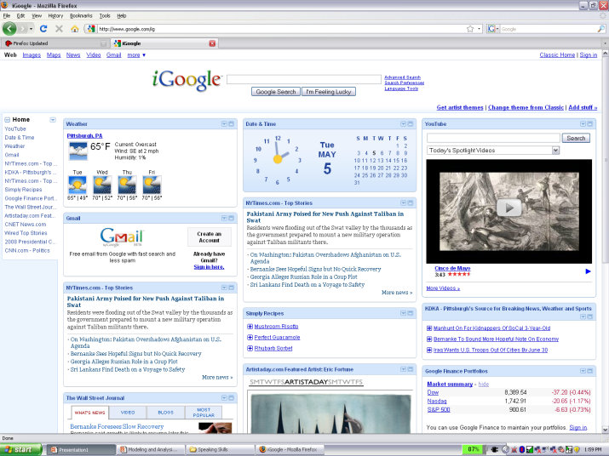


Secure System Designs
Secure System
Security Property
Web Server
The VMM maintains the confidentiality and integrity of data store in honest VMs.
System maintains integrity of OS and web server code.
Communication between frames remains confidential.
OS
BIOS
Adversary
Malicious Thread
Malicious Frame & Server
Malicious Virtual Machine
Notes:
Project Goal: Formally specify system designs & adversaries and prove security properties
Example Systems:
Operating systems, virtual machine monitors, web browsers, secure co-processor-based systems, etc…
Adversary capabilities encompass common attacks:
Network Protocol Attacks: Freshness, MITM
Local Systems Attacks: TOCTTOU and other race conditions, atomicity violation, violations of code integrity and data confidentiality and integrity violation
Combinations of network and system attacks, e.g., web attacks
Security properties:
Data confidentiality and integrity, code and execution integrity

Slide 3
Informal Analysis of System Designs
Security Property
Adversary
Informal Analysis
Known attacks
Secure System
Successful attacks
Attacks may be missed!
Notes:
Project Goal: Formally specify system designs & adversaries and prove security properties
Example Systems:
Operating systems, virtual machine monitors, web browsers, secure co-processor-based systems, etc…
Adversary capabilities encompass common attacks:
Network Protocol Attacks: Freshness, MITM
Local Systems Attacks: TOCTTOU and other race conditions, atomicity violation, violations of code integrity and data confidentiality and integrity violation
Combinations of network and system attacks, e.g., web attacks
Security properties:
Data confidentiality and integrity, code and execution integrity

Slide 4
Logic-Based Analysis of System Designs
Security Property
Formal Model of Adversary
Adversary defined by a set of capabilities
Analysis Engine
Secure System
Proof implies that an adversary with these capabilities cannot launch a successful attack
Proof of security property

Slide 5
Contributions (Method)
Secure System
Security Property
Modeled as a set of programs in a concurrent programming language containing primitives relevant to secure systems
Cryptography, network communication, shared memory, access control, machine resets, dynamic code loading
Specified as logical formulas in the Logic of Secure Systems (LS²)‏
Adversary Model
Analysis Engine
Any set of programs running concurrently with the system
Sound proof system for LS²
Notes:
Summarize quickly. Explained later.

Slide 6
Contributions (Adversary Model)
Adversary capabilities:
  Local process on a machine
    E.g., change unprotected code and data, steal secrets, reset machines
    In general, constrained only by system interfaces
  Network adversary – Symbolic (Dolev-Yao):
    E.g., create, read, delete, inject messages
  Cannot break cryptography
These capabilities enable many common attacks:
  Network Protocol Attacks: Freshness, MITM
  Local Systems Attacks: TOCTTOU and other race conditions, violations of code integrity and data confidentiality and integrity violation
  Combinations of network and system attacks, e.g., web attacks

Slide 7
Contributions (Application)
Case study of Trusted Computing Platform
  TCG specifications are industry and ISO/IEC standard
  Over 100 million deployments
  Applications include Microsoft’s BitLocker and HP’s ProtectTools
Formal model of parts of the TPM co-processor
First logical security proofs of two attestation protocols (SRTM and DRTM)
Analysis identifies:
  Previously unknown incompatibility between SRTM and DRTM
    Cannot be used together without additional protection
  2 new weaknesses in SRTM
  Previously known TOCTTOU attacks on SRTM
  [GCB+(Oakland’06),SPD(Oakland’05)]

Slide 8
Outline
Introduction
LS²: Illustrated with example (SRTM)‏
  Description of SRTM
  Programming model
  Specification of properties
  Proving properties
  Soundness
Conclusion

Slide 9

Static Root of Trust Measurement (SRTM)
What’s your software stack?
Remote
Verifier
Client
Why should the client’s answer be trusted?

Slide 10

Static Root of Trust Measurement (SRTM)
Client
Append only log; Set to -1 on reset
Co-processor for cryptographic operations
Protected private key (AIK)
Remote
Verifier
PCR
Check
Trusted Platform
Module (TPM)‏
‏
-1

Slide 11
Static Root of Trust Measurement (SRTM)
Client
APP
OS
Signature
BL
BIOS
Remote
Verifier
PCR
BL
H(APP)
OS
Check
APP
H(OS)
Trusted Platform
Module (TPM)‏
‏
H(BL)
-1

Slide 12
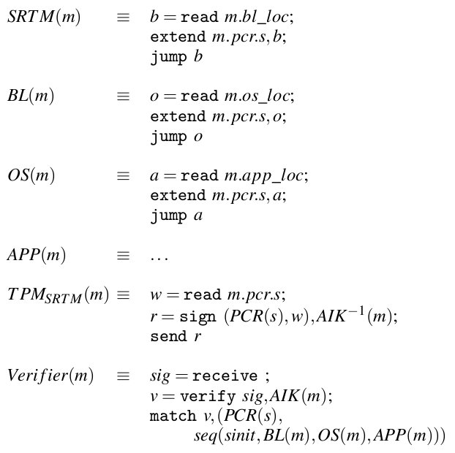
Example: SRTM in LS²
Trusted BIOS
Ideal boot loader
Ideal operating system
Co-processor
Remote Verifier

Slide 13
Modeling Systems
Trusted BIOS
Every system component is a program.
Ideal boot loader
Generality: Common primitives to model many systems
Extensibility: Add new primitives
Ideal operating system
Co-processor
Remote Verifier

Slide 14
Model of Trusted Hardware
Trusted BIOS
extend is a primitive
Ideal boot loader
Ideal operating system
Co-processor is a program
Co-processor
Remote Verifier

Slide 15
Challenge: Adversaries
Trusted BIOS
Ideal boot loader
Ideal operating system
Co-processor
Remote Verifier

Slide 16
Challenge: Dynamic Code Loading
Trusted BIOS
Ideal boot loader
What is b?
Ideal operating system
Reasoning about dynamically loaded code in presence of adversaries requires careful proof system design
Co-processor
Remote Verifier

Slide 17
SRTM Security Property
Suppose Verifier’s code finishes execution at time t
t_{T}
t_{B}
t_{O}
t_{A}
t
Reset
Load
BL
Load
OS
Load
APP
Verifier
Finishes
Weaknesses:
  No recency – how old is t_{T}? [GCB+’06,SPD’05]
  No guarantee that APP was loaded.
  Assume that no adversary may extend the PCR

Slide 18
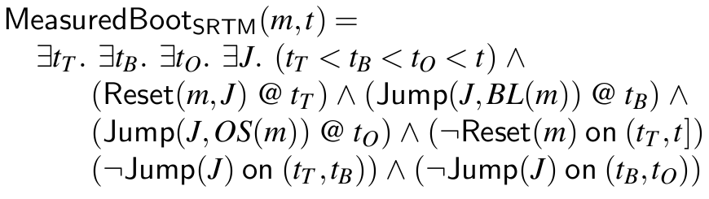
SRTM Security Property in LS²
Suppose Verifier’s code finishes execution at
t_{T}
t_{B}
t_{O}
t
Reset
Load
BL
Load
OS
Verifier
Finishes

Slide 19
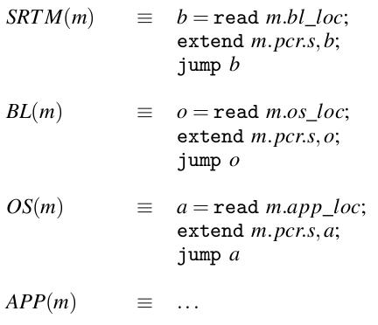

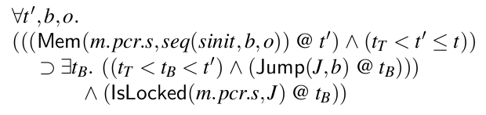
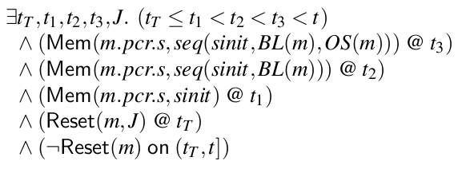
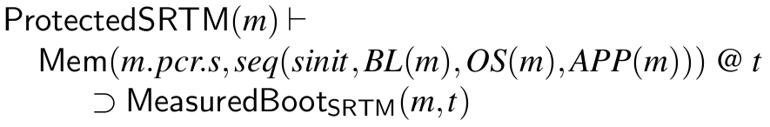
Reasoning about Dynamic Code Loading
Proofs do not explicitly refer to adversarial actions

Slide 20
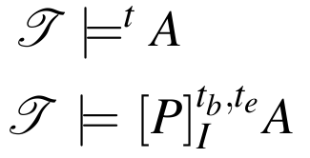

Semantics and Soundness
Semantic Relations
Accounts for adversaries’ actions
Proof of correctness implies security with any number of adversaries
Soundness Theorem
Notes:
Write how soundness implies security with adversaries.

Slide 21
Summary of LS²
Use logic to prove systems secure
Model systems are programs in an expressive language
Specify security properties in a logic
Prove properties in a sound proof system
Guaranteed freedom from attacks against a strong adversary
Technical difficulties:
  Dynamically loaded unknown code
  Access control on concurrent memory
  Machine resets

Slide 22
Work Related to LS²
Work on network protocol analysis
  BAN, …, Protocol Composition Logic (PCL)‏
    Inspiration for LS², limited to protocols only
    LS² adds a model of local computation and local adversary
Work on program correctness (no adversaries)
  Concurrent Separation Logic
    Synchronization through locks is similar
  Higher-order extensions of Hoare Logic
    Code being called has to be known in advance
  Temporal, dynamic logic
    Similar goals, different formal treatment
Formal analysis of Trusted Computing Platforms
  Primarily using model checking

Slide 23
Conclusion
LS²: Logic based framework to prove security properties of system designs
Used for analysis of an industrial standard
Expressive, extensible
  Ongoing application to web security and virtualization

Slide 24
Thank You.
Questions?

Slide 25
Technical Challenges
Expressiveness:
  Security primitives non-exhaustive; some in this paper, some future work
  Interactions, e.g., dynamic code loading and concurrency
  Scalability: how easily can new primitives be added?
Usability:
  Axioms must be intuitive
Strong adversary model:
  Network adversary (Dolev-Yao)
  Local adversary (new)‏

Slide 26
Operational Semantics
Configuration (C) = Concurrent threads
  System components + unspecified adversary
  State information: memory contents + locks
Thread = Program + Owner + Unique id
Reduction relation on configurations
t₁
t₂
t_{n}
C₀
C₁
...
C_{n}
t₁ ... t_{n} are real numbers,
monotonically increasing

Slide 27
Programming Model
Distributed system = Concurrent programs
Program = Sequence of actions
  x1 := a1; x2 := a2; ....; xn := an
Actions a =
  read l write l,v
  lock l unlock l
  send v receive
  sign v,K verify v,K
  jump v ...
Resets modeled
as a reduction
in operational
semantics

Slide 28
Logic Syntax
Predicates P:
  Send(I,v) Receive(I,v)
  Sign(I,v,K) Verify(I,v,K)
  Read(I,l) Write(I,l,v)‏
  Lock(I,l) Unlock(I,l)‏
  Mem(l,v) IsLocked(l,I)
  Reset(m,I) Jump(I,v)‏
Formulas A, B: ... | A@t | A on I
Modal Formulas: [P]_{I}^{tb,te} A

Slide 29
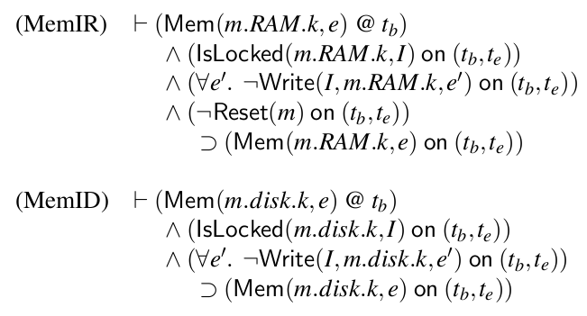
Proof System: Axioms
Axioms capture meaning of primitives

Slide 30
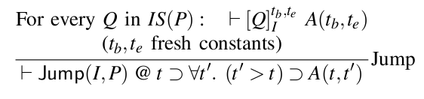
Proof System: Inference Rules
Rules analyze modal formulas [P]_{I}^{tb,te} A
Example, the jump rule:
IS(P) = Set of prefixes of the action sequence of P

