Slide 1





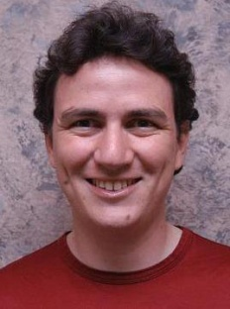
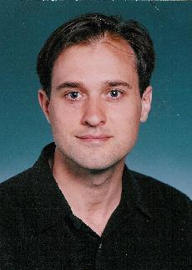

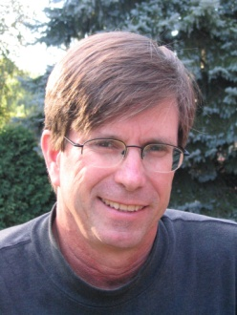
A New Parallel Framework for Machine Learning
Joseph Gonzalez
Joint work with
Yucheng
Low
Aapo
Kyrola
Danny
Bickson
Kanat
Tangwon-
gsan
Carlos
Guestrin
Guy
Blelloch
Joe
Hellerstein
David
O’Hallaron

Slide 2
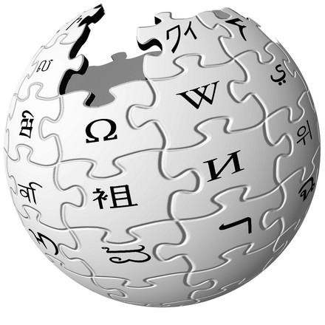



In ML we face BIG problems
750 Million
Facebook Users
13 Million
Wikipedia Pages
3.6 Billion
Flickr Photos
24 Hours a Minute
YouTube

Slide 3
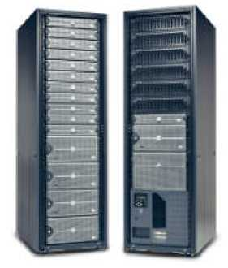
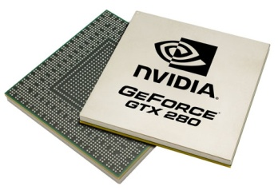
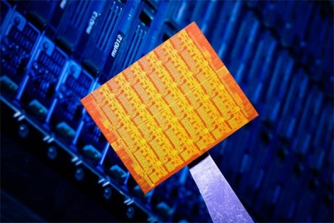
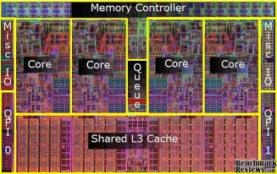

Parallelism: Hope for the Future
Wide array of different parallel architectures:
New Challenges for Designing Machine Learning Algorithms:
Race conditions and deadlocks
Managing distributed model state
New Challenges for Implementing Machine Learning Algorithms:
Parallel debugging and profiling
Hardware specific APIs
GPUs
Multicore
Clusters
Mini Clouds
Clouds
Notes:
any non-trivial algorithm to scale will require the designer to reason about race conditions, deadlocks as well as a variety of other systems issues.
ML experts have to repeated address these same parallel design challeges
Therefore we typically Make use of High level abstractions to manage much of the complexity for us.
An abstraction that has gained significant popularity lately is the MapReduce abstraction. We will quickly review it here.

Slide 4
Core Question
How will we design and implement parallel learning systems?

Slide 5
Threads, Locks, & Messages
We could use ….
Build each new learning systems using low level parallel primitives

Slide 6
Threads, Locks, and Messages
ML experts repeatedly solve the same parallel design challenges:
Implement and debug complex parallel system
Tune for a specific parallel platform
Two months later the conference paper contains:
“We implemented ______ in parallel.”
The resulting code:
is difficult to maintain
is difficult to extend
couples learning model to parallel implementation
Graduate students
Notes:
any non-trivial algorithm to scale will require the designer to reason about race conditions, deadlocks as well as a variety of other systems issues.
ML experts have to repeated address these same parallel design challeges
Therefore we typically Make use of High level abstractions to manage much of the complexity for us.
An abstraction that has gained significant popularity lately is the MapReduce abstraction. We will quickly review it here.

Slide 7
Map-Reduce / Hadoop
... a better answer:
Build learning algorithms on-top of high-level parallel abstractions

Slide 8



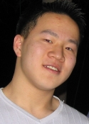






MapReduce – Map Phase
CPU 1
4
2
.
3
2
1
.
3
2
5
.
8
1
2
.
9
CPU 2
CPU 3
CPU 4
Embarrassingly Parallel independent computation
No Communication needed
Notes:
2 parts. A Map stage and a Reduce stage. The Map stage represents embarassingly parallel computation. That is, each computation is independent and can performed on different macheina without any communciation.

Slide 9
MapReduce – Map Phase
CPU 1
8
4
.
3
1
8
.
4
8
4
.
4
2
4
.
1
CPU 2
CPU 3
CPU 4
1
2
.
9
4
2
.
3
2
1
.
3
2
5
.
8
Embarrassingly Parallel independent computation
No Communication needed
Notes:
For instance, we could use MapReduce to perform feature extraction on a large number of pictures. For instance, .. To compute an attractiveness score.

Slide 10
MapReduce – Map Phase
CPU 1
6
7
.
5
1
4
.
9
3
4
.
3
1
7
.
5
CPU 2
CPU 3
CPU 4
1
2
.
9
2
4
.
1
4
2
.
3
8
4
.
3
2
1
.
3
1
8
.
4
2
5
.
8
8
4
.
4
Embarrassingly Parallel independent computation
No Communication needed

Slide 11
MapReduce – Reduce Phase
22
26
.
26
17
26
.
31
CPU 1
CPU 2
1
2
.
9
2
4
.
1
1
7
.
5
4
2
.
3
8
4
.
3
6
7
.
5
2
1
.
3
1
8
.
4
1
4
.
9
2
5
.
8
8
4
.
4
3
4
.
3
Fold/Aggregation
Notes:
The Reduce stage is essentially a “fold” or an aggregation operation over the results. This for instance can be used to compile summary statistics.

Slide 12
Map-Reduce for Data-Parallel ML
Excellent for large data-parallel tasks!
Data-Parallel Graph-Parallel
Is there more to
Machine Learning
?
Map Reduce
Feature
Extraction
Cross
Validation
SVM
Lasso
Belief
Propagation
Kernel
Methods
Computing Sufficient
Statistics
Tensor
Factorization
Sampling
Deep Belief
Networks
Neural
Networks
Notes:
Algorithms such as cross validation and feature extraction are data parallel algorithms, which are easily map-reduceable.
But there is a much larger world of algorithms which have complex parallel structure and do not fit well in the MapReduce framework. However, there are some useful properties common to a number of ML algorithms which we can exploit.

Slide 13
Concrete Example
Label Propagation

Slide 14
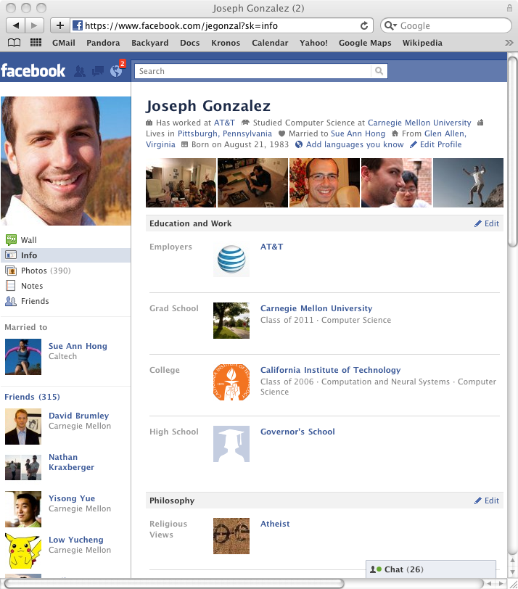
Label Propagation Algorithm
Social Arithmetic:
Recurrence Algorithm:
iterate until convergence
Parallelism:
Compute all Likes[i] in parallel
Sue Ann
50% What I list on my profile
40% Sue Ann Likes
30% Carlos Like
80% Cameras
20% Biking
+
40%
I Like:
60% Cameras, 40% Biking
Profile
50%
50% Cameras
50% Biking
Me
Carlos
10%
30% Cameras
70% Biking

Slide 15
Properties of Graph Parallel Algorithms
Dependency
Graph
Factored
Computation
Iterative
Computation
What I Like
What My Friends Like

Slide 16
Map-Reduce for Data-Parallel ML
Excellent for large data-parallel tasks!
Data-Parallel Graph-Parallel
Map Reduce
Map Reduce?
?
Feature
Extraction
Cross
Validation
SVM
Lasso
Belief
Propagation
Kernel
Methods
Computing Sufficient
Statistics
Tensor
Factorization
Sampling
Deep Belief
Networks
Neural
Networks
Notes:
Algorithms such as cross validation and feature extraction are data parallel algorithms, which are easily map-reduceable.
But there is a much larger world of algorithms which have complex parallel structure and do not fit well in the MapReduce framework. However, there are some useful properties common to a number of ML algorithms which we can exploit.

Slide 17
Why not use Map-Reduce for Graph Parallel Algorithms?

Slide 18
Data Dependencies
Map-Reduce does not efficiently express dependent data
User must code substantial data transformations
Costly data replication
Independent Data Rows

Slide 19
Iterative Algorithms
Map-Reduce not efficiently express iterative algorithms:
Iterations
Data
Data
Data
Data
CPU 1
CPU 1
CPU 1
Data
Data
Data
Data
Data
Data
Data
Data
Slow
Processor
CPU 2
CPU 2
CPU 2
Data
Data
Data
Data
Data
Data
Data
Data
CPU 3
CPU 3
CPU 3
Data
Data
Data
Data
Data
Data
Data
Data
Barrier
Barrier
Barrier

Slide 20
MapAbuse: Iterative MapReduce
Only a subset of data needs computation:
Iterations
Data
Data
Data
Data
CPU 1
CPU 1
CPU 1
Data
Data
Data
Data
Data
Data
Data
Data
CPU 2
CPU 2
CPU 2
Data
Data
Data
Data
Data
Data
Data
Data
CPU 3
CPU 3
CPU 3
Data
Data
Data
Data
Data
Data
Data
Data
Barrier
Barrier
Barrier
Notes:
S

Slide 21
MapAbuse: Iterative MapReduce
System is not optimized for iteration:
Iterations
Data
Data
Data
Data
CPU 1
CPU 1
CPU 1
Data
Data
Data
Data
Data
Data
Data
Data
CPU 2
CPU 2
CPU 2
Startup Penalty
Disk Penalty
Startup Penalty
Disk Penalty
Startup Penalty
Data
Data
Disk Penalty
Data
Data
Data
Data
Data
Data
CPU 3
CPU 3
CPU 3
Data
Data
Data
Data
Data
Data
Data
Data

Slide 22
Synchronous vs. Asynchronous
Example Algorithm: If Red neighbor then turn Red
Synchronous Computation (Map-Reduce) :
Evaluate condition on all vertices for every phase
4 Phases each with 9 computations → 36 Computations
Asynchronous Computation (Wave-front) :
Evaluate condition only when neighbor changes
4 Phases each with 2 computations → 8 Computations
Time 0
Time 1
Time 2
Time 3
Time 4

Slide 23
Data-Parallel Algorithms can be Inefficient
Optimized in Memory MapReduceBP
Asynchronous Splash BP
The limitations of the Map-Reduce abstraction can lead to inefficient parallel algorithms.

Slide 24
The Need for a New Abstraction
Map-Reduce is not well suited for Graph-Parallelism
Data-Parallel Graph-Parallel
Map Reduce
?
Feature
Extraction
Cross
Validation
Belief
Propagation
Kernel
Methods
SVM
Computing Sufficient
Statistics
Tensor
Factorization
Sampling
Neural
Networks
Lasso
Deep Belief
Networks

Slide 25
What is GraphLab?

Slide 26
The GraphLab Framework
Graph Based
Data Representation
Update Functions
User Computation
Scheduler
Consistency Model

Slide 27
Data Graph
A graph with arbitrary data (C++ Objects) associated with each vertex and edge.
Graph:
Social Network
Vertex Data:
User profile text
Current interests estimates
Edge Data:
Similarity weights

Slide 28
Data Graph: Gibbs Sampling
Graph = Markov Random Field (MRF)
Vertices correspond to random variables
Edges correspond to dependencies in the MRF
Algorithm:
For each variable draw a new assignment given its neighbors assignments and edge potentials.
Vertex Data:
Node potential
Current assignment
Sequence of samples
Edge Data:
Edge Potential
Notes:
The data graph is a graph with data associated with every vertex and edge. Data can be any kind of data. Parameters, vectors, matrices, images, and so on. For instance in the case of Gibbs sampling, the data graph will e exactly the markov random field.. on each vertex we might sture the current variable sample as well as a histogram of all the samples seen so far. While on the edges we will store the binary potential.

Slide 29
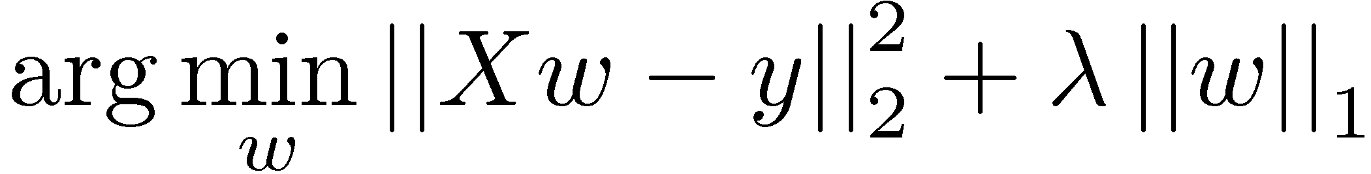
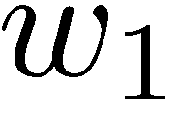
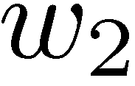
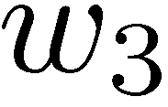
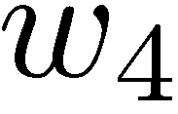
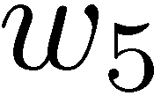
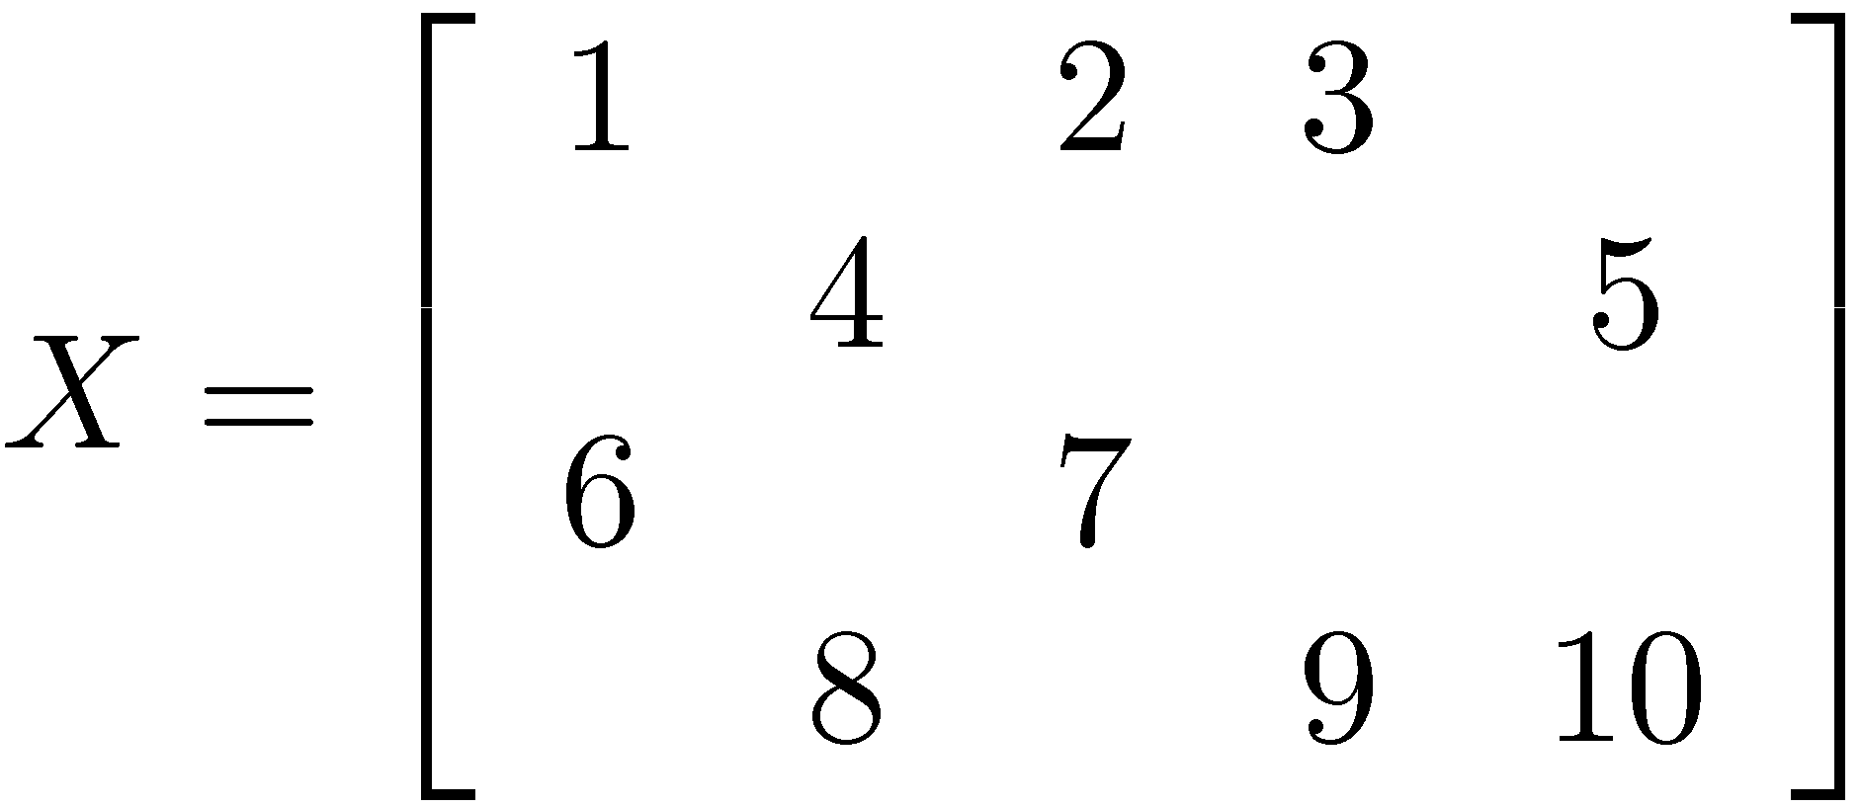
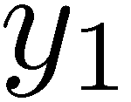
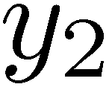
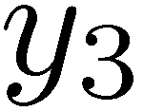
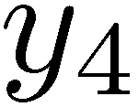
Data Graph: Lasso
Data matrix,
n x d
weights d x 1
Observations
n x 1
5 Features
4 Examples
Shooting Algorithm:
Sequentially optimize each weight holding all other weights fixed
Vertex Data:
Weights and losses
Edge Data:
Entries in X
Notes:
The data graph is a graph with data associated with every vertex and edge. Data can be any kind of data. Parameters, vectors, matrices, images, and so on. For instance in the case of Gibbs sampling, the data graph will e exactly the markov random field.. on each vertex we might sture the current variable sample as well as a histogram of all the samples seen so far. While on the edges we will store the binary potential.

Slide 30
The GraphLab Framework
Graph Based
Data Representation
Update Functions
User Computation
Scheduler
Consistency Model

Slide 31
Update Functions
An update function is a user defined program which when applied to a vertex transforms the data in the scope of the vertex
label_prop(i, scope){
// Get Neighborhood data
(Likes[i], W_{ij}, Likes[j]) ←scope;
// Update the vertex data
// Reschedule Neighbors if needed
if Likes[i] changes then
reschedule_neighbors_of(i);
}
Notes:
The data graph is modified via update functions.
Update Functions are operations which are applied on a vertex and transform the data in the scope of the vertex.
Where the scope of the vertex consists of the data on the vertex itself, adjacent vertices and edges. For instance, in the case of Gibbs sampling, the sampling function just …. And this fits nicely within the framkwork of the update function.

Slide 32
The GraphLab Framework
Graph Based
Data Representation
Update Functions
User Computation
Scheduler
Consistency Model

Slide 33
The Scheduler
The scheduler determines the order that vertices are updated.
CPU 1
b
c
d
a
b
c
Scheduler
e
f
b
e
f
g
a
i
h
i
j
h
i
j
k
CPU 2
The process repeats until the scheduler is empty.
Notes:
These update functions are evalauted in parallel based on a schedule, which abstractly represents a sequence of tasks to be executed..
For instance, here we have 2 cpus, and a data graph. Each processor then reads a vertex from the schedule…executes it.

Slide 34
Choosing a Schedule
The choice of schedule affects the correctness and parallel performance of the algorithm
GraphLab provides several different schedulers
Round Robin: vertices are updated in a fixed order
FIFO: Vertices are updated in the order they are added
Priority: Vertices are updated in priority order
Obtain different algorithms by simply changing a flag!
--scheduler=roundrobin
--scheduler=fifo
--scheduler=priority
Notes:
Scheduler determines the order of Uddate function evaluations.
We could define simple static schedules:
Synchronous -> every update function is evaluated simultaneously -> also known as Jacobi
Round-Robin -> where every update function is evaluated sequentially -> Gauss-Siedel

Slide 35
Dynamic Computation
Converged
Slowly Converging
Focus Effort
Notes:
However, static schedules are insufficient.
For instance, one part of the problem could be easy, can could have converged in much fewer iterations than another part of the problem.
Dynamic scheduling could allow us to “focus” computation on the difficult part of the problem.

Slide 36
The GraphLab Framework
Graph Based
Data Representation
Update Functions
User Computation
Scheduler
Consistency Model

Slide 37
GraphLab Ensures Sequential Consistency
For each parallel execution, there exists a sequential execution of update functions which produces the same result.
CPU 1
time
Parallel
CPU 2
Sequential
Single
CPU
Notes:
With the right choice of model, ….
…
If we have the followig simple 3 vertex graph.
And graphlab using 2 cpus in parallel perform a particular sequence of update functions.
If the execution is sequentially consistent means that There exiss a sequentialization of the update functions onto a single processor sequence such that the final result is exactly the same as the parallel verison

Slide 38
GraphLab Guarantee
Race-Free:
For every parallel execution of a GraphLab program there exists an equivalent sequential execution of update functions.
Consistency Model

Slide 39
Ensuring Race-Free Code
How much can computation overlap?

Slide 40
Common Problem: Write-Write Race
Processors running adjacent update functions simultaneously modify shared data:
CPU1 writes:
CPU 1
CPU 2
CPU2 writes:
Final Value
Notes:
But if two adjacent vertices are updated simultaneously…. We could get a clash on the center edge.
The result on the center edges could become inconsistent. For instance, the left vertex could write the blue histogram to the edge.
The right.
But due to the collision, it is possible for the final value can be very wrong.

Slide 41
Nuances of Sequential Consistency
Data consistency depends on the update function:
Some algorithms are “robust” to data-races
GraphLab Solution
The user can choose from three consistency models
Full, Edge, Vertex
GraphLab automatically enforces the users choice
Unsafe
Safe
CPU 1
CPU 2
CPU 1
Read
CPU 2
Notes:
Just one of the many possible races that could occur in your code.
Race free code is extremely difficult to write
The GraphLab design however, can ensure race-free operation.
Graphlab does this through the use of scope rules.

Slide 42
Consistency Rules
Full Consistency
Guaranteed sequential consistency for all update functions
Notes:
GraphLab allows you to pick from a few consistency models, of which the strongest is called the full consiteny model. This works by ensuring that all update function scopes do not overlap

Slide 43
Full Consistency
Full Consistency
Only allow update functions two vertices apart to be run in parallel
Reduced opportunities for parallelism
Notes:
It however has reduced opportunities for parallelsim
Only allows update fnctions two vertices apart to be run in parallel.

Slide 44
Obtaining More Parallelism
Not all update functions will modify the entire scope!
Full Consistency
Edge Consistency
Edge consistency is sufficient for a large number of algorithms including:
Label Propagation
Notes:
We can however relax this to try to obtain more parallelism .
By taking advantage of the fact… not all update functions will modifythe entire scope!
..
.
.
So we have an edge consistency model which only guarantees safe access to data on the current vertex and adjacent edge.

Slide 45
Edge Consistency
Edge Consistency
Safe
CPU 1
Read
CPU 2
Notes:
Edge consistency model is weaker, and comes at a corresponding increase in parallelism as now update functions which are just one vertex apart can be run in parallel.

Slide 46
Obtaining More Parallelism
Full
Edge
Vertex
“Map” operations. Feature extraction on vertex data
Notes:
Finally, if the update functions does not even need to access edge data, for instance, Map style operations. Vertex consistency is sufficient. The vertex consistency model is the weakest only guarantees safe access to the vertex data itself.

Slide 47
Vertex Consistency
Vertex
Notes:
Largest amount of parallelism available since adjacent vertices can be all run in parallel

Slide 48
Importance of Consistency
Many algorithms require strict consistency, or performs significantly better under strict consistency.
Alternating Least Squares
Notes:
There are some people who have claimed that ML is resilient to “soft-computation”
-- ask me afterwards I can give a number of examples

Slide 49
The GraphLab Framework
Graph Based
Data Representation
Update Functions
User Computation
Scheduler
Consistency Model

Slide 50
Anatomy of a GraphLab Program:
Define C++ Update Function
Build data graph using the C++ graph object
Set engine parameters:
Scheduler type
Consistency model
Add initial vertices to the scheduler
Run the engine on the graph [Blocking C++ call]
Final answer is stored in the graph

Slide 51
Algorithms Implemented
PageRank
Loopy Belief Propagation
Gibbs Sampling
CoEM
Graphical Model Parameter Learning
Probabilistic Matrix/Tensor Factorization
Alternating Least Squares
Lasso with Sparse Features
Support Vector Machines with Sparse Features
Label-Propagation
…

Slide 52
Implementing the GraphLab API
Multi-core & Cloud Settings

Slide 53
Multi-core Implementation
Implemented in C++ on top of:
Pthreads, GCC Atomics
Consistency Models implemented using:
Read-Write Locks on each vertex
Canonically ordered lock acquisition (dining philosophers)
Approximate schedulers:
Approximate FiFo/Priority ordering to reduced locking overhead
Experimental Matlab/Java/Python support
Nearly Complete Implementation
Available under Apache 2.0 License at graphlab.org

Slide 54
Distributed Cloud Implementation
Implemented in C++ on top of:
Multi-core implementation for each multi-core node
Custom RPC built on-top of TCP/IP and MPI
Graph is Partitioned over Cluster using either:
ParMETIS: High-performance partitioning heuristics
Random Cuts: Seems to work well on natural graphs
Consistency models are enforced using either
Distributed RW-Locks with pipelined acquisition
Graph-coloring with phased execution
No Fault Tolerance: we are working on a solution
Still Experimental

Slide 55
Shared Memory Experiments
Shared Memory Setting
16 Core Workstation

Slide 56
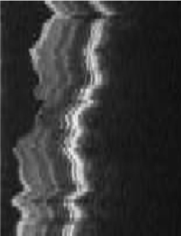
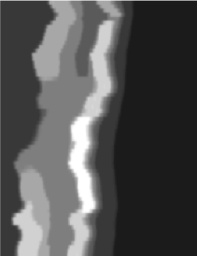
Loopy Belief Propagation
3D retinal image denoising
Vertices: 1 Million
Edges: 3 Million
Data Graph
Update Function:
Loopy BP Update Equation
Scheduler:
Approximate Priority
Consistency Model:
Edge Consistency
Notes:
The first experiment demonstrate use of the complete GraphLab pipeline.
3D retina images are acquired measuring the density at each voxel with a laser beam. The resultant images are however quite noisy, and the aim to use belief propagation to denoise the image. Parameter learning is used to estimate the edge potentials. ….
The datagraph is pairwise markov random field arranged as a 3d cube. That’s over a million variables. The update function used here is …
We store the shared edge potentials in the shared data talbe and we use a sync operation to perform parameter learning. How do we do that?
The accumulation phase is used to gather inference statistics on the gaph, while the apply phase is used to take a gradient step

Slide 57
Loopy Belief Propagation
Better
Optimal
SplashBP
15.5x speedup
Notes:
I will now present speedup results from running the problem on 1 to 16 processors.
We tested two schedulers on this problem, a priority queue scheduler and a splash scheduler. And we obtained nearly linear speedup, achieving.15x to 15.5x speedup on 16 proc.
However, we can do better with GraphLab

Slide 58

Gibbs Sampling
Protein-protein interaction networks [Elidan et al. 2006]
Provably correct Parallelization
Edge Consistency
Round-Robin Scheduler
Side-Chain
Interactions
Backbone
Discrete MRF
14K Vertices
100K Edges
Protein
Notes:
We demonstrate this on a protein-protein interaction network which is a .pairwise MRF…….
Using the round-robin scheduler on the edge consistency model provides a good 8x speedup on 16 processors. While using the colored scheduler, we can attain nearly a 10x speed up due to the decreased locking overhead.

Slide 59
Gibbs Sampling
Optimal
Better
Chromatic Gibbs
Sampler
Notes:
We demonstrate this on a protein-protein interaction network which is a .pairwise MRF…….
Using the round-robin scheduler on the edge consistency model provides a good 8x speedup on 16 processors. While using the colored scheduler, we can attain nearly a 10x speed up due to the decreased locking overhead.

Slide 60
CoEM (Rosie Jones, 2005)
Named Entity Recognition Task
the dog
<X> ran quickly
Is “Dog” an animal?
Is “Catalina” a place?
Australia
travelled to <X>
Vertices: 2 Million
Edges: 200 Million
Catalina Island
<X> is pleasant
Hadoop | 95 Cores | 7.5 hrs
Notes:
Our 3rd experiment CoEM, a named entity recognition task. We test the scalability of our GraphLab implementation. The aim of coEM is to classify noun phrases. For instance…. The CoEM problem can be represented as a bipartite graph with noun phrases on the left, and contexts on the right. An edge between a noun phrase and a context means that the NP was observed with that context in the corpus. For instance, on the top edge, it means that the phrase “the dog ran quickly” was observed.

Slide 61
CoEM (Rosie Jones, 2005)
Better
Optimal
Hadoop | 95 Cores | 7.5 hrs
GraphLab | 16 Cores | 30 min
GraphLab CoEM
6x fewer CPUs!
15x Faster!
61
Notes:
We now show the performance of our implementation.
On the small problem, we achieve a respectable 12x speedup on 16 processors.
On the large problem, we are able to achieve nearly a perfect speedup. This is due to the large amount of work available.
So we used 6x fewer CPUS to get 15x faster performance.

Slide 62
Lasso: Regularized Linear Model
Data matrix,
n x d
weights d x 1
Observations
n x 1
Regularization
5 Features
4 Examples
Shooting Algorithm [Coordinate Descent]
Updates on weight vertices modify losses on observation vertices.
Requires the
Full Consistency Model
Financial prediction dataset from Kogan et al [2009].
Notes:
The data graph is a graph with data associated with every vertex and edge. Data can be any kind of data. Parameters, vectors, matrices, images, and so on. For instance in the case of Gibbs sampling, the data graph will e exactly the markov random field.. on each vertex we might sture the current variable sample as well as a histogram of all the samples seen so far. While on the edges we will store the binary potential.

Slide 63
Full Consistency
Optimal
Better
Sparse
Dense
Notes:
Now for some results.
With the full consistency scope. We obtain a poor 2.1x speedup on 16 processors.
But we do better on the sparser dataset, attaining a 4x speedup. This is expected as the full consistency model has much fewer oopportunities for parallelism on denser model

Slide 64
Relaxing Consistency
Optimal
Better
Dense
Sparse
Why does this work? (See Shotgut ICML Paper)
Notes:
Now, however, here is an interesting observation we made.
What if we relax the consistency to the weakest vertex consistency model.
To our surprise, it still converges to the same loss!
But of course, now at a significant increase in performance, attaining about 9x speedup on 16 processors on the dense dataset, and a 5x speedup on the sparse dataset..
Just as a comparison, here are the curves when the full consistency model is used.
It is however, still an open question. Why does the system still converge in this setting.

Slide 65
Experiments
Amazon EC2 High-Performance Nodes

Slide 66
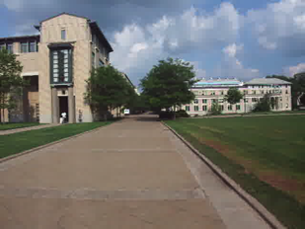
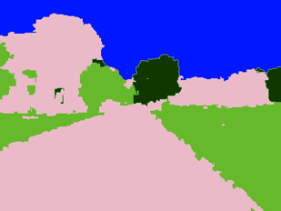
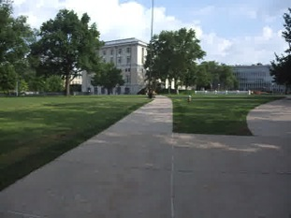
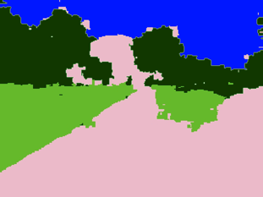
Video Cosegmentation
Segments mean the same
Gaussian EM clustering + BP on 3D grid
Model: 10.5 million nodes, 31 million edges
Notes:
2160 frames

Slide 67
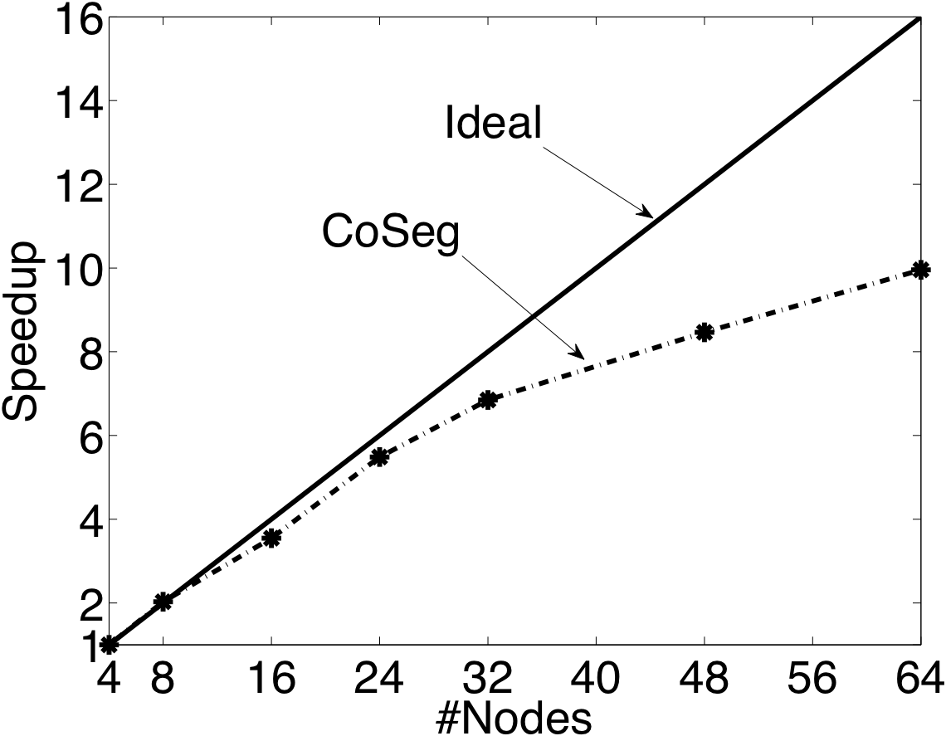
Video Coseg. Speedups

Slide 68
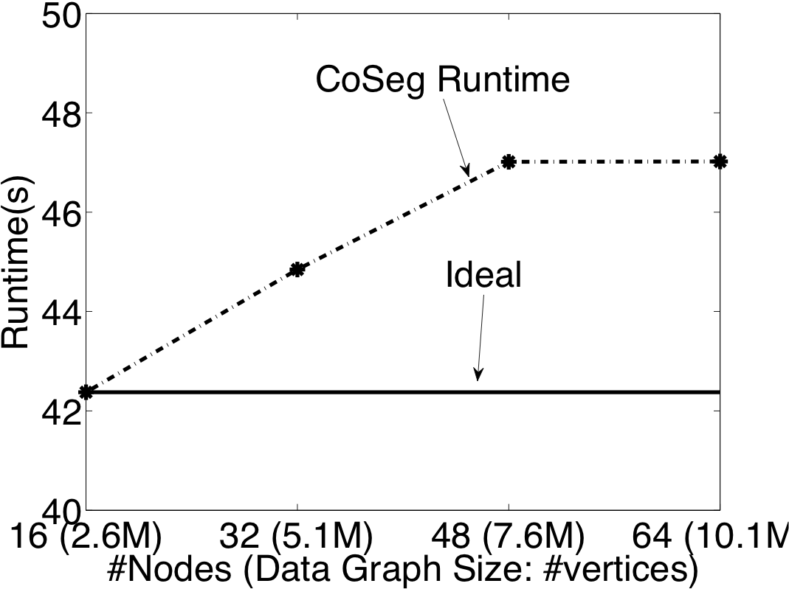
Video Segmentation

Slide 69
Video Segmentation

Slide 70
Matrix Factorization
Netflix Collaborative Filtering
Alternating Least Squares Matrix Factorization
Model: 0.5 million nodes, 99 million edges
Users
Netflix
d
Movies

Slide 71
Netflix
Speedup Increasing size of the matrix factorization

Slide 72
Netflix

Slide 73
Netflix: Comparison to MPI
Cluster Nodes

Slide 74
Summary
An abstraction tailored to Machine Learning
Targets Graph-Parallel Algorithms
Naturally expresses
Data/computational dependencies
Dynamic iterative computation
Simplifies parallel algorithm design
Automatically ensures data consistency
Achieves state-of-the-art parallel performance on a variety of problems
Notes:
GraphLab is an abstraction tailored specifically to the needs of a good number of ML algorithm.
And most importantly.. It is easy to use.

Slide 75
Current/Future Work
Out-of-core Storage
Hadoop/HDFS Integration
Graph Construction
Graph Storage
Launching GraphLab from Hadoop
Fault Tolerance through HDFS Checkpoints
Sub-scope parallelism
Address the challenge of very high degree nodes
Update Functions -> Update Functors
Allows update functions to send state when rescheduling.

Slide 76



Checkout GraphLab
Documentation… Code… Tutorials…
http://graphlab.org
Questions & Feedback
jegonzal@cs.cmu.edu
Notes:
We are open sourcing our reference implementation of Parallel GraphLab today.

Slide 77
Outline of the GraphLab Model
Data Graph
Update Functions
Scheduling
Consistency Model
Shared Data Table
Notes:
The GraphLab model is defined in 4 parts. The Data Graph which is used to express sparse data dependencies in your computation.
And the Shared Data Table which is used to express global data as well as global computation
In addition, we also have the scheduler which determines the order of computation
And the scope system which provides thread safety and consistency.

Slide 78
Global Information
Shared Data Table
What if we need global information?
Algorithm Parameters
Sufficient Statistics
Global loss estimate for termination assessment
Notes:
However, all these is restricted to just local computation.
What if we need some global information?
For instance, what if you want to specify algorithm parameters to update functions?
…

Slide 79
Shared Data Table (SDT)
Global constant parameters
Global computation (Sync Operation)
Reduce: repeatedly computed in the background by “summing” over all vertices.
Constant
Required Number
of Samples
Constant
Temperature
Sync
Termination
criterion
Sync
Log-likelihood
Notes:
SO in context of the Gibbs example,

Slide 80
Automatic Termination Checking
User attaches predicates to Shared Data Table
Example:
residualCheck(Shared Data Table)
Returns True if termination condition is satisfied
The termination functions are evaluated every time the Shared Data Table is updated

