Slide 1

Adaptive Submodularity:
A New Approach to Active Learning and Stochastic Optimization
Daniel Golovin
Joint work with Andreas Krause
California Institute of Technology
Center for the Mathematics of Information
1

Slide 2

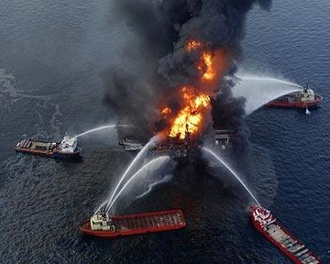
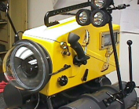
Max K-Cover (Oil Spill Edition)

Slide 3
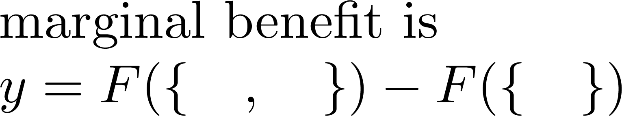
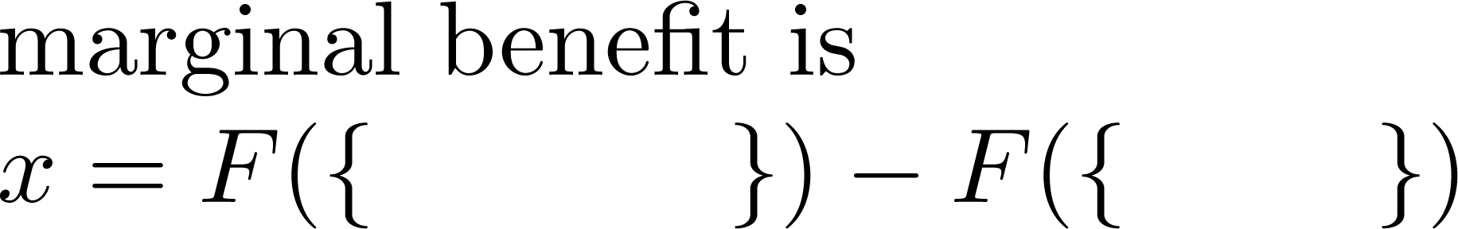
Submodularity
Discrete diminishing returns property for set functions.
``Playing an action at an earlier stage
only increases its marginal benefit''
Time
Time

Slide 4
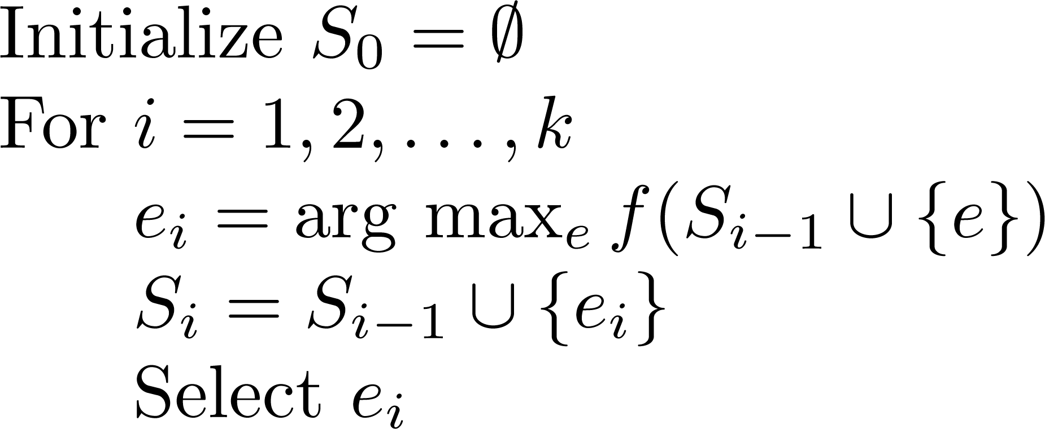
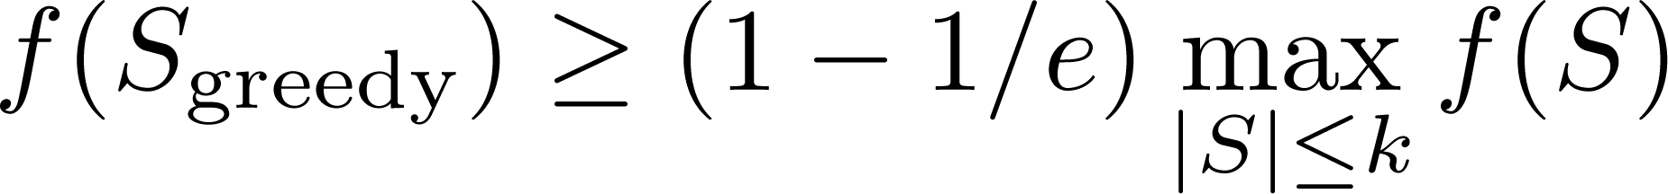
The Greedy Algorithm
Theorem [Nemhauser et al ‘78]

Slide 5

Stochastic Max K-Cover
Bayesian: Known failure distribution.
Adaptive: Deploy a sensor and see what you get. Repeat K times.
At 1st location
0.3
0.2
  Asadpour et al. (`08): (1-1/e)-approx if sensors
  (independently) either work perfectly or fail completely.
0.5

Slide 6
Adaptive Submodularity
[G & Krause, 2010]
Select Item
Stochastic
Outcome
Time
Gain less
Gain more
Playing an action at an earlier stage
only increases its marginal benefit
(i.e., at an ancestor)
Δ(action | observations)
expected
(taken over its outcome)
Adaptive Monotonicity:
Δ(a | obs) ≥ 0, always

Slide 7
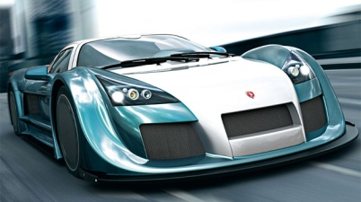
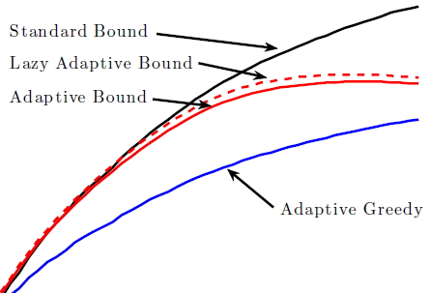
What’s it good for?
Allows us to generalize results to the adaptive realm, including:
  (1-1/e)-approximation for Max K-Cover, submodular maximization
  (ln(n)+1)-approximation for Set Cover
  “Accelerated” implementation
  Data-Dependent Upper Bounds on OPT

Slide 8
Recall the Greedy Algorithm
Theorem [Nemhauser et al ‘78]

Slide 9
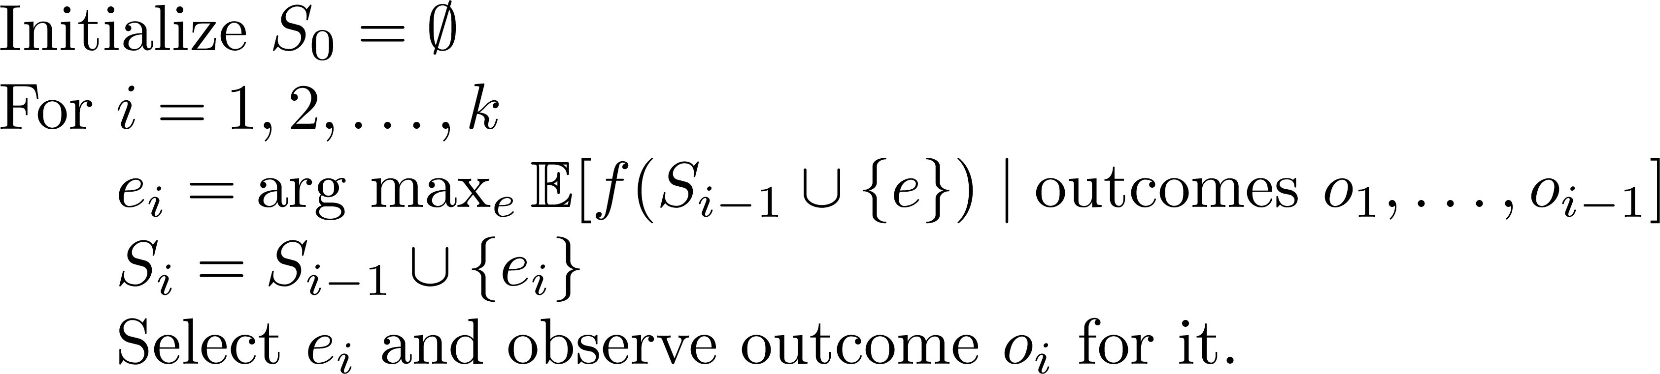
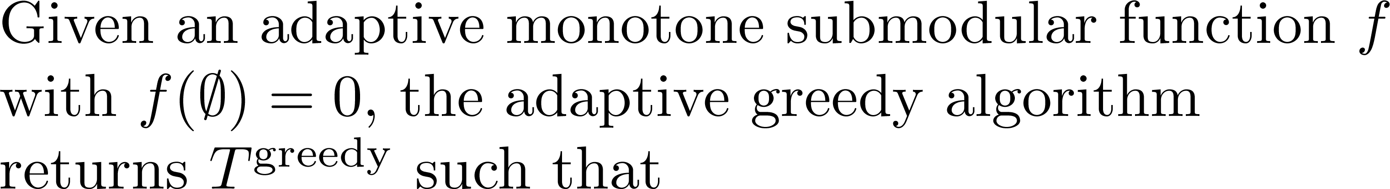
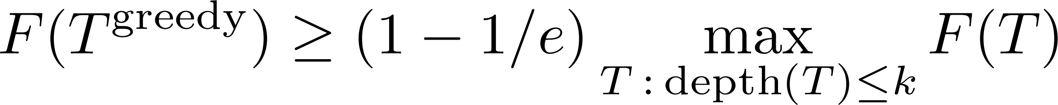
The Adaptive-Greedy Algorithm
Theorem [G & Krause, COLT ‘10]

Slide 10
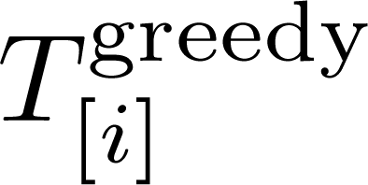
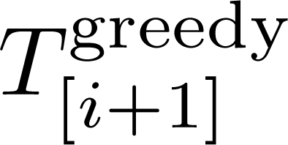


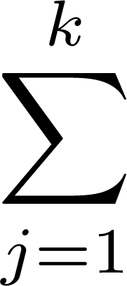

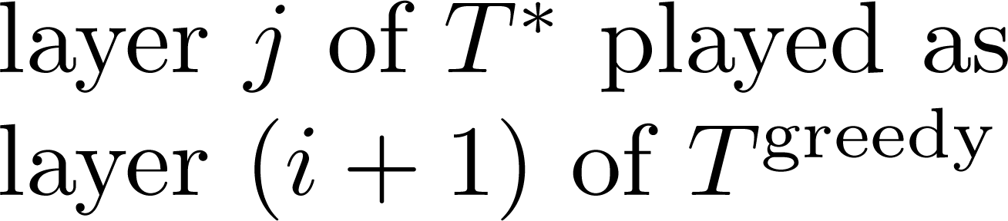
-
-
[Adapt-monotonicity]
(
-
)
[Adapt-submodularity]

Slide 11
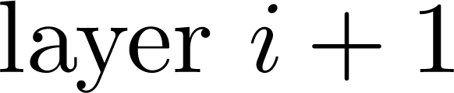
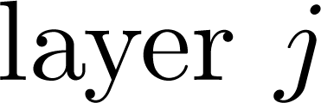
How to play layer j at layer i+1
The world-state dictates which path in the tree we’ll take.
For each node at layer i+1,
Sample path to layer j,
Play the resulting layer j action at layer i+1.
By adapt. submod.,
playing a layer earlier
only increases it’s
marginal benefit
…

Slide 12


-
-
[Adapt-monotonicity]
(
-
)
[Adapt-submodularity]
(
-
)
-
(
)
[Def. of adapt-greedy]

Slide 13
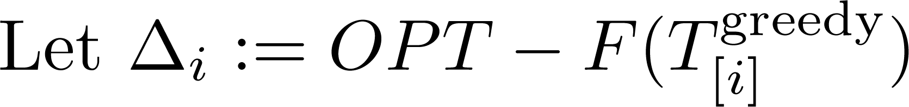

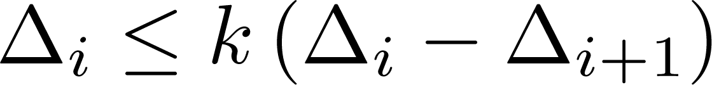

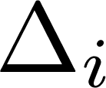
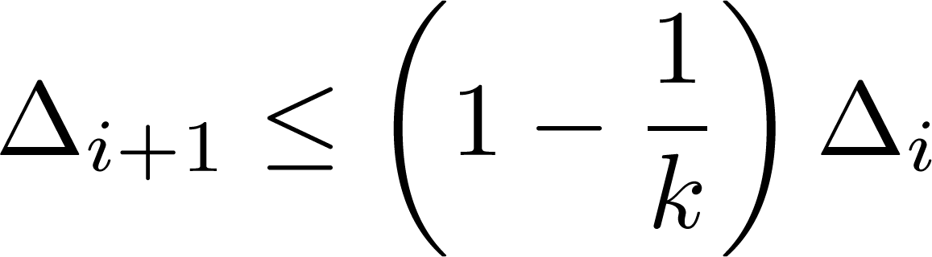
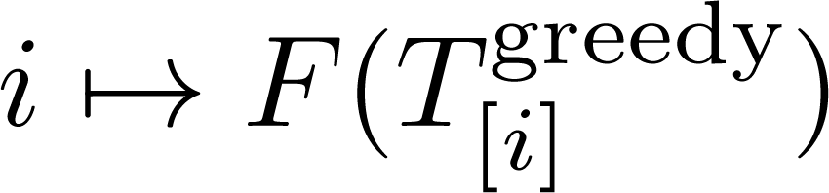
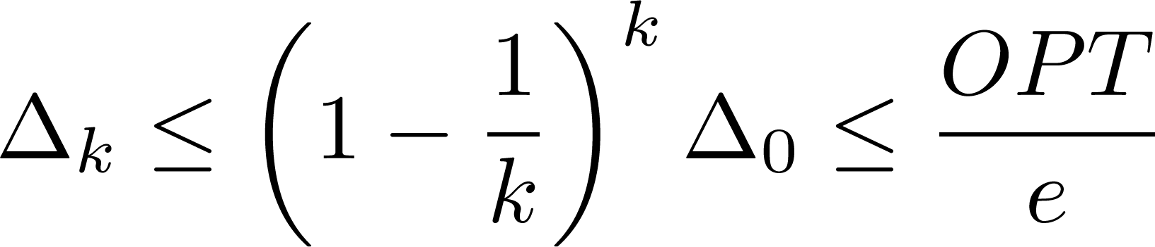
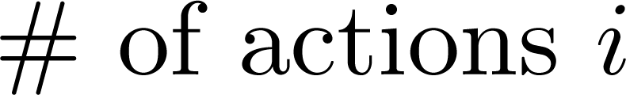
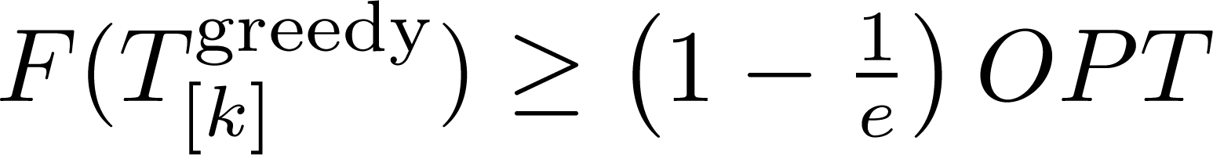

Slide 14
Stochastic Max Cover is Adapt-Submod
2
1
3
1
3
Random sets distributed
independently.
adapt-greedy is a (1-1/e) ≈ 63%
approximation to the
adaptive optimal solution.
Gain less
Gain more

Slide 15





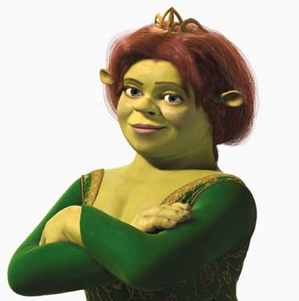
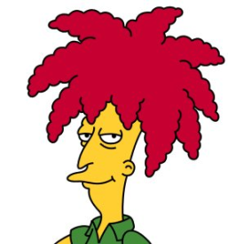
Influence in Social Networks
  [Kempe, Kleinberg, & Tardos, KDD `03]
Daria
Eric
Alice
0.2
Prob. of
influencing
0.5
0.4
0.3
0.2
0.5
Bob
0.5
Fiona
Charlie
Who should get free cell phones?
V = {Alice, Bob, Charlie, Daria, Eric, Fiona}
F(A) = Expected # of people influenced when targeting A

Slide 16
Daria
Eric
Alice
0.2
0.5
0.4
0.3
0.2
0.5
Bob
0.5
Fiona
Charlie
Key idea: Flip coins c in advance ➔ “live” edges
F_{c}(A) = People influenced under outcome c (set cover!)
F(A) = ∑_{c} P(c) F_{c}(A) is submodular as well!

Slide 17
Adaptive Viral Marketing
Daria
Eric
Alice
0.2
Prob. of
influencing
0.5
?
0.4
0.3
0.2
0.5
Bob
0.5
Fiona
Charlie
Adaptively select promotion targets, see which of their friends are influenced.

Slide 18
Adaptive Viral Marketing
Daria
Eric
Alice
0.2
0.5
0.4
0.3
0.2
0.5
Bob
0.5
Fiona
Charlie
Objective adapt monotone & submodular.
Hence, adapt-greedy is a (1-1/e) ≈ 63% approximation to the adaptive optimal solution.

Slide 19
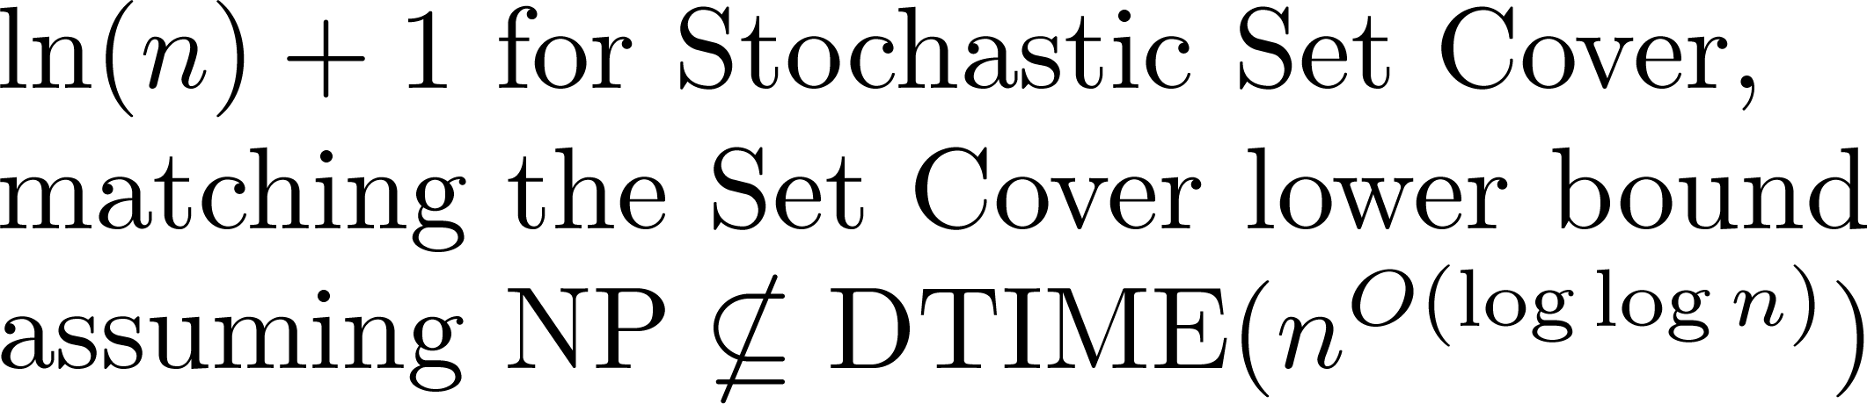
Stochastic Min Cost Cover
Adaptively get a threshold amount of value.
Minimize expected number of actions.
If objective is adapt-submod and monotone, we get a logarithmic approximation.
  [Goemans & Vondrak, LATIN ‘06]
  [Liu et al., SIGMOD ‘08]
  [Feige, JACM ‘98]
c.f., Interactive Submodular Set Cover
  [Guillory & Bilmes, ICML ‘10]

Slide 20
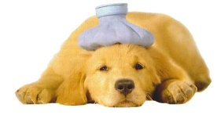

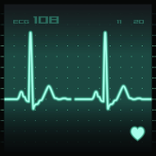
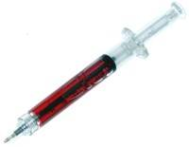
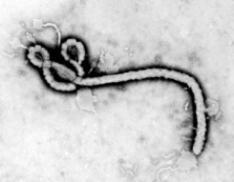
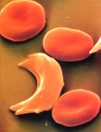
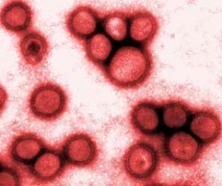
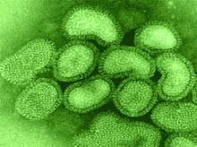
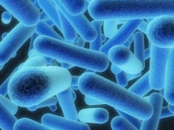
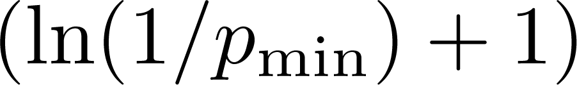
Optimal Decision Trees
“Diagnose the patient as cheaply as possible (w.r.t. expected cost)”
x₁
=
Garey & Graham, 1974;
Loveland, 1985;
Arkin et al., 1993;
Kosaraju et al., 1999;
Dasgupta, 2004;
Guillory & Bilmes, 2009;
Nowak, 2009;
Gupta et al., 2010
0
1
x₂
=
0
1
0
1
x₃
=
0
1

Slide 21
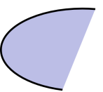
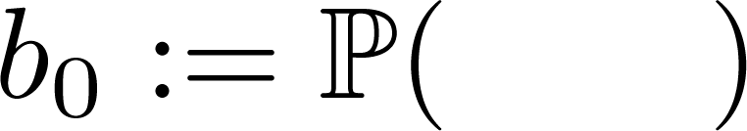

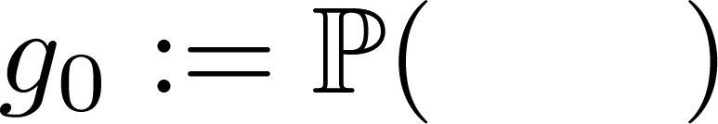
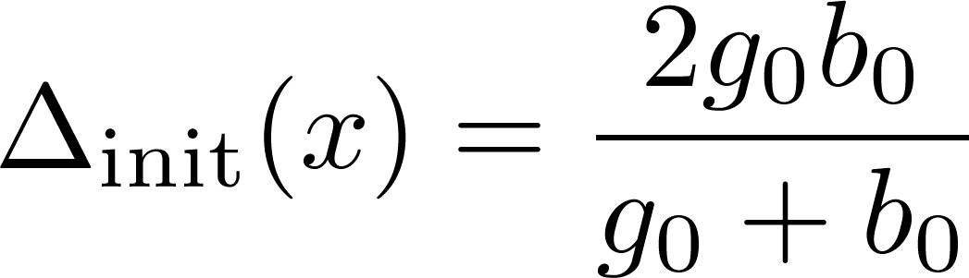
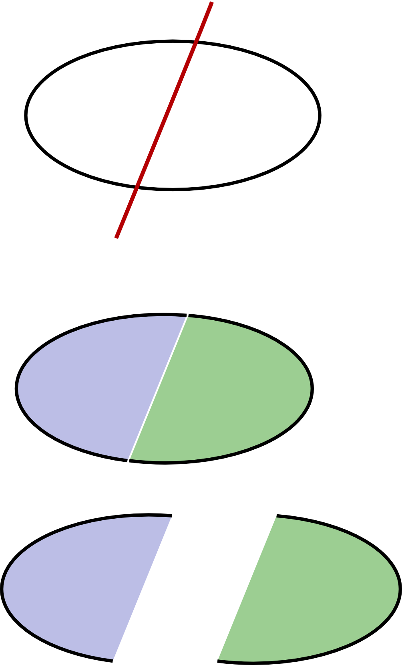

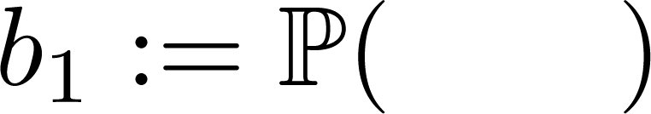
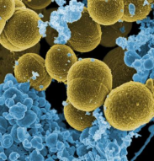
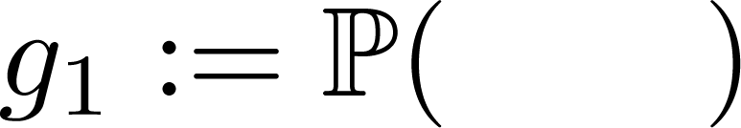
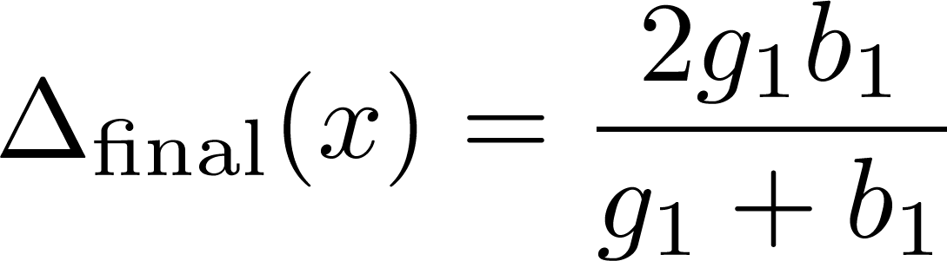
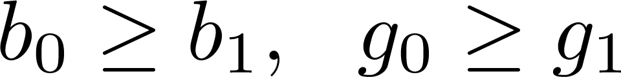
Objective = probability mass of hypotheses
you have ruled out.
It’s Adaptive Submodular.
Test x
Test w
Test v
Outcome = 0
Outcome = 1

Slide 22
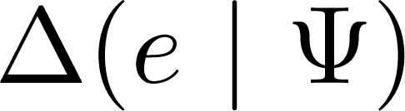
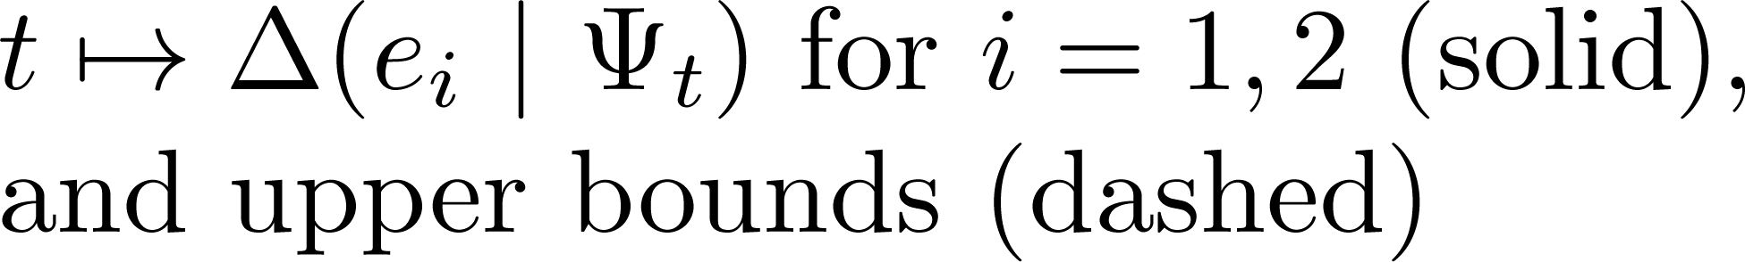
Accelerated Greedy
Generate upper bounds on
Use them to avoid some evaluations.
time
Saved evaluations

Slide 23
Accelerated Greedy
Generate upper bounds on
Use then to avoid some evaluations.
Empirical Speedups we obtained:
- Temperature Monitoring: 2 - 7x
- Traffic Monitoring: 20 - 40x
- Speedup often increases with
instance size.

Slide 24
Ongoing work
Active learning with noise
With Andreas Krause & Debajyoti Ray, to appear NIPS ‘10
Edges between any two
diseases in distinct groups

Slide 25
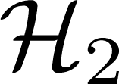














Active Learning of Groups via Edge Cutting
Edge Cutting Objective is Adaptive Submodular
First approx-result for noisy observations

Slide 26
Conclusions
New structural property useful for design & analysis of adaptive algorithms
Recovers and generalizes many known results in a unified manner. (We can also handle costs)
Tight analyses & optimal-approx factors in many cases.
“Accelerated” implementation yields significant speedups.
x₁
0.2
2
0
1
x₂
0.5
0.4
0.2
1
3
0.3
0.5
0
1
0
1
x₃
0.5

Slide 27

Q&A
x₁
0.2
2
0
1
0.5
x₂
0.4
0.2
0.5
1
3
0.3
0
1
0
1
x₃
0.5

