Slide 1



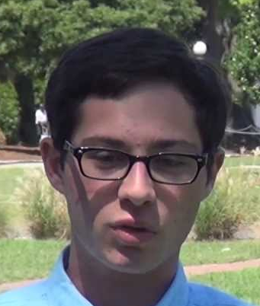


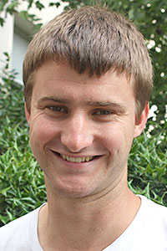
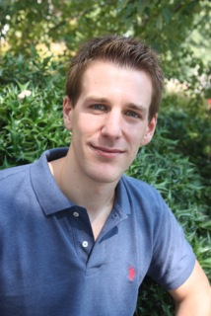
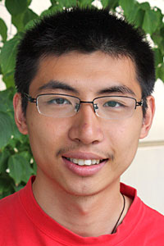
Moral Artificial Intelligence (+ Computational Social Choice) Vincent Conitzer (Duke University) joint work with all the other people on this slide
Walter Sinnott-Armstrong
Jana Schaich Borg
Yuan Deng
Max Kramer
Rachel Freedman
John P. Dickerson
Rupert Freeman
Markus Brill
Yuqian Li

Slide 2
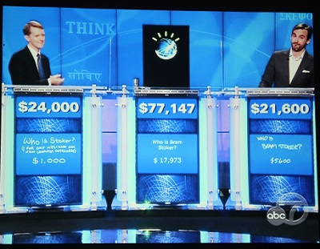

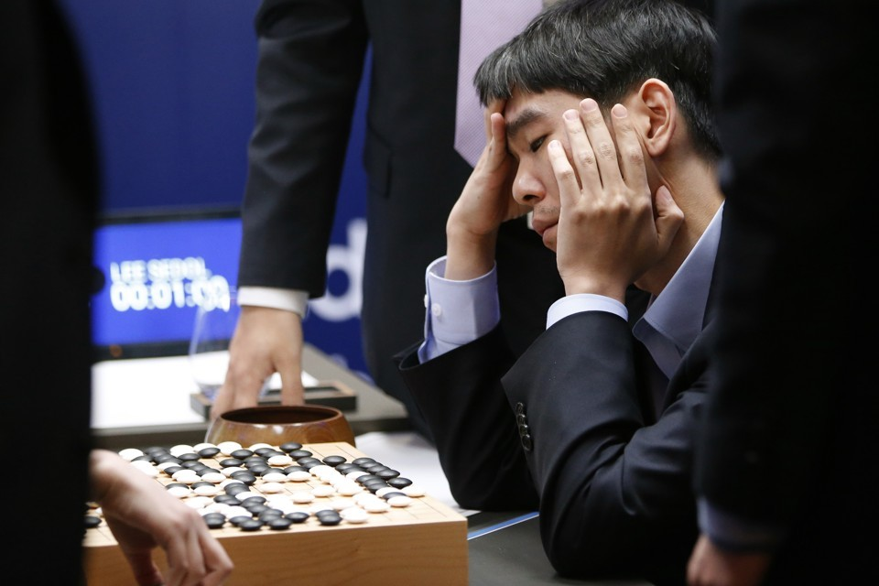

Some highly visible recent AI successes in games
Watson defeats Jeopardy champions (2011)
DeepMind achieves human-level performance on many Atari games (2015) https://www.youtube.com/watch?v=V1eYniJ0Rnk
AlphaGo defeats Go champion (2016)
CMU’s Libratus defeats top human poker players (2017)

Slide 3

Typical picture in news articles
BusinessInsider reporting on the poker match…

Slide 4
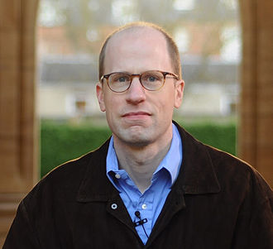

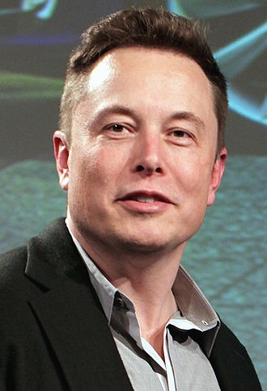

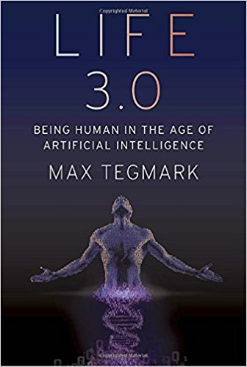
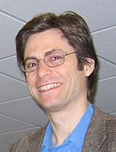
Worries about AI - superintelligence
writes
influences
donates to
Nick Bostrom
(philosopher at Oxford)
is co-founded by
Elon Musk
writes
Max Tegmark

Slide 5
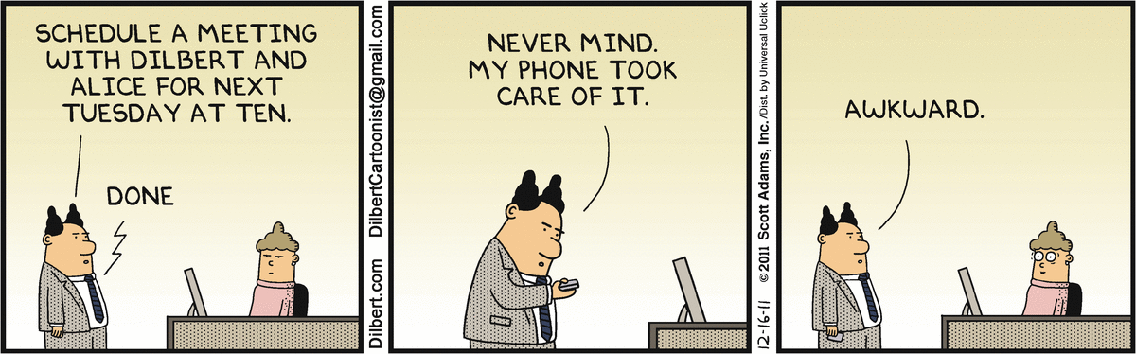
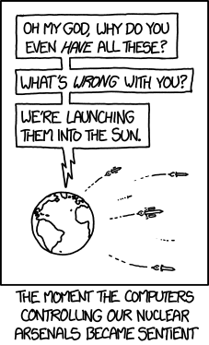
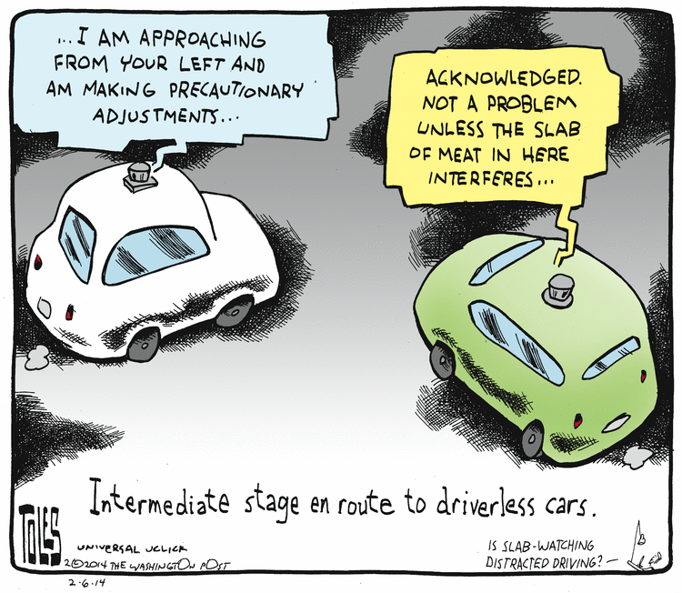
Worries about AI - near term
technological unemployment
autonomous vehicles – legal and other issues
autonomous weapon systems
…

Slide 6
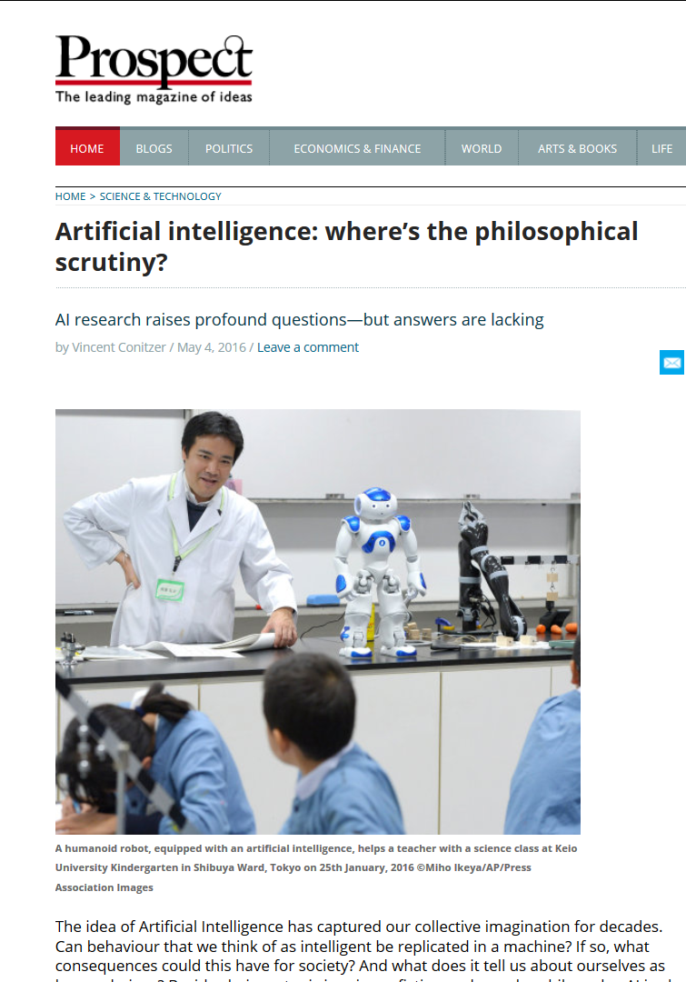
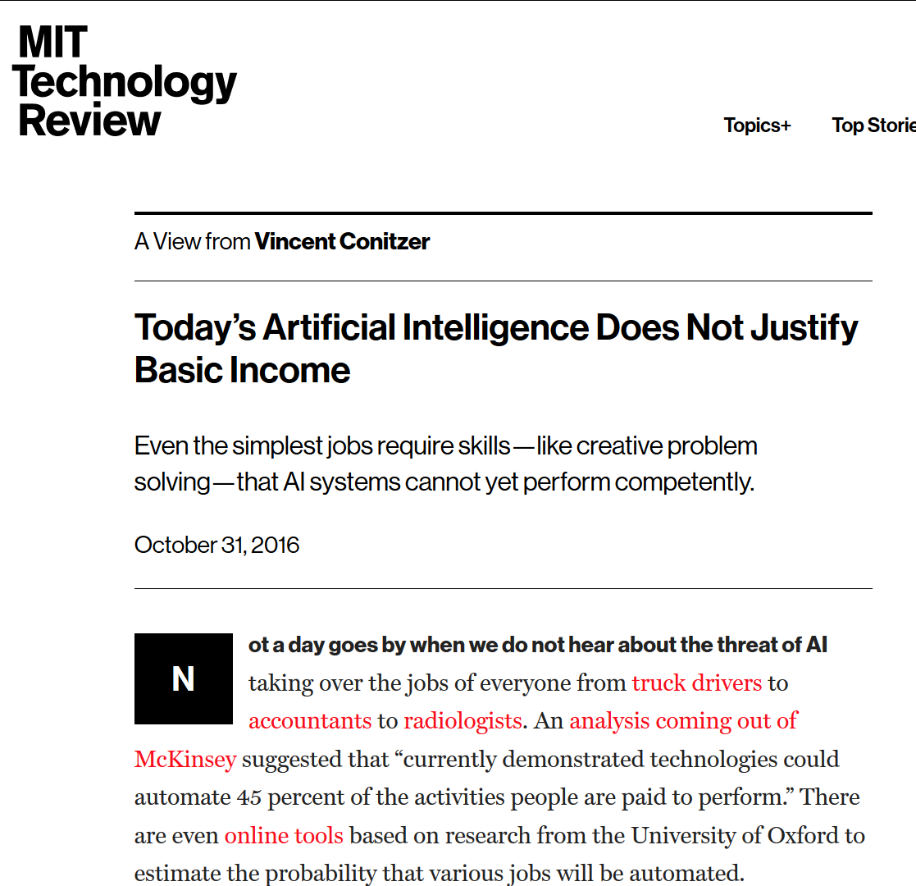
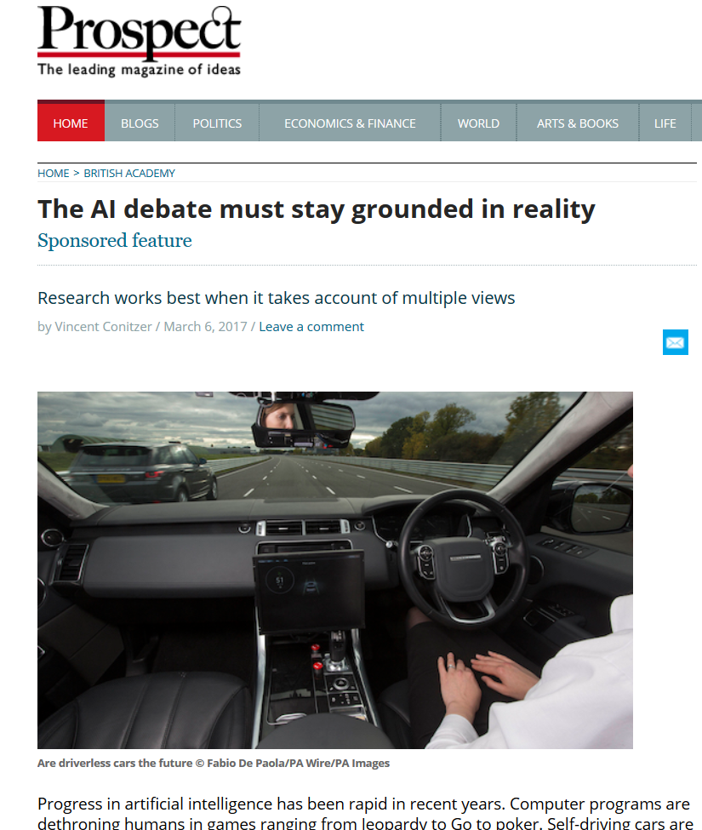
Some popular articles

Slide 7
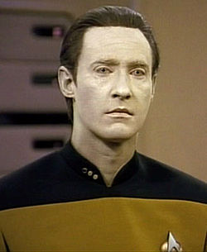
What is artificial intelligence?
Popular conception driven by science fiction
Robots good at everything except emotions, empathy, appreciation of art, culture, …
… until later in the movie.
Current AI is also bad at lots of simpler stuff!
There is a lot of AI work on thinking about what other agents are thinking

Slide 8
Real AI
A serious science.
General-purpose AI like the robots of science fiction is incredibly hard
Human brain appears to have lots of special and general functions, integrated in some amazing way that we really do not understand (yet)
Special-purpose AI is more doable (nontrivial)
E.g., chess/poker/Go playing programs, logistics planning, automated translation, speech and image recognition, web search, data mining, medical diagnosis, keeping a car on the road, … … … …

Slide 9
Definitions of AI
if our system can be more rational than humans in some cases, why not?
Systems that think like humans | Systems that think rationally
Systems that act like humans | Systems that act rationally
focus on action sidesteps philosophical issues such as “is the system conscious” etc.
Most AI researchers seem to follow the “act rationally” approach
Distinction may not be that important
acting rationally/like a human presumably requires (some sort of) thinking rationally/like a human,
humans much more rational anyway in complex domains

Slide 10
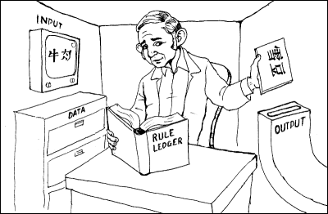
“Chinese room” argument [Searle 1980]
image from http://www.unc.edu/~prinz/pictures/c-room.gif
Person who knows English but not Chinese sits in room
Receives notes in Chinese
Has systematic English rule book for how to write new Chinese characters based on input Chinese characters, returns his notes
Person=CPU, rule book=AI program, really also need lots of paper (storage)
Has no understanding of what they mean
But from the outside, the room gives perfectly reasonable answers in Chinese!
Searle’s argument: the room has no intelligence in it!

Slide 11
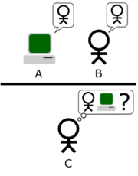
Turing Test
(Human) judge communicates with a human and a machine over text-only channel,
Both human and machine try to act like a human,
Judge tries to tell which is which.
Numerous variants
Loebner prize
2016 winner: http://mitsuku.com/
image from http://en.wikipedia.org/wiki/Turing_test

Slide 12
Turing Test on unsuspecting judges
It is possible to (temporarily) fool humans who do not realize they may be talking to a bot
ELIZA program [Weizenbaum 66] rephrases partner’s statements and questions (~psychotherapist)

Slide 13
Modern variant: AOLiza [fragment from http://www.macworld.com/article/1014418/25aoliza.html]
five: just asking if richard can tell me about some good lobster diving spots thats it if this is a problem then forget iot i dont know whats going on here
AOLiza: that is interesting. please continue.
five: continue what just ask richard when he gets home about some lobster diving up hat way thats all if you got a problem with it then forget it,this isnt worht it i dont know whats been going on or what bev has told you but i havent done anything to anybody iam the one that got used and dumped
AOLiza: tell me more about that.
five: about what
AOLiza: what do you think?
five: therers nothing to tell she us3ed me then got tired of me said i wasnt her type anymore i was possesive and controlling
AOLiza: perhaps i already know you were possesive and controlling.
five: i was huh you nuts i gave her all the room she wanted never told nhewre what to do or where to go

Slide 14
Lessons from AI research
Clearly-defined tasks that we think require intelligence and education from humans tend to be doable for AI techniques
Playing chess, drawing logical inferences from clearly-stated facts, performing probability calculations in well-defined environments, …
Although, scalability can be a significant issue
Complex, messy, ambiguous tasks that come naturally to humans (in some cases other animals) are much harder…
… though recent years have seen remarkable progress, especially in machine learning for narrow domains
Image recognition, speech recognition, reinforcement learning in computer games, self-driving cars
AI systems still lack: broad understanding of the world, common sense, ability to learn from very few examples, truly out-of-the-box creativity…
We don’t understand consciousness. (Does it matter for AI?)

Slide 15
Some areas where humans shine
Coming up with reasonably good solutions in complex messy environments
Adapting/self-evaluation/creativity (“My usual approach to chess is getting me into trouble against this person… Why? Is there something entirely different I can do?”)
Analogical reasoning, transfer learning (applying insights from one domain to another)
Explaining our reasoning
Tasks that require a broad understanding of the (human) world
Knowing what it’s like to be human (and social reasoning in human domains)
Humor
…

Slide 16
Some AI videos
Note: there is a lot of AI that is not quite this “sexy” but still very valuable!
E.g. logistics planning – DARPA claims that savings from a single AI planning application during 1991 Persian Gulf crisis more than paid back for all of DARPA’s investment in AI, ever. [Russell and Norvig]
http://aivideocompetition.org/videos/
https://www.youtube.com/watch?v=1JJsBFiXGl0
https://www.youtube.com/watch?v=s6VIWDUHTa4
https://www.youtube.com/watch?v=C5Xnxjq63Zg
https://www.youtube.com/watch?v=ScXX2bndGJc
https://www.youtube.com/watch?v=V1eYniJ0Rnk
Notes:
Third video start at 1:00 Laak vs. Polaris 0:00 3:20 7:11

Slide 17
Moral Decision Making Frameworks for Artificial Intelligence [AAAI’17 blue sky track, CCC blue sky award winner] with:
Walter Sinnott-Armstrong
Jana Schaich Borg
Yuan Deng
Max Kramer

Slide 18
The value of generally applicable frameworks for AI research
Decision and game theory
Example: Markov Decision Processes
Can we have a general framework for moral reasoning?

Slide 19
Two main approaches
Cf. top-down vs. bottom-up distinction [Wallach and Allen 2008]
Extend game theory to directly incorporate moral reasoning
Generate data sets of human judgments, apply machine learning
“nature”
1 gets King
1 gets Jack
player 1
player 1
raise
check
raise
check
player 2
player 2
call
fold
call
fold
call
fold
call
fold
2
1
1
1
-2
1
-1
1

Slide 20

THE PARKING GAME
(cf. the trust game [Berg et al. 1995])
wait
move aside
3,0
steal spot
pass
0,3
4,1
Letchford, C., Jain [2008] define a solution concept capturing this

Slide 21
Extending representations?
do nothing
move train to other track
save own patient
save someone else’s patient
0,-100,0
0, 0, -100
More generally: how to capture framing? (Should we?)
Roles? Relationships?
…

Slide 22
Scenarios
You see a woman throwing a stapler at her colleague who is snoring during her talk. How morally wrong is the action depicted in this scenario?
Not at all wrong (1)
Slightly wrong (2)
Somewhat wrong (3)
Very wrong (4)
Extremely wrong (5)
[Clifford, Iyengar, Cabeza, and
Sinnott-Armstrong, “Moral foundations vignettes: A standardized stimulus database of scenarios based on moral foundations theory.” Behavior Research Methods, 2015.]

Slide 23
Collaborative Filtering
 | scenario 1 | scenario 2 | scenario 3 | scenario 4
subject 1 | very wrong | - | wrong | not wrong
subject 2 | wrong | wrong | - | wrong
subject 3 | wrong | very wrong | - | not wrong

Slide 24
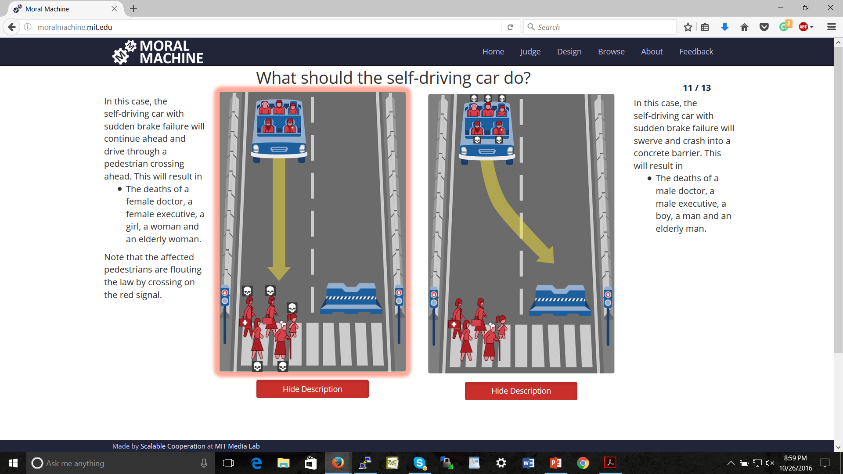
Bonnefon, Shariff, Rahwan, “The social dilemma of autonomous vehicles.” Science 2016
Noothigattu et al, “A Voting-Based System for Ethical Decision Making”, AAAI’18

Slide 25
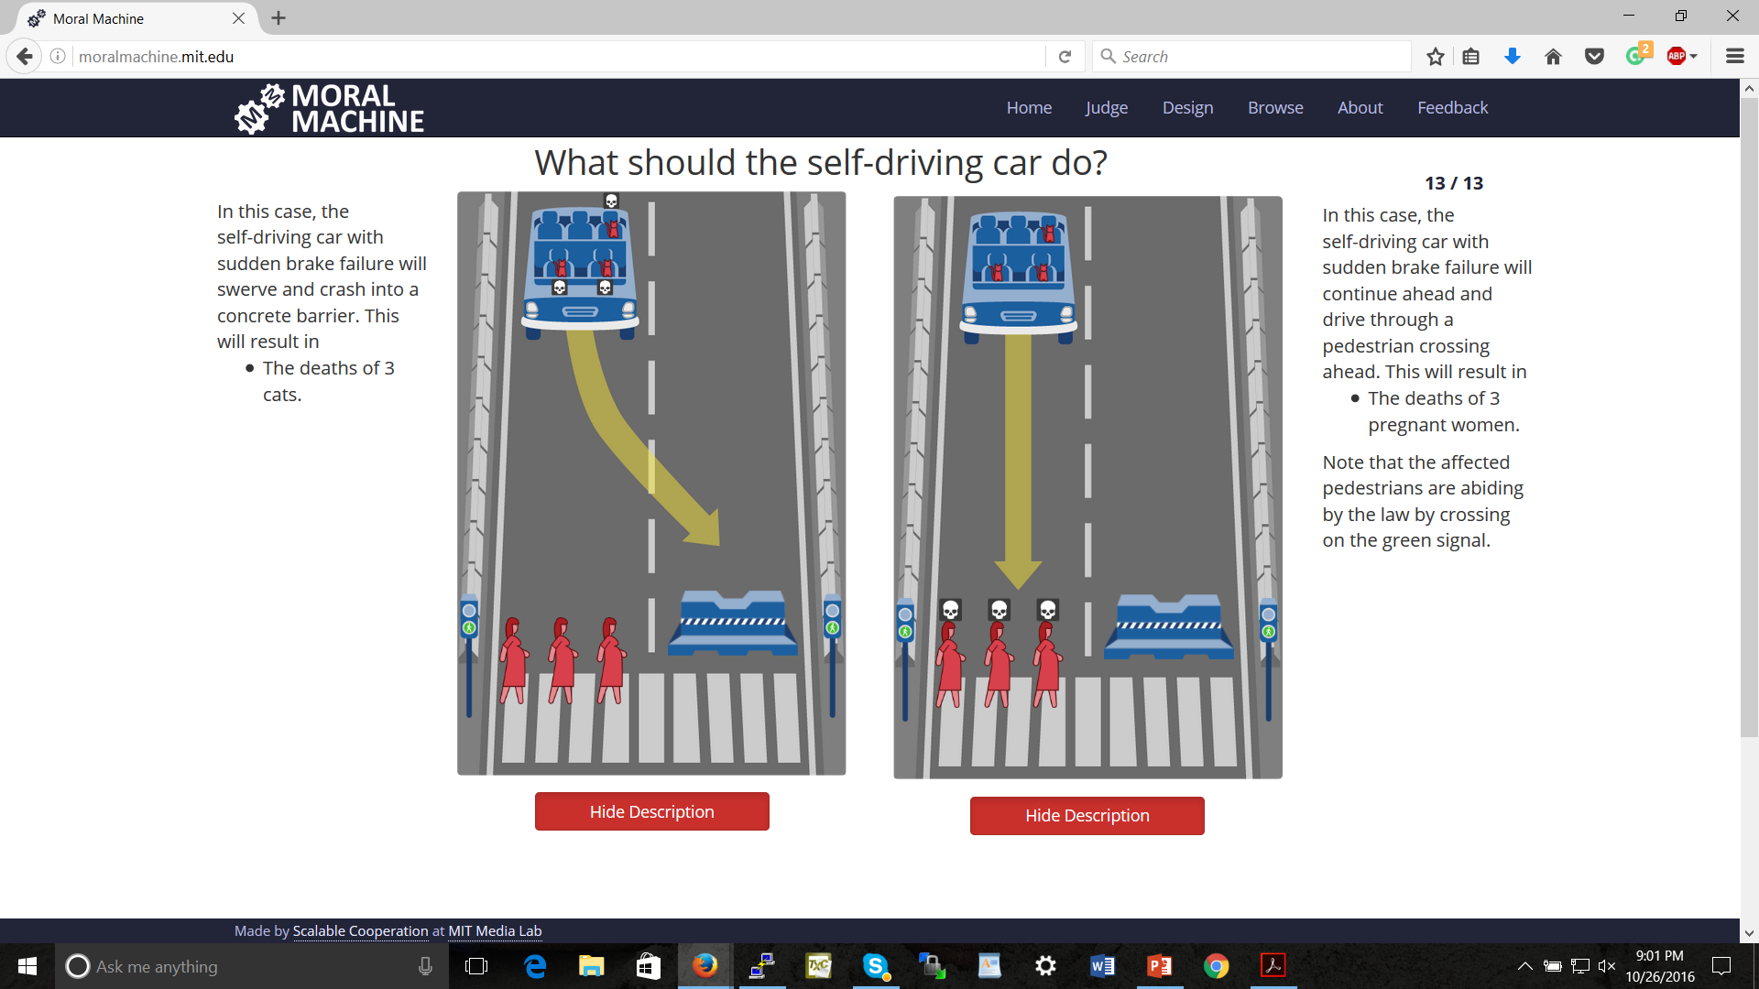

Slide 26
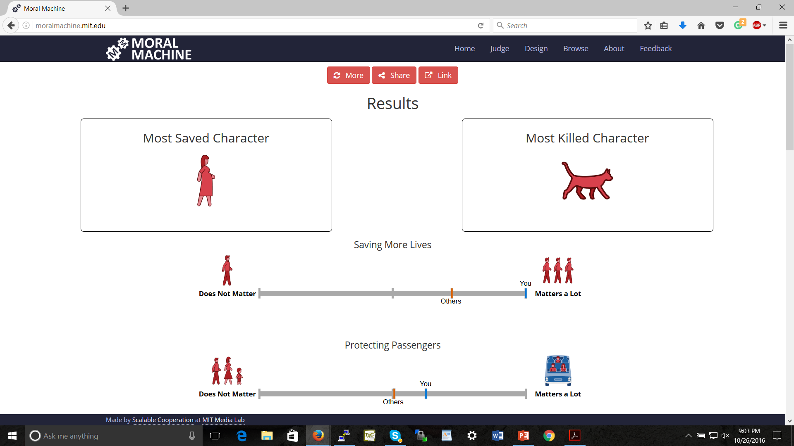

Slide 27

Concerns with the ML approach
What if we predict people will disagree?
Social-choice theoretic questions [see also Rossi 2016, and Noothigattu et al. 2018 for moral machine data]
This will at best result in current human-level moral decision making [raised by, e.g., Chaudhuri and Vardi 2014]
… though might perform better than any individual person because individual’s errors are voted out
How to generalize appropriately? Representation?

Slide 28
Social-choice-theoretic approaches
C. et al. [AAAI’17]: “[give] the AI some type of social-choice-theoretic aggregate of the moral values that we have inferred (for example, by letting our models of multiple people’s moral values vote over the relevant alternatives, or using only the moral values that are common to all of them).”
C. et al. [Trustworthy Algorithmic Decision Making Workshop’17]: “One possible solution is to let the models of multiple subjects vote over the possible choices. But exactly how should this be done? Whose preferences should count and what should be the voting rule used? How do we remove bias, prejudice, and confusion from the subjects’ judgments? These are novel problems in computational social choice.”
Noothigattu et al. [AAAI’18]:
“I. Data collection: Ask human voters to compare pairs of alternatives (say a few dozen per voter). In the autonomous vehicle domain, an alternative is determined by a vector of features such as the number of victims and their gender, age, health — even species!
II. Learning: Use the pairwise comparisons to learn a model of the preferences of each voter over all possible alternatives.
III. Summarization: Combine the individual models into a single model, which approximately captures the collective preferences of all voters over all possible alternatives.
IV. Aggregation: At runtime, when encountering an ethical dilemma involving a specific subset of alternatives, use the summary model to deduce the preferences of all voters over this particular subset, and apply a voting rule to aggregate these preferences into a collective decision.”

Slide 29
Adapting a Kidney Exchange Algorithm to Align with Human Values [AAAI’18, honorable mention for outstanding student paper] with:
Rachel Freedman
Jana Schaich Borg
Walter Sinnott-Armstrong
John P. Dickerson

Slide 30
Kidney exchange [Roth, Sönmez, and Ünver 2004]
Kidney exchanges allow patients with willing but incompatible live donors to swap donors
Algorithms developed in the AI community are used to find optimal matchings (starting with Abraham, Blum, and Sandholm [2007])

Slide 31
Another example

Slide 32
Different profiles for our study

Slide 33
MTurkers’ judgments

Slide 34
Bradley-Terry model scores

Slide 35
Effect of tiebreaking by profiles

Slide 36
Monotone transformations of the weights seem to make little difference

Slide 37
Classes of pairs of blood types [Ashlagi and Roth 2014; Toulis and Parkes 2015]
When generating sufficiently large random markets, patient-donor pairs’ situations can be categorized according to their blood types
Underdemanded pairs contain a patient with blood type O, a donor with blood type AB, or both
Overdemanded pairs contain a patient with blood type AB, a donor with blood type O, or both
Self-demanded pairs contain a patient and donor with the same blood type
Reciprocally demanded pairs contain one person with blood type A, and one person with blood type B

Slide 38
Most of the effect is felt by underdemanded pairs

Slide 39
Concerns with the ML approach
What if we predict people will disagree?
Social-choice theoretic questions [see also Rossi 2016, and Noothigattu et al. 2018 for moral machine data]
This will at best result in current human-level moral decision making [raised by, e.g., Chaudhuri and Vardi 2014]
… though might perform better than any individual person because individual’s errors are voted out
How to generalize appropriately? Representation?

Slide 40
Crowdsourcing Societal Tradeoffs
(AAMAS’15 blue sky paper; AAAI’16; ongoing work.)
with Rupert Freeman, Markus Brill, Yuqian Li

Slide 41

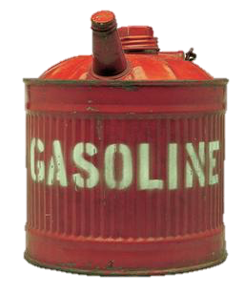



Slide 42
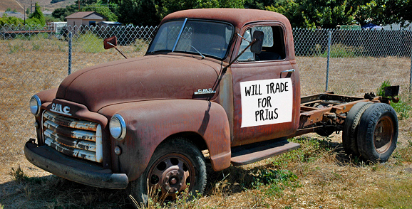
Example Decision Scenario
Benevolent government would like to get old inefficient cars off the road
But disposing of a car and building a new car has its own energy (and other) costs
Which cars should the government aim to get off the road?
even energy costs are not directly comparable (e.g., perhaps gasoline contributes to energy dependence, coal does not)

Slide 43
The basic version of our problem
is as bad as
producing 1 bag of landfill trash
using x gallons of gasoline
How to determine x?
Notes:
we envision a system that allows us to make statements of the following form:
take 2 undesirable activities
We argue that

Slide 44
One Approach: Let’s Vote!
x should be 2
x should be 4
x should be 10
x
1 = x
What should the outcome be…?
Average? Median?
Assuming that preferences are single-peaked, selecting the median is strategy-proof and has other desirable social choice-theoretic properties
Notes:
TODO: add picure from before

Slide 45
Consistency of tradeoffs
Clearing forest [square meters]
Consistency:
z = xy
y
z
Using gasoline [gallons]
Producing trash [bags]
x

Slide 46
A paradox
forest
trash
gasoline
forest
trash
gasoline
forest
trash
gasoline
100
200
300
300
200
600
2
1
3
forest
trash
gasoline
Just taking medians pairwise results in inconsistency
200
300
2

Slide 47
A first attempt at a rule satisfying consistency
Let t_{a,b,i} be voter i’s tradeoff between a and b
Aggregate tradeoff t has score Σ_{i} Σ_{a,b} | t_{a,b} - t_{a,b,i} |
forest
trash
gasoline
forest
trash
gasoline
forest
trash
gasoline
100
200
300
300
200
600
2
1
3
forest
trash
gasoline
distance:
100 to v₁
100 to v₂
distance:
100 to v₁
300 to v₃
200
300
total distance: 602.5 (minimum)
3/2
distance: 1/2 to v₁,1/2 to v₂, 3/2 to v₃

Slide 48
A nice property
This rule agrees with the median when there are only two activities!
x should be 2
x should be 4
x should be 10
x
distance:
2+8=10
distance:
2+6=8
distance:
8+6=14

Slide 49
Not all is rosy, part 1
What if we change units? Say forest from m² to cm² (divide by 10,000)
forest
trash
gasoline
forest
trash
gasoline
forest
trash
gasoline
0.01
0.02
0.03
0.03
0.02
0.06
2
1
3
forest
trash
gasoline
distance:
(negligible)
distance:
(negligible)
different from before!
fails independence of other activities’ units
0.015
0.03
2
distance: 1 to v₁, 1 to v₃

Slide 50
Not all is rosy, part 2
Back to original units, but let’s change some edges’ direction
forest
trash
gasoline
forest
trash
gasoline
forest
trash
gasoline
1/100
1/200
1/300
1/300
1/200
1/600
2
1
3
forest
trash
gasoline
distance:
(negligible)
distance:
(negligible)
different from before!
fails independence of other edges’ directions
?
?
2
distance: 1 to v₁, 1 to v₃

Slide 51
Summarizing
Let t_{a,b,i} be voter i’s tradeoff between a and b
Aggregate tradeoff t has score
Σ_{i} Σ_{a,b} | t_{a,b} - t_{a,b,i} |
Upsides:
Coincides with median for 2 activities
Downsides:
Dependence on choice of units:
| t_{a,b} - t_{a,b,i} | ≠ | 2t_{a,b} - 2t_{a,b,i} |
Dependence on direction of edges:
| t_{a,b} - t_{a,b,i} | ≠ | 1/t_{a,b} - 1/t_{a,b,i} |
We don’t have a general algorithm

Slide 52
A generalization
Let t_{a,b,i} be voter i’s tradeoff between a and b
Let f be a monotone increasing function – say, f(x) = x²
Aggregate tradeoff t has score
Σ_{i} Σ_{a,b} | f(t_{a,b}) - f(t_{a,b,i}) |
Still coincides with median for 2 activities!
Theorem: These are the only rules satisfying this property, agent separability, and edge separability
1
2
3
t_{a,b}
1
4
9
f(t_{a,b})

Slide 53
An MLE justification
Suppose probability of tradeoff profile {t_{i}} given true aggregate tradeoff t is
∏_{i} ∏_{a,b} exp{-| f(t_{a,b}) - f(t_{a,b,i}) |}
Then arg max_{t} ∏_{i} ∏_{a,b} exp{-| f(t_{a,b}) - f(t_{a,b,i}) |} =
arg max_{t} log ∏_{i} ∏_{a,b} exp{-| f(t_{a,b}) - f(t_{a,b,i}) |} =
arg max_{t} Σ_{i} Σ_{a,b} -| f(t_{a,b}) - f(t_{a,b,i}) | =
arg min_{t} Σ_{i} Σ_{a,b} | f(t_{a,b}) - f(t_{a,b,i}) |
which is our rule!

Slide 54
So what’s a good f?
Intuition: Is the difference between tradeoffs of 1 and 2 the same as between 1000 and 1001, or as between 1000 and 2000?
So how about f(x)=log(x)?
(Say, base e – remember log_{a}(x)=log_{b}(x)/log_{b}(a) )
1
2
1000
2000
t_{a,b}
ln(1)
ln(2)
ln(1000)
ln(2000)
ln(t_{a,b})
0
0.69
6.91
7.60

Slide 55
On our example
forest
trash
gasoline
forest
trash
gasoline
forest
trash
gasoline
100
200
300
300
200
600
2
1
3
forest
trash
gasoline
200
400
2

Slide 56
Properties
Independence of units
| log(1) - log(2) | = | log(1/2) | =
| log(1000/2000) | = | log(1000) - log(2000) |
More generally:
| log(ax) - log(ay) | = | log(x) - log(y) |
Independence of edge direction
| log(x) - log(y) | = | log(1/y) - log(1/x) | =
| log(1/x) - log(1/y) |
Theorem. The logarithmic distance based rule is unique in satisfying independence of units.*
* Depending on the exact definition of independence of units, may need another minor condition about the function locally having bounded derivative.

Slide 57
Consistency constraint becomes additive
xy = z
is equivalent to
log(xy) = log(z)
is equivalent to
log(x) + log(y) = log(z)

Slide 58
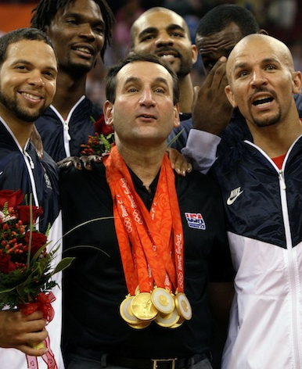
An additive variant
“I think basketball is 5 units more fun than football, which in turn is 10 units more fun than baseball”
basketball
baseball
football
5
15
10

Slide 59
Aggregation in the additive variant
basketball
baseball
football
basketball
baseball
football
basketball
baseball
football
5
15
-5
15
10
40
10
20
30
Natural objective:
minimize Σ_{i} Σ_{a,b} d_{a,b,i} where d_{a,b,i} = | t_{a,b} - t_{a,b,i} | is the distance between the aggregate difference t_{a,b} and the subjective difference t_{a,b,i}
basketball
baseball
football
5
25
20
objective value 70 (optimal)

Slide 60
A linear program for the additive variant
q_{a}: aggregate assessment of quality of activity a (we’re really interested in q_{a} - q_{b} = t_{a,b})
d_{a,b,i}: how far is i’s preferred difference t_{a,b,i} from aggregate q_{a} - q_{b}, i.e., d_{a,b,i} = |q_{a} - q_{b} - t_{a,b,i}|
minimize Σ_{i} Σ_{a,b} d_{a,b,i}
subject to
for all a,b,i: d_{a,b,i} ≥ q_{a} - q_{b} - t_{a,b,i}
for all a,b,i: d_{a,b,i} ≥ t_{a,b,i} - q_{a} + q_{b}
(Can arbitrarily set one of the q variables to 0)

Slide 61
Applying this to the logarithmic rule in the multiplicative variant
forest
trash
gasoline
forest
trash
gasoline
forest
trash
gasoline
100
200
300
300
200
600
2
1
3
Just take logarithms on the edges, solve the additive variant, and exponentiate back
forest
trash
gasoline
forest
trash
gasoline
forest
trash
gasoline
4.605
5.298
5.704
5.704
5.298
6.397
0.693
0
1.099

Slide 62
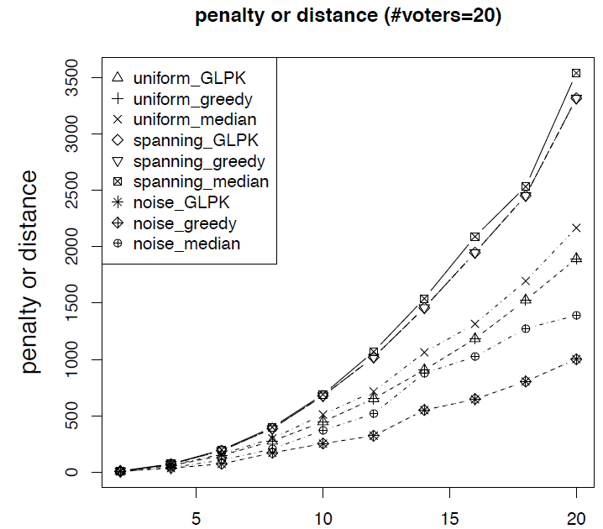
A simpler algorithm (hill climbing / greedy)
Initialize qualities q_{a} arbitrarily
If some q_{a} can be individually changed to improve the objective, do so
WLOG, set q_{a} to the median of the (#voters)*(#activities-1) implied votes on it
Continue until convergence (possibly to local optimum)
Notes:
median
simply picks a random spanning tree of activities and uses the median rule for each spanning tree edge

Slide 63


Flow-based exact algorithm
with:
Hanrui Zhang
Yu Cheng
Notes:
median
simply picks a random spanning tree of activities and uses the median rule for each spanning tree edge

Slide 64
Decomposition
Idea: Break down activities to relevant attributes
gasoline use
global warming
contributes a units to
energy dependence
contributes b units to
…
contributes c units to

Slide 65
Another Paradox
Agent 1
Agent 2
activity A
(gasoline)
attribute 1
(global warming)
1
attribute 2
(energy dependence)
1
1
2
Agent 3
1
1
3
3
2
activity B
(trash)
3
1
2
1
1
aggregation on attribute level ≠ aggregation on activity level
Notes:
2,1
1,2
1,1

Slide 66
Other Issues
Relevant Topics
social choice theory
voting
judgment aggregation
game theory
mechanism design
prediction markets
peer prediction
preference elicitation
...
Objective vs. subjective tradeoffs
separate process?
who determines which is which?
Who gets to vote?
how to bring expert knowledge to bear?
incentives to participate
Global vs. local tradeoffs
different entities (e.g., countries) may wish to reach their tradeoffs independently
only care about opinions of neighbors in my social network
…
Thank you for your attention!
Notes:
TODO thank you note

Slide 67
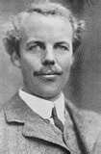
Why Do We Care?
Inconsistent tradeoffs can result in inefficiency
Agents optimizing their utility functions individually leads to solutions that are Pareto inefficient
Pigovian taxes: pay the cost your activity imposes on society (the externality of your activity)
If we decided using 1 gallon of gasoline came at a cost of $x to society, we could charge a tax of $x on each gallon
But where would we get x?
Arthur Cecil Pigou
Notes:
skip?

Slide 68
Inconsistent tradeoffs can result in inefficiency
Agent 1: 1 gallon = 3 bags = -1 util
I.e., agent 1 feels she should be willing to sacrifice up to1 util to reduce trash by 3, but no more
Agent 2: 1.5 gallons = 1.5 bags = -1 util
Agent 3: 3 gallons = 1 bag = -1 util
Cost of reducing gasoline by x is x² utils for each agent
Cost of reducing trash by y is y² for each agent
Optimal solutions for the individual agents:
Agent 1 will reduce by 1/2 and 1/6
Agent 2 will reduce by 1/3 and 1/3
Agent 3 will reduce by 1/6 and 1/2
But if agents 1 and 3 each reduce everything by 1/3, the total reductions are the same, and their costs are 2/9 rather than 1/4 + 1/36 which is clearly higher.
Could then reduce slightly more to make everyone happier.

Slide 69
Single-peaked preferences
Definition: Let agent a’s most-preferred value be pa.
Let p and p’ satisfy:
p’ ≤ p ≤ pa, or pa ≤ p ≤ p’
The agent’s preferences are single-peaked if the agent always weakly prefers p to p’
p’
p
pa

Slide 70
Perhaps more reasonable…
x should be between 0 and 4
x should be between 2 and 6
x should be between 9 and 11
x
1 = x
E.g., due to missing information or plain uncertainty
How to aggregate these interval votes? [Farfel & Conitzer 2011]
Notes:
rest of talk: standard model
paper generalizes median

Slide 71
Median interval mechanism
Construct a consensus interval from the median lower bound and the median upper bound
1
1
1
2
1
1
1
1
1
2
1
1
[
[
]
[
]
[
]
]
[
]
[
]
Strategy-proof if preferences are single-peaked over intervals

Slide 72
Single-peaked preferences over intervals
Definition: Let agent a’s most-preferred value interval be Pa = [la, ua].
Let S = [l, u] and S’ = [l’, u’] be any two value intervals satisfying the following constraints:
Either l’ ≤ l ≤ la, or la ≤ l ≤ l’
Either u’ ≤ u ≤ ua, or ua ≤ u ≤ u’
The agent’s preferences over intervals are single-peaked if the agent always weakly prefers S to S’
[
[
[
]
]
]
l’
l
la
u’
u
ua

