Slide 1


Tutorial: Foundations of Cooperative AI See also: Foundations of Cooperative AI Lab (FOCAL) at CMU Vision paper: Vincent Conitzer and Caspar Oesterheld. Foundations of Cooperative AI. AAAI’23 Materials of Spring’25 CMU course on Foundations of Cooperative AI
Other relevant events at AAMAS:
Wednesday 5:30pm
Cooperative AI panel
Friday in Game Theory 3, 10:45AM - 12:30PM
Vojtech Kovarik et al., Game Theory with Simulation in the Presence of Unpredictable Randomisation.
Vincent Conitzer
Caspar Oesterheld

Slide 2
Plan for today
Part I (Vince): overview
Motivation, landscape
A bit of game theory
Approaches towards cooperation that are natural for humans
Approaches towards cooperation that are less natural for humans
Part II (Caspar): foundations for the game theory of AI agents
Program equilibrium
Self-locating belief
Decision theories

Slide 3

From The Atlantic, “Want to See How Crazy a Bot-Run Market Can Be?”
By James Fallows
April 23, 2011

Slide 4


Slide 5
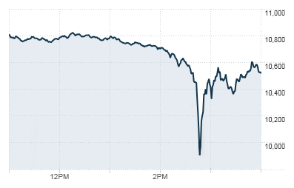
Between 2:45:13 and 2:45:27, HFTs traded over 27,000 contracts, which accounted for about 49 percent of the total trading volume, while buying only about 200 additional contracts net.
The May 6, 2010, flash crash,^{[1][2][3]} also known as the crash of 2:45 or simply the flash crash, was a United States trillion-dollar^{[4]} stock market crash, which started at 2:32 p.m. EDT and lasted for approximately 36 minutes.^{[5]:1}

Slide 6
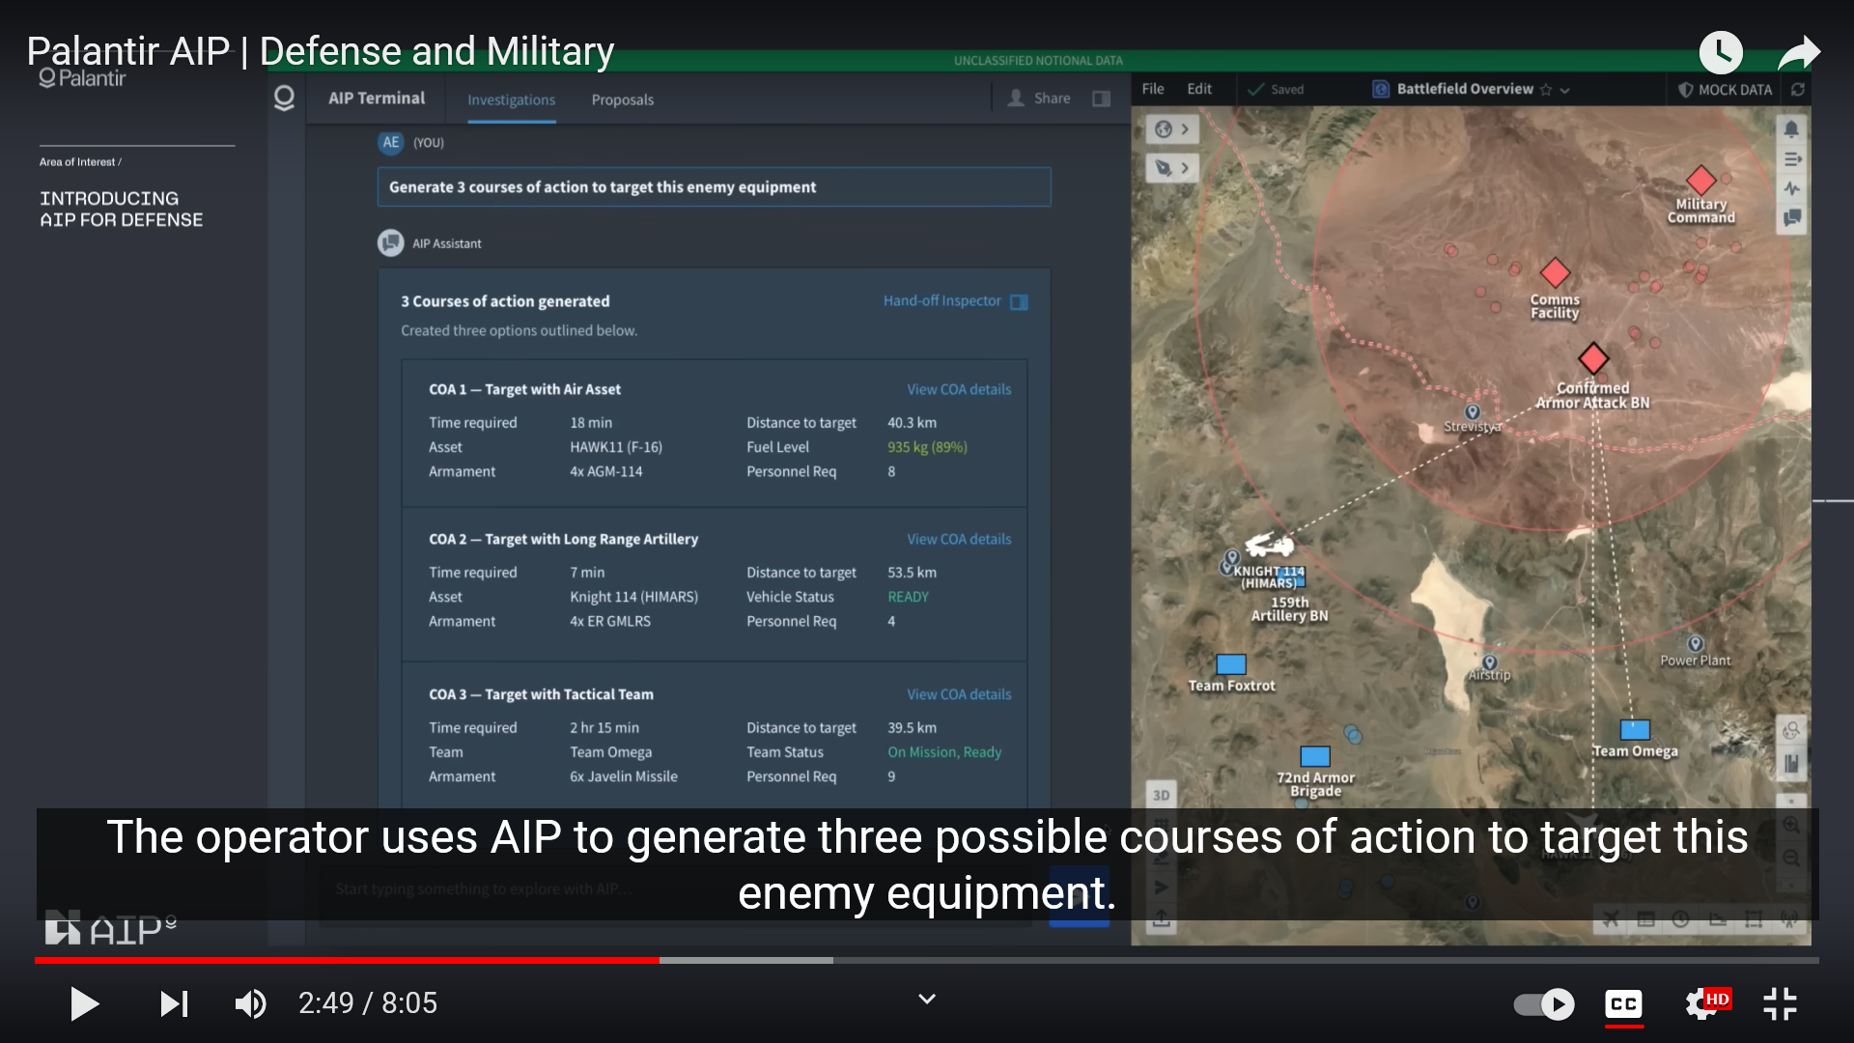

Slide 7
https://arxiv.org/abs/2401.03408

Slide 8
What is going wrong / can go wrong?
Systems insufficiently capable/intelligent
Systems insufficiently aligned with what we (really) want them to do
Game-theoretic issues between multiple systems

Slide 9

A(n imagined) conversation between two self-driving cars (see paper Designing Preferences, Beliefs, and Identities for Artificial Intelligence)
If I tailgate you, will your occupant take back control and pull over?
What makes you think I would tell you?
You just did. Better move aside now.
You’re bluffing.
Are you willing to take that chance?

Slide 10
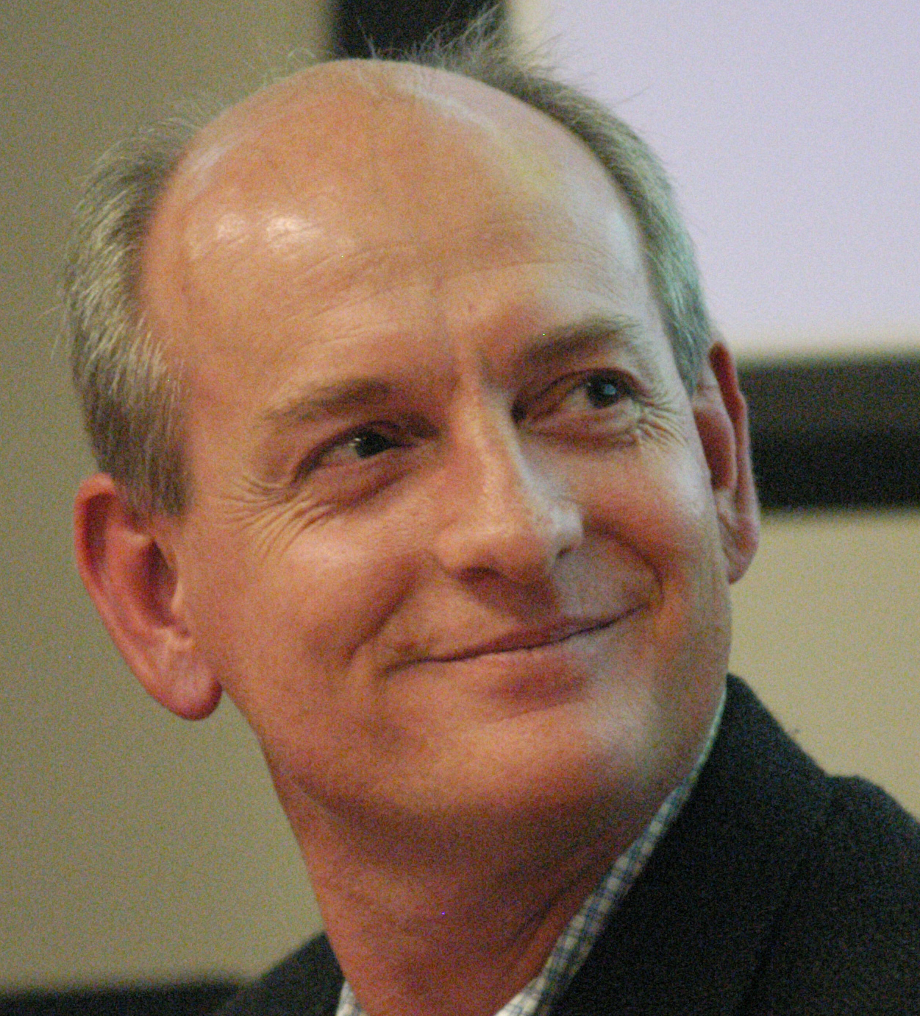
Russell and Norvig’s “AI: A Modern Approach”
Stuart Russell
Peter Norvig
“… we will insist on an objective performance measure imposed by some authority. In other words, we as outside observers establish a standard of what it means to be successful in an environment and use it to measure the performance of agents.”

Slide 11
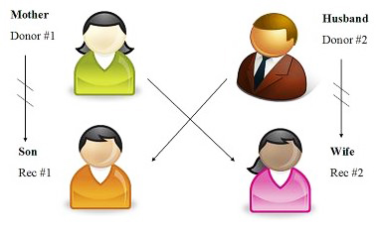
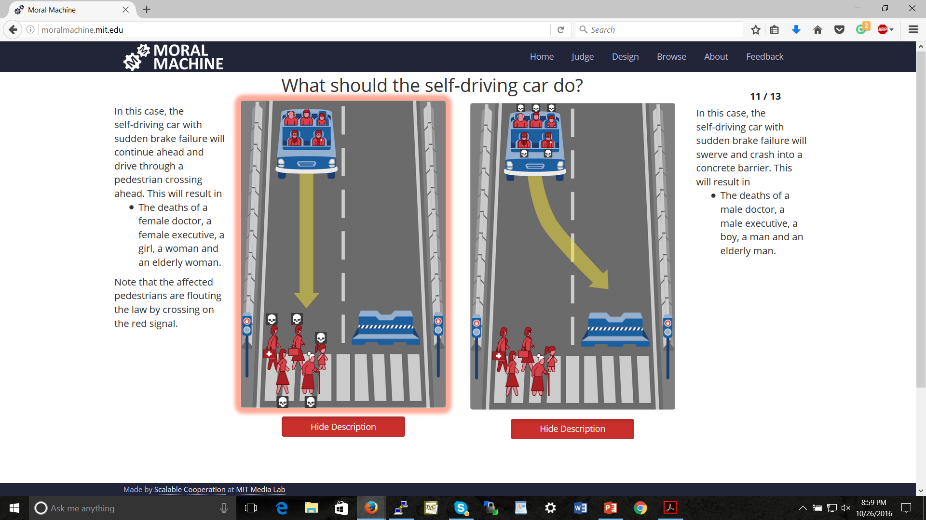

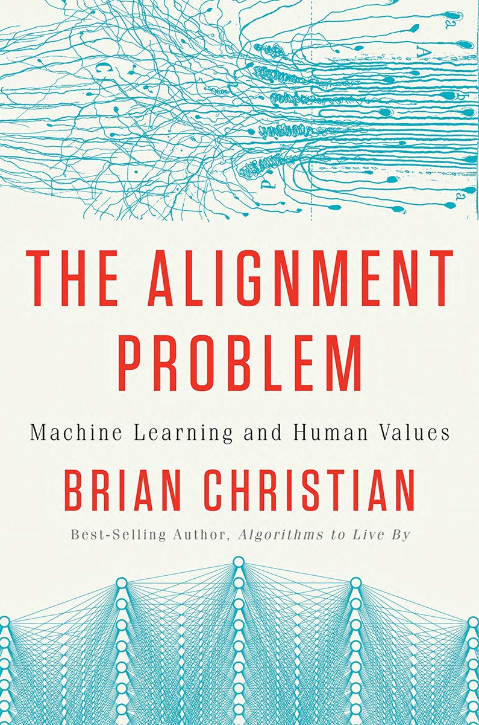



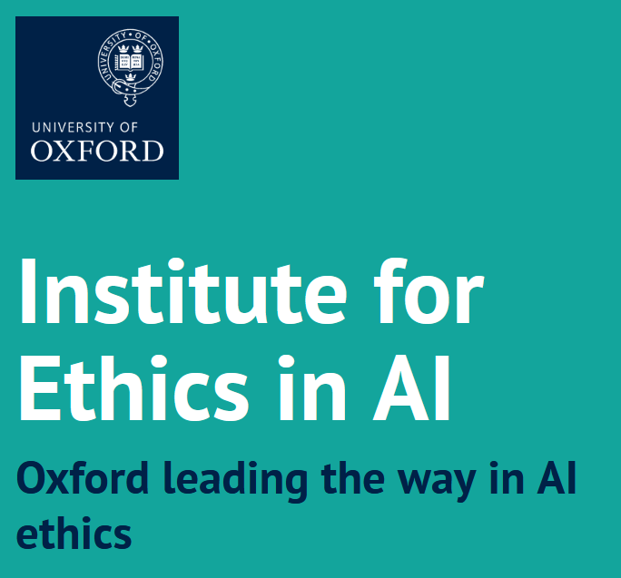
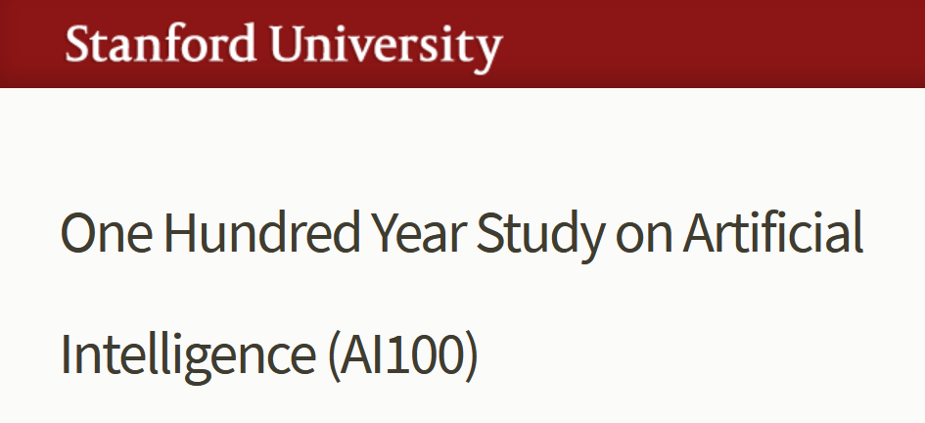
AI Alignment

Slide 12
Even almost perfectly aligned agents can perform horribly in equilibrium
Two agents each provide part of a service, each chooses quality q_{i}
Overall quality determined by min_{i} q_{i}
Agents care primarily about overall quality, but also have a slight incentive to be the lower one
 | 100 | 90 | 80 | 70 | 60 | 50 | 40 | 30 | 20 | 10 | 0
100 | 111, 111 | 90, 112 | 80, 102 | 70, 92 | 60, 82 | 50, 72 | 40, 62 | 30, 52 | 20, 42 | 10, 32 | 0, 22
90 | 112, 90 | 101, 101 | 80, 102 | 70, 92 | 60, 82 | 50, 72 | 40, 62 | 30, 52 | 20, 42 | 10, 32 | 0, 22
80 | 102, 80 | 102, 80 | 91, 91 | 70, 92 | 60, 82 | 50, 72 | 40, 62 | 30, 52 | 20, 42 | 10, 32 | 0, 22
70 | 92, 70 | 92, 70 | 92, 70 | 81, 81 | 60, 82 | 50, 72 | 40, 62 | 30, 52 | 20, 42 | 10, 32 | 0, 22
60 | 82, 60 | 82, 60 | 82, 60 | 82, 60 | 71, 71 | 50, 72 | 40, 62 | 30, 52 | 20, 42 | 10, 32 | 0, 22
50 | 72, 50 | 72, 50 | 72, 50 | 72, 50 | 72, 50 | 61, 61 | 40, 62 | 30, 52 | 20, 42 | 10, 32 | 0, 22
40 | 62, 40 | 62, 40 | 62, 40 | 62, 40 | 62, 40 | 62, 40 | 51, 51 | 30, 52 | 20, 42 | 10, 32 | 0, 22
30 | 52, 30 | 52, 30 | 52, 30 | 52, 30 | 52, 30 | 52, 30 | 52, 30 | 41, 41 | 20, 42 | 10, 32 | 0, 22
20 | 42, 20 | 42, 20 | 42, 20 | 42, 20 | 42, 20 | 42, 20 | 42, 20 | 42, 20 | 31, 31 | 10, 32 | 0, 22
10 | 32, 10 | 32, 10 | 32, 10 | 32, 10 | 32, 10 | 32, 10 | 32, 10 | 32, 10 | 32, 10 | 21, 21 | 0, 22
0 | 22, 0 | 22, 0 | 22, 0 | 22, 0 | 22, 0 | 22, 0 | 22, 0 | 22, 0 | 22, 0 | 22, 0 | 11, 11
(Cf. Traveler’s Dilemma)

Slide 13
Prisoner’s Dilemma
Pair of criminals has been caught
District attorney has evidence to convict them of a minor crime (1 year in jail); knows that they committed a major crime together (3 years in jail) but cannot prove it
Offers them a deal:
If both confess to the major crime, they each get a 1 year reduction
If only one confesses, that one gets 3 years reduction
confess
don’t confess
confess
-2, -2 | 0, -3
-3, 0 | -1, -1
don’t confess

Slide 14
“Should I buy an SUV?”
purchasing + gas cost
accident cost
cost: 5
cost: 5
cost: 5
cost: 8
cost: 2
cost: 3
cost: 5
cost: 5
-10, -10 | -7, -11
-11, -7 | -8, -8

Slide 15
Choosing a cause to support
Red agent cares about climate change (+2 if someone works on that) and about cleaning up Red Town (+3 if someone works on that)
Blue agent cares about climate change (+2 if someone works on that) and about cleaning up Blue Town (+3 if someone works on that)
clean BT
climate change
3, 3 | 5, 2
2, 5 | 4, 4
clean RT
climate change

Slide 16
Tragedy of the commons
Overuse the environment (overgraze, pollute the river, …) or don’t
The overusing agent benefits 3 from overusing, but everyone experiences a cost of 2 from each instance of overusing
overuse
don’t
-1, -1 | 1, -2
-2, 1 | 0, 0
overuse
don’t

Slide 17
Prisoner’s Dilemma
cooperate
defect
2, 2 | 0, 3
3, 0 | 1, 1
cooperate
defect

Slide 18
Should AI systems cooperate like humans do?

Slide 19
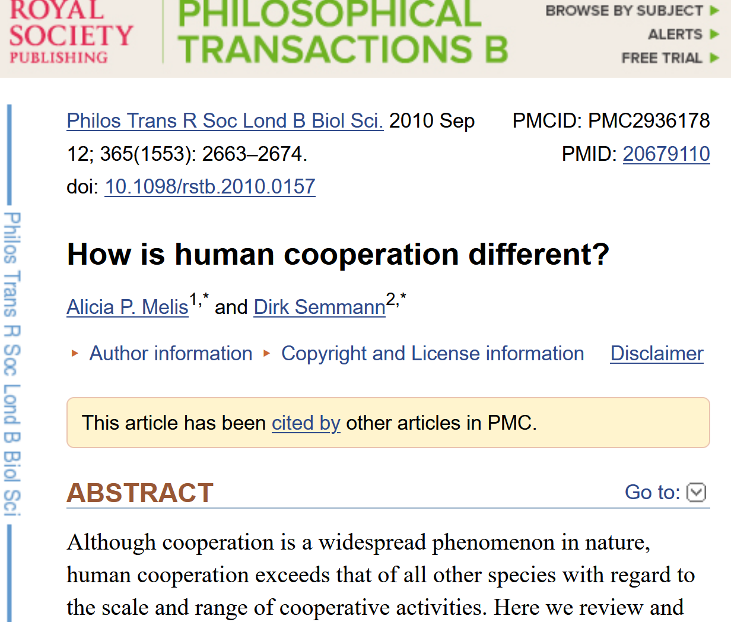
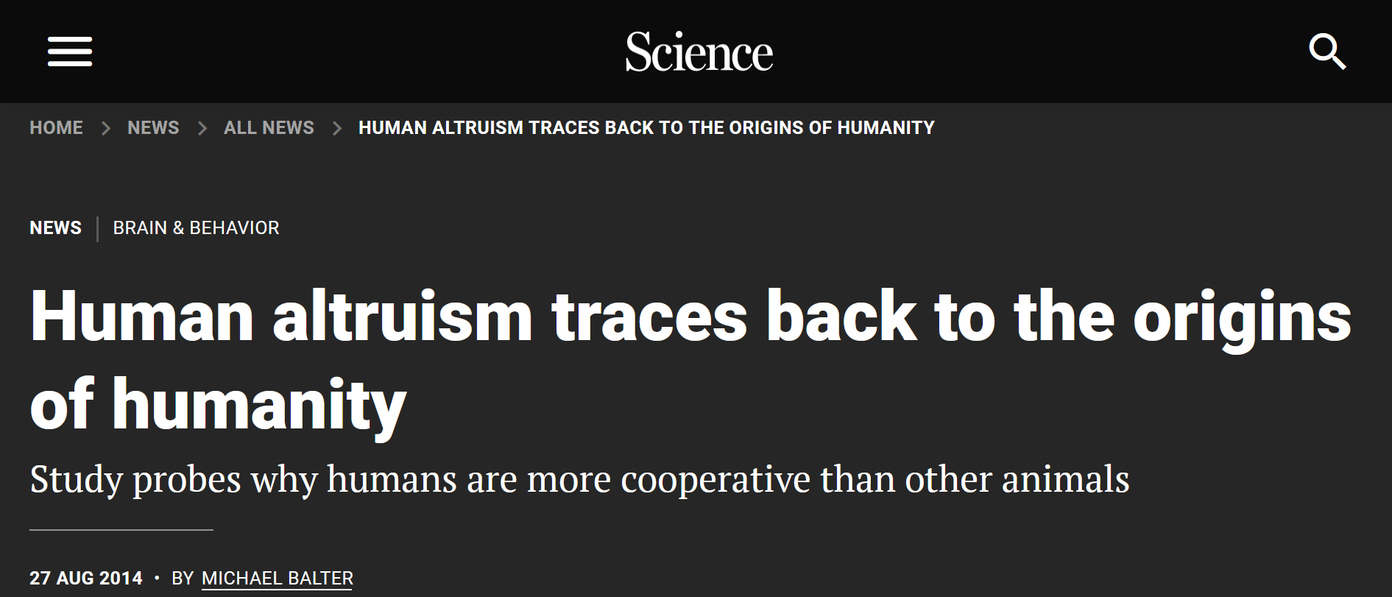

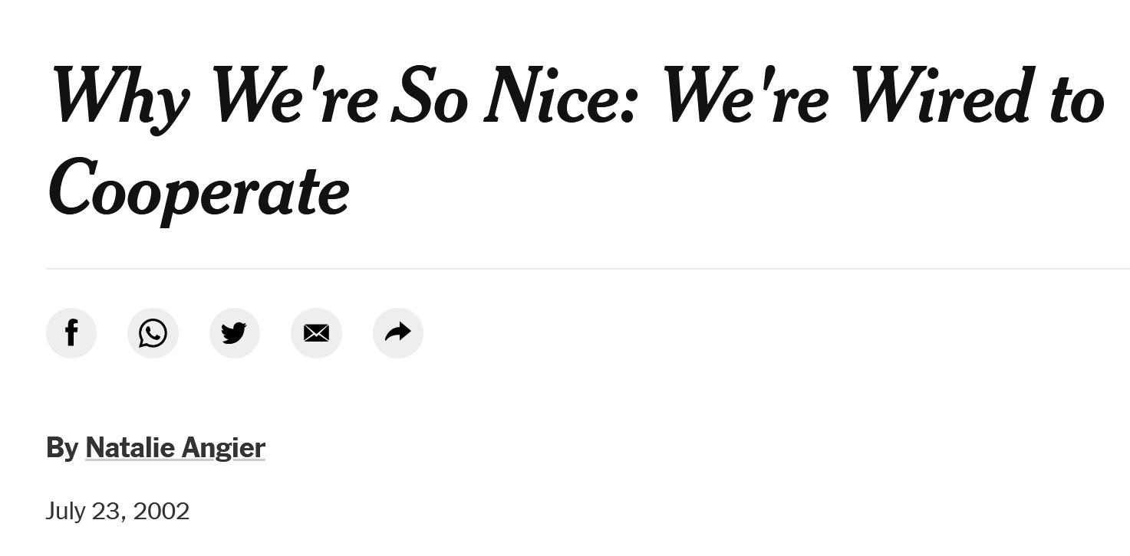

Slide 20

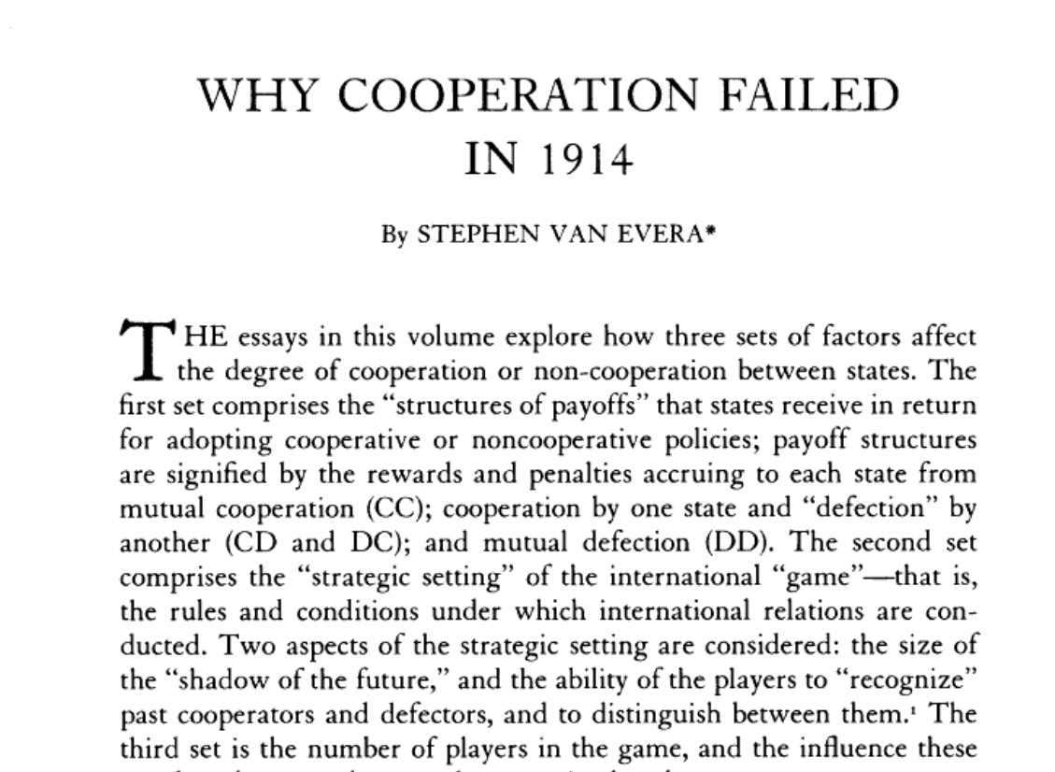

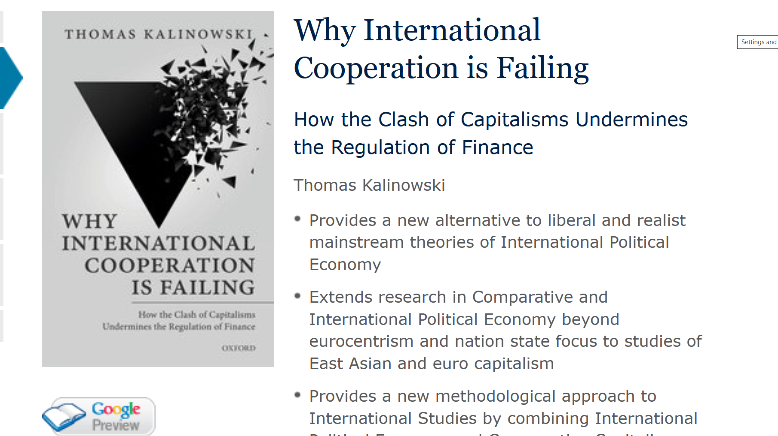

Slide 21
Some (highly interdisciplinary) discussion points: Should we make AI more human-like?
Should we make our agents have prosocial inclinations? Ethics?
Genuine solution vs. wishful thinking?
What about norms and rules?
Do certain human cognitive limitations limit tragedies? Should/can we replicate that in AI agents?
Traveler’s dilemma and behavioral game theory
Any fool can tell the truth, but it requires a man of some sense to know how to lie well. -- Samuel Butler
Might AI do better on cooperation than humans? On its own? With some deliberate design decisions?

Slide 22
Improving issues already found in the world today
Problems of collective action
Climate change and other environmental problems
Nuclear disarmament and preventing wars
Agreeing on causes to support
…
Making better decisions in contexts with strategic aspects
Allocating scarce resources
Predicting the future
Collective deliberation
…

Slide 23
Why, technically, is AI useful in addressing these problems?
Dealing with combinatorial explosions in incentive-minded way
Combinatorial auctions, kidney exchanges, expressive donations
Efficiently learning / eliciting important information from the world such as preferences / values
Again above topics
Taking advantage of rich data
Automated mechanism design takes advantage of knowledge about distribution of preferences
Monitoring, transparency, openness
Nuclear test monitoring, emissions monitoring, …
Enabling simulation of complex environments
E.g., climate change competition (next)
Introduction of mediators and other strategic entities to strategically steer to better outcomes
…

Slide 24


Slide 25
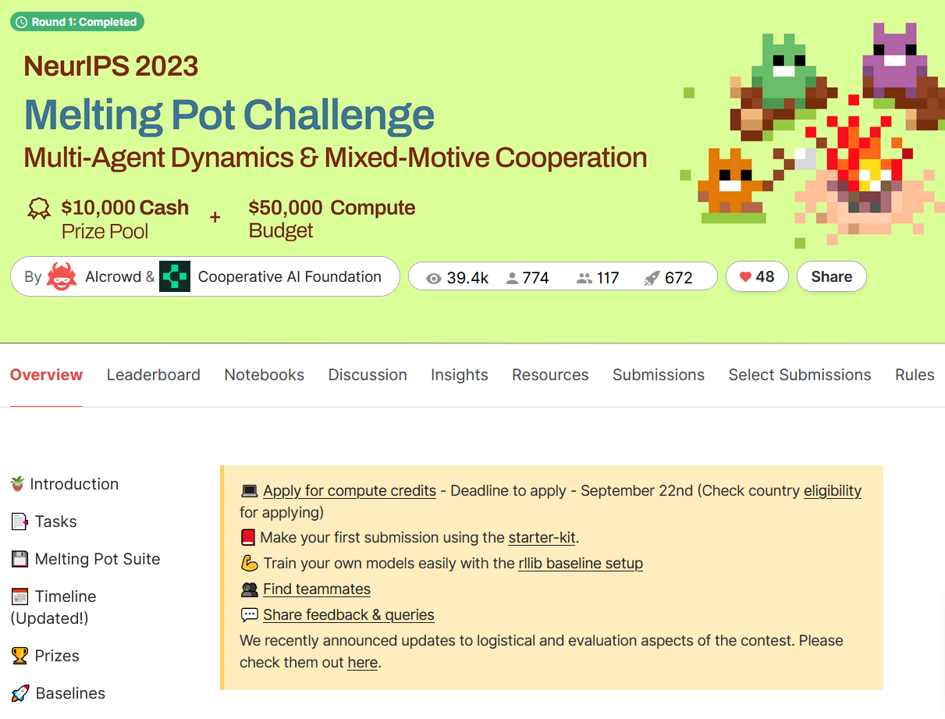
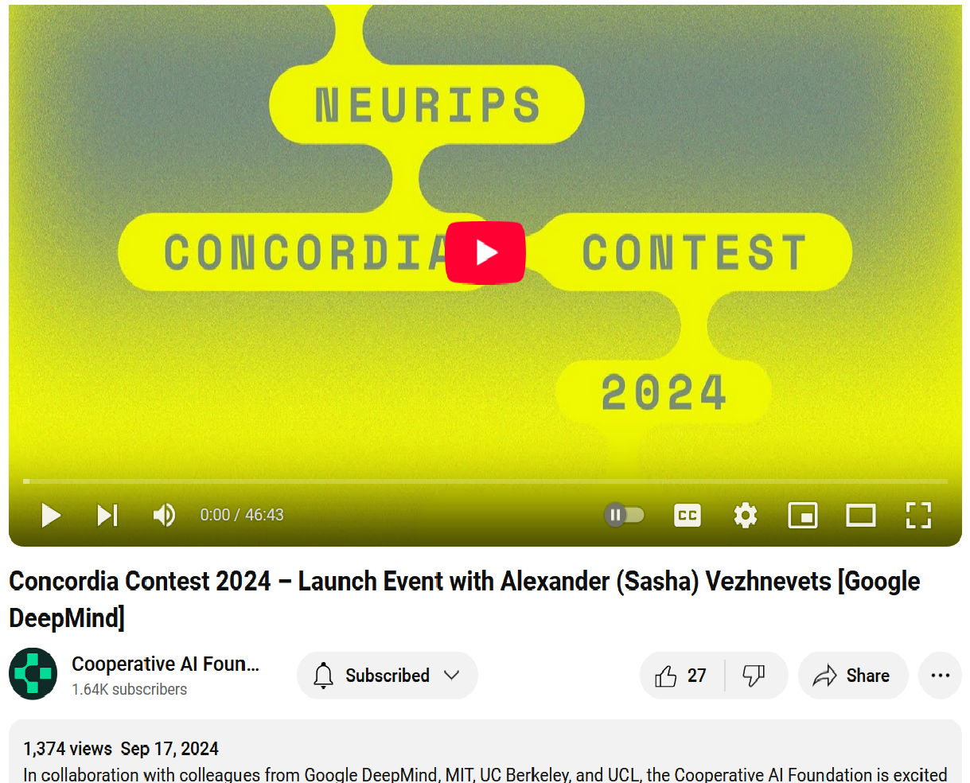
Cooperative AI Foundation competitions

Slide 26
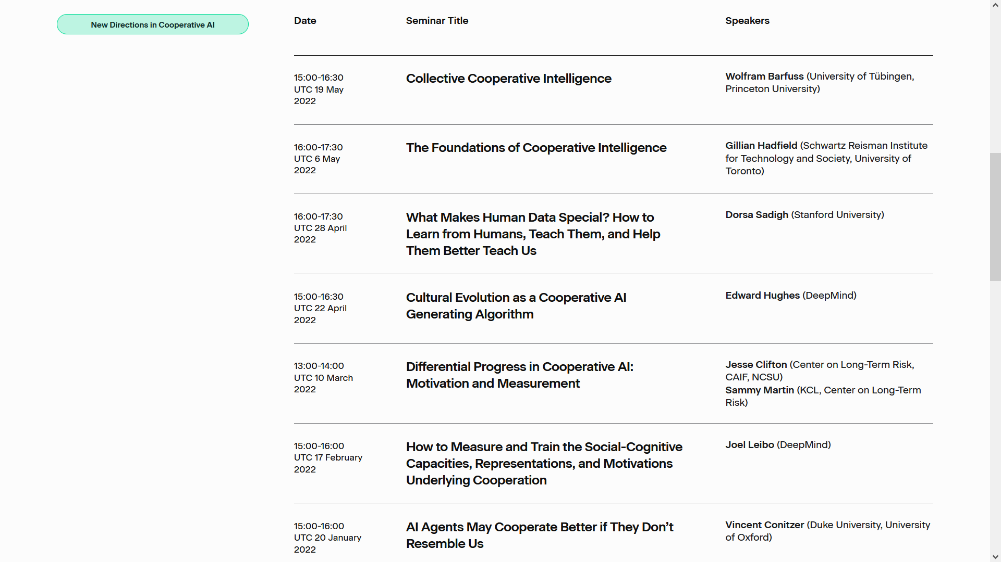
Cooperative AI Foundation seminar series

Slide 27
Equilibrium multiplicity and selection
A better new technology is introduced, but it’s most important to have the same technology as your friend
new
old
new
2, 2 | 0, 0
0, 0 | 1, 1
old
How do we compute / learn / move over to the better equilibrium?
How do we avoid miscoordination?

Slide 28
THE PARKING GAME
(cf. the trust game [Berg et al. 1995])
wait
move aside
3,0
steal spot
pass
0,3
4,1
Letchford, C., Jain [2008] define a solution concept capturing this

Slide 29
Infinitely Repeated Prisoner’s Dilemma
cooperate
defect
cooperate
defect
2, 2 | 0, 3
3, 0 | 1, 1
2, 2 | 0, 3
3, 0 | 1, 1
cooperate
cooperate
…
defect
defect
t=0
t=1
Grim trigger strategy: cooperate as long as everyone cooperates; after that, defect forever. (Equilibrium, if players are somewhat patient.)
Folk theorem: with sufficiently patient players, can always sustain cooperation this way, in any game.
Folk theorem can be used to efficiently compute equilibria (in infinitely repeated games with sufficiently patient players) [Littman & Stone DSS 2005, Andersen & C., AAAI’13]

Slide 30
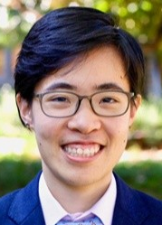

Repeated games on social networks
[Moon & C., IJCAI’15]
Common assumption: an agent’s behavior is instantly observable to all other agents (instant punishment)
What if there is a delay in knowledge propagation due to network structure?
Catherine Moon
Algorithm for finding (unique) maximal set of cooperating agents

Slide 31
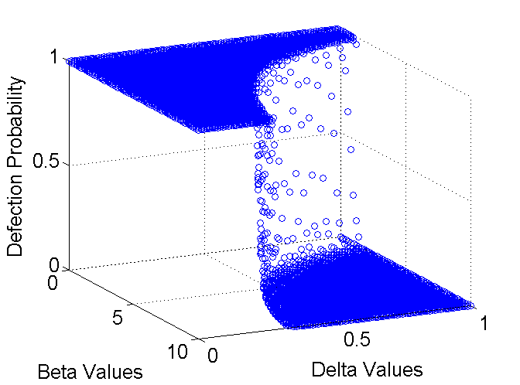
Experiments on random graphs:
Phase transition between complete cooperation and complete defection
Random graph models:
Erdős–Rényi (ER)
Barabási–Albert preferential-attachment (PA)
Beta = cooperation benefit, delta = discount factor

Slide 32
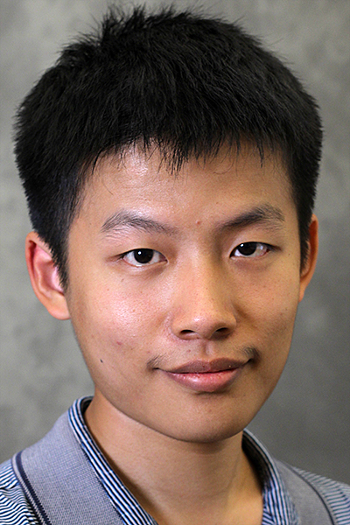
Disarmament Game [Deng & C., AAAI’17, ’18]
Yuan Deng
 | GR | KR | ST
R | 10, -5 | 0, -4 | 0, -4
PF | 4, 1 | -10, 3 | -0.5, -0.5
PD | -6, 8 | -10, 3 | -0.5, -0.5

Slide 33
Disarmament Game
 | GR | KR | ST
R | 10, -5 | 0, -4 | 0, -4
PF | 4, 1 | -10, 3 | -0.5, -0.5
PD | -6, 8 | -10, 3 | -0.5, -0.5
Pure Nash equilibria
Pure Stackelberg equilibria (no matter who takes the lead)

Slide 34
Disarmament Game
 | GR | KR | ST
R | 10, -5 | 0, -4 | 0, -4
PF | 4, 1 | -10, 3 | -0.5, -0.5
PD | -6, 8 | -10, 3 | -0.5, -0.5
Desired Outcome
Pareto better than the Nash equilibrium outcome

Slide 35
Multiple-round (pure) commitments
 | GR | KR | ST
R | 10, -5 | 0, -4 | 0, -4
PF | 4, 1 | -10, 3 | -0.5, -0.5
PD | -6, 8 | -10, 3 | -0.5, -0.5

Slide 36
Multiple-round (pure) commitments
 | GR |  | ST
R | 10, -5 |  | 0, -4
PF | 4, 1 |  | -0.5, -0.5
PD | -6, 8 |  | -0.5, -0.5

Slide 37
Multiple-round (pure) commitments
 | GR |  | ST
R | 10, -5 |  | 0, -4
PF | 4, 1 |  | -0.5, -0.5
PD | -6, 8 |  | -0.5, -0.5
Incentivize Row to commit in the next round

Slide 38
Multiple-round (pure) commitments
 | GR |  | ST
R | 10, -5 |  | 0, -4
PF | 4, 1 |  | -0.5, -0.5
PD | -6, 8 |  | -0.5, -0.5

Slide 39
Multiple-round (pure) commitments
 | GR |  | ST
PF | 4, 1 |  | -0.5, -0.5
PD | -6, 8 |  | -0.5, -0.5

Slide 40
Multiple-round (pure) commitments
 | GR |  | ST
PF | 4, 1 |  | -0.5, -0.5
PD | -6, 8 |  | -0.5, -0.5

Slide 41
Multiple-round (pure) commitments
 | GR | KR | ST
R | 10, -5 | 0, -4 | 0, -4
PF | 4, 1 | -10, 3 | -0.5, -0.5
PD | -6, 8 | -10, 3 | -0.5, -0.5

Slide 42
Multiple-round (pure) commitments
 | GR | KR | ST
R | 10, -5 | 0, -4 | 0, -4
PF | 4, 1 | -10, 3 | -0.5, -0.5
PD | -6, 8 | -10, 3 | -0.5, -0.5
Fact: The desired outcome cannot be achieved if Row commits first
In general, it is an NP-hard problem to determine whether an outcome can be reached without creating incentive to deviate from disarmament

Slide 43
AI agents can be unlike us…

Slide 44

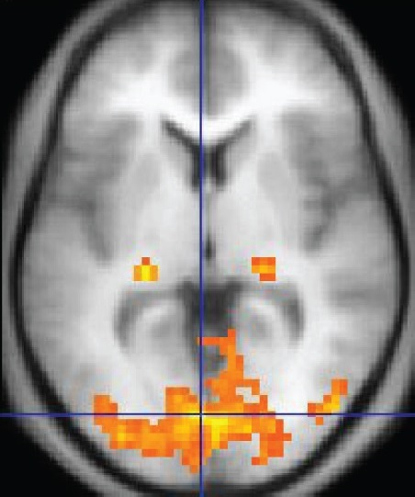

What should you do if…
… you knew others could read your code?
… you knew you were facing someone running the same code?
… you knew you had been in the same situation before but can’t possibly remember what you did?

Slide 45
Program equilibrium [Tennenholtz 2004]
Make your own code legible to the other player’s program!
If (other’s code = my code)
Cooperate
Else
Defect
If (other’s code = my code)
Cooperate
Else
Defect
cooperate
defect
2, 2 | 0, 3
3, 0 | 1, 1
cooperate
defect
See also: [Fortnow 2009, Kalai et al. 2010, Barasz et al. 2014, Critch 2016, Oesterheld 2018, …]

Slide 46
Robust program equilibrium [Oesterheld 2018]
Can we make the equilibrium less fragile?
Caspar Oesterheld
With probability ε
Cooperate
Else
Do what the other program does against this program
…
cooperate
defect
2, 2 | 0, 3
3, 0 | 1, 1
cooperate
defect
See also: Vojtech Kovarik, Caspar Oesterheld, and Vincent Conitzer. Recursive Joint Simulation in Games. LOFT’24. Emery Cooper, Caspar Oesterheld, and Vincent Conitzer. Characterising simulation-based program equilibria. AAAI’25

Slide 47
Safe Pareto improvements for delegated game playing [JAAMAS’22]
Caspar Oesterheld

Slide 48
Disarmament revisited: Committing to your first few lines of code
Yuan Deng
2. With probability 40%, cooperate
4. With probability 40%, cooperate
cooperate
defect
1. With probability 40%, cooperate
2, 2 | 0, 3
3, 0 | 1, 1
cooperate
...
3. With probability 40%, cooperate
defect
...
E.g., if Blue refuses to add line 2, then Red defects with probability .6, resulting in at most .4*3 + .6*1 = 1.8 for Blue
“Folk theorem” [Deng & C., AAAI’17, ‘18] that cooperation can always be achieved this way!

Slide 49
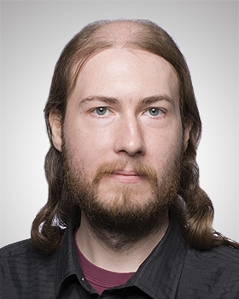
Prisoner’s Dilemma against (possibly) a copy
instruction₁ instruction₂
…
cooperate
defect
instruction₁ instruction₂
…
2, 2 | 0, 3
3, 0 | 1, 1
cooperate
defect
What if you play against your twin that you always agree with?
What if you play against your twin that you almost always agree with?
related to: Caspar Oesterheld, Abram Demski, and Vincent Conitzer. A theory of bounded inductive rationality. TARK’23
Caspar Oesterheld
Abram Demski

Slide 50

Newcomb’s Demon
Demon earlier put positive amount of money in each of two boxes
Your choice now: (I) get contents of Box B, or (II) get content of both boxes (!)
Twist: demon first predicted what you would do, is uncannily accurate
If demon predicted you’d take just B, there’s $1,000,000 in B (and $1,000 in A)
Otherwise, there’s $1,000 in each
What would you do?
A
B

Slide 51
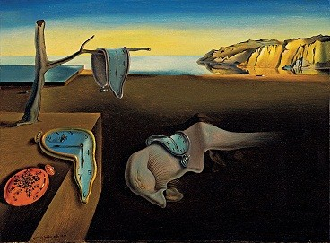
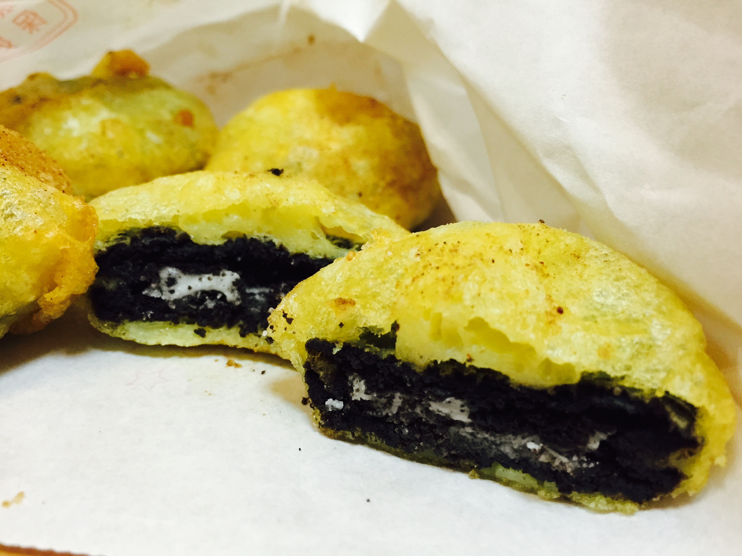
The lockdown dilemma
Lockdown is monotonous: you forget what happened before, you forget what day it is
Suppose you know lockdown lasts two days (unrealistic)
Every morning, you can decide to eat an unhealthy cookie! (or not)
Eating a cookie will give you +1 utility immediately, but then -3 later the next day
But, carpe diem: you only care about today
Should you eat the cookie right now?
related to working paper [C.]

Slide 52
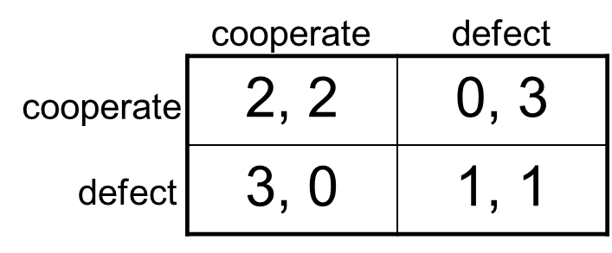
Your own choice is evidence…
… for what the demon put in the boxes
… for whether your twin defects
… for whether you eat the cookie on the other day
Evidential Decision Theory (EDT): When considering how to make a decision, consider how happy you expect to be conditional on taking each option and choose an option that maximizes that
Causal Decision Theory (CDT): Your decision should focus on what you causally affect

Slide 53

Simulating our way to cooperation?
Restricted trust game [Berg et al. 1995]: P1 can give 5 which would be tripled, or 0; after receiving 15, P2 can give back 10, or 0
Twist: P1 can simulate P2 first, at a cost of 1
Vojta Kovařík
Caspar Oesterheld
P1
As (AI system) P2, how likely is it you’re now running as a simulation? → self-locating belief
What happens in equilibrium?
P2
(simulated) P2
5, 0
P2
10, 5
0, 15
4, 0
Vojtech Kovarik, Caspar Oesterheld, and Vincent Conitzer. Game Theory with Simulation of Other Players. IJCAI’23 Vojtech Kovarik, Nathaniel Sauerberg, Lewis Hammond, and Vincent Conitzer. Game Theory with Simulation in the Presence of Unpredictable Randomisation. AAMAS’25
9, 5
-1, 15

Slide 54
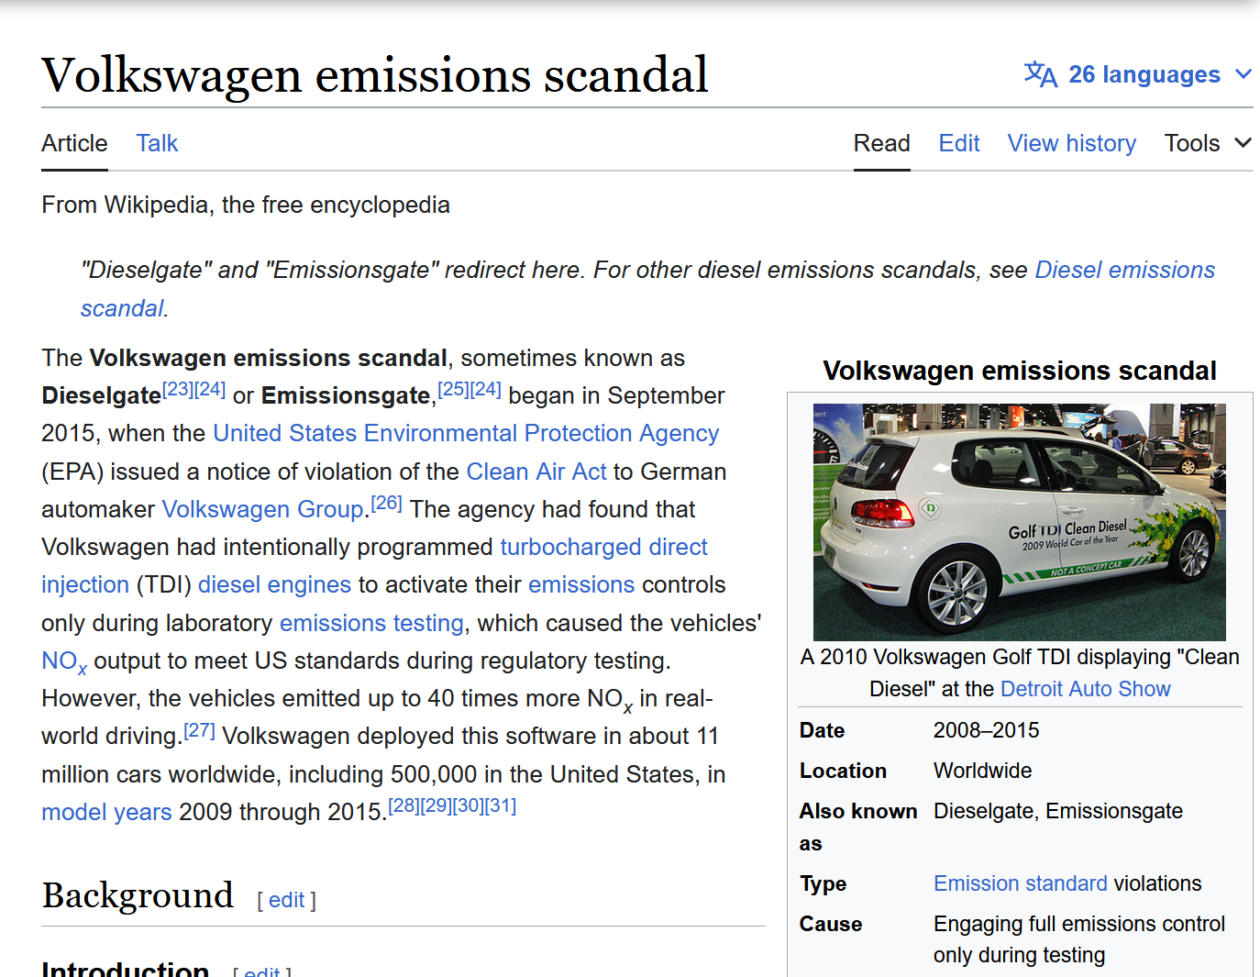

Slide 55

Simulation interpretation of Newcomb’s Demon
Slightly modified: the demon always puts 1 in box A and:
50% of the time the demon simulates you and puts 1 in box B if you take both, 5 in B otherwise;
50% of the time it just puts 1 in B
Nature / Demon
don’t simulate
simulate
Emery Cooper, Caspar Oesterheld, and Vincent Conitzer. Can CDT rationalise the ex ante optimal policy via modified anthropics?
you
(simulated) you
one-box
two-box
you
1
2
5
6
1
2

Slide 56

The Sleeping Beauty problem [Elga’00]
There is a participant in a study (call her Sleeping Beauty)
On Sunday, she is given drugs to fall asleep
A coin is tossed (H or T)
If H, she is awoken on Monday, then made to sleep again
If T, she is awoken Monday, made to sleep again, then again awoken on Tuesday
Due to drugs she cannot remember what day it is or whether she has already been awoken once, but she remembers all the rules
Imagine you are SB and you’ve just been awoken. What is your (subjective) probability that the coin came up H?
Sunday
Monday
Tuesday
H
T
don’t do this at home / without IRB approval…
Ties to many philosophical questions in metaphysics, philosophy of mind, … (see references in paper)

Slide 57
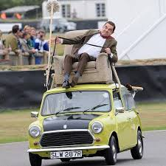
Modern version
Low-level autonomy cars with AI that intervenes when driver makes major error
Does not keep record of such event
Two types of drivers: Good (1 major error), Bad (2 major errors)
Upon intervening, what probability should the AI system assign to the driver being good?
(Similarly: half of households install a given AI system on two devices – with what probability does the AI system think it is alone? And what about simulation case from before?)
Sunday
Monday
Tuesday
H
T

Slide 58

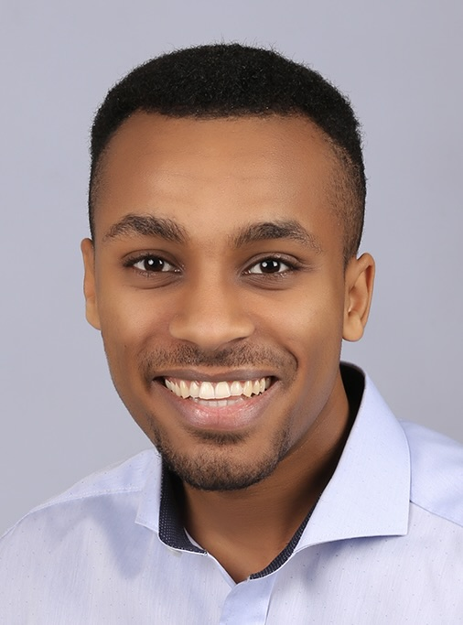

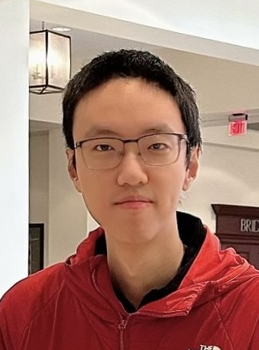
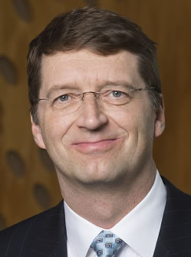
Complexity of imperfect-recall equilibrium concepts
Emanuel Tewolde, Caspar Oesterheld, Vincent Conitzer, and Paul Goldberg. The Computational Complexity of Single-Player Imperfect-Recall Games. IJCAI’23
Emanuel Tewolde, Brian Zhang, Caspar Oesterheld, Manolis Zampetakis, Tuomas Sandholm, Paul Goldberg, and Vincent Conitzer. Imperfect-Recall Games: Equilibrium Concepts and Their Complexity. IJCAI’24
Manolis Zampetakis
Emanuel Tewolde
Caspar Oesterheld
Paul Goldberg
CDT+Thirding
EDT+Halfing
Ex ante optimal
Brian Zhang
CLS-complete*
PLS-complete*
NP-hard*
*under conditions / greatly oversimplifying
Tuomas Sandholm

Slide 59
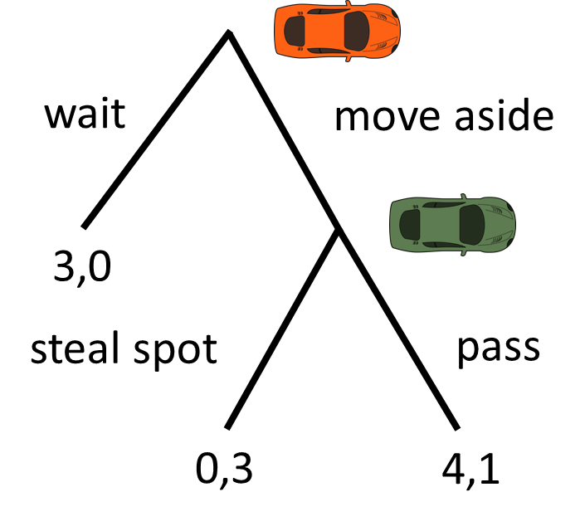
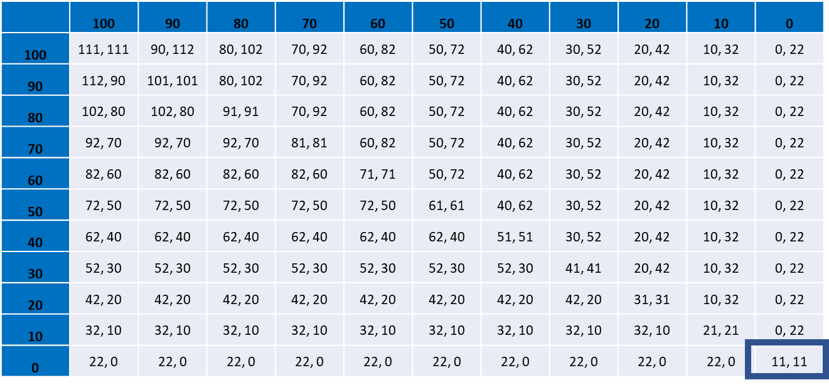
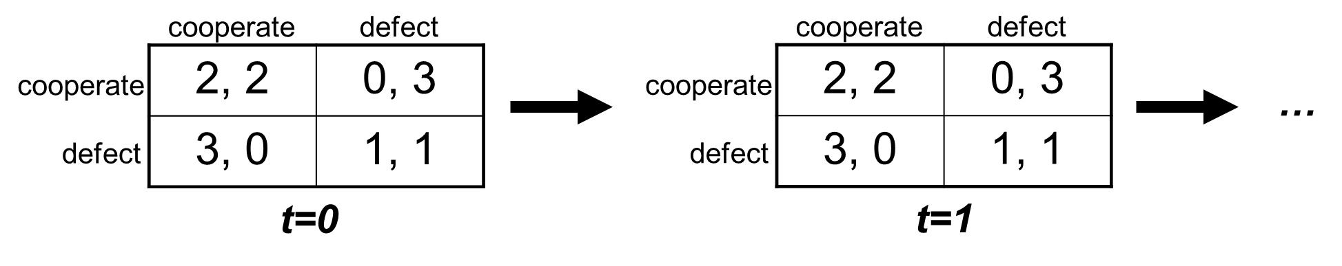
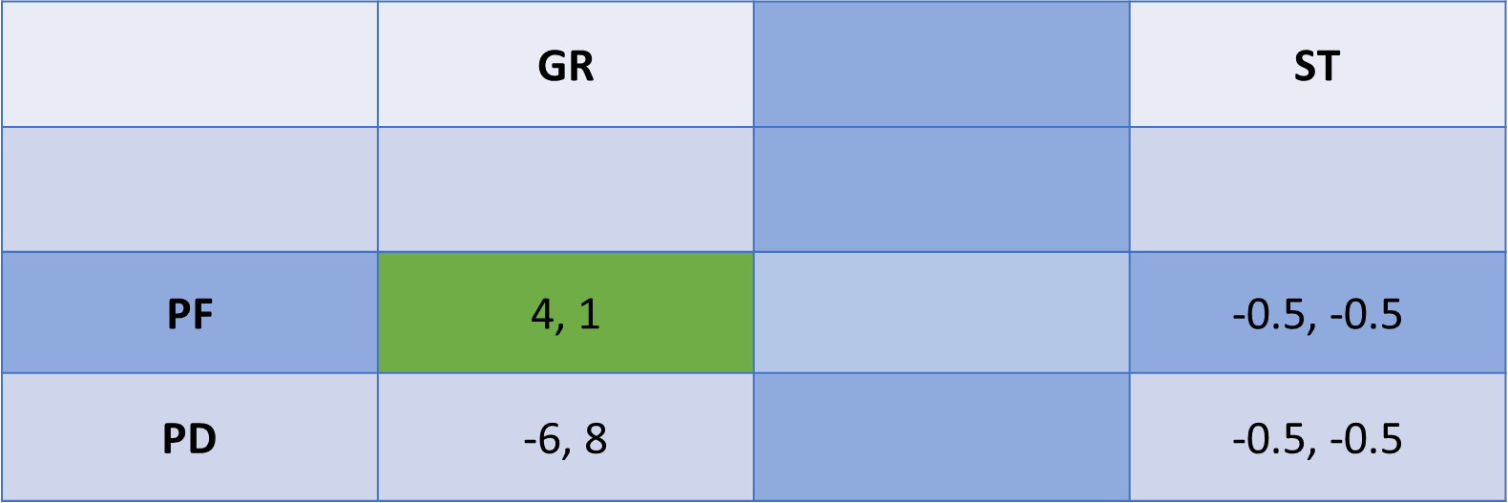
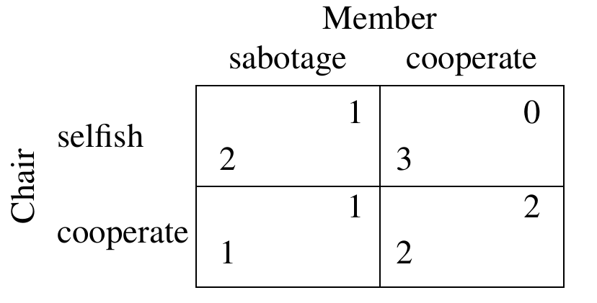
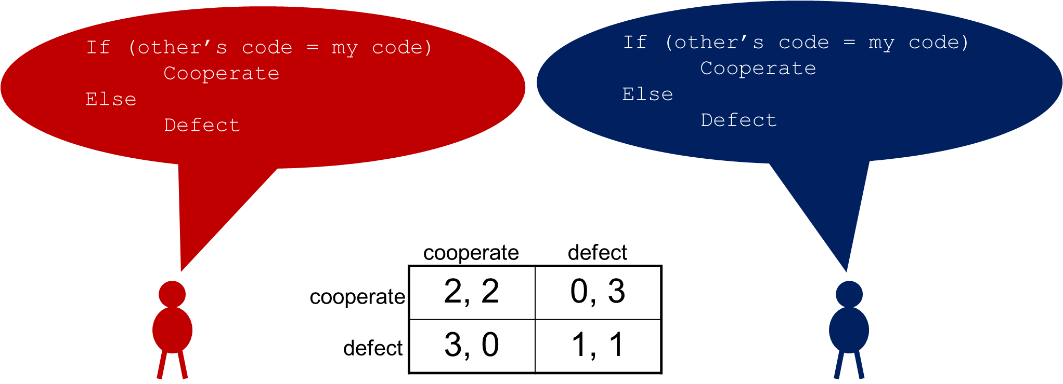
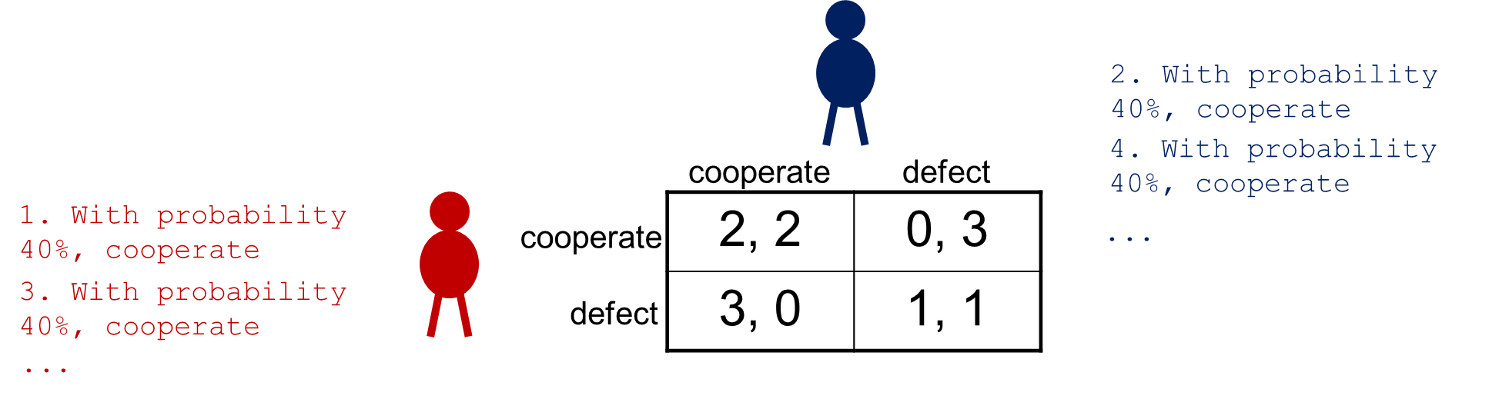
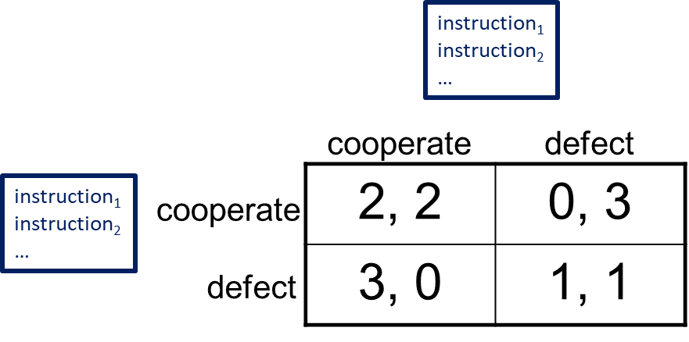
Summary of approach
Game-theoretic failures to cooperate can happen even with almost perfectly aligned agents
Some ways of getting to cooperation make sense for humans as well…
... but there are others that seem more natural for (advanced) AI agents
Let’s not unnecessarily limit our toolkit!
ethics & norms
repeated games
disarmament (pure strategies)
role assignment / agent boundaries
program equilibrium, simulation
disarmament (mixed strategies)
philosophical foundations (evidential decision theory, self-locating belief, …)

Slide 60
Many open questions
What are the foundations of game theory for highly advanced AI?
How should an agent play with other agents with overlapping code? With visible code?
How should an agent play when it may be being simulated? When it can’t remember the past?
What design decisions can improve cooperation?
How realistic are they? How do we make them more so?
How robust are they? How do we make them more so?
What is the role of learning?
Can we design learning algorithms that converge to good equilibria?
In contexts of logical uncertainty?
…

Slide 61
(We did not cover slides after this one; the below is just in case you’re interested.)

Slide 62
Turning causal decision theorists into money pumps [Oesterheld and C., Phil. Quarterly’21]
Adversarial Offer:
Demon (really, any good predictor) put $3 into each box it predicted you would not choose
Each box costs $1 to open; can open at most one
Demon 75% accurate (you have no access to randomization)
CDT will choose one box, knowing that it will regret doing so
Can add earlier opt-out step where the demon promises not to make the adversarial offer later, if you pay the demon $0.20 now
Sunday
$3
EXIT
Monday
$0
$0.20
Tuesday
A
OR
B
OR
Ø
$1
$1
$0
A
B

Slide 63
Taking advantage of a Halfer [Hitchcock’04]
Offer Beauty the following bet whenever she awakens:
If the coin landed Heads, Beauty receives 11
If it landed Tails, Beauty pays 10
Argument: Halfer will accept, Thirder won’t
If it’s Heads, Halfer Beauty will get +11
If it’s Tails, Halfer Beauty will get -20
Can combine with another bet to make Halfer Beauty end up with a sure loss (a Dutch book)
Sunday
Monday
Tuesday
H
T

Slide 64
Evidential decision theory
Idea: when considering how to make a decision, should consider what it would tell you about the world if you made that decision
EDT Halfer: “With prob. ½, it’s Heads; if I accept, I will end up with 11. With prob. ½, it’s Tails; if I accept, then I expect to accept the other day as well and end up with -20. I shouldn’t accept.”
As opposed to more traditional causal decision theory (CDT)
CDT Halfer: “With prob. ½, it’s Heads; if I accept, it will pay off 11. With prob. ½, it’s Tails; if I accept, it will pay off -10. Whatever I do on the other day I can’t affect right now. I should accept.”
EDT Thirder can also be Dutch booked
CDT Thirder and EDT Halfer cannot
[Draper & Pust ‘08; Briggs ’10; Oesterheld & C. working paper]
EDTers arguably can in more general setting
[C., Synthese’15]
… though we’ve argued against CDT in other work [Oesterheld & C, Phil. Quarterly’21]
Sunday
Monday
Tuesday
H
T

Slide 65
Dutch book against EDT [C. 2015]
Modified version of Sleeping Beauty where she wakes up in rooms of various colors

Slide 66
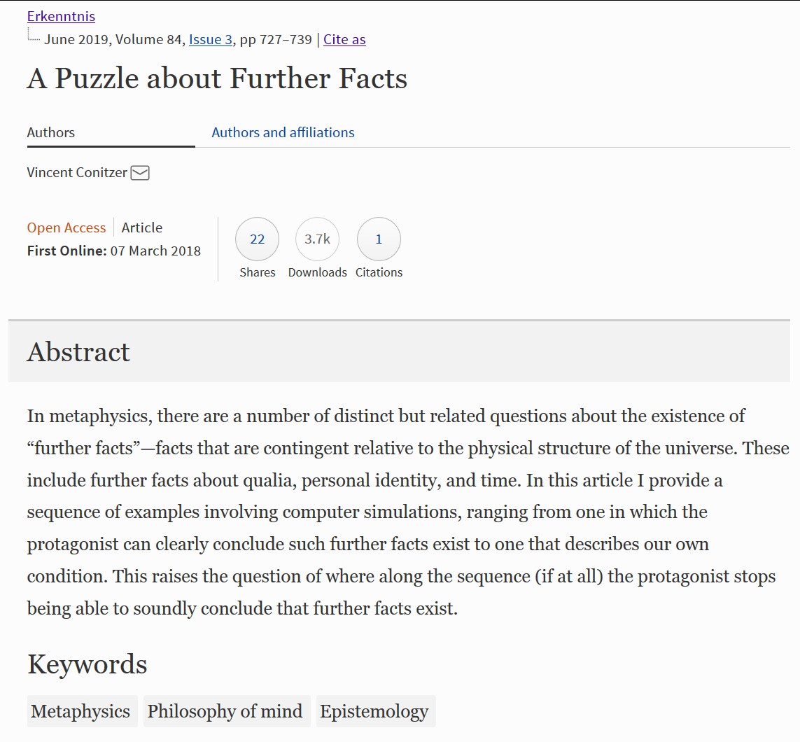
Philosophy of “being present” somewhere, sometime
simulated light (no direct correspondence to light in our world)
1: world with creatures simulated on a computer
2: displayed perspective of one of the creatures
To get from 1 to 2, need additional code to:
A. determine in which real-world colors to display perception
B. which agent’s perspective to display
Is 2 more like our own conscious experience than 1? If so, are there further facts about presence, perhaps beyond physics as we currently understand it?
Related to A-theory and B-theory of time in metaphysics [C., dialectica’20]
See also: [Hare 2007-2010, Valberg 2007, Hellie 2013, Merlo 2016, …]

Slide 67
Absentminded Driver Problem [Piccione and Rubinstein, 1997]
Driver on monotonous highway wants to take second exit, but exits are indistinguishable and driver is forgetful
Deterministic (behavioral) strategies are not stable
Optimal randomized strategy: exit with probability p where p maximizes 4p(1-p) + (1-p)² = -3p² + 2p + 1, so p* = 1/3
What about “from the inside”? P&R analysis: Let b be the belief/credence that we’re at X, and p the probability that we exit. Maximize with respect to p: (1-b)(4p+1(1-p)) + b(4p(1-p) + 1(1-p)²) = -3bp² + (3-b)p + 1, so p* = (3-b) / (6b) = 1/(2b) - 1/6
But if p = 1/3, then b = 3/5, which would give p* = 5/6 - 1/6 = 2/3? So also not stable?
Resembles EDT reasoning… But not really halfing… Shouldn’t b depend on p...
Image from Aumann, Hart, Perry 1997

Slide 68
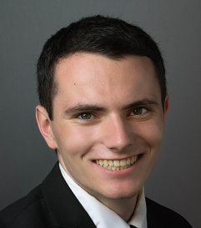

A different analysis [Aumann, Hart, Perry, 1997]
AHP reason more along thirder / CDT lines:
Imagine we normally expect to play p = 1/3. Should we deviate this time only?
If we exit now, get (3/5)*0 + (2/5)*4 = 8/5
If we continue now, get (3/5)*((1/3)*4+(2/3)*1) + (2/5)*1 = 8/5
So indifferent and willing to randomize (equilibrium)
Questions
Joint work with:
Does this always work? Yes! (See also Taylor [2016])
Does some version of EDT work with some version of belief formation?
AHP reason more along thirder / CDT lines:
Imagine we normally expect to play p = 1/3. Should we deviate this time only?
If we exit now, get (3/5)*0 + (2/5)*4 = 8/5
If we continue now, get (3/5)*((1/3)*4+(2/3)*1) + (2/5)*1 = 8/5
So indifferent and willing to randomize (equilibrium)
Questions
Joint work with:
Does this always work? Yes! (See also Taylor [2016])
Does some version of EDT work with some version of belief formation?
Scott Emmons, Caspar Oesterheld, Andrew Critch, Vincent Conitzer, and Stuart Russell. For Learning in Symmetric Teams, Local Optima are Global Nash Equilibria. ICML’22
Andrew Critch
Scott Emmons
Caspar Oesterheld
Andrew Critch
Scott Emmons
Caspar Oesterheld
Stuart Russell
Image from Aumann, Hart, Perry 1997

Slide 69
A challenging example for the evidential decision theorist
Optimal strategy to commit to is to just go left: (p_{l}, p_{s}, p_{r}) = (1, 0, 0)
If you’re at an intersection, what does EDT say you should do?
When considering (p_{l}, p_{s}, p_{r}) = (1, 0, 0), you presumably expect to be at X and get 1 (really just need: no more than 1)
When considering (p_{l}, p_{s}, p_{r}) = (0, ½, ½), then say b is your subjective probability of being at Y
Assume: b > 0
Assume: b is not a function of ε
So, expected utility: b*½*(4-ε) + (1-b)*¼*(4-ε) = 1+b-¼ε-¼bε
For sufficiently small ε this is greater than 1
Hence EDT suggests (0, ½, ½) over (1, 0, 0)!
... right? ... right?
0
0
Y
4-ε
1
X
0
START

Slide 70
A way for EDT to get the right answer (+SSA)
Consider probabilities of whole trajectories, plus where you are, under strategy (0, ½, ½), in a halfing sort of way
P(XY(4-ε), @X) = P(XY(4-ε)) * P(@X|XY(4-ε)) = ¼ * ½
P(XY(4-ε), @Y) = P(XY(4-ε)) * P(@Y|XY(4-ε)) = ¼ * ½
Any other trajectory with positive probability gives payoff 0
So expected utility is 2 * ¼ * ½ * (4-ε) = 1- ε/4, which is worse than 1, so EDT gets the right answer
What just happened?
Under this way of reasoning, if you tell me that I’m at X, it’s more likely that I’m on trajectory X(0) than on one of the XY ones
P(XY(4-ε), @X) = ¼ * ½ ; P(XY(0), @X) = ¼ * ½ ; P(X(0), @X) = ½ * 1
So P(X(0) | @X) = ½ / (½ + ¼) = 2/3 (not 1/2)
Previous slide had hidden assumption: where I am carries no information about my future coin tosses
0
0
Y
4-ε
1
X
0
START

Slide 71
Making decisions with imperfect recall [cf. absentminded driver problem: PR97, AHP97]
task of value 1
with p. ½, task of value 2 (if so game ends)
Optimal strategy without recall: go Right with probability 5/8. (Outside view.) Follow that.
You arrive at decision point. What is the probability that you’re there for the first time? (Inside view.)
Thirder: in expectation 1 first awakening, and (1/2)(5/8)(16/25) / (1-(5/8)(16/25)) = 1/3 later awakenings, so probability of first time = 1/(4/3) = ¾
Going Left gives 1 and going Right gives (1/2)(3/4)(2) + ((1/2)(3/4)+(1/4))(16/25)(3/8) / (1-(5/8)(16/25)) = 1
Theorem. This is always true!
… but can have other equilibria
decision point!
start
discount factor (probability that game continues): γ = 16/25 = .64
with:
Andrew Critch
Scott Emmons
Caspar Oesterheld
Andrew Critch
Scott Emmons
Caspar Oesterheld
Stuart Russell
Notes:
Given 5/8 strategy, only 1/5 probability you make it to a second decision

Slide 72
Fraction of time replicator dynamic finds best solution
N = #players (or #nodes)
A = #actions per player (or per node)

Slide 73
Functional Decision Theory [Soares and Levinstein 2017; Yudkowsky and Soares 2017]
One interpretation: act as you would have precommitted to act
Avoids my EDT Dutch book (I think)
… still one-boxes in Newcomb’s problem
… even one-boxes in Newcomb’s problem with transparent boxes
An odd example: Demon that will send you $1,000 if it believes you would otherwise destroy everything (worth -$1,000,000 to everyone)
FDT says you should destroy everything, even if you only find out that you are playing this game after the entity has already decided not to give you the money (too-late extortion?)
Don’t do it!

