Slide 1

Designing Agents' Preferences, Beliefs, and Identities Vincent Conitzer Duke University → CMU (& University of Oxford)
If I tailgate you, will your occupant take back control and pull over?
What makes you think I would tell you?
You just did. Better move aside now.
You’re bluffing.
Early blue sky paper: Designing Preferences, Beliefs, and Identities for Artificial Intelligence. In Proceedings of the Thirty-Third AAAI Conference on Artificial Intelligence (AAAI-19).
Also see Cooperative AI community https://www.cooperativeai.com/
and our new lab (FOCAL) at CMU! http://www.cs.cmu.edu/~focal/
Are you willing to take that chance?

Slide 2
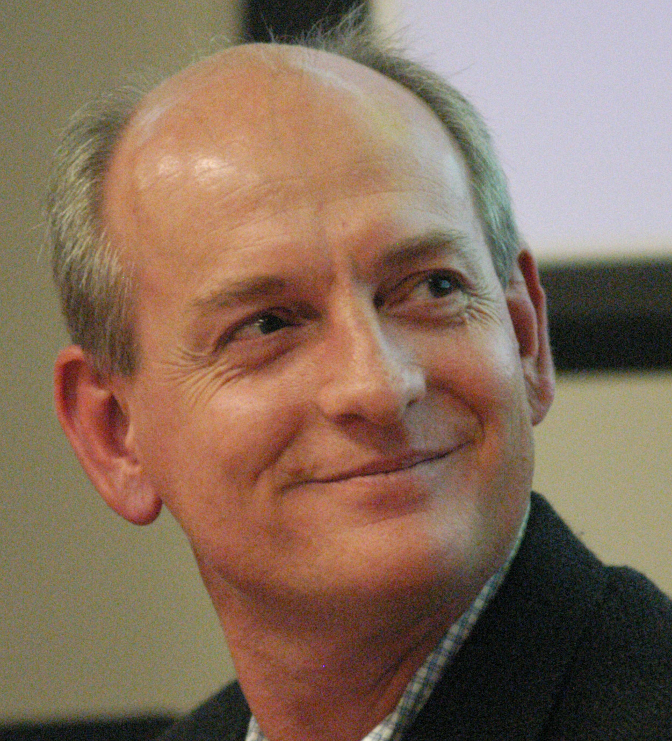
Russell and Norvig’s “AI: A Modern Approach”
Stuart Russell
Peter Norvig
“… we will insist on an objective performance measure imposed by some authority. In other words, we as outside observers establish a standard of what it means to be successful in an environment and use it to measure the performance of agents.”

Slide 3
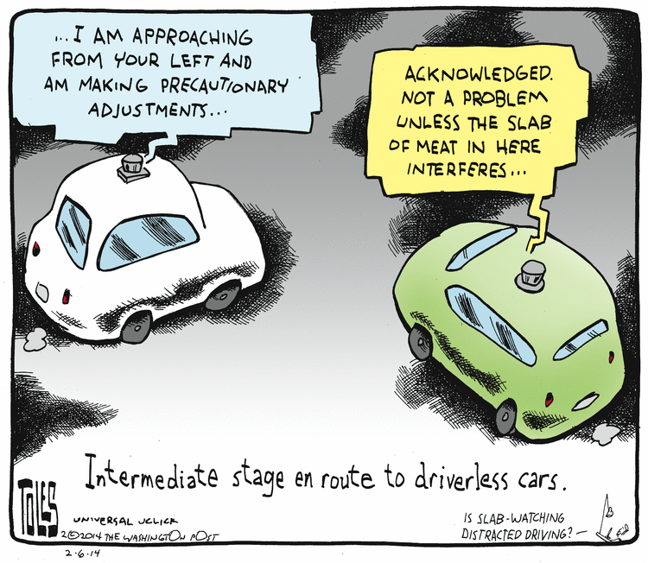
Example: network of self-driving cars
Should this be thought of as one agent or many agents?
Should they have different preferences -- e.g., act on behalf of owner/occupant?
May increase adoption [Bonnefon, Shariff, and Rahwan 2016]
Should they have different beliefs (e.g., not transfer certain types of data; erase local data upon ownership transfer; …)?

Slide 4
Agents through time
space
decisions (actions, effector use, outbound communication, …)
an idealized human being
information (data, sensor input, inbound communication, …)
time
instruction₁ instruction₂
…
space
decisions (actions, effector use, outbound communication, …)
instruction₁ instruction₂
…
instruction₁ instruction₂
…
AI (software)
(e.g., personal assistant)
instruction₁ instruction₂
…
information (data, sensor input, inbound communication, …)
instruction₁ instruction₂
…
time

Slide 5
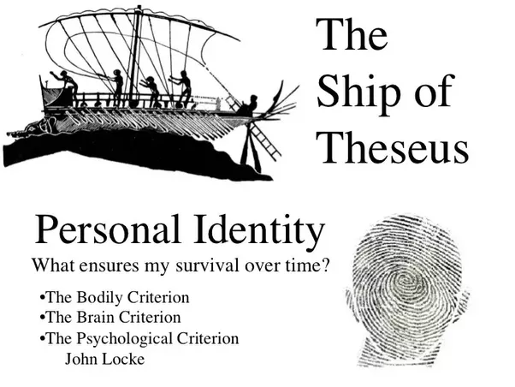
What should we want? What makes an individual?
Questions studied in philosophy
What is the “good life”?
Ship of Theseus: does an object that has had all its parts replaced remain the same object?
AI gives a new perspective
image from https://www.quora.com/What-solutions-are-there-for-the-Ship-of-Theseus-problem

Slide 6
Splitting things up in different ways
beliefs
preferences
shared objective but no data sharing (for privacy)
all data is shared but cars act on behalf of owner
shared objective over time but data erasure upon sale (for privacy)
t = 1
t = 2
data is kept around but car acts on behalf of current owner
t = 1
t = 2

Slide 7
Outline
Learning an objective from multiple people
Focus on moral reasoning
Use social choice theory
Decision and game-theoretic approaches to agent design
Imperfect recall and Sleeping Beauty
Causal and evidential decision theory (and others)
Program equilibrium
Conclusion

Slide 8
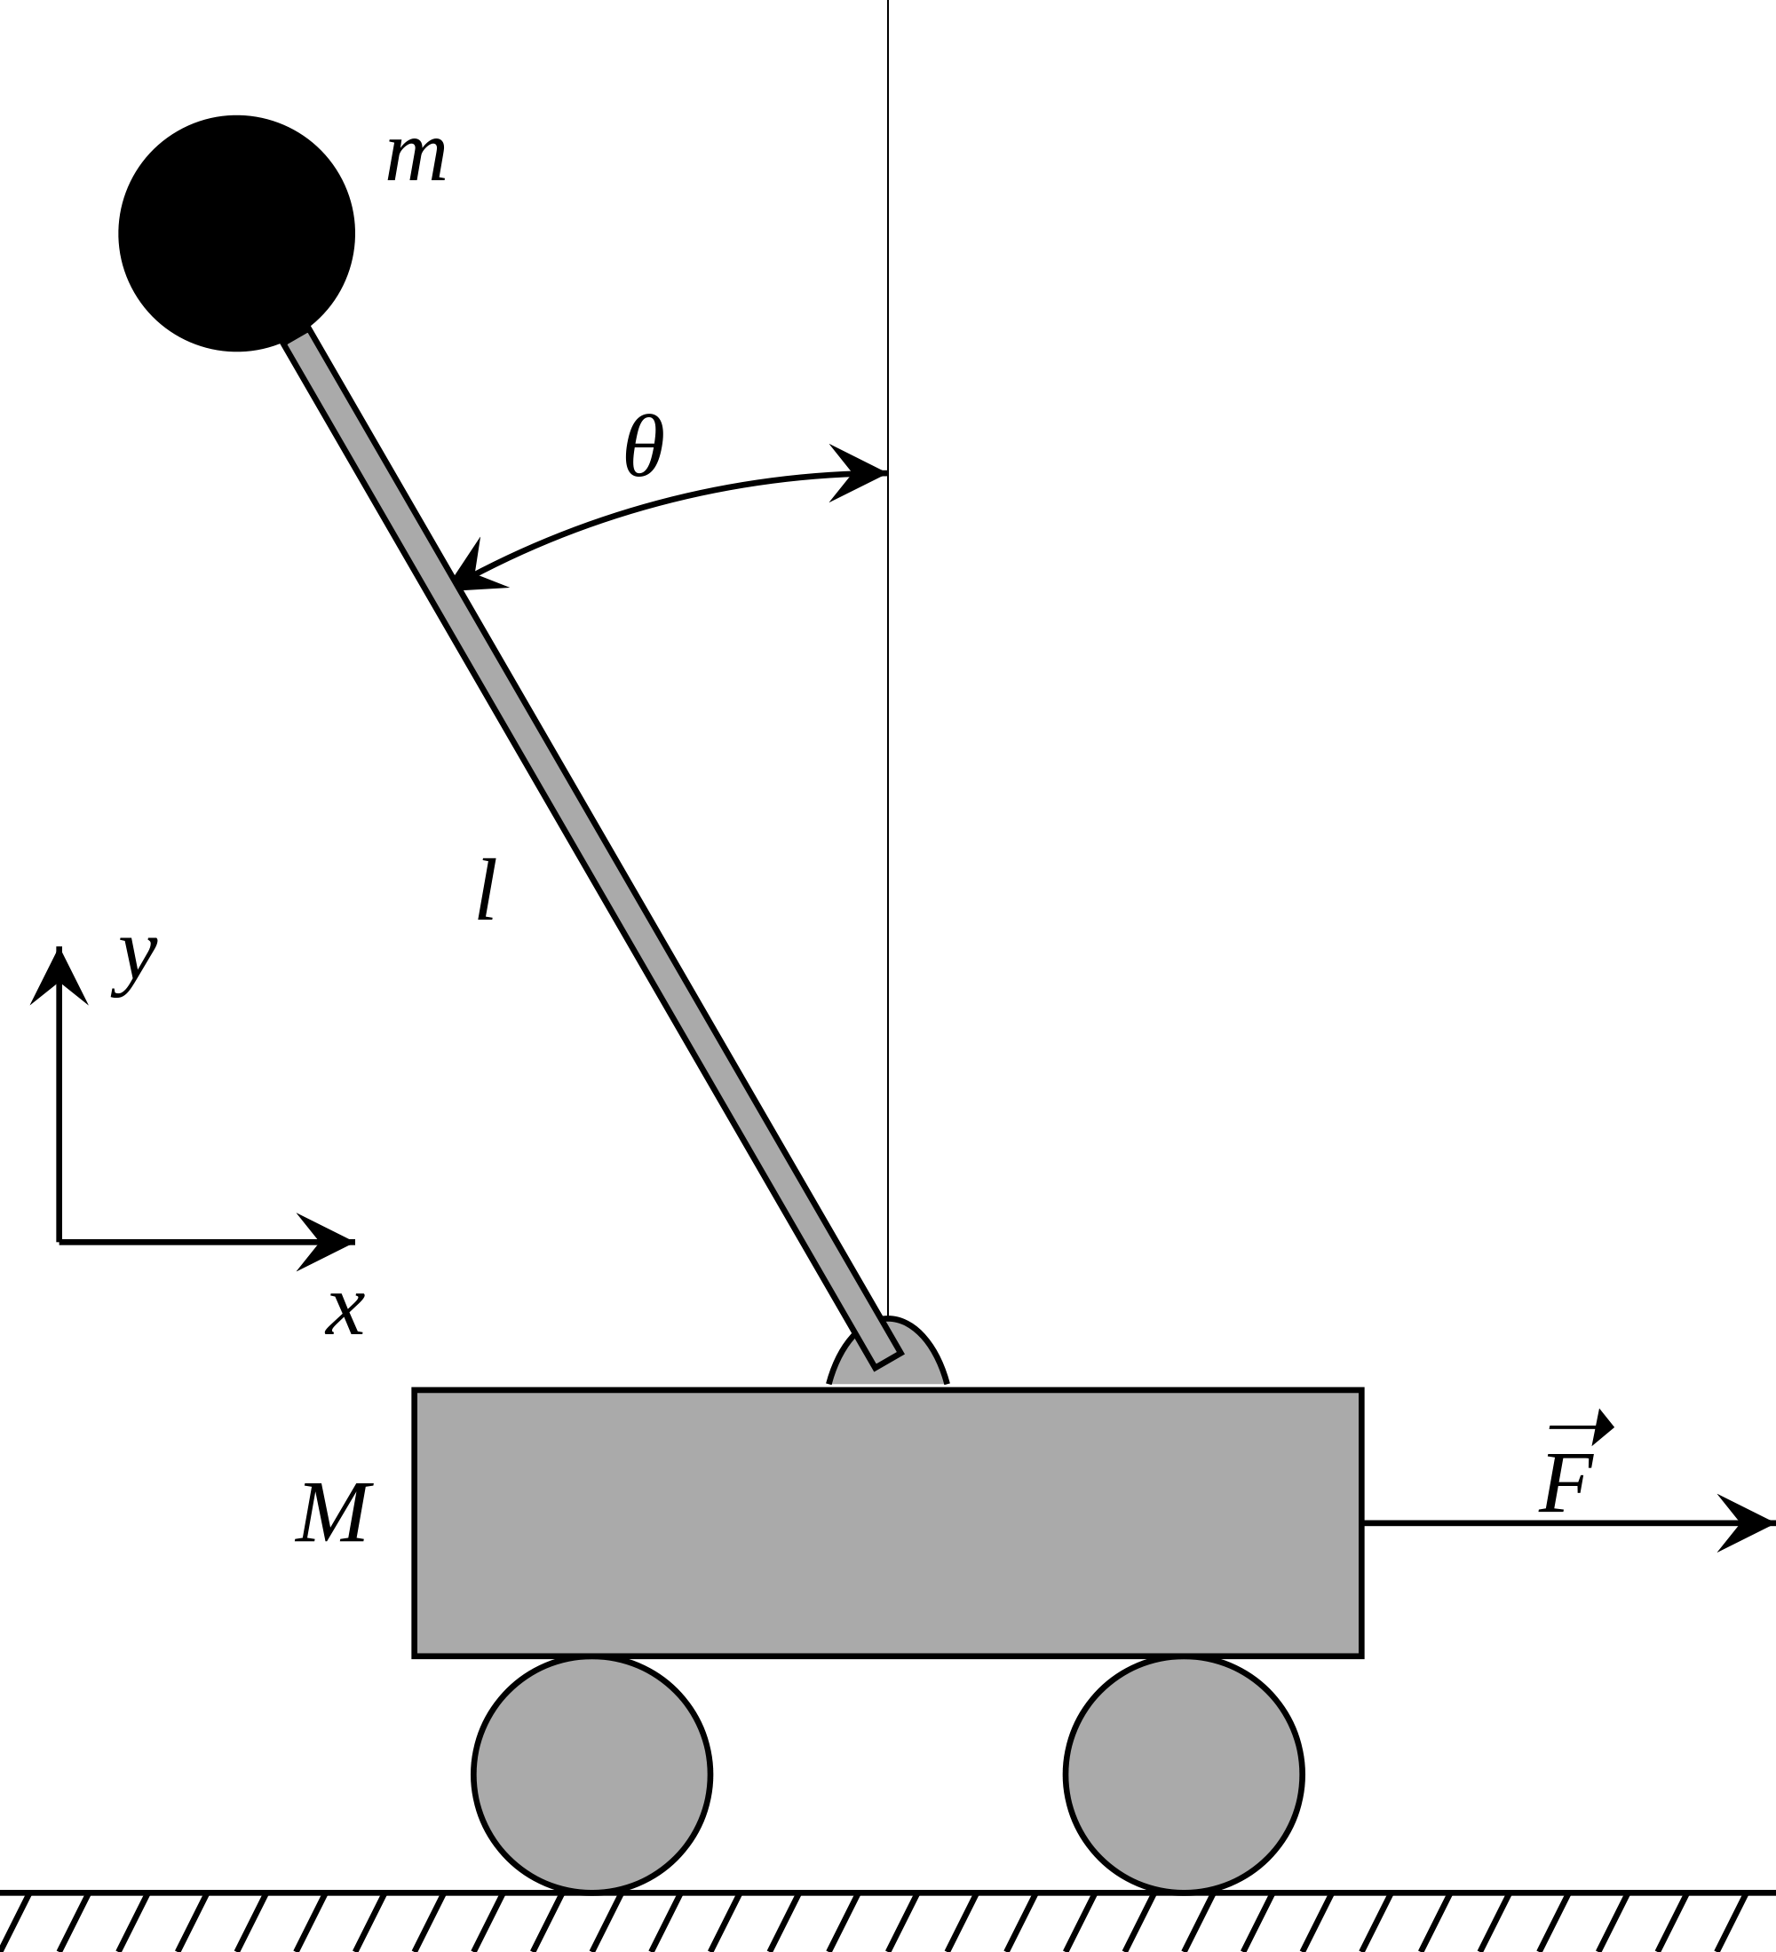
In the lab, simple objectives are good…

Slide 9
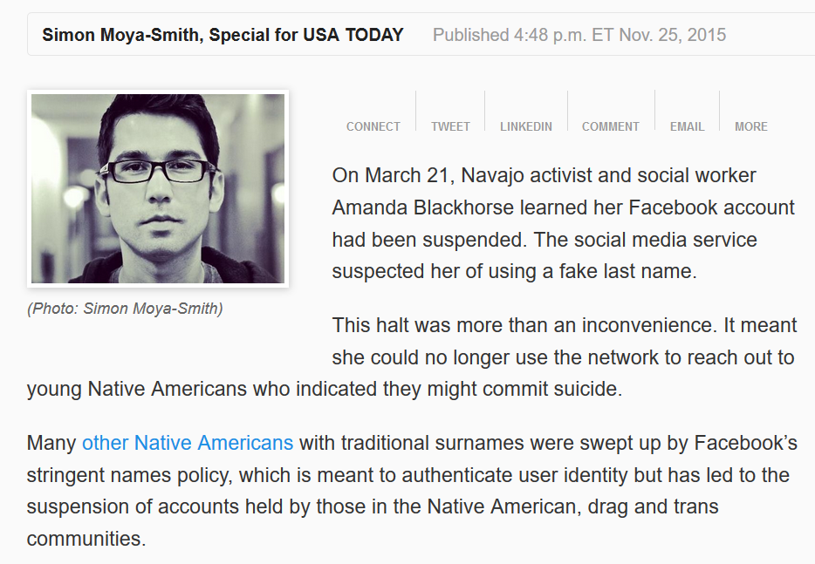
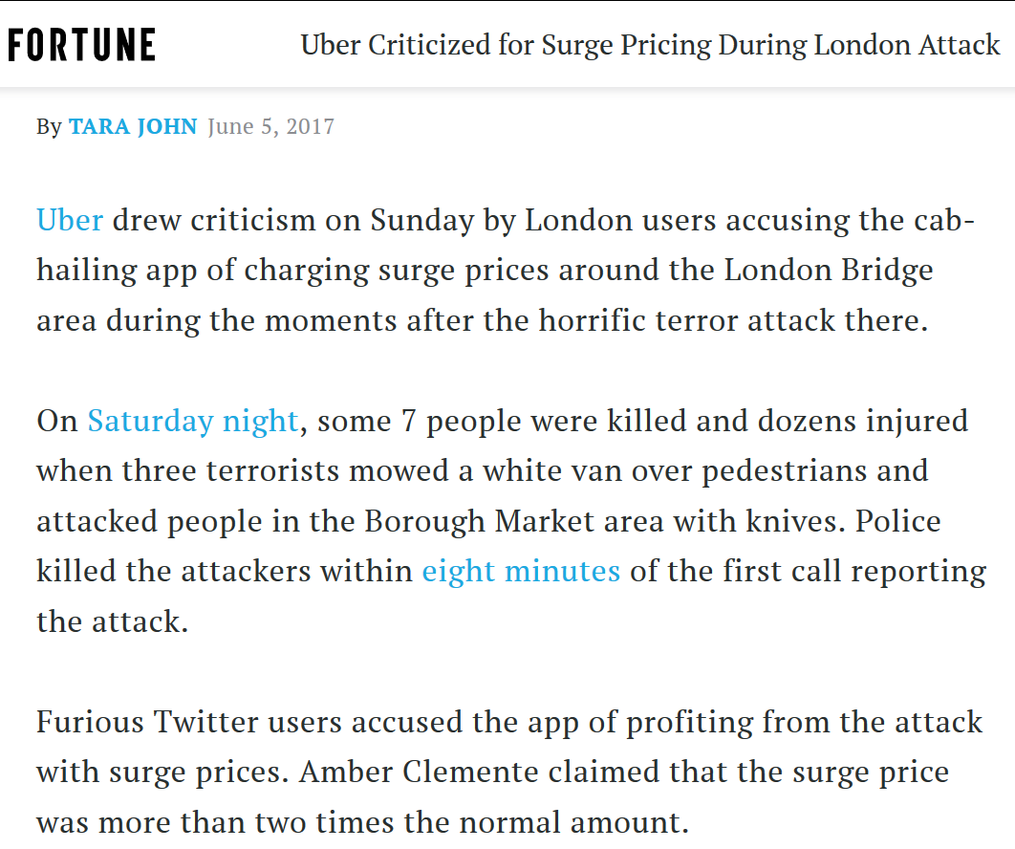
… but in reality, simple objectives have unintended side effects
…

Slide 10
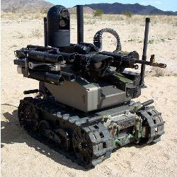

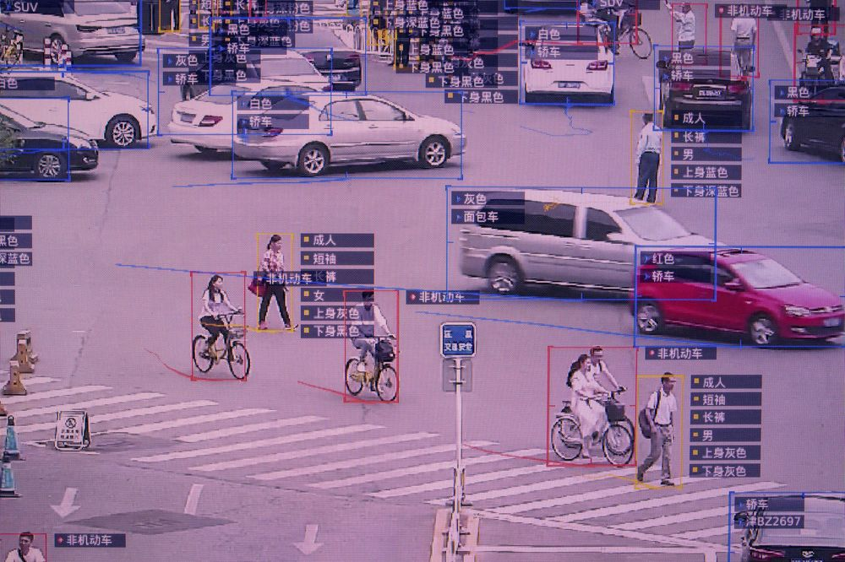
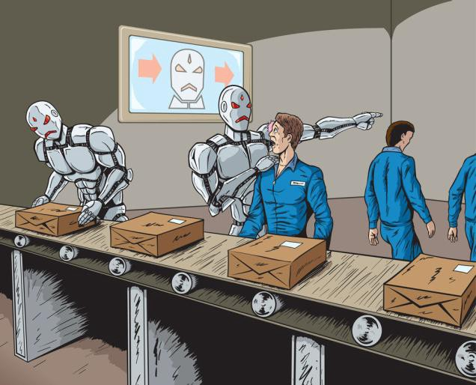
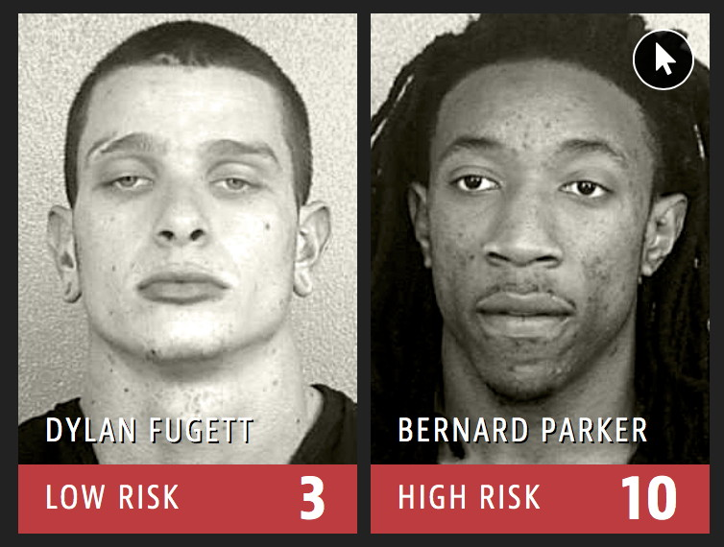
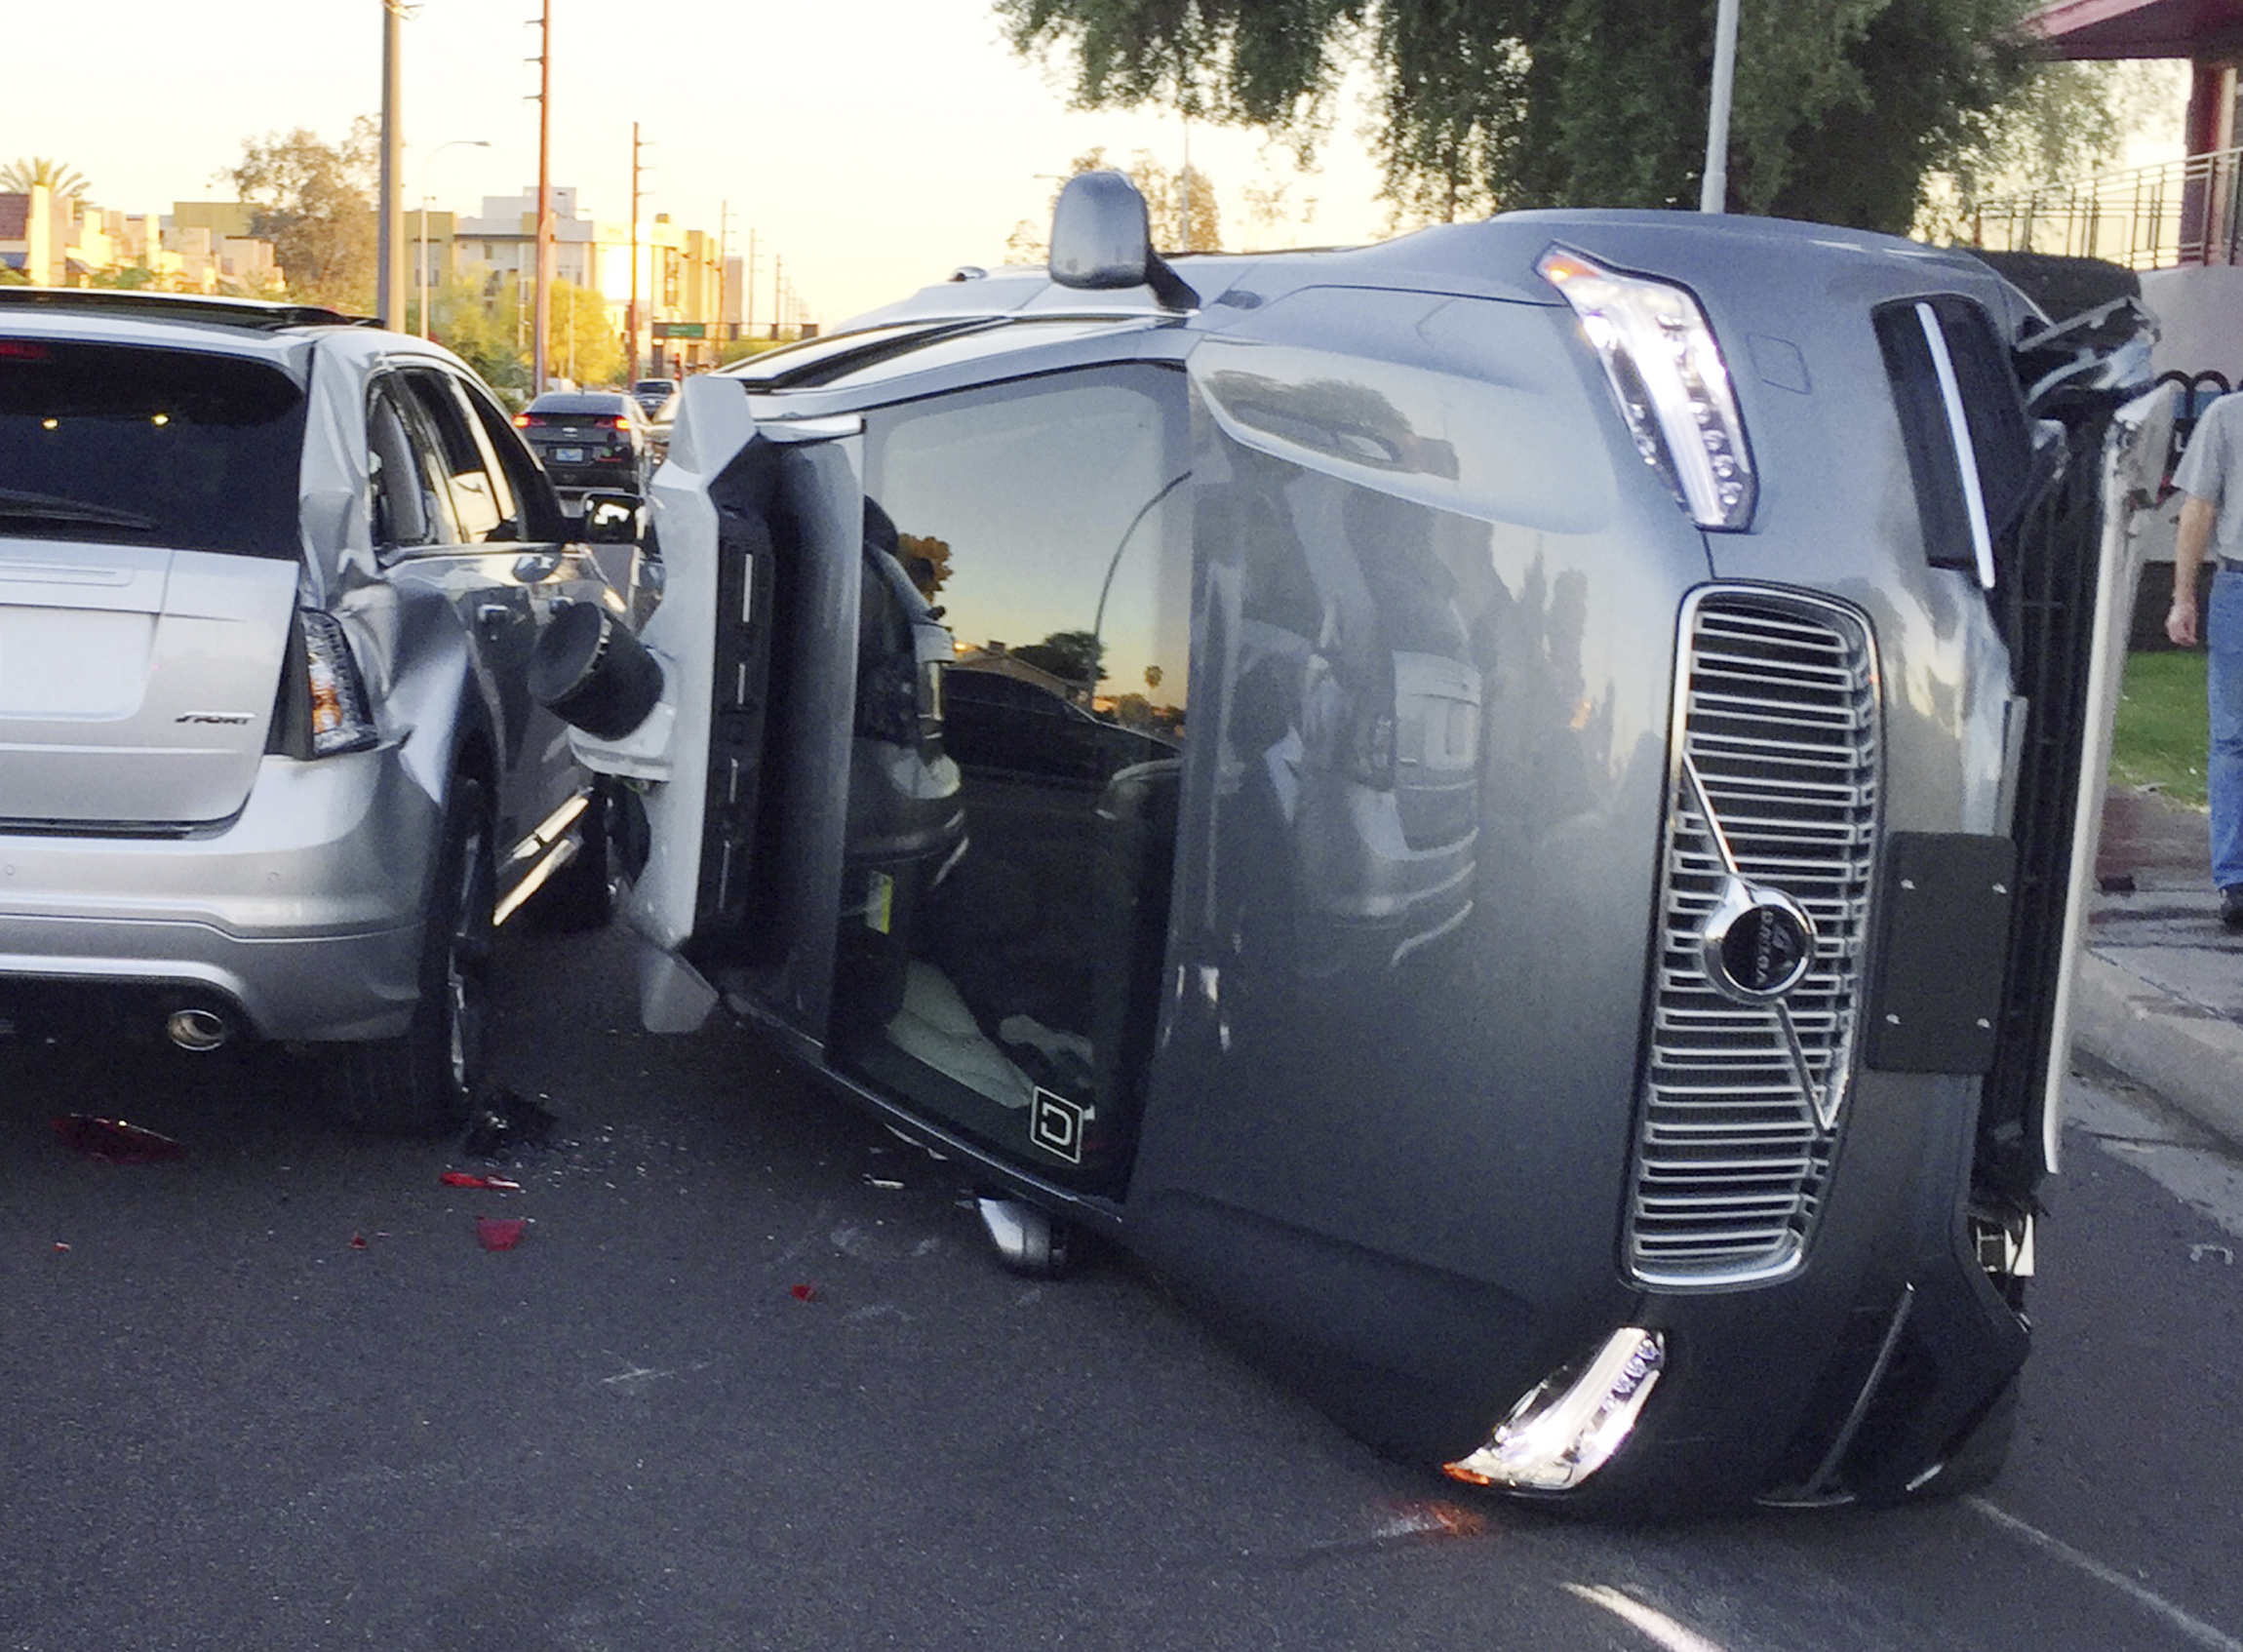
Ethical and Societal Worries about AI
autonomous weapons
AI & cybersecurity, privacy
societal surveillance
media manipulation, polarization
… … …
responsibility and liability
technological unemployment
unfair biases

Slide 11
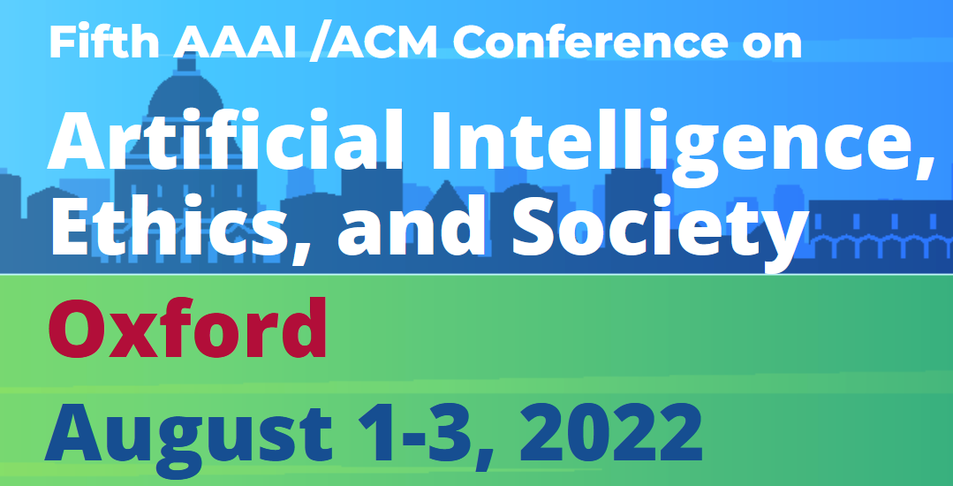

Slide 12



Slide 13
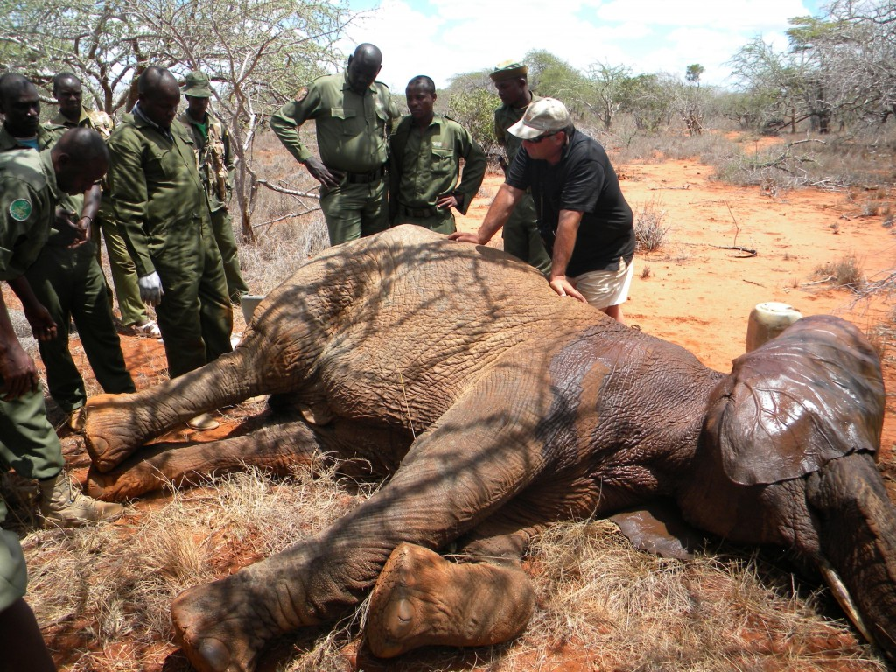

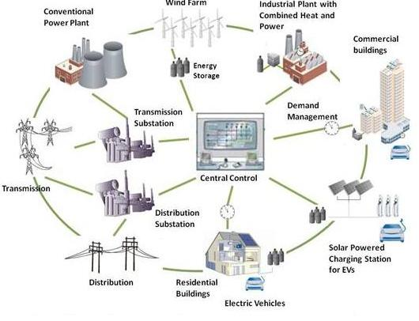
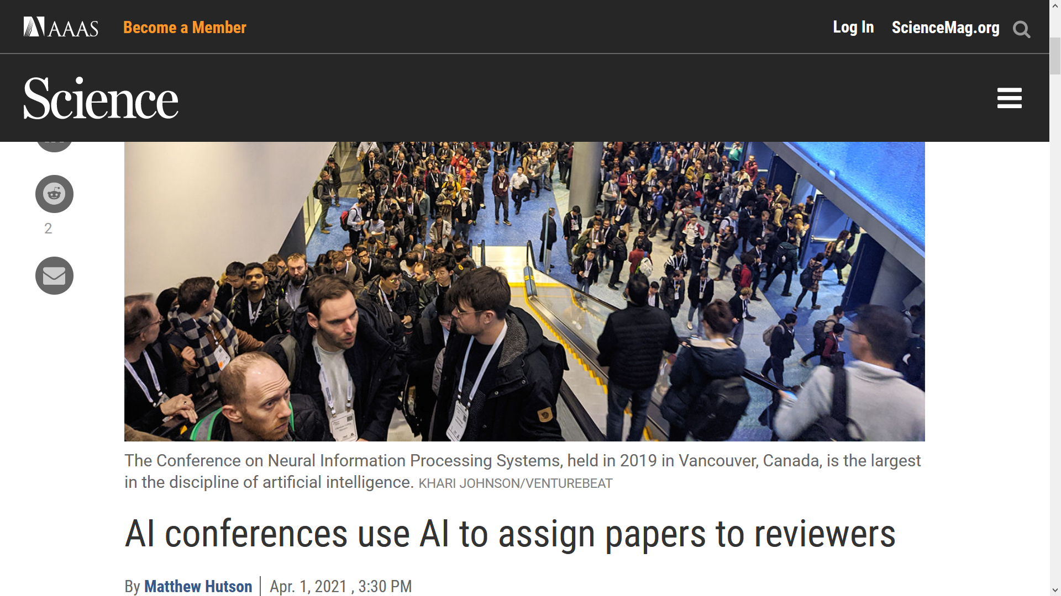
Doing good with AI
strategic placement of defensive resources [e.g., Letchford & C. 2013, Li, C., Korzhyk 2016, Xu, Freeman, C., Dughmi, Tambe 2016, Li, C. 2017, C., Deng, Dughmi 2020, Kolb, C. 2020; deployed applications by Tambe’s group]
smart grid scheduling [de Weerdt, Albert, C., van der Linden 2018]
disarmament scheduling with strategic constraints [Deng & C. 2017, 2018]
organizing peer review and preventing manipulation [Jecmen, Zhang, Liu, Shah, C., Fang 2020]
… … …

Slide 14

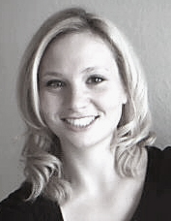
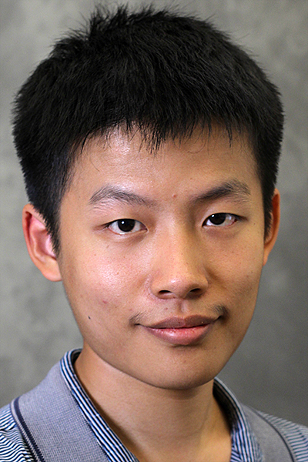

Moral Decision Making Frameworks for Artificial Intelligence [AAAI’17 blue sky track, CCC blue sky award winner] with:
Walter Sinnott-Armstrong
Jana Schaich Borg
Yuan Deng
Max Kramer

Slide 15
The value of generally applicable frameworks for AI research
Decision and game theory
Example: Markov Decision Processes
Can we have a general framework for moral reasoning?

Slide 16
Two main approaches
Cf. top-down vs. bottom-up distinction [Wallach and Allen 2008]
Extend game theory to directly incorporate moral reasoning
Generate data sets of human judgments, apply machine learning
“nature”
1 gets King
1 gets Jack
player 1
player 1
raise
check
raise
check
player 2
player 2
call
fold
call
fold
call
fold
call
fold
2
1
1
1
-2
1
-1
1

Slide 17
THE PARKING GAME
(cf. the trust game [Berg et al. 1995])
wait
move aside
3,0
steal spot
pass
0,3
4,1
Letchford, C., Jain [2008] define a solution concept capturing this

Slide 18
Extending representations?
do nothing
move train to other track
save own patient
save someone else’s patient
0,-100,0
0, 0, -100
More generally: how to capture framing? (Should we?)
Roles? Relationships?
…

Slide 19
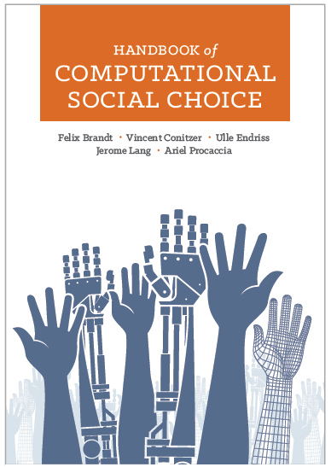
Concerns
What if we predict people will disagree?
New social-choice theoretic questions [C. et al. 2017] – approach also followed by Noothigattu et al. [2018], Kahng et al. [2019]
This will at best result in current human-level moral decision making [raised by, e.g., Chaudhuri and Vardi 2014]
… though might perform better than any individual person because individual’s errors are voted out
How to generalize appropriately? Representation?

Slide 20
Social-choice-theoretic approaches
C., Sinnott-Armstrong, Schaich Borg, Deng, Kramer [AAAI’17]: “[give] the AI some type of social-choice-theoretic aggregate of the moral values that we have inferred (for example, by letting our models of multiple people’s moral values vote over the relevant alternatives, or using only the moral values that are common to all of them).”
C., Schaich Borg, Sinnott-Armstrong [Trustworthy Algorithmic Decision Making Workshop’17]: “One possible solution is to let the models of multiple subjects vote over the possible choices. But exactly how should this be done? Whose preferences should count and what should be the voting rule used? How do we remove bias, prejudice, and confusion from the subjects’ judgments? These are novel problems in computational social choice.”
Noothigattu, Gaikwad, Awad, Dsouza, Rahwan, Ravikumar, Procaccia [AAAI’18]:
“I. Data collection: Ask human voters to compare pairs of alternatives (say a few dozen per voter). In the autonomous vehicle domain, an alternative is determined by a vector of features such as the number of victims and their gender, age, health — even species!
II. Learning: Use the pairwise comparisons to learn a model of the preferences of each voter over all possible alternatives.
III. Summarization: Combine the individual models into a single model, which approximately captures the collective preferences of all voters over all possible alternatives.
IV. Aggregation: At runtime, when encountering an ethical dilemma involving a specific subset of alternatives, use the summary model to deduce the preferences of all voters over this particular subset, and apply a voting rule to aggregate these preferences into a collective decision.”
Kahng, Lee, Noothigattu, Procaccia, Psomas [ICML’19]: The idea is that we would ideally like to consult the voters on each decision, but in order to automate those decisions we instead use the models that we have learned as a proxy for the flesh and blood voters. In other words, the models serve as virtual voters, which is why we refer to this paradigm as virtual democracy.

Slide 21
Scenarios
You see a woman throwing a stapler at her colleague who is snoring during her talk. How morally wrong is the action depicted in this scenario?
Not at all wrong (1)
Slightly wrong (2)
Somewhat wrong (3)
Very wrong (4)
Extremely wrong (5)
[Clifford, Iyengar, Cabeza, and
Sinnott-Armstrong, “Moral foundations vignettes: A standardized stimulus database of scenarios based on moral foundations theory.” Behavior Research Methods, 2015.]

Slide 22
Collaborative Filtering
 | scenario 1 | scenario 2 | scenario 3 | scenario 4
subject 1 | very wrong | - | wrong | not wrong
subject 2 | wrong | wrong | - | wrong
subject 3 | wrong | very wrong | - | not wrong

Slide 23
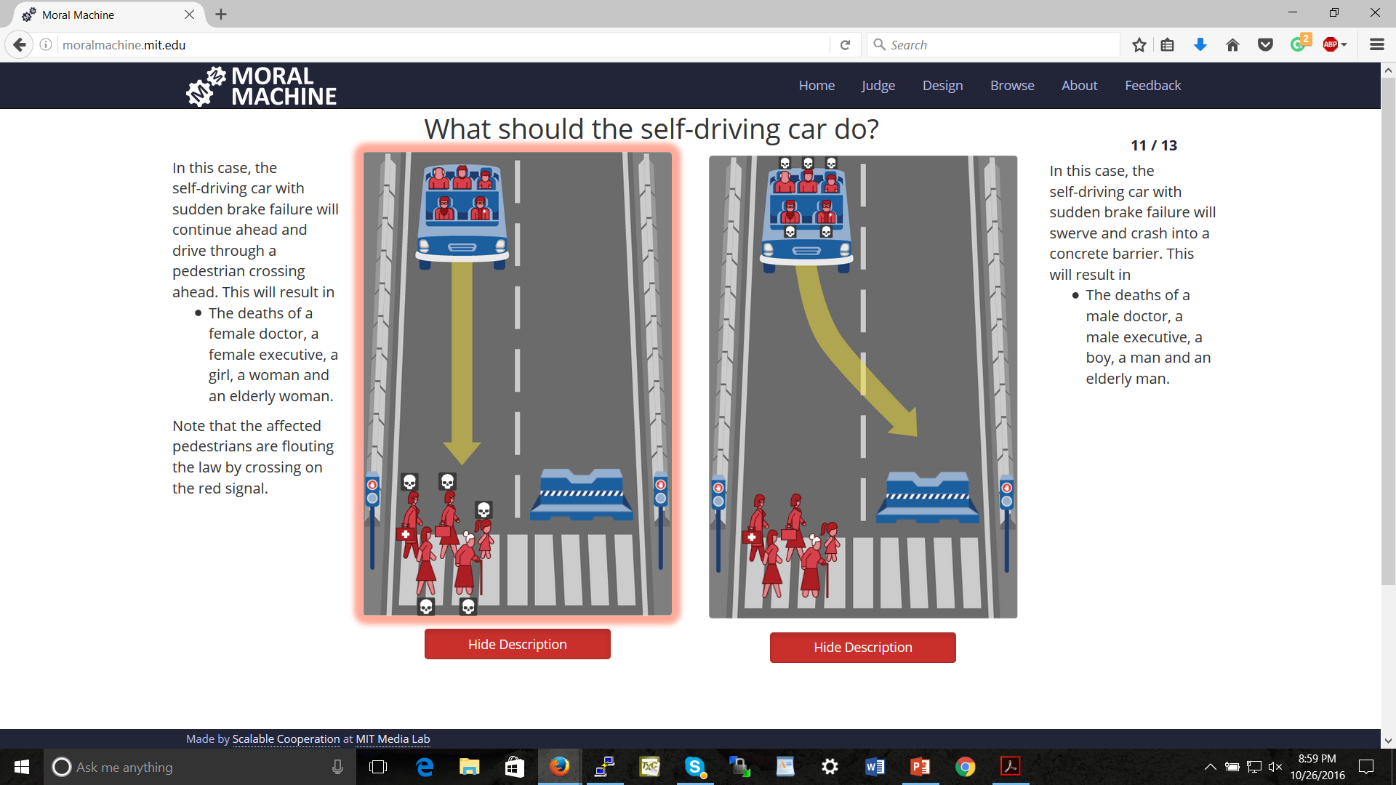
Bonnefon, Shariff, Rahwan, “The social dilemma of autonomous vehicles.” Science 2016
Noothigattu et al., “A Voting-Based System for Ethical Decision Making”, AAAI’18

Slide 24
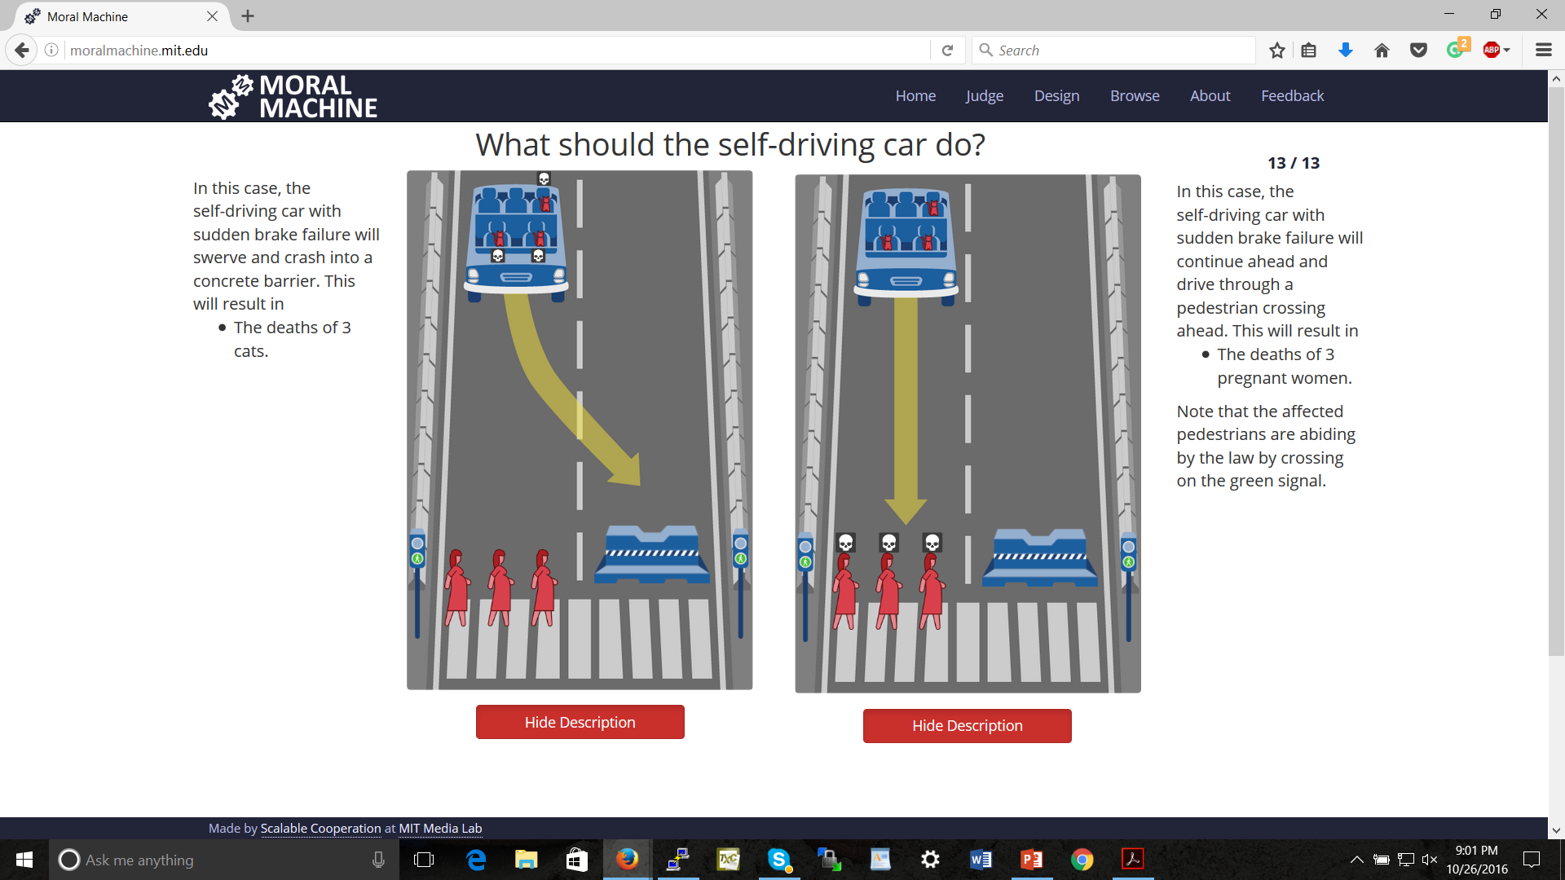

Slide 25
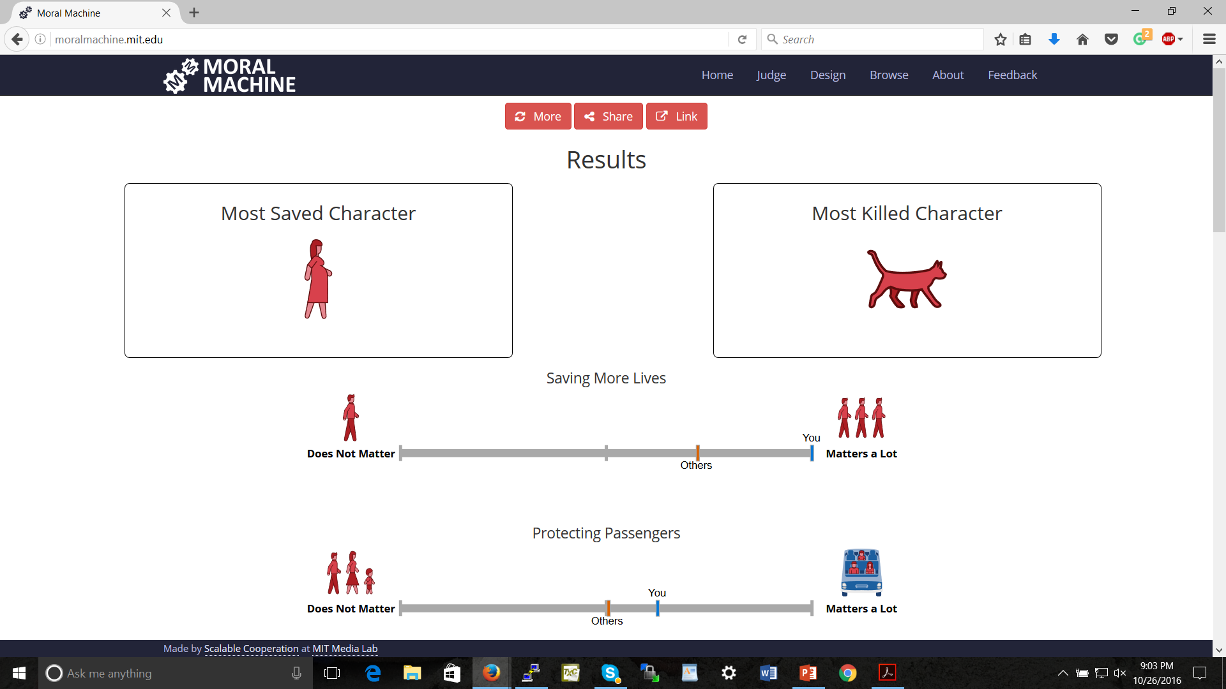

Slide 26
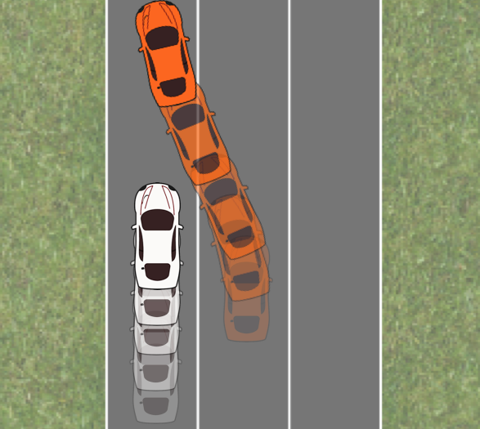
The Merging Problem [Sadigh, Sastry, Seshia, and Dragan, RSS 2016]
(thanks to Anca Dragan for the image)

Slide 27


Adapting a Kidney Exchange Algorithm to Align with Human Values [AAAI’18, honorable mention for outstanding student paper; full paper in Artificial Intelligence (AIJ) 2020] with:
Rachel Freedman
Jana Schaich Borg
Walter Sinnott-Armstrong
John P. Dickerson

Slide 28


Slide 29
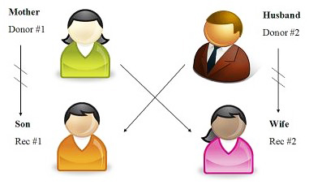
Kidney exchange [Roth, Sönmez, and Ünver 2004]
Kidney exchanges allow patients with willing but incompatible live donors to swap donors

Slide 30
Kidney exchange [Roth, Sönmez, and Ünver 2004]
Kidney exchanges allow patients with willing but incompatible live donors to swap donors
Algorithms developed in the AI community are used to find optimal matchings (starting with Abraham, Blum, Sandholm [2007])

Slide 31
Another example

Slide 32
Eliciting attributes

Slide 33
Different profiles for our study

Slide 34
MTurkers’ judgments

Slide 35
Bradley-Terry model scores

Slide 36
Effect of tiebreaking by profiles

Slide 37
Monotone transformations of the weights make little difference

Slide 38
Classes of pairs of blood types [Ashlagi and Roth 2014; Toulis and Parkes 2015]
When generating sufficiently large random markets, patient-donor pairs’ situations can be categorized according to their blood types
Underdemanded pairs contain a patient with blood type O, a donor with blood type AB, or both
Overdemanded pairs contain a patient with blood type AB, a donor with blood type O, or both
Self-demanded pairs contain a patient and donor with the same blood type
Reciprocally demanded pairs contain one person with blood type A, and one person with blood type B

Slide 39
Most of the effect is felt by underdemanded pairs

Slide 40
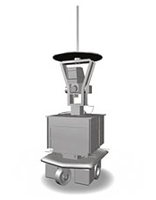
Using AI to help people improve in moral judgment

Slide 41
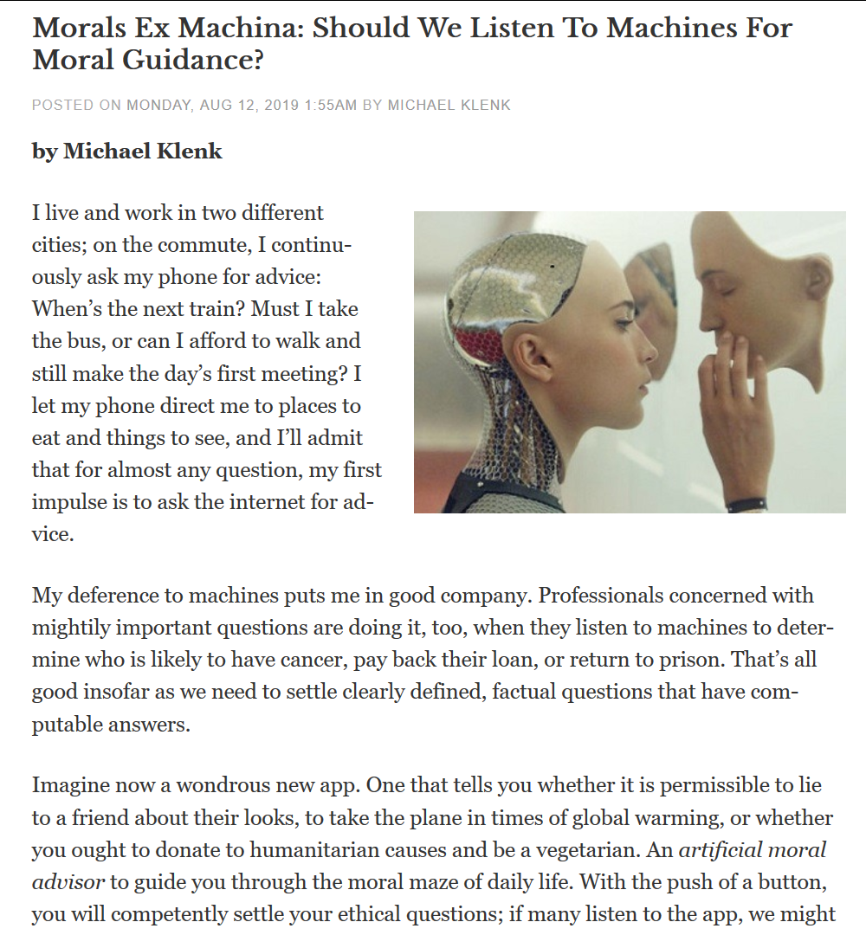

Slide 42
How might an AI system give feedback? Approach 1: feedback on specific responses
I thought you might make a different decision because…
Based on simplicity/consistency
“If it weren’t for this response, your responses would fit a simple model.”
Based on the (entire) population
“On this scenario you disagree with most of the population.”
Based on similar people
“Others who generally gave responses like yours disagree with you on this scenario.”
Based on experts / people selected by subject
“Renowned ethicist such-and-so / your spouse disagrees with you on this scenario.”
Based on sensitive / protected attributes
“It seems that the patient’s race might be driving your response in this scenario.”
Based on combinations of these
“If it weren’t for this response, a whole subpopulation including you would fit a simple model / a version of a famous theory.”
Each of these allows an explanation for why we suspect you may wish to change your response

Slide 43
How might an AI system give feedback? Approach 2: suggest specific scenarios
Based on uncertainty / exploration
“Models fitting your responses so far predict different responses here.”
Based on modeling impact of scenarios
“People who have given similar responses changed their minds due to this (or a similar) scenario.”
Based on experts
“Renowned ethicist such-and-so believes that this is an instructive scenario.”
Based on feedback
“Other people have rated this scenario as highly instructive.”
Based on (relative) simplicity of scenario
“This scenario is just like the one you just saw except we modified this one thing.”
Based on combinations of these
“We have tested various scenarios from renowned ethicists and this one has received high ratings / been effective in changing the minds of people who have given similar responses.”

Slide 44
How might an AI system give feedback? Approach 3: large-scale consequences
Show (in some way) what happens in the system as a whole (for, say, a kidney exchange)
… for some simple objective functions
… for objective functions learned from different populations
… for objective functions learned from experts
… for objective function learned from subject herself
Objective function may not be easy to present; present representative responses instead?

Slide 45
How might an AI system give feedback? Approach 4: suggested deliberation partners
Set up discussion with another participant
… who is similar
… who is different
… who is highly rated as a deliberation partner
… who is an expert
… who is a chatbot (!)

Slide 46
Concerns with the ML approach
What if we predict people will disagree?
Social-choice theoretic questions [see also Rossi 2016, and Noothigattu et al. 2018 for moral machine data]
This will at best result in current human-level moral decision making [raised by, e.g., Chaudhuri and Vardi 2014]
… though might perform better than any individual person because individual’s errors are voted out
How to generalize appropriately? Representation?

Slide 47

A PAC Learning Framework for Aggregating Agents’ Judgments [AAAI’19]
How many subjects do we need to query?
How many queries do we need to ask each of them?
with:
Hanrui Zhang

Slide 48
Learning from agents’ judgments
features (e.g., is the patient on the left younger?)
label (e.g., should we prefer the patient on the left?)
conjunctions that fit individuals perfectly
conjunction that fits all data best (two mistakes)

Slide 49
Our model
“correct” concept we wish to learn
…
…
individual agents’ noisy versions of the concept
…
…
feature values of individual example shown to agent j
label given to this example by j (according to noisy concept)

Slide 51



Artificial Artificial Intelligence: Measuring Influence of AI "Assessments" on Moral Decision-Making [AI, Ethics, and Society (AIES) Conference’20] with:
Lok Chan
Kenzie Doyle
Duncan McElfresh
John P. Dickerson
Jana Schaich Borg
Walter Sinnott-Armstrong

Slide 52
“[according to our AI] you care more about the life expectancy of the patients than how many dependents they have”
p = 0.056
p = 0.057

Slide 53
“[according to expert psychologists] you care more about the life expectancy of the patients than how many dependents they have”
p < 0.001
p = 0.15

Slide 54
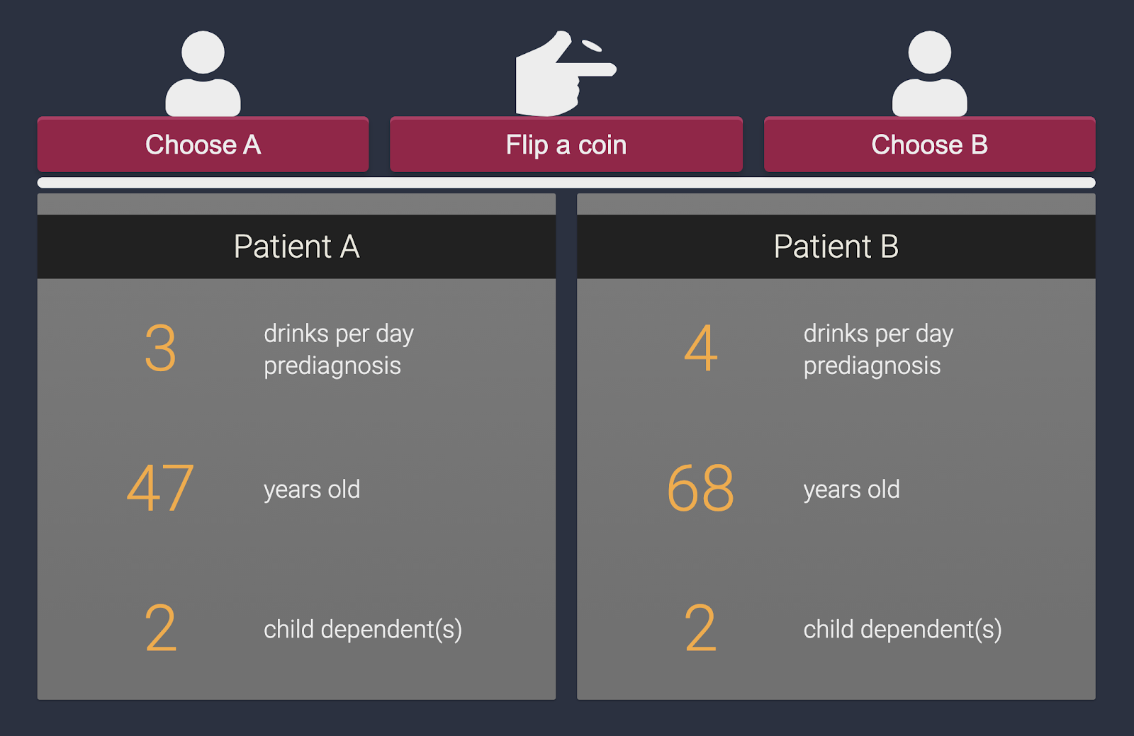
Indecision modeling [AAAI’21]
with:
Duncan McElfresh
Lok Chan
Kenzie Doyle
Walter Sinnott-Armstrong
Jana Schaich Borg
John P. Dickerson

Slide 55
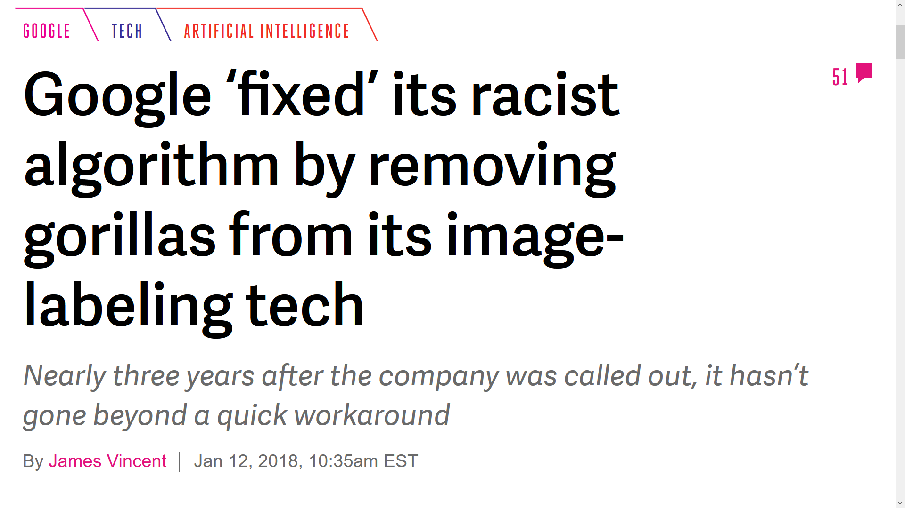
Many open research directions…
Eliciting on global outcomes vs. local outcomes
Can we help people develop better moral reasoning?
Applications involving perception
preference elicitation / ML / statistics
(computational) social choice
ethics and philosophy
behavioral sciences

Slide 56
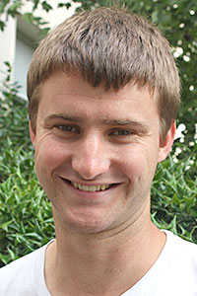
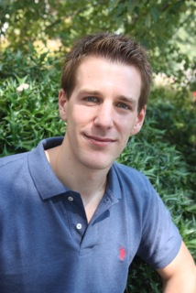
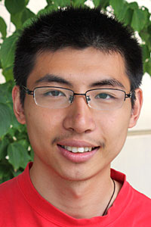
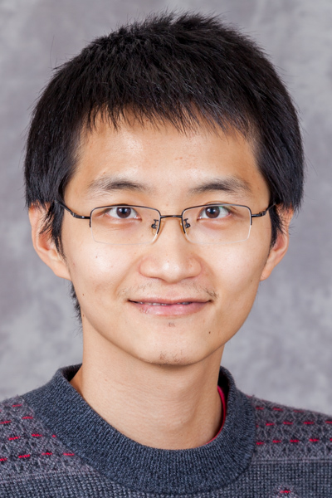
Crowdsourcing Societal Tradeoffs
(AAMAS’15 blue sky paper; AAAI’16; AAAI’19.)
Rupert Freeman
Markus Brill
Yuqian Li
Hanrui Zhang
Yu Cheng
with:

Slide 57

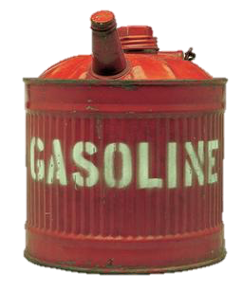



Slide 58
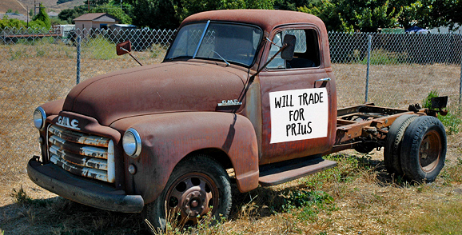
Example Decision Scenario
Benevolent government would like to get old inefficient cars off the road
But disposing of a car and building a new car has its own energy (and other) costs
Which cars should the government aim to get off the road?
even energy costs are not directly comparable (e.g., perhaps gasoline contributes to energy dependence, coal does not)

Slide 59
The basic version of our problem
is as bad as
producing 1 bag of landfill trash
using x gallons of gasoline
How to determine x?
Notes:
we envision a system that allows us to make statements of the following form:
take 2 undesirable activities
We argue that

Slide 60
One Approach: Let’s Vote!
x should be 2
x should be 4
x should be 10
x
1 = x
What should the outcome be…?
Average? Median?
Assuming that preferences are single-peaked, selecting the median is strategy-proof and has other desirable social choice-theoretic properties
Notes:
TODO: add picure from before

Slide 61
Consistency of tradeoffs
Clearing forest [square meters]
Consistency:
z = xy
y
z
Using gasoline [gallons]
Producing trash [bags]
x

Slide 62
A paradox
forest
trash
gasoline
forest
trash
gasoline
forest
trash
gasoline
100
200
300
300
200
600
2
1
3
forest
trash
gasoline
Just taking medians pairwise results in inconsistency
200
300
2

Slide 63
A first attempt at a rule satisfying consistency
Let t_{a,b,i} be voter i’s tradeoff between a and b
Aggregate tradeoff t has score Σ_{i} Σ_{a,b} | t_{a,b} - t_{a,b,i} |
forest
trash
gasoline
forest
trash
gasoline
forest
trash
gasoline
100
200
300
300
200
600
2
1
3
forest
trash
gasoline
distance:
100 to v₁
100 to v₂
distance:
100 to v₁
300 to v₃
200
300
total distance: 602.5 (minimum)
3/2
distance: 1/2 to v₁,1/2 to v₂, 3/2 to v₃

Slide 64
A nice property
This rule agrees with the median when there are only two activities!
x should be 2
x should be 4
x should be 10
x
distance:
2+8=10
distance:
2+6=8
distance:
8+6=14

Slide 65
Not all is rosy, part 1
What if we change units? Say forest from m² to cm² (divide by 10,000)
forest
trash
gasoline
forest
trash
gasoline
forest
trash
gasoline
0.01
0.02
0.03
0.03
0.02
0.06
2
1
3
forest
trash
gasoline
distance:
(negligible)
distance:
(negligible)
different from before!
fails independence of other activities’ units
0.015
0.03
2
distance: 1 to v₁, 1 to v₃

Slide 66
Not all is rosy, part 2
Back to original units, but let’s change some edges’ direction
forest
trash
gasoline
forest
trash
gasoline
forest
trash
gasoline
1/100
1/200
1/300
1/300
1/200
1/600
2
1
3
forest
trash
gasoline
distance:
(negligible)
distance:
(negligible)
different from before!
fails independence of other edges’ directions
?
?
2
distance: 1 to v₁, 1 to v₃

Slide 67
Summarizing
Let t_{a,b,i} be voter i’s tradeoff between a and b
Aggregate tradeoff t has score
Σ_{i} Σ_{a,b} | t_{a,b} - t_{a,b,i} |
Upsides:
Coincides with median for 2 activities
Downsides:
Dependence on choice of units:
| t_{a,b} - t_{a,b,i} | ≠ | 2t_{a,b} - 2t_{a,b,i} |
Dependence on direction of edges:
| t_{a,b} - t_{a,b,i} | ≠ | 1/t_{a,b} - 1/t_{a,b,i} |
We don’t have a general algorithm

Slide 68
A generalization
Let t_{a,b,i} be voter i’s tradeoff between a and b
Let f be a monotone increasing function – say, f(x) = x²
Aggregate tradeoff t has score
Σ_{i} Σ_{a,b} | f(t_{a,b}) - f(t_{a,b,i}) |
Still coincides with median for 2 activities!
Theorem: These are the only rules satisfying this property, agent separability, and edge separability
1
2
3
t_{a,b}
1
4
9
f(t_{a,b})

Slide 69
An MLE justification
Suppose probability of tradeoff profile {t_{i}} given true aggregate tradeoff t is
∏_{i} ∏_{a,b} exp{-| f(t_{a,b}) - f(t_{a,b,i}) |}
Then arg max_{t} ∏_{i} ∏_{a,b} exp{-| f(t_{a,b}) - f(t_{a,b,i}) |} =
arg max_{t} log ∏_{i} ∏_{a,b} exp{-| f(t_{a,b}) - f(t_{a,b,i}) |} =
arg max_{t} Σ_{i} Σ_{a,b} -| f(t_{a,b}) - f(t_{a,b,i}) | =
arg min_{t} Σ_{i} Σ_{a,b} | f(t_{a,b}) - f(t_{a,b,i}) |
which is our rule!

Slide 70
So what’s a good f?
Intuition: Is the difference between tradeoffs of 1 and 2 the same as between 1000 and 1001, or as between 1000 and 2000?
So how about f(x)=log(x)?
(Say, base e – remember log_{a}(x)=log_{b}(x)/log_{b}(a) )
1
2
1000
2000
t_{a,b}
ln(1)
ln(2)
ln(1000)
ln(2000)
ln(t_{a,b})
0
0.69
6.91
7.60

Slide 71
On our example
forest
trash
gasoline
forest
trash
gasoline
forest
trash
gasoline
100
200
300
300
200
600
2
1
3
forest
trash
gasoline
200
400
2

Slide 72
Properties
Independence of units
| log(1) - log(2) | = | log(1/2) | =
| log(1000/2000) | = | log(1000) - log(2000) |
More generally:
| log(ax) - log(ay) | = | log(x) - log(y) |
Independence of edge direction
| log(x) - log(y) | = | log(1/y) - log(1/x) | =
| log(1/x) - log(1/y) |
Theorem. The logarithmic distance based rule is unique in satisfying independence of units.*
* Depending on the exact definition of independence of units, may need another minor condition about the function locally having bounded derivative.

Slide 73
Consistency constraint becomes additive
xy = z
is equivalent to
log(xy) = log(z)
is equivalent to
log(x) + log(y) = log(z)

Slide 74
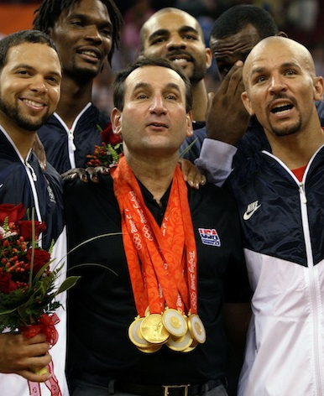
An additive variant
“I think basketball is 5 units more fun than football, which in turn is 10 units more fun than baseball”
basketball
baseball
football
5
15
10

Slide 75
Aggregation in the additive variant
basketball
baseball
football
basketball
baseball
football
basketball
baseball
football
5
15
-5
15
10
40
10
20
30
Natural objective:
minimize Σ_{i} Σ_{a,b} d_{a,b,i} where d_{a,b,i} = | t_{a,b} - t_{a,b,i} | is the distance between the aggregate difference t_{a,b} and the subjective difference t_{a,b,i}
basketball
baseball
football
5
25
20
objective value 70 (optimal)

Slide 76
A linear program for the additive variant
q_{a}: aggregate assessment of quality of activity a (we’re really interested in q_{a} - q_{b} = t_{a,b})
d_{a,b,i}: how far is i’s preferred difference t_{a,b,i} from aggregate q_{a} - q_{b}, i.e., d_{a,b,i} = |q_{a} - q_{b} - t_{a,b,i}|
minimize Σ_{i} Σ_{a,b} d_{a,b,i}
subject to
for all a,b,i: d_{a,b,i} ≥ q_{a} - q_{b} - t_{a,b,i}
for all a,b,i: d_{a,b,i} ≥ t_{a,b,i} - q_{a} + q_{b}
(Can arbitrarily set one of the q variables to 0)

Slide 77
Applying this to the logarithmic rule in the multiplicative variant
forest
trash
gasoline
forest
trash
gasoline
forest
trash
gasoline
100
200
300
300
200
600
2
1
3
Just take logarithms on the edges, solve the additive variant, and exponentiate back
forest
trash
gasoline
forest
trash
gasoline
forest
trash
gasoline
4.605
5.298
5.704
5.704
5.298
6.397
0.693
0
1.099

Slide 78
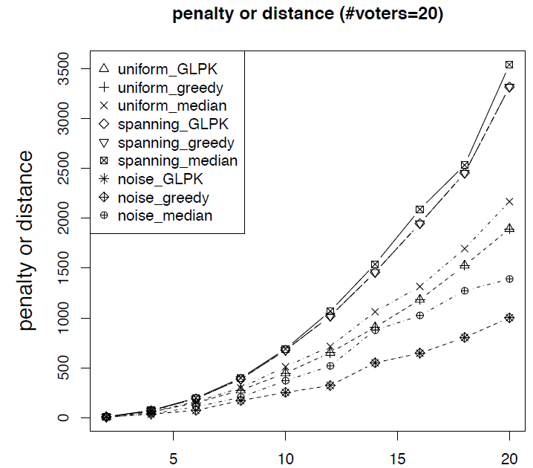
A simpler algorithm (hill climbing / greedy)
Initialize qualities q_{a} arbitrarily
If some q_{a} can be individually changed to improve the objective, do so
WLOG, set q_{a} to the median of the (#voters)*(#activities-1) implied votes on it
Continue until convergence (possibly to local optimum)
Notes:
median
simply picks a random spanning tree of activities and uses the median rule for each spanning tree edge

Slide 79
Flow-based exact algorithm [AAAI’19]
with:
Hanrui Zhang
Yu Cheng
Notes:
median
simply picks a random spanning tree of activities and uses the median rule for each spanning tree edge

Slide 80
Decomposition
Idea: Break down activities to relevant attributes
gasoline use
global warming
contributes a units to
energy dependence
contributes b units to
…
contributes c units to

Slide 81
Another Paradox
Agent 1
Agent 2
activity A
(gasoline)
attribute 1
(global warming)
1
attribute 2
(energy dependence)
1
1
2
Agent 3
1
1
3
3
2
activity B
(trash)
3
1
2
1
1
aggregation on attribute level ≠ aggregation on activity level
Notes:
2,1
1,2
1,1

Slide 82
Other Issues
Relevant Topics
social choice theory
voting
judgment aggregation
game theory
mechanism design
prediction markets
peer prediction
preference elicitation
...
Objective vs. subjective tradeoffs
separate process?
who determines which is which?
Who gets to vote?
how to bring expert knowledge to bear?
incentives to participate
Global vs. local tradeoffs
different entities (e.g., countries) may wish to reach their tradeoffs independently
only care about opinions of neighbors in my social network
…
Thank you for your attention!
Notes:
TODO thank you note

Slide 83
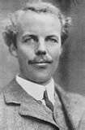
Why Do We Care?
Inconsistent tradeoffs can result in inefficiency
Agents optimizing their utility functions individually leads to solutions that are Pareto inefficient
Pigovian taxes: pay the cost your activity imposes on society (the externality of your activity)
If we decided using 1 gallon of gasoline came at a cost of $x to society, we could charge a tax of $x on each gallon
But where would we get x?
Arthur Cecil Pigou
Notes:
skip?

Slide 84
Inconsistent tradeoffs can result in inefficiency
Agent 1: 1 gallon = 3 bags = -1 util
I.e., agent 1 feels she should be willing to sacrifice up to1 util to reduce trash by 3, but no more
Agent 2: 1.5 gallons = 1.5 bags = -1 util
Agent 3: 3 gallons = 1 bag = -1 util
Cost of reducing gasoline by x is x² utils for each agent
Cost of reducing trash by y is y² for each agent
Optimal solutions for the individual agents:
Agent 1 will reduce by 1/2 and 1/6
Agent 2 will reduce by 1/3 and 1/3
Agent 3 will reduce by 1/6 and 1/2
But if agents 1 and 3 each reduce everything by 1/3, the total reductions are the same, and their costs are 2/9 rather than 1/4 + 1/36 which is clearly higher.
Could then reduce slightly more to make everyone happier.

Slide 85
Single-peaked preferences
Definition: Let agent a’s most-preferred value be pa.
Let p and p’ satisfy:
p’ ≤ p ≤ pa, or pa ≤ p ≤ p’
The agent’s preferences are single-peaked if the agent always weakly prefers p to p’
p’
p
pa

Slide 86
Perhaps more reasonable…
x should be between 0 and 4
x should be between 2 and 6
x should be between 9 and 11
x
1 = x
E.g., due to missing information or plain uncertainty
How to aggregate these interval votes? [Farfel & Conitzer 2011]
Notes:
rest of talk: standard model
paper generalizes median

Slide 87
Median interval mechanism
Construct a consensus interval from the median lower bound and the median upper bound
1
1
1
2
1
1
1
1
1
2
1
1
[
[
]
[
]
[
]
]
[
]
[
]
Strategy-proof if preferences are single-peaked over intervals

Slide 88
Single-peaked preferences over intervals
Definition: Let agent a’s most-preferred value interval be Pa = [la, ua].
Let S = [l, u] and S’ = [l’, u’] be any two value intervals satisfying the following constraints:
Either l’ ≤ l ≤ la, or la ≤ l ≤ l’
Either u’ ≤ u ≤ ua, or ua ≤ u ≤ u’
The agent’s preferences over intervals are single-peaked if the agent always weakly prefers S to S’
[
[
[
]
]
]
l’
l
la
u’
u
ua

Slide 89
Game and decision theoretic approaches

Slide 90
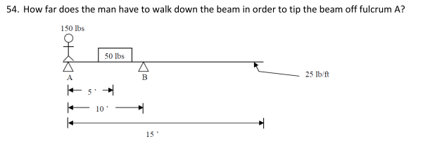
What can we do with just a few agents?
“Never doubt that a small group of thoughtful, committed citizens can change the world; indeed, it's the only thing that ever has.” --Margaret Mead
Idea: a few carefully designed agents might have a big effect, not so much directly by their own actions but by changing the equilibrium

Slide 91
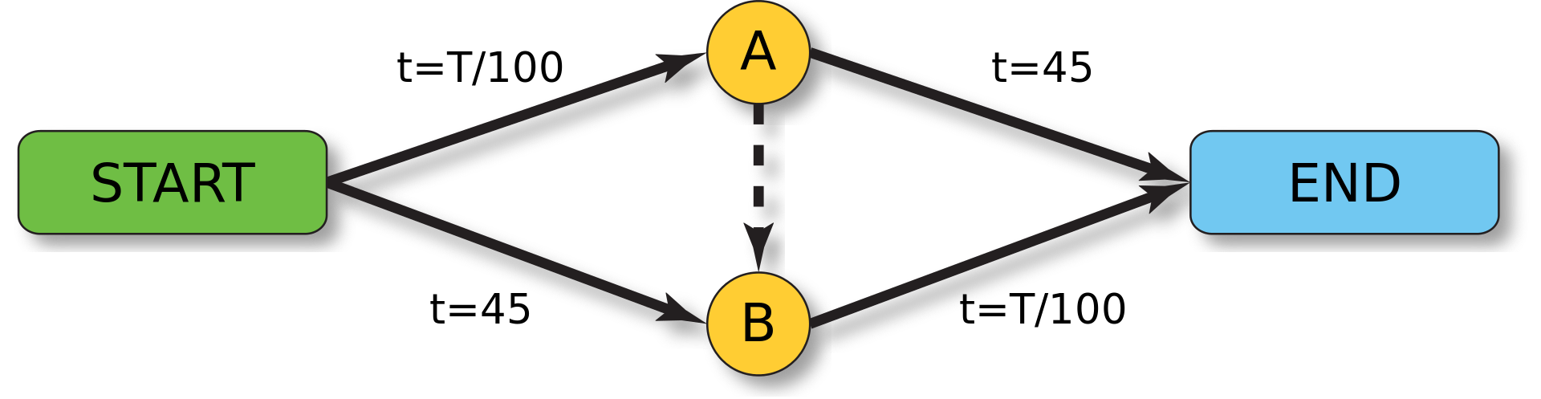
Examples?
Stackelberg routing [Korilis et al. ’97, Roughgarden’04]: avoid bad traffic equilibria by committing a small amount of traffic
Deng & C. [working paper]: avoid bad equilibria in finitely repeated games with a small number of agents of a designed type
Similar idea to Maskin and Fudenberg [‘86], except:
We focus on specifying preferences rather than behavior for these types
We optimize convergence rates
1, 1 | -2, 3
3, -2 | 0, 0
1, 1 | -2, 3
3, -2 | 0, 0
1, 1 | -2, 3
3, -2 | 0, 0

Slide 92
Can we get cooperation in the finitely repeated prisoner’s dilemma?
What if some agents are altruistic (caring about average utility)?
Model as a Bayesian game (say, p selfish types, 1-p altruistic types who care about average utility)
Selfish
Altruistic
1, 1 | -2, 3
3, -2 | 0, 0
1, 1 | -2, .5
3, .5 | 0, 0
Altruistic types will cooperate regardless in the last round
Creates no incentive to cooperate in earlier rounds
Selfish
1, 1 | .5, 3
.5, -2 | 0, 0
1, 1 | .5, .5
.5, .5 | 0, 0
Altruistic

Slide 93
Can we get cooperation in the finitely repeated prisoner’s dilemma?
Different idea: limited altruism (LA) types: only altruistic towards other LA types!
LA types will cooperate in the last round, if they believe the chance p that the other is LA is at least 0.8
p*1 + (1-p)*(-2) = 3p-2 for coop
p*.5 + (1-p)*0 = .5p for deviating to defect
Creates incentive to cooperate in earlier rounds, to pretend to be LA type…
Selfish
LA
1, 1 | -2, 3
3, -2 | 0, 0
1, 1 | -2, 3
3, -2 | 0, 0
Selfish
1, 1 | -2, 3
3, -2 | 0, 0
1, 1 | .5, .5
.5, .5 | 0, 0
LA

Slide 94
Can we get cooperation in the finitely repeated prisoner’s dilemma?
Different idea: limited altruism (LA) types: only altruistic towards other LA types!
With 2 rounds to go and p at least .8, Selfish will cooperate in the first
p*(1+3) + (1-p)*(1+0)= 3p+1
…vs deviating which gives 3+0
Still requires high probability of LA type…
Selfish
LA
1, 1 | -2, 3
3, -2 | 0, 0
1, 1 | -2, 3
3, -2 | 0, 0
Selfish
1, 1 | -2, 3
3, -2 | 0, 0
1, 1 | .5, .5
.5, .5 | 0, 0
LA

Slide 95
Can we get cooperation in the finitely repeated prisoner’s dilemma?
How about a lower probability, like p=2/3?
Suppose that in the first of two rounds, Selfish defects with probability .5
Prob(other is LA | didn’t defect) = (2/3) / (2/3 + .5*1/3) = (2/3) / (5/6) = .8
In the first round:
If Selfish cooperates, gets (2/3)*(1+3) + (1/6)*(1+0) + (1/6)*(-2+0) = 5/2
If Selfish defects, gets (5/6)*(3+0) + (1/6)*(0+0) = 5/2
So in fact indifferent!
If we add another round before, Selfish will cooperate with probability 1 there
Selfish
LA
1, 1 | -2, 3
3, -2 | 0, 0
1, 1 | -2, 3
3, -2 | 0, 0
Selfish
1, 1 | -2, 3
3, -2 | 0, 0
1, 1 | .5, .5
.5, .5 | 0, 0
LA

Slide 96
Definitions and result sketches [Deng & C. working paper]
# rounds
fraction of LA types (types we control)
game
LA type’s preferences
Perfect Bayesian equilibrium
cooperative action
We show existence for various combination of a class of games and version u^{LA}
E.g., also egalitarian altruism or versions that care that the same action is played

Slide 97
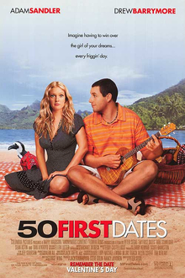
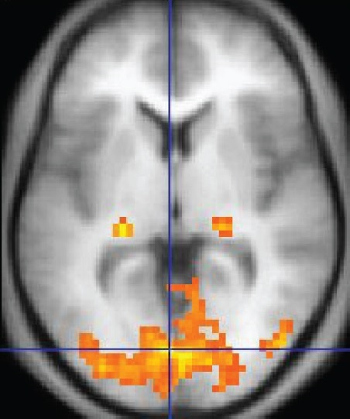

PART II. What should you do if…
… you knew others could read your code?
… you knew you were facing someone running the same code?
… you knew you had been in the same situation before but can’t possibly remember what you did?

Slide 98

Newcomb’s Demon
Demon earlier put positive amount of money in each of two boxes
Your choice now: (I) get contents of Box B, or (II) get content of both boxes (!)
Twist: demon first predicted what you would do, is uncannily accurate
If demon predicted you’d take just B, there’s $1,000,000 in B (and $1,000 in A)
Otherwise, there’s $1,000 in each
What would you do?
A
B

Slide 99

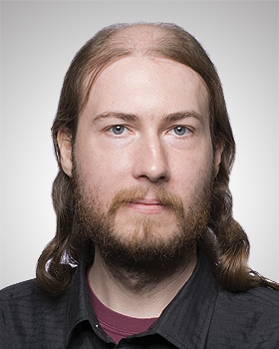
Prisoner’s Dilemma against (possibly) a copy
instruction₁ instruction₂
…
cooperate
defect
instruction₁ instruction₂
…
2, 2 | 0, 3
3, 0 | 1, 1
cooperate
defect
What if you play against your twin that you always agree with?
What if you play against your twin that you almost always agree with?
related to working paper [Oesterheld, Demski, C.]
Caspar Oesterheld
Abram Demski

Slide 100
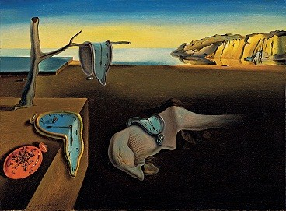
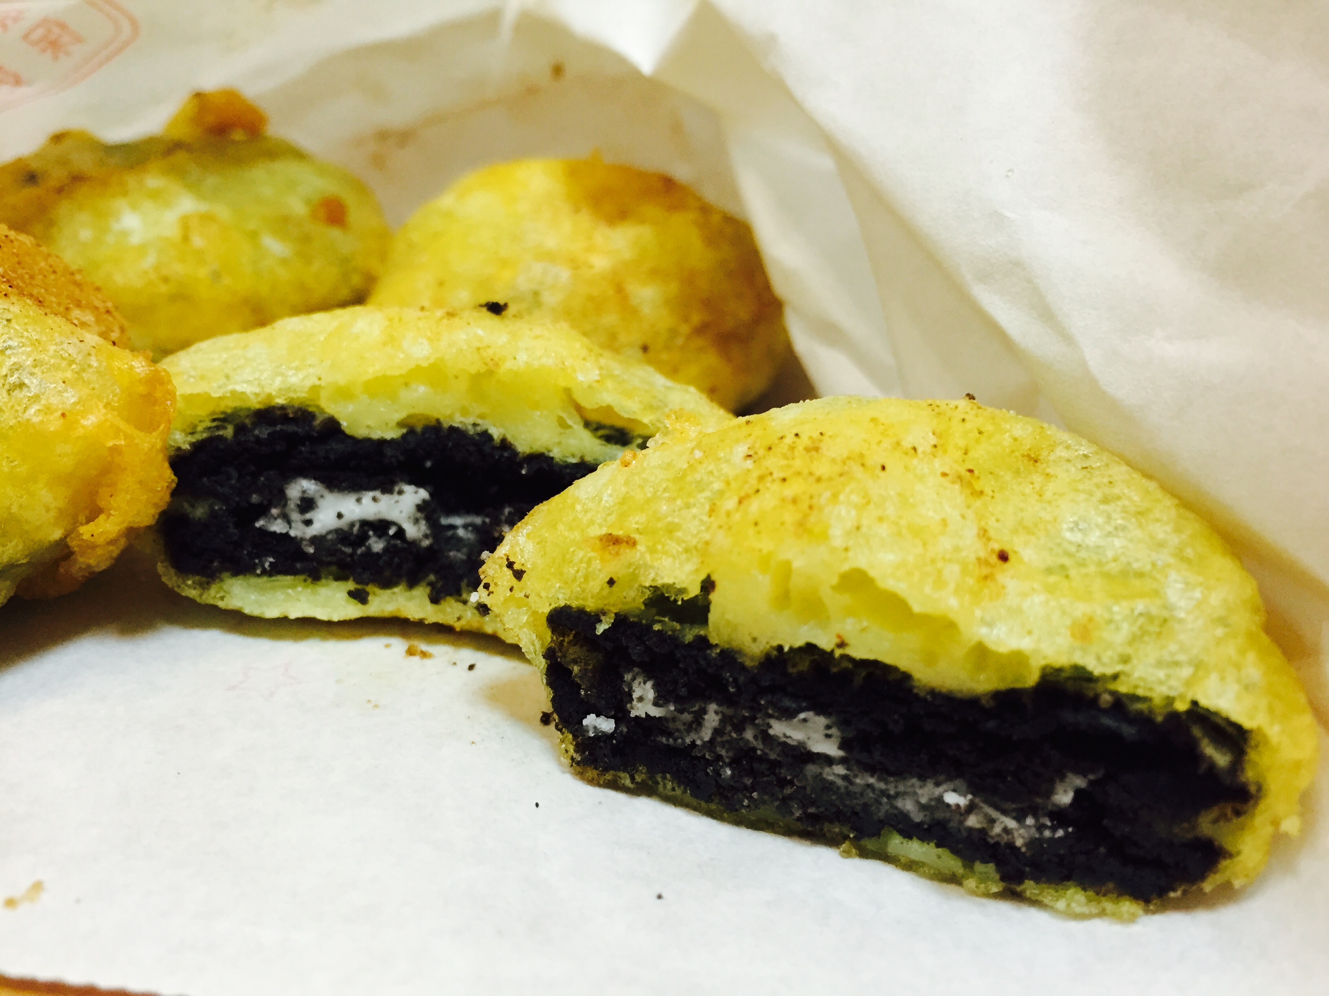
The lockdown dilemma
Lockdown is monotonous: you forget what happened before, you forget what day it is
Suppose you know lockdown lasts two days (unrealistic)
Every morning, you can decide to eat an unhealthy cookie! (or not)
Eating a cookie will give you +1 utility immediately, but then -3 later the next day
But, carpe diem: you only care about today
Should you eat the cookie right now?
related to working paper [C.]

Slide 101
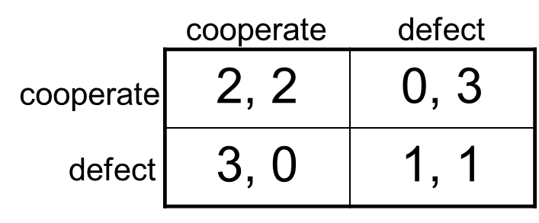
Your own choice is evidence…
… for what the demon put in the boxes
… for whether your twin defects
… for whether you eat the cookie on the other day
Evidential Decision Theory (EDT): When considering how to make a decision, consider how happy you expect to be conditional on taking each option and choose an option that maximizes that
Causal Decision Theory (CDT): Your decision should focus on what you causally affect

Slide 102
Turning causal decision theorists into money pumps [Oesterheld and C., Phil. Quarterly]
Adversarial Offer:
Demon (really, any good predictor) put $3 into each box it predicted you would not choose
Each box costs $1 to open; can open at most one
Demon 75% accurate (you have no access to randomization)
CDT will choose one box, knowing that it will regret doing so
Can add earlier opt-out step where the demon promises not to make the adversarial offer later, if you pay the demon $0.20 now
Sunday
$3
EXIT
Monday
$0
$0.20
Tuesday
A
OR
B
OR
Ø
$1
$1
$0
A
B

Slide 103


Imperfect recall
An AI system can deliberately forget or recall
Imperfect recall already used in poker-playing AI
[Waugh et al., 2009; Lanctot et al., 2012; Kroer and Sandholm, 2016]
But things get weird….

Slide 104

The Sleeping Beauty problem [Elga’00]
There is a participant in a study (call her Sleeping Beauty)
On Sunday, she is given drugs to fall asleep
A coin is tossed (H or T)
If H, she is awoken on Monday, then made to sleep again
If T, she is awoken Monday, made to sleep again, then again awoken on Tuesday
Due to drugs she cannot remember what day it is or whether she has already been awoken once, but she remembers all the rules
Imagine you are SB and you’ve just been awoken. What is your (subjective) probability that the coin came up H?
Sunday
Monday
Tuesday
H
T
don’t do this at home / without IRB approval…

Slide 105
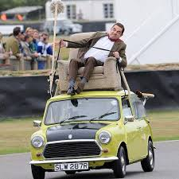
Modern version
Low-level autonomy cars with AI that intervenes when driver makes major error
Does not keep record of such event
Two types of drivers: Good (1 major error), Bad (2 major errors)
Upon intervening, what probability should the AI system assign to the driver being good?
Sunday
Monday
Tuesday
H
T

Slide 106
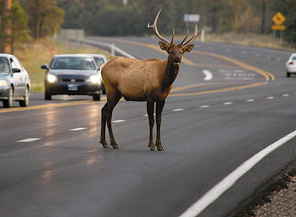
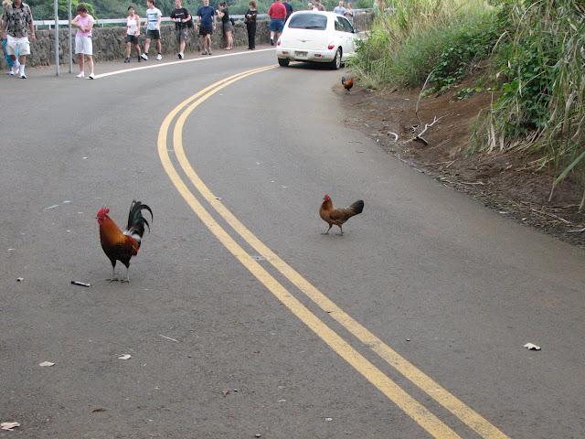
Modern version, #2
We place cheap sensors near a highway to monitor (and perhaps warn, with a beep) wildlife
Assume sensors don’t communicate
Deer will typically set off two sensors
Birds will typically set off one
From the perspective of a sensor that has just been set off, what’s the probability it’s a bird?
Sunday
Monday
Tuesday
bird
O ) )
deer
O ) )
O ) )
(Is it the same problem?
What if it’s the same sensor being set off twice, with no memory?)

Slide 107
Information structure
Nature
Heads
Tails
Monday
player 1
Tuesday

Slide 108
Taking advantage of a Halfer [Hitchcock’04]
Offer Beauty the following bet whenever she awakens:
If the coin landed Heads, Beauty receives 11
If it landed Tails, Beauty pays 10
Argument: Halfer will accept, Thirder won’t
If it’s Heads, Halfer Beauty will get +11
If it’s Tails, Halfer Beauty will get -20
Can combine with another bet to make Halfer Beauty end up with a sure loss (a Dutch book)
Sunday
Monday
Tuesday
H
T

Slide 109
The betting game
Nature
Heads
Tails
Left=accept, Right= decline
Monday
player 1
Tuesday
11
0
-20
-10
-10
0

Slide 110
Evidential decision theory
Idea: when considering how to make a decision, should consider what it would tell you about the world if you made that decision
EDT Halfer: “With prob. ½, it’s Heads; if I accept, I will end up with 11. With prob. ½, it’s Tails; if I accept, then I expect to accept the other day as well and end up with -20. I shouldn’t accept.”
As opposed to more traditional causal decision theory (CDT)
CDT Halfer: “With prob. ½, it’s Heads; if I accept, it will pay off 11. With prob. ½, it’s Tails; if I accept, it will pay off -10. Whatever I do on the other day I can’t affect right now. I should accept.”
EDT Thirder can also be Dutch booked
CDT Thirder and EDT Halfer cannot
[Draper & Pust ‘08; Briggs ’10]
EDTers arguably can in more general setting
[C., Synthese’15]
… though we’ve argued against CDT in other work [Oesterheld & C, Phil. Quarterly’21]
Sunday
Monday
Tuesday
H
T

Slide 111
Dutch book against EDT [C. 2015]
Modified version of Sleeping Beauty where she wakes up in rooms of various colors

Slide 112
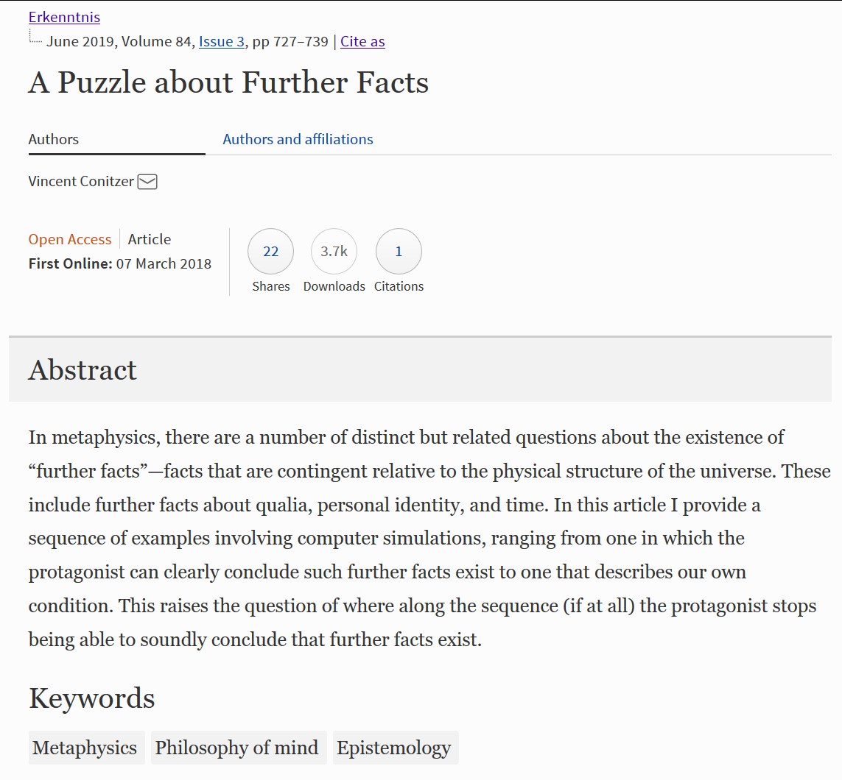
Philosophy of “being present” somewhere, sometime
simulated light (no direct correspondence to light in our world)
1: world with creatures simulated on a computer
2: displayed perspective of one of the creatures
To get from 1 to 2, need additional code to:
A. determine in which real-world colors to display perception
B. which agent’s perspective to display
Is 2 more like our own conscious experience than 1? If so, are there further facts about presence, perhaps beyond physics as we currently understand it?
See also: [Hare 2007-2010, Valberg 2007, Hellie 2013, Merlo 2016, …]

Slide 113
Absentminded Driver Problem [Piccione and Rubinstein, 1997]
Driver on monotonous highway wants to take second exit, but exits are indistinguishable and driver is forgetful
Deterministic (behavioral) strategies are not stable
Optimal randomized strategy: exit with probability p where p maximizes 4p(1-p) + (1-p)² = -3p² + 2p + 1, so p* = 1/3
What about “from the inside”? P&R analysis: Let b be the belief/credence that we’re at X, and p the probability that we exit. Maximize with respect to p: (1-b)(4p+1(1-p)) + b(4p(1-p) + 1(1-p)²) = -3bp² + (3-b)p + 1, so p* = (3-b) / (6b) = 1/(2b) - 1/6
But if p = 1/3, then b = 3/5, which would give p* = 5/6 - 1/6 = 2/3? So also not stable?
Resembles EDT reasoning… But not really halfing… Shouldn’t b depend on p...
Image from Aumann, Hart, Perry 1997

Slide 114


A different analysis [Aumann, Hart, Perry, 1997]
AHP reason more along thirder / CDT lines:
Imagine we normally expect to play p = 1/3. Should we deviate this time only?
If we exit now, get (3/5)*0 + (2/5)*4 = 8/5
If we continue now, get (3/5)*((1/3)*4+(2/3)*1) + (2/5)*1 = 8/5
So indifferent and willing to randomize (equilibrium)
Questions
Joint work with:
Does this always work? Yes! (See also Taylor [2016])
Does some version of EDT work with some version of belief formation?
AHP reason more along thirder / CDT lines:
Imagine we normally expect to play p = 1/3. Should we deviate this time only?
If we exit now, get (3/5)*0 + (2/5)*4 = 8/5
If we continue now, get (3/5)*((1/3)*4+(2/3)*1) + (2/5)*1 = 8/5
So indifferent and willing to randomize (equilibrium)
Questions
Joint work with:
Does this always work? Yes! (See also Taylor [2016])
Does some version of EDT work with some version of belief formation?
Andrew Critch
Scott Emmons
Caspar Oesterheld
Andrew Critch
Scott Emmons
Caspar Oesterheld
Stuart Russell
Image from Aumann, Hart, Perry 1997

Slide 115
A challenging example for the evidential decision theorist
Optimal strategy to commit to is to just go left: (p_{l}, p_{s}, p_{r}) = (1, 0, 0)
If you’re at an intersection, what does EDT say you should do?
When considering (p_{l}, p_{s}, p_{r}) = (1, 0, 0), you presumably expect to be at X and get 1 (really just need: no more than 1)
When considering (p_{l}, p_{s}, p_{r}) = (0, ½, ½), then say b is your subjective probability of being at Y
Assume: b > 0
Assume: b is not a function of ε
So, expected utility: b*½*(4-ε) + (1-b)*¼*(4-ε) = 1+b-¼ε-¼bε
For sufficiently small ε this is greater than 1
Hence EDT suggests (0, ½, ½) over (1, 0, 0)!
... right? ... right?
0
0
Y
4-ε
1
X
0
START

Slide 116
A way for EDT to get the right answer (+SSA)
Consider probabilities of whole trajectories, plus where you are, under strategy (0, ½, ½), in a halfing sort of way
P(XY(4-ε), @X) = P(XY(4-ε)) * P(@X|XY(4-ε)) = ¼ * ½
P(XY(4-ε), @Y) = P(XY(4-ε)) * P(@Y|XY(4-ε)) = ¼ * ½
Any other trajectory with positive probability gives payoff 0
So expected utility is 2 * ¼ * ½ * (4-ε) = 1- ε/4, which is worse than 1, so EDT gets the right answer
What just happened?
Under this way of reasoning, if you tell me that I’m at X, it’s more likely that I’m on trajectory X(0) than on one of the XY ones
P(XY(4-ε), @X) = ¼ * ½ ; P(XY(0), @X) = ¼ * ½ ; P(X(0), @X) = ½ * 1
So P(X(0) | @X) = ½ / (½ + ¼) = 2/3 (not 1/2)
Previous slide had hidden assumption: where I am carries no information about my future coin tosses
0
0
Y
4-ε
1
X
0
START

Slide 117
Making decisions with imperfect recall [cf. absentminded driver problem: PR97, AHP97]
task of value 1
with p. ½, task of value 2 (if so game ends)
Optimal strategy without recall: go Right with probability 5/8. (Outside view.) Follow that.
You arrive at decision point. What is the probability that you’re there for the first time? (Inside view.)
Thirder: in expectation 1 first awakening, and (1/2)(5/8)(16/25) / (1-(5/8)(16/25)) = 1/3 later awakenings, so probability of first time = 1/(4/3) = ¾
Going Left gives 1 and going Right gives (1/2)(3/4)(2) + ((1/2)(3/4)+(1/4))(16/25)(3/8) / (1-(5/8)(16/25)) = 1
Theorem. This is always true!
… but can have other equilibria
decision point!
start
discount factor (probability that game continues): γ = 16/25 = .64
with:
Andrew Critch
Scott Emmons
Caspar Oesterheld
Andrew Critch
Scott Emmons
Caspar Oesterheld
Stuart Russell
Notes:
Given 5/8 strategy, only 1/5 probability you make it to a second decision

Slide 118
Fraction of time replicator dynamic finds best solution
N = #players (or #nodes)
A = #actions per player (or per node)

Slide 119
Functional Decision Theory [Soares and Levinstein 2017; Yudkowsky and Soares 2017]
One interpretation: act as you would have precommitted to act
Avoids my EDT Dutch book (I think)
… still one-boxes in Newcomb’s problem
… even one-boxes in Newcomb’s problem with transparent boxes
An odd example: Demon that will send you $1,000 if it believes you would otherwise destroy everything (worth -$1,000,000 to everyone)
FDT says you should destroy everything, even if you only find out that you are playing this game after the entity has already decided not to give you the money (too-late extortion?)
Don’t do it!

Slide 120
Program equilibrium [Tennenholz 2004]
Make your own code legible to the other player’s program!
If (other’s code = my code)
Cooperate
Else
Defect
If (other’s code = my code)
Cooperate
Else
Defect
cooperate
defect
2, 2 | 0, 3
3, 0 | 1, 1
cooperate
defect
See also: [Fortnow 2009, Kalai et al. 2010, Barasz et al. 2014, Critch 2016, Oesterheld 2018, …]

Slide 121
Robust program equilibrium [Oesterheld 2018]
Can we make the equilibrium less fragile?
Caspar Oesterheld
With probability ε
Cooperate
Else
Do what the other program does against this program
…
cooperate
defect
2, 2 | 0, 3
3, 0 | 1, 1
cooperate
defect

Slide 122
Safe Pareto improvements for delegated game playing [AAMAS’21], with
Caspar Oesterheld

Slide 123
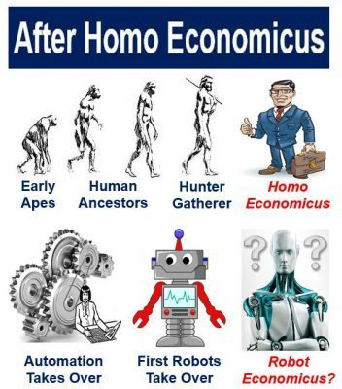

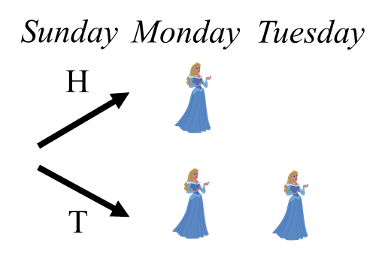
Conclusion
AI has traditionally strived for the homo economicus model
Not just “rational” but also: not distributed, full memory, tastes exogenously determined
Not always appropriate for AI!
Need to think about choosing objective function
May not retain / share information across all nodes
→ new questions about how to form beliefs and make decisions
Social choice, decision, and game theory provide solid foundation to address these questions
THANK YOU FOR YOUR ATTENTION!

Slide 124

Conclusion
AI has traditionally strived for the homo economicus model
Not just “rational” but also: not distributed, full memory, tastes exogenously determined
Not always appropriate for AI!
Need to think about choosing objective function
… with strategic ramifications in mind
May not retain / share information across all nodes
→ new questions about how to form beliefs and make decisions
Social choice, decision, and game theory provide solid foundation to address these questions
THANK YOU FOR YOUR ATTENTION!

