Slide 1
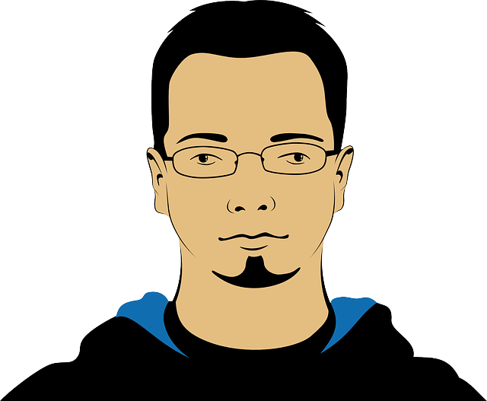
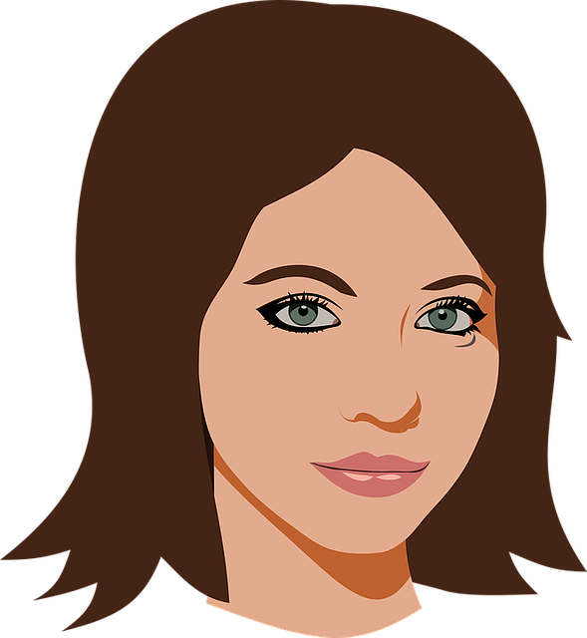
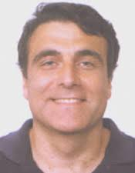
Graphs for Fun and Profit
John Smith
Mary Johnson
Christos Faloutsos
CMU-SCS

Slide 2

Outline
Problem definition - motivation
Main idea
Experiments
Conclusions
<Show the ‘outline’ slide, a few times – this very one should be suitable for most talks>

Slide 3
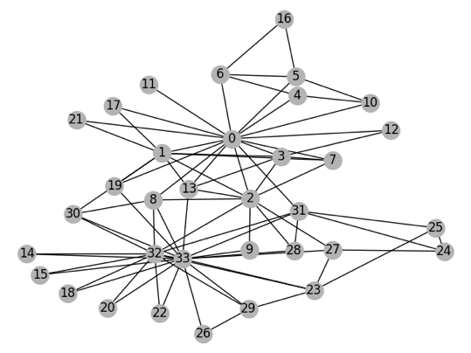
Graphs for fraud detection
<at least one image, on every slide>
Font size >=28 (this one is 32)
Who else is ‘red’? ‘green’?
* Fast
* Accurate

Slide 4
Outline
Problem definition - motivation
Main idea
Experiments
Conclusions

Slide 5
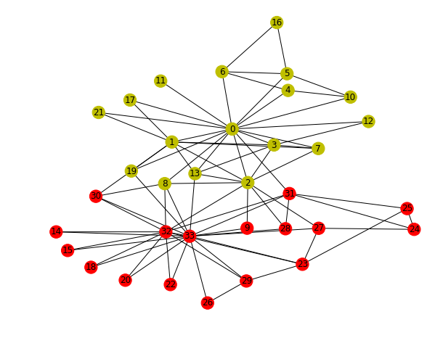
Belief Propagation to the rescue
Explain, with a drawing
Zachary karate club
before
after

Slide 6
Outline
Problem definition - motivation
Main idea
Experiments
Conclusions

Slide 7
Our method wins on speed
✓
Fast
Accurate
3x savings

Slide 8
Our method wins on accuracy
✓
Fast
Accurate
✓
precision
+7pcp
10%
recall

Slide 9

THANK YOU
OurMethod
Fast
Accurate
✓
christos@cs.cmu.edu
✓
3x savings
<Last slide: ‘grand finale’ – your take-home message, pictorially>

