Slide 1
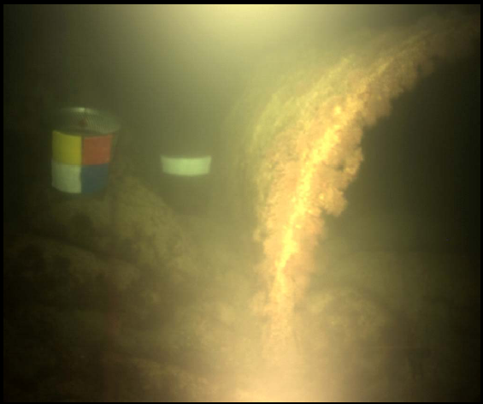
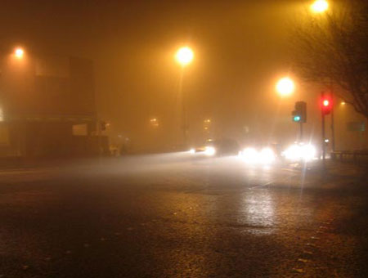
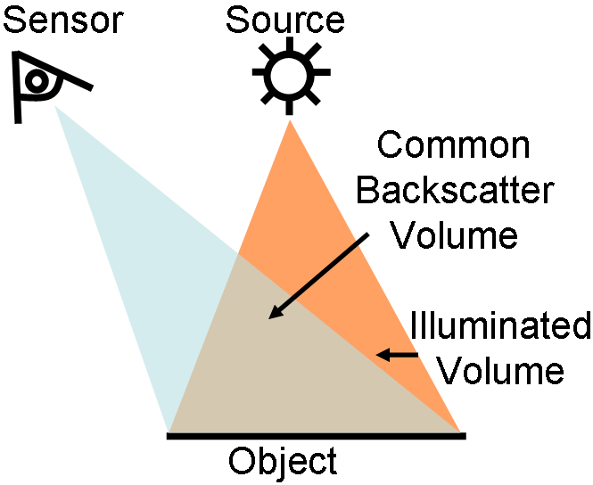
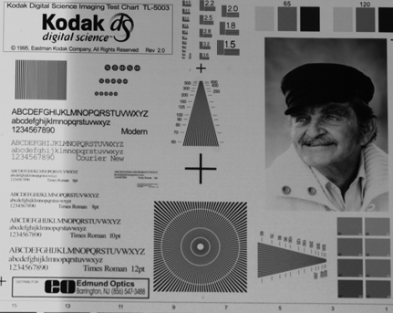
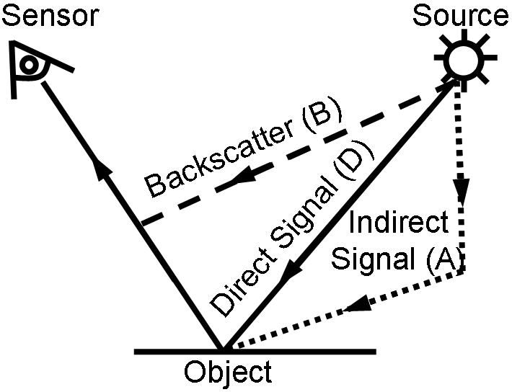
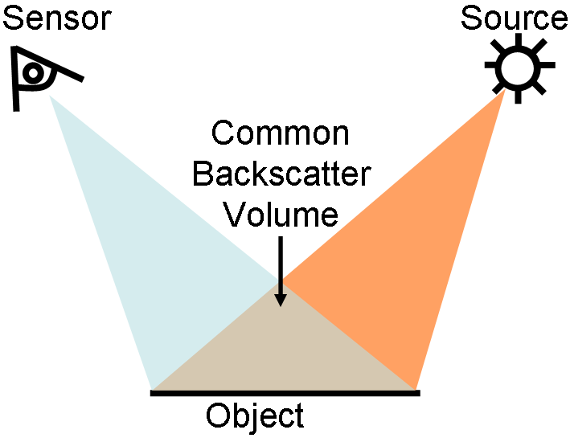
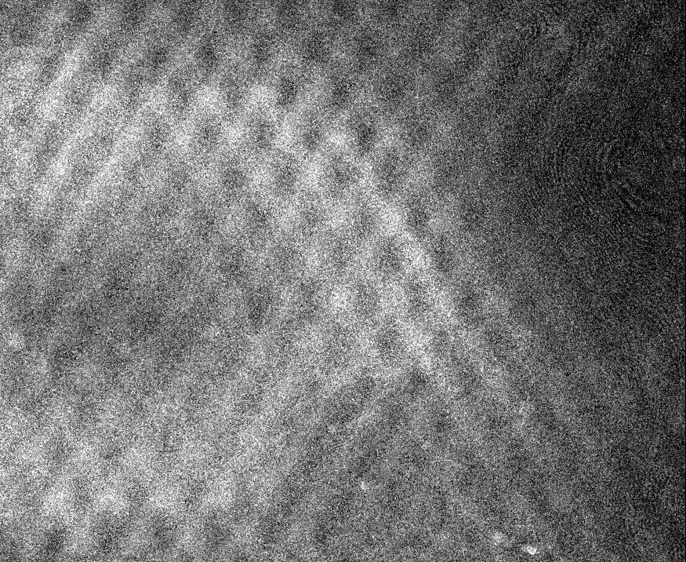
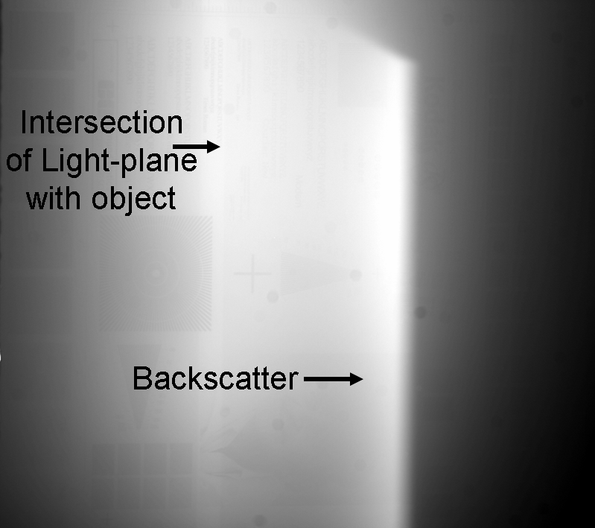
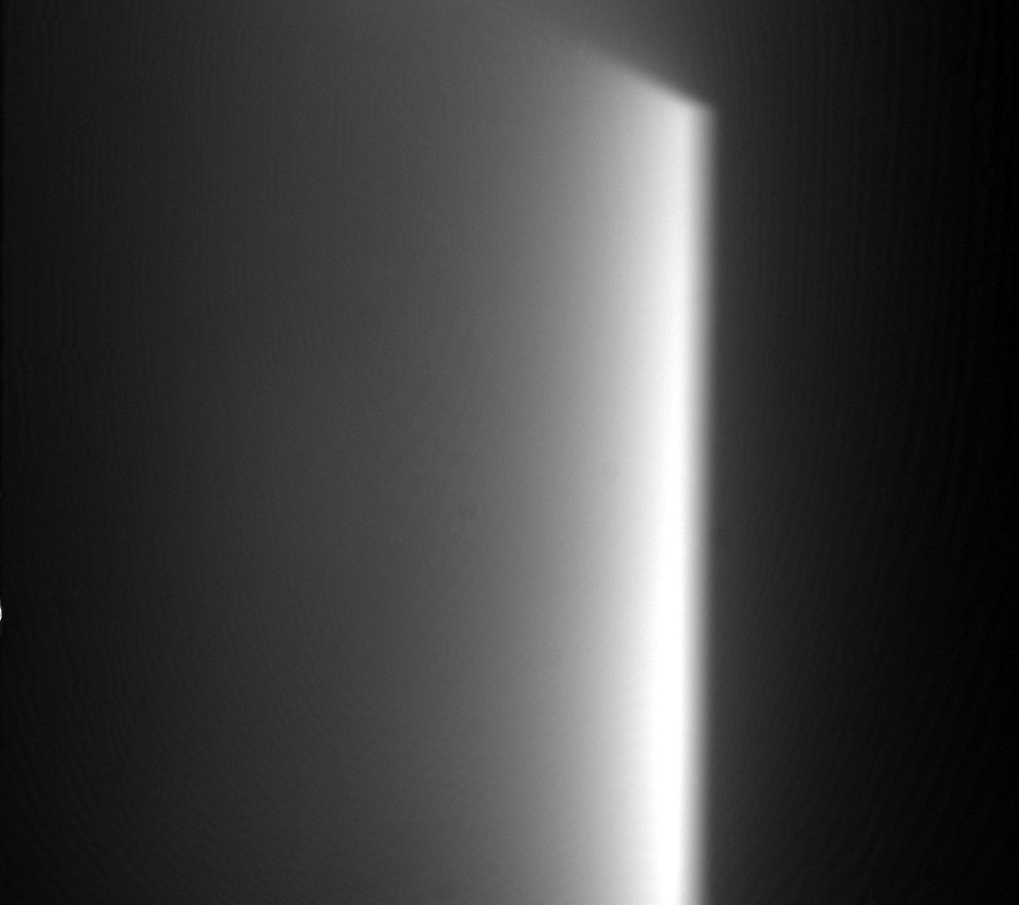
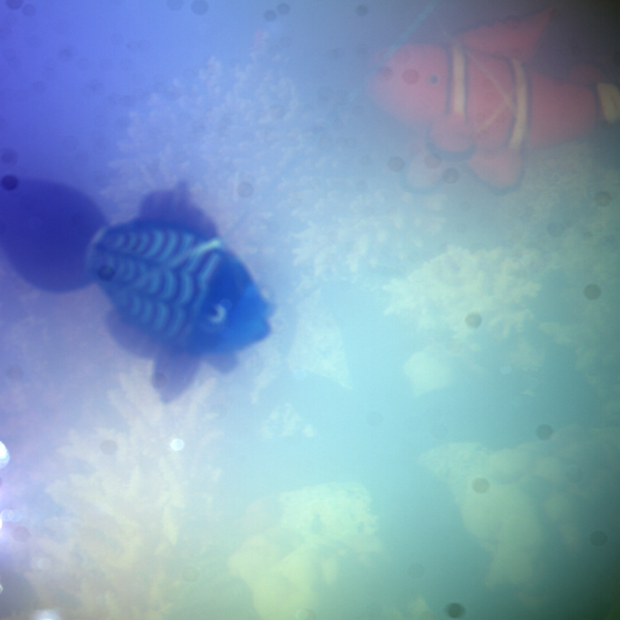
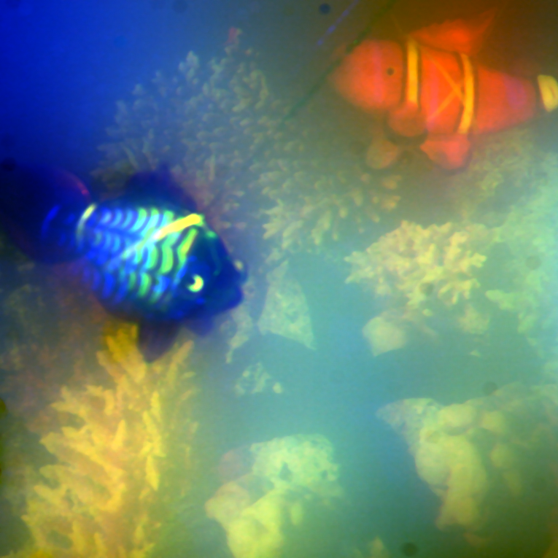
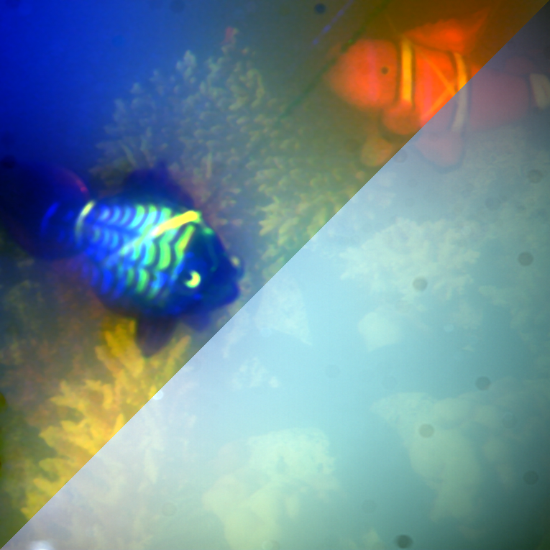
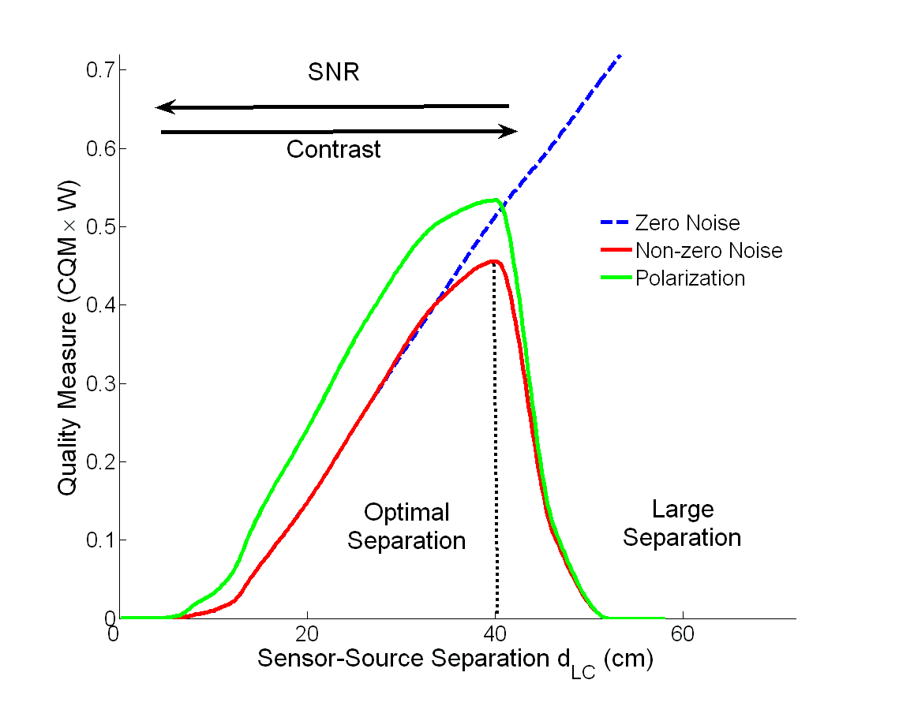
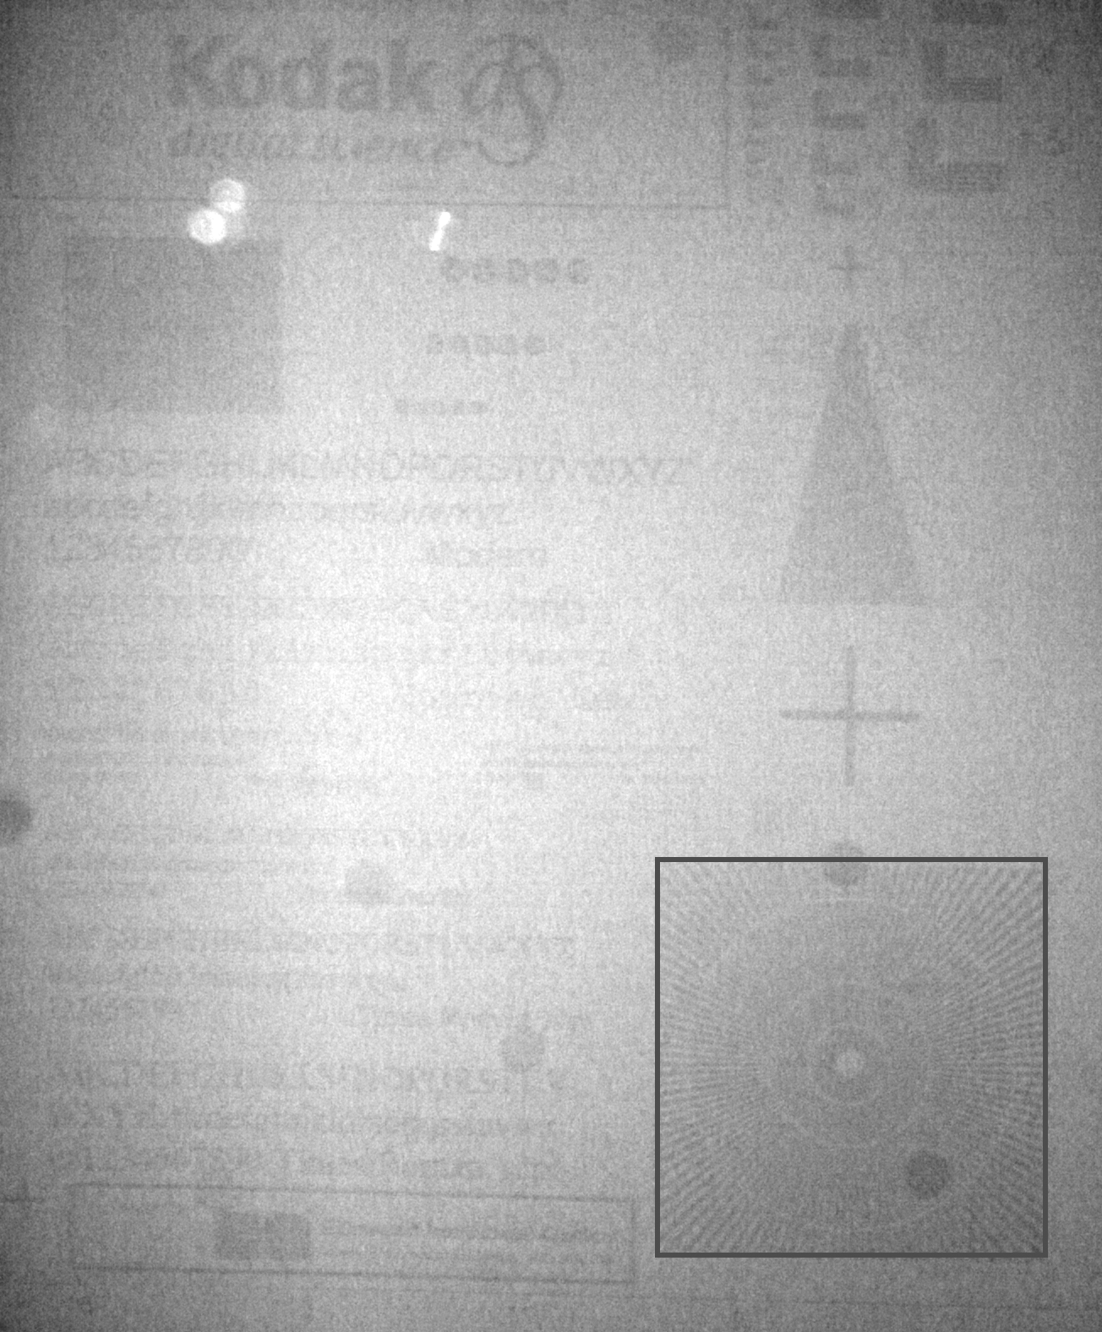
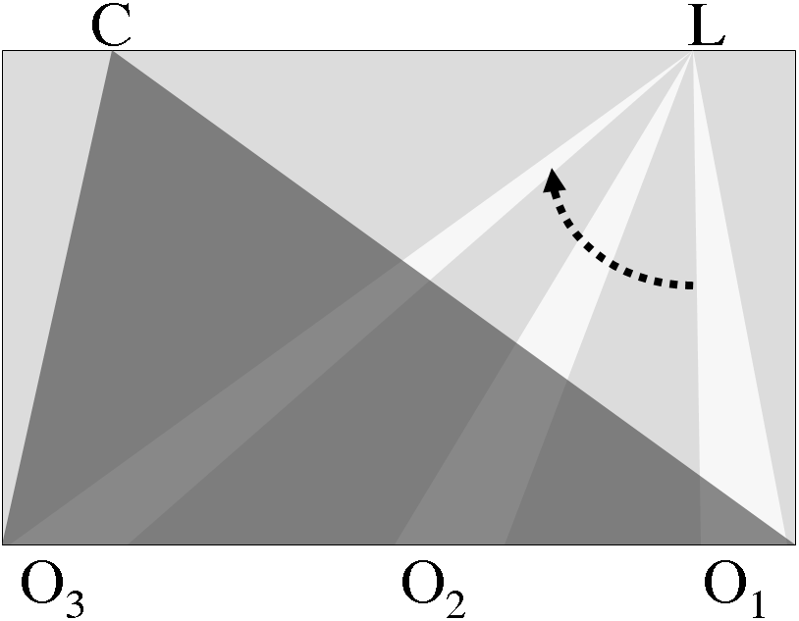
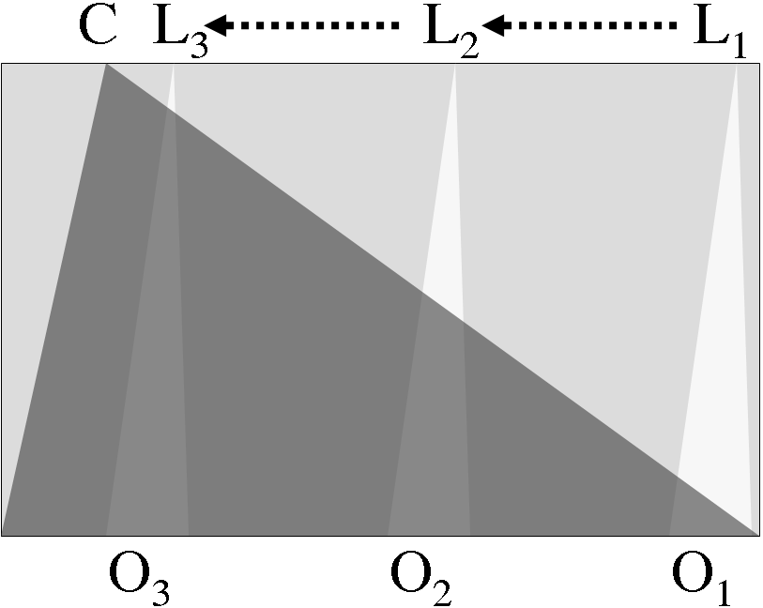
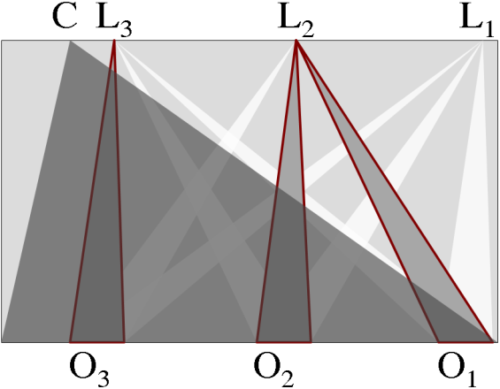
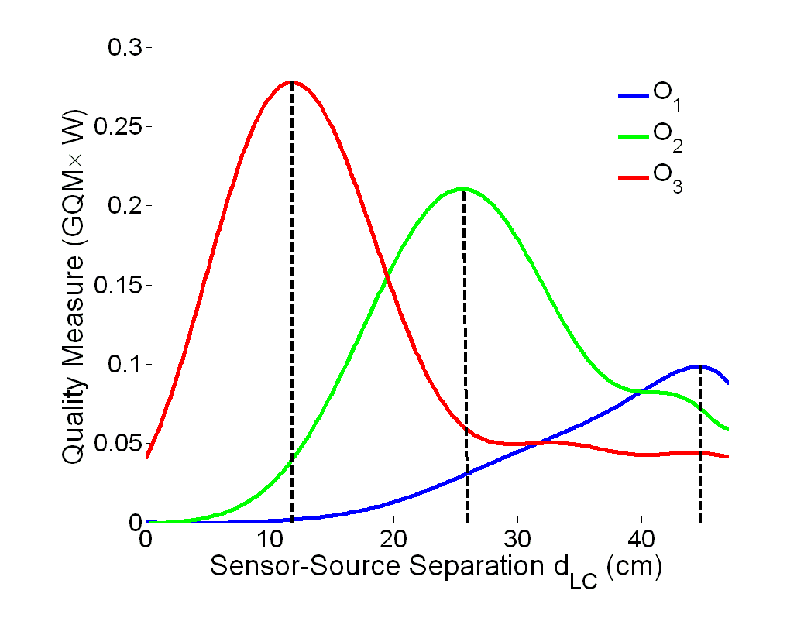
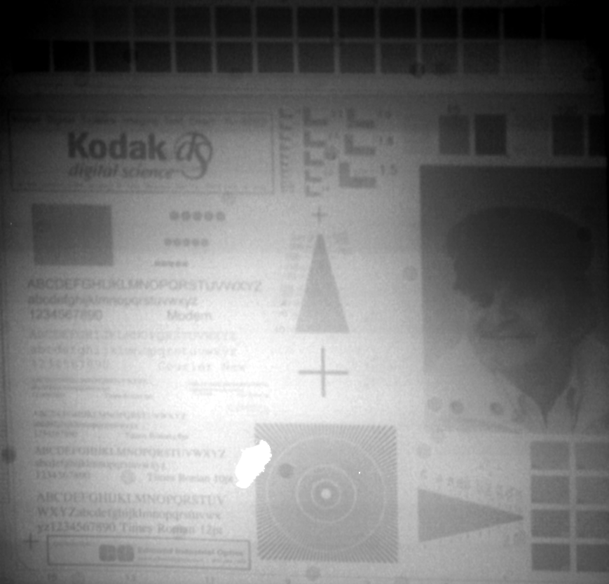
On Controlling Light Transport in Poor Visibility Environments
Mohit Gupta
Srinivasa G. Narasimhan
Yoav Y. Schechner
Light Transport in Scattering Media
How to Illuminate the Scene in Poor Visibility Environments?
1. Flood Lighting
3. Confocal Imaging [Levoy et al]
Backscatter degrades visibility
Treibitz et al, CVPR06
edsphotoblog.com
Object
Floodlit (Low contrast)
Scanning
Coded aperture
Synthetic aperture
2. High-frequency Illumination [Nayar et al]
4. Light Stripe Scanning [Narasimhan et al]
Signal S(x,y)
Backscatter
Direct (High noise)
Global (Low contrast)
Less backscatter
Light striping input
Increased contrast
Improving Image Contrast using Polarization + Light Stripe Scanning
Unpolarized vs. Polarized Light Striping
Increasing image contrast
Increasing image contrast
Strong scattering
Unpolarized light stripe
Polarized light stripe
Difference Removed backscatter
Polarized flood lighting
Unpolarized light striping
Polarized light striping
Flood lighting
Polarized light striping
Comparison
No post-processing
Where to Place the Camera and the Source for the Best Image Quality?
Large camera-source separation
Small camera-source separation
The optimal separation for flood-lighting
The optimal light stripe scan
Image contrast
Rotating
Translating
Combination
OR
?
High contrast High noise
Low contrast Low noise
SNR
Image quality versus separation
Large separation
Optimal separation
Delineation of light-plane stripe
High noise
Image quality versus separation
Image from the optimal scan

