Slide 1
Markov Decision Processes II
Tai Sing Lee
15-381/681 AI Lecture 15
Read Chapter 17.1-3 of Russell & Norvig
With thanks to Dan Klein, Pieter Abbeel (Berkeley), and Past 15-381 Instructors for slide contents, particularly Ariel Procaccia, Emma Brunskill and Gianni Di Caro.

Slide 2
Midterm exam grades
distribution of scores:
90 - 99.5 : 11 students
80 - 89.5 : 19 students
70 - 79.5 : 25 students
60 - 69.5 : 26 students
50 - 59.5 : 16 students
40 - 49.5 : 8 students
30 - 39.5 : 3 students
Mean: 69.9
Median: 71.3
StdDev: 14.9
Max: 99.5
Min: 35.0

Slide 3
Markov Decision Processes
Sequential decision problem for a fully observable, stochastic environment
Assume Markov transition model and additive reward
Consists of
  A set S of world states (s, with initial state s₀)
  A set A of feasible actions (a)
  A Transition model P(s’|s,a)
  A reward or penalty function R(s)
  Start and terminal states.
Want optimal Policy: what to do at each state
Choose policy depends on expected utility of being in each state.
Notes:
Reflex agent – deterministic decision (stochastic outcome)

Slide 4
Utility and MDPs
MDP quantities so far:
  Policy π = Choice of action for each state
  Utility/Value = sum of (discounted) rewards
  Optimal policy π* = Best choice, that max Utility
Value function of discounted reward:
Bellman equation for value function:

Slide 5
Optimal Policies
Optimal plan had minimal cost to reach goal
Utility or value of a policy π starting in state s is the expected sum of future rewards will receive by following π starting in state s
Optimal policy has maximal expected sum of rewards from following it

Slide 6
Goal: find optimal (utility) value V* and π*
Optimal value: V* Highest possible expected utility for each s
Satisfies the Bellman Equation
Optimal policy
Notes:
Optimal plan had minimal cost to reach goal
Utility or value of a policy π starting in state s is the expected sum of future rewards will receive by following π starting in state s
Optimal policy has maximal expected sum of rewards from following it

Slide 7
Value Iteration Algorithm
Initialize V₀(s_{i})=0 for all states s_{i,} Set K=1
While k < desired horizon or (if infinite horizon) values have converged
  For all s,
Extract Policy
S_{j})
S_{j})

Slide 9
Value Iteration on Grid World
Example figures from P. Abbeel

Slide 10
Value Iteration on Grid World
Example figures from P. Abbeel

Slide 11
Introducing …
Q: Action value or State-Action Value
Expected immediate reward for taking an action
Plus expected future reward after taking that action from that state and following π
Notes:
Actually there’s a typo in this equation. Can anyone see it?

Slide 12
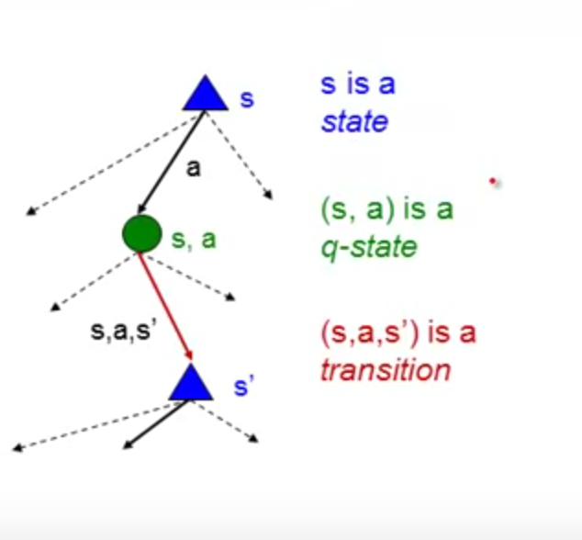
State Values and Action-State Values
Max
Choose a with max V
One action chosen
Q(s,a) Holding position – action taken
don’t know the outcome
Average: Expected reward
Transition probability
Immediate and future reward
Notes:
Actually there’s a typo in this equation. Can anyone see it?

Slide 13
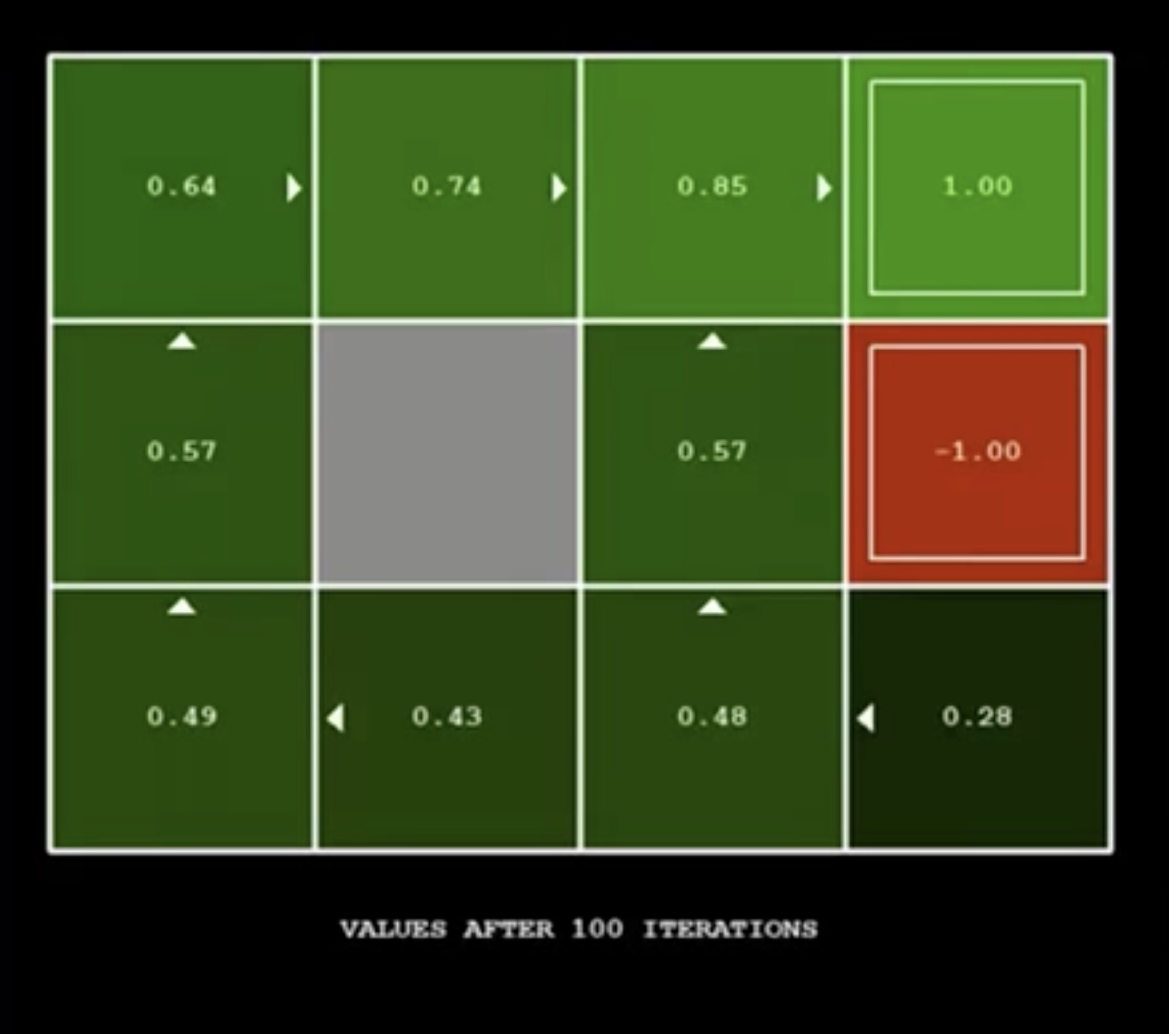
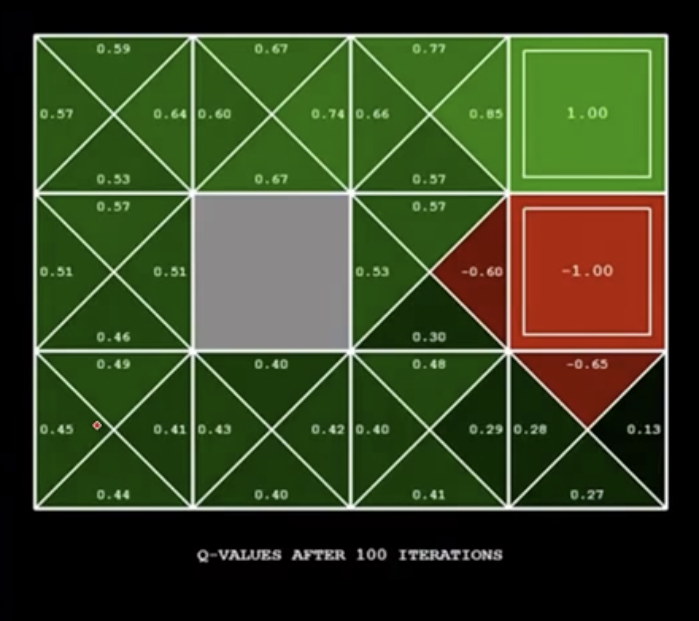
State Value V* Action Value Q*
Notes:
Declining values because it is further away. Optimal functions.

Slide 15
Value function and Q-function
The expected utility - value V^{π}(s) of a state s under the policy π is the expected value of its return, the utility of all state sequences starting in s and applying π
State
Value-function
The value Q ^{π}(s,a) of taking an action a in state s under policy π is the expected return starting from s, taking action a, and thereafter following π:
Action
Value-function
a doesn’t have to be optimal – we are evaluating all actions and then choose…
Notes:
The rational agent tries to select actions so that the sum of the discounted rewards it receives over the future is maximized (i.e., its utility is maximized)

Slide 16
Optimal state and action value functions
V*(s) = Highest possible expected utility from s
Optimal action-value function:

Slide 17
Goal: find optimal policy π*
Optimal value: V* Highest possible expected utility for each s
Satisfies the Bellman Equation
Optimal policy
Notes:
Optimal plan had minimal cost to reach goal
Utility or value of a policy π starting in state s is the expected sum of future rewards will receive by following π starting in state s
Optimal policy has maximal expected sum of rewards from following it

Slide 18
Bellman optimality equations for V
The value V*(s)=V^{π*}(s) of a state s under the optimal policy π* must equal the expected utility for the best action from that state →

Slide 19
Bellman optimality equations for V
|S| non-linear equations in |S| unknowns
The vector V* is the unique solution to the system
Cost per iteration: O(AS²)
Notes:
For all S, for all actions, for all s’.

Slide 20
Bellman optimality equations for Q
|S| × |A(s)| non-linear equations
The vector Q* is the unique solution to the system
Notes:
Why bother with Q?

Slide 21
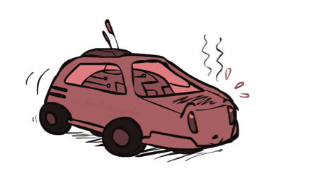
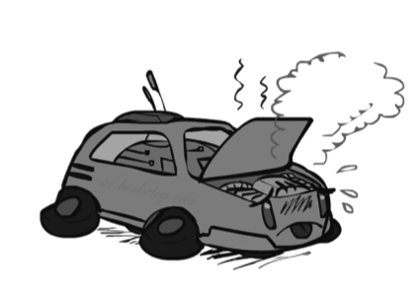
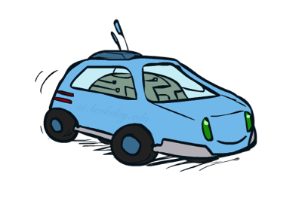
Racing Car Example
A robot car wants to travel far, quickly
Three states: Cool, Warm, Overheated
Two actions: Slow, Fast
Going faster gets double reward
Green numbers are rewards
0.5
+1
1.0
Fast
Slow
-10
+1
0.5
Warm
Slow
Fast
+2
0.5
Cool
0.5
Overheated
+1
1.0
+2
Example from Klein and Abbeel

Slide 22




Racing Search Tree
fast
Chance nodes
slow
Slide adapted from Klein and Abbeel

Slide 23
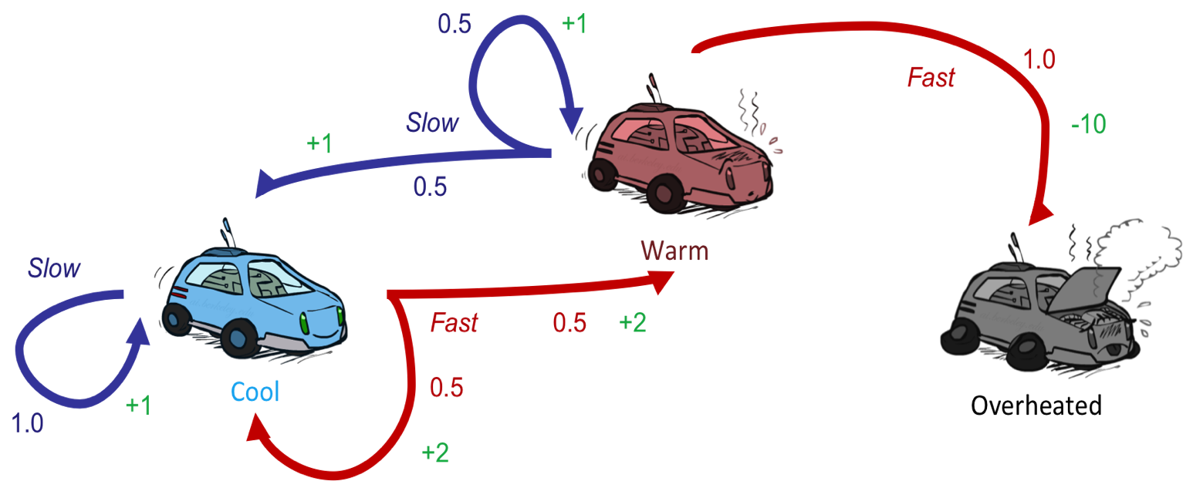
Calculate V₂(warmCar)
Assume ϒ=1
Slide adapted from Klein and Abbeel
Notes:
We’re going to move on now. If you didn’t get this, feel free to see us after class

Slide 24

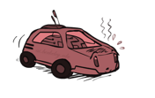
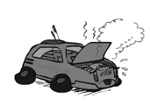
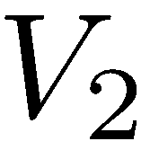
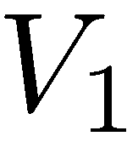
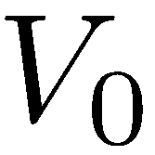
Value iteration example
Assume ϒ=1
slow
fast
0 0 0
Q(fast, )=2
Q(slow, )=1
0.5 * (2 + 0)
1.0 * (1 + 0)
0.5 * (2 + 0)
Slide adapted from Klein and Abbeel
Notes:
We’re going to move on now. If you didn’t get this, feel free to see us after class

Slide 25
Value iteration example
Assume ϒ=1
2
slow
fast
0 0 0
Q(fast, )=2
Q(slow, )=2
0.5 * (2 + 0)
1.0 * (1 + 0)
0.5 * (2 + 0)
Slide adapted from Klein and Abbeel
Notes:
We’re going to move on now. If you didn’t get this, feel free to see us after class

Slide 26
Value iteration example
Assume ϒ=1
2 1 0
slow
fast
0 0 0
Q(fast, )=-10
Q(slow, )=1
0.5 * (1 + 0)
0.5 * (1 + 0)
1.0 * (-10)
Notes:
We’re going to move on now. If you didn’t get this, feel free to see us after class

Slide 27
Value iteration example
Assume ϒ=1
3.5
2 1 0
slow
fast
0 0 0
Q(fast, )=3.5
Q(slow, )=2
0.5 * (2 + 2)
1.0 * (1 + 1)
0.5 * (2 + 1)
Slide adapted from Klein and Abbeel
Notes:
We’re going to move on now. If you didn’t get this, feel free to see us after class

Slide 28
Value iteration: Pool 1
The expected utility of being in the warm car state at time 2 steps away from the end, i.e. V₂ is equal to
0.5
1.5
2.0
2.5
3.5
3.5
?
2 1 0
0 0 0
Notes:
We’re going to move on now. If you didn’t get this, feel free to see us after class

Slide 29
Value iteration example
Assume ϒ=1
3.5
?
2 1 0
slow
fast
0 0 0
Q(fast, =?
Q(slow, )=?
Slide adapted from Klein and Abbeel
Notes:
We’re going to move on now. If you didn’t get this, feel free to see us after class

Slide 30
Will Value Iteration Converge?
Yes, if discount factor γ < 1 or end up in a terminal state with probability 1
Bellman equation is a contraction if discount factor, γ < 1
If apply it to two different value functions, distance between value functions shrinks after apply Bellman equation to each.

Slide 31
Bellman Operator is a Contraction (γ<1)
|| V-V’|| = Infinity norm (find max difference over all states, e.g. max(s) |V(s) – V’(s) |

Slide 32
Contraction Operator
Let O be an operator
If |OV – OV’| <= |V-V|’
Then O is a contraction operator
Only has 1 fixed point when applied repeatedly.
Do different initial values lead to different final values or the same final value?
Notes:
When apply contraction function to any argument, value must get closer to fixed point
Fixed point doesn’t move
Repeated function applications yield fixed point

Slide 33
Value Convergence in the grid world

Slide 34
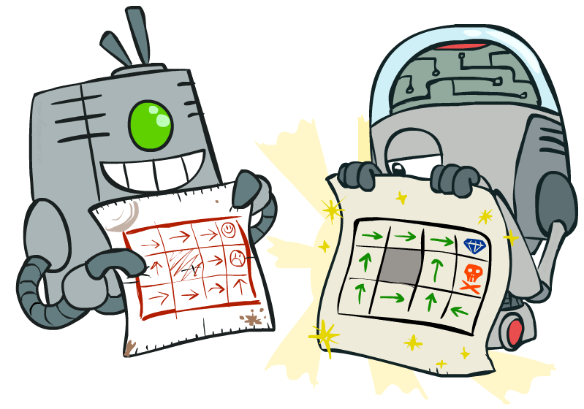
What we really care
Is the best policy.
Do we need to know V* (optimal value), wait till finishing computing V*, to extract the optimal policy?
Notes:
do we really need to wait for convergence in the value functions before to use the value functions to define a good (greedy) policy?

Slide 35
Review: Value of a Policy
Expected immediate reward for taking action prescribed by policy
And expected future reward get after taking policy from that state and following π

Slide 36
Policy loss
In practice, it often occurs that π(k) becomes optimal long before V_{k} has converged!
Grid World: After k=4, the greedy policy is optimal, while the estimation error in V_{k} is still 0.46
||V^{π(k)} – V*|| = Policy loss: the max the agent can lose by executing π(k) instead of π* → This is what matters!
Notes:
π(k) is the greedy policy obtained at iteration k from V_{k} and V^{π(k)}(s) is value of state s applying greedy policy π(k)

Slide 37
Finding optimal policy
If one action (the optimal) gets really better than the others, the exact magnitude of the V(s) doesn’t really matter to select the action in the greedy policy (i.e., don’t need “precise” V values), more important are relative proportions.

Slide 38
Finding optimal policy
  Policy evaluation: given a policy, calculate the value of each state as that policy were executed
  Policy improvement: Calculate a new policy according to the maximization of the utilities using one-step look-ahead based on current policy

Slide 39
Finding the optimal policy
If we have computed V* →
If we have computed Q* →
Notes:
It’s one-step ahead search
→ Greedy policy with respect to V*

Slide 40
Value Iteration by following a particular policy
Initialize V₀(s) to 0 for all s
For k=1… convergence

Slide 41
Solving V analytically
Let be a S x S matrix where the (i,j) entry is:
Requires taking an inverse of a S by S matrix
O(S³)
Or you can do simplified value iteration for large system.
Notes:
No max in eqn so linear set of equations… Analytic Solution!

Slide 42
Policy Improvement
Have V^{π}(s) for all s
First compute
Then extract new policy. For each s,

Slide 43
Policy Iteration for Infinite Horizon
Policy Evaluation: Calculate exact value of acting in infinite horizon for a particular policy
Policy Improvement
Repeat 1 & 2 until policy doesn’t change
If Policy Doesn’t Change (π’(s) =π(s) for all s), Can It Ever Change Again in More Iterations?
Notes:
No.

Slide 44
Policy Improvement
Suppose we have computed V^{π} for a deterministic policy π
For a given state s, is there any better action a, a ≠ π(s)?
The value of doing a in s can be computed with Q^{π}(s,a)
If an a ≠ π(s) is found, such that Q^{π}(s,a) > V^{π}(s), then it’s better to switch to action a
The same can be done for all states

Slide 45
Policy Improvement
A new policy π’ can be obtained in this way by being greedy with respect to the current V^{π}
Performing the greedy operation ensures that V^{π’} ≥ V^{π}
Monotonic policy improvement by being greedy wrt current value functions / policy
If V^{π’} = V^{π} then we are back to the Bellman equations, meaning that both policies are optimal, there is no further space for improvement
Notes:
↔ V₁(s) ≥V₂(s) ∀s∈S
Proposition: V^{π’} ≥ V^{π} with strict inequality if π is suboptimal, where π’ is the new policy we get from doing policy improvement (i.e., being one-step greedy)

Slide 46
Proof
Notes:
If you choose a better policy and then follow the same policy again, greedy algorithm, you can only do better. Is that true?

Slide 47
Policy Iteration

Slide 48
Policy Iteration
Notes:
Have V^{π}(s) for all s
Want a better policy
Idea:
Find the state-action Q value of doing an action followed by following π forever, for each state
Then take argmax of Qs

Slide 49
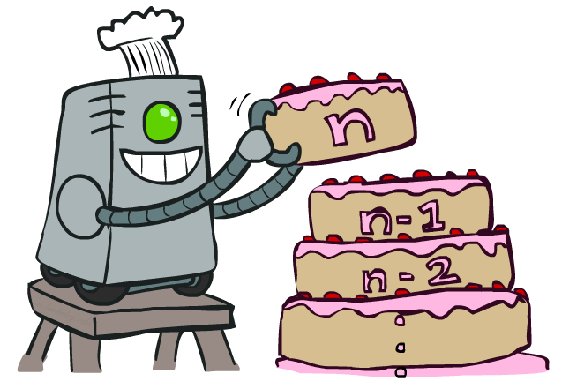
Value Iteration in Infinite Horizon
Optimal values if there are t more decisions to make
Extracting optimal policy for t^{th} step yields optimal action should take, if have t more steps to act
Before convergence, these are approximations
After convergence, value is always the same if do another update, and so is the policy
Drawing by Ketrina Yim
Notes:
(because actually get to act forever!)

Slide 50
Policy Iteration for Infinite Horizon
Maintain value of following a particular policy forever
Instead of maintaining optimal value if have t steps left…
Calculate exact value of acting in infinite horizon for a particular policy
Then try to improve the policy
Repeat 1 & 2 until policy doesn’t change
Drawing by Ketrina Yim
Notes:
Do text to voice

Slide 51
Policy Iteration
Fewer Iterations
More expensive per iteration
Value Iteration
More iterations
Cheaper per iteration
O(|A|.|S|²) Improvement
O(||S|³) Evaluation
Max |A|^{|S|} possible policies
to evaluate and improve
O(|A|.|S|²) per iteration
In principle an exponential
number of iterations to ɛ→0
Drawings by Ketrina Yim

Slide 52
MDPs: What You Should Know
Definition
How to define for a problem
Value iteration and policy iteration
  How to implement
  Convergence guarantees
  Computational complexity

