Slide 1
Deep Belief Nets
Tai Sing Lee
15-381/681 AI Lecture 12
Read Chapter 14.4-5 of Russell and Norvig
Hinton, G. E, Osindero, S., and Teh, Y. W. (2006). A fast learning algorithm for deep belief nets. Neural Computation, 18:1527-1554.
With thanks to Past 15-381 Instructors for slide contents, as well as Russell and Norvig and Geoff Hinton for slides in this lecture.
Notes:
Syntax = the grammatical arrangement of words in sentences
a systematic orderly arrangement
Semantics: the meaning of a word, phrase, sentence, or text

Slide 2
Pr(Cloudy | Sprinkler=T,Rain=T)?
Cloudy
Sprinkler
Rain
Wet Grass
Samples of Cloudy given Sprinkler=T & Rain=T): 1 0 1 1 0 1 1 1 1 0
Posterior probability of taking on any value given some evidence: Pr[Q | E₁=e₁,...,E_{k}=e_{k}]
Pr(Cloudy = T | Sprinkler=T, Rain=T) ≈ .7
Pr(Cloudy = F | Sprinkler=T, Rain=T) ≈ .3
Notes:
http://onlinestatbook.com/stat_sim/sampling_dist/index.html

Slide 3
Rejection sampling
What about when we have evidence?
Want to estimate Pr[Rain=t|Sprinkler=t] using 100 direct samples
73 have S=f, of which 12 have R=t
27 have S=t, of which 8 have R=t
What’s the estimate?
20/100
12/73
8/27
Not sure.
What if S=t, happen very rarely?
Notes:
8/27
Good/bad?

Slide 4
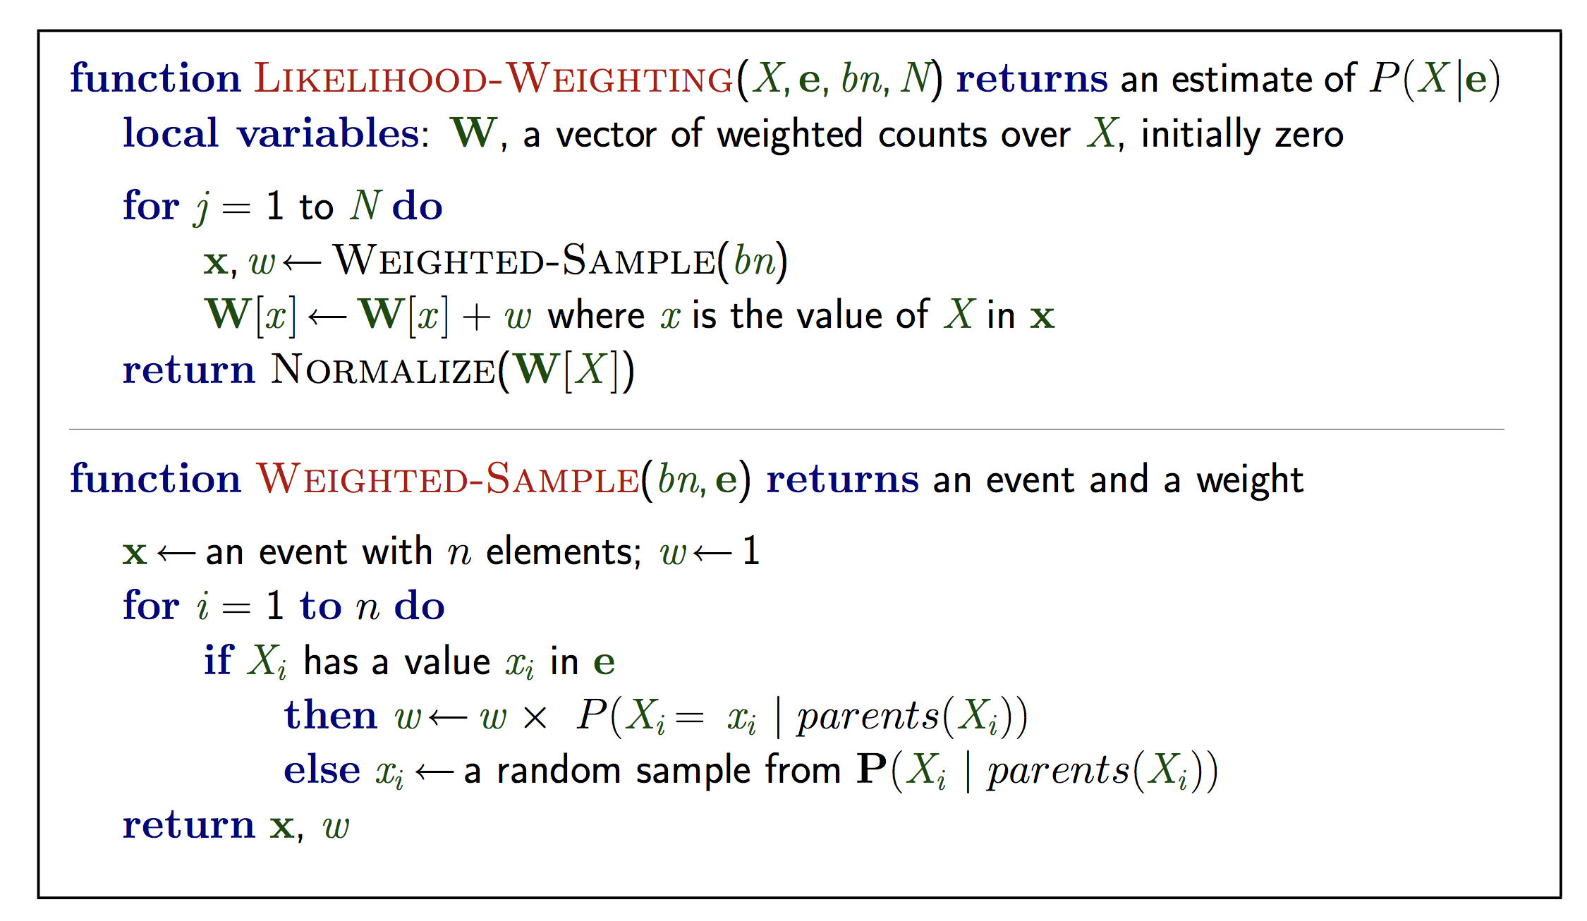
Likelihood Weighting Recap:
W[x] = Total Weight
Notes:
Idea: instead of direct sampling, fix evidence variables, sample only non-evidence variables, and weigh each sample by the likelihood it accords the evidence.
But we only generate the samples under the assumptions of these evidence. If something (evidence) rarely, it will just have a small weight.
X is the query variable. e observed values for variables E, bn is the Bayes network, and N: total number of variables sampled.

Slide 5
Likelihood weighting
Want P(R| C=t,W=t)
Evidence variables: C=t,W=t
Order:C, S, R, W
⇒ w = 1⋅Pr[C=t] = 0.5
Sample Pr[S|C=t]=(.1,.9) ⇒ false
Sample Pr[R|C=t]=(.8,.2) ⇒ true
W is evidence var ⇒ w = 0.5⋅Pr[W=t|S=f,R=t] = .45
Sampled [t,f,t,t] with weight .45, tallied under R=t
+c | 0.5
-c | 0.5
Cloudy
+c | +s | .1
+c | -s | .9
-c | +s | .5
-c | -s | .5
+c | +r | .8
+c | -r | .2
-c | +r | .2
-c | -r | .8
Sprinkler
Rain
Wet Grass
+s | +r | +w | .99
+s | +r | -w | .01
+s | -r | +w | .90
+s | -r | -w | .10
-s | +r | +w | .90
-s | +r | -w | .10
-s | -r | +w | 0
-s | -r | -w | 1.0
This generated one weighted sample

Slide 6
Intuition
The distribution of the sample value of R or S drawn is influenced by evidence variable C=t, their parents
But the non-descendent evidence due to W=t is ignored (for the time being).
C=t
Cloudy
Will generate many samples with S=f and R = f, despite it is not consistent with evidence W=t.
However, when sampling reaches evidence W=t, the likelihood weight w will take care of that, making the sampling consistent with the P(z|e). w could be very small because it is unlikely W would be t if S=f, R=f.
Sprinkler
Rain
Wet Grass
W=t
Notes:
= 1/ 3

Slide 7
Pool
Recall: Want P(R| C=t,W=t), 500 samples (R=t, …, C=t, W=t) and (R=f, … C=t, W=t) are generated by likelihood weighting.
If we have 100 samples with R=t and total weight 1, and 400 samples with R=f and total weight 2, what is estimate of R=t?
1. 1/9
2. 1/3
3. 1/5
4. no idea.
Total weight is W, not w.
Notes:
= 1/ 3

Slide 8
Likelihood Weighting Recap:
W[x] = Total Weight
Notes:
Idea: instead of direct sampling, fix evidence variables, sample only non-evidence variables, and weigh each sample by the likelihood it accords the evidence.
But we only generate the samples under the assumptions of these evidence. If something (evidence) rarely, it will just have a small weight.
X is the query variable. e observed values for variables E, bn is the Bayes network, and N: total number of variables sampled.

Slide 9
Markov Chain Monte Carlo Methods
Direct, rejection and likelihood weighting methods generate each new sample from scratch
MCMC generate each new sample by making a random change to preceding sample
Notes:
Can view algorithm as being in a particular state (assignment of values to each variable)

Slide 10
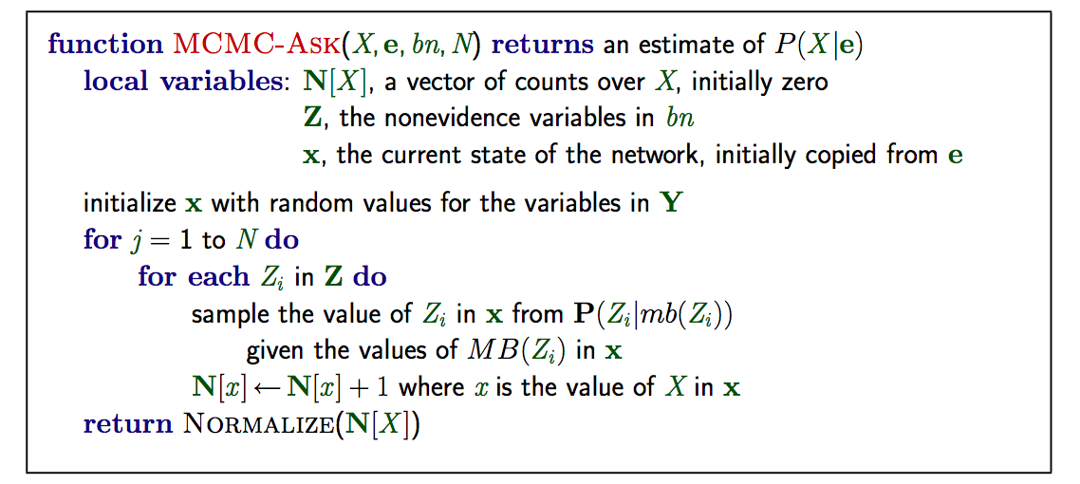
Gibbs sampling
“State” of network = current assignment to all variables.
Generate next state by sampling one variable given Markov blanket Sample each variable in turn, keeping evidence fixed
Notes:
Can also choose a variable to sample at random each time

Slide 11
Gibbs sampling
From G. Mori

Slide 12
Gibbs sampling
From G. Mori

Slide 13
Gibbs Sampling Example
+c | 0.5
-c | 0.5
Want to estimate Pr(R|S=t,W=t)
Non-evidence variables are C & R
Initialize randomly: C= t and R=f
Initial state (C,S,R,W)= [t,t,f,t]
Sample C given current values of its Markov Blanket
What is its Markov blanket?
Cloudy
+c | +s | .1
+c | -s | .9
-c | +s | .5
-c | -s | .5
+c | +r | .8
+c | -r | .2
-c | +r | .2
-c | -r | .8
Sprinkler
Rain
Wet Grass
+s | +r | +w | .99
+s | +r | -w | .01
+s | -r | +w | .90
+s | -r | -w | .10
-s | +r | +w | .90
-s | +r | -w | .10
-s | -r | +w | 0
-s | -r | -w | 1.0

Slide 14
Gibbs Sampling Example
+c | 0.5
-c | 0.5
Want Pr(R|S=t,W=t)
Non-evidence variables are C & R
Initialize randomly: C= t and R=f
Initial state (C,S,R,W)= [t,t,f,t]
Sample C given current values of its Markov Blanket
Markov blanket is parents, children and children’s parents:
Cloudy
+c | +s | .1
+c | -s | .9
-c | +s | .5
-c | -s | .5
+c | +r | .8
+c | -r | .2
-c | +r | .2
-c | -r | .8
Sprinkler
Rain
Wet Grass
+s | +r | +w | .99
+s | +r | -w | .01
+s | -r | +w | .90
+s | -r | -w | .10
-s | +r | +w | .90
-s | +r | -w | .10
-s | -r | +w | 0
-s | -r | -w | 1.0
Notes:
Do on board if running fast (< 1pm?)
Talk about how to calculate in a moment

Slide 15
Gibbs Sampling Example
+c | 0.5
-c | 0.5
Want Pr(R|S=t,W=t)
Non-evidence variables are C & R
Initialize randomly: C= t and R=f
Initial state (C,S,R,W)= [t,t,f,t]
Sample C given current values of its Markov Blanket
Markov blanket is parents, children and children’s parents:
Sample C given P(C|S=t,R=f)
First have to compute P(C|S=t,R=f)
Use exact inference to do this
Cloudy
+c | +s | .1
+c | -s | .9
-c | +s | .5
-c | -s | .5
+c | +r | .8
+c | -r | .2
-c | +r | .2
-c | -r | .8
Sprinkler
Rain
Wet Grass
+s | +r | +w | .99
+s | +r | -w | .01
+s | -r | +w | .90
+s | -r | -w | .10
-s | +r | +w | .90
-s | +r | -w | .10
-s | -r | +w | 0
-s | -r | -w | 1.0
Notes:
Do on board if running fast (< 1pm?)
Talk about how to calculate in a moment

Slide 16



Exercise: compute P(C=t|S=t,R=f)?
+c | 0.5
-c | 0.5
Quick refresher
Sum rule
Product/Chain rule
Bayes rule
Cloudy
+c | +s | .1
+c | -s | .9
-c | +s | .5
-c | -s | .5
+c | +r | .8
+c | -r | .2
-c | +r | .2
-c | -r | .8
Sprinkler
Rain
Wet Grass
+s | +r | +w | .99
+s | +r | -w | .01
+s | -r | +w | .90
+s | -r | -w | .10
-s | +r | +w | .90
-s | +r | -w | .10
-s | -r | +w | 0
-s | -r | -w | 1.0
Notes:
Have students do this

Slide 17
Exact Inference Exercise
What is the probability P(C=t | S=t, R= f)?
P(C=t | S=t, R= f) = P(C=t, S=t, R=f) / (P(S=t,R=f))
Proportional to P(C=t, S=t, R=f)
Use normalization trick, & compute the above for C=t and C=f
P(C=t, S=t, R=f) = P(C=t) P(S=t|C=t) P (R=f | C=t, S=t) product rule
= P(C=t) P(S=t|C=t) P (R=f | C=t) (BN independencies)
= 0.5 * 0.1 * 0.2 = 0.01
P(C=f, S=t, R=f) = P(C=f) P (S=t|C=f) P(R=f|C=f)
= 0.5 * 0.5 * 0.8 = 0.2
(P(S=t,R=f)) use sum rule = P(C=f, S=t, R=f) + P(C=t, S=t, R=f)
= 0.21
P (C=t | S=t, R = f) = 0.01 / 0.21 ~ 0.0476
+c | 0.5
-c | 0.5
Cloudy
+c | +s | .1
+c | -s | .9
-c | +s | .5
-c | -s | .5
+c | +r | .8
+c | -r | .2
-c | +r | .2
-c | -r | .8
Sprinkler
Rain
Wet Grass
+s | +r | +w | .99
+s | +r | -w | .01
+s | -r | +w | .90
+s | -r | -w | .10
-s | +r | +w | .90
-s | +r | -w | .10
-s | -r | +w | 0
-s | -r | -w | 1.0
Notes:
Do on board if running fast (< 1pm?)
Talk about how to calculate in a moment

Slide 18
Gibbs Sampling Example
+c | 0.5
-c | 0.5
Want Pr(R|S=t,W=t)
Non-evidence variables are C & R
Initialize randomly: C= t and R=f
Initial state (C,S,R,W)= [t,t,f,t]
Sample C given current values of its Markov Blanket
Exactly compute P(C|S=t,R=f)
Sample C given P(C|S=t,R=f)
Get C = f
New state (f,t,f,t)
Cloudy
+c | +s | .1
+c | -s | .9
-c | +s | .5
-c | -s | .5
+c | +r | .8
+c | -r | .2
-c | +r | .2
-c | -r | .8
Sprinkler
Rain
Wet Grass
+s | +r | +w | .99
+s | +r | -w | .01
+s | -r | +w | .90
+s | -r | -w | .10
-s | +r | +w | .90
-s | +r | -w | .10
-s | -r | +w | 0
-s | -r | -w | 1.0
Notes:
Do on board if running fast (< 1pm?)
Talk about how to calculate in a moment

Slide 19
Gibbs Sampling Example
+c | 0.5
-c | 0.5
Want Pr(R|S=t,W=t)
Initialize non-evidence variables (C and R) randomly to t and f
Initial state (C,S,R,W)= [t,t,f,t]
Sample C given current values of its Markov Blanket, p(C|S=t,R=f)
Get sample C=f
New state (f,t,f,t)
Sample Rain given its MB
What is Rain’s Markov blanket?
Cloudy
+c | +s | .1
+c | -s | .9
-c | +s | .5
-c | -s | .5
+c | +r | .8
+c | -r | .2
-c | +r | .2
-c | -r | .8
Sprinkler
Rain
Wet Grass
+s | +r | +w | .99
+s | +r | -w | .01
+s | -r | +w | .90
+s | -r | -w | .10
-s | +r | +w | .90
-s | +r | -w | .10
-s | -r | +w | 0
-s | -r | -w | 1.0
Notes:
Do on board if running fast (< 1pm?)
Talk about how to calculate in a moment

Slide 20
Gibbs Sampling Example
+c | 0.5
-c | 0.5
Want Pr(R|S=t,W=t)
Sample Rain given its MB, p(R|C=f,S=t,W=t)
Get sample R=t
New state (f,t,t,t)
Cloudy
+c | +s | .1
+c | -s | .9
-c | +s | .5
-c | -s | .5
+c | +r | .8
+c | -r | .2
-c | +r | .2
-c | -r | .8
Sprinkler
Rain
Wet Grass
+s | +r | +w | .99
+s | +r | -w | .01
+s | -r | +w | .90
+s | -r | -w | .10
-s | +r | +w | .90
-s | +r | -w | .10
-s | -r | +w | 0
-s | -r | -w | 1.0
Notes:
Everybody.

Slide 21
Poll: Gibbs Sampling Ex.
+c | 0.5
-c | 0.5
Want Pr(R|S=t,W=t)
Initialize non-evidence variables (C and R) randomly to t and f
Initial state (C,S,R,W)= [t,t,f,t]
Current state (f,t,t,t)
What is not a possible next state
1. (f,t,t,t)
2. (t,t,t,t)
3. (f,t,f,t)
4. (f,f,t,t)
5. Not sure
Cloudy
+c | +s | .1
+c | -s | .9
-c | +s | .5
-c | -s | .5
+c | +r | .8
+c | -r | .2
-c | +r | .2
-c | -r | .8
Sprinkler
Rain
Wet Grass
+s | +r | +w | .99
+s | +r | -w | .01
+s | -r | +w | .90
+s | -r | -w | .10
-s | +r | +w | .90
-s | +r | -w | .10
-s | -r | +w | 0
-s | -r | -w | 1.0
Notes:
Talk about how to calculate in a moment. 3

Slide 22
Gibbs sampling
From G. Mori

Slide 23
Gibbs is Consistent
Sampling process settles into a stationary distribution where long-term fraction of time spent in each state is exactly equal to posterior probability
→ if draw enough samples from this stationary distribution, will get consistent estimate because sampling from true posterior
See Proof in Textbook.
Notes:
General Gibbs: sample the value of a new variable conditioned on all the other variables
Can prove this version of Gibbs satisfies detailed balance equation with stationary distribution of P(X|e)
Sampling conditioned on all variables is equivalent to sampling given Markov Blanket for Bayes Nets
See text for recap

Slide 24
Belief Nets
A belief net is a directed acyclic graph composed of stochastic variables.
Hidden variables (not observed) and visible variables
The inference problem: Infer the states of the unobserved variables.
The learning problem: Learn interaction between variables to make the network more likely to generate the observed data.
stochastic
hidden causes
visible units:
observations
Notes:
We will use nets composed of layers of stochastic binary variables with weighted connections. Could be generalized to other types of variable.

Slide 25
Stochastic binary units (Bernoulli variables)
These have a state (s_{i} ) of 1 or 0.
The probability of turning on is determined by the weighted input from other units (plus a bias)
1
0
0

Slide 26
Two types of generative belief nets
If we connect binary stochastic neurons in a directed acyclic graph we get a Sigmoid Belief Net (Radford Neal 1992).
If we connect binary stochastic neurons using symmetric connections we get a Boltzmann Machine (Hinton & Sejnowski, 1983).
If we restrict the connectivity in a special way, it is easy to learn a Boltzmann machine.

Slide 27
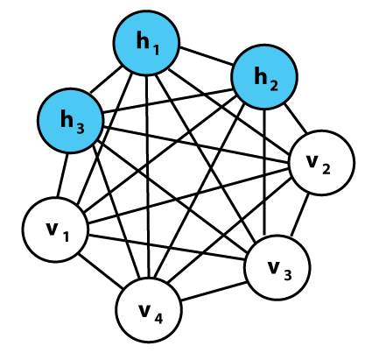
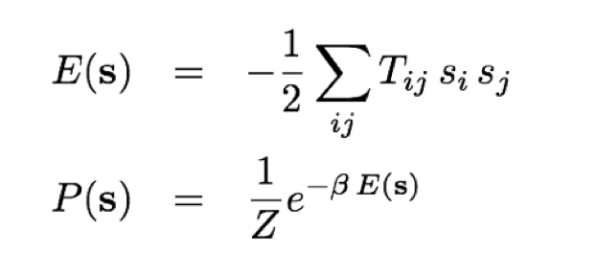
The Boltzmann Machine
(Hinton and Sejnowski 1985)
Energy of a state
Probability of
being in a state
_{T = w connections}
Notes:
A Boltzmann machine is a type of stochastic recurrent neural network invented by Geoffrey Hinton and Terry Sejnowski. Boltzmann machines can be seen as the stochastic, generative counterpart of Hopfield nets. They were one of the first examples of a neural network capable of learning internal representations, and are able to represent and (given sufficient time) solve difficult combinatoric problems.
The network is run by repeatedly choosing a unit and setting its state according to the above formula. After running for long enough at a certain temperature, the probability of a global state of the network will depend only upon that global state's energy,
Add hidden layers, the network can now capture more than correlation in the data. Otherwise, we will just learn the pairwise statistics.
One way to make the system learn higher order correlation is by adding the hidden units.
Now the full distributions of the hidden units and the visibile units.
P(s^v, s^h) = 1/Z e^{ \sum_{ij} T_{ij}^W Si^v s_j^v + \sum ij s_ivsj^hTij^hv+ \sum_{ij} Tij^hhs_ihs_j^h.
Terms coupling visible with hidden, and hidden with hidden, and visible with hidden.
Want to write probability of visibile units only.
P(s^v) = \sum_{s^h} P(s^v, s^h).
Marginalize, sum over a set of variables, sum of all the states of the hidden variables, n units, sum over 2^n states, huge sum.
Delta T^vh, delta T^hh, takes the log and calculates the derivatives. Same step. To calculate the learning rules.
his means that log-probabilities of global states become linear in their energies. This relationship is true when the machine is "at thermal equilibrium", meaning that the probability distribution of global states has converged. If we start running the network from a high temperature, and gradually decrease it until we reach a thermal equilibrium at a low temperature, we are guaranteed to converge to a distribution where the energy level fluctuates around the global minimum. This process is called simulated annealing.

Slide 28
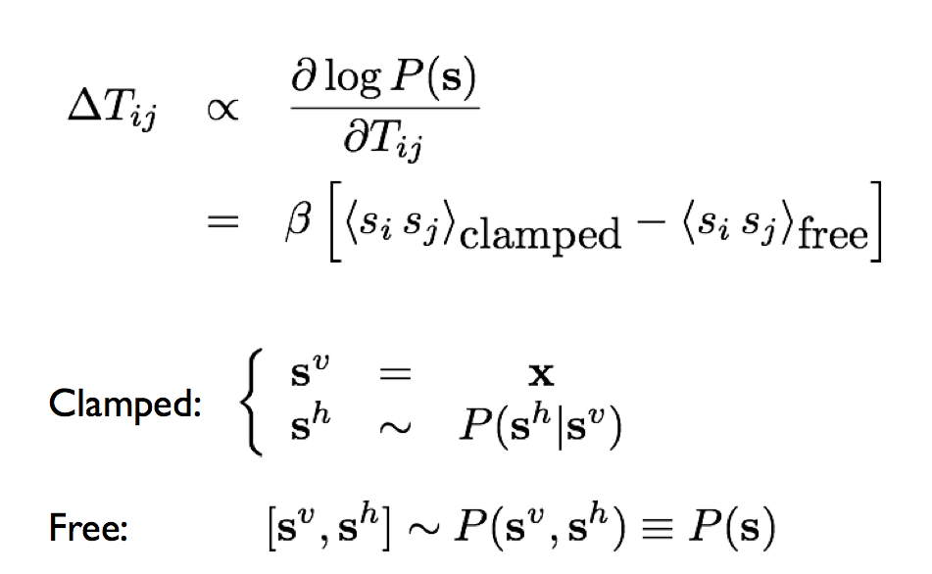
Learning in Boltzmann machine
Hebbian learning fantasy/expectation
input
Direct sampling from the distributions
Learn to model the data distribution of the observable units.
Notes:
For the case of visible units only, first term, clamp states: set the visibile units to the data, , there are two phrases: fist phrase, learn from the world, and compare with the free states, sampling the visibile units from the joint distributions.
Sampling: Gibbs sampling. Proceed coordinate-wise, fix the others, get the distribution for this kind, and sample from that one.
Hebbian learning rule, learning during the day, and sampling through the night, and to compare with each other.
Free states, sampling from the joint.
For hidden units, the clamped states, hiddnen units have no data to set to, but they do have the posterior, but this makes learning
S^h~ P(s^h|s^v=x).
In Boltzmann machine difficult.
When you put hidden units, things slow down.

Slide 29
Weights → Energies → Probabilities
Each possible joint configuration of the visible and hidden units has an energy
The energy is determined by the weights and biases
The energy of a joint configuration of the visible and hidden units determines its probability:
A state with lower energy has higher probability.
The probability of a configuration over the visible units is found by summing the probabilities of all the joint configurations that contain it.

Slide 30
Conditional independence
Recall, two dependent variables can be made conditional independent when they can be explained by a common cause.
Alarm
John call
Mary call

Slide 31
Explaining away (Judea Pearl)
On the other hand, if two hidden causes are independent, they can become dependent when we observe an effect that they can both influence. They compete to explain the observation!
If we learn that there was an earthquake, it reduces the probability that the alarm is triggered by burglary.
Burglary
earthquake
Alarm

Slide 32
Difficult to learn sigmoid belief nets
To learn W, we need the posterior distribution in the first hidden layer.
Problem 1: The posterior is typically complicated because of “explaining away”.
Problem 2: The posterior depends on the prior as well as the likelihood.
So to learn W, we need to know the weights in higher layers, even if we are only approximating the posterior. All the weights interact.
Problem 3: We need to integrate over all possible configurations of the higher variables to get the prior for first hidden layer. Yuk!
hidden variables
hidden variables
prior
hidden variables
likelihood
W
data

Slide 33
Restricted Boltzmann Machines (Smolensky ,1986, called them “harmoniums”)
We restrict the connectivity to make learning easier.
Only one layer of hidden units.
Learn one layer at a time …
No connections between hidden units.
In an RBM, the hidden units are conditionally independent given the visible states.
So we can quickly get an unbiased sample from the posterior distribution when given a data-vector.
This is a big advantage over directed belief nets
hidden
j
i
visible

Slide 34
The Energy of a Joint Configuration
binary state of visible unit i
binary state of hidden unit j
Energy with configuration v on the visible units and h on the hidden units
weight between units i and j
Notes:
(ignoring terms to do with biases)

Slide 35
Using energies to define probabilities
The probability of a joint configuration over both visible and hidden units depends on the energy of that joint configuration compared with the energy of all other joint configurations.
The probability of a configuration of the visible units is the sum of the probabilities of all the joint configurations that contain it.
partition function
Hinton

Slide 36
A picture of the maximum likelihood learning algorithm for an RBM
j
j
j
j
a fantasy
i
i
i
i
t = 0 t = 1 t = 2 t = infinity
Start with a training vector on the visible units.
Then alternate between updating all the hidden units in parallel and updating all the visible units in parallel.
Hinton

Slide 37
A quick way to learn an RBM
j
j
Start with a training vector on the visible units.
Update all the hidden units in parallel
Update the all the visible units in parallel to get a “reconstruction”.
Update the hidden units again.
i
i
t = 0 t = 1
data
reconstruction
This is not following the gradient of the log likelihood. But it works well. It is approximately following the gradient of another objective function (Carreira-Perpinan & Hinton, 2005).
Hinton

Slide 38
How to learn a set of features that are good for reconstructing images of the digit 2
50 binary feature neurons
50 binary feature neurons
Increment weights between an active pixel and an active feature
Decrement weights between an active pixel and an active feature
16 x 16 pixel image
16 x 16 pixel image
data (reality)
reconstruction

Slide 39
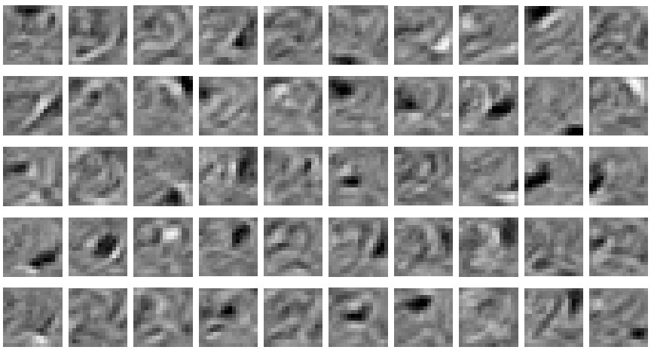
The final 50 x 256 weights for learning digit 2
Each neuron grabs a different feature – a cause, weighted sum of the causes to explain the input.

Slide 40
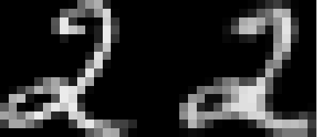
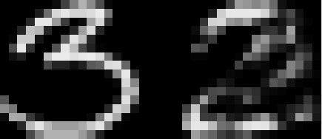
How well can we reconstruct the digit images from the binary feature activations ?
Reconstruction from activated binary features
Reconstruction from activated binary features
Data
Data
New test images from the digit class that the model was trained on
Images from an unfamiliar digit class (the network tries to see every image as a 2)

Slide 41
Training a deep belief net
First train a layer of features that receive input directly from the pixels.
Then treat the activations of the trained features as if they were pixels and learn features of features in a second hidden layer.
It can be proved that each time we add another layer of features we improve the bound on the log probability of the training data.
The proof is complicated.
But it is based on a neat equivalence between an RBM and a deep directed model (described later)

Slide 42
DBN after learning 3 layers
To generate data:
Get an equilibrium sample from the top-level RBM by performing alternating Gibbs sampling for a long time.
Perform a top-down pass to get states for all the other layers.
So the lower level bottom-up connections are not part of the generative model. They are just used for inference.
h3
h2
h1
data

Slide 43
A model of digit recognition
The top two layers form an associative memory whose energy landscape models the low dimensional manifolds of the digits.
The energy valleys have names
2000 top-level neurons
10 label neurons
500 neurons
The model learns to generate combinations of labels and images.
To perform recognition we start with a neutral state of the label units and do an up-pass from the image followed by a few iterations of the top-level associative memory.
500 neurons
28 x 28 pixel image

Slide 44
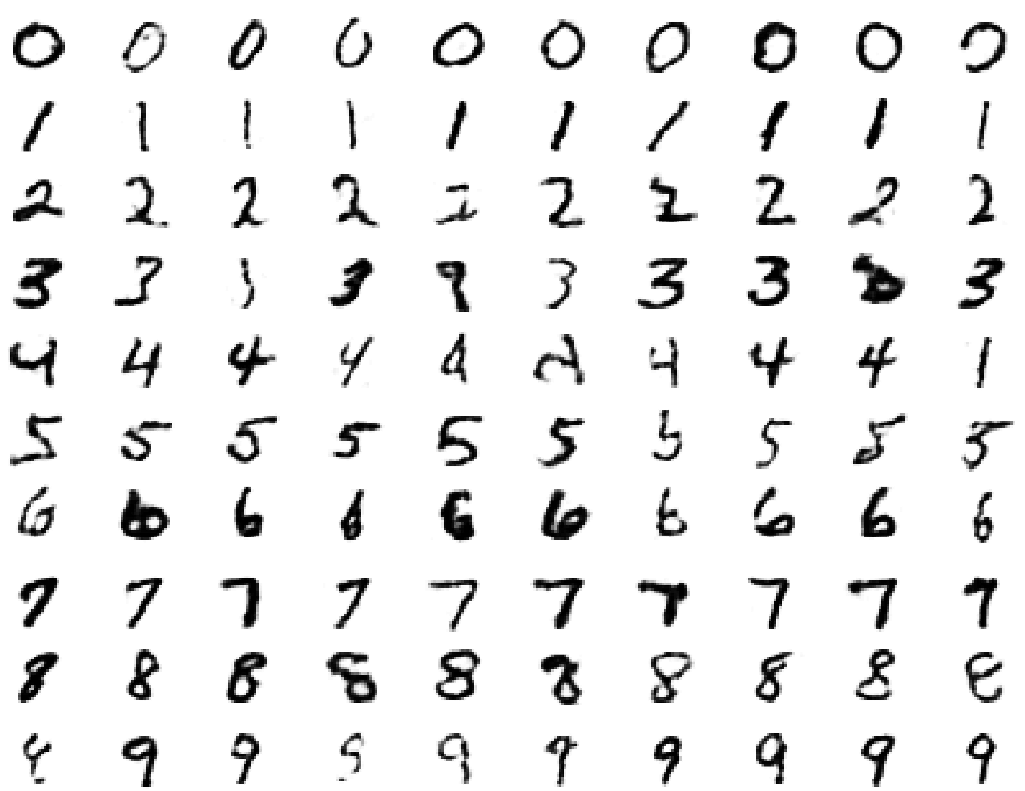
Samples generated by letting the associative memory run with one label clamped.
Notes:
There are 1000 iterations of alternating Gibbs sampling

Slide 45
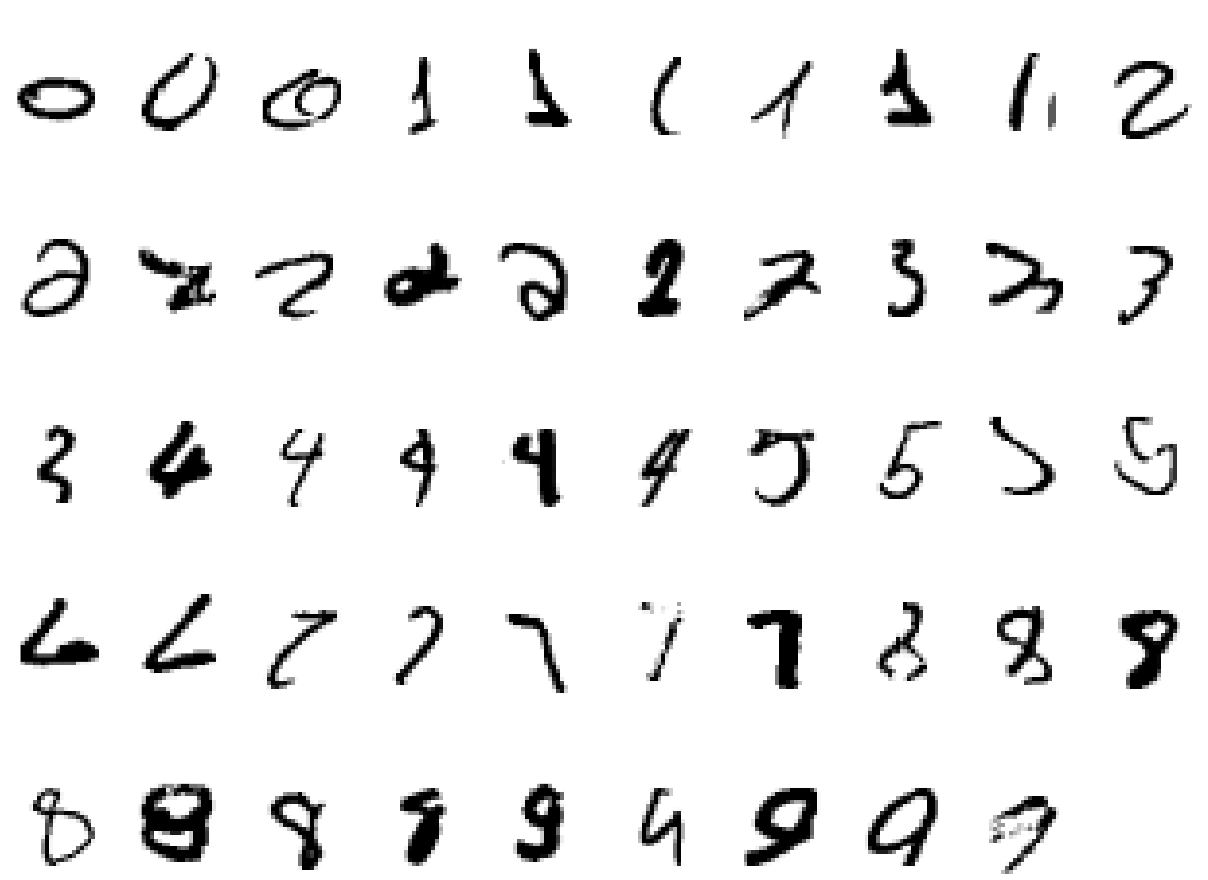
Examples of correctly recognized handwritten digits that the neural network had never seen before

Slide 46
Show the movie of the network generating digits (available at www.cs.toronto/~hinton)

Slide 47
An infinite sigmoid belief net that is equivalent to an RBM
etc.
h2
The distribution generated by this infinite directed net with replicated weights is the equilibrium distribution for a compatible pair of conditional distributions: p(v|h) and p(h|v) that are both defined by W
A top-down pass of the directed net is exactly equivalent to letting a Restricted Boltzmann Machine settle to equilibrium.
So this infinite directed net defines the same distribution as an RBM.
v2
h1
v1
h0
Hinton, G. E, Osindero, S., and Teh, Y. W. (2006). A fast learning algorithm for deep belief nets. Neural Computation, 18:1527-1554.
v0

