Slide 1
Inference in Bayesian Networks
Tai Sing Lee
15-381/681 AI Lecture 11
Read Chapter 14.4-5 of Russell & Norvig
With thanks to Dan Klein (Berkeley), Percy Liang (Stanford) and Past 15-381 Instructors for slide contents, particularly Ariel Procaccia, Emma Brunskill and Gianni Di Caro.
Notes:
Syntax = the grammatical arrangement of words in sentences
a systematic orderly arrangement
Semantics: the meaning of a word, phrase, sentence, or text

Slide 2
Bayesian Network
Compact representation of the joint distribution
Conditional independence relationships explicit
Each var conditionally independent of all its non-descendants in the graph given the value of its parents
Still represents joint so can be used to answer any probabilistic query

Slide 3
Overview
Exact inference
Approximate inference through sampling
Direct
Rejection
Likelihood weighting
Gibbs sampling
Know why each approach is consistent
Cost of generating a sample in each method
Efficiency (# of samples need to get a good estimate)

Slide 4
Dynamic Bayes Net
Temporal models with hidden variables: (HMM, DBN)
The variable representing the state of the environment at time t , Rain_{t}(T/F), is not directly observable (hidden) but defines causal dynamics
The variable Umbrella_{t}(T/F) is the evidence variable at time t
Filtering / State estimation: Probability of Rain_{t} given evidence in 1:t
Prediction: Probability of Rain_{t+1} given evidence in 1:t
Notes:
An HMM is defined by:Initial distribution: P(R

Slide 5

Scene context can dis-ambiguage object recognition
Torralba, et al. ICCV, 2003. Context-based vision system for place and object recognition.
Notes:
The key computational question is how to represent the whole image in a compact, yet informative, form. Torralba [21] suggests a representation, called the “gist” of the image, based on PCA of a set of spatially averaged filter-bank outputs. The gist acts as an holistic, low-dimensional representation of the whole image. Torralba shows that this is sufficient to provide a useful prior for what types of objects may appear in the image, and at which location/scale.
We extend [21] by combining the prior suggested by the gist with the outputs of bottom-up, local object detectors, which are trained using boosting (see Section 2). Note

Slide 6
Scene context can dis-ambiguage object recognition
Torralba, et al. ICCV, 2003. Context-based vision system for place and object recognition.
Notes:
The key computational question is how to represent the whole image in a compact, yet informative, form. Torralba [21] suggests a representation, called the “gist” of the image, based on PCA of a set of spatially averaged filter-bank outputs. The gist acts as an holistic, low-dimensional representation of the whole image. Torralba shows that this is sufficient to provide a useful prior for what types of objects may appear in the image, and at which location/scale.
We extend [21] by combining the prior suggested by the gist with the outputs of bottom-up, local object detectors, which are trained using boosting (see Section 2). Note

Slide 7
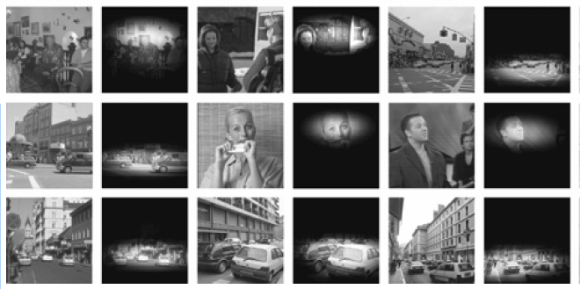
We can prime locations of objects based on scene context
Torralba, et al. ICCV, 2003. Context-based vision system for place and object recognition.
Notes:
The key computational question is how to represent the whole image in a compact, yet informative, form. Torralba [21] suggests a representation, called the “gist” of the image, based on PCA of a set of spatially averaged filter-bank outputs. The gist acts as an holistic, low-dimensional representation of the whole image. Torralba shows that this is sufficient to provide a useful prior for what types of objects may appear in the image, and at which location/scale.
We extend [21] by combining the prior suggested by the gist with the outputs of bottom-up, local object detectors, which are trained using boosting (see Section 2). Note

Slide 8
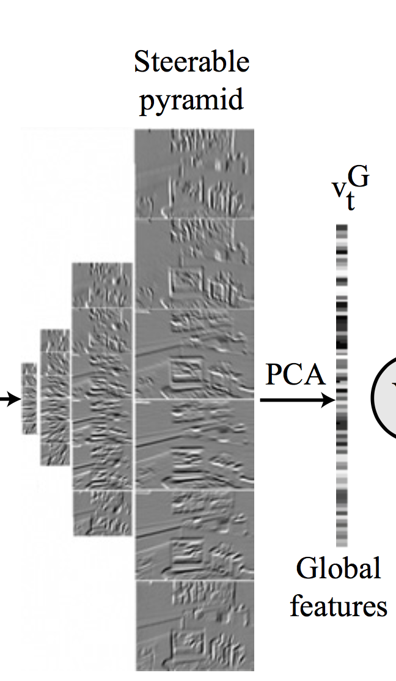
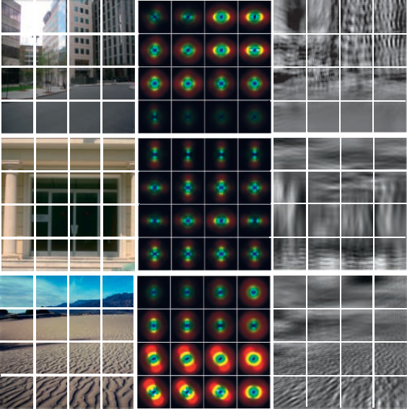
Context can be recognized by summary of low-level features
Notes:
The key computational question is how to represent the whole image in a compact, yet informative, form. Torralba [21] suggests a representation, called the “gist” of the image, based on PCA of a set of spatially averaged filter-bank outputs. The gist acts as an holistic, low-dimensional representation of the whole image. Torralba shows that this is sufficient to provide a useful prior for what types of objects may appear in the image, and at which location/scale.
We extend [21] by combining the prior suggested by the gist with the outputs of bottom-up, local object detectors, which are trained using boosting (see Section 2). Note Two images from our data set, and noise pat- terns which have the same global features. This shows that the features pick up on coarse-grained texture, dominant orientations and spatial organization.

Slide 9
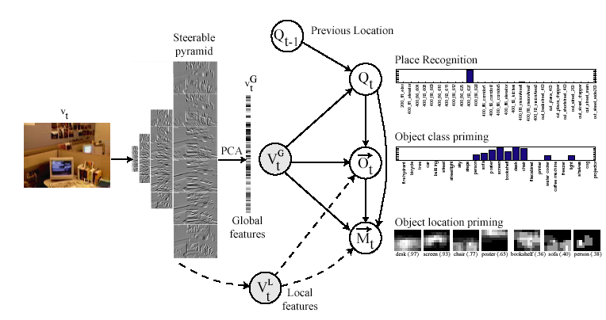
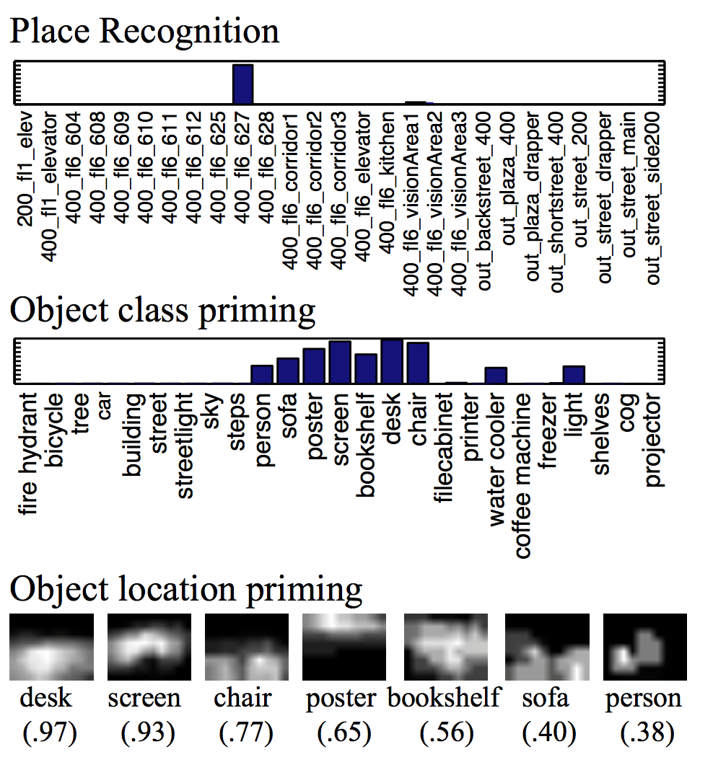
Place and object recognition using dynamic Bayes net
Torralba, et al. ICCV, 2003. Context-based vision system for place and object recognition.

Slide 10
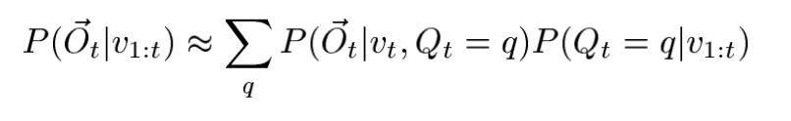

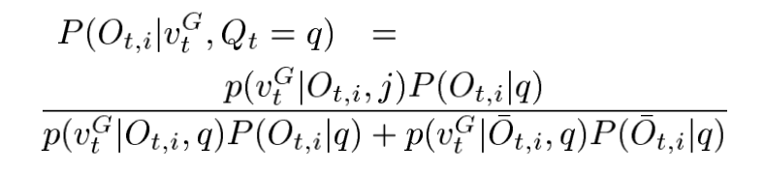
Place and object recognition using dynamic Bayes net
Inferring object types based on scene and object features
Context priming to decide which object detectors to run
Notes:
The key computational question is how to represent the whole image in a compact, yet informative, form. Torralba [21] suggests a representation, called the “gist” of the image, based on PCA of a set of spatially averaged filter-bank outputs. The gist acts as an holistic, low-dimensional representation of the whole image. Torralba shows that this is sufficient to provide a useful prior for what types of objects may appear in the image, and at which location/scale.
We extend [21] by combining the prior suggested by the gist with the outputs of bottom-up, local object detectors, which are trained using boosting (see Section 2). Note

Slide 11
Inferring room location, object category and location
Notes:
The key computational question is how to represent the whole image in a compact, yet informative, form. Torralba [21] suggests a representation, called the “gist” of the image, based on PCA of a set of spatially averaged filter-bank outputs. The gist acts as an holistic, low-dimensional representation of the whole image. Torralba shows that this is sufficient to provide a useful prior for what types of objects may appear in the image, and at which location/scale.
We extend [21] by combining the prior suggested by the gist with the outputs of bottom-up, local object detectors, which are trained using boosting (see Section 2). Note

Slide 12
Training with labelled data
Hand labelled 1000 scene images to specify presence of objects for contextual priming of objects.
Learn the transition matrix over time from labelled sequence data by counting the number of transitions from location I to location j. Add a smoothing prior to remove zero likelihood of some locations,.
Notes:
The key computational question is how to represent the whole image in a compact, yet informative, form. Torralba [21] suggests a representation, called the “gist” of the image, based on PCA of a set of spatially averaged filter-bank outputs. The gist acts as an holistic, low-dimensional representation of the whole image. Torralba shows that this is sufficient to provide a useful prior for what types of objects may appear in the image, and at which location/scale.
We extend [21] by combining the prior suggested by the gist with the outputs of bottom-up, local object detectors, which are trained using boosting (see Section 2). Note

Slide 13
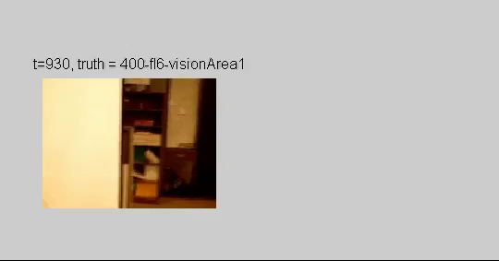
Dynamic Bayes Net in action

Slide 14
Probabilistic Inference
Compute probability of a query variable (or variables) taking on a value (or set of values) given some evidence
Pr[Q | E₁=e₁,...,E_{k}=e_{k}]

Slide 15
General inference procedure
Let’s partition the set of random variables in the model in:
Evidence variables E, and be e the list of observed values from them
Remaining unobserved / hidden variables Y
Query variables X (let’s consider single query for simplicity)
An inference query is P(X | e)? and can be evaluated as:
→ Given the full joint distribution, any probabilistic query can then be answered
Notes:
from prob recall: marginal of a subset of variables + normalization constants)

Slide 16
Inference with BNs
An inference query P(X | e) can be evaluated as:
A BN is a compact way to represent a joint distribution, where the terms in the joint distribution are written as products of conditional probabilities from the network

Slide 17
Exact inference by enumeration
P(B, | J=T, M=T)
Evidence: J, M
Hidden: E, A Query: B

Slide 18
Inference by enumeration

Slide 19
Inference by enumeration
P(B=b) is a constant and can be moved outside the sums
P(e) can be moved outside the summation over a

Slide 20
Inference by enumeration
Top-down DF evaluation:
× Values along each path
+ at the branching nodes
Notes:
This is polytree,

Slide 21
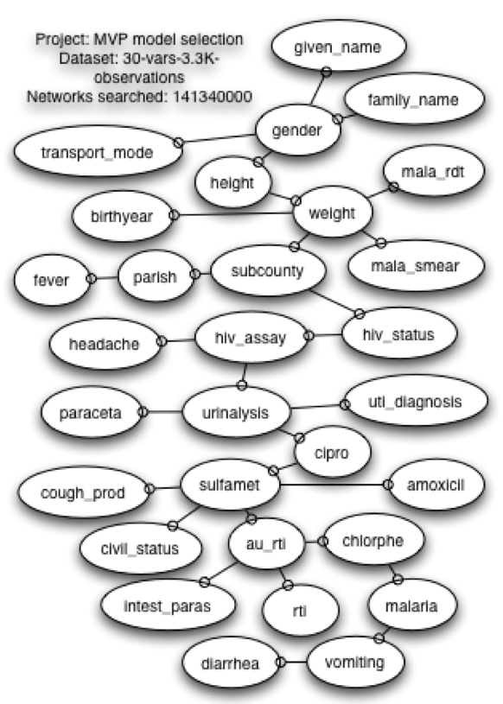
Approximate inference in BN
Exact Inference is intractable in large, multiply connected networks.
Approximate inference methods
Sampling: we express the quantity we want to know as the expected value of a random variable X, such as 𝜇=E(X). Then we generate sample values X₁, ... , X_{n} independently and randomly from the distribution of X and take their sample average as the estimate of 𝜇 (→ law of large numbers)
O(n2^{n}) n = number of nodes
Notes:
Exact: Worse case is NP-hard.
Problems: it might be difficult to sample from X’s distribution; a large number of samples might be needed

Slide 22
Sampling for inference
Have some method for generating samples given a known probability distribution (e.g., uniform in [0,1])
A sample is an assignment of values to each variable in the network
Use samples to approximately compute posterior probabilities
Queries can be issued after finish sampling
X₁ | X₂ | X₃ | X₄ | X₅
T | T | F | T | T
F | F | F | F | T
T | T | T | F | F
T | F | F | F | T
T | T | T | T | T
Prob (T,T,F,F,T)?
#(T,T,F,F,T) / #Samples
P

Slide 23
Approximate Inference
Often interested in:
Posterior probability of taking on any value given some evidence: Pr[Q | E₁=e₁,...,E_{k}=e_{k}]
Most likely explanation given some evidence: argmax_{q} Pr[Q=q | E₁=e1,...,E_{k}=e_{k}]
Imagine we could get samples from the posterior distribution of the query variable given some evidence
Could use these samples to approximate posterior distribution and/or most likely explanation

Slide 24
Wet Grass Example
Variables: Cloudy, Sprinkler, Rain, Wet Grass
Domain of each variable: 2 (true or false)
Joint encodes probability of all combos of variables & values
+c | +s | +r | +w | .01
+c | +s | +r | -w | .01
+c | +s | -r | +w | .05
+c | +s | -r | -w | .1
+c | -s | +r | +w | #
+c | -s | +r | -w | #
+c | -s | -r | +w | #
+c | -s | -r | -w | #
-c | +s | +r | +w | #
-c | +s | +r | -w | #
-c | +s | -r | +w | #
-c | +s | -r | -w | #
-c | -s | +r | +w | #
-c | -s | +r | -w | #
-c | -s | -r | +w | #
-c | -s | -r | -w | #
P(Cloudy=false & Sprinkler = true & Rain = false & WetGrass = True)

Slide 25
Joint as Product of Conditionals (Chain rule)
+c | +s | +r | +w | .01
+c | +s | +r | -w | .01
+c | +s | -r | +w | .05
+c | +s | -r | -w | .1
+c | -s | +r | +w | #
+c | -s | +r | -w | #
+c | -s | -r | +w | #
+c | -s | -r | -w | #
-c | +s | +r | +w | #
-c | +s | +r | -w | #
-c | +s | -r | +w | #
-c | +s | -r | -w | #
-c | -s | +r | +w | #
-c | -s | +r | -w | #
-c | -s | -r | +w | #
-c | -s | -r | -w | #
P(WetGrass|Cloudy,Sprinkler,Rain)*
P(Rain|Cloudy,Sprinkler)*
P(Sprinkler|Cloudy)*
P(Cloudy)
=
Notes:
Product/chain

Slide 26
Conditional Independencies
+c | 0.5
-c | 0.5
+c | +s | +r | +w | .01
+c | +s | +r | -w | .01
+c | +s | -r | +w | .05
+c | +s | -r | -w | .1
+c | -s | +r | +w | #
+c | -s | +r | -w | #
+c | -s | -r | +w | #
+c | -s | -r | -w | #
-c | +s | +r | +w | #
-c | +s | +r | -w | #
-c | +s | -r | +w | #
-c | +s | -r | -w | #
-c | -s | +r | +w | #
-c | -s | +r | -w | #
-c | -s | -r | +w | #
-c | -s | -r | -w | #
Cloudy
+c | +s | .1
+c | -s | .9
-c | +s | .5
-c | -s | .5
+c | +r | .8
+c | -r | .2
-c | +r | .2
-c | -r | .8
Sprinkler
Rain
→
Wet Grass
+s | +r | +w | .99
+s | +r | -w | .01
+s | -r | +w | .90
+s | -r | -w | .10
-s | +r | +w | .90
-s | +r | -w | .10
-s | -r | +w | 0
-s | -r | -w | 1.0
Try different sampling distributions
http://onlinestatbook.com/stat_sim/sampling_dist/index.html
Notes:
Less parameters to specify
Can help with inference

Slide 27
Pr(Cloudy | Sprinkler=T,Rain=T)?
Cloudy
Sprinkler
Rain
Wet Grass
Samples of Cloudy given Sprinkler=T & Rain=T): 1 0 1 1 0 1 1 1 1 0
Posterior probability of taking on any value given some evidence: Pr[Q | E₁=e₁,...,E_{k}=e_{k}]
Pr(Cloudy = T | Sprinkler=T, Rain=T) ≈ .7
Pr(Cloudy = F | Sprinkler=T, Rain=T) ≈ .3
Notes:
http://onlinestatbook.com/stat_sim/sampling_dist/index.html

Slide 28
Sampling From a Distribution
We’ll spend time today talking about different ways to obtain samples from posterior distribution from a Bayes Net
But first, how to sample the value of a single variable

Slide 29
Sampling Single Variable
Consider when have a CPT (conditional probability table) that specifies the probability of C being true or false
Want to sample values from this distribution
Simple approach
r = random # generator between (0,1)
If(r < 0.5) sample = c+ (c=true)
Else sample = c- (c=false)
P(C)
+c | 0.5
-c | 0.5

Slide 30
Sampling with condition
Want to sample s when C=-c (c is false)
Simple approach
r = random # generator between (0,1)
If(r < 0.5) sample = s+
Else sample = s-
Note: can be a bit more complicated for certain parametric distributions
P(S|C)
+c | +s | 0.90
+c | -s | 0.10
-c | +s | 0.5
-c | -s | 0.5

Slide 31
Sampling
Have some method for generating samples given a known probability distribution
Sample will be an assignment of values to each variable in the network
Generally will only be interested in query variables after finish sampling
Use samples to approximately compute posterior probabilities

Slide 32
Direct Sampling
Generate samples from a network with no evidence
Create a topological order of the variables in the Bayes Net
Sample each variable conditioned on the values of its parents

Slide 33
Topological Order
Any ordering in directed acyclic graph where a node can only appear after all of its ancestors in the graph
E.g.
Cloudy, Sprinkler, Rain, WetGrass
Cloudy, Rain, Sprinkler, WetGrass
Cloudy
Sprinkler
Rain
Wet Grass

Slide 34
Direct Sampling
+c | 0.5
-c | 0.5
Cloudy
Sample Pr[C]=(.5,.5) ⇒ true
+c | +s | .1
+c | -s | .9
-c | +s | .5
-c | -s | .5
+c | +r | .8
+c | -r | .2
-c | +r | .2
-c | -r | .8
Sprinkler
Rain
Wet Grass
+s | +r | +w | .99
+s | +r | -w | .01
+s | -r | +w | .90
+s | -r | -w | .10
-s | +r | +w | .90
-s | +r | -w | .10
-s | -r | +w | 0
-s | -r | -w | 1.0

Slide 35
Direct Sampling
Sample Pr[C]=(.5,.5) ⇒ true
Sample Pr[S|C=t]=(.1,.9) ⇒ false
+c | 0.5
-c | 0.5
Cloudy
+c | +s | .1
+c | -s | .9
-c | +s | .5
-c | -s | .5
+c | +r | .8
+c | -r | .2
-c | +r | .2
-c | -r | .8
Sprinkler
Rain
Wet Grass
+s | +r | +w | .99
+s | +r | -w | .01
+s | -r | +w | .90
+s | -r | -w | .10
-s | +r | +w | .90
-s | +r | -w | .10
-s | -r | +w | 0
-s | -r | -w | 1.0

Slide 36
Direct Sampling
+c | 0.5
-c | 0.5
Sample Pr[C]=(.5,.5) ⇒ true
Sample Pr[S|C=t]=(.1,.9) ⇒ false
Sample Pr[R|C=t]=(.8,.2) ⇒ true
Cloudy
+c | +s | .1
+c | -s | .9
-c | +s | .5
-c | -s | .5
+c | +r | .8
+c | -r | .2
-c | +r | .2
-c | -r | .8
Sprinkler
Rain
Wet Grass
+s | +r | +w | .99
+s | +r | -w | .01
+s | -r | +w | .90
+s | -r | -w | .10
-s | +r | +w | .90
-s | +r | -w | .10
-s | -r | +w | 0
-s | -r | -w | 1.0

Slide 37
Direct Sampling
+c | 0.5
-c | 0.5
Cloudy
Sample Pr[C]=(.5,.5) ⇒ true
Sample Pr[S|C=t]=(.1,.9) ⇒ false
Sample Pr[R|C=t]=(.8,.2) ⇒ true
Sample Pr[W|S=f,R=t]=(.9,.1) ⇒ true
Sampled [t,f,t,t]
+c | +s | .1
+c | -s | .9
-c | +s | .5
-c | -s | .5
+c | +r | .8
+c | -r | .2
-c | +r | .2
-c | -r | .8
Sprinkler
Rain
Wet Grass
+s | +r | +w | .99
+s | +r | -w | .01
+s | -r | +w | .90
+s | -r | -w | .10
-s | +r | +w | .90
-s | +r | -w | .10
-s | -r | +w | 0
-s | -r | -w | 1.0
Notes:
Remind them of notation

Slide 38
Direct Sampling
Sampling process generates samples from prior joint distribution specified by BN
Use samples to estimate probability of a specific event
Reminder: event is assignment of values to variables
Pr[X₁=x₁,...,X₅=x₅] ≈ #(x₁,...,x₅)/#samples
≈ means becomes exact in large-sample limit
Implies estimate is consistent
Notes:
Why should we want this?

Slide 39
Rejection sampling
What about when we have evidence?
Want to estimate Pr[Rain=t|Sprinkler=t] using 100 direct samples
73 have S=f, of which 12 have R=t
27 have S=t, of which 8 have R=t
What’s the estimate?
20/100
12/73
8/27
Not sure.
Notes:
8/27
Good/bad?

Slide 40

Rejection sampling
What about when we have evidence?
Use direct sampling
Reject all samples inconsistent with evidence, and estimate probability of events in remaining samples
Problem: try to estimate Pr[Rain|RedSkyAtNight=t]!
Notes:
Why is this a problem? Most samples won’t match

Slide 41
Solution: Likelihood weighting
Current approach: generate samples until have many that agree with evidence
Proposed approach:
Generate only samples that agree with evidence
Weight them according to likelihood of evidence

Slide 42
Generating a Sample Using Likelihood Weighting
Select a topological ordering of variables
Set w = 1
x ← an event with n-elements, including evidence variables
For each variable X_{i} in order (X₁,X₂,…):
If X_{i} is an evidence variable with value e_{i}
Update w ← w * P(X_{i} = e_{i} |Parents(X_{i}))
Else x[i] ← sample from P(X_{i} | Parents(X_{i}))
Notes:
Compute the probability and update the weight of that sample. Likelihood weighting verus importance sampling.

Slide 43
Likelihood weighting
+c | 0.5
-c | 0.5
Evidence: C=t,W=t
C is evidence var ⇒ w = 1⋅Pr[C=t] = 0.5
Cloudy
+c | +s | .1
+c | -s | .9
-c | +s | .5
-c | -s | .5
+c | +r | .8
+c | -r | .2
-c | +r | .2
-c | -r | .8
Sprinkler
Rain
Wet Grass
+s | +r | +w | .99
+s | +r | -w | .01
+s | -r | +w | .90
+s | -r | -w | .10
-s | +r | +w | .90
-s | +r | -w | .10
-s | -r | +w | 0
-s | -r | -w | 1.0

Slide 44
Likelihood weighting
+c | 0.5
-c | 0.5
Cloudy
Evidence: C=t,W=t
C is evidence var ⇒ w = 1⋅Pr[C=t] = 0.5
Sample Pr[S|C=t]=(.1,.9) ⇒ false
+c | +s | .1
+c | -s | .9
-c | +s | .5
-c | -s | .5
+c | +r | .8
+c | -r | .2
-c | +r | .2
-c | -r | .8
Sprinkler
Rain
Wet Grass
+s | +r | +w | .99
+s | +r | -w | .01
+s | -r | +w | .90
+s | -r | -w | .10
-s | +r | +w | .90
-s | +r | -w | .10
-s | -r | +w | 0
-s | -r | -w | 1.0

Slide 45
Likelihood weighting
+c | 0.5
-c | 0.5
Evidence: C=t,W=t
C is evidence var ⇒ w = 1⋅Pr[C=t] = 0.5
Sample Pr[S|C=t]=(.1,.9) ⇒ false
Sample Pr[R|C=t]=(.8,.2) ⇒ true
Cloudy
+c | +s | .1
+c | -s | .9
-c | +s | .5
-c | -s | .5
+c | +r | .8
+c | -r | .2
-c | +r | .2
-c | -r | .8
Sprinkler
Rain
Wet Grass
+s | +r | +w | .99
+s | +r | -w | .01
+s | -r | +w | .90
+s | -r | -w | .10
-s | +r | +w | .90
-s | +r | -w | .10
-s | -r | +w | 0
-s | -r | -w | 1.0

Slide 46
Likelihood weighting
+c | 0.5
-c | 0.5
Evidence: C=t,W=t
C is evidence var ⇒ w = 1⋅Pr[C=t] = 0.5
Sample Pr[S|C=t]=(.1,.9) ⇒ false
Sample Pr[R|C=t]=(.8,.2) ⇒ true
W is evidence var ⇒ w = 0.5⋅Pr[W=t|S=f,R=t] = .45
Sampled [t,f,t,t] with weight .45, tallied under R=t
Cloudy
+c | +s | .1
+c | -s | .9
-c | +s | .5
-c | -s | .5
+c | +r | .8
+c | -r | .2
-c | +r | .2
-c | -r | .8
Sprinkler
Rain
Wet Grass
+s | +r | +w | .99
+s | +r | -w | .01
+s | -r | +w | .90
+s | -r | -w | .10
-s | +r | +w | .90
-s | +r | -w | .10
-s | -r | +w | 0
-s | -r | -w | 1.0

Slide 47
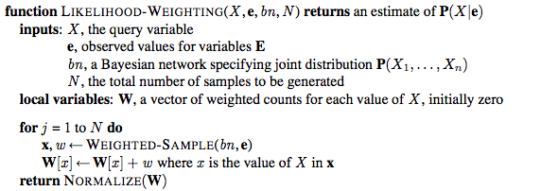
Likelihood Weighting: Computing P(X|e)
Notes:
Example: probability of rain.
Be clear what normalization is

Slide 48
Consistency
In the limit of infinite samples, estimated Pr[Q | E₁=e₁,...,E_{k}=e_{k}] will converge to true posterior probability
Desirable property (otherwise always have some error)

Slide 49
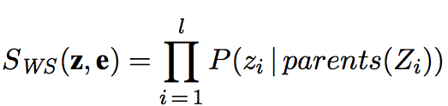
Consistency
Samples each non-evidence variable z in a sample according to
Is this the true posterior distribution P(z|e)?
No, but weights fix this!
Notes:
On the other hand, SWS pays less attention to the evidence than does the true posterior distribution P (z | e), because the sampled values for each Zi ignore evidence among Zi’s non-ancestors.5 For example, when sampling Sprinkler and Rain the algorithm ignores the evidence in the child variable WetGrass = true ; this means it will generate many samples with Sprinkler = false and Rain = false despite the fact that the evidence actually rules out this case.
No, why?
Doesn’t consider evidence that is not an ancestor…
Weights fix this!

Slide 50
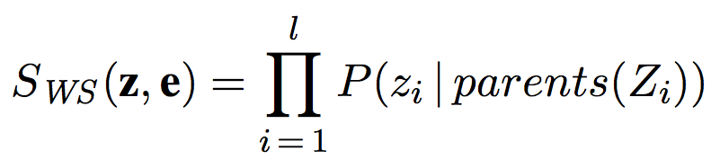
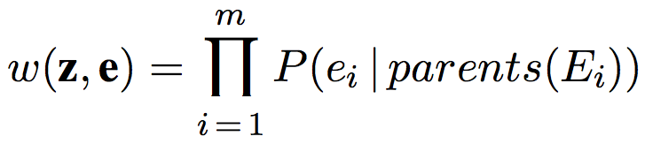
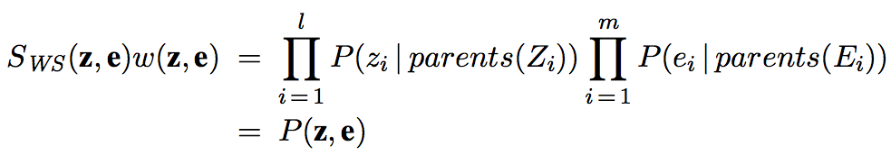
Weighted Probability
Samples each non-evidence variable z according to
Weight of a sample is
Weighted probability of a sample is
Notes:
Because covers all variables in network. Product rule
From chain rule & conditional independence.

Slide 51
Pool
When sampling S and R the evidence W=t is ignored
Samples with S=f and R=f although evidence rules this out
Weight makes up for this difference
above weight would be 0
If we have 100 samples with R=t and total weight 1, and 400 samples with R=f and total weight 2, what is estimate of R=t?
1. 1/9
2. 1/3
3. 1/5
4. no idea.
Notes:
= 1/ 3

