Slide 1
Bayesian Networks
Tai Sing Lee
15-381/681 AI Lecture 10
Read Chapter 14.1-3 of Russell & Norvig
With thanks to Dan Klein (Berkeley), Percy Liang (Stanford) and Past 15-381 Instructors for slide contents, particularly Ariel Procaccia, Emma Brunskill and Gianni Di Caro.
Notes:
Syntax = the grammatical arrangement of words in sentences
a systematic orderly arrangement
Semantics: the meaning of a word, phrase, sentence, or text

Slide 2

Summary from last time
Definitions / facts
  Language of probability
  Conditional probability
  Probabilistic inference
Three useful rules:
  Chain Rule
  Bayes’ Rule
  Sum Rule

Slide 3
Bayesian networks
We can answer any query using the joint probability table.
But: full joint distribution is hard to estimate and too big to represent explicitly.
Bayes’ net: describes complex joint distributions (model) using simple, local distributions (conditional probabilities)
  Graphical models
  How local variables interact
  How local interaction chain together to give global, indirect interaction.

Slide 4
The Burglar Scenario
I’m at work, neighbor John calls to say my alarm is ringing, but neighbor Mary doesn’t call. Sometimes it’s set off by minor earthquakes. Is there a burglar?
How do we model this scenario? Causal knowledge --
  A burglar can set the alarm off
  An earthquake can set the alarm off
  The alarm can cause Mary to call
  The alarm can cause John to call
Variables: Burglar, Earthquake, Alarm, JohnCalls, MaryCalls

Slide 5
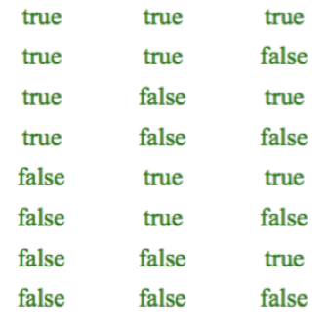
Joint probability table for 3 variables
Alarm Earthquake Burglar
Joint Probability
Now, how big is this table when we have 5 variables?

Slide 6
Patient Visit Scenario
Joint distribution over:
  LastName, FirstName, Gender, Height, Birthdate, Weight, Fever, Subcounty, HIV status, HIV assay, Headache, UTI diagnosis, Vomiting, Diarrhea, Malaria, Cipro, Productive cough, Civil Status, TransportMode …
Notes:
How many parameters need to represent joint?
Potential computational cost?

Slide 7
Chain rule

Slide 8
Bayes rule

Slide 9
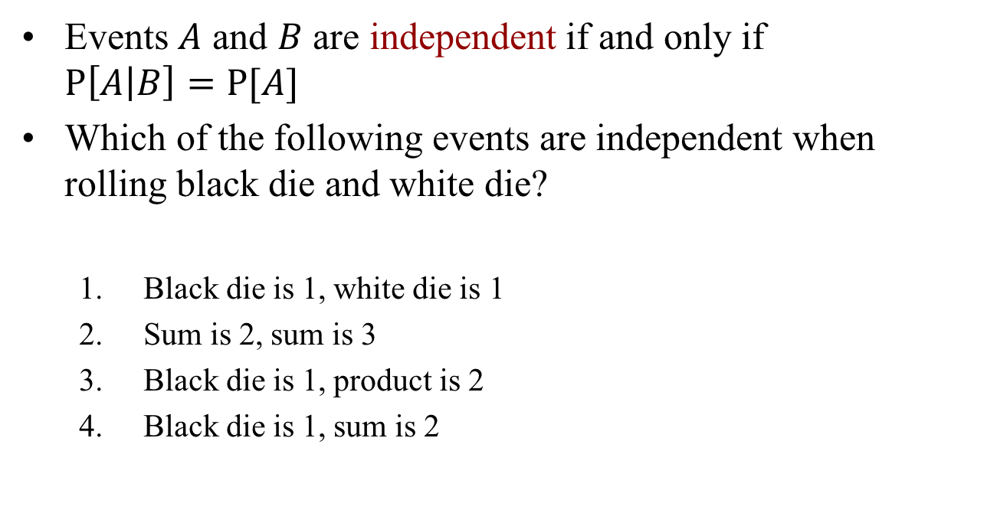
Notion of Independence
Events $A$ and $B$ are independent if and only if $P\left[A | B\right]=P{[A]}$
Which of the following events are independent when rolling black die and white die?
  Black die is 1, white die is 1
  Sum is 2, sum is 3
  Black die is 1, product is 2
  Black die is 1, sum is 2

Slide 10
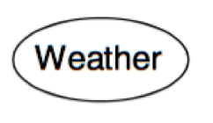
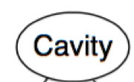
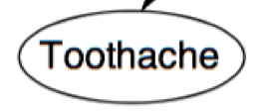

Independence
Events $A$ and $B$ are independent if and only if $P\left[A | B\right]=P{[A]}$
?
?
?
?
On-Time

Slide 11
Independence
Poll 1: x and y are independent in
1. Case 1
2. Case 2
3. None
4. Both Cases

Slide 12
Independence
Two RVs are independent if: P(X₁, X₂) = P(X₁)P(X₂)
n variables are independent if: P(X₁, X_{2, ...,} X_{n}) = P(X₁)P(X₂)...P(X_{n})
Are x and y are independent in the following two cases?
Case 1

Slide 13
Independence
Are x and y independent in this case?
Case 2

Slide 14
Conditional Independence
Cavity can cause toothache and caused “probe” (of a dentist) to be caught in a tooth. Are toothache and catch independent?
Notes:
They are correlated. But correlation is not causation.

Slide 15
Conditional Independence
If a probe catches in the tooth, then it is likely the tooth has a cavity and the cavity causes toothache. They are NOT independent.

Slide 16
Conditional Independence
However, these variables (toothache, catch) become independent given the knowledge about the absence or presence of a cavity.
Cavity explains away their dependency.

Slide 17
Conditional Independence
X₁ and X₂ are conditionally independent given X₃ if: P(X₁ | X_{2,} X₃ ) = P(X₁ | X₃)
Once the value of X₃ is known, knowing X₂ doesn’t tell anything more about X₁
Another way of saying the same thing,
P(X₁, X₂ | X₃ ) = P(X₁ | X₃) P(X₂ | X₃)
In a sense, the dependence between X₁ and X₂ “dissolves” once the knowldge about X₃ is made available

Slide 18
Conditional Independence
Weather is conditionally independent of other variables
Toothache and Catch are conditionally independent given Cavity
P(toothache, catch | cavity ) = P(toothache | cavity) P(catch | cavity)

Slide 19
Conditional independence table
Poll 2: With the understanding of the dependency of these three variables in their joint probability table, how many numbers (rows) of probability do you need now to represent the joint probability table?
  1. 6
  2. 5
  3. 4
  4 . 3
How many numbers do you need to represent the joint table originally? All variables here are binary.

Slide 20
The burglar scenario
I’m at work, neighbor John calls to say my alarm is ringing, but neighbor Mary doesn’t call. Sometimes it’s set off by minor earthquakes. Is there a burglar?
How do we model this scenario?
  A burglar can set the alarm off
  An earthquake can set the alarm off
  The alarm can cause Mary to call
  The alarm can cause John to call
Variables: Burglar (B), Earthquake (E), Alarm (A), JohnCalls (J), MaryCalls (M)

Slide 21
A Compact Network to Represent Knowledge
Notes:
How to code this network? Why coding network this way?
It is a way to encode causal knowledge.

Slide 22
Bayesian networks
Graphical data structure for conditional independence assertions → A compact specification of full joint distributions
A set of nodes, one per variable X
A directed, acyclic graph (link ≈ “directly influences”)
A CPT (conditional probability table) for each node
  Collection of distributions over X, one for each combination of parents’ values
A Bayes net = topology (graph) + local conditional probabilities
Notes:
A node is a parent of a child (or successor) if there is an arc from the former to the latter
If there is a directed chain of nodes, a node is ancestor of another if it appears earlier in the chain, a descendant if it appears later

Slide 23
Answering query using this Network
Notation: J=T, M=T, A=T, B=T, E=F is indicated as j,m,a,b,-e
How to read this out?

Slide 24
Answering query using this Network
Notation: J=T, M=T, A=T, B=T, E=F is indicated as j,m,a,b,-e

Slide 25
Bayesian networks
Bayes network: a compact representation of a joint probability distribution in terms of conditional distribution
A conditional distribution for each node given its parents: P(X_{i} | Parents(X_{i}))
It can be a Conditional Probability Table (CPT) giving the distribution over X_{i} for each combination of the parent values

Slide 26
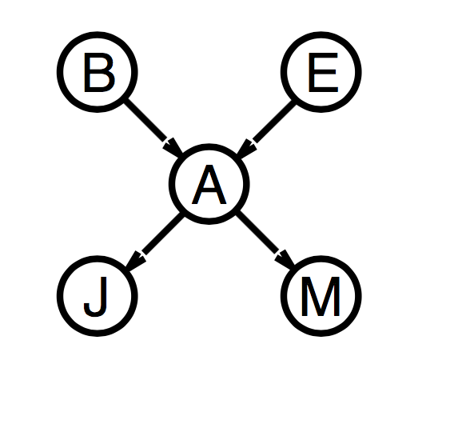
A compact representation
A CPT for binary variables X_{i} each with k parents has 2^{k} rows for the combination of parent values
If each variable has no more than k parents, the network requires O(n2^{k}) parameter values to specify the CPTs
i.e. grows linearly with n, while the full joint distribution goes as O(2^{n})
burglary example: 1+1+4+2+2=10 numbers, vs. 2⁵-1=31

Slide 27
Global semantics
Global semantics: define the full joint distribution as the product of the local conditional distributions
＊

Slide 28
Global semantics
The derivation stems from the chain rule:
This holds for any set of variables, in particular, by numbering the variables in a way that is consistent with the partial order implicit in the graph structure.

Slide 29
Local semantics
Local semantics: each node is conditionally independent of
its non-descendants given its parents
Local semantics ⟺ Global semantics
Notes:
U₁, U_{m} = Parents
Y₁, Y_{n} = Descendants
Z_{ij} = Other nodes from which X is conditionally independent
John call is independent of bulgary. Earthquke and Marycall given the alarm.
The key is that the values of y1 and y2 are not given, so x and z are conditionally independent. If y1 and y2 are given, then they are not.

Slide 30
Markov Blanket
Each node is conditionally independent of all others given its Markov blanket: parents + children + children’s parents.
Notes:
For example, burglary is independent of J and M given Alarm and Earthquake.

Slide 31
Markov Blanket
Each node is conditionally independent of all others given its Markov blanket: parents + children + children’s parents.
Notes:
For example, bugary is indepddnent of J and M given Alarm and Earthquake.

Slide 32
Markov Blanket Poll
Markov blanket
  Parents
  Children
  Children’s parents
Pool 3: What is the Markov blanket of D?
  A,F,G
  A,F,G,E
  A,F,G,E,B,C
  Not sure
B
C
A
D
E
G
F
H
Notes:
Ahswer is A,F, G, E.

Slide 33
Markov Blanket & Independence
Variable conditionally independent of all other nodes given know values of all variables in its Markov Blanket
Ex: Evidence is G=True. Is E conditionally independent of A given G=True?
B
C
A
D
E
G
F
H
Notes:
Not necessarily

Slide 34
Construction of a BN
Make a series of locally testable assertions of conditional independence guarantees the required global semantics
Add link, write down CPT.

Slide 35
Order matters (for efficiency)
Parents of X_{i} should contain all those nodes in X₁,…,X_{i-1} that directly influence X_{i}.
You can order the variables in anyway you wish, but how to order the variables is important.
Consider a particular order: M, J, A, B, E
Notes:
arcs should go from causes to effects, rather than the reverse, that would require to specify additional dependencies among otherwise independent causes
If M=T then likely Alarm=T, which makes likely that J=T → M parent of J
If both M=T & J=T, then it’s likely that A=T → M and J parents of A
If A=T then M and J do not give any information about B → A is the only parent of B
If A=T then E is likely, but if also B=T, then this would explain A → Both A and B are parents of E

Slide 36
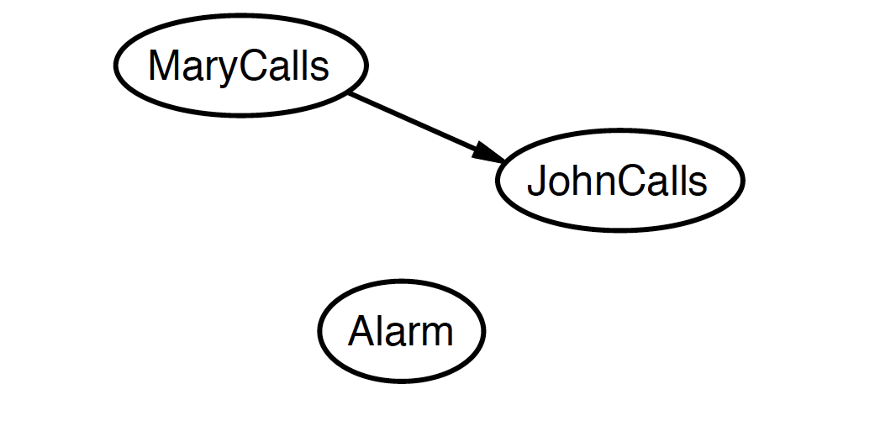
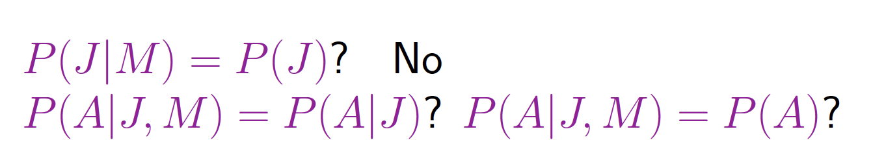
Order matters (for efficiency)
Consider a particular order: M, J, A, B, E

Slide 37
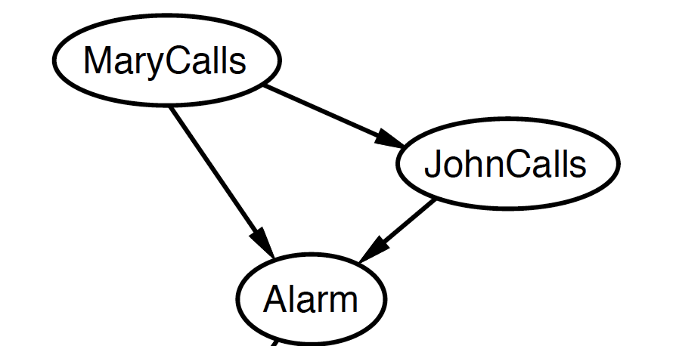
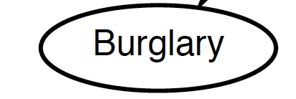


Order matters (for efficiency)
Consider a particular order: M, J, A, B, E

Slide 38
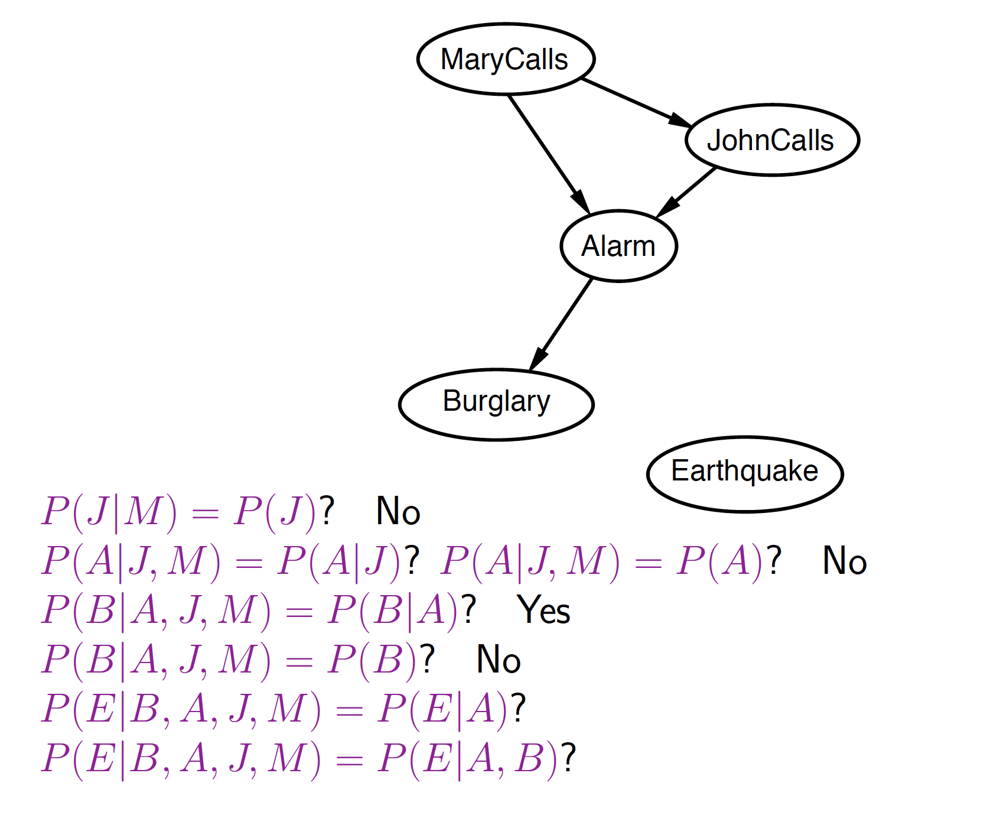
Order matters (for efficiency)
Consider a particular order: M, J, A, B, E

Slide 39
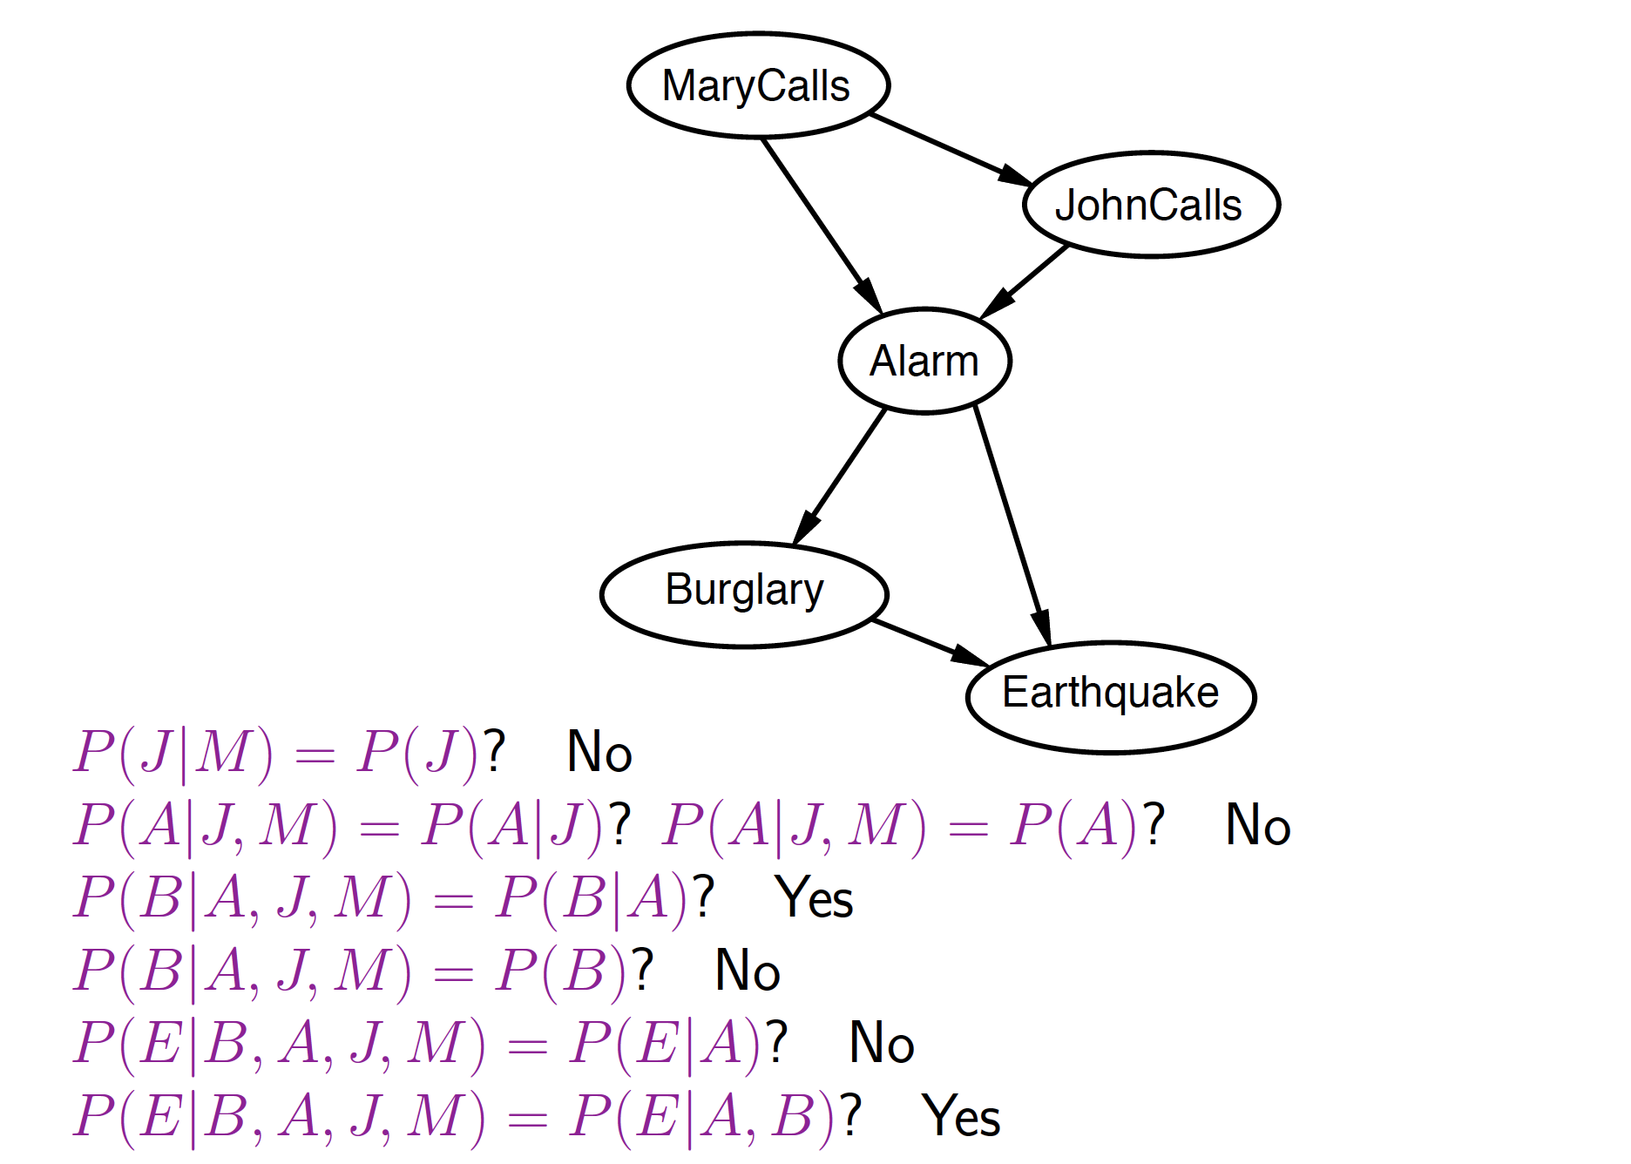
Order matters (for efficiency)
Consider a particular order: M, J, A, B, E

Slide 40
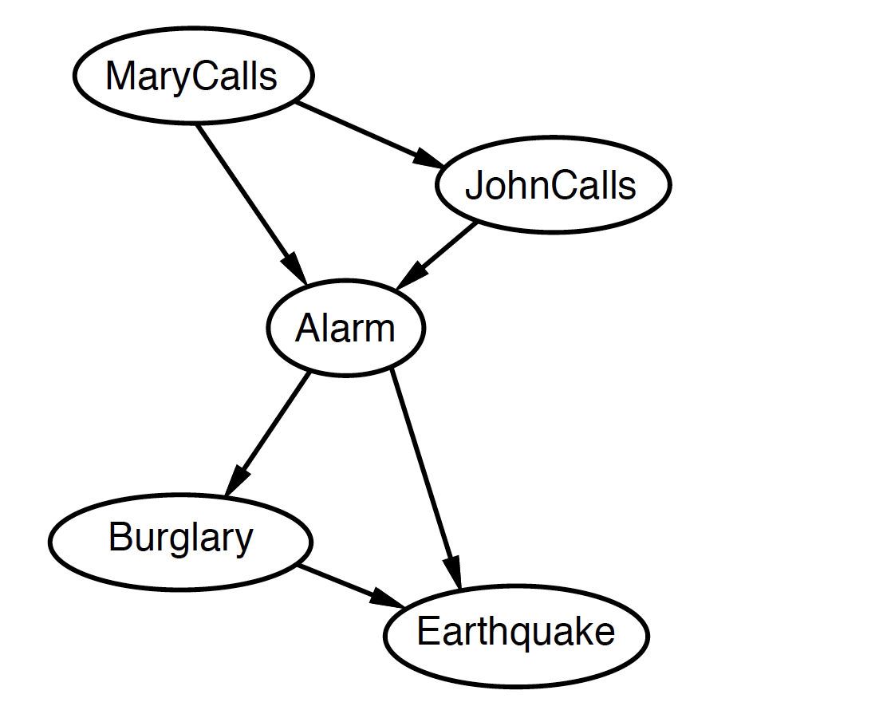
Order matters (for efficiency)
Both are legitimate Bayesian Networks. Which one is better?
Notes:
What is the difference between these two networks? One is causal, the other is “non-causal”.

Slide 41
Order matters (for efficiency)
Deciding conditional independence is hard in non-causal directions
Causal models and conditional independence seem hardwired for humans!
Assessing conditional probabilities is hard in non-causal directions.
Network is less compact 1+2+4+2+4= 13 numbers needed.

Slide 42
Use of Bayesian Networks
Diagnosis: P(cause | symptom)?
Prediction: P(symptom | cause)?
Classification: max_{class} P(class | data)
Decision-making (given a cost function)

Slide 43
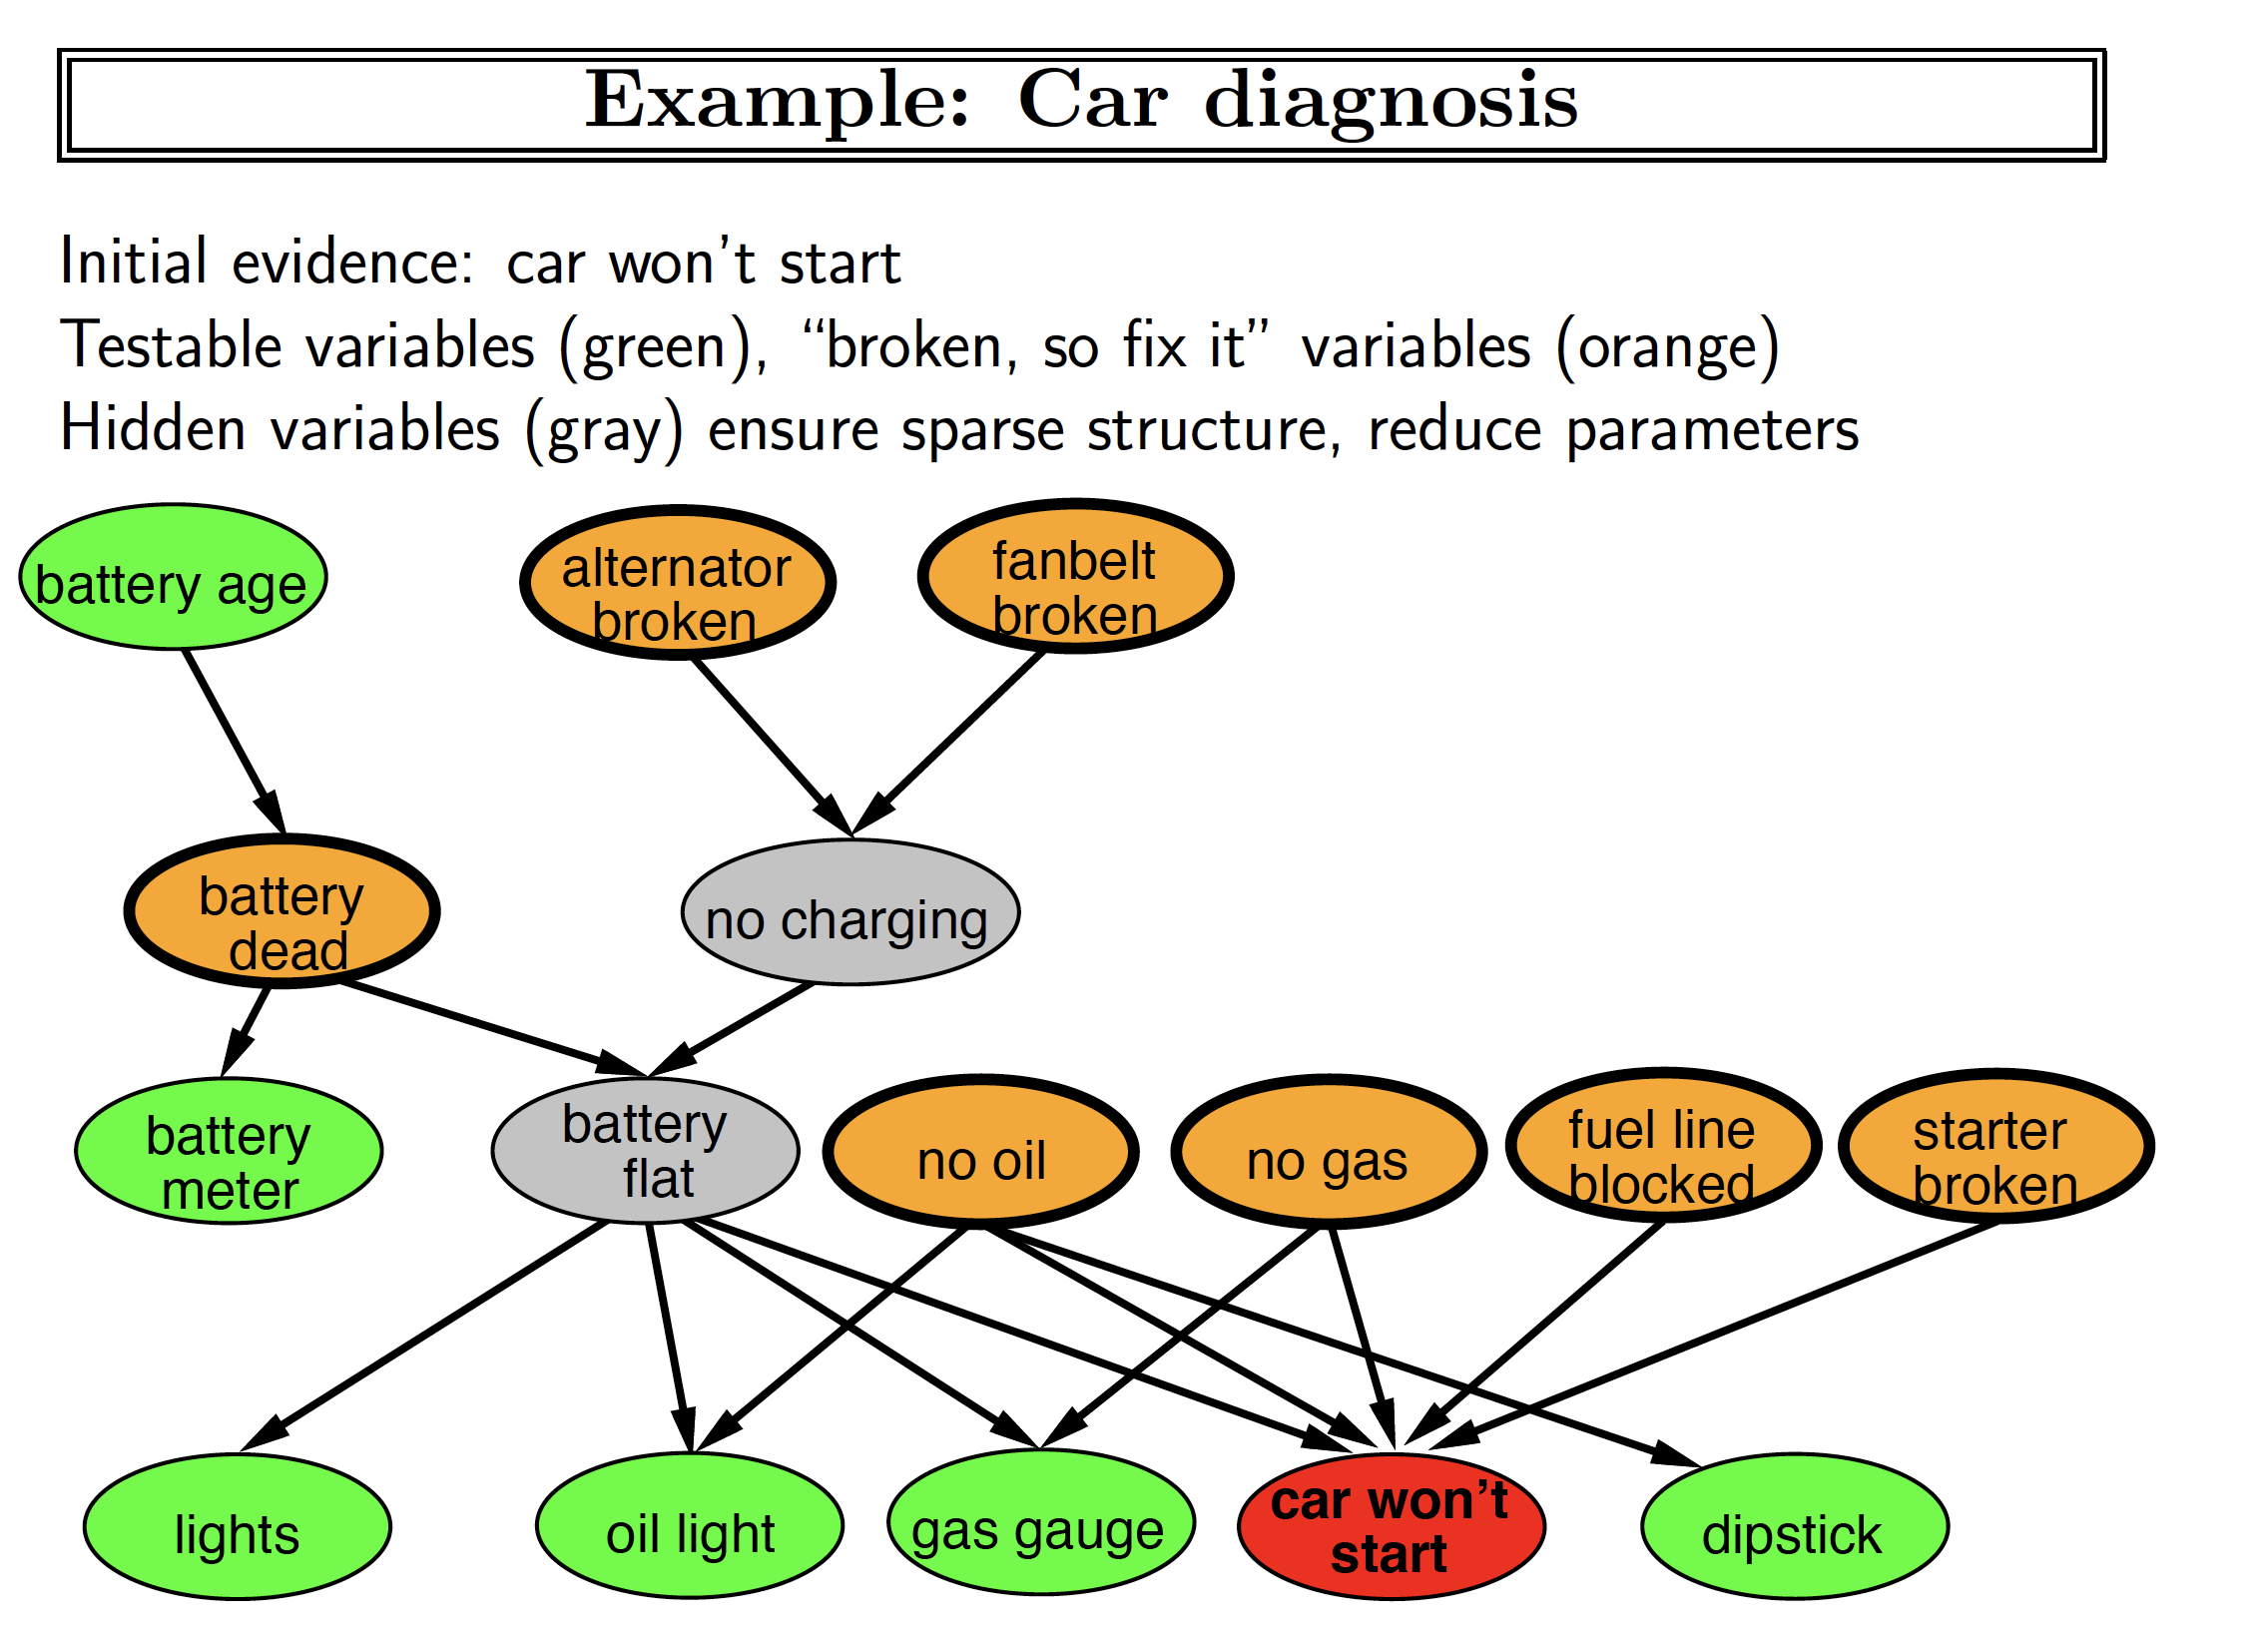
Russel and Novig

Slide 44
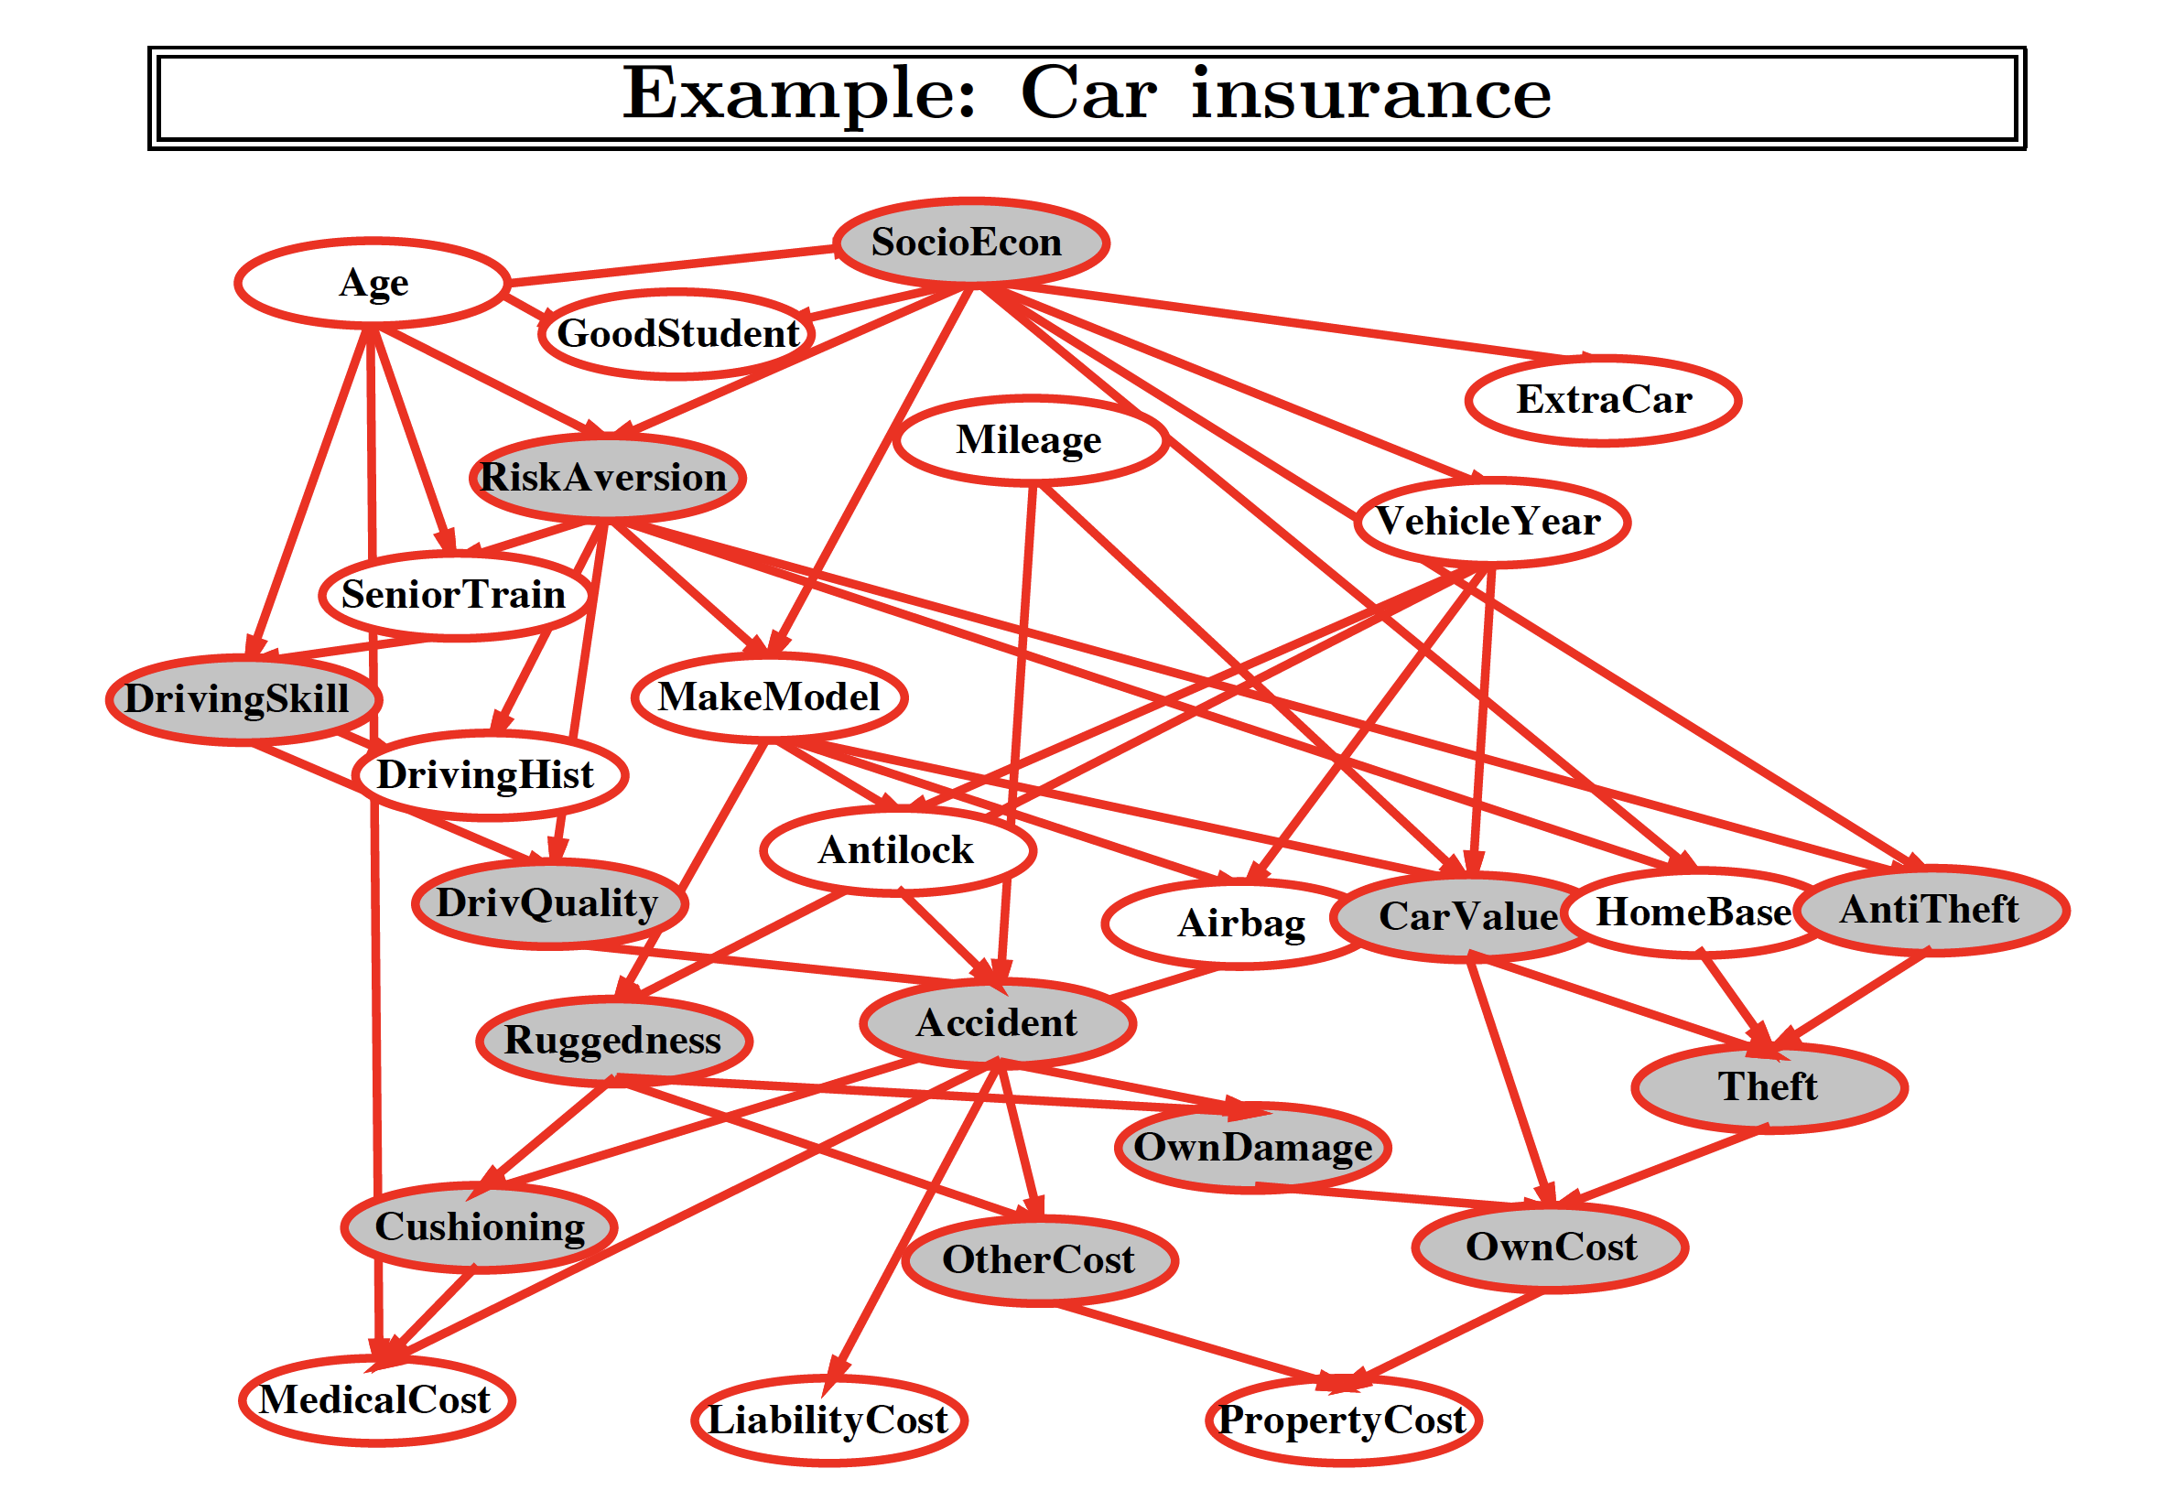
Russel and Novig

Slide 45
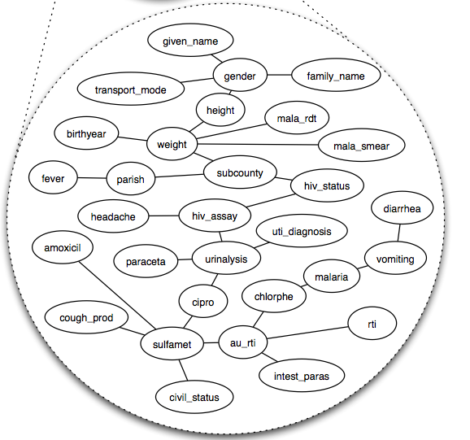
Patient Visit Bayes Net
Figure: Chen, Hellerstein, Parikh, UIST 2010

Slide 46
Dynamic Bayes Net
Temporal models with hidden variables: (HMM, DBN)
The variable representing the state of the environment at time t , Rain_{t}(T/F), is not directly observable (hidden) but defines causal dynamics
The variable Umbrella_{t}(T/F) is the evidence variable at time t
Filtering / State estimation: Probability of Rain_{t} given evidence in 1:t
Prediction: Probability of Rain_{t+1} given evidence in 1:t

Slide 47
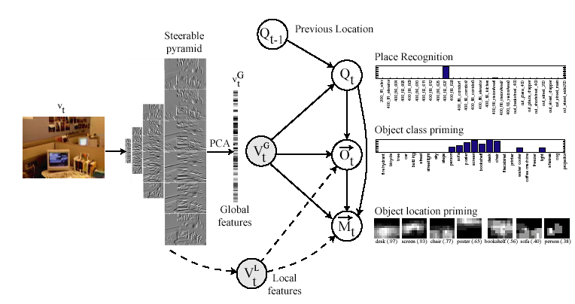
Place and object recognition using dynamic Bayes net
Torralba, et al. ICCV, 2003. Context-based vision system for place and object recognition.

Slide 48
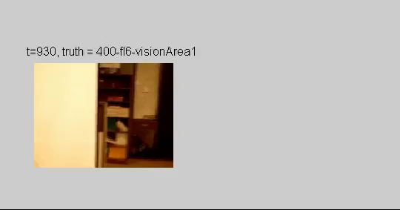
Dynamic Bayes Net in action

Slide 49
Summary
Bayes net compactly encode joint distributions to facilitate learning and inference.
Guaranteed independencies of distributions can be deduced from BN graphical structure.

