Slide 1
Deep Belief Nets II
Tai Sing Lee
15-381/681 AI Lecture 13
Supplementary readings:
Hinton, G.E. (2007) Learning multiple layers of representations, recommended.
See other papers for optional reading.
With thanks Geoff Hinton for slides in this DBN lecture, and G.A. Di Caro for the conditional independence slides.
Notes:
Syntax = the grammatical arrangement of words in sentences
a systematic orderly arrangement
Semantics: the meaning of a word, phrase, sentence, or text

Slide 2
Mid-term preparation
For my part: Study the pool questions during class, focused on basic concepts, maybe do some simple calculations.
Probability. Remember chain rule, Bayes rule, sum rule.
Bayes Net – conditional independence, chain rule, factorization.
Sampling – understand the different sampling methods and the motivation and situations for using them.
Deep belief net -- BM and rBM, deep rBM, basic concepts, what they can do.
Focus on concepts, rather than memorization of equations

Slide 3
Independence & information propagation
Question: Given a BN structure what dependence and independence relationships are represented?
How information propagates over the network?

Slide 4
Independence & information propagation
Types of probabilistic relationships

Slide 5
Converging connection
(common effect)
If neither Z nor any of its descendants are observed, X and Y are independent.
Information cannot be transmitted through Z among parents of Z.
If Z or any of its descendants are observed, X and Y are dependent.
Information can be transmitted through Z among parents of Z if Z or any of its descendants are observed. Observing Z or its descendants opens the information path.
Notes:
Subtlety: why the cascaded version of the AND rather than feeding all OR clauses into a single AND? Answer: a single AND would have an exponentially large CPT, whereas with representation
above the Bayes’ net has small CPTs only.
! Hence inference in Bayes’ nets is NP-hard. No known efficient probabilistic inference in general.
32If we can answer P(z) equal to zero or not, we answered whether the 3-SAT problem has a solution.
! Subtlety: why the cascaded version of the AND rather than feeding all OR clauses into a single
AND? Answer: a single AND would have an exponentially large CPT, whereas with representation
above the Bayes’ net has small CPTs only.
! Hence inference in Bayes’ nets is NP-hard. No known efficient probabilistic inference in general.
32

Slide 6
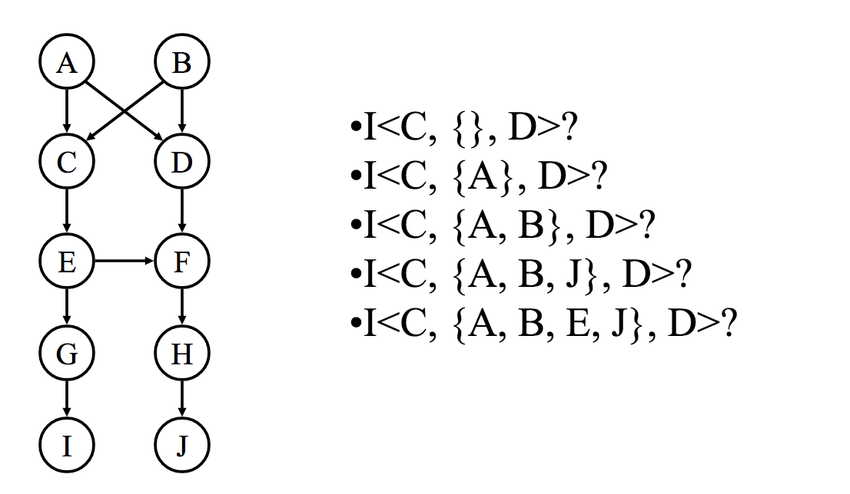
Pool : Are C and D independent, given { X}?
False. True, True, False, True
True, True, True, True, True
False, False, False, True, True
True, False, False, True, False
False, False, True, False, True
Notes:
Subtlety: why the cascaded version of the AND rather than feeding all OR clauses into a single AND? Answer: a single AND would have an exponentially large CPT, whereas with representation
above the Bayes’ net has small CPTs only.
! Hence inference in Bayes’ nets is NP-hard. No known efficient probabilistic inference in general.
32If we can answer P(z) equal to zero or not, we answered whether the 3-SAT problem has a solution.
! Subtlety: why the cascaded version of the AND rather than feeding all OR clauses into a single
AND? Answer: a single AND would have an exponentially large CPT, whereas with representation
above the Bayes’ net has small CPTs only.
! Hence inference in Bayes’ nets is NP-hard. No known efficient probabilistic inference in general.
32

Slide 7
Markov Chain Monte Carlo Methods
Direct, rejection and likelihood weighting methods generate each new sample from scratch
MCMC generate each new sample by making a random change to preceding sample
Notes:
Can view algorithm as being in a particular state (assignment of values to each variable)

Slide 8
Belief Nets
A belief net is a directed acyclic graph composed of stochastic variables.
Hidden variables (not observed) and visible variables
The inference problem: Infer the states of the unobserved variables.
The learning problem: Learn interaction between variables to make the network more likely to generate the observed data.
stochastic
hidden causes
visible units:
observations
Notes:
We will use nets composed of layers of stochastic binary variables with weighted connections. Could be generalized to other types of variable.

Slide 9
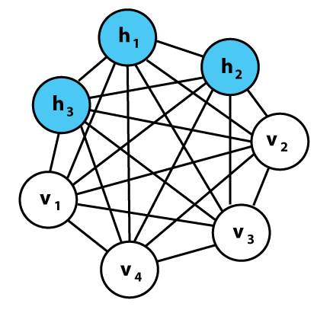
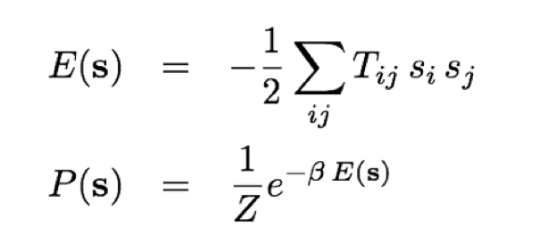
The Boltzmann Machine
(Hinton and Sejnowski 1985)
Energy of a state
Probability of
being in a state
_{T = w connections}
Notes:
A Boltzmann machine is a type of stochastic recurrent neural network invented by Geoffrey Hinton and Terry Sejnowski. Boltzmann machines can be seen as the stochastic, generative counterpart of Hopfield nets. They were one of the first examples of a neural network capable of learning internal representations, and are able to represent and (given sufficient time) solve difficult combinatoric problems.
The network is run by repeatedly choosing a unit and setting its state according to the above formula. After running for long enough at a certain temperature, the probability of a global state of the network will depend only upon that global state's energy,
Add hidden layers, the network can now capture more than correlation in the data. Otherwise, we will just learn the pairwise statistics.
One way to make the system learn higher order correlation is by adding the hidden units.
Now the full distributions of the hidden units and the visibile units.
P(s^v, s^h) = 1/Z e^{ \sum_{ij} T_{ij}^W Si^v s_j^v + \sum ij s_ivsj^hTij^hv+ \sum_{ij} Tij^hhs_ihs_j^h.
Terms coupling visible with hidden, and hidden with hidden, and visible with hidden.
Want to write probability of visibile units only.
P(s^v) = \sum_{s^h} P(s^v, s^h).
Marginalize, sum over a set of variables, sum of all the states of the hidden variables, n units, sum over 2^n states, huge sum.
Delta T^vh, delta T^hh, takes the log and calculates the derivatives. Same step. To calculate the learning rules.
his means that log-probabilities of global states become linear in their energies. This relationship is true when the machine is "at thermal equilibrium", meaning that the probability distribution of global states has converged. If we start running the network from a high temperature, and gradually decrease it until we reach a thermal equilibrium at a low temperature, we are guaranteed to converge to a distribution where the energy level fluctuates around the global minimum. This process is called simulated annealing.

Slide 10
Pool
Which of the following three sampled configurations of states has the higher probability of occurring?
1
0.9
1
-1
0.9
-1
1
0.9
-1
0.8
0.8
0.8
1
-0.7
-1
-0.7
1
-0.7
0.2
0.2
0.2
-1
-1
-1
A B C
A
B
C
Not sure.

Slide 11
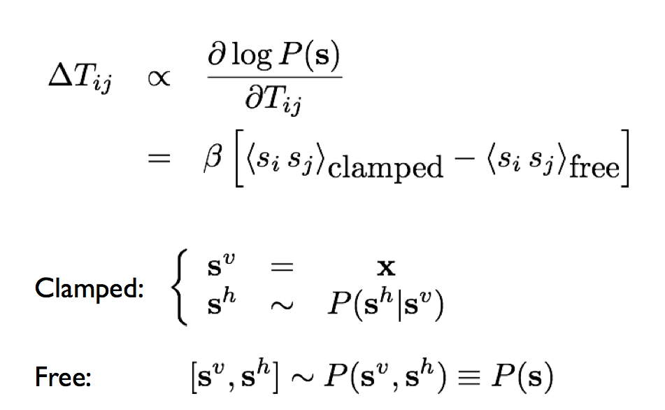
Learning in Boltzmann machine
Hebbian learning fantasy/expectation
input
Direct sampling from the distributions
Learn to model the data distribution of the observable units.
Notes:
For the case of visible units only, first term, clamp states: set the visibile units to the data, , there are two phrases: fist phrase, learn from the world, and compare with the free states, sampling the visibile units from the joint distributions.
Sampling: Gibbs sampling. Proceed coordinate-wise, fix the others, get the distribution for this kind, and sample from that one.
Hebbian learning rule, learning during the day, and sampling through the night, and to compare with each other.
Free states, sampling from the joint.
For hidden units, the clamped states, hiddnen units have no data to set to, but they do have the posterior, but this makes learning
S^h~ P(s^h|s^v=x).
In Boltzmann machine difficult.
When you put hidden units, things slow down.

Slide 12
Restricted Boltzmann Machines
(Smolensky ,1986, called them “harmoniums”)
We restrict the connectivity to make learning easier.
  Only one layer of hidden units.
    Learn one layer at a time …
  No connections between hidden units.
In an RBM, the hidden units are conditionally independent given the visible states.
  So we can quickly get an unbiased sample from the posterior distribution when given a data-vector.
  This is a big advantage over directed belief nets
hidden
j
i
visible
1
0
0

Slide 13
The Energy of a Joint Configuration
binary state of visible unit i
binary state of hidden unit j
Energy with configuration v on the visible units and h on the hidden units
weight between units i and j
Notes:
(ignoring terms to do with biases)

Slide 14
Using energies to define probabilities
The probability of a joint configuration over both visible and hidden units depends on the energy of that joint configuration compared with the energy of all other joint configurations.
The probability of a configuration of the visible units is the sum of the probabilities of all the joint configurations that contain it.
partition function
Hinton

Slide 15
A picture of the maximum likelihood learning algorithm for an RBM
j
j
j
j
a fantasy
i
i
i
i
t = 0 t = 1 t = 2 t = infinity
Start with a training vector on the visible units.
Then alternate between updating all the hidden units in parallel and updating all the visible units in parallel.
Hinton
Notes:
Compute a_{i}=∑_{j}w_{ij}x_{j} of unit i in layer 2 as weighted sum of activities all units j in layer 1. x_{j} is the 0 or 1 state of unit j.
Compute p_{i}=σ(a_{i}), where σ(x)=1/(1+exp(−x)). turn unit i on with probability p_{i}, and turn it off with probability 1−p_{i}.
For each edge eij, compute Positive(e_{ij})=x_{i}∗x_{j} (i.e., for each pair of units, measure whether they’re both on)
Reconstruct: for each visible unit, compute its activation energy a_{i}, and update its state.
Update the hidden units again, and compute Negative(e_{ij})=x_{i}∗x_{j} for each edge.
Update the weight of each edge e_{ij} by setting w_{ij}=w_{ij}+L∗(Positive(e_{ij})−Negative(e_{ij})), where L is a learning rate. Repeat over all training examples.

Slide 16
A quick way to learn an RBM
j
j
Start with a training vector on the visible units.
Update all the hidden units in parallel
Update the all the visible units in parallel to get a “reconstruction”.
Update the hidden units again.
i
i
t = 0 t = 1
data
reconstruction
This is not following the gradient of the log likelihood. But it works well. It is approximately following the gradient of another objective function (Carreira-Perpinan & Hinton, 2005).
Hinton

Slide 17
How to learn a set of features that are good for reconstructing images of the digit 2
50 binary feature neurons
50 binary feature neurons
Increment weights between an active pixel and an active feature
Decrement weights between an active pixel and an active feature
16 x 16 pixel image
16 x 16 pixel image
data (reality)
reconstruction

Slide 18
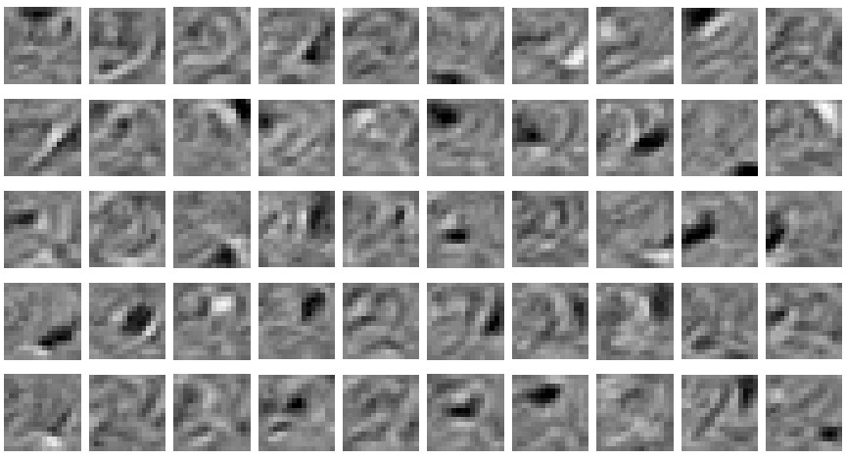
The final 50 x 256 weights for learning digit 2
Each neuron grabs a different feature – a cause, weighted sum of the causes to explain the input.

Slide 19
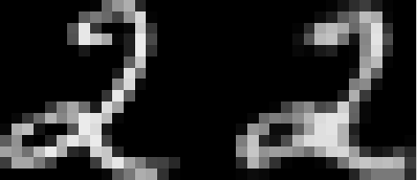
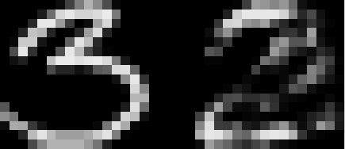
How well can we reconstruct the digit images from the binary feature activations ?
Reconstruction from activated binary features
Reconstruction from activated binary features
Data
Data
New test images from the digit class that the model was trained on
Images from an unfamiliar digit class (the network tries to see every image as a 2)

Slide 20
Training a deep belief net
First train a layer of features that receive input directly from the pixels.
Then treat the activations of the trained features as if they were pixels and learn features of features in a second hidden layer.
It can be proved that each time we add another layer of features we improve the bound on the log probability of the training data.
  The proof is complicated.
  But it is based on a neat equivalence between an RBM and a deep directed model (described later)

Slide 21
DBN after learning 3 layers
To generate data:
  Get an equilibrium sample from the top-level RBM by performing alternating Gibbs sampling for a long time.
  Perform a top-down pass to get states for all the other layers.
  So the lower level bottom-up connections are not part of the generative model. They are just used for inference.
h3
h2
h1
data

Slide 22
A model of digit recognition
The top two layers form an associative memory whose energy landscape models the low dimensional manifolds of the digits.
The energy valleys have names
2000 top-level neurons
10 label neurons
500 neurons
The model learns to generate combinations of labels and images.
To perform recognition we start with a neutral state of the label units and do an up-pass from the image followed by a few iterations of the top-level associative memory.
500 neurons
28 x 28 pixel image

Slide 23
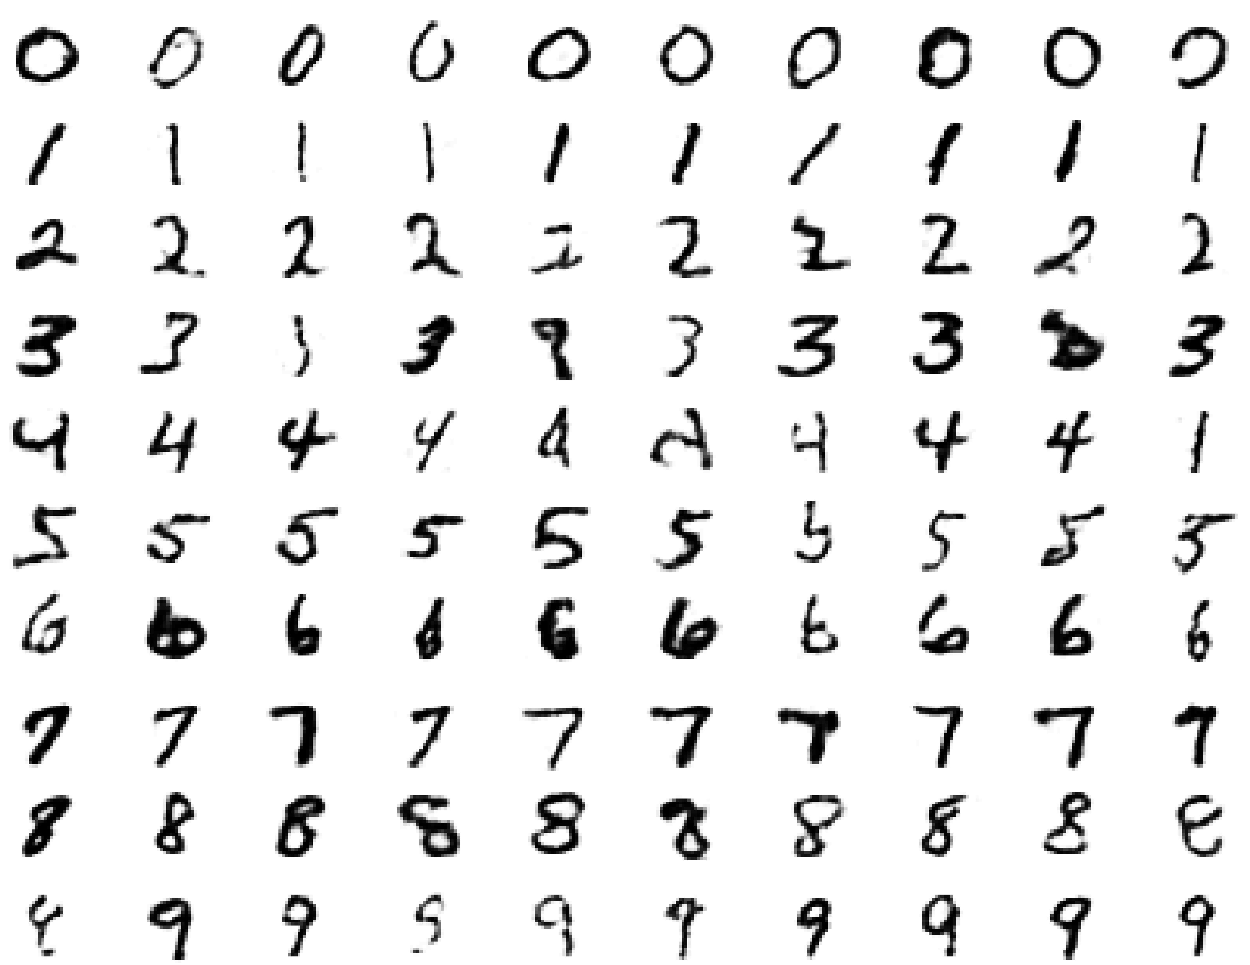
Samples generated by letting the associative memory run with one label clamped.
Notes:
There are 1000 iterations of alternating Gibbs sampling

Slide 24
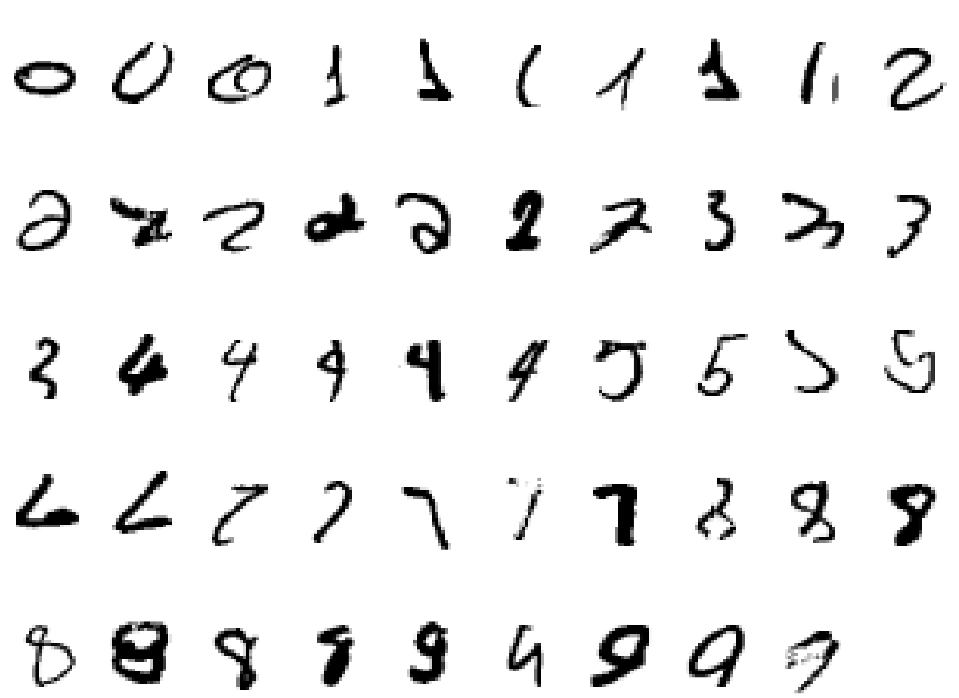
Examples of correctly recognized handwritten digits that the neural network had never seen before

Slide 25
Show the movie of the network generating digits
(available at www.cs.toronto/~hinton)

Slide 26
An infinite sigmoid belief net that is equivalent to an RBM
etc.
h2
The distribution generated by this infinite directed net with replicated weights is the equilibrium distribution for a compatible pair of conditional distributions: p(v|h) and p(h|v) that are both defined by W
  A top-down pass of the directed net is exactly equivalent to letting a Restricted Boltzmann Machine settle to equilibrium.
  So this infinite directed net defines the same distribution as an RBM.
v2
h1
v1
h0
Hinton, G. E, Osindero, S., and Teh, Y. W. (2006). A fast learning algorithm for deep belief nets. Neural Computation, 18:1527-1554.
v0

Slide 27
Representational Learning:
Generative model for factor analysis
signals
sources
mixing matrix
Notes:
P(x|A) is a function of A, f(A).

Slide 28
Blind source separation of two sources
Experiment setup:
  100000 samples of sound
?
?
1
100000
1
100000
x1
s1
…
=
…
x2
s2
a1
a2
X
A
S
2x2

Slide 29


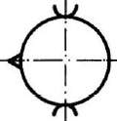
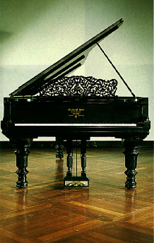
Blind Source Separation
(Independent Component Analysis ICA)

Slide 30
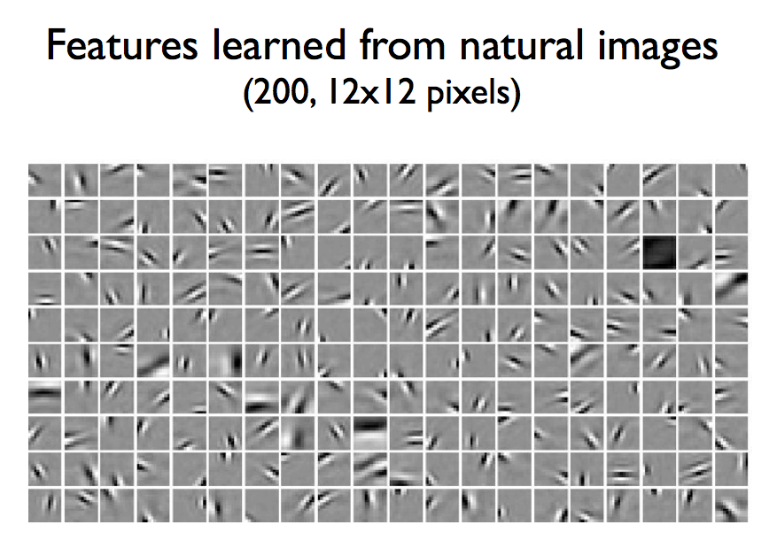
Olshausen and Field 1996. Bell and Sejnowski 1996.

Slide 31
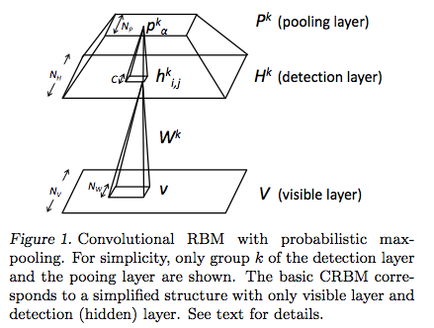
Convolutional Deep Belief net
Honglak Lee, Roger Grosse, Rajesh Ranganath and Andrew Y. Ng. In Proceedings of the Twenty-Sixth International Conference on Machine Learning, 2009.
Notes:
Image 100 x 100, RF 10 x 10, S map 91 x 91, Pooling 45 x 45 (pooling 2 x 2 grid)
Use the sparsity.
Convolution DBN (Andrew Ng and Honglak Lee)
Dropout (Toronto group, Geoff Hinton): Dropout is meant to reduce overfitting by randomly omitting half of the feature detectors on each training case.
Sparsity: A small fraction of neurons is allowed to respond at a time.

Slide 32
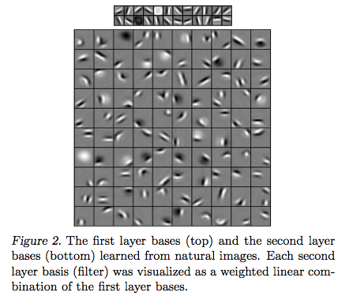

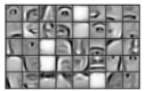
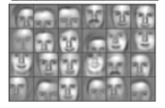
Notes:
Forms interesting separable states with DBN.

Slide 33
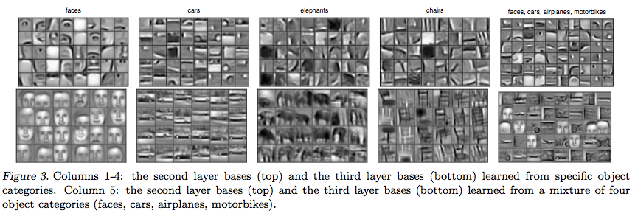
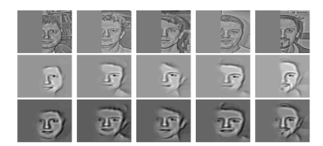
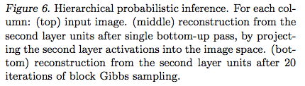
Notes:
Forms interesting separable states with DBN. Layer 1: Gabor edges 24. RF 10 x 10 S1 filters. Trained natural images. 150 x 150, S1 141 x 141 x 24. C1 (max pooling of S1): 47 x 47 x 24, (pooling grid 3 x 3). S2: 40 cell types. Map. 38 x 38 x 40. 40-10+1. S2 from C1 is 10 x 10 RF. 10 x 10 x 24 connections. Max pooling. 2 x 2 grid, to get 19 x 19 C2 map.
S3 taking 14 x 14 x 40 C2 neurons to make 24 S3 cells.

Slide 34
Large scale DBN
Building High-level Features Using Large Scale Unsupervised Learning Quoc V. Le, Marc’Aurelio Ranzato, Rajat Monga, Matthieu Devin, Kai Chen, Greg S. Corrado,J. Dean and Andrew Ng.
a 9-layered locally connected sparse autoencoder with pooling and local contrast normalization on a large dataset of images
1 billion connections, the dataset has 10 million 200x200 pixel images downloaded from the Internet.
Train on 1000 machines (16,000 cores) for three days.

Slide 35
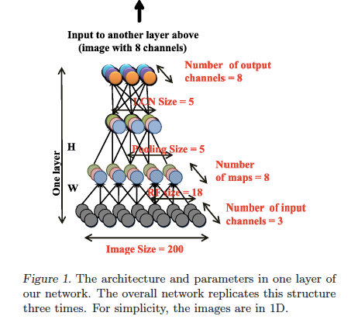

Slide 36
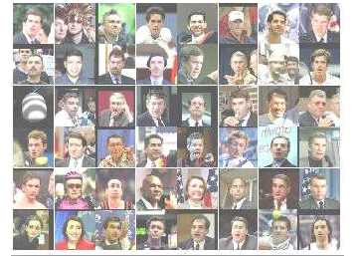
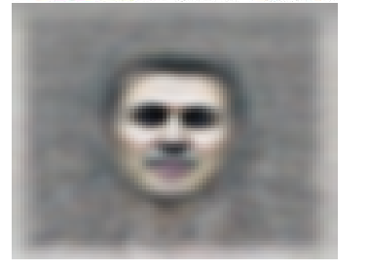
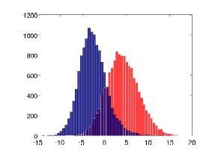
Notes:
Contrary to what appears to be a widely-held intuition, our experimental results reveal that it is possible to train a face detector without having to label images as containing a face or not. Control experiments show that this feature detector is robust not only to translation but also to scaling and out-of-plane rotation. We also find that the same network is sensitive to other high-level concepts such as cat faces and human bodies. Starting with these learned features, we trained our network to obtain 15.8% accuracy in recognizing 20,000 object categories from ImageNet, a leap of 70% relative improvement over the previous state-of-the-art.

Slide 37
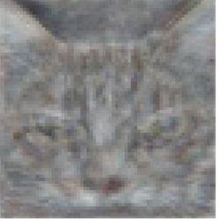
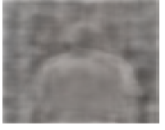

Slide 38
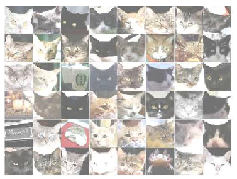

Slide 39
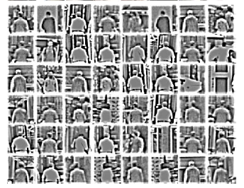

Slide 40
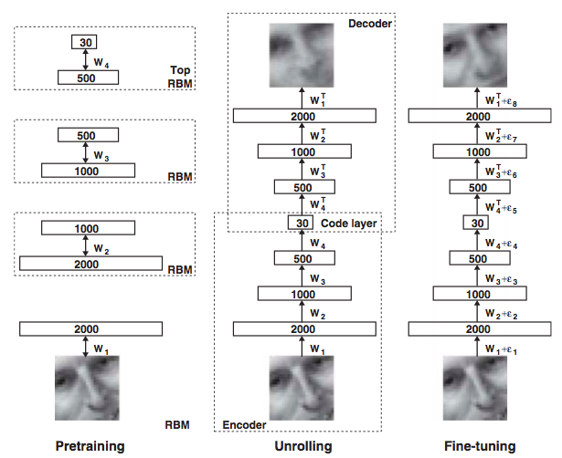
DBN deep autoencoder
Hinton and Salakhutdinov (2006) Reducing the dimensionality of data with neural networks (Science 313, 504-507)

Slide 41
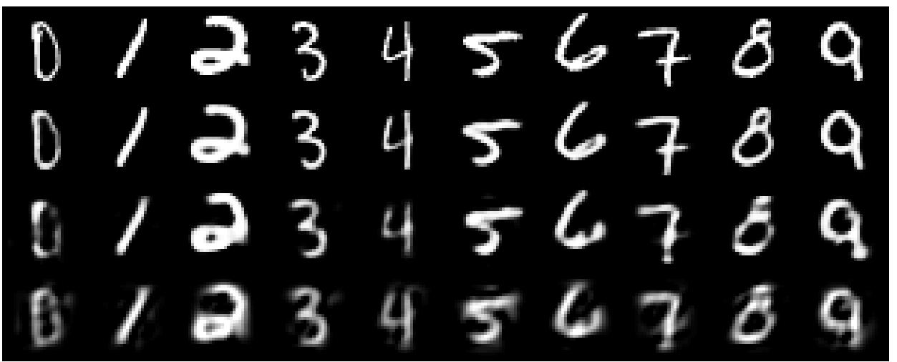
A comparison of methods for compressing digit images to 30 real numbers.
real data
30-D deep auto
30-D logistic PCA
30-D PCA

Slide 42
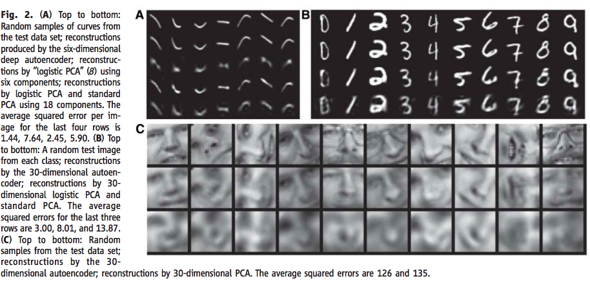


Slide 43
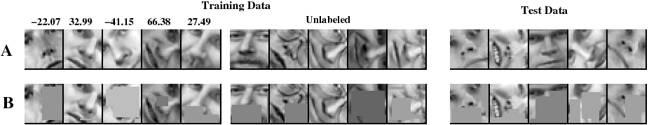
The training and test sets for predicting face orientation
100, 500, or 1000 labeled cases
11,000 unlabeled cases
face patches from new people

Slide 44
Retrieving documents that are similar to a query document
We can use an auto-encoder to find low-dimensional codes for documents that allow fast and accurate retrieval of similar documents from a large set.
We start by converting each document into a “bag of words”. This a 2000 dimensional vector that contains the counts for each of the 2000 commonest words.

Slide 45
How to compress the count vector
output vector
2000 reconstructed counts
500 neurons
We train the neural network to reproduce its input vector as its output
This forces it to compress as much information as possible into the 10 numbers in the central bottleneck.
These 10 numbers are then a good way to compare documents.
250 neurons
10
250 neurons
500 neurons
2000 word counts
input vector

Slide 46
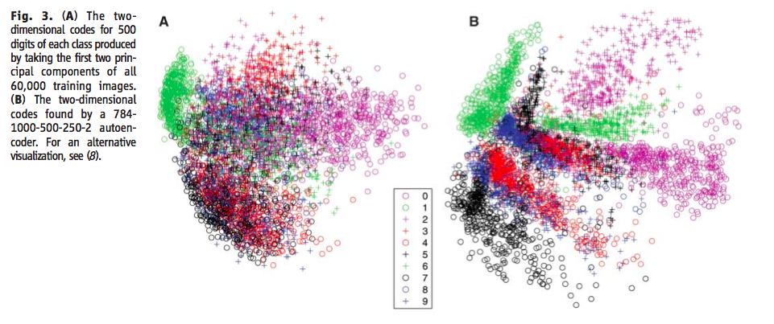
Top layer only have two hidden nodes
Notes:
Train on bags of 2000 words for 400,000 training cases of business documents.
First train a stack of RBM’s. Then fine-tune with backprop.
Test on a separate 400,000 documents.
Pick one test document as a query. Rank order all the other test documents by using the cosine of the angle between codes.
Repeat this using each of the 400,000 test documents as the query (requires 0.16 trillion comparisons).
Plot the number of retrieved documents against the proportion that are in the same hand-labeled class as the query document.

Slide 47
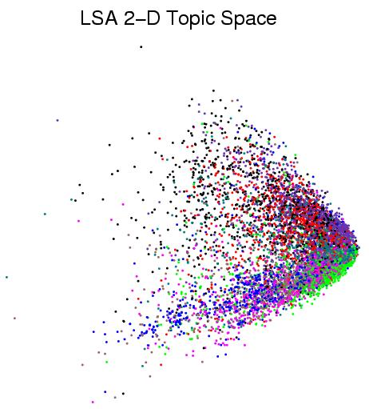
First compress all documents to 2 numbers using a type of PCA Then use different colors for different document categories

Slide 48
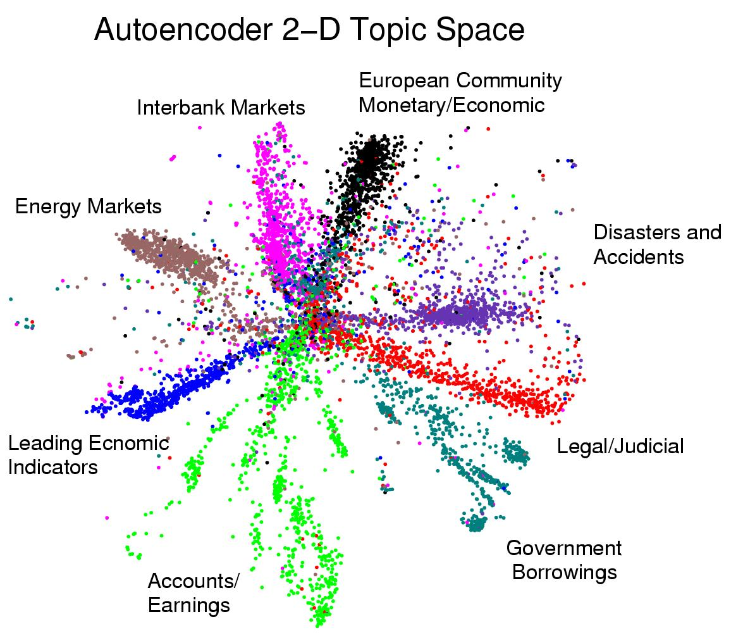
First compress all documents to 2 numbers. Then use different colors for different document categories

