Slide 1
Plan
Last Time
Linear programming (LP) formulation
Problem description
Optimization representation
Graphical representation
Today
LP: Continue graphical representation
Solving linear programs
Higher dimensions than just 2
Integer programs

Slide 2
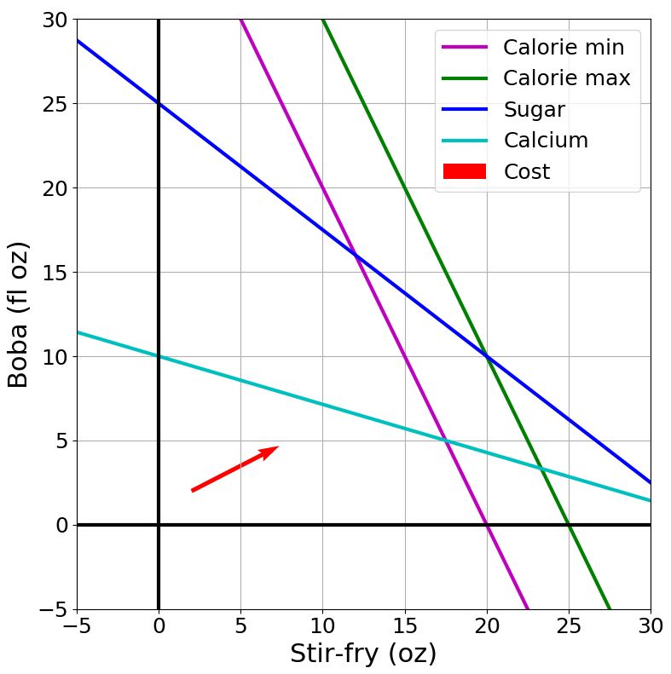
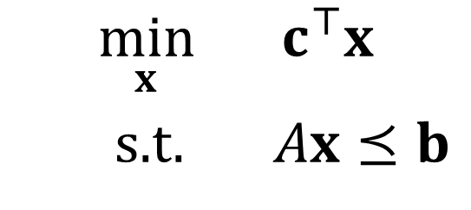

Optimization
Graphical Representation
Problem Description
Optimization Representation
$$\min_{x}{ c^{⊤}x}$$
s.t. $Ax⪯b$

Slide 3
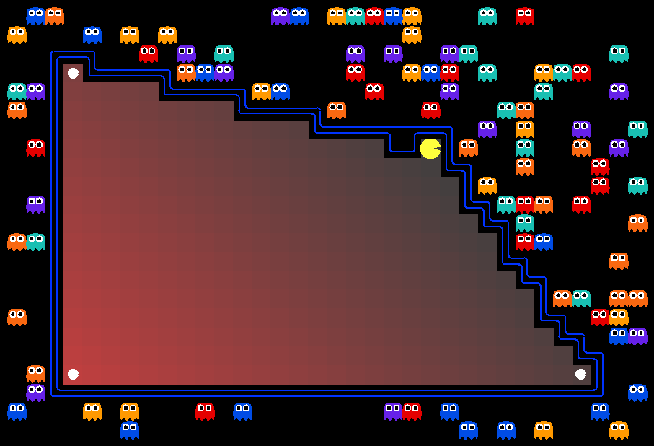
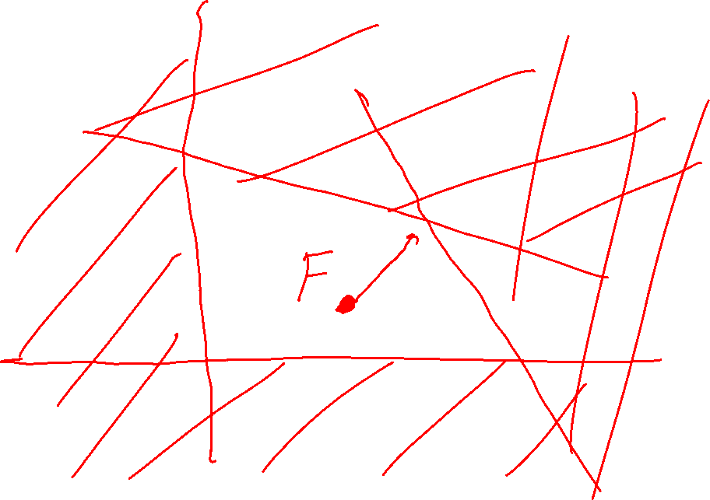
AI: Representation and Problem Solving
Linear and Integer Programming
Instructor: Pat Virtue
Slide credits: CMU AI with drawings from http://ai.berkeley.edu

Slide 4
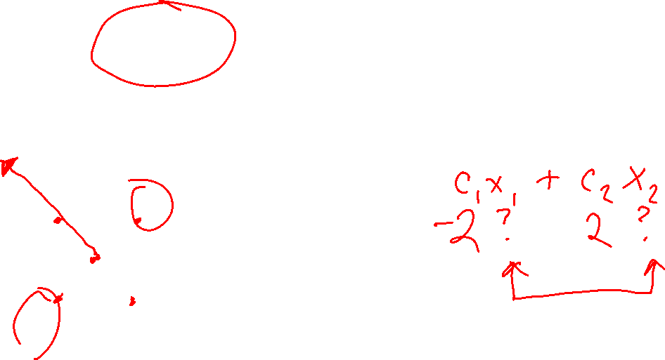

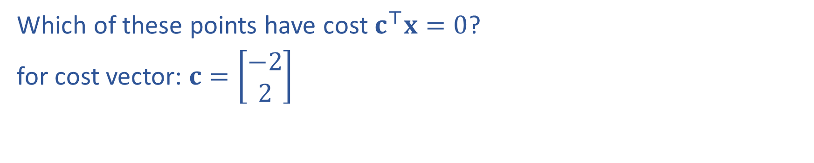
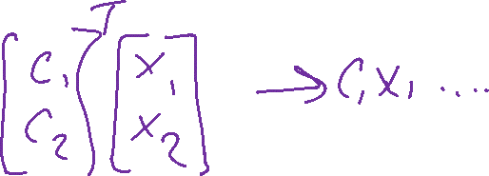

Poll 1
Which of these points have cost $c^{⊤}x=0$?
for cost vector: $c=\left[\begin{matrix}−2 \\ 2\end{matrix}\right]$
$$x_{2}$$
II
I
$$x_{1}$$
III
IV

Slide 5


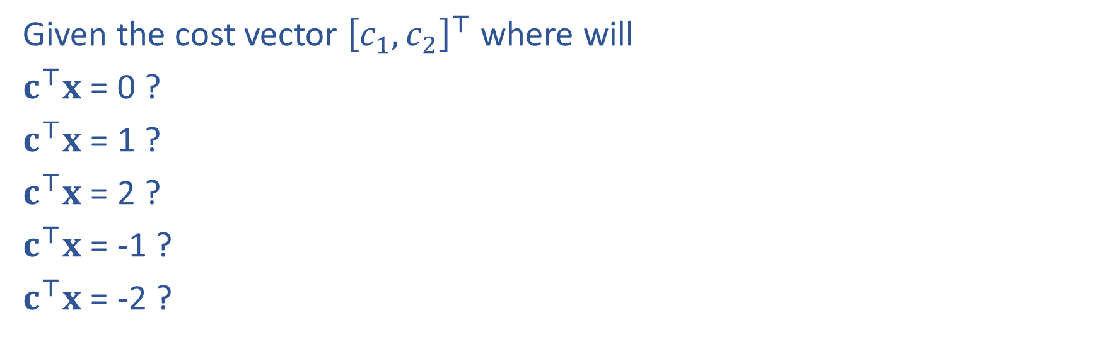


Question
Given the cost vector ${\left[c_{1}, c_{2}\right]}^{⊤}$ where will
$c^{⊤}x$ = 0 ?
$c^{⊤}x$ = 1 ?
$c^{⊤}x$ = 2 ?
$c^{⊤}x$ = -1 ?
$c^{⊤}x$ = -2 ?
$$x_{2}$$
$$c$$
$$x_{1}$$

Slide 6
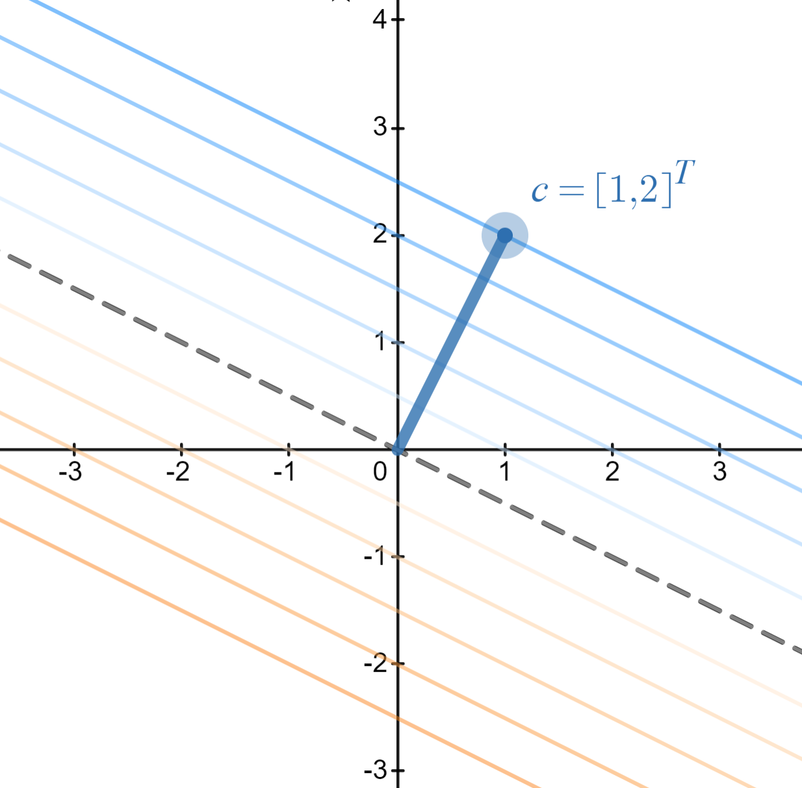
Cost Contours
Given the cost vector ${\left[c_{1}, c_{2}\right]}^{⊤}$ where will
$c^{⊤}x$ = 0 ?
$c^{⊤}x$ = 1 ?
$c^{⊤}x$ = 2 ?
$c^{⊤}x$ = -1 ?
$c^{⊤}x$ = -2 ?
https://www.desmos.com/calculator/8d9kxbdq9u

Slide 7

Question
As the magnitude of $c$ increases, the distance between
the contours lines of the objective $c^{⊤}x$:
Increases
Decreases
https://www.desmos.com/calculator/8d9kxbdq9u

Slide 8

Graphics Representation
Geometry / Algebra I Quiz
What shape does this inequality represent?
$$a_{1} x_{1}+a_{2} x_{2}≤b_{1}$$

Slide 9
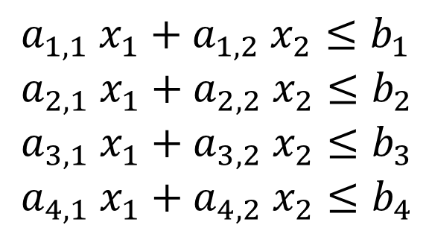

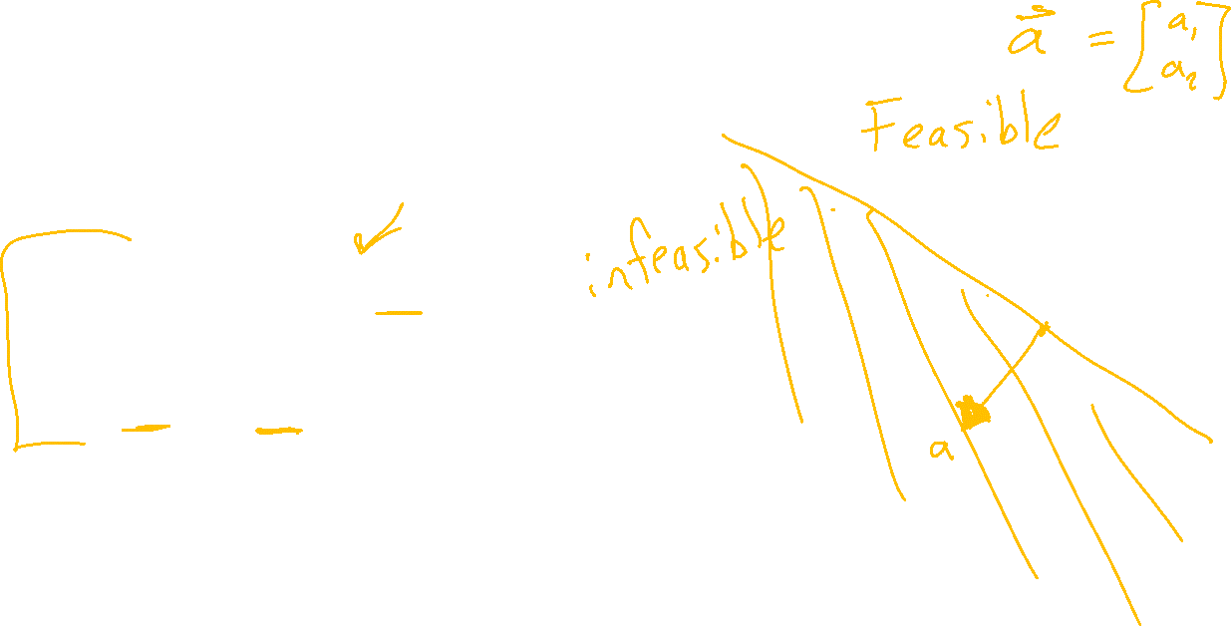

Graphics Representation
Geometry / Algebra I Quiz
What shape do these represent?
$$a_{1} x_{1}+a_{2} x_{2}=b_{1}$$
$$a_{1} x_{1}+a_{2} x_{2}≤b_{1}$$
$a_{1,1} x_{1}+a_{1,2} x_{2}≤b_{1}$
$a_{2,1} x_{1}+a_{2,2} x_{2}≤b_{2}$
$a_{3,1} x_{1}+a_{3,2} x_{2}≤b_{3}$
$a_{4,1} x_{1}+a_{4,2} x_{2}≤b_{4}$
Feasible region:
All points x that satisfy the constraints

Slide 10

Graphics Representation
Geometry / Algebra I Quiz
What shape do these represent?
$$a_{1} x_{1}+a_{2} x_{2}=b_{1}$$
$$a_{1} x_{1}+a_{2} x_{2}≤b_{1}$$
$a_{1,1} x_{1}+a_{1,2} x_{2}≤b_{1}$
$a_{2,1} x_{1}+a_{2,2} x_{2}≤b_{2}$
$a_{3,1} x_{1}+a_{3,2} x_{2}≤b_{3}$
$a_{4,1} x_{1}+a_{4,2} x_{2}≤b_{4}$
Feasible region:
All points x that satisfy the constraints

Slide 11
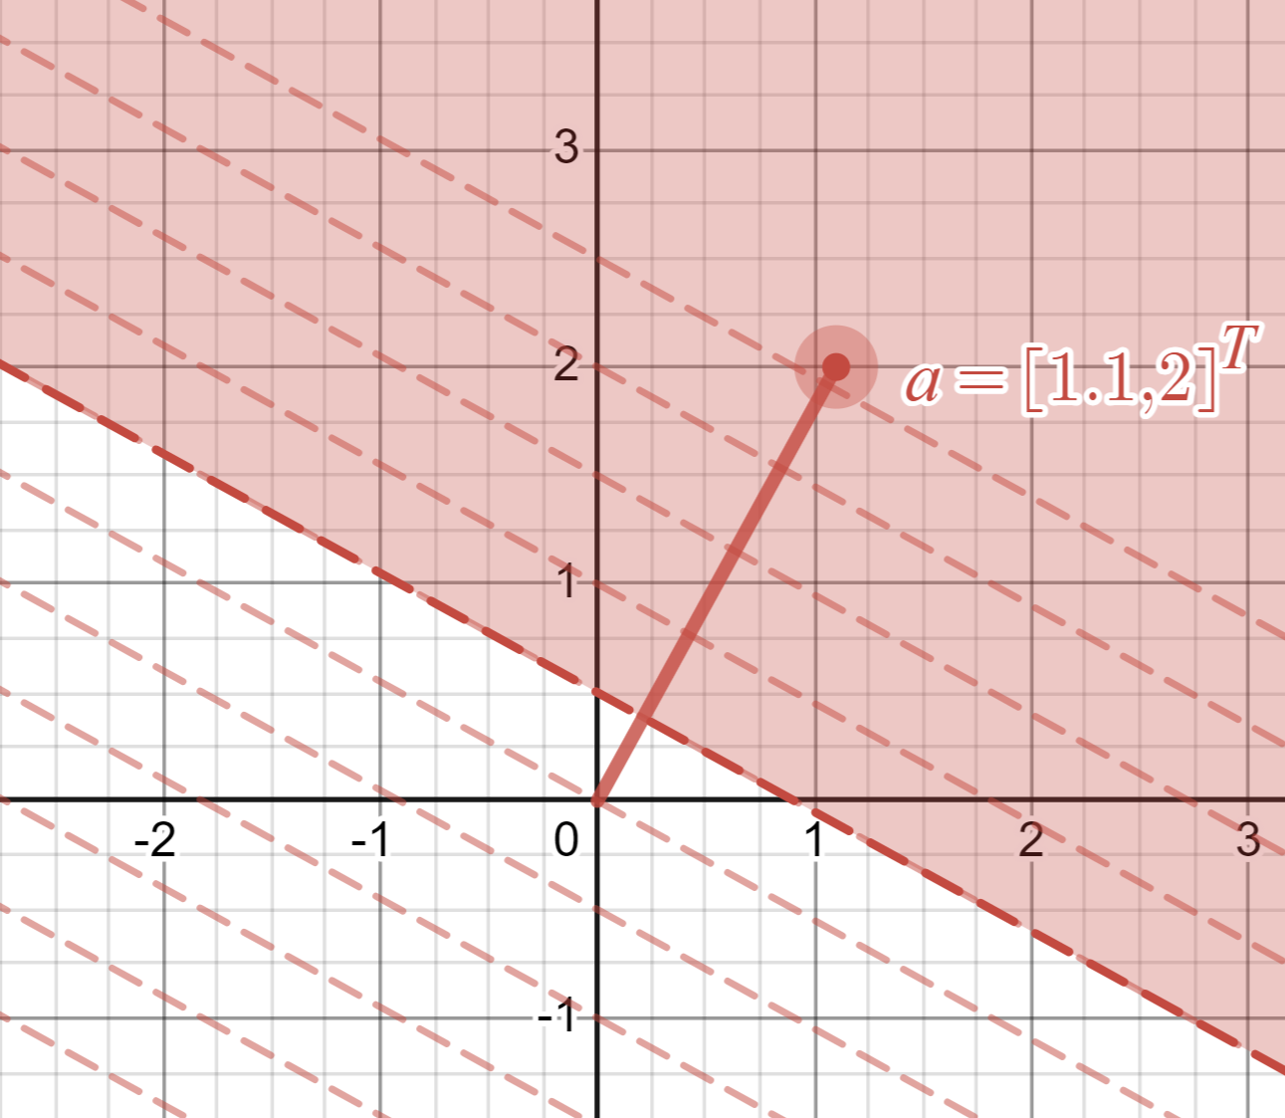
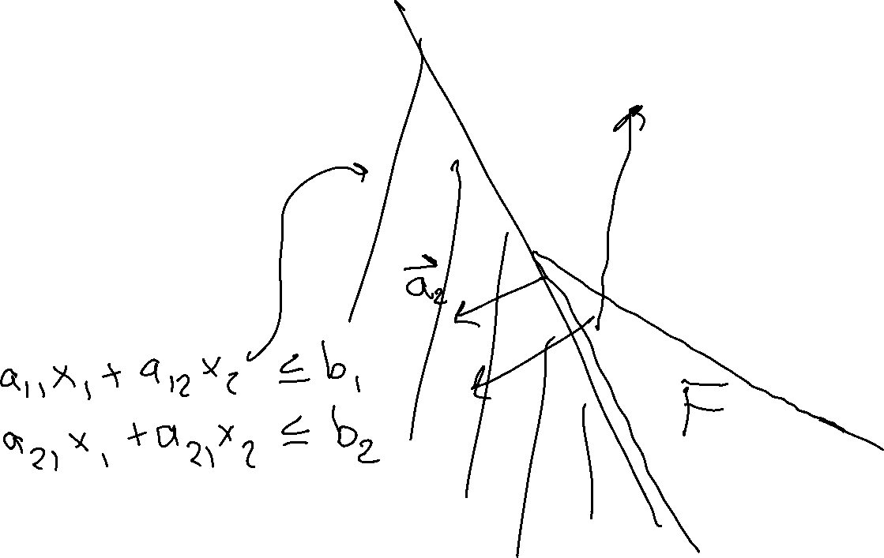
Graphics Representation
Geometry / Algebra I Quiz
What shape do these represent?
$$a_{1} x_{1}+a_{2} x_{2}=b_{1}$$
$$a_{1} x_{1}+a_{2} x_{2}≤b_{1}$$
https://www.desmos.com/calculator/lp0rqsb1w6

Slide 12
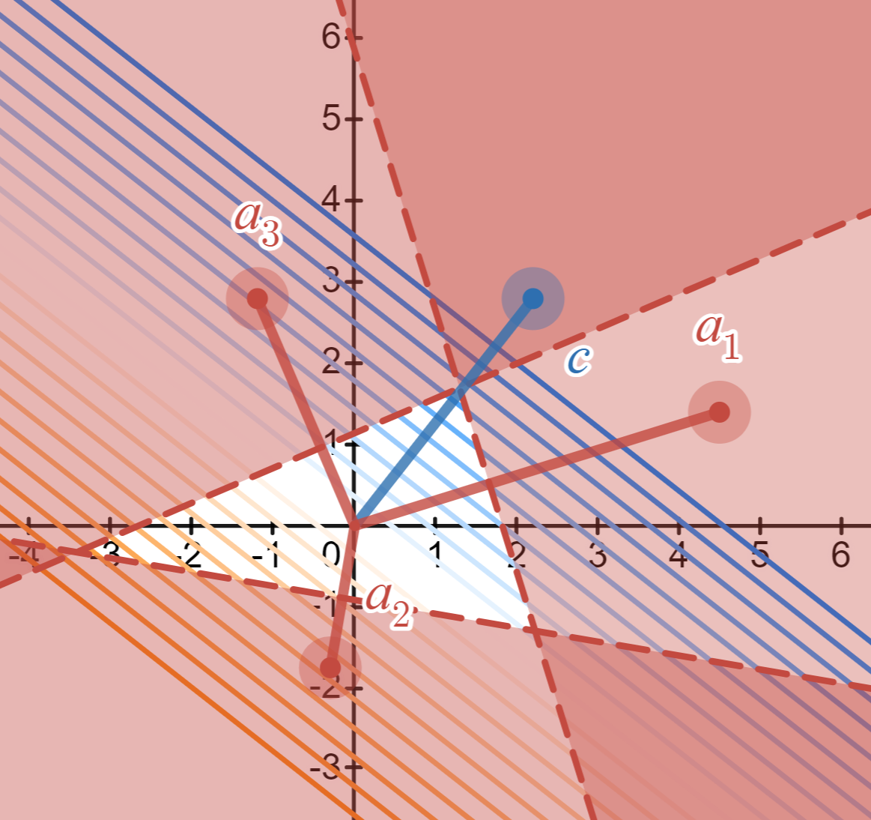
Graphics Representation
Geometry / Algebra I Quiz
What shape do these represent?
$$a_{1} x_{1}+a_{2} x_{2}=b_{1}$$
$$a_{1} x_{1}+a_{2} x_{2}≤b_{1}$$
$a_{1,1} x_{1}+a_{1,2} x_{2}≤b_{1}$
$a_{2,1} x_{1}+a_{2,2} x_{2}≤b_{2}$
$a_{3,1} x_{1}+a_{3,2} x_{2}≤b_{3}$
$a_{4,1} x_{1}+a_{4,2} x_{2}≤b_{4}$
https://www.desmos.com/calculator/plp1thgsbh

Slide 13
Reminder: Cost Contours
Given the cost vector ${\left[c_{1}, c_{2}\right]}^{⊤}$ where will
$c^{⊤}x$ = 0 ?
$c^{⊤}x$ = 1 ?
$c^{⊤}x$ = 2 ?
$c^{⊤}x$ = -1 ?
$c^{⊤}x$ = -2 ?
https://www.desmos.com/calculator/8d9kxbdq9u

Slide 14
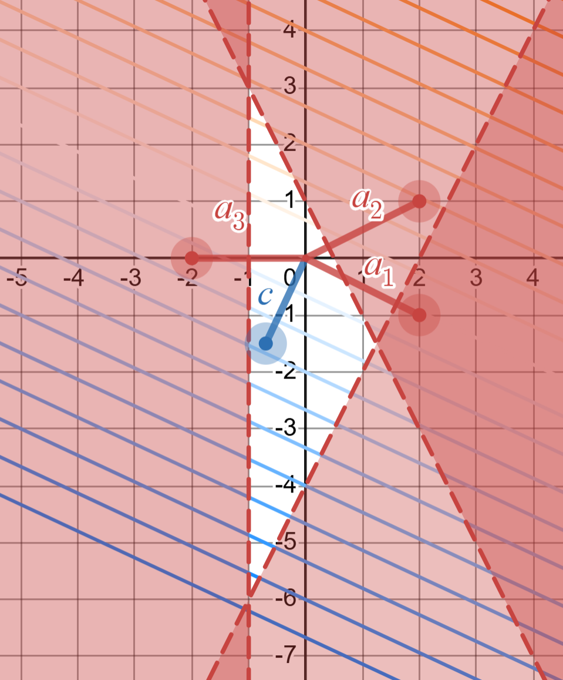
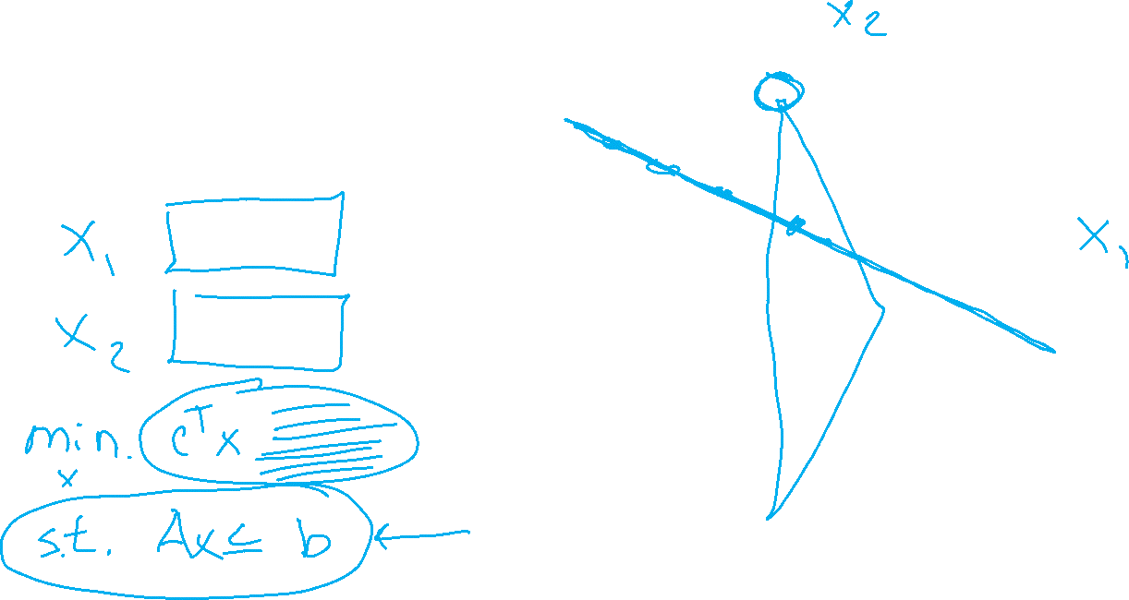
Poll 2
What is the solution to this LP?
https://www.desmos.com/calculator/tnlo7p5plp

Slide 15
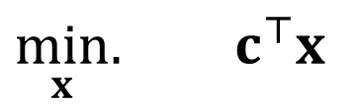
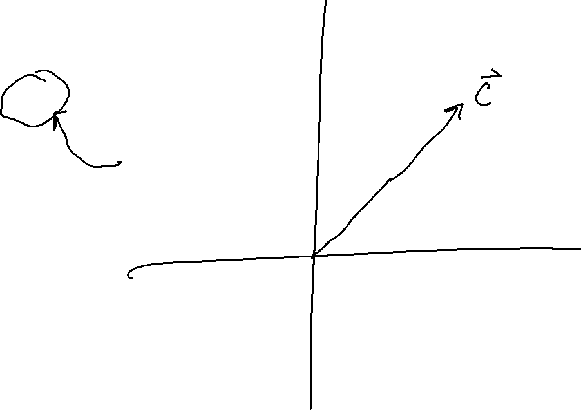
Solving a Linear Program
Inequality form, with no constraints
$\min_{x}.{ c^{⊤}x}$

Slide 16
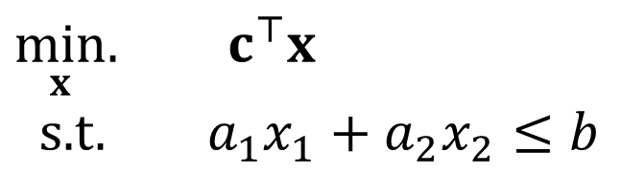
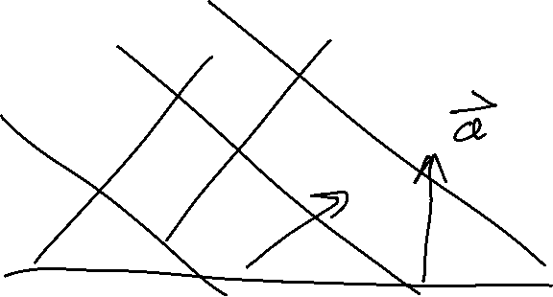
Solving a Linear Program
Inequality form, with one constraint
$\min_{x}.{ c^{⊤}x}$
s.t. $a_{1}x_{1}+a_{2}x_{2}≤b$

Slide 17

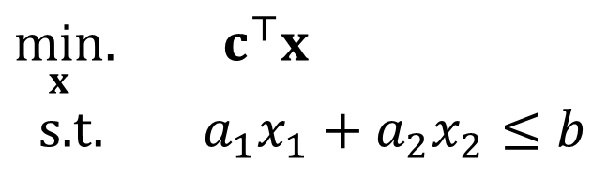
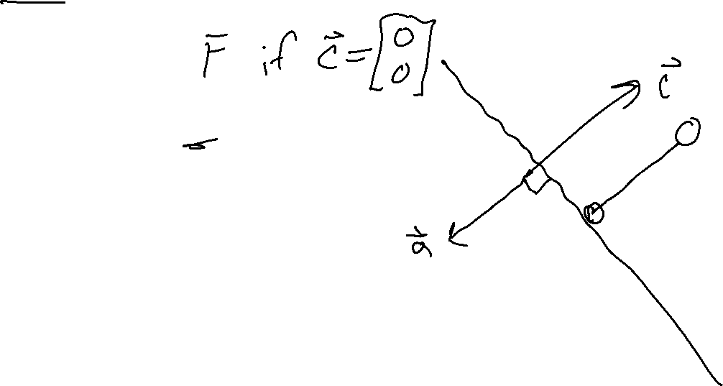
Poll 3
True or False: A minimizing LP with exactly on constraint, will always have a minimum objective at $−∞$.
$\min_{x}.{ c^{⊤}x}$
s.t. $a_{1}x_{1}+a_{2}x_{2}≤b$

Slide 18

Solving an LP
Solutions are at feasible intersections
of constraint boundaries!!
Algorithms
Check objective at all feasible intersections
In more detail:
Enumerate all intersections
Keep only those that are feasible (satisfy all inequalities)
Return feasible intersection with the lowest objective value

Slide 19
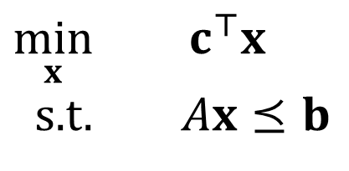
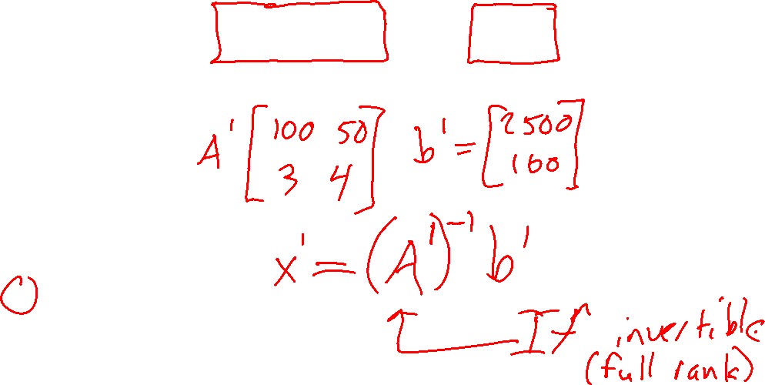
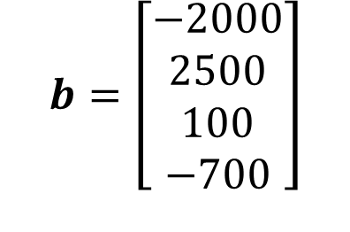
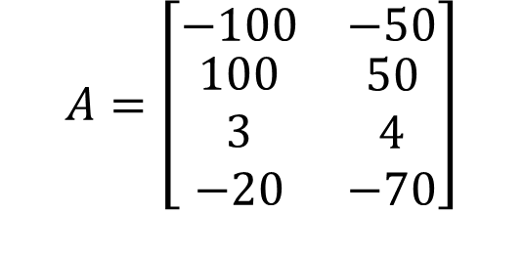
Solving an LP
But, how do we find the intersection between boundaries?
$$A=\left[\begin{matrix}−100 & −50 \\ \begin{aligned}100 \\ 3 \\ −20\end{aligned} & \begin{aligned}50 \\ 4 \\ −70\end{aligned}\end{matrix}\right]$$
$$b=\left[\begin{aligned}−2000 \\ 2500 \\ 100 \\ −700\end{aligned}\right]$$
Calorie min
$\min_{x}{ c^{⊤}x}$
s.t. $Ax⪯b$
Calorie max
Sugar
Calcium

Slide 20
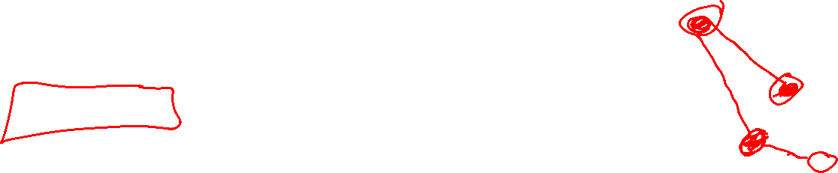
Solving an LP
Solutions are at feasible intersections
of constraint boundaries!!
Algorithms
Check objective at all feasible intersections
Simplex

Slide 21

Solving an LP
Simplex algorithm
Start at a feasible intersection (if not trivial, can solve another LP to find one)
Define successors as “neighbors” of current intersection
i.e., remove one row from our square subset of A, and add another row not in the subset; then check feasibility
Move to any successor with lower objective than current intersection
If no such successors, we are done
Greedy local hill-climbing search! … but always finds optimal solution

Slide 22
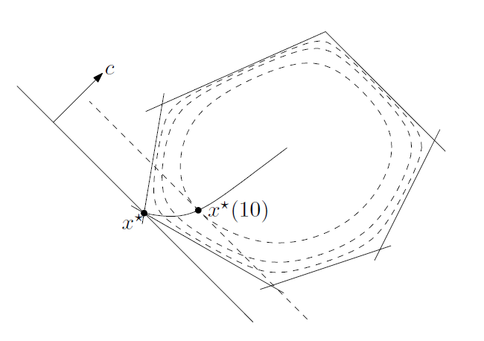
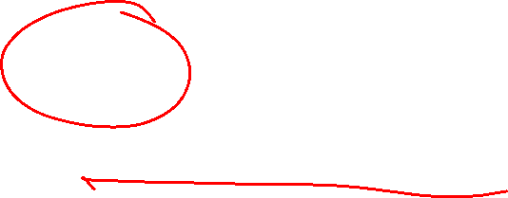
Solving an LP
Solutions are at feasible intersections
of constraint boundaries!!
Algorithms
Check objective at all feasible intersections
Simplex
Interior Point
Figure 11.2 from Boyd and Vandenberghe, Convex Optimization

Slide 23
What about higher dimensions?
Problem Description
Graphical Representation
Optimization Representation
$$\min_{x}{ c^{⊤}x}$$
s.t. $Ax⪯b$

Slide 24

“Marty, you’re not thinking fourth-dimensionally”
https://www.youtube.com/watch?v=CUcNM7OsdsY

Slide 25
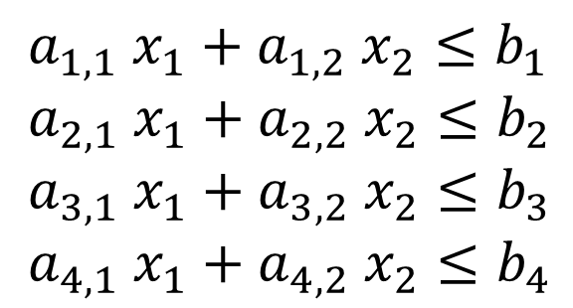

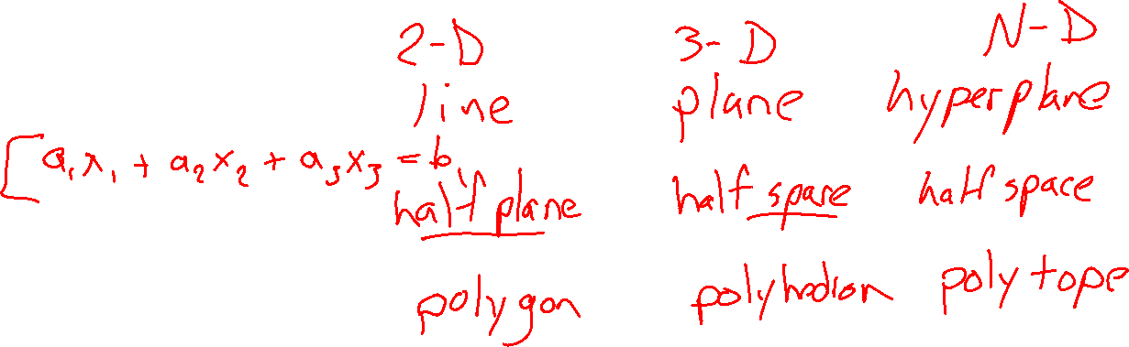

Shapes in higher dimensions
How do these linear shapes extend to 3-D, N-D?
$$a_{1} x_{1}+a_{2} x_{2}=b_{1}$$
$$a_{1} x_{1}+a_{2} x_{2}≤b_{1}$$
$a_{1,1} x_{1}+a_{1,2} x_{2}≤b_{1}$
$a_{2,1} x_{1}+a_{2,2} x_{2}≤b_{2}$
$a_{3,1} x_{1}+a_{3,2} x_{2}≤b_{3}$
$a_{4,1} x_{1}+a_{4,2} x_{2}≤b_{4}$

Slide 26
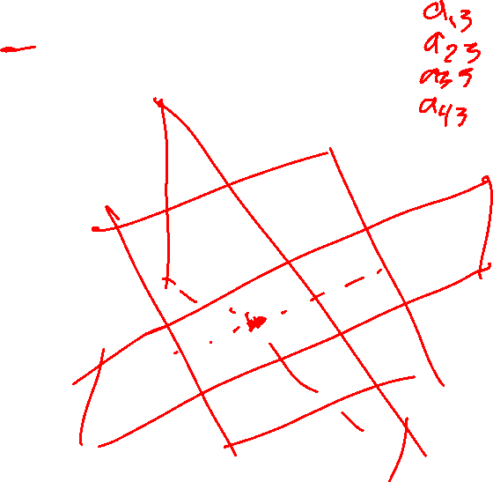


What are intersections in higher dimensions?
How do these linear shapes extend to 3-D, N-D?
$$A=\left[\begin{matrix}−100 & −50 \\ \begin{aligned}100 \\ 3 \\ −20\end{aligned} & \begin{aligned}50 \\ 4 \\ −70\end{aligned} \end{matrix}\right]$$
$$b=\left[\begin{aligned}−2000 \\ 2500 \\ 100 \\ −700\end{aligned}\right]$$
Calorie min
$\min_{x}{ c^{⊤}x}$
s.t. $Ax⪯b$
Calorie max
Sugar
Calcium

Slide 27

How do we find intersections in higher dimensions?
Still looking at subsets of $A$ matrix
$$A=\left[\begin{matrix}−100 & −50 \\ \begin{aligned}100 \\ 3 \\ −20\end{aligned} & \begin{aligned}50 \\ 4 \\ −70\end{aligned} \end{matrix}\right]$$
$$b=\left[\begin{aligned}−2000 \\ 2500 \\ 100 \\ −700\end{aligned}\right]$$
Calorie min
$\min_{x}{ c^{⊤}x}$
s.t. $Ax⪯b$
Calorie max
Sugar
Calcium

Slide 28
Integer Programming

Slide 29
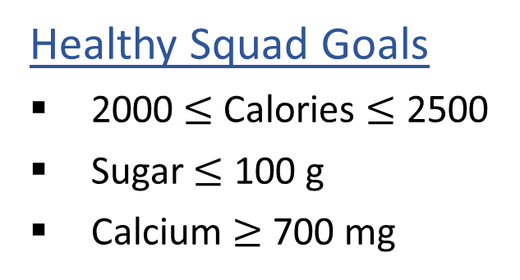

Linear Programming
We are trying healthy by finding the optimal amount of food to purchase.
We can choose the amount of stir-fry (ounce) and boba (fluid ounces).
Healthy Squad Goals
2000 $≤$ Calories $≤$ 2500
Sugar $≤$ 100 g
Calcium $≥$ 700 mg
Food | Cost | Calories | Sugar | Calcium
Stir-fry (per oz) | 1 | 100 | 3 | 20
Boba (per fl oz) | 0.5 | 50 | 4 | 70
What is the cheapest way to stay “healthy” with this menu?
How much stir-fry (ounce) and boba (fluid ounces) should we buy?

Slide 30

Linear Programming → Integer Programming
We are trying healthy by finding the optimal amount of food to purchase.
We can choose the amount of stir-fry (bowls) and boba (glasses).
Healthy Squad Goals
2000 $≤$ Calories $≤$ 2500
Sugar $≤$ 100 g
Calcium $≥$ 700 mg
Food | Cost | Calories | Sugar | Calcium
Stir-fry (per bowl) | 1 | 100 | 3 | 20
Boba (per glass) | 0.5 | 50 | 4 | 70
What is the cheapest way to stay “healthy” with this menu?
How much stir-fry (ounce) and boba (fluid ounces) should we buy?

Slide 31
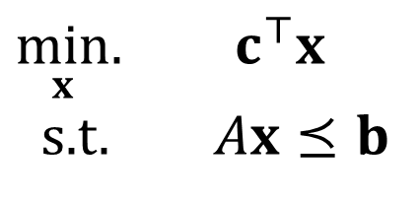
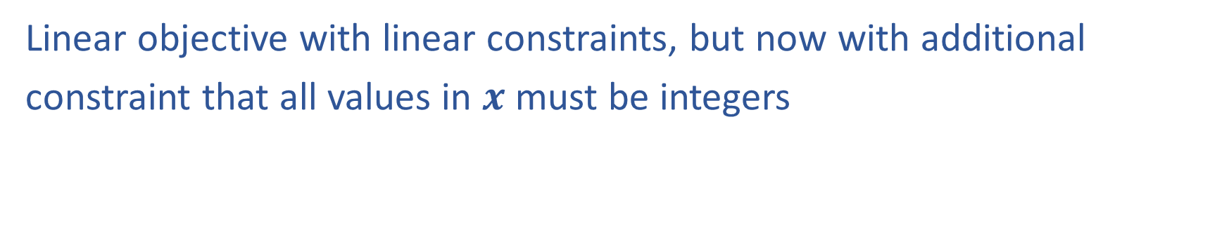
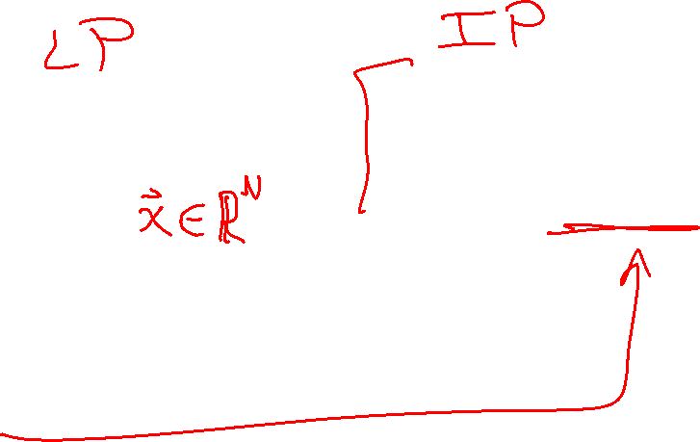
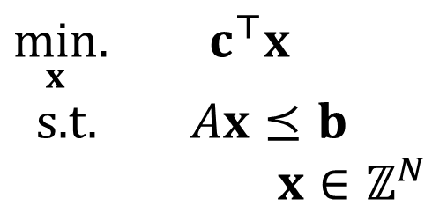
Linear Programming vs Integer Programming
Linear objective with linear constraints, but now with additional
constraint that all values in $x$ must be integers
$\min_{x}.{ c^{⊤}x}$
s.t. $Ax⪯b$
$\min_{x}.{ c^{⊤}x}$
s.t. $Ax⪯b$
$x∈ℤ^{N}$
We could also do:
Even more constrained: Binary Integer Programming
A hybrid: Mixed Integer Linear Programming
Notation Alert!

Slide 32

Integer Programming: Graphical Representation
Just add a grid of integer points onto our LP representation
$\min_{x}.{ c^{T}x}$
s.t. $Ax⪯b$
$x∈ℤ^{N}$

Slide 33
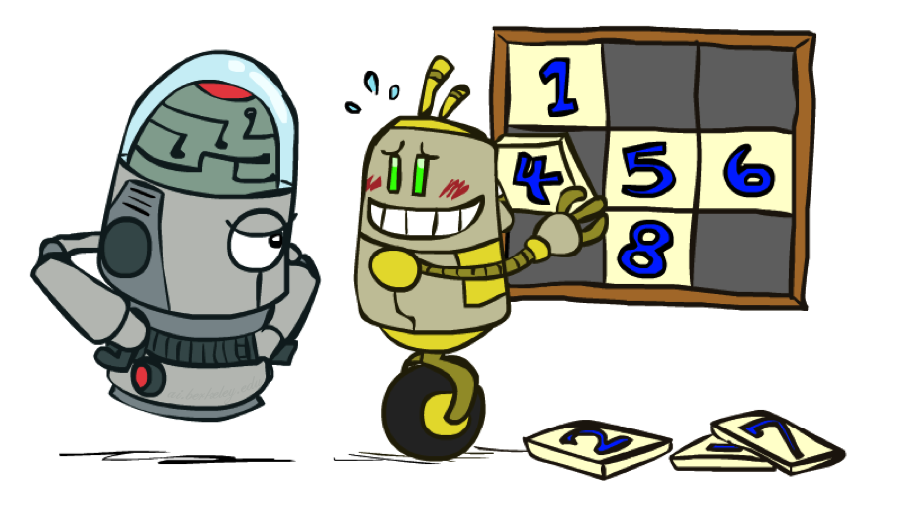
Relaxation
Relax IP to LP by dropping integer constraints
$\min_{x}.{ c^{T}x}$
s.t. $Ax⪯b$
$x∈ℤ^{N}$
Remember heuristics?

Slide 34
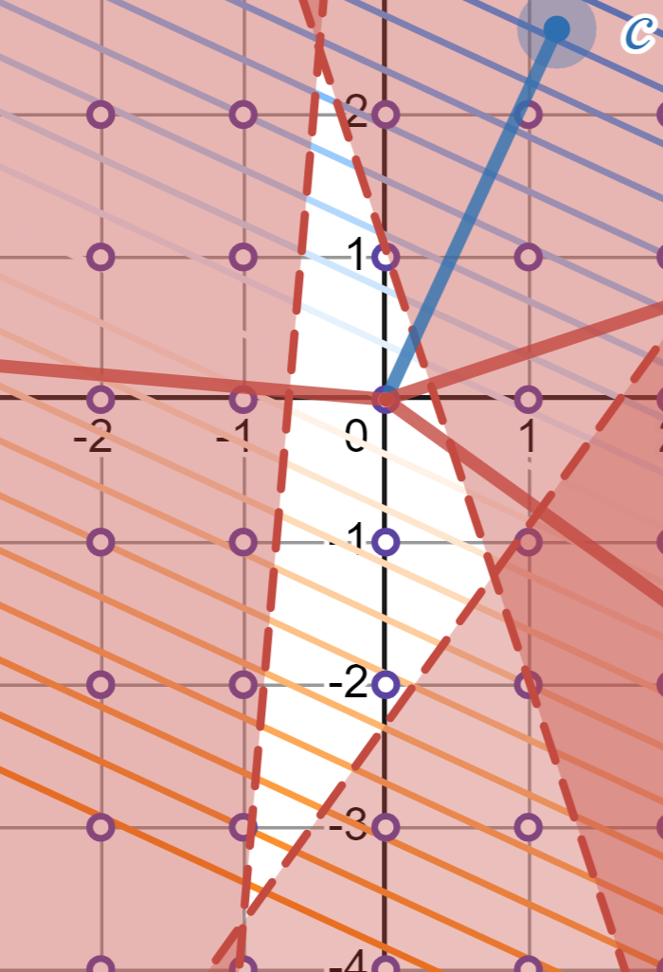
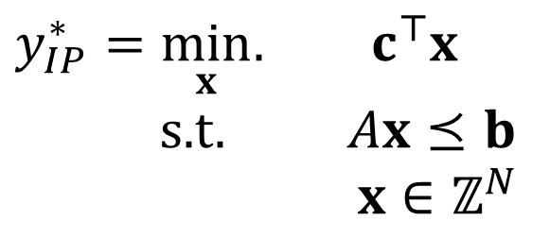

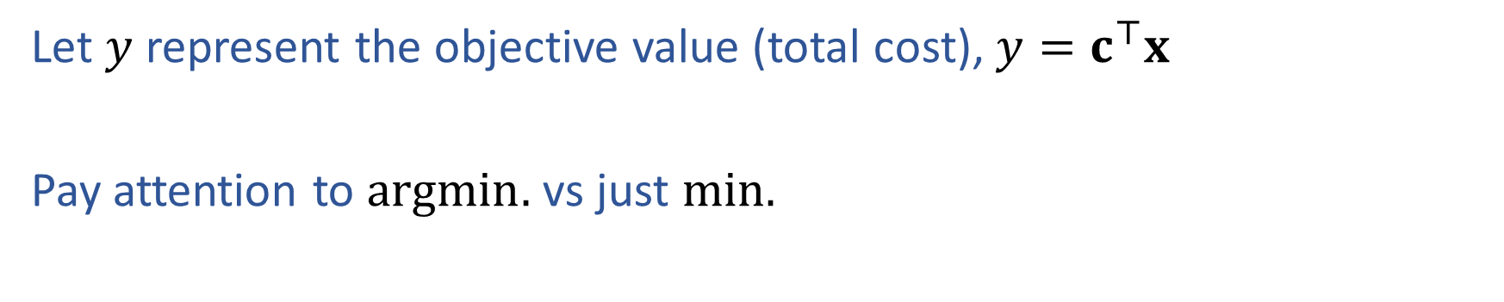

Notation Alert
Let $y$ represent the objective value (total cost), $y=c^{⊤}x$
Pay attention to $argmin.$ vs just $min.$
$x_{IP}^{∗}=\underset{x}{argmin}.{ c^{⊤}x}$
s.t. $Ax⪯b$
$x∈ℤ^{N}$
$y_{IP}^{∗}=\min_{x}.{ c^{⊤}x}$
s.t. $Ax⪯b$
$x∈ℤ^{N}$

Slide 35





Poll 4:
Let $y_{IP}^{∗}$ be the optimal objective of an integer program $P$.
Let $x_{IP}^{∗}$ be an optimal point of an integer program $P$.
Let $y_{LP}^{∗}$ be the optimal objective of the LP-relaxed version of $P$.
Let $x_{LP}^{∗}$ be an optimal point of the LP-relaxed version of $P$.
Assume that $P$ is a minimization problem.
Which of the following are true?
$x_{IP}^{∗}=x_{LP}^{∗}$
$y_{IP}^{∗}≤y_{LP}^{∗}$
$y_{IP}^{∗}≥y_{LP}^{∗}$
$y_{IP}^{∗}=\min_{x}.{ c^{⊤}x}$
s.t. $Ax⪯b$
$x∈ℤ^{N}$
$y_{LP}^{∗}=\min_{x}.{ c^{⊤}x}$
s.t. $Ax⪯b$

Slide 36


Poll 5:
True/False: It is sufficient to consider the integer points around the corresponding LP solution?

Slide 37


Solving an IP
16
17
18
19
5
Branch and Bound algorithm
Core steps:
Use LP solver to find $x_{LP}^{⋆}$
If $x_{LP}^{⋆}$ is all integer valued,
return solution
Otherwise:
Create two branches
Left branch: Added constraint $x_{i}≤floor\left(x_{i}\right)$
Right branch: Added constraint $x_{i}≥ceil\left(x_{i}\right)$
16
17
18
19
16
17
18
19
5
5

Slide 38


Solving an IP
Branch and Bound algorithm
Push LP solution of problem into priority queue,
ordered by objective value of LP solution
Repeat:
If queue is empty, return IP is infeasible
Pop candidate solution $x_{LP}^{⋆}$ from priority queue ()
If $x_{LP}^{⋆}$ is all integer valued, we are done; return solution
Otherwise, select a coordinate $x_{i}$ that is not integer valued, and add two additional LPs to the priority queue:
Left branch: Added constraint $x_{i}≤floor\left(x_{i}\right)$
Right branch: Added constraint $x_{i}≥ceil\left(x_{i}\right)$
Note: Only add LPs to the queue if they are feasible

Slide 39






Branch and Bound Example
$$x^{⋆}=\left(17.5,5\right)$$
$$y^{⋆}=20.5$$
$$x_{1}≤17$$
$$x_{1}≥18$$
Priority Queue:
$x^{⋆}=\left(17.5,5\right), y^{⋆}=20.5$
$$c={\left[1, 0.6\right]}^{T}$$

Slide 40
Branch and Bound Example
15
10
5
10
15
20
25

Slide 41



Branch and Bound Example
15
10
$$x_{1}≤17$$
$$x_{1}≥18$$
5
10
15
20
25
15
15
10
10
5
5
10
15
20
25
10
15
20
25

Slide 42




Branch and Bound Example
$$x^{⋆}=\left(17.5,5\right)$$
$$y^{⋆}=20.5$$
$$x_{1}≤17$$
$$x_{1}≥18$$
$$x^{⋆}=\left(17,6\right)$$
$$y^{⋆}=20.6$$
$$x^{⋆}=\left(18,4.85\right)$$
$$y^{⋆}=20.91$$
Priority Queue:
$x^{⋆}=\left(17,6\right), { y}^{⋆}=20.6$
$x^{⋆}=\left(18,4.85\right), y^{⋆}=20.91$
$$c={\left[1, 0.6\right]}^{T}$$

