Slide 1

15-281 AI: Representation and Problem Solving
Reinforcement Learning I
Instructors: Aditi Raghunathan and Vince Conitzer
Carnegie Mellon University
Slide credits: CMU AI and http://ai.berkeley.edu
Notes:
Please retain proper attribution, including the reference to ai.berkeley.edu. Thanks!

Slide 2
Logistics
HW6 due today
P3 due Friday
Mid semester grades are out
Midsemester feedback forms due Sunday

Slide 3
MDP recap
Important quantities
  States
  Actions
  Transitions
  Rewards
  Policy
  V-values, Q-value
What is known and what’s unknown?

Slide 4

Solving MDPs: value iteration
Depth-limited expectimax -> increasing depth each iteration
Bellman equation for optimality -> repeatedly apply till we converge
Then extract policy from values (policy extraction)

Slide 5
Policy iteration
Actual policies may converge faster than values
We could iterate on policies instead
Step one: Evaluate current policy
  Simpler expectimax / solve linear system satisfying Bellman condition
Step two: Improve current policy
  One-step lookahead
Iterate

Slide 6
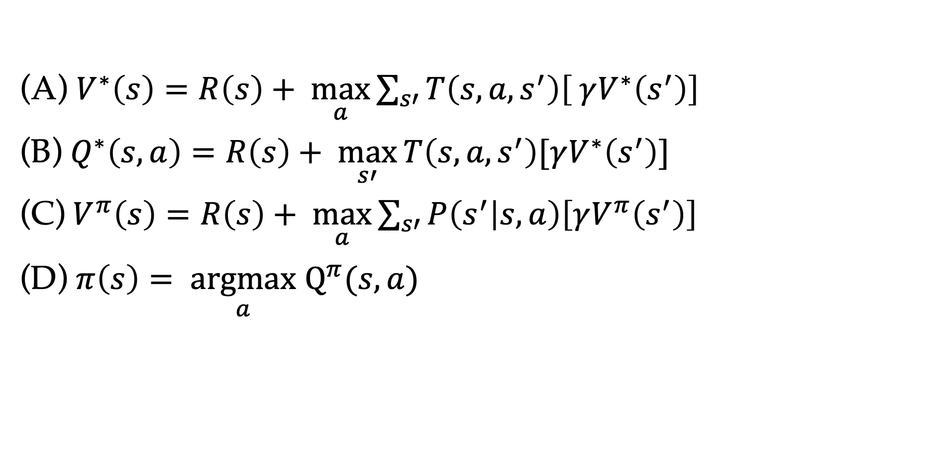
Poll: Which equations are wrong?
Suppose $R\left(s, a, s’\right)= R\left(s\right).$Which eqs are wrong?
(A) $V^{∗}\left(s\right)=R\left(s\right)+ \max_{a}{\sum_{s′}{T\left(s, a, s^{′}\right)\left[ γV^{∗}\left(s^{′}\right)\right]}}$
(B) $Q^{∗}\left(s,a\right)=R\left(s\right)+ \max_{s′}{T\left(s, a, s^{′}\right)[γV^{∗}\left(s^{′}\right)]}$
(C)${ V}^{π}\left(s\right)=R\left(s\right)+ \max_{a}{\sum_{s′}{P\left(s^{′} | s,a\right)\left[γV^{π}\left(s^{′}\right)\right]}}$
(D) $π\left(s\right)= \underset{a}{argmax}$ $Q^{π}(s, a)$

Slide 7
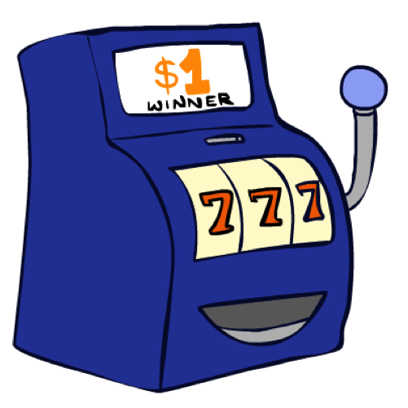
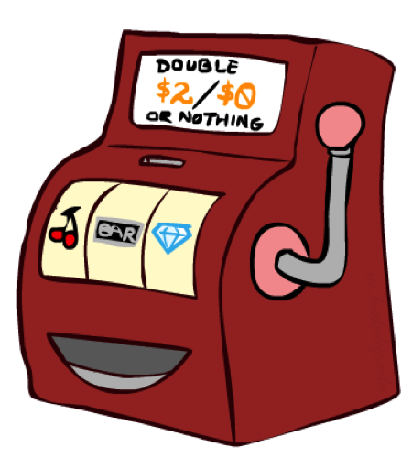
New decision process…
Choose
Can you make the optimal decision without ever playing?

Slide 8
From MDPs to RL
MDPs (offline)
Know the model of the world
Find policy to maximize utility
Run our MDP solvers but only ever deploy the optimal policy
Reinforcement Learning (online)
Still assume the world is an MDP
Do not know how the world works
Find policy to maximize utility
Need to take actions in the world to understand the world

Slide 9
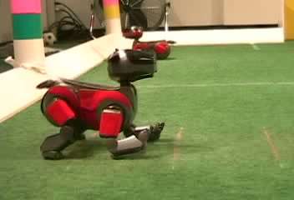
Example: Learning to Walk
Initial
[Kohl and Stone, ICRA 2004]
[Video: AIBO WALK – initial]

Slide 10
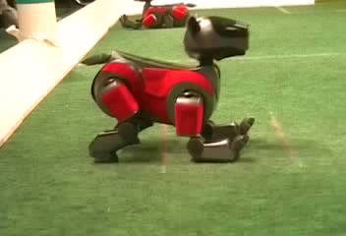
Example: Learning to Walk
Training
[Kohl and Stone, ICRA 2004]
[Video: AIBO WALK – training]

Slide 11
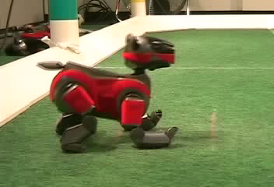
Example: Learning to Walk
Finished
[Kohl and Stone, ICRA 2004]
[Video: AIBO WALK – finished]

Slide 12
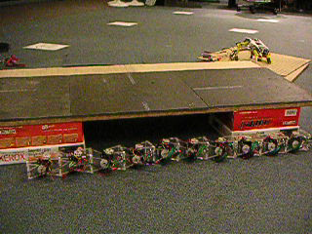
Example: Sidewinding
[Andrew Ng]
[Video: SNAKE – climbStep+sidewinding]

Slide 13

Example: Toddler Robot
[Tedrake, Zhang and Seung, 2005]
[Video: TODDLER – 40s]
Notes:
MIT

Slide 14

DeepMind Atari (©Two Minute Lectures)

Slide 15
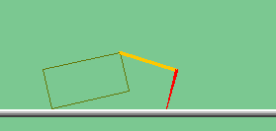
The Crawler!
[You, in P4]
Notes:
At times no reward accumulated at all, just sitting still

Slide 16
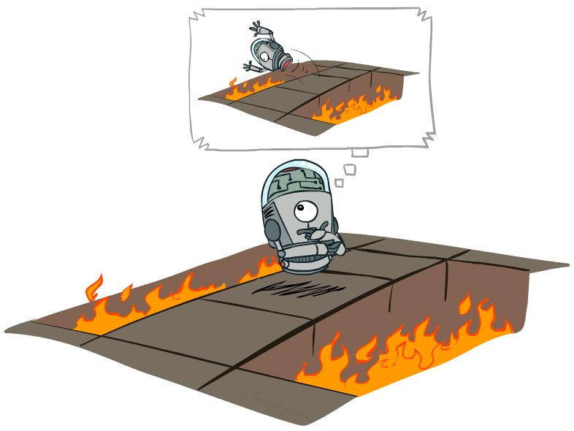
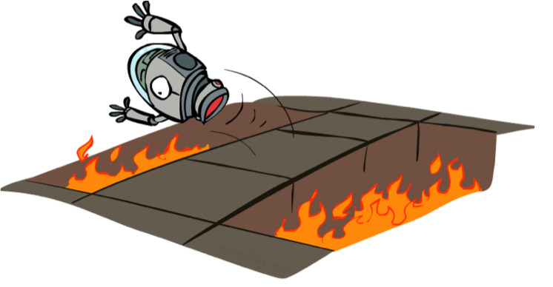
From MDPs to RL
MDPs (offline)
Reinforcement Learning (online)

Slide 17
Reinforcement Learning
We need to take actions in the world
Agent
State: s
Reward: r
Actions: a
Environment

Slide 18
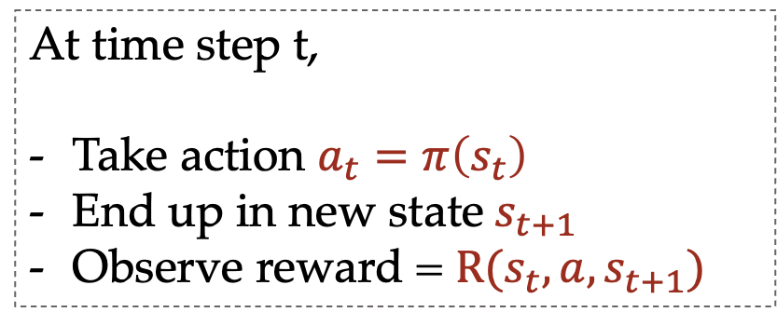
Reinforcement Learning
We need to estimate quantities by trying out
Agent
State: s
Reward: r
Actions: a
Environment
At time step t,
Take action $a_{t}=π\left(s_{t}\right)$
End up in new state$s_{t+1}$
Observe reward = $R(s_{t}, a, s_{t+1})$

Slide 19

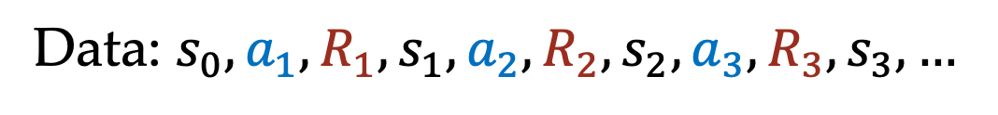
Reinforcement Learning
We need to estimate quantities by trying out
At time step t,
Take action $a_{t}=π\left(s_{t}\right)$
End up in new state$s_{t+1}$
Observe reward = $R(s_{t}, a, s_{t+1})$
Data: $s_{0}, a_{1},R_{1},s_{1},a_{2},R_{2}, s_{2}, a_{3},R_{3},s_{3},…$

Slide 20
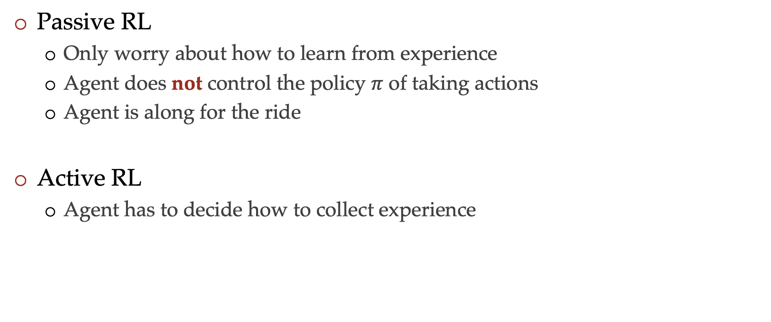
Passive vs Active RL
Passive RL
  Only worry about how to learn from experience
  Agent does not control the policy $π$ of taking actions
  Agent is along for the ride
Active RL
  Agent has to decide how to collect experience

Slide 21
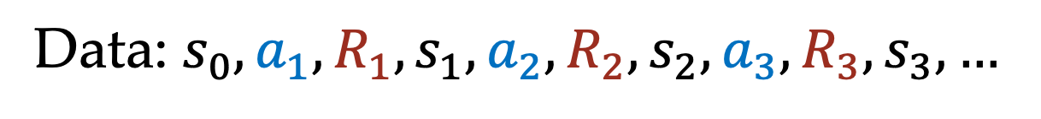

Passive RL
Agent has to learn from some experience
  Ideally learn the optimal policy
Data collected via a policy $π$
Data: $s_{0}, a_{1},R_{1},s_{1},a_{2},R_{2}, s_{2}, a_{3},R_{3},s_{3},…$

Slide 22
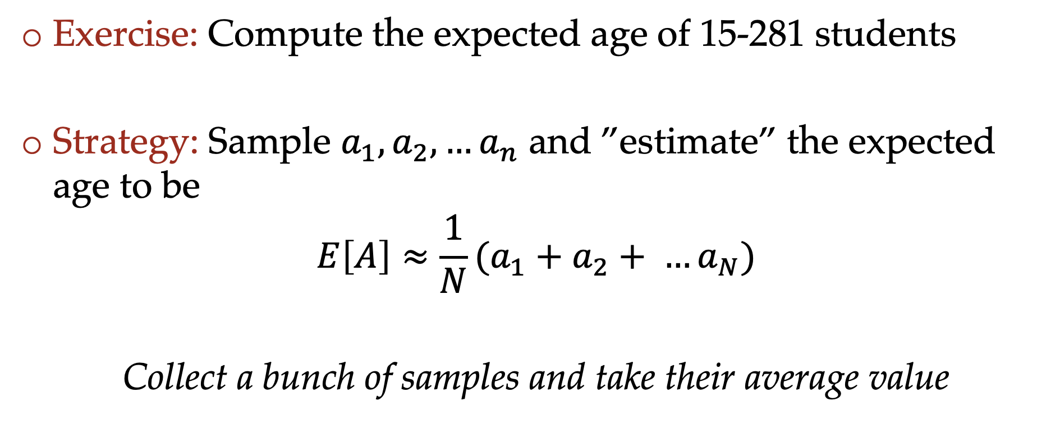
Monte-Carlo estimation
Exercise: Compute the expected age of 15-281 students
Strategy: Sample $a_{1},a_{2},…a_{n}$ and ”estimate” the expected age to be
$$E\left[A\right]≈{\frac{1}{N}(a}_{1}+a_{2}+ …a_{N})$$
Collect a bunch of samples and take their average value

Slide 23
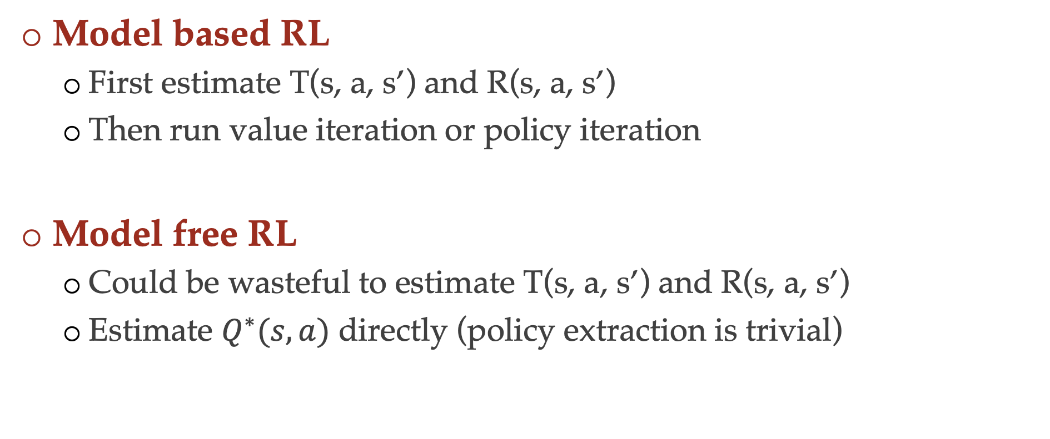
Reinforcement learning approaches
Model based RL
  First estimate T(s, a, s’) and R(s, a, s’)
  Then run value iteration or policy iteration
Model free RL
  Could be wasteful to estimate T(s, a, s’) and R(s, a, s’)
  Estimate $Q^{∗}(s, a)$ directly (policy extraction is trivial)

Slide 24
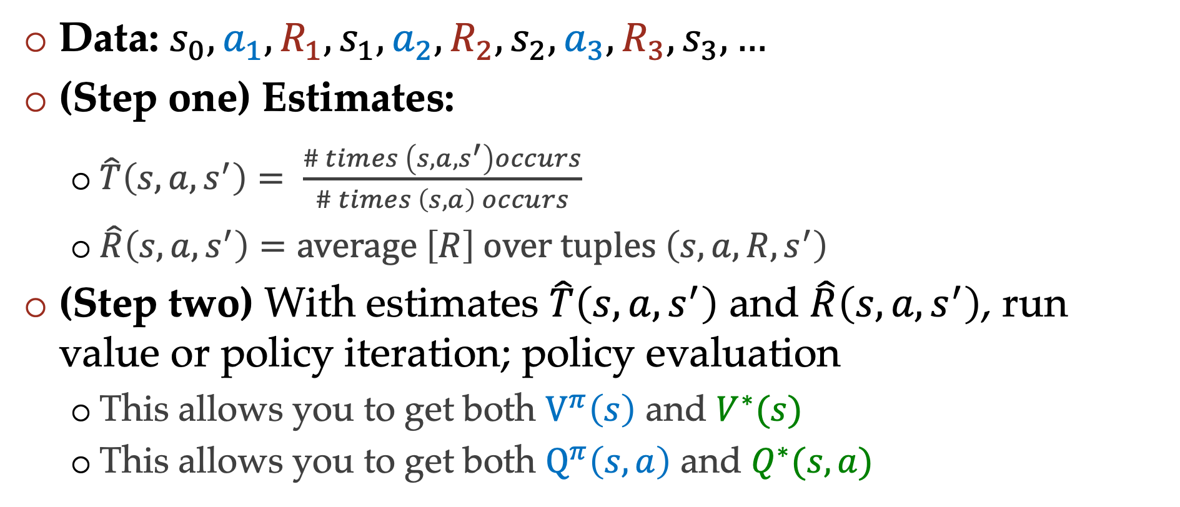
Model-based Monte Carlo
Data: $s_{0}, a_{1},R_{1},s_{1},a_{2},R_{2}, s_{2}, a_{3},R_{3},s_{3},…$
(Step one) Estimates:
  $\hat{T}\left(s, a, s^{′}\right)= \frac{\# times \left(s, a, s^{′}\right)occurs}{\# times \left(s, a\right) occurs}$
  $\hat{R}\left(s, a, s^{′}\right)=average \left[R\right] over tuples \left(s, a, R, s^{′}\right)$
(Step two) With estimates $\hat{T}\left(s, a, s^{′}\right)$ and $\hat{R}\left(s, a, s^{′}\right)$, run value or policy iteration; policy evaluation
  This allows you to get both $V^{π}\left(s\right)$ and $V^{∗}(s)$
  This allows you to get both $Q^{π}\left(s, a\right)$ and $Q^{∗}(s, a)$

Slide 25

Model-free Monte Carlo
Do not want to model the transitions and rewards
Let us first start with a simpler problem of policy evaluation
Can we estimate $V^{π}\left(s\right), Q^{π}(s, a)$ directly?

Slide 26
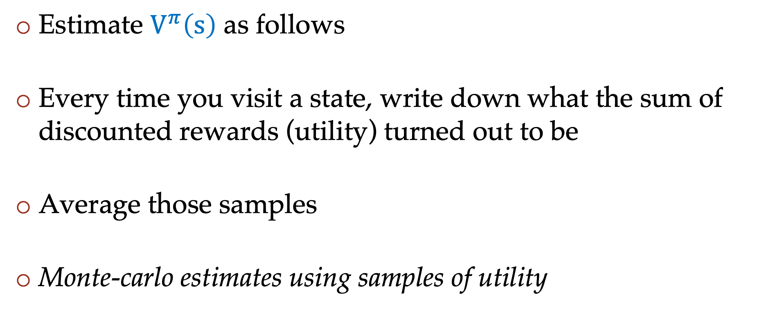
Direct policy evaluation
Estimate $V^{π}\left(s\right)$ as follows
Every time you visit a state, write down what the sum of discounted rewards (utility) turned out to be
Average those samples
Monte-carlo estimates using samples of utility

Slide 27
Direct policy evaluation
Average utility from every time we visit a state
This does not utilize the MDP structure (wasteful)
 | A
B | C | D
 | E
If B and E both go to C under this policy, how can their values be different?

Slide 28
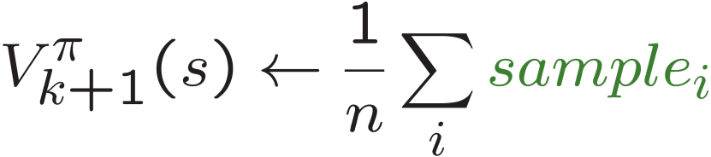
“Better” policy evaluation
s
Bootstrap in a way that resembles expectimax updates
Can we do this without T, R but just via samples?
π(s)
s, π(s)
s, π(s),s’
s’
Sample-based policy evaluation

Slide 29
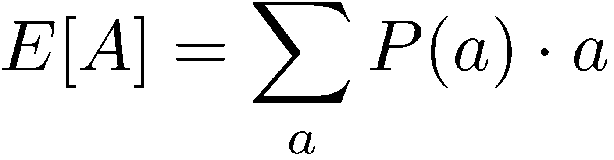
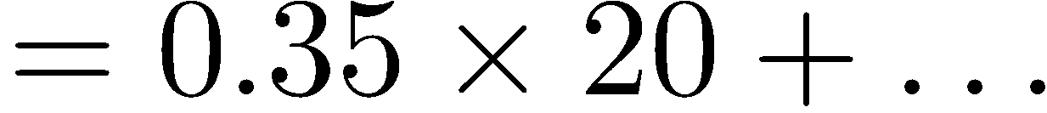
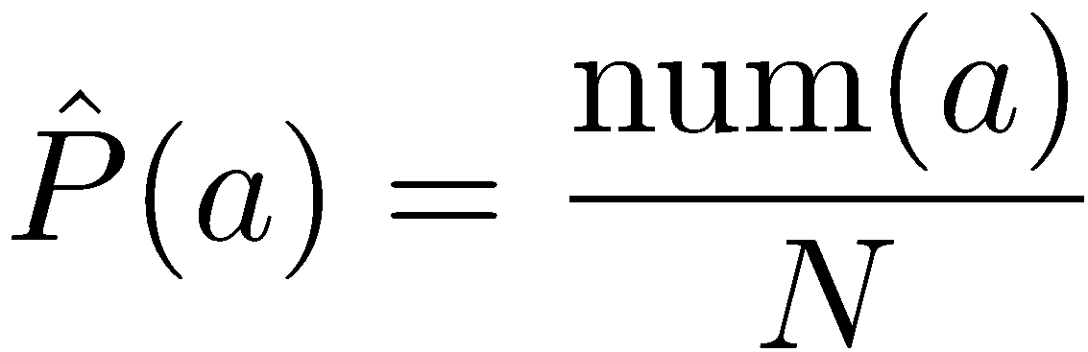
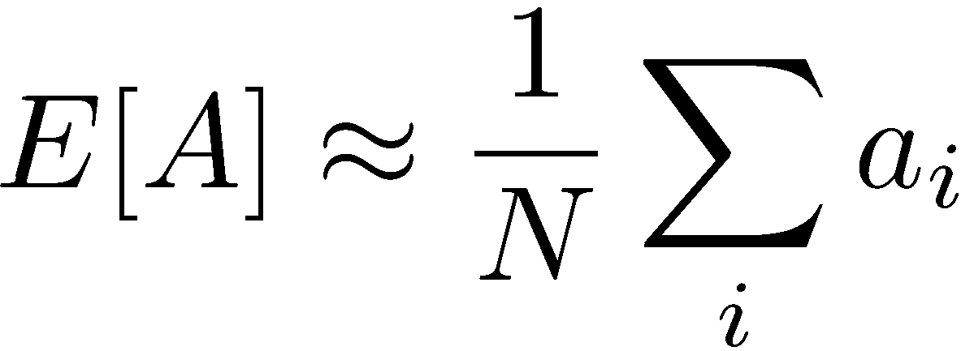
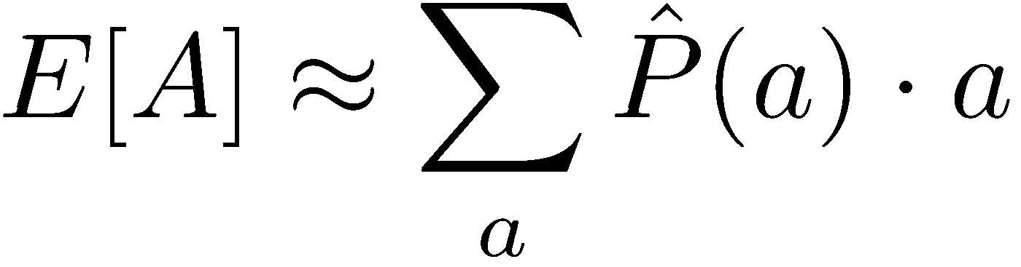
Analogy: Expected Age
Goal: Compute expected age of 15-281 students
Known P(A)
Without P(A), instead collect samples [a₁, a₂, … a_{N}]
Unknown P(A): “Model Based”
Unknown P(A): “Model Free”
Why does this work? Because eventually you learn the right model.
Why does this work? Because samples appear with the right frequencies.

Slide 30
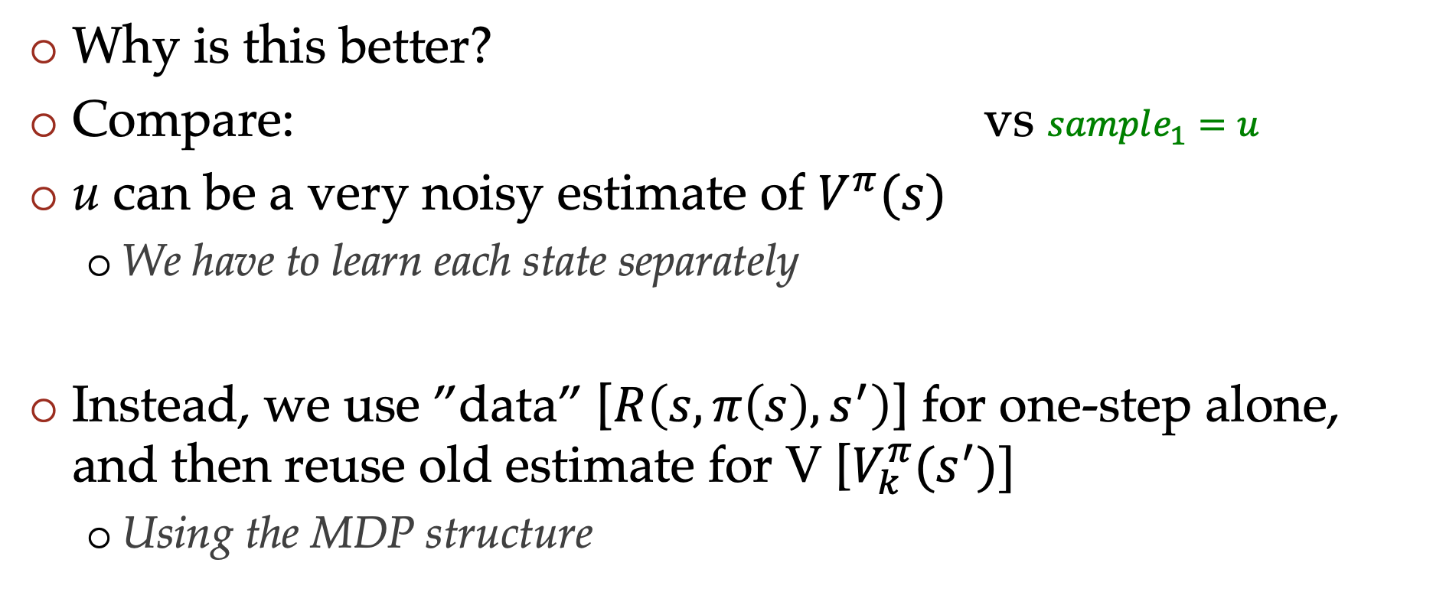
“Better” policy estimation
Why is this better?
Compare: vs $sample_{1}=u$
u can be a very noisy estimate of $V^{π}(s)$
  We have to learn each state separately
Instead, we use ”data” [$R\left(s, π\left(s\right), s^{′}\right)$] for one-step alone, and then reuse old estimate for V [$V_{k}^{π}(s^{′})]$
  Using the MDP structure

Slide 31
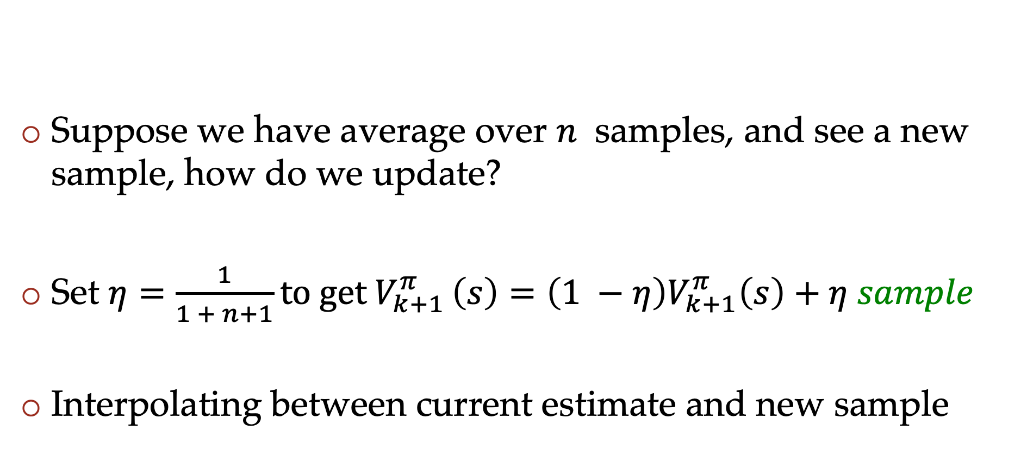
Reinterpreting sample average
Suppose we have average over $n$ samples, and see a new sample, how do we update?
Set $η=\frac{1}{1 + n+1}to get V_{k+1 }^{π}\left(s\right)=\left(1 −η\right)V_{k+1}^{π}\left(s\right)+η sample$
Interpolating between current estimate and new sample

Slide 32
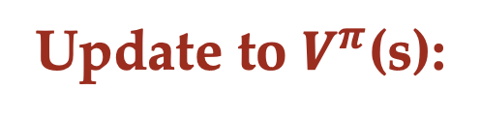
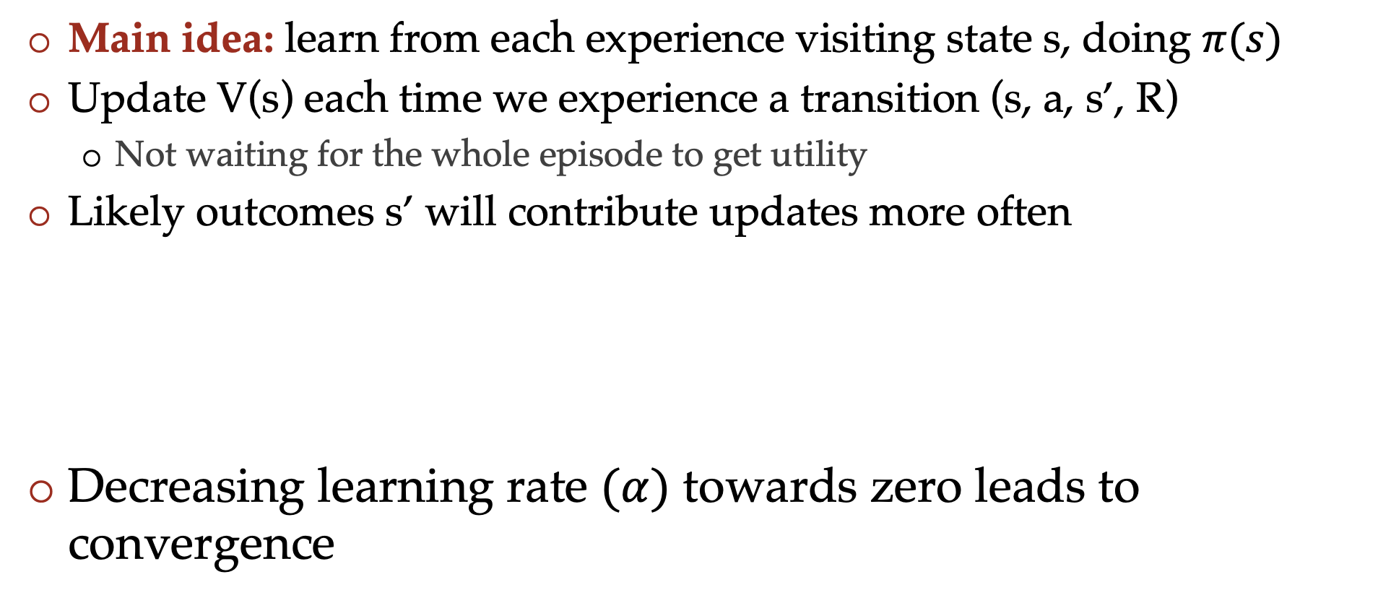
Temporal Difference learning
Main idea: learn from each experience visiting state s, doing $π(s)$
Update V(s) each time we experience a transition (s, a, s’, R)
  Not waiting for the whole episode to get utility
Likely outcomes s’ will contribute updates more often
Decreasing learning rate $(α)$ towards zero leads to convergence
Sample of $V^{π}$(s): sample = $R+γ V^{π}(s^{′})$
Update to $V^{π}$(s):

Slide 33
Summary so far
Passive RL: agent has to learn from experience
Model-based: Estimate the transition and rewards; run value iteration or policy iteration
Model-free:
  Direct policy evaluation – empirical average utility
  Temporal difference learning – sample based policy iteration update via running averages

Slide 34


Example: Model-Based Learning
Input Policy π
Observed Episodes (Training)
Learned Model
Episode 1
Episode 2
T(s,a,s’).
T(B, east, C) =
T(C, east, D) =
T(C, east, A) =
…
R(s,a,s’).
R(B, east, C) =
R(C, east, D) =
R(D, exit, x) =
…
 | A
B | C | D
 | E
B, east, C, -1
C, east, D, -1
D, exit, x, +10
B, east, C, -1
C, east, D, -1
D, exit, x, +10
Episode 3
Episode 4
E, north, C, -1
C, east, D, -1
D, exit, x, +10
E, north, C, -1
C, east, A, -1
A, exit, x, -10
Assume: γ = 1
Notes:
T(s,a,s’).
T(B, east, C) = 1.00
T(C, east, D) = 0.75
T(C, east, A) = 0.25
R(s,a,s’).
R(B, east, C) = -1
R(C, east, D) = -1
R(D, exit, x) = +10
…

Slide 35
Example: Model-free direct Evaluation
Input Policy π
Observed Episodes (Training)
Output Values
Episode 1
Episode 2
A:
B:
C:
D:
E:
 | A
B | C | D
 | E
B, east, C, -1
C, east, D, -1
D, exit, x, +10
B, east, C, -1
C, east, D, -1
D, exit, x, +10
Episode 3
Episode 4
E, north, C, -1
C, east, D, -1
D, exit, x, +10
E, north, C, -1
C, east, A, -1
A, exit, x, -10
Assume: γ = 1
Algorithm: Average all total/future rewards that start at each state
Notes:
A = -10
D = +10
C = (10-1)+(10-1)+(10-1)+(-10-1)/4 = 16/4 = 4
B = (8 + 8)/2 = 8
E = 8+-12/2 = -2

Slide 36
Example: Model-free direct Evaluation
Input Policy π
Observed Episodes (Training)
Output Values
Episode 1
Episode 2
A: -10 [-10]
B: 8, 8 [8]
C: 9, 9, 9, -11 [4]
D: 10, 10, 10 [10]
E: 8, -12 [-2]
 | A
B | C | D
 | E
B, east, C, -1
C, east, D, -1
D, exit, x, +10
B, east, C, -1
C, east, D, -1
D, exit, x, +10
Episode 3
Episode 4
E, north, C, -1
C, east, D, -1
D, exit, x, +10
E, north, C, -1
C, east, A, -1
A, exit, x, -10
Assume: γ = 1
Algorithm: Average all total/future rewards that start at each state
Notes:
A = -10
D = +10
C = (10-1)+(10-1)+(10-1)+(-10-1)/4 = 16/4 = 4
B = (8 + 8)/2 = 8
E = 8+-12/2 = -2

Slide 37
Example: Temporal Difference Learning
States
Observed Transitions
B, east, C, -2
C, east, D, -2
 | A
B | C | D
 | E
 | 0
0 | 0 | 8
 | 0
 | 0
-1 | 0 | 8
 | 0
 | 0
-1 | 3 | 8
 | 0
Assume: γ = 1, α = 0.5
Notes:
i = 0.8*0 + 0.2*(-2) = -0.4
ii = -0.4 (doesn’t change)
iii = 0.8*0 + 0.2*(-2+8) = 1.2

Slide 38
Poll
Which of the following allows you to estimate the optimal policy?
(A) Model-based RL
(B) Model-free RL : direct policy evaluation
(C) Model-free RL : temporal difference learning

Slide 39
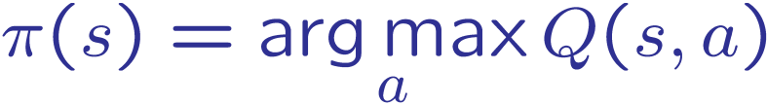
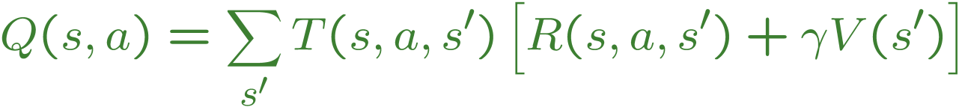
Problems with TD Value Learning
TD value leaning is a model-free way to do policy evaluation, mimicking Bellman updates with running sample averages
However, if we want to turn values into a (new) policy, we’re sunk:
Idea: learn Q-values, not values
s
a
s, a
s,a,s’
s’

Slide 40
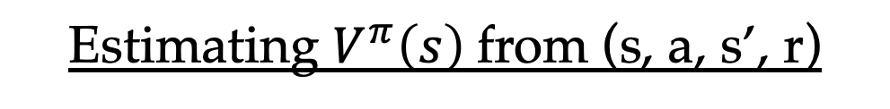

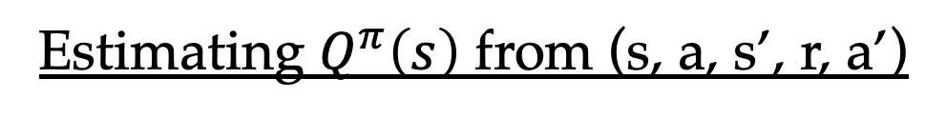
Bootstrapped prediction of Q-values
Estimating $V^{π}\left(s\right)$from (s, a, s’, r)
Sample of $V^{π}$(s): sample = $r+γ V^{π}(s^{′})$
Update to $V^{π}$(s):
Estimating $Q^{π}\left(s\right)$ from (s, a, s’, r, a’)
Sample of $Q^{π}$(s): sample = $r+γ Q^{π}(s^{′}, a^{′})$
Update to $Q^{π}$(s): $Q^{π}\left(s\right) ←\left(1 −α\right) Q^{π}\left(s\right)+α sample$

Slide 41
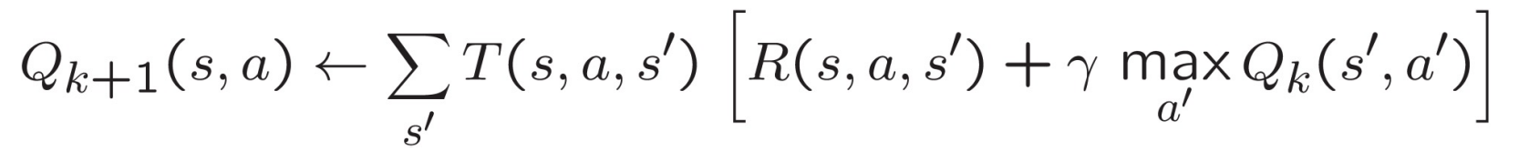
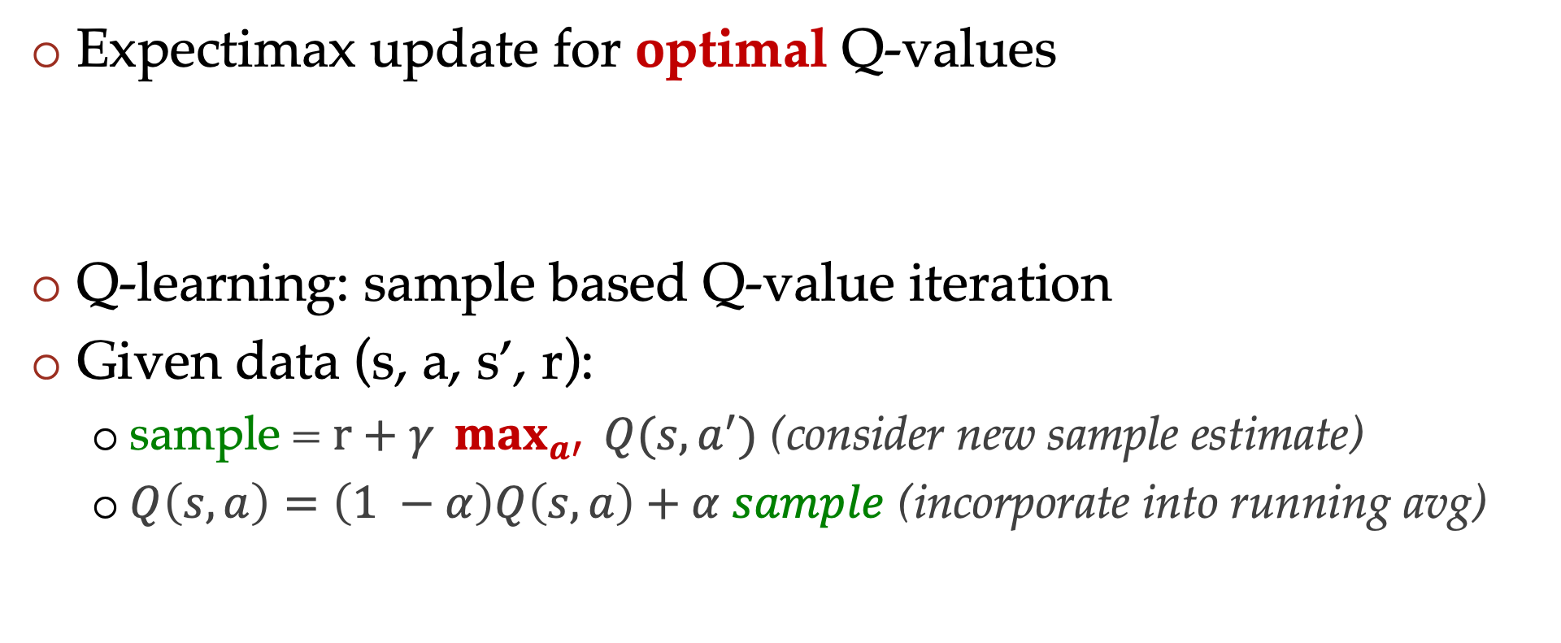
Q-learning
Expectimax update for optimal Q-values
Q-learning: sample based Q-value iteration
Given data (s, a, s’, r):
  sample = $r+γ \max_{a′}{ Q(s, a^{′})}$ (consider new sample estimate)
  $Q\left(s, a\right)=\left(1 −α\right)Q\left(s, a\right)+α sample$ (incorporate into running avg)

Slide 42
Q-learning properties
Important property: Q-learning converges to values of the optimal policy even if you are acting suboptimally
This is called off-policy learning
  Learning about the optimal policy while the experience is obtained via a different (suboptimal) policy
Caveats:
  Data-collecting policy has to explore enough
  Have to lower the learning rate eventually
    But not too quickly

