Slide 1
Internetworking
15-213: Introduction to Computer Systems
19th Lecture, Oct. 28, 2010
Instructors:
Randy Bryant and Dave O’Hallaron

Slide 2
A Client-Server Transaction
1. Client sends request
Client
process
Server
process
Resource
4. Client
handles
response
3. Server sends response
2. Server
handles
request
Note: clients and servers are processes running on hosts
(can be the same or different hosts)
Most network applications are based on the client-server model:
  A server process and one or more client processes
  Server manages some resource
  Server provides service by manipulating resource for clients
  Server activated by request from client (vending machine analogy)

Slide 3
Hardware Organization of a Network Host
CPU chip
register file
ALU
system bus
memory bus
main
memory
MI
I/O
bridge
Expansion slots
I/O bus
USB
controller
graphics
adapter
disk
controller
network
adapter
mouse
keyboard
monitor
disk
network

Slide 4
Computer Networks
A network is a hierarchical system of boxes and wires organized by geographical proximity
  SAN (System Area Network) spans cluster or machine room
    Switched Ethernet, Quadrics QSW, …
  LAN (Local Area Network) spans a building or campus
    Ethernet is most prominent example
  WAN (Wide Area Network) spans country or world
    Typically high-speed point-to-point phone lines
An internetwork (internet) is an interconnected set of networks
  The Global IP Internet (uppercase “I”) is the most famous example of an internet (lowercase “i”)
Let’s see how an internet is built from the ground up

Slide 5
Lowest Level: Ethernet Segment
host
host
host
100 Mb/s
100 Mb/s
hub
port
Ethernet segment consists of a collection of hosts connected by wires (twisted pairs) to a hub
Spans room or floor in a building
Operation
  Each Ethernet adapter has a unique 48-bit address (MAC address)
    E.g., 00:16:ea:e3:54:e6
  Hosts send bits to any other host in chunks called frames
  Hub slavishly copies each bit from each port to every other port
    Every host sees every bit
    Note: Hubs are on their way out. Bridges (switches, routers) became cheap enough to replace them (means no more broadcasting)

Slide 6
Next Level: Bridged Ethernet Segment
A
B
host
host
host
host
host
X
hub
100 Mb/s
bridge
100 Mb/s
hub
1 Gb/s
host
host
hub
100 Mb/s
bridge
100 Mb/s
hub
Y
host
host
host
host
host
C
Spans building or campus
Bridges cleverly learn which hosts are reachable from which ports and then selectively copy frames from port to port

Slide 7
Conceptual View of LANs
For simplicity, hubs, bridges, and wires are often shown as a collection of hosts attached to a single wire:
host
host
...
host

Slide 8
Next Level: internets
Multiple incompatible LANs can be physically connected by specialized computers called routers
The connected networks are called an internet
host
host
...
host
host
host
...
host
LAN
LAN
router
router
router
WAN
WAN
LAN 1 and LAN 2 might be completely different, totally incompatible
(e.g., Ethernet and Wifi, 802.11*, T1-links, DSL, …)

Slide 9
Logical Structure of an internet
host
host
router
router
router
router
router
router
Ad hoc interconnection of networks
  No particular topology
  Vastly different router & link capacities
Send packets from source to destination by hopping through networks
  Router forms bridge from one network to another
  Different packets may take different routes

Slide 10
The Notion of an internet Protocol
How is it possible to send bits across incompatible LANs and WANs?
Solution:
  protocol software running on each host and router
  smooths out the differences between the different networks
Implements an internet protocol (i.e., set of rules)
  governs how hosts and routers should cooperate when they transfer data from network to network
  TCP/IP is the protocol for the global IP Internet

Slide 11
What Does an internet Protocol Do?
Provides a naming scheme
  An internet protocol defines a uniform format for host addresses
  Each host (and router) is assigned at least one of these internet addresses that uniquely identifies it
Provides a delivery mechanism
  An internet protocol defines a standard transfer unit (packet)
  Packet consists of header and payload
    Header: contains info such as packet size, source and destination addresses
    Payload: contains data bits sent from source host

Slide 12
Transferring Data Over an internet
LAN1
Host A
Host B
LAN2
client
server
(1)
data
(8)
data
protocol
software
protocol
software
internet packet
(2)
data
PH
FH1
(7)
data
PH
FH2
LAN1 frame
LAN1
adapter
LAN2
adapter
Router
(3)
data
PH
FH1
(6)
data
PH
FH2
LAN1
adapter
LAN2
adapter
LAN2 frame
(4)
data
PH
FH1
data
PH
FH2
(5)
protocol
software
PH: Internet packet header
FH: LAN frame header

Slide 13
Other Issues
We are glossing over a number of important questions:
  What if different networks have different maximum frame sizes? (segmentation)
  How do routers know where to forward frames?
  How are routers informed when the network topology changes?
  What if packets get lost?
These (and other) questions are addressed by the area of systems known as computer networking

Slide 14
Global IP Internet
Most famous example of an internet
Based on the TCP/IP protocol family
  IP (Internet protocol) :
    Provides basic naming scheme and unreliable delivery capability
    of packets (datagrams) from host-to-host
  UDP (Unreliable Datagram Protocol)
    Uses IP to provide unreliable datagram delivery from
    process-to-process
  TCP (Transmission Control Protocol)
    Uses IP to provide reliable byte streams from process-to-process over connections
Accessed via a mix of Unix file I/O and functions from the sockets interface

Slide 15
Hardware and Software Organization of an Internet Application
Internet client host
Internet server host
Client
User code
Server
Sockets interface
(system calls)
TCP/IP
Kernel code
TCP/IP
Hardware interface
(interrupts)
Network
adapter
Hardware
and firmware
Network
adapter
Global IP Internet

Slide 16
Basic Internet Components
Internet backbone:
  collection of routers (nationwide or worldwide) connected by high-speed point-to-point networks
Network Access Point (NAP):
  router that connects multiple backbones (often referred to as peers)
Regional networks:
  smaller backbones that cover smaller geographical areas
  (e.g., cities or states)
Point of presence (POP):
  machine that is connected to the Internet
Internet Service Providers (ISPs):
  provide dial-up or direct access to POPs

Slide 17
NAP-Based Internet Architecture
NAPs link together commercial backbones provided by companies such as AT&T and Worldcom
Currently in the US there are about 50 commercial backbones connected by ~12 NAPs (peering points)
Similar architecture worldwide connects national networks to the Internet

Slide 18
Internet Connection Hierarchy
Private
“peering”
agreements
between
two backbone
companies
often bypass
NAP
NAP
NAP
NAP
Colocation
sites
Backbone
Backbone
Backbone
Backbone
POP
POP
POP
POP
POP
POP
POP
T3
Regional net
ISP
Big Business
POP
POP
POP
POP
POP
POP
POP
Cable
modem
DSL
T1
T1
ISP (for individuals)
Small Business
Pgh employee
DC employee

Slide 19
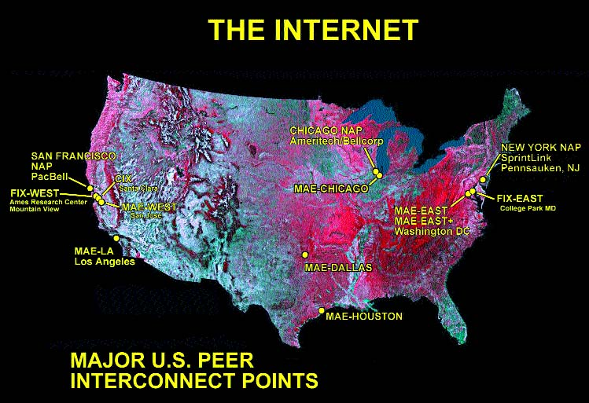
Network Access Points (NAPs)
Note: Peers in this context are
commercial backbones (droh)
Source: Boardwatch.com

Slide 20
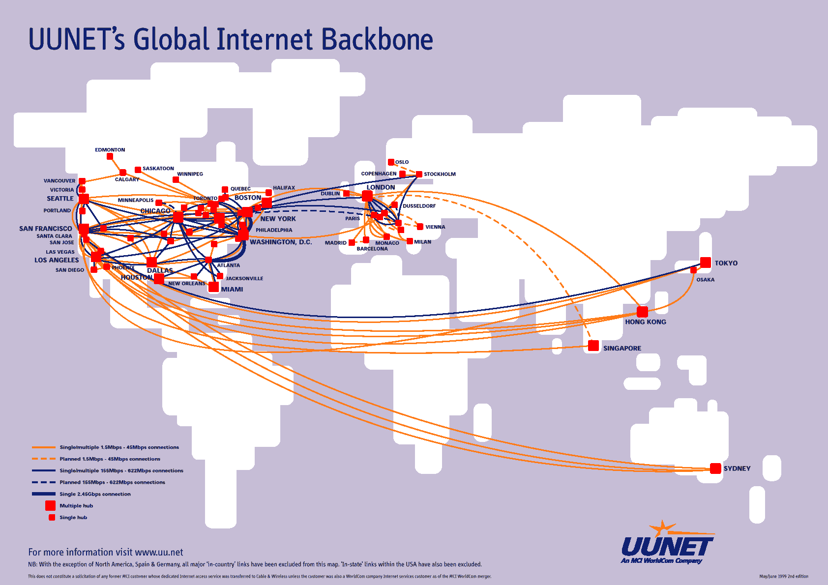
MCI/WorldCom/UUNET Global Backbone
Source: http://personalpages.manchester.ac.uk/staff/m.dodge/cybergeography/atlas/

Slide 21
Naming and Communicating on the Internet
Original Idea
  Every node on Internet would have unique IP address
    Everyone would be able to talk directly to everyone
  No secrecy or authentication
    Messages visible to routers and hosts on same LAN
    Possible to forge source field in packet header
Shortcomings
  There aren't enough IP addresses available
  Don't want everyone to have access or knowledge of all other hosts
  Security issues mandate secrecy & authentication

Slide 22
Evolution of Internet: Naming
Dynamic address assignment
  Most hosts don't need to have known address
    Only those functioning as servers
  DHCP (Dynamic Host Configuration Protocol)
    Local ISP assigns address for temporary use
Example:
  My laptop at CMU (wired connection)
    IP address 128.2.213.29 (bryant-tp4.cs.cmu.edu)
    Assigned statically
  My laptop at home
    IP address 192.168.1.5
    Only valid within home network

Slide 23
Evolution of Internet: Firewalls
1
176.3.3.3
10.2.2.2
4
Firewall
2
3
216.99.99.99
Corporation X
Internet
Firewalls
  Hides organizations nodes from rest of Internet
  Use local IP addresses within organization
  For external service, provides proxy service
    Client request: src=10.2.2.2, dest=216.99.99.99
    Firewall forwards: src=176.3.3.3, dest=216.99.99.99
    Server responds: src=216.99.99.99, dest=176.3.3.3
    Firewall forwards response: src=216.99.99.99, dest=10.2.2.2

Slide 24
Virtual Private Networks
10.x.x.x
Firewall
10.6.6.6
198.3.3.3
Corporation X
Internet
Supporting road warrior
  Employee working remotely with assigned IP address 198.3.3.3
  Wants to appear to rest of corporation as if working internally
    From address 10.6.6.6
    Gives access to internal services (e.g., ability to send mail)
Virtual Private Network (VPN)
  Overlays private network on top of regular Internet

Slide 25
A Programmer’s View of the Internet
Hosts are mapped to a set of 32-bit IP addresses
  128.2.203.179
The set of IP addresses is mapped to a set of identifiers called Internet domain names
  128.2.203.179 is mapped to www.cs.cmu.edu
A process on one Internet host can communicate with a process on another Internet host over a connection

Slide 26
IP Addresses
32-bit IP addresses are stored in an IP address struct
  IP addresses are always stored in memory in network byte order
  (big-endian byte order)
  True in general for any integer transferred in a packet header from one machine to another.
    E.g., the port number used to identify an Internet connection.
/* Internet address structure */
struct in_addr {
unsigned int s_addr; /* network byte order (big-endian) */
};
Useful network byte-order conversion functions (“l” = 32 bits, “s” = 16 bits)
  htonl: convert uint32_t from host to network byte order
  htons: convert uint16_t from host to network byte order
  ntohl: convert uint32_t from network to host byte order
  ntohs: convert uint16_t from network to host byte order

Slide 27
Dotted Decimal Notation
By convention, each byte in a 32-bit IP address is represented by its decimal value and separated by a period
    IP address: 0x8002C2F2 = 128.2.194.242
Functions for converting between binary IP addresses and dotted decimal strings:
  inet_aton: dotted decimal string → IP address in network byte order
  inet_ntoa: IP address in network byte order → dotted decimal string
  “n” denotes network representation
  “a” denotes application representation

Slide 28
IP Address Structure
IP (V4) Address space divided into classes:
Network ID Written in form w.x.y.z/n
  n = number of bits in host address
  E.g., CMU written as 128.2.0.0/16
    Class B address
Unrouted (private) IP addresses:
  10.0.0.0/8 172.16.0.0/12 192.168.0.0/16
0 1 2 3 8 16 24 31
Class A
0
Net ID
Host ID
Class B
1
0
Net ID
Host ID
Class C
1
1
0
Net ID
Host ID
Class D
1
1
1
0
Multicast address
Class E
1
1
1
1
Reserved for experiments

Slide 29
Internet Domain Names
unnamed root
.net
.edu
.gov
.com
First-level domain names
mit
cmu
berkeley
amazon
Second-level domain names
cs
ece
www
2007.171.166.252
Third-level domain names
ics
sp
greatwhite
128.2.220.10
i386-f7
128.2.200.47

Slide 30
Domain Naming System (DNS)
The Internet maintains a mapping between IP addresses and domain names in a huge worldwide distributed database called DNS
  Conceptually, programmers can view the DNS database as a collection of millions of host entry structures:
Functions for retrieving host entries from DNS:
  gethostbyname: query key is a DNS domain name.
  gethostbyaddr: query key is an IP address.
/* DNS host entry structure */
struct hostent {
char *h_name; /* official domain name of host */
char **h_aliases; /* null-terminated array of domain names */
int h_addrtype; /* host address type (AF_INET) */
int h_length; /* length of an address, in bytes */
char **h_addr_list; /* null-terminated array of in_addr structs */
};

Slide 31
Properties of DNS Host Entries
Each host entry is an equivalence class of domain names and
IP addresses
Each host has a locally defined domain name localhost which always maps to the loopback address 127.0.0.1
Different kinds of mappings are possible:
  Simple case: one-to-one mapping between domain name and IP address:
    greatwhile.ics.cs.cmu.edu maps to 128.2.220.10
  Multiple domain names mapped to the same IP address:
    eecs.mit.edu and cs.mit.edu both map to 18.62.1.6
  Multiple domain names mapped to multiple IP addresses:
    google.com maps to multiple IP addresses
  Some valid domain names don’t map to any IP address:
    for example: ics.cs.cmu.edu

Slide 32
A Program That Queries DNS
int main(int argc, char **argv) { /* argv[1] is a domain name */
char **pp; /* or dotted decimal IP addr */
struct in_addr addr;
struct hostent *hostp;
if (inet_aton(argv[1], &addr) != 0)
hostp = Gethostbyaddr((const char *)&addr, sizeof(addr),
AF_INET);
else
hostp = Gethostbyname(argv[1]);
printf("official hostname: %s\n", hostp->h_name);
for (pp = hostp->h_aliases; *pp != NULL; pp++)
printf("alias: %s\n", *pp);
for (pp = hostp->h_addr_list; *pp != NULL; pp++) {
addr.s_addr = ((struct in_addr *)*pp)->s_addr;
printf("address: %s\n", inet_ntoa(addr));
}
}

Slide 33
Using DNS Program
linux> ./dns greatwhite.ics.cs.cmu.edu
official hostname: greatwhite.ics.cs.cmu.edu
address 128.2.220.10
linux> ./dns 128.2.220.11
official hostname: ANGELSHARK.ICS.CS.CMU.EDU
address: 128.2.220.11
linux> ./dns www.google.com
official hostname: www.l.google.com
alias: www.google.com
address: 72.14.204.99
address: 72.14.204.103
address: 72.14.204.104
address: 72.14.204.147
linux> dig +short -x 72.14.204.103
iad04s01-in-f103.1e100.net.

Slide 34
Querying DIG
Domain Information Groper (dig) provides a scriptable command line interface to DNS
linux> dig +short greatwhite.ics.cs.cmu.edu
128.2.220.10
linux> dig +short -x 128.2.220.11
ANGELSHARK.ICS.CS.CMU.EDU.
linux> dig +short google.com
72.14.204.104
72.14.204.147
72.14.204.99
72.14.204.103
linux> dig +short -x 72.14.204.103
iad04s01-in-f103.1e100.net.

Slide 35
More Exotic Features of DIG
Provides more information than you would ever want about DNS
linux> dig www.phys.msu.ru a +trace
128.2.220.10
linux> dig www.google.com a +trace

Slide 36
Internet Connections
Clients and servers communicate by sending streams of bytes over connections:
  Point-to-point, full-duplex (2-way communication), and reliable.
A socket is an endpoint of a connection
  Socket address is an IPaddress:port pair
A port is a 16-bit integer that identifies a process:
  Ephemeral port: Assigned automatically on client when client makes a connection request
  Well-known port: Associated with some service provided by a server (e.g., port 80 is associated with Web servers)
A connection is uniquely identified by the socket addresses of its endpoints (socket pair)
  (cliaddr:cliport, servaddr:servport)

Slide 37
Putting it all Together:
Anatomy of an Internet Connection
Client socket address
128.2.194.242:51213
Server socket address
208.216.181.15:80
Client
Server
(port 80)
Connection socket pair
(128.2.194.242:51213, 208.216.181.15:80)
Client host address
128.2.194.242
Server host address
208.216.181.15

Slide 38
Next Time
How to use the sockets interface to establish Internet connections between clients and servers
How to use Unix I/O to copy data from one host to another over an Internet connection

