Slide 1
Choice Screen Auctions
Michael Ostrovsky
Stanford Graduate School of Business and NBER
June 23, 2023

Slide 2
Product A
Product B
Platform A

Slide 3
Choice Screen – Microsoft Windows/browsers
Initially proposed by Microsoft in 1999 as a potential remedy in the US, not adopted at the time
Adopted in Europe 2010 – 2014 (agreement between MS and EC)
Accidentally removed on one of the versions of Windows from May 2011 until July 2012, affecting ~15 million users. Microsoft admitted the error and paid a fine of €561 million.

Slide 4
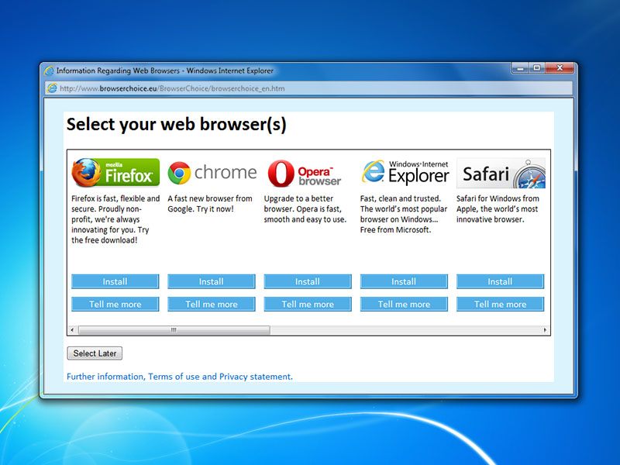

Slide 5
Choice Screens for search engines and browsers on Google’s Android platform
In 2017, Google paid a €4.3 billion fine to the EC for illegal tying of its Chrome browser and Google Search app and default search engine on the Android platform
As part of the subsequent settlement, in 2018 Google agreed to display choice screens for alternative search engines and browsers to Android users in Europe, starting in 2019

Slide 6
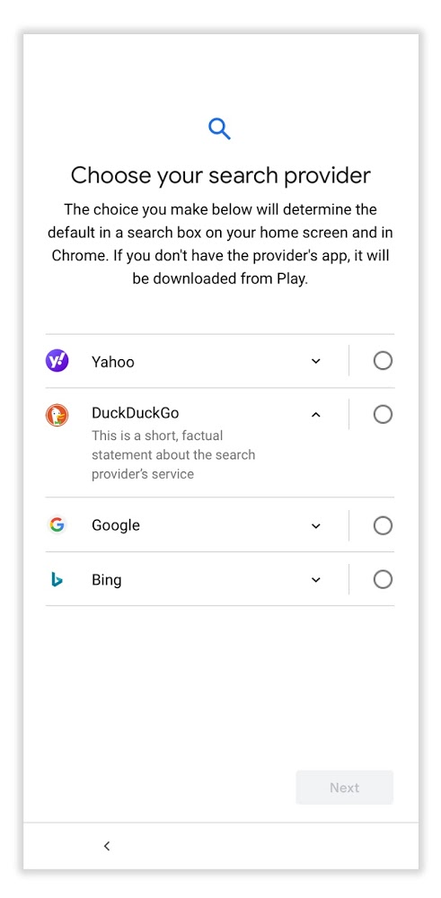
Choice Screen Auctions
Announced in August 2019
Auctions are conducted quarterly, first auction for the period March 2020 – June 2020
“The auction revenues help [Google] to continue to invest in developing and maintaining the Android platform.”

Slide 7
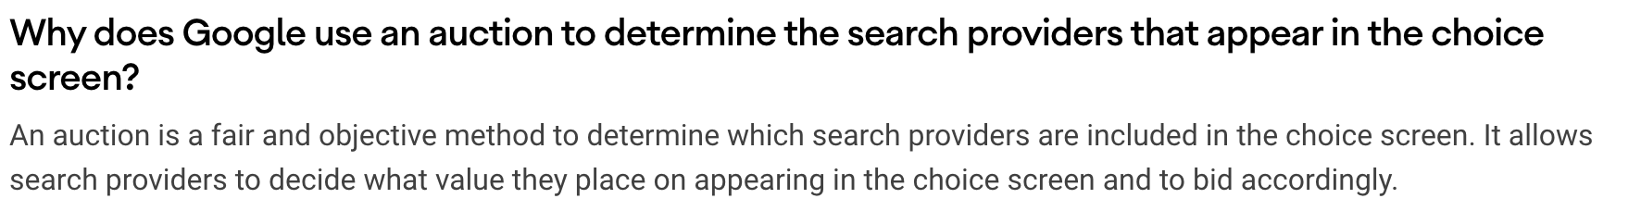
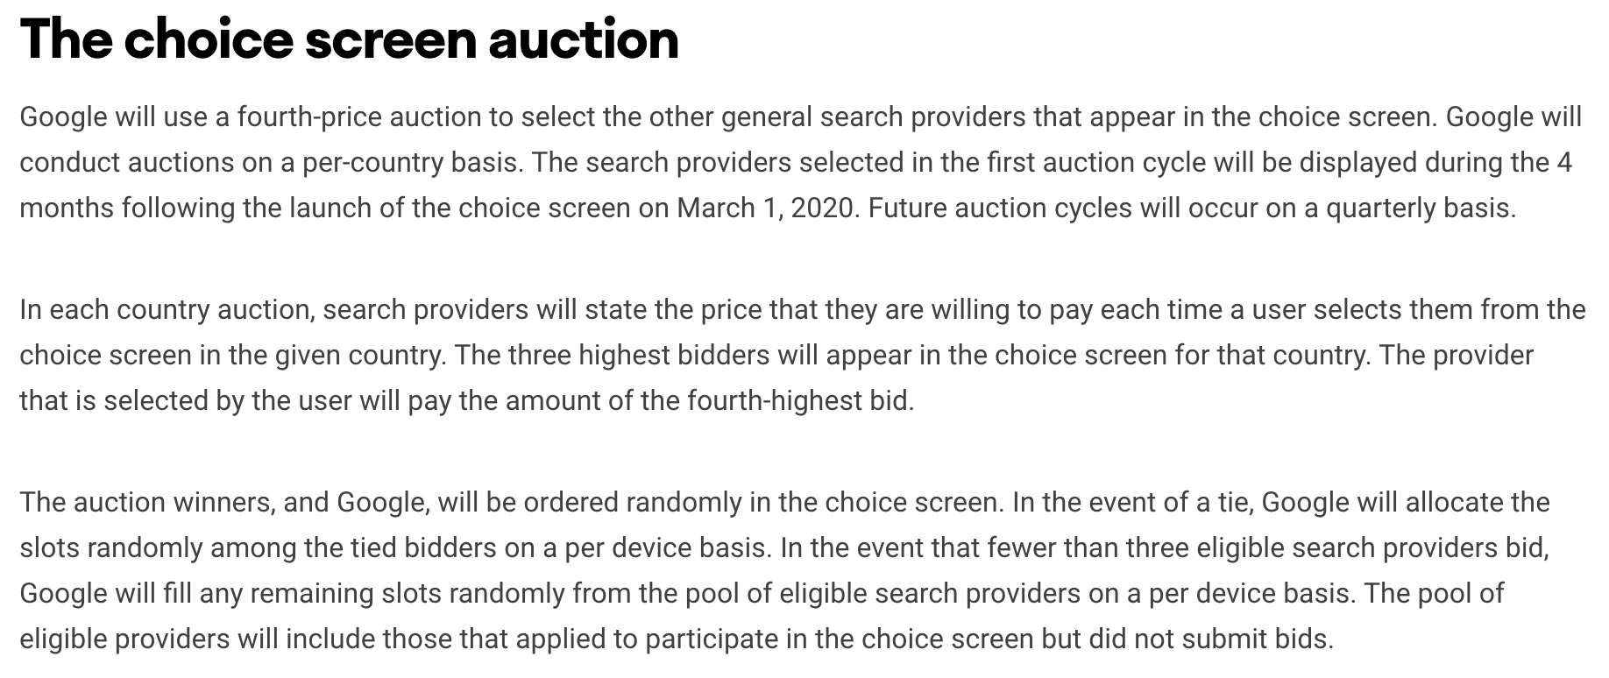

Slide 8
Example
Search Engine X
Search Engine Y
Values each user at $20
50 users will install it
(if it is shown on the choice screen)
Values each user at $10
5000 users will install it
(if it is shown on the choice screen)

Slide 9
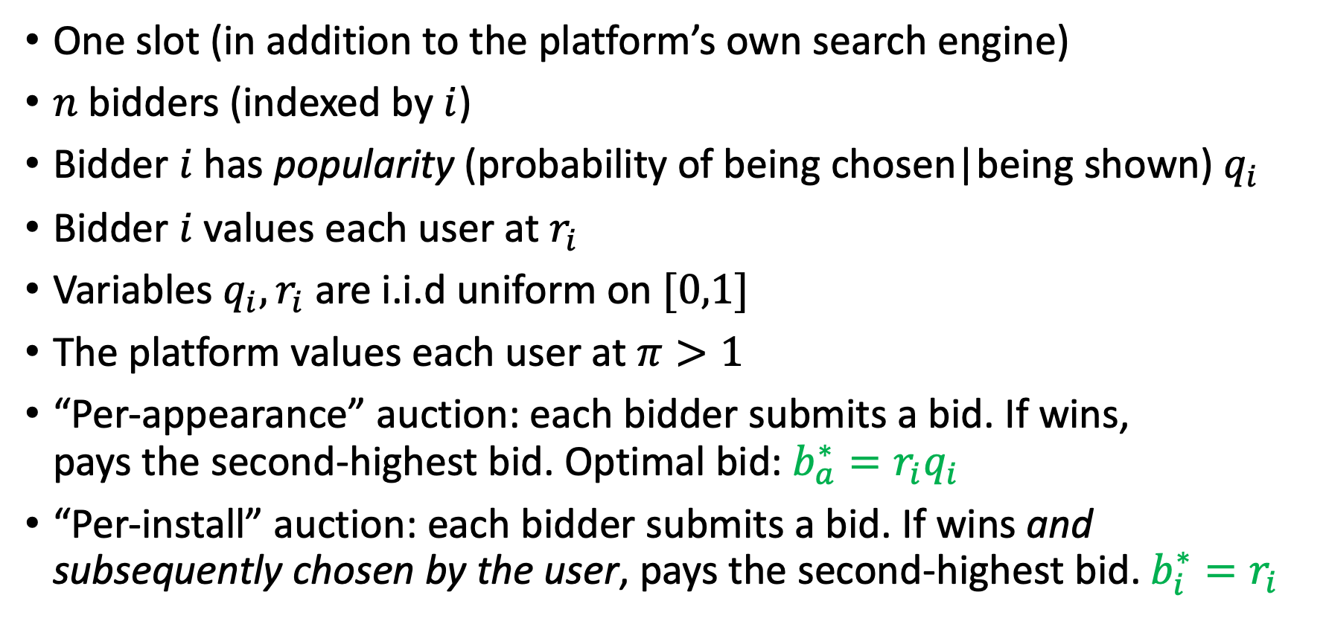
Basic Model
One slot (in addition to the platform’s own search engine)
$n$ bidders (indexed by $i$)
Bidder $i$has popularity (probability of being chosen|being shown) $q_{i}$
Bidder $i$ values each user at $r_{i}$
Variables $q_{i}, r_{i}$are i.i.d uniform on $[0,1]$
The platform values each user at $π>1$
“Per-appearance” auction: each bidder submits a bid. If wins,
pays the second-highest bid. Optimal bid: ${b_{a}^{∗}=r_{i}q}_{i}$
“Per-install” auction: each bidder submits a bid. If wins and subsequently chosen by the user, pays the second-highest bid.${ b_{i}^{∗}=r}_{i}$

Slide 10
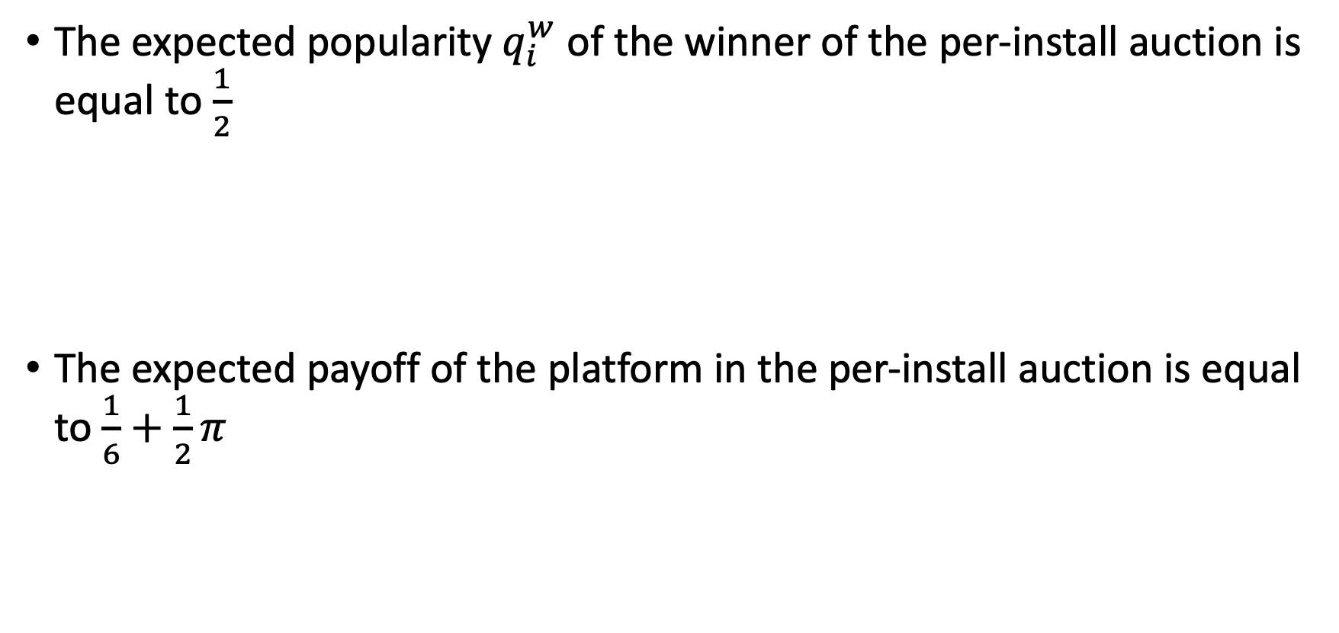

Results ($n=2$)
The expected popularity $q_{i}^{w}$ of the winner of the per-install auction is equal to $\frac{1}{2}$
The expected popularity $q_{a}^{w}$ of the winner of the per-appearance auction is strictly greater than $q_{i}^{w}=\frac{1}{2}$
The expected payoff of the platform in the per-install auction is equal to $\frac{1}{6}+\frac{1}{2}π$
The expected payoff of the platform in the per-appearance auction is strictly lower than $\frac{1}{6}+\frac{1}{2}π$

Slide 11
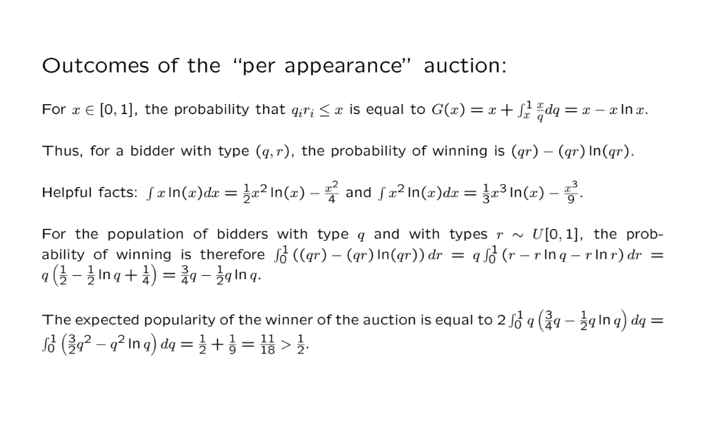

Slide 13
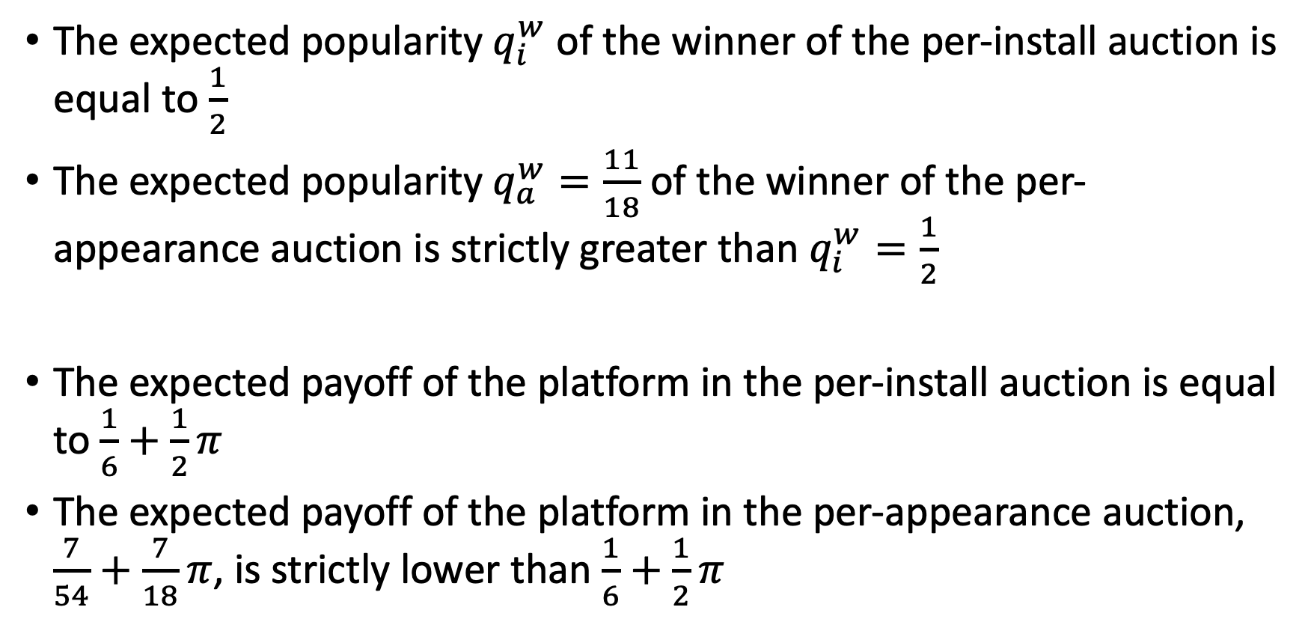
Results ($n=2$)
The expected popularity $q_{i}^{w}$ of the winner of the per-install auction is equal to $\frac{1}{2}$
The expected popularity $q_{a}^{w}=\frac{11}{18}$ of the winner of the per-appearance auction is strictly greater than $q_{i}^{w}=\frac{1}{2}$
The expected payoff of the platform in the per-install auction is equal to $\frac{1}{6}+\frac{1}{2}π$
The expected payoff of the platform in the per-appearance auction, $\frac{7}{54}+\frac{7}{18}π$, is strictly lower than $\frac{1}{6}+\frac{1}{2}π$

Slide 14
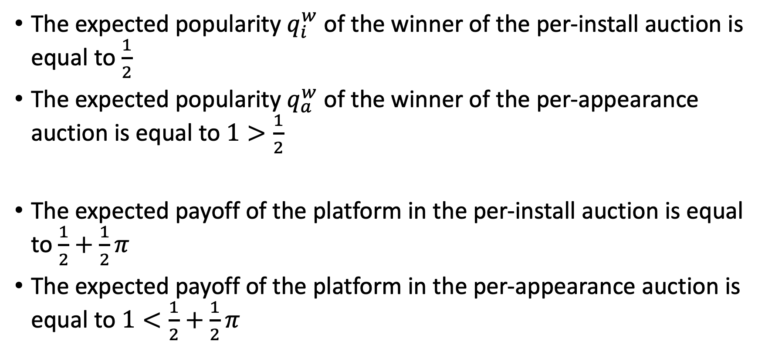

Results ($n→∞$)
The expected popularity $q_{i}^{w}$ of the winner of the per-install auction is equal to $\frac{1}{2}$
The expected popularity $q_{a}^{w}$ of the winner of the per-appearance auction is equal to $1>\frac{1}{2}$
The expected payoff of the platform in the per-install auction is equal to $\frac{1}{2}+\frac{1}{2}π$
The expected payoff of the platform in the per-appearance auction is equal to $1<\frac{1}{2}+\frac{1}{2}π$

Slide 15
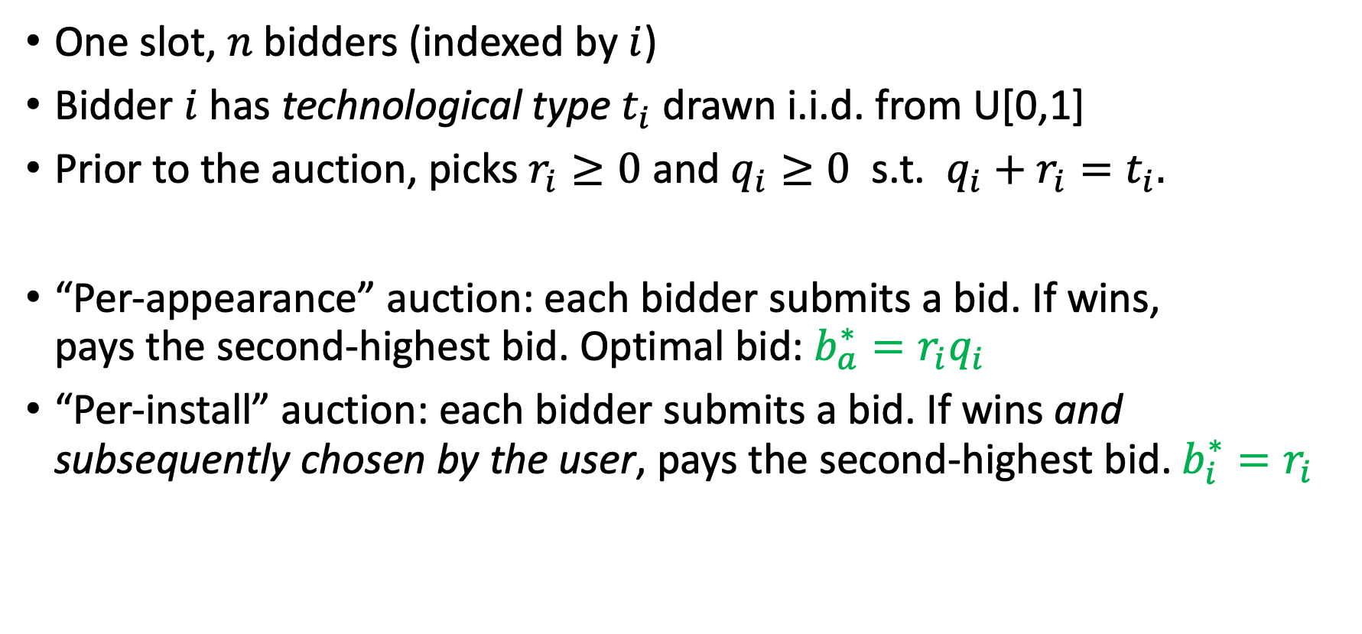

Extension: endogenous $q_{i}$ and $r_{i}$
One slot, $n$ bidders (indexed by $i$)
Bidder $i$has technological type $t_{i}$ drawn i.i.d. from U[0,1]
Prior to the auction, picks $r_{i}≥0$ and $q_{i}≥0$ s.t. ${q_{i}+r}_{i}=t_{i}.$
“Per-appearance” auction: each bidder submits a bid. If wins,
pays the second-highest bid. Optimal bid: ${b_{a}^{∗}=r_{i}q}_{i}$
“Per-install” auction: each bidder submits a bid. If wins and subsequently chosen by the user, pays the second-highest bid.${ b_{i}^{∗}=r}_{i}$

Slide 17
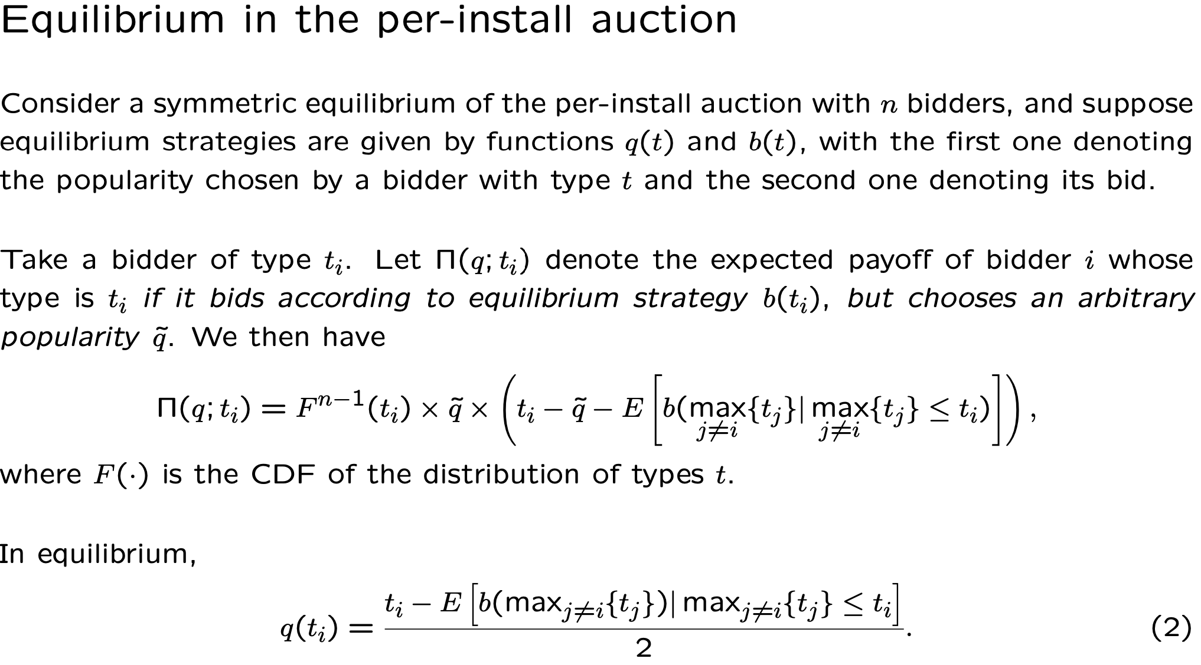

Slide 20
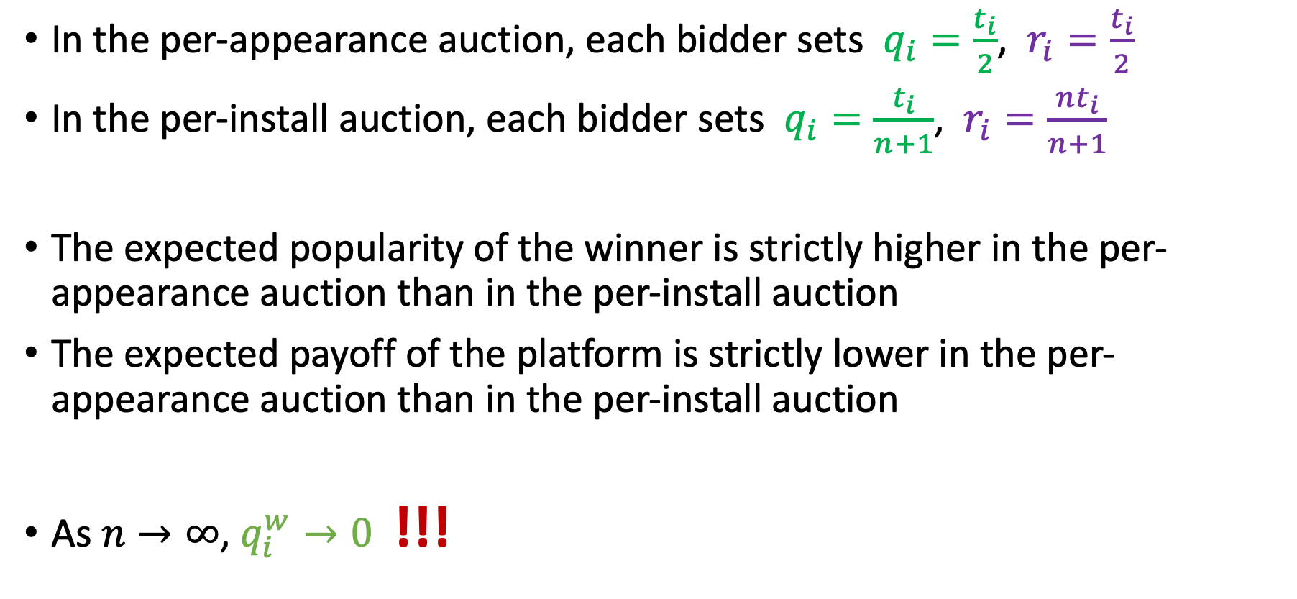
Results
In the per-appearance auction, each bidder sets $q_{i}=\frac{t_{i}}{2}$, $r_{i}=\frac{t_{i}}{2}$
In the per-install auction, each bidder sets $q_{i}=\frac{t_{i}}{n+1}$, $r_{i}=\frac{nt_{i}}{n+1}$
The expected popularity of the winner is strictly higher in the per-appearance auction than in the per-install auction
The expected payoff of the platform is strictly lower in the per-appearance auction than in the per-install auction
As $n→∞$, $q_{i}^{w}→0$ !!!

Slide 21
Empirical Evidence from
Android Choice Screen Auctions
Four batches of auctions: January 2020 (for the period from March until June), June 2020 (for Q3), September 2020 (for Q4), and December 2020 (for Q1 of 2021).
Each period, 31 independent auctions (one per country).
Auctions on a per-install basis, with those submitting top three bids being shown on the choice screen and paying the fourth highest price every time a user chose one of them from the choice screen.
Outcomes from https://www.android.com/choicescreen-winners/

Slide 22
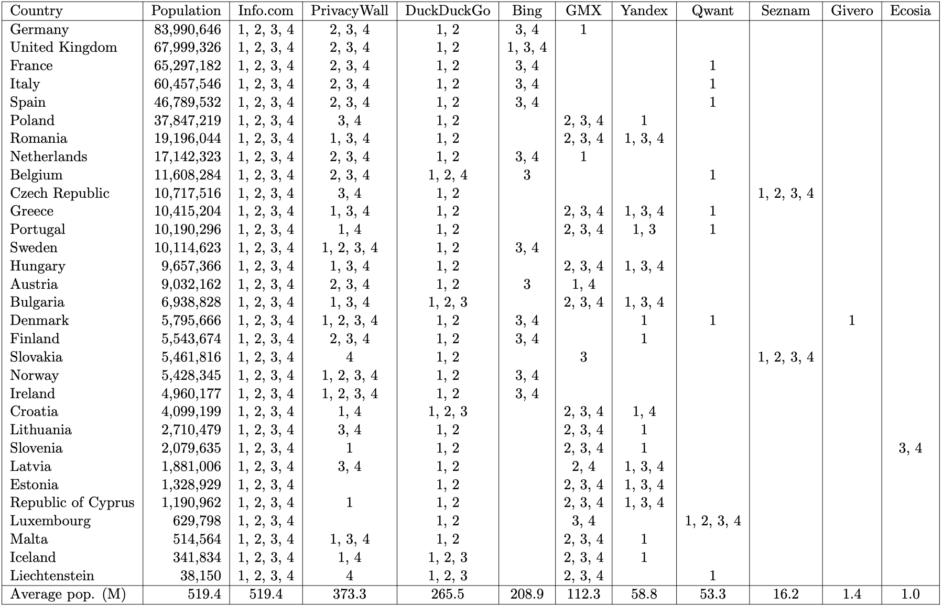

Slide 23
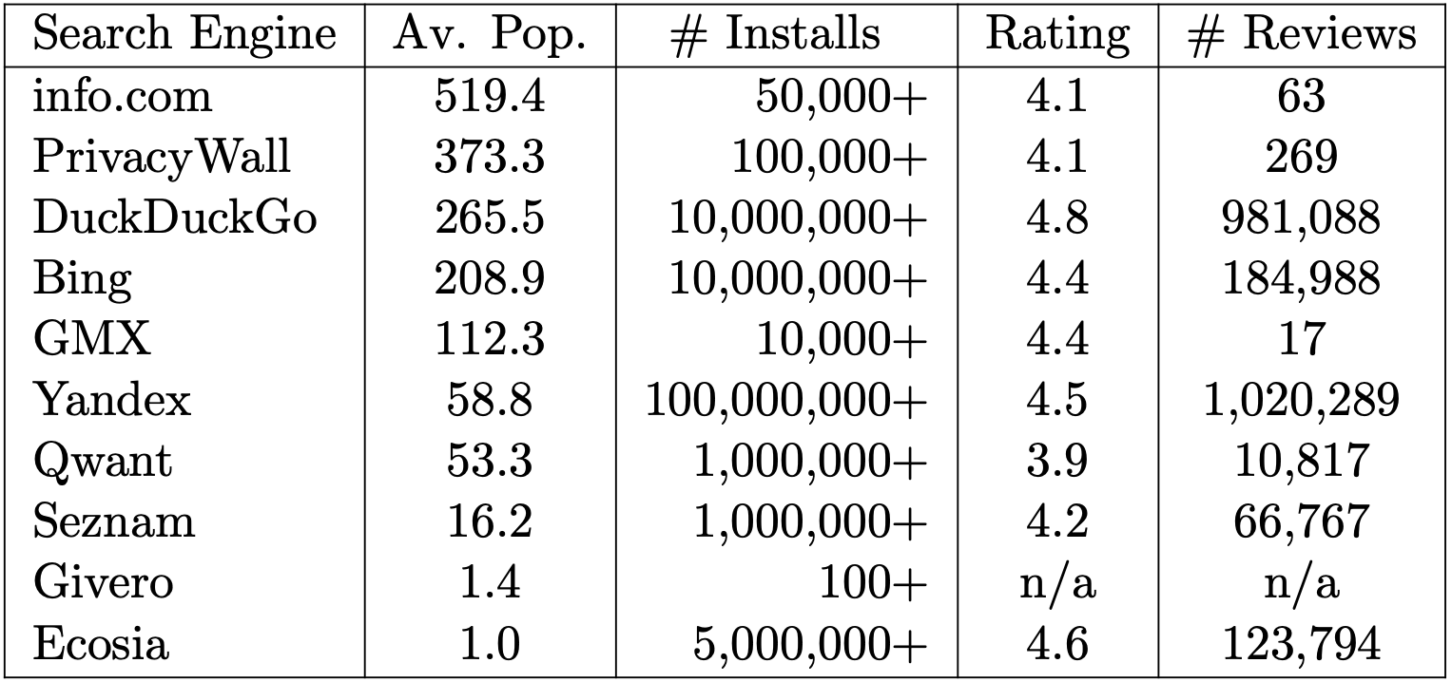
Popularity and Ratings of Search Engine Apps

Slide 24
Incentives: quotes from search engines
DuckDuckGo (the most highly rated search engine app, 10M+ installs): “Despite DuckDuckGo being robustly proﬁtable since 2014, we have been priced out of this auction because we choose to not maximize our proﬁts by exploiting our users. In practical terms, this means our commitment to privacy and a cleaner search experience translates into less money per search. This means we must bid less relative to other, proﬁt-maximizing companies.”
Ecosia (the second most highly rated search engine app, uses its proﬁts to plant trees around the world, 5M+ installs): “Ecosia is a not-for-proﬁt search engine. Taking part in Google’s auction would force us to spend our income on an unnecessary bidding war with other (proﬁt-oriented) search engines. We’d rather use it to plant trees on our endangered planet.”

Slide 25
A few months later …
“Following further feedback from the [European Commission], we are now making some final changes to the Choice Screen including making participation free for eligible search providers. We will also be increasing the number of search providers shown on the screen. These changes will come into effect from September this year on Android devices.”
Official Google announcement (June 8, 2021)

Slide 26
Conclusions
New regulatory tool (kudos to Google and EC for trying new solutions)
... that is potentially applicable in other important settings
… but needs to be fixed
Details matter!

Slide 27
Thank you!

