Slide 2
Sharing server nodes for storage and compute
Batch on EOS Extra Resources
CHEP 2018, SOFIA, July 10

Slide 3
BEER Contributors
IT-CM
  Tim Bell, Ben Jones, Domenico Giordano,
  Gavin McCance, Jaroslava Schovancova, Havard Tollefsen
IT-ST
  Dirk Duellmann, Massimo Lamanna, Herve Rousseau
IT-DI
  Markus Schulz, Andrea Sciaba, Andrea Valassi, David Smith
Petersburg Nuclear Physics Institute
  Andrey Kirianov
ATLAS for using the resource

Slide 4

Background
EOS is CERN’s large storage management system
  https://eos.web.cern.ch/
  Frequent reports at CHEP ☺
The hardware architecture follows CERN’s commodity paradigm
  Disk servers are based on standard servers with shelfs of disks

Slide 5
Motivation
Observation of relative low average loads on our storage systems
  Sometimes I/O bound (internally and network)
    Most nodes are not CPU saturated even when they are I/O saturated
Average usage per server node (snapshot):
  Read: 35MB/sec - 67MB/sec, write: <10MB/sec
  IOPS: read 290-500 Hz, write: 28Hz
CERN has a relatively large storage system, 1339 nodes with data
  Several have 40 cores with 3.2 GB/core
Questions:
  Can we make use of some of these cores?
  What value does this correspond to?
  Proof of concept tests where done by Andrey using some older nodes.

Slide 6
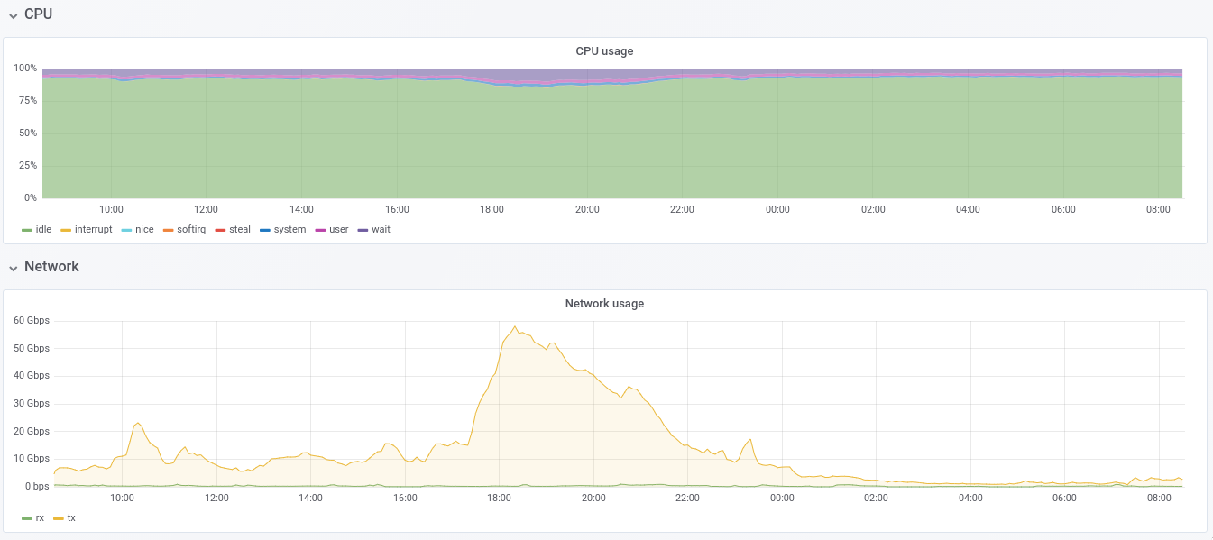
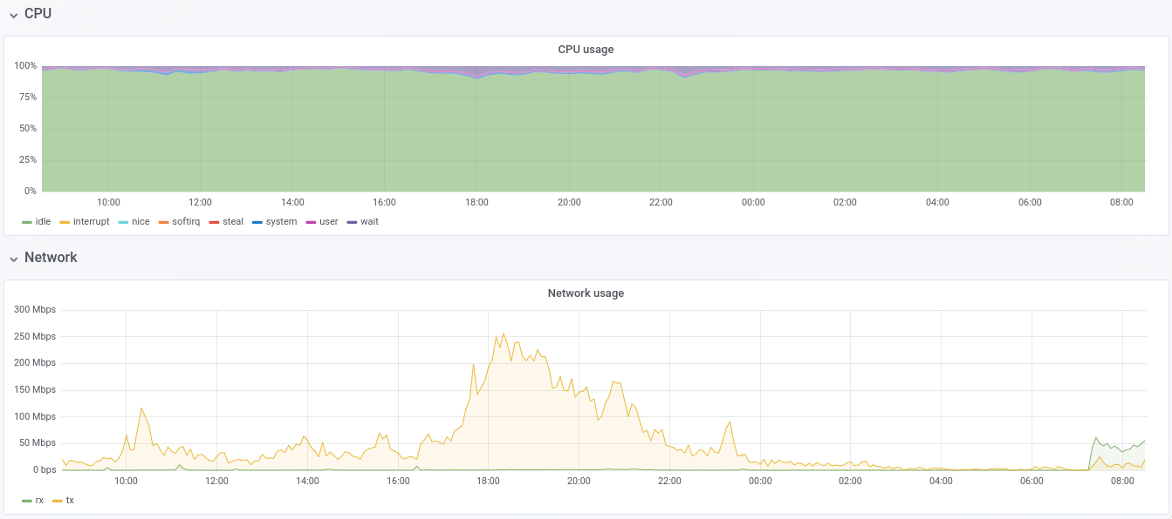
Recent Loads (spring 2018)
ALICE EOS cluster average CPU utilization is <=20% – left plot
ALICE EOS disk server CPU utilization is <=20% – right plot
  Some IOWait, which can be used by other processes → Significant Potential
Cluster
Node
Average: System+User+IRQ < 20%
Idle
Idle
Busy: System+User+IRQ < 20%
59 Gb/s
250 Mb/s
Proof of Concept

Slide 7

First Steps
Proof of concept tests by Andrey Kiryanov
  Testbed (puppetized)
    Small EOS system(s)
    Client/load-generator cluster
    Condor based test with computational loads
      Using lhc@home
      Boinc based system
      Using nice to limit impact on EOS
Proof of Concept

Slide 8
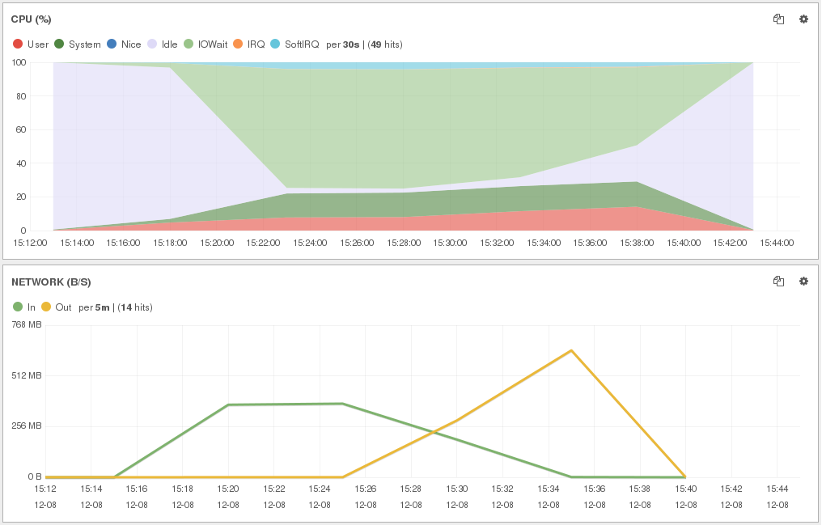
Test systems
EOS head
(namespace in memory)
I/O load
generators
(13 hosts)
metadata 10Gbps
1Gbps
EOS disk server 1
+
Condor (vLHC@Home)
22X
First system
  Disk servers with 1Gb interface
  Local IO generator also used
Second system
  Disk server with 10Gb interface
1Gbps
EOS disk server 2
+
Condor (vLHC@Home)
1Gbps
22X
file I/O
1Gbps
EOS disk server 3
+
Condor (vLHC@Home)
22X
EOS disk server 4
+
Condor (vLHC@Home)
22X
EOS only
  161 MB/s read
  93 MB/s write
EOS head
(namespace in memory)
I/O load
generators
(13 hosts)
metadata 1Gbps
10Gbps
file I/O
EOS disk server 1
+
Condor (vLHC@Home)
  156 MB/s read
  93 MB/s write
EOS + vLHC@home
4X
Proof of Concept

Slide 9
Tests with more recent hardware
EOS head
(namespace in memory)
I/O load
generators
(7 hosts)
10Gbps metadata
EOS disk server
+
Condor (vLHC@Home)
10Gbps file I/O
48X
New disk server with decent hardware
  Dual E5-2630 v3 @ 2.40GHz (32 vcores with HT)
  64 GB RAM
  48 disks 6TB each + 2 SSD (OS + swap)
  10 Gbps network
Proof of Concept II

Slide 10
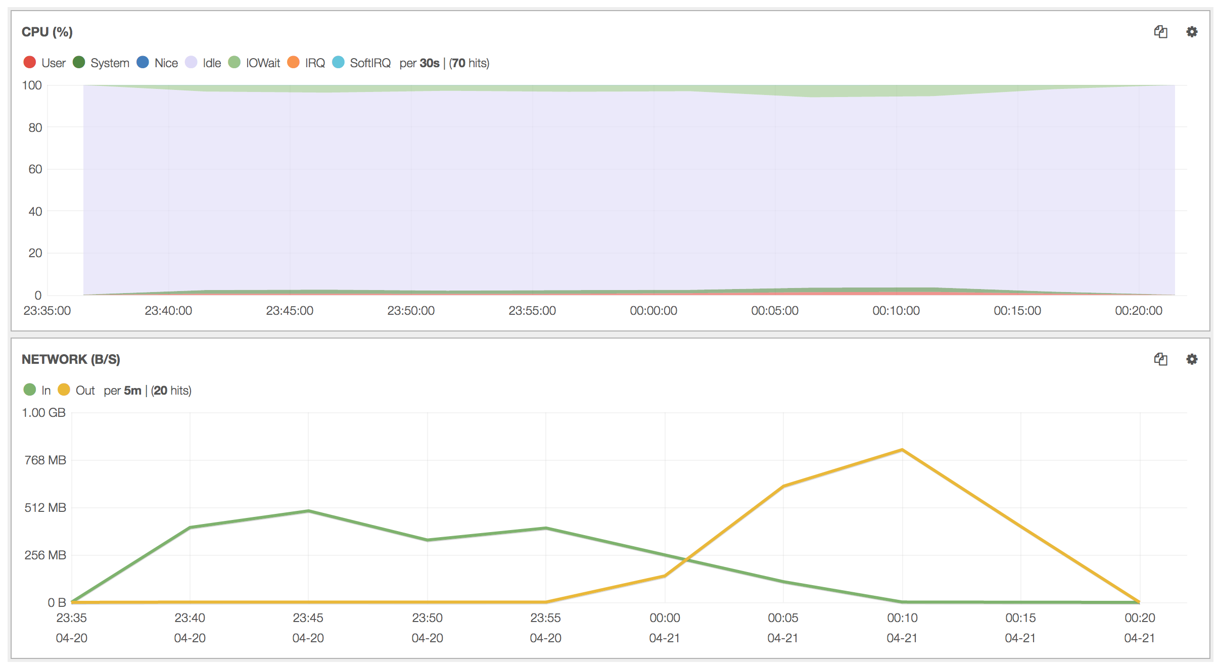
Running with no payload
>80% of CPU resources are idle
Proof of Concept II

Slide 11
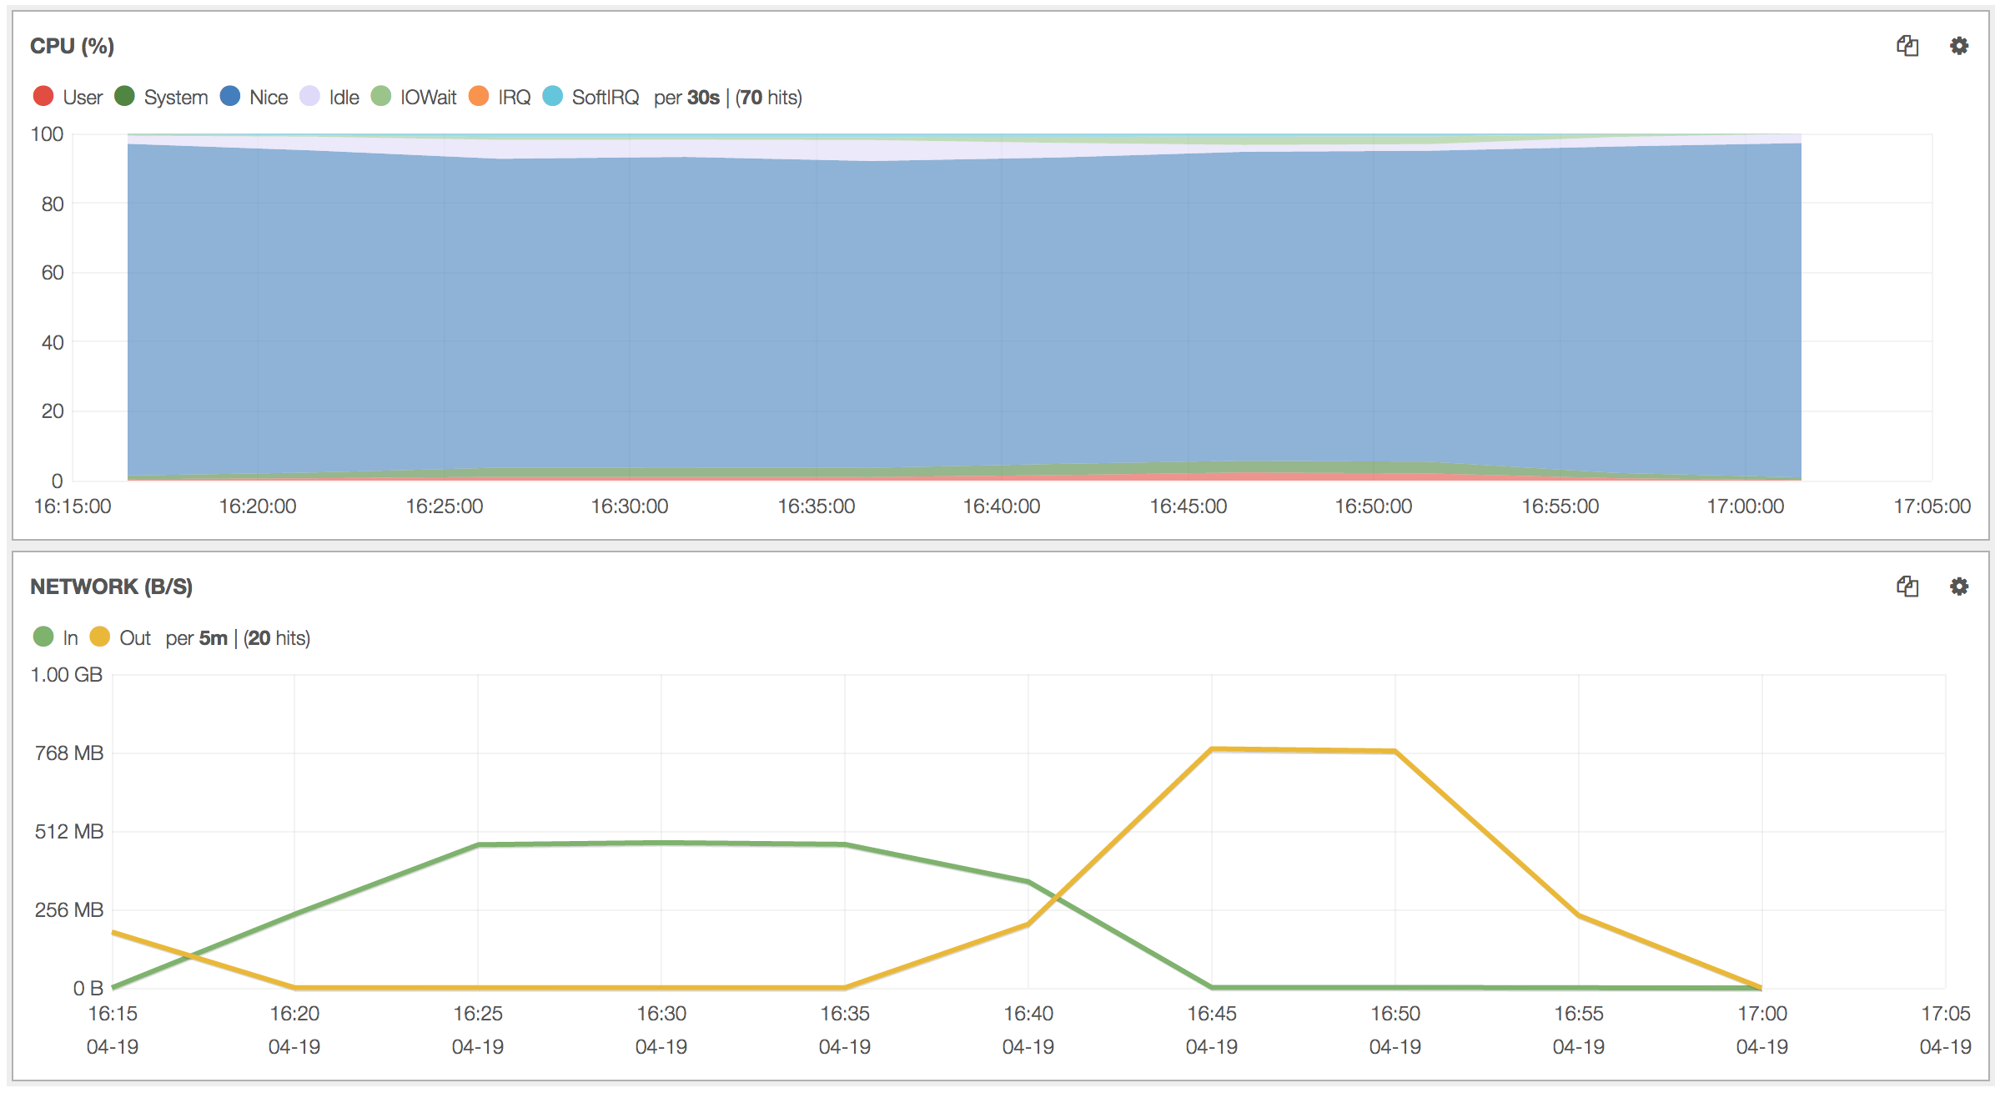
Running with compute payload
>80% of CPU resources used for compute payload
Almost identical results
Same rates as before
Proof of Concept II

Slide 12
What did we learn?
With a simple setup Storage and Computing can be run without much interference
  HTCondor + nice
For typical I/O loads in production we can expect to use >80% of the CPU for non storage tasks
  Worst case would be about 50%
Interesting....... But....

Slide 13
How to turn this into production?
Needs to be deployable
  Configuration Management challenge
    Two services on the same node
      Responsibility split between two teams
EOS service must not be compromised
  Resources (CPUs, memory .....)
  Halting the computational tasks on demand
Monitoring

Slide 14


A model emerged
“Partition” the resources
  To guarantee that storage performance is not crippled
  To provide accountable resources (not like lhc@home)
  Control groups (Cgroups)
  Run Condor jobs in Containers
    Using Cgroups to limit resource usage
  One puppet configuration for the node
Integrate resources in CERN’s Condor batch system
  Queues for suitable workloads
BEER Pilot to explore this approach
  Participation from storage and batch team
  JIRA for ticketing

Slide 15
Condor + Containers
EOS
Cores reserved for EOS
Cores integrated in Condor running jobs at low priority, memory and scratch space restricted by cgroups,
cores
Monitored by:
cadvisor/collectd
memory
cgroups
Condor
job
job
job
job
container
Proof of Concept III
Local disk

Slide 16
Testbed #3
Three disk servers: each
  48 6TB HDD (1 HDD apparently failed on one server)
  2 x E5-2630 v3 (haswell; 2 x 8 physical cores => 32 w/ SMT)
  2 x 800GB SSD (Intel DC S3510 series; 0.3 DWPD for 5 yrs)
  10Gbit network
Centos7; EOS 0.3.240 (Aquamarine)
  Using puppet, hostgroup based on eos hostgroup and using modified eos module and cerncondor module (beer branch)
Local Disc Setup:
  1 ssd set aside for the batch work (including addition of 96GB swap)
  CVMFS installed
  cerncondor module used to install and run condor
Changes in the batch environment (possibly amongst others):
  set memory.memsw.limit_in_bytes and add condor to the cpuset cgroup controller: cpuset.cpus and cpuset.mems
  (systemd already set mem limit, but no support for memsw or cpuset)

Slide 17
Limits
Memory limit
  is set as a parameter in /etc/systemd/system/condor.service and systemd uses the setting when setting up the cgroup for the condor service: 48GB
  But does not limit swap usage
  Modified condor.service to also set memsw limit (ram + swap) to 96GB
Add condor to another cgroup using cpuset
    cpus 2-7,10-15,18-23,26-31
      leaves 4 physical cores entirely excluded covering both sockets
    Later only number of cpus has been limited.
Condor configured to offer 24 job slots and 96GB ram
Number of processes has been limited to 8000
blkio is used to control the I/O scheduling
  Blkio.weight == 50
Network traffic limits can be set via iptables on the docker level, but are currently not used.
See detailed setup description at the end

Slide 18
Security?
Data on the node is protected by UNIX ownership
Separation between users is done by CONDOR
In addition jobs are run in containers
  EOS data disks not visible within container

Slide 19
Load generation
For load run 10 instances of xrdstress
  4 jobs; 20 files; rw; size 1GB +- 256MB on 4 hosts
  No difference between 3 and 4 hosts → saturation
Run 3 ATLAS Pile job (8 cores per job)
  Staging pileup data on node
  Signal + min bias mixing;
  Digitisation
  Trigger simulation
  Reconstruction
  Convert ESD to AOD
  Start jobs with short delay
  Similar, shorter, job has been added to HammerCloud
    For generating steady stream of jobs

Slide 20
Test Job:
2000 MC Events, 8 cores
Pileup
30GB
MC-Geant
1.5GB
MC RAW RDO
4.6GB
TRG RAW RDO
5.2 GB
ESD
6.0 GB
AOD
700MB
Digitisation & Pileup
Trigger Verification
Reconstruction Raw2ESD
ESD2AOD
Merge Verify
MC RAW RDO
4.6GB
TRG RAW RDO
5.2 GB
ESD
6.0 GB
AOD
700MB
AOD
680 MB

Slide 21
I/O OFF
job ON
I/O ON
job ON
I/O ON
job OFF
Phase 1
Phase 2
Phase 3
Out = load + replication
No difference in I/O performance!
Proof of Concept III

Slide 22
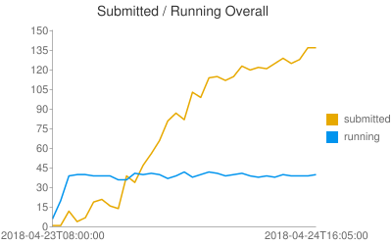
Preproduction
3 test servers
Stopped using cpusets, only cpu shares
4 nodes from EOS pre-production cluster
HammerCloud (ATLAS Pile job)
  Hammercloud submits to Condor, Condor schedules and starts the job →like a standard Grid job
  ATHENA MP (i.e. each job starts 4 processes)
    About 30 mins runtime (choose a small number of events / job)

Slide 23
BEER on Production Nodes
70 nodes with 40 cores
Disk Servers from ATLAS Production
  Initial loads from ATLAS
    Later will become part of CERN resources
Jobs experience so far
  Production jobs started last week

Slide 24
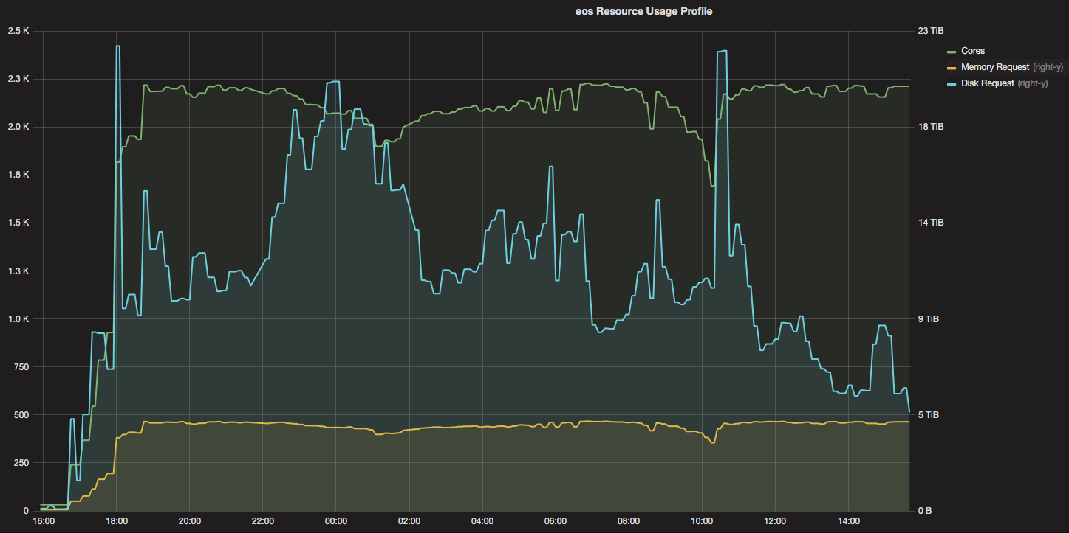
Plots from monitoring: production
32 1-core job slots available per 40 core machine
  No hard limit on CPU usage; but uses cgroup cpu shares to reduce job priority to EOS service processes
70 disc servers involved

Slide 25
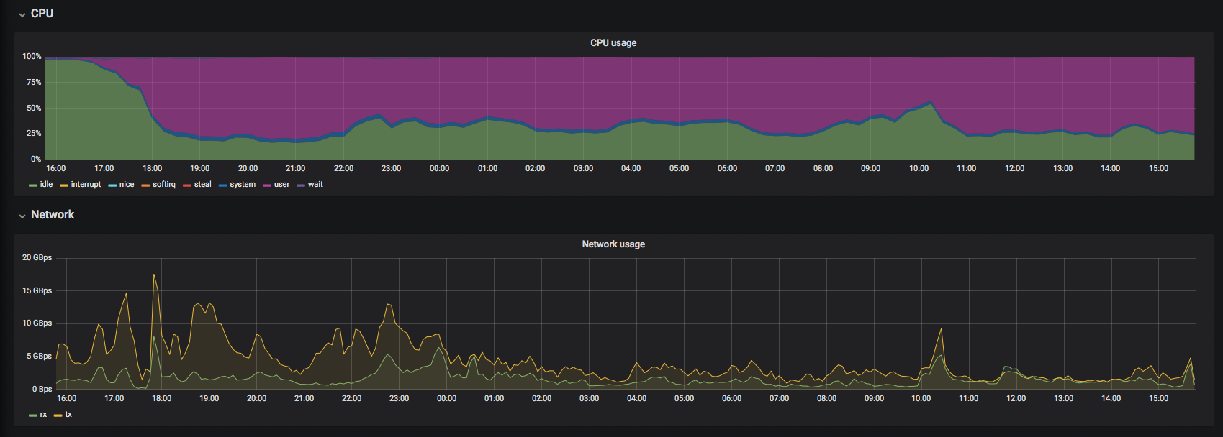
Plots from monitoring: production

Slide 26
Next Steps
More detailed monitoring of the situation
  Already increased logging on the CONDOR level
  I/O and network related monitoring also needed
Study of mixed workloads
  Different experiments
  Different processing steps
Scaling UP!

Slide 27
What could be gained for CERN? precision at best 10 – 20 %, but based on conservative assumptions roughly 10 HEP-SPECs / core
Near future:
  Assuming 40|80% of 350 machines can be used:
    Our measurements show that this is far less than what can be done when the node is fully saturated
  350 * 32 * 0.4|0.8 = 4480|8960 cores ~ 44,800|89,600 HEP-SPEC06
  ~3.8|7.6% of the 2017 T0 pledge
Long term (somewhat optimistic):
  Assuming 40|80% of 1200 machines:
  1200 * 32 * 0.4|0.8 = 15360|30720 cores ~ 153,600|307,200 HEP-SPEC06
  ~13|26% of the 2017 T0 pledge

Slide 29
Estimated effort
Activity from Proof of Concept to production readiness took about 2.5 years
Several people have been involved. All intermittent and at small overall percentages.
  PoC work about 3 person months over 2 years
  Planning and coordination of production mode required intense communication
Total effort is difficult to estimate
  3PM + 6PM = 9PM ← rough estimate assuming 5%/person
  Some of the work was foreseen for other reasons
    HTCondor + containers

